Slide 1
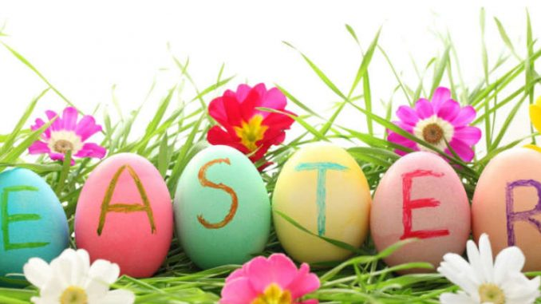

Slide 2
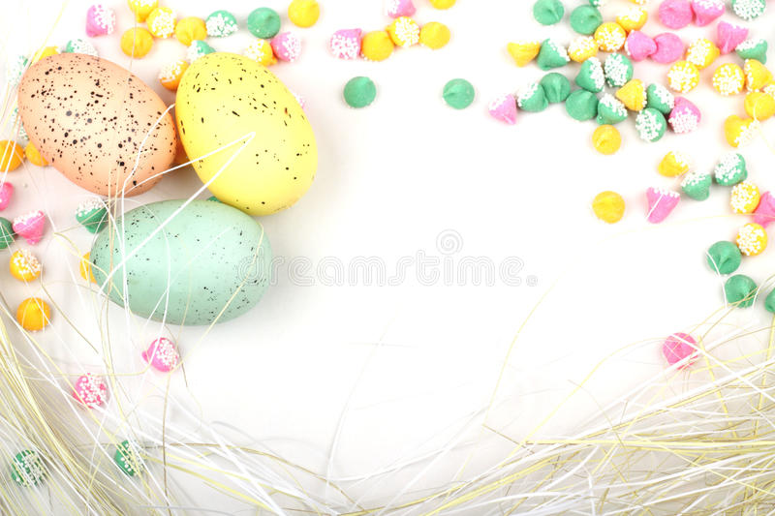
Phonetic drill
[і] little, symbol, children, Christian, tradition, spring;
[i:] Easter, people, eating, sweet, green, meal;
[^] funny, Sunday, love, hunt, Bunny;
[a:] card, party, garden.

Slide 3
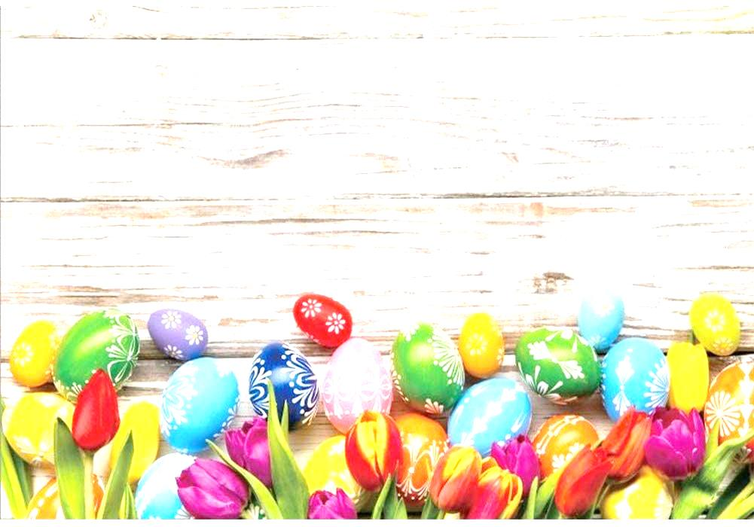
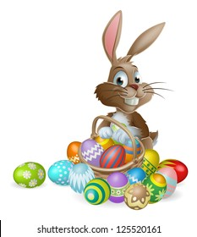
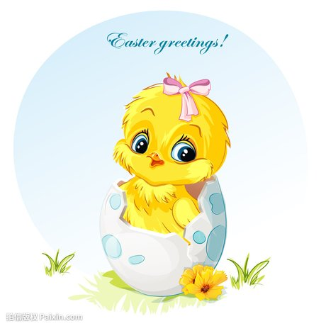
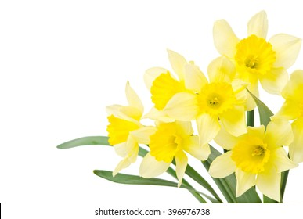
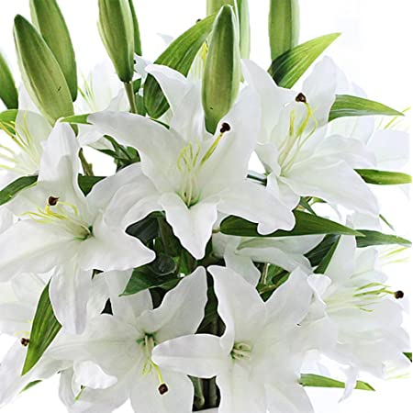
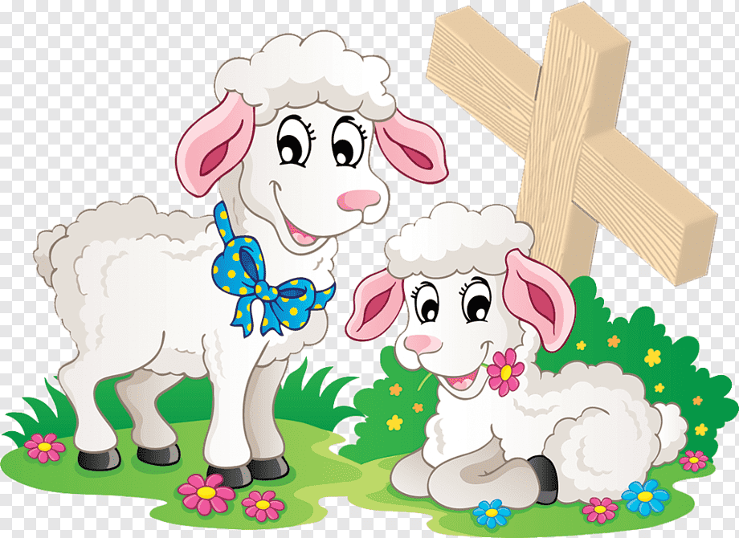
Easter Symbols
Easter symbols in Britain are Bunnies, chicks, lambs and flowers (especially daffodils and lilies).
The cross and colored eggs are also well-known Easter symbols

Slide 4

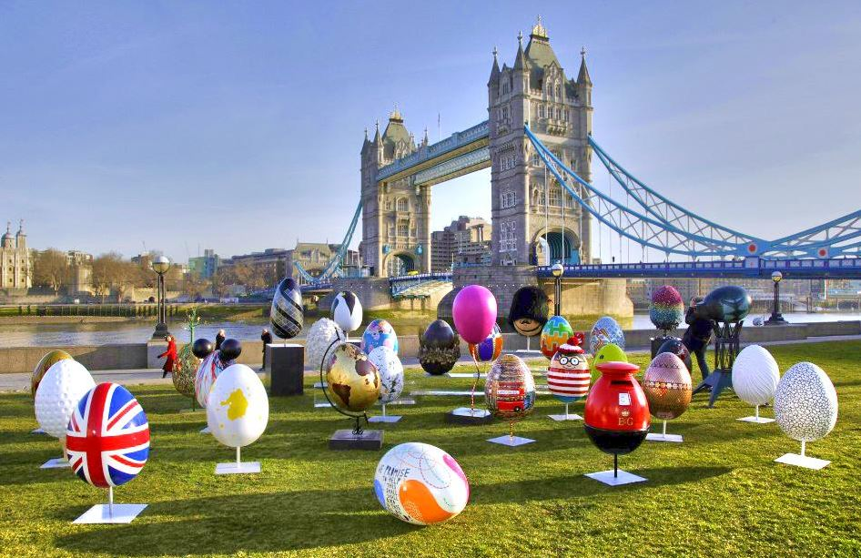
Easter in Britain

Slide 5

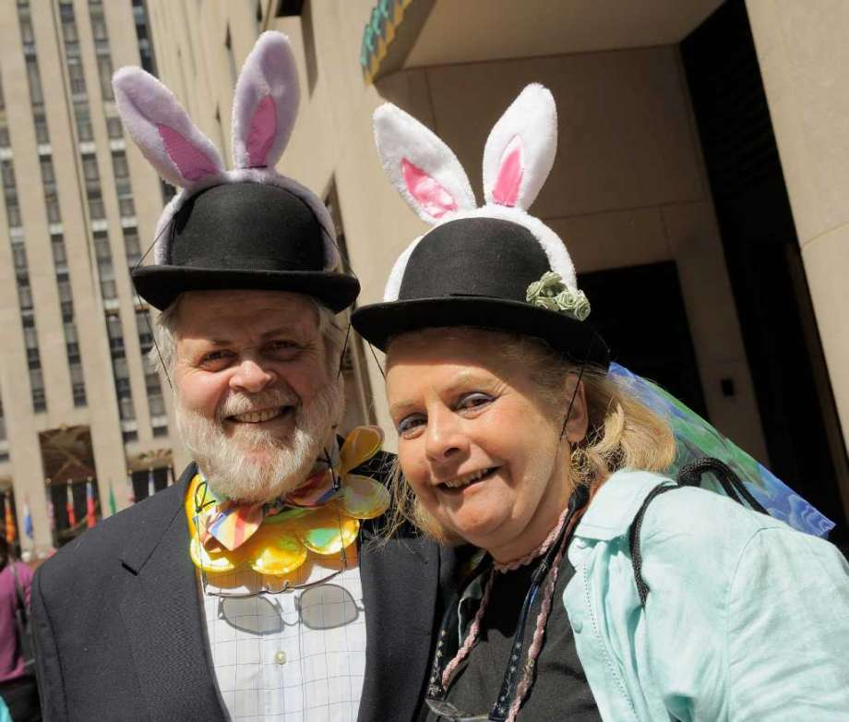
Easter is a great spring holiday in Britain.
The British like it very much!

Slide 6
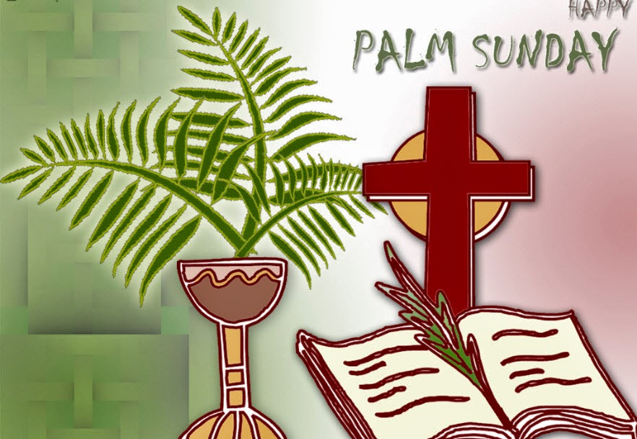
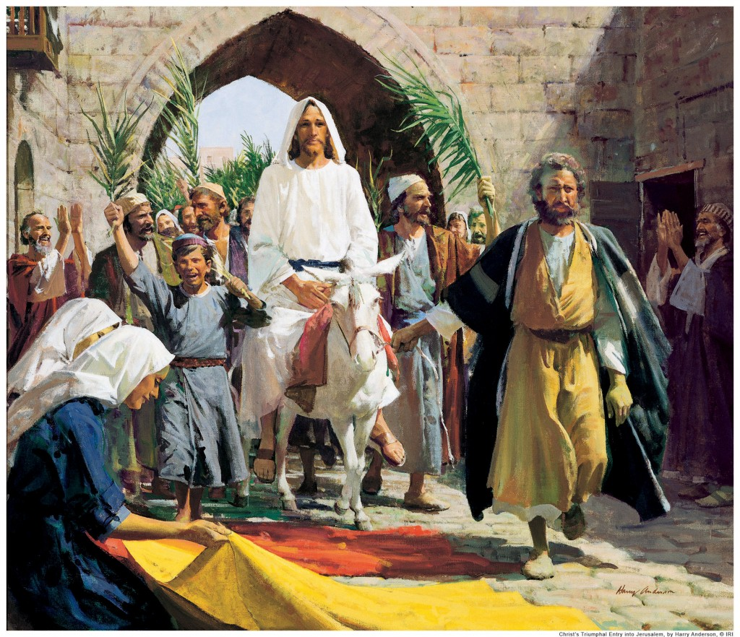
The Sunday before Easter is Palm Sunday. It was the day when the day Jesus arrived in Jerusalem for the celebrating.

Slide 7
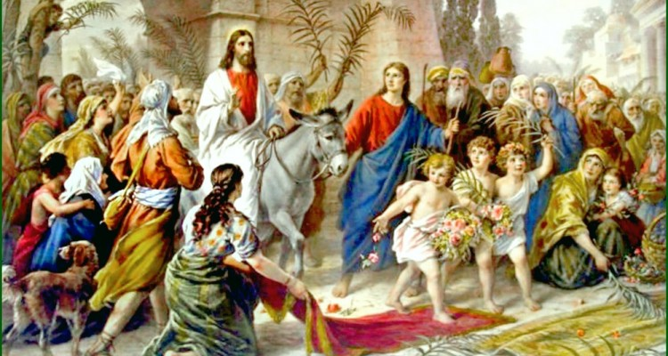
A lot of people lined the streets waving palm branches to welcome him. The people were very excited. They shouted 'Save us Now!'
They waved palm branches.

Slide 8
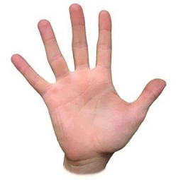


Sallow, or pussy willow, was used in many places as a palm branch.

Slide 9
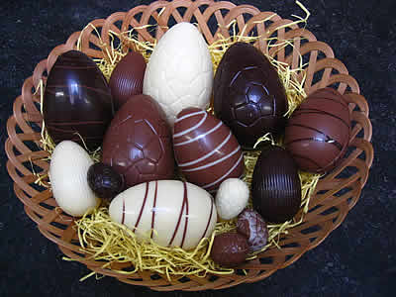
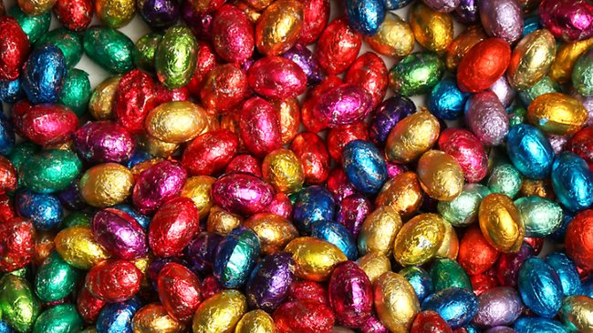
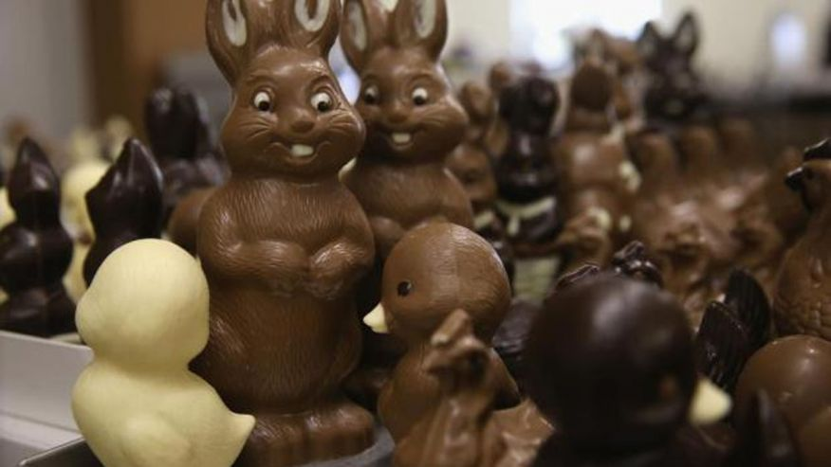
They give each other Easter eggs. But eggs are chocolate!
Or they give each other Easter presents (souvenirs).

Slide 10
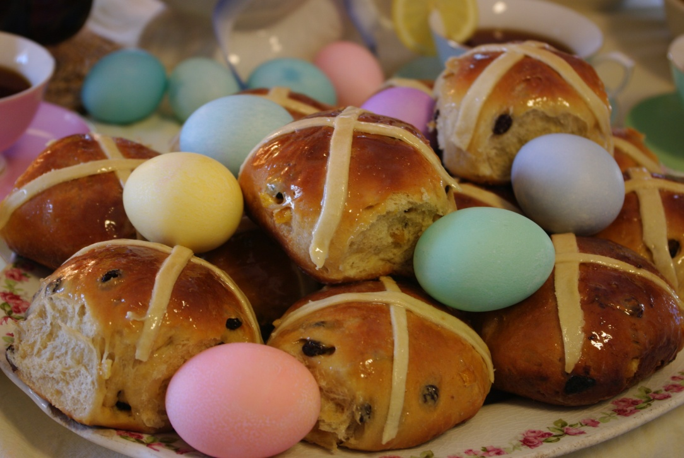
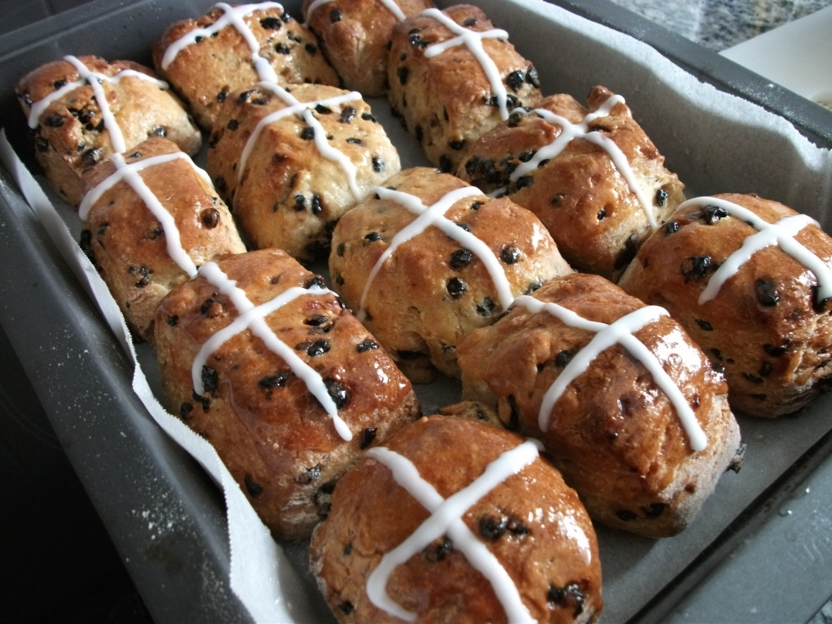
Last Friday before Easter is Good Friday. They eat hot cross buns –a tasty sweet bread for Easter.

Slide 11
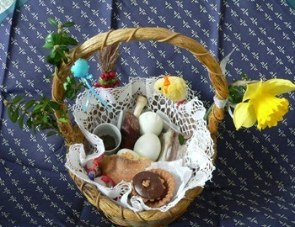
At Easter Day they go to the church and take Easter basket. There are eggs, bread and other food in it.

Slide 12
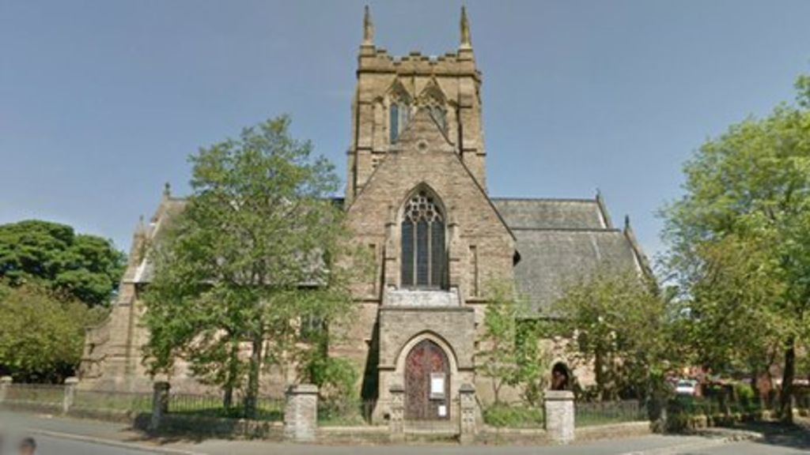
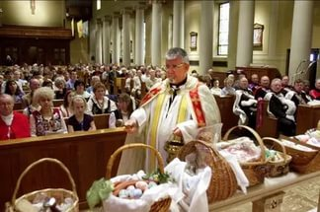
At Easter Day they go to the church and take Easter basket. There are eggs, bread and other food in it. They leave this basket in the church.

Slide 13
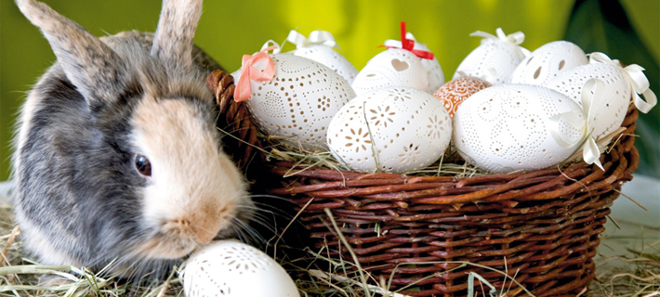
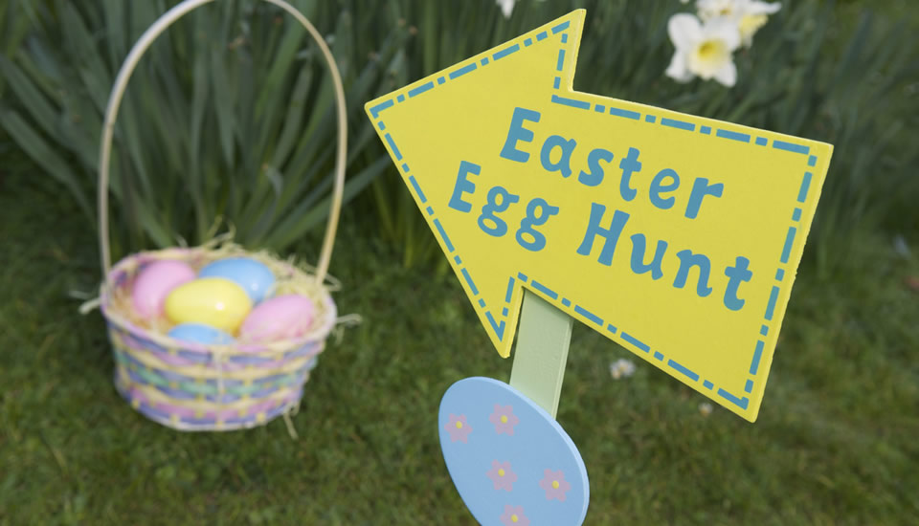
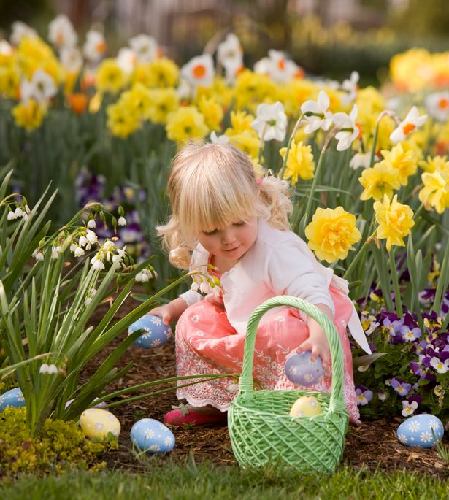
At Easter Day they think that Easter Bunny hides the Easter eggs.
And the children have to find them.

Slide 14
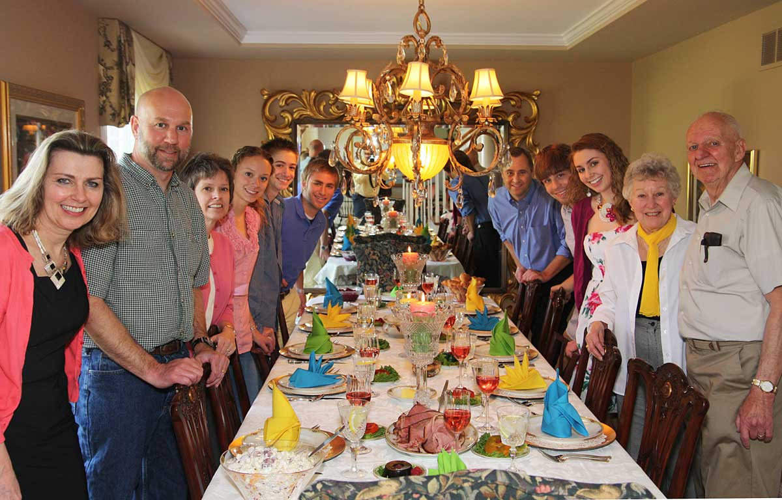
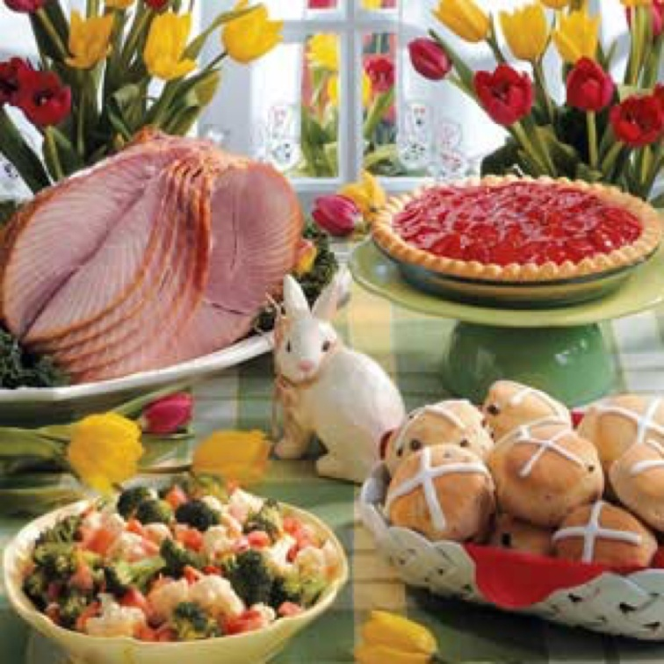
They have Easter dinner all the family.

Slide 15
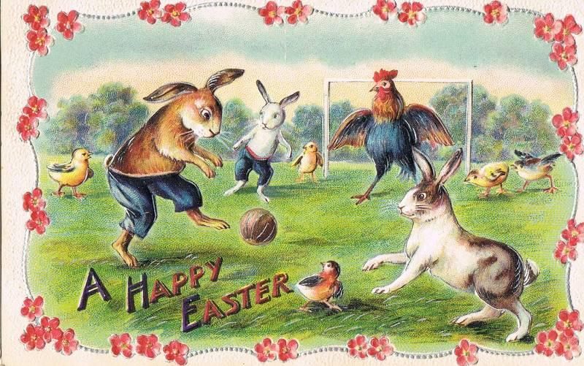
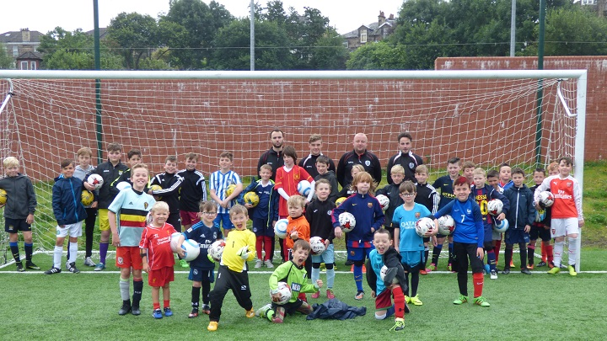
Englishmen play football at this day.

Slide 16
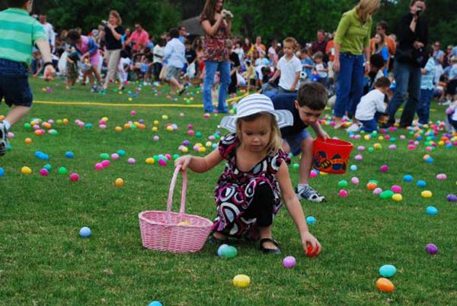
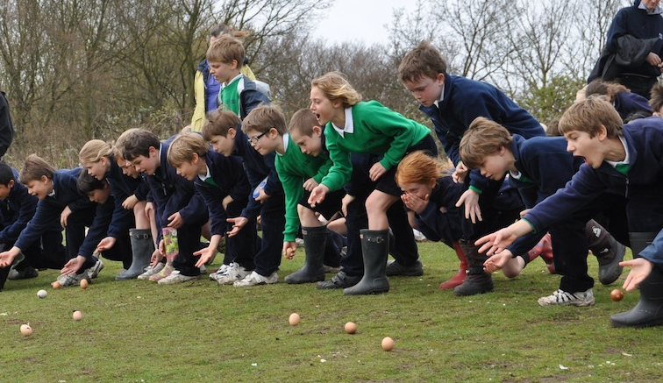
They have Easter rolling eggs competitions.

Slide 17
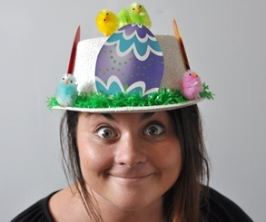
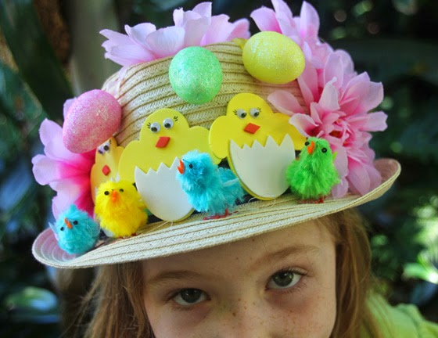
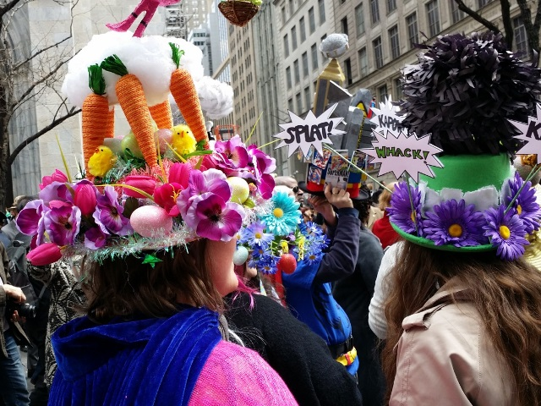
The women wear Easter hats at this day.

Slide 18
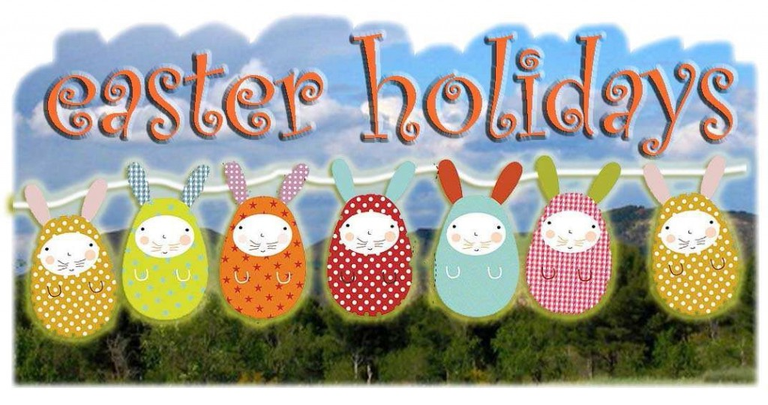
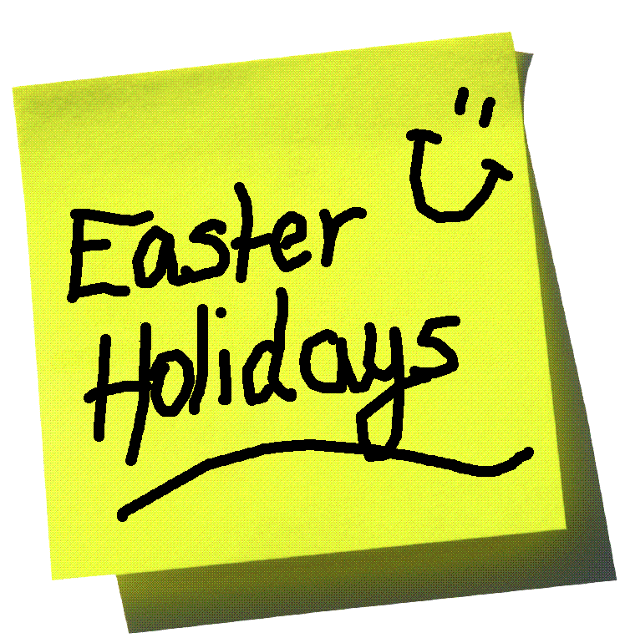
Children have 2-weeks Easter holidays!

Slide 19
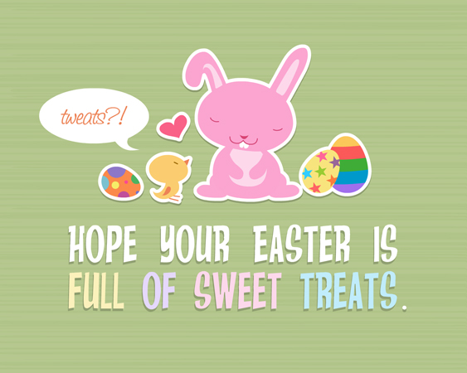
What about your country?
And do you like Easter?

Slide 20
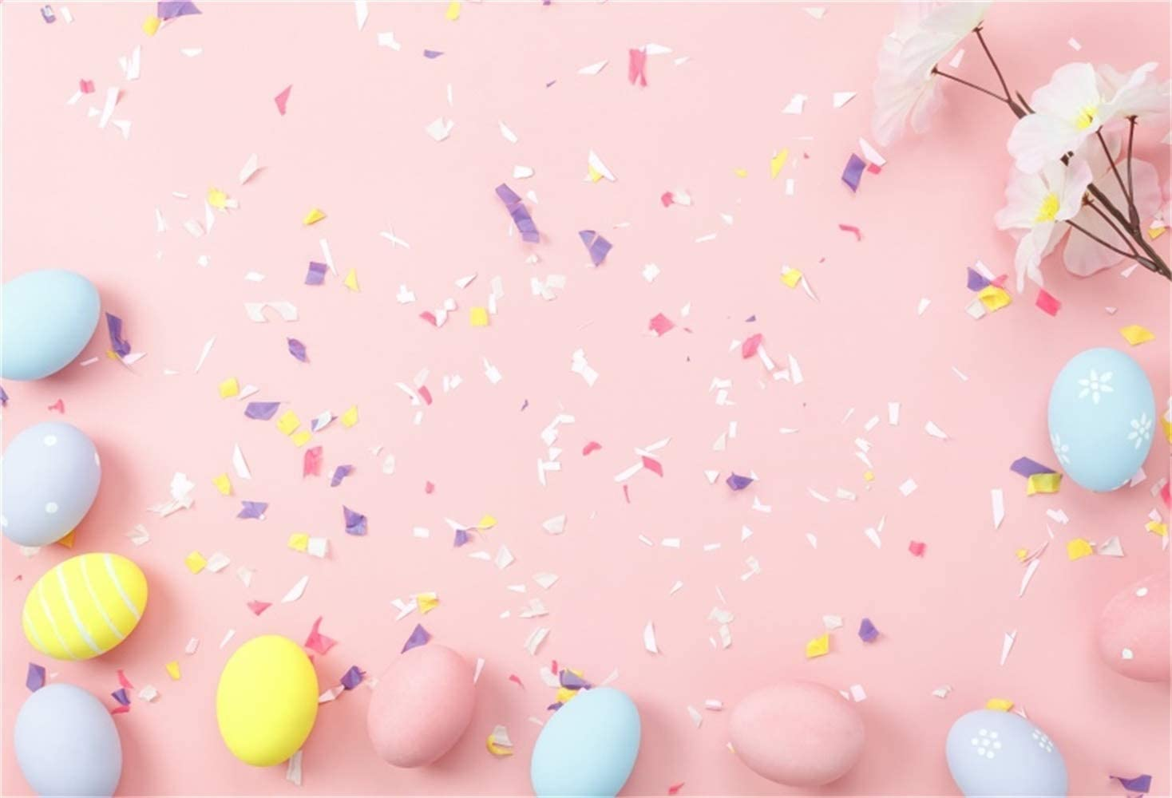
What do you know about Easter?
When is Easter?
What do people celebrate at Easter?
What do we do at Easter?
What are the symbols of this holiday?
How do you celebrate Easter in your family?

