Slide 1
How VeraSol Can Help Drive Business & Deliver Results
SEPTEMBER 17, 2020

Slide 2
AGENDA
Introduction to VeraSol
Resources overview
Using the Product Database
Additional digital resources
Questions
SPEAKERS
Ari Reeves
Elisa Lai
Riley Macdonald
Lauren Boucher

Slide 3
Housekeeping
We have dedicated Q&A periods at the end of the database tour and the website tour
To ask a question
Use the raise hand feature in your Zoom application to notify our team
When called upon, a member of our team will enable you to talk.
You will then receive a prompt to unmute your microphone. You must confirm in order to speak.
After your question is answered, a member of our team will lower your hand and mute your microphone
You may also use the Q&A feature on your control panel to ask a question.

Slide 4
About VeraSol
VeraSol is a quality assurance program that helps a wide variety of market actors.
Increase Impact
Reduce Risk
Increase Impact
Improve Efficiency
We increase the quantity, accuracy & value of product performance and quality data so the industry can make better-informed decisions.
We give investors, market development programs & others tools to conduct due diligence and invest in companies that meet minimum quality standards.
We help ensure products perform as advertised, increasing consumer satisfaction and confidence in off-grid solar solutions.
We’ve merged quality assurance services for solar energy kits and off-grid appliances under a single program and team.

Slide 6
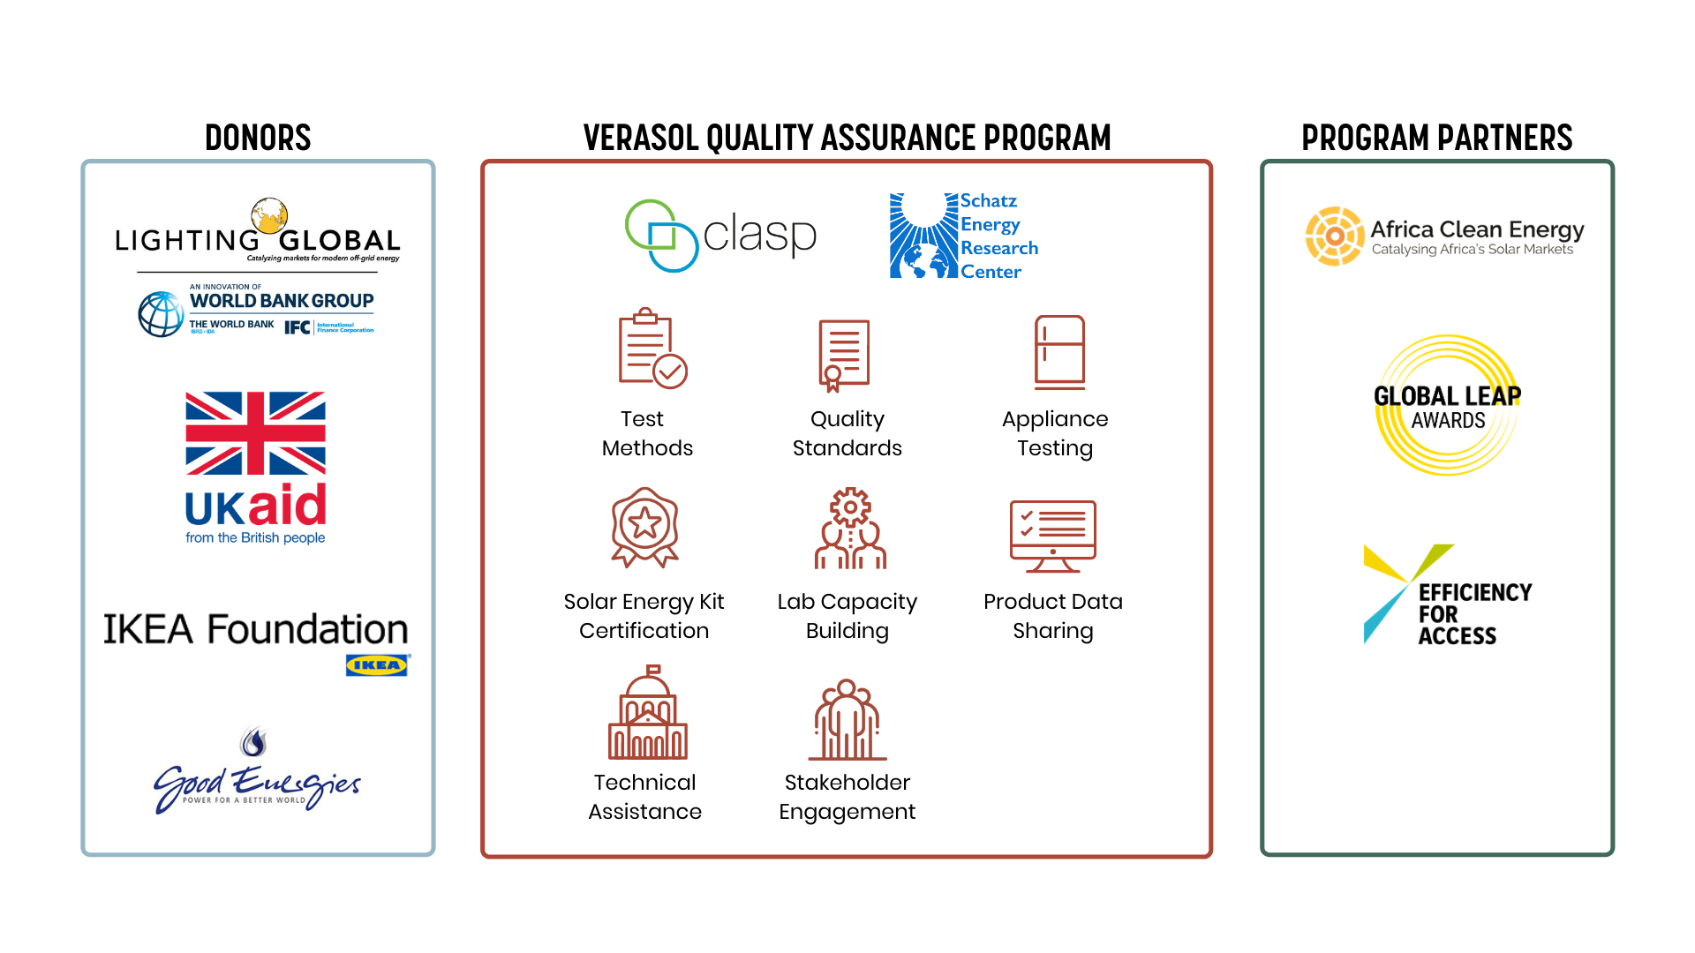
A Dedicated Partnership in Service of the Sector

Slide 7
OVERVIEW OF DIGITAL TOOLS
VERASOL WEBSITE
VERASOL PRODUCT DATABASE

Slide 8
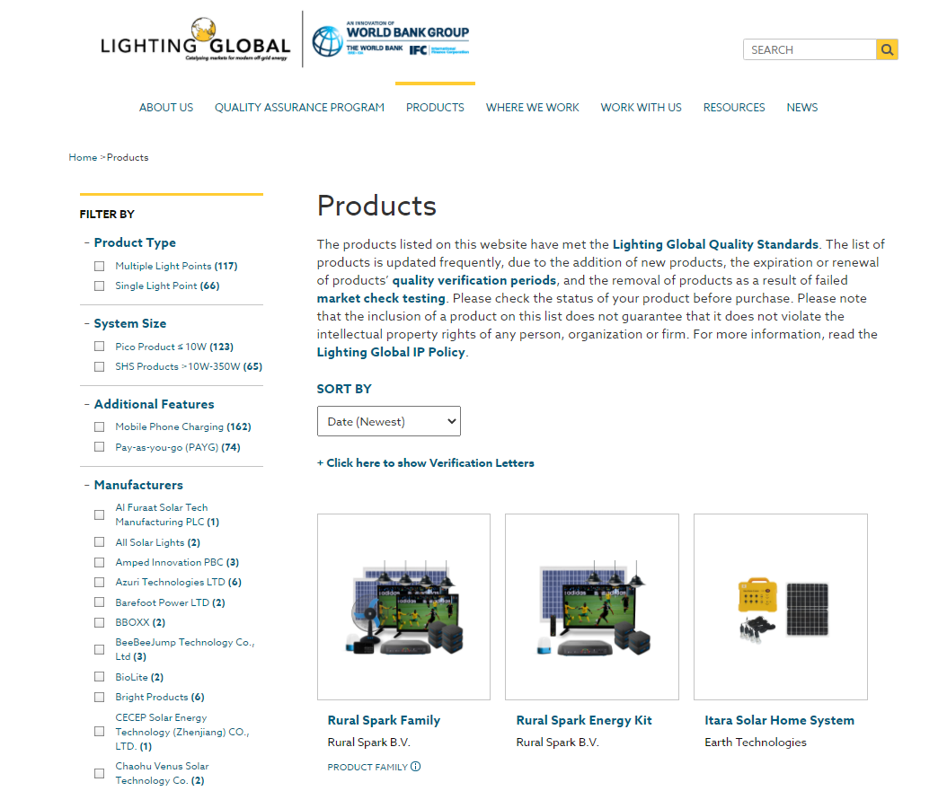
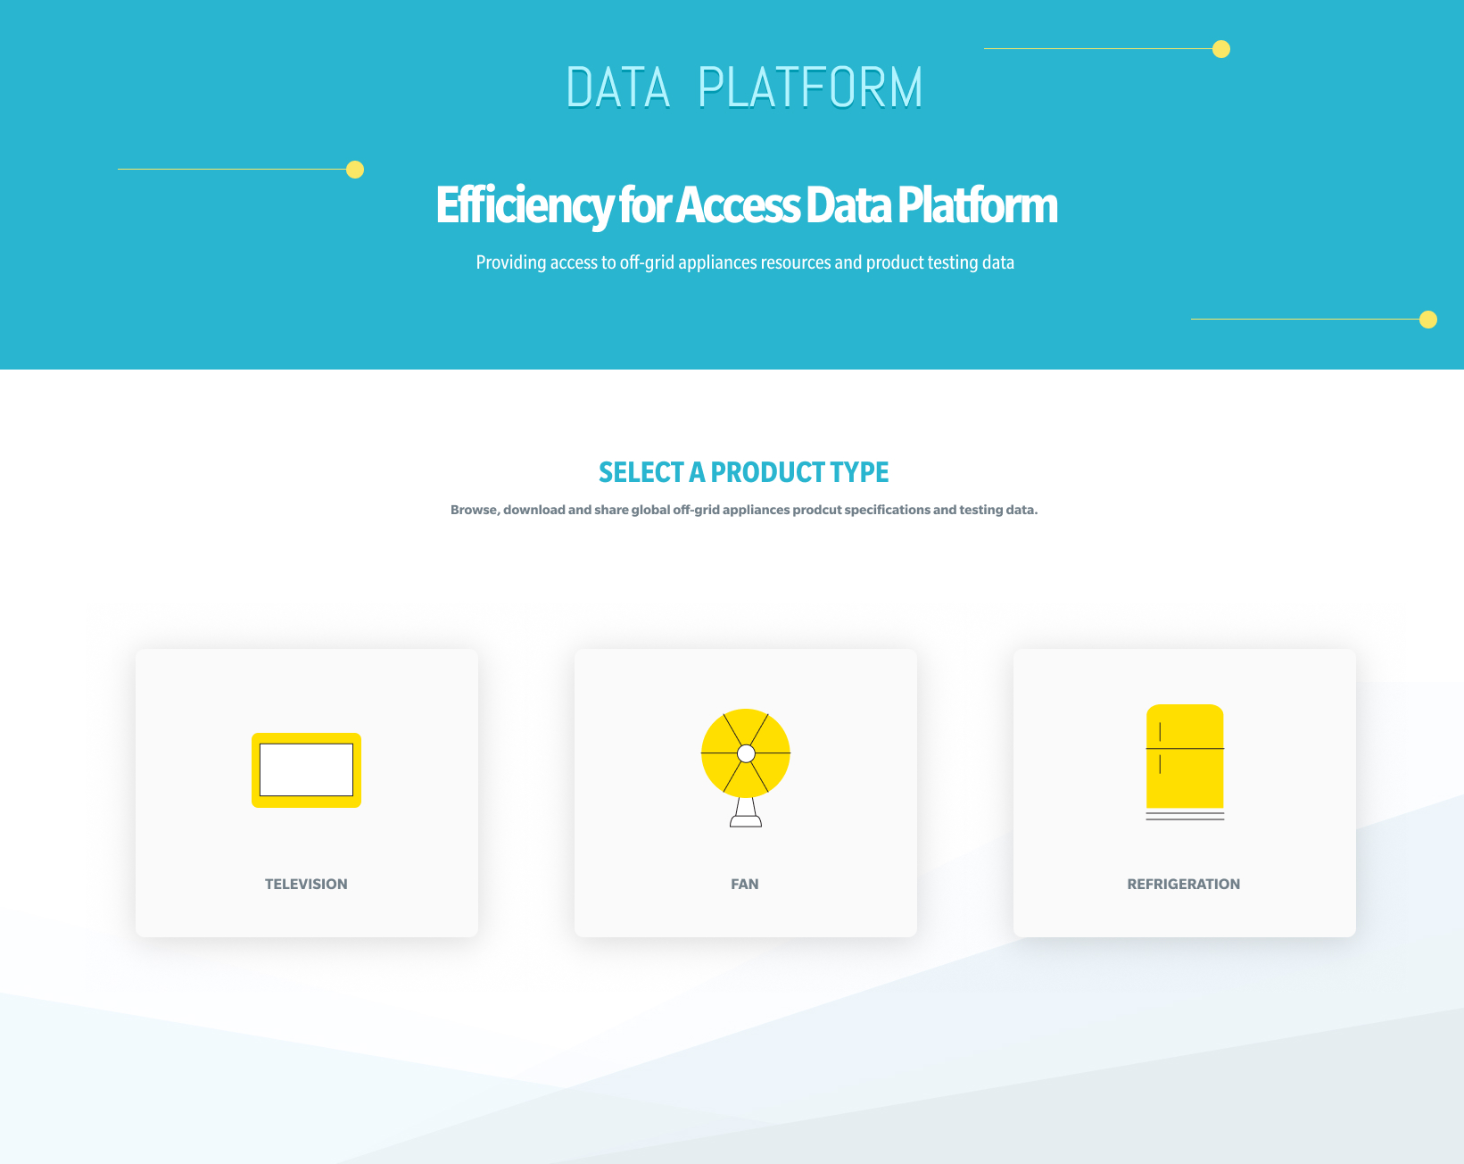
Our History
Lighting Global Quality Assurance
pico-solar products & solar home systems
Equip Data
appliances & productive uses

Slide 9
VeraSol Product Database
VeraSol-Certified & VeraSol-Tested
Rigorous sampling process and independent testing conducted by ISO-accredited test labs
VeraSol Certified
Solar energy kits
Tested based on IEC 62257-9-5
Certified based on Lighting Global Quality Standards or IEC 62257-9-8
Only display products that met certification requirements
VeraSol Tested
Standalone appliances & productive use equipment
Tested based on Global LEAP off-grid test methods
Display all tested products

Slide 10
Features
View
Sort/filter
Compare
Download

Slide 11
Features
View
Sort/filter
Compare
Download

Slide 12
Features
View
Sort/filter
Compare
Download

Slide 13
Features
View
Sort/filter
Compare
Download

Slide 14
Users & Usage Scenarios
Manufacturers
Distributors
Investors & Development Institutions
Governments
Benchmark the performance and quality of your product against others
Make faster, informed sourcing and procurement decisions
Validate product quality and inform the due-diligence process when assessing which products or companies to support
Easily access certification documents, key performance metrics

Slide 15
USING THE PRODUCT DATABASE

Slide 16
Additional Digital Tools

Slide 17
RESOURCES
138
35
39
RESOURCES
TECHNICAL NOTES
QUALITY STANDARDS
& POLICIES
Featured Publications
Full Archive

Slide 18
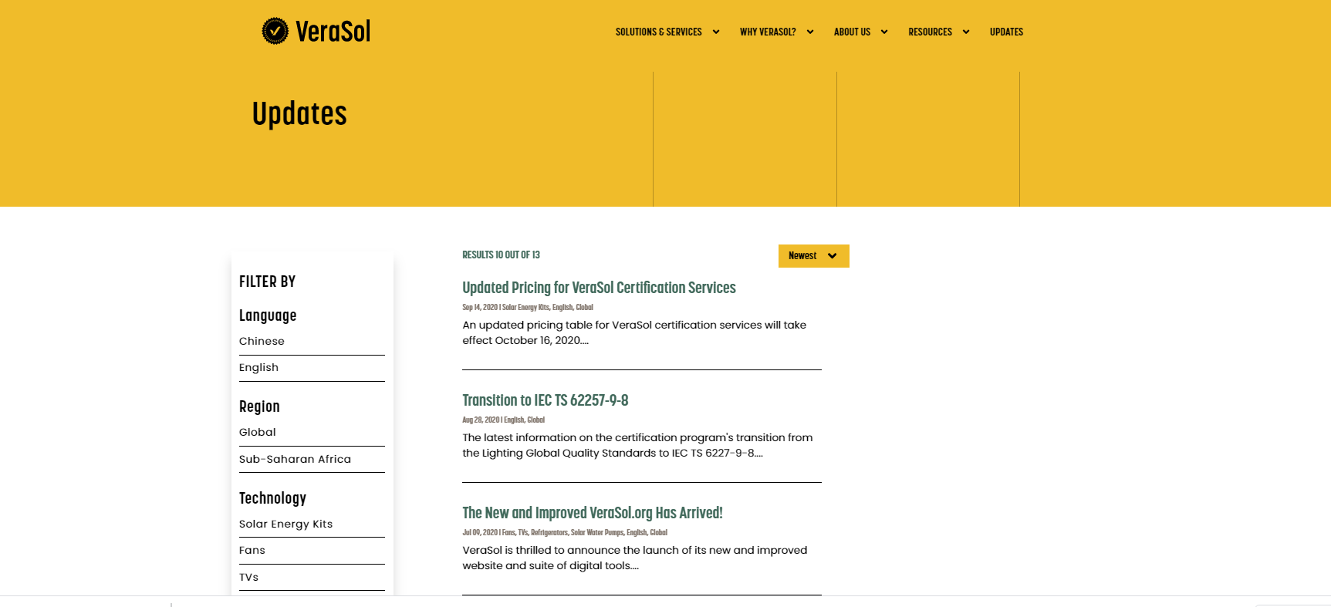
Updates Library
Browse updates

Slide 19
Solutions & Services
Test Methods
Quality Standards
Appliance Testing
Certification
Test Lab Capacity Building
Product Data Sharing
Technical Assistance
Stakeholder Engagement

Slide 20
Frequently Asked Questions
FAQ Library

Slide 21
Stay Connected
Give us feedback: https://www.surveymonkey.com/r/JGTCYDZ
VeraSol.org
http://zc.vg/UVaNI
VeraSol Quality Assurance
info@verasol.org
@VeraSol_QA
@VeraSol

