Slide 1
Visual Design
What is Visual Design?
Layout Best Practices and Considerations
Improving Visual Design
Notes:
Good morning everyone and thanks for being here today. So, what we are going to go over is what a lot of new, and even some experienced, instructional designers struggle with, and that is, visual design.
We’re going to start off with some simple fundamentals of what visual design is…and is not.
We’re then going to move into laying out elements and designing from the ground up.
And we’ll finish up with some ways to improve visual design in courses you may already have published.
So let’s get started.

Slide 2
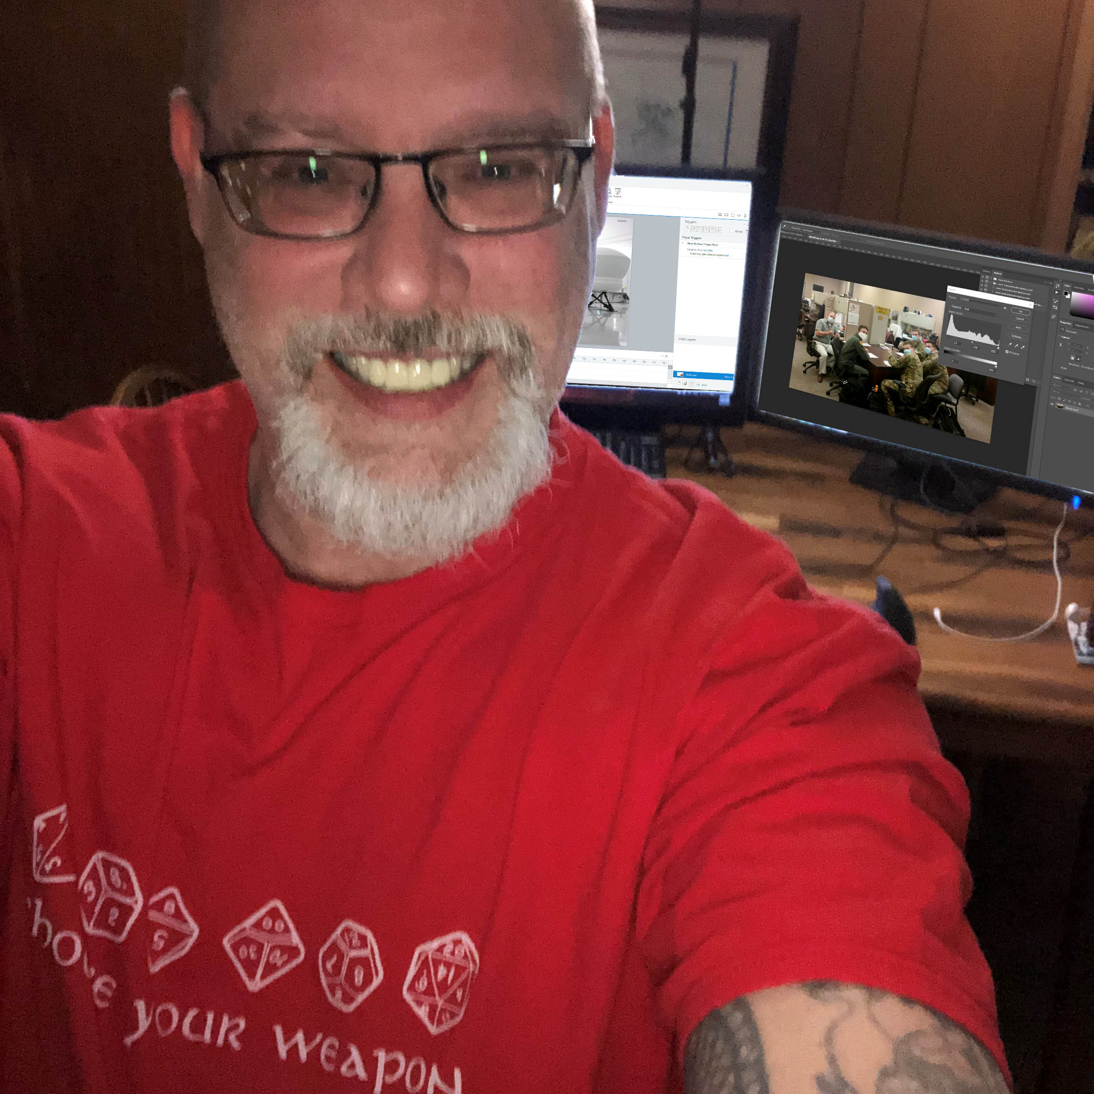
James Washok, M.Ed., M.S. IDT
Lead/Senior Instructional Designer
Senior Graphic Designer, Data Publishing Inc.
Senior Learning Consultant
Notes:
First, a little bit about me. My name is James and I am currently finishing up my second Master’s degree in instructional design technology. My first Master’s was in curriculum development and instructional design, and I have my Bachelor’s degree in education…yes, I used to be a high school science teacher!
I am also the former senior graphic designer for Data Publishing, Inc, an advertising firm based out of Hilton Head Island, SC. It was there that I received formal training in graphic and publication design and I’ve trained with some of the big names from Adobe, including Deke MacLelland’s crew from the “Bible” series of Adobe applications. I also received my graduate certification from the Art Institute of San Francisco as well as various Adobe certifications, including Adobe’s Master Trainer and Creative Educator Level 2.

Slide 3

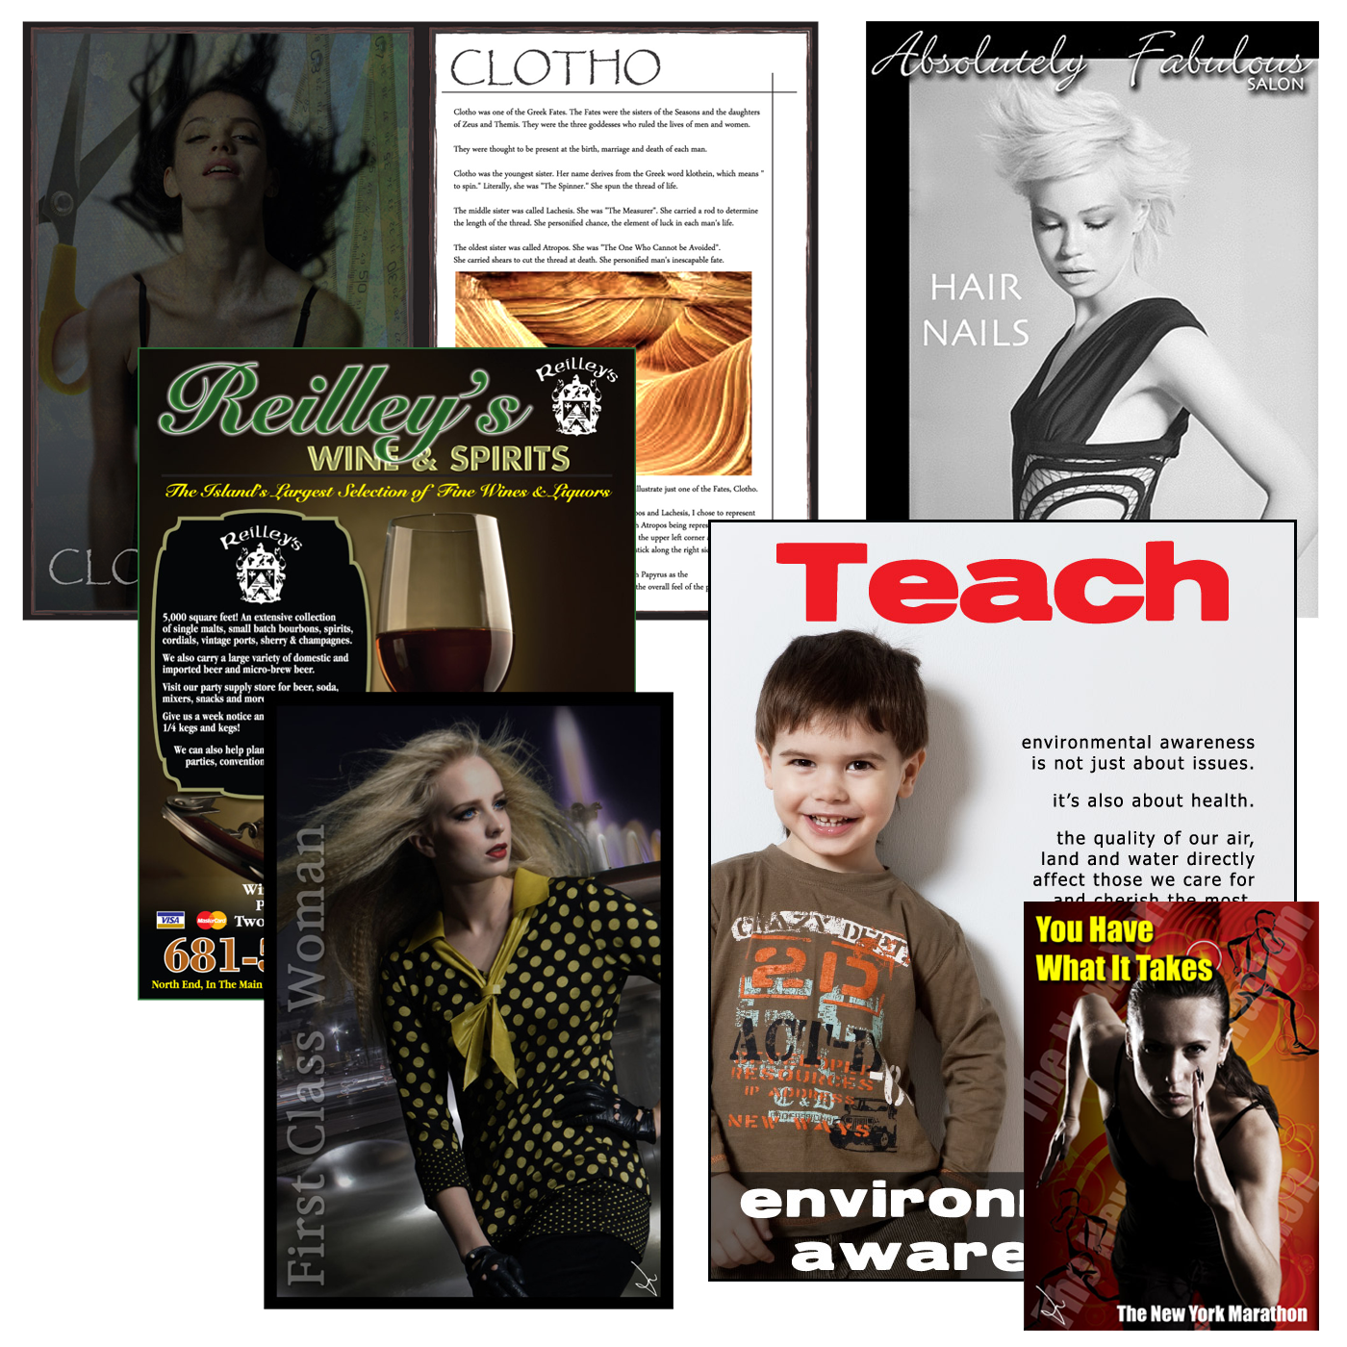
Notes:
One of the things I love about visual and graphic design is, of course, the element of creativity. Many of us may not have creative license when it comes to our products; we may have to stick to brand images and colors and specifications. Others may have the freedom to create, but don’t know where to begin or how to lay things out. <CLICK>
These are just some of the things I’ve designed for various organizations and on the job. The poster here for HOG was created using Adobe Illustrator and images manipulated in Photoshop. The colors are pulled from the National HOG logo and the background elements added for effect and drawing the users attention to the website. Additionally, we went ahead and created a QR code that viewers can scan with their smart phones and be taken directly to the website.
The group on the right are examples of the advertising and promotional elements for various projects or Clients. The interesting – and fun things – about the “First Class Woman” example is that this a compilation using 6 different images with over 20 layers all built using Photoshop.

Slide 4
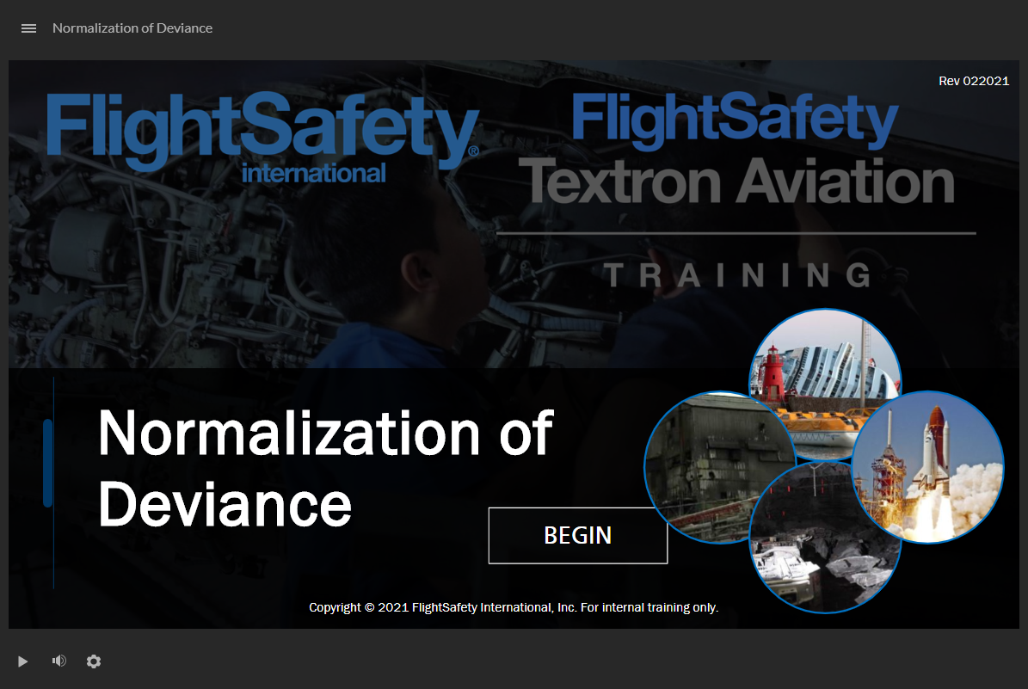
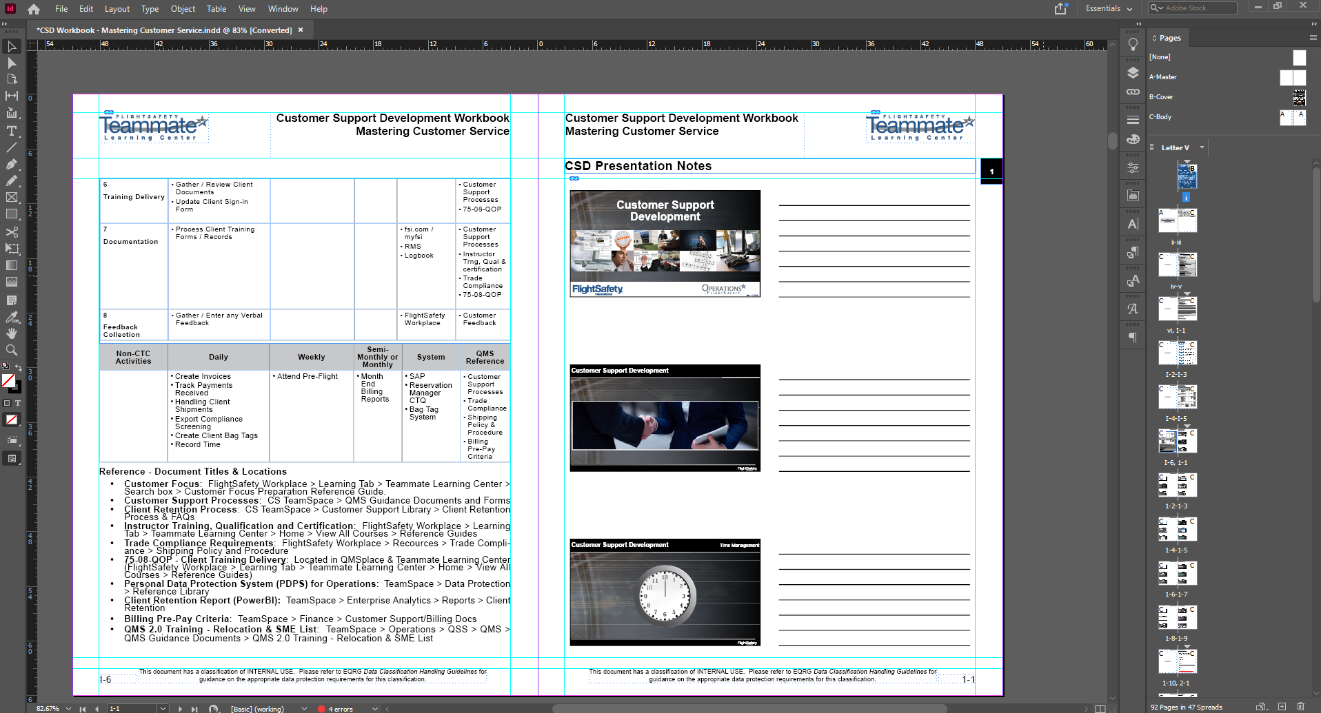
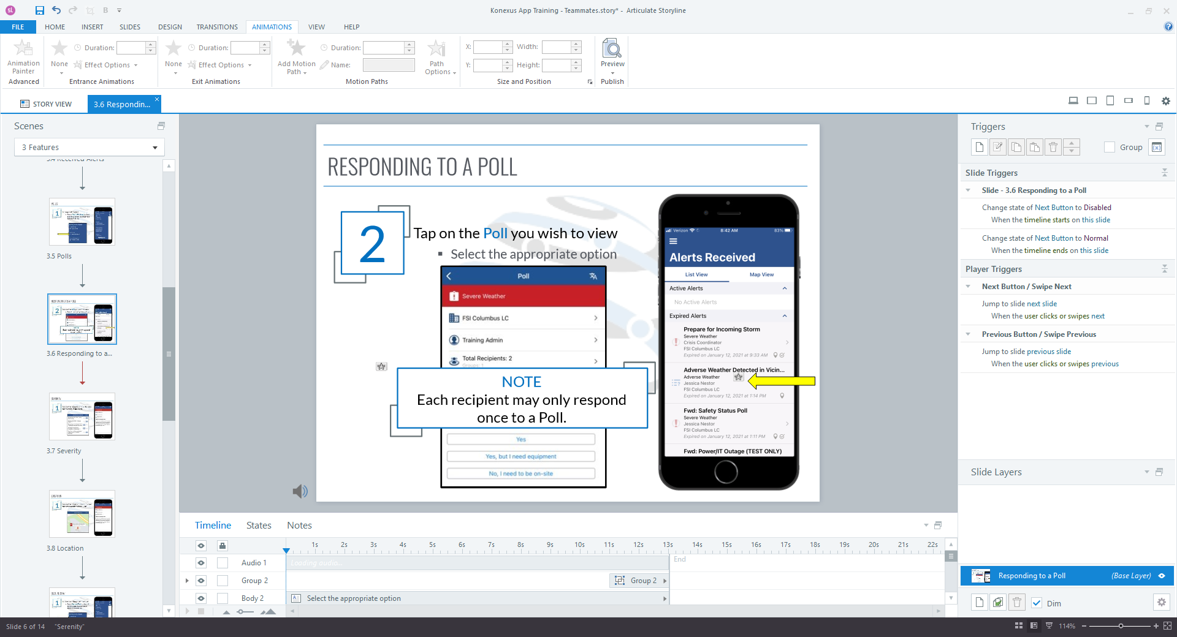
Notes:
And here are some elements of my more current works.
The Normalization of Deviance screenshot is from a recent module I built for FlightSafety. <CLICK>
This center image is from a 120 page publication designed and developed for a Customer Support Development Course for FSI.
And this last image is a working screen from within Storyline 360 building a module for Konexus AlertSense. <CLICK>
ALL of these have showcase various elements of visual design that I hope will help you look at the science and aesthetics of being creative.
<CLICK>

Slide 5
What is Visual Design?
Use of various elements to enhance and enforce user experience
Colors, Media, Typography, White Space, and Layout
Creating a scientifically and aesthetically pleasing experience
Notes:
So what, exactly is Visual Design? When you hear the phrase “visual design” what comes to mind?
In the most fundamental and traditional sense, visual design is the application of design theories and sciences to improve the user’s experience, or UX.
It does this through the use of visual elements, including:
Colors
Media, including audio, animations, static images, and video
Typography, including font styles and faces
The use of White Space to draw or focus attention on elements
And Layout techniques and placement of elements on a board/slide
All of this is done in order to create a scientifically and aesthetically pleasing experience for the end user.

Slide 6

Visual Design Basics
Visual Design Basics | Usability.gov
Focuses on the aesthetics of a site and its related materials by strategically (or scientifically) implementing colors, fonts, images, and other elements
Notes:
The definition here is taken from Usability.gov and their page “Visual Design Basics” and I strongly urge you to look over and save these resources as we come across them.
So, what does Usability.gov have to say about visual design? They state that visual design “Focuses on the aesthetics of a site and its related materials by strategically (or scientifically) implementing colors, fonts, images, and other elements.”
Let’s start off by looking at this slide. <CLICK>

Slide 7
Visual Design Basics
Visual Design Basics | Usability.gov
Focuses on the aesthetics of a site and its related materials by strategically (or scientifically) implementing colors, fonts, images, and other elements
Notes:
First off, we have the overall BACKGROUND element.
The Title slide set the tone for the delivery. But, we are also introducing concepts and other elements as we proceed. Therefore, to maintain a consistency throughout the presentation, the same graphical element is used, but is faded or watermarked so that it is not as powerful – or WEIGHTED – as the Title and Transition slides are.
Speaking of graphical elements, there’s the image we are using. Now, many newer designers will go with the traditional rectangle or square image and place it XYZ and maybe add a solid border. But notice how this image is placed and enhanced.
Rather than use a hard-edged image like square, I went with a circular aspect. Now, in order to achieve this using PowerPoint and an image as a background for a perfect shape, I modified the original image to suit. Since this is a perfect circle, I cropped the original image – in Photoshop – to a perfect square to place within. This means there’s no stretching or pinching to fit the image. I also cropped the image to a suitable place from the original. There’s just enough of the overall image to show the various aspects and elements that went into creating it without revealing the entire image. Finally, the outer border was added and, as you can see, rather than go with a solid line, an element of design was integrated by making a transparent background with a solid line, adding more weight to overall graphic.
And, to top it off, rather than place it in a corner or along the side – which is what the old me would have done years ago – notice where I placed it. It falls nicely within the swoops of the background image which now acts like a tertiary border and placeholder for the image. It rests “naturally” there. <CLICK>

Slide 8
Visual Design Basics
Visual Design Basics | Usability.gov
Focuses on the aesthetics of a site and its related materials by strategically (or scientifically) implementing colors, fonts, images, and other elements
Notes:
Now for the text.
Notice the header is offset, meaning, traditionally, it would be placed in the top left corner, usually left or centered “justified” (aligned). Here, and for all Introductory slides, I have placed the Heading in an offset manner. This draws the eye from the picture on the left to the text on the right…a natural progression hitting not only “readability” but “weight” of elements. You eye will usually be drawn to the image FIRST, then TEXT.
Look at the font used. As we will go over in a little more detail, the use of sans serif fonts for electronic delivery is widely accepted as best practices. It reduced “eye fatigue”…another concept we will discuss later. Also, the color and “face” of the fonts used. You want to keep font “differences” to a minimum, usually no more than two different fonts, and you want to keep the font faces or styles – italics, bold, etc. – consistent throughout. Therefore, due to web tradition, the website is immediately recognized and different than the Heading and Body text (blue underlined).
And, as with the Heading, the Body text is also placed non-traditionally. But, rather than be confusing or distracting, it, like the image, seems to “fit” where it is placed. Using the background image as reference, the Body text is placed in such a manner as to infer centralism without being centered. Also, the slight animation of the Body text draws the eye to it. Use animations to draw the user’s attention, but avoid overusing it or using inappropriate animations. <CLICK>

Slide 9
Visual Design Basics
Visual Design Basics | Usability.gov
Focuses on the aesthetics of a site and its related materials by strategically (or scientifically) implementing colors, fonts, images, and other elements
Notes:
Putting it all back together, this slide, with just a few elements on it, provides an overall feeling of being “right.” This is how I approach people looking to get into graphic design for the first time…look at those elements that feel “right” and pick them apart. Why does it feel right? What is it about some art or design that makes it feel natural and others seem to be forced or unpleasant?
There’s a science behind all the aesthetics. And knowing the science as well as what’s pleasing can make or break your design!
<CLICK>

Slide 10

Visual Design Basics
Color palette
Use of fonts
Element “weighting”
Element positioning
Important! Remember image QUALITY – or resolution – when designing.
72 DPI for typical web elements, 150+DPI for presentation delivery, 300+ DPI for print.
Notes:
Here’s the original image. Again, this is a compilation of several images and effects in Photoshop. This is actually my wife dressed as the Wicked Witch and me as a Flying Monkey for a chili cookoff we took part in several years ago. All of the elements of sound graphic design are here. <CLICK through each element>
<CLICK>

Slide 11
Why is Visual Design Important?
What is Visual Design And Why It is Important
“Visual design has as much of an effect on the overall experience as actual usability.”
Don Norman, Emotional Design: Why We Love (or Hate) Everyday Things
Notes:
Just as the quote states, visual design is just as important for overall user experience as actual usability. I actually tell people that visual design is nearly as important as content; if you have poor design, the users will automatically “fight” the presentation or training. Good design can not only promote training, but actually enhance it, aiding in retention of knowledge and concepts.
So what are the elements of good visual design? <CLICK>

Slide 12
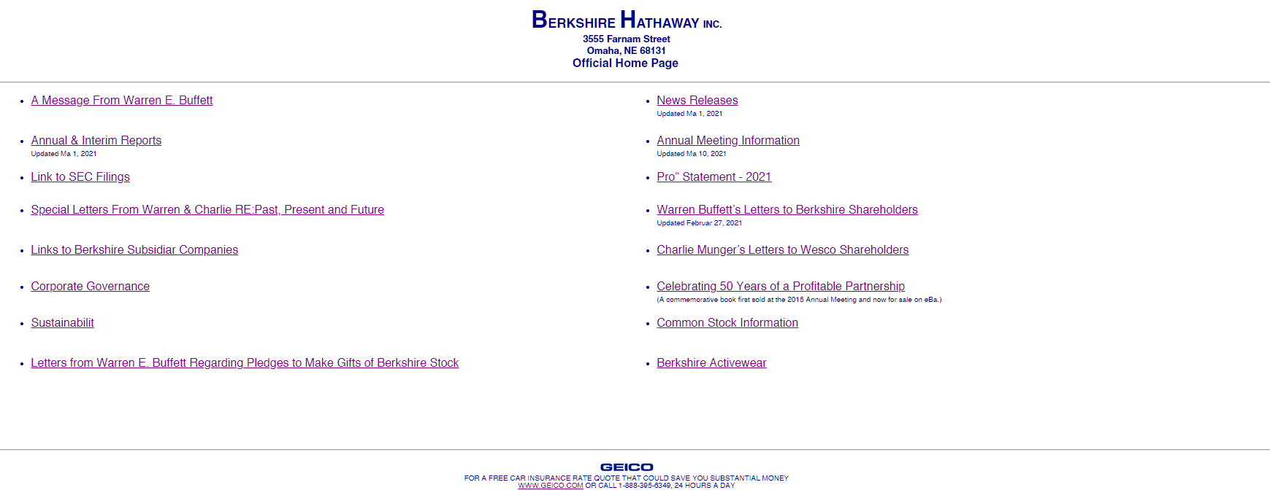
Design Should Enhance
Notes:
Design should ENHANCE the concepts, topics, or lessons you are presenting. It should present your ideas in a positive manner, inviting and welcoming people to participate.
Take a second and look at this website landing page. Does it look inviting? Does it look welcoming? Does it look like it’s the “presenter” of information regarding Berkshire-Hathaway Inc?
<ASK OPINIONS>
For those that may not know, Berkshire-Hathaway Inc. is the parent corporation owned by Warren Buffet, and the companies presented here, all part of Warren’s conglomerate, have revenues in the billions of dollars.
Does THIS website look present that?
<CLICK>

Slide 13
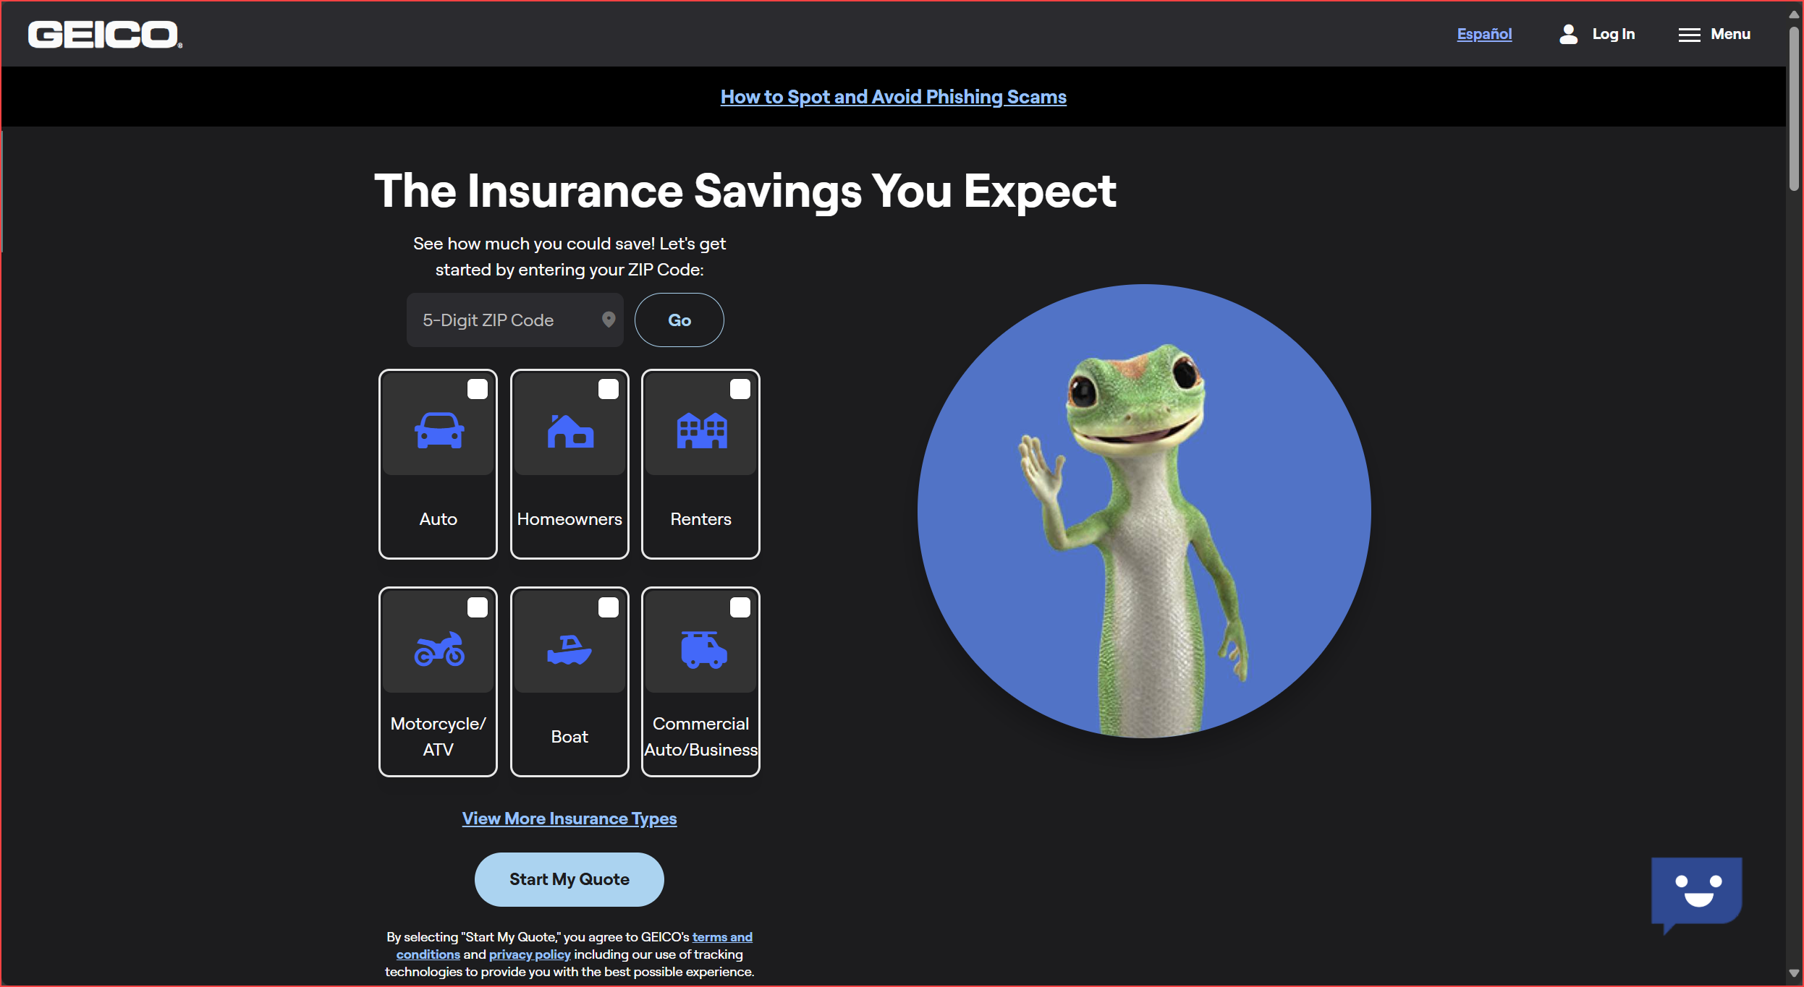
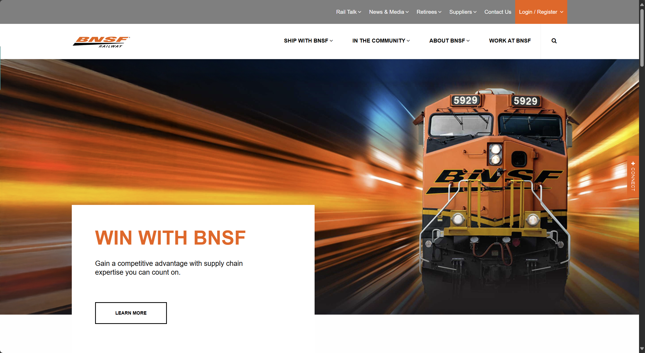
Design Should Enhance
Notes:
Now, look at these websites.
Compare this to the previous site.
Would you even know that these two companies were PART of Berkshire-Hathaway from what the previous site showed?
<ASK OPINIONS and what the LIKE about what they see>
Notice the layout, the use of color, typography, and images. These are all elements of design, good and bad. And these are the elements we will be covering.
So let’s look at some more examples and see what’s bad or good about them.
<CLICK>

Slide 14
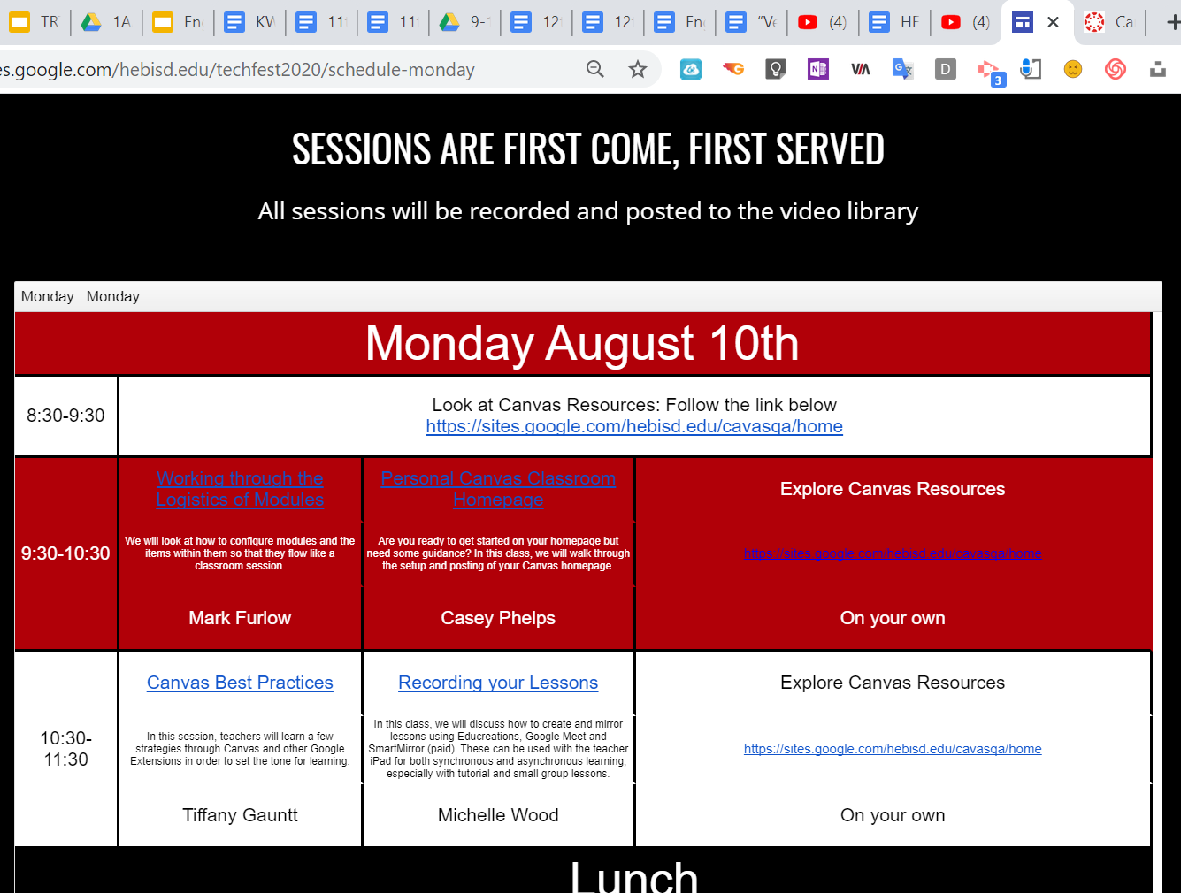
Bad Design vs. Good Design
Poor color palette
BLUE text on RED background??
Poor alignment
(Lunch and Top Heading)
Light Blue on White background with small font size
Notes:
This is an example from a local school promoting some Professional Development for the educators. Take a look and tell me what YOU see and think. <GIVE TIME>
At first glance, it’s not “bad” but it’s certainly not pleasing to look at, especially for professionals such as educators and administrators.
Look more closely however. The color of fonts and font sizes. The blue text on a red background. Notice how “Lunch” is misaligned with the “Monday” portion.
Bad design!
<CLICK>

Slide 15
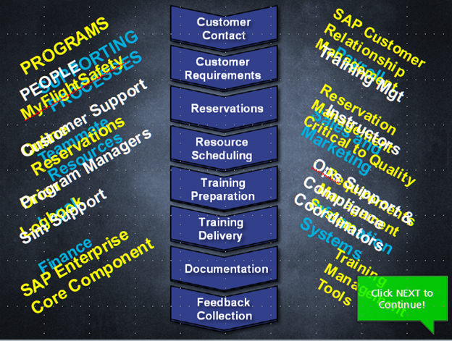
Bad Design vs. Good Design
Poor color palette
The central image is the concept, but the diagonal text does not support the chevron topics
The ugly green “Click NEXT to Continue!”
The phrasing is DEMANDING/YELLING at the user
Notes:
Another example, and this one close to home. This was training that was designed and developed by the former team at Teammate Training before my boss and I came in.
Where to even start with this mess? First off, it’s developed in Storyline, so there’s absolutely no reason why everything should be “gunked” up on the main layer. Additional layers would have at least made this less messy to deal with.
The central image does nothing to balance the awful text on either side. The colors used make no sense nor do they “highlight” or differentiate anything; they just used colors to use colors.
And that hideous “Click next to Continue” with the exclamation point DEMANDING you do something.
Bad design!
<CLICK>

Slide 16

Bad Design vs. Good Design
Poor color palette
FlightSafety LOGO not used as is required by FSI on all FSI training deliverables
Washed out Teammate Training logo and “Presents”
Wasted space at bottom for revision information and copyright declaration
RED on BLUE…VERY BAD!
Notes:
Another former training module developed by the previous team. Here, they are almost attempting to follow good practice, but fail.
First off, the FSI logo is simply text…a “no-no” in the policies regarding corporate identification.
The washed out “Teammate Learning Center” with the blue fading into the blue background. The white text in the center of the slide almost completely lost in the white gradient portion.
Nasty font choice. Period.
And all of that wasted space at the bottom portion for the revision and copyright information as well as – again – red text on blue background.
BAD DESIGN!!
<CLICK>

Slide 17
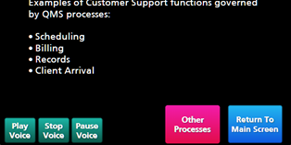
Bad Design vs. Good Design
Poor color palette
Bullet spacing between bullet and text
Poor font use for buttons (no BOLD and SHADOW)
Poor choice of “buttons” for use (too clunky and bulky)
Non-intuitive interface
Notes:
Finally, yet another portion pulled from the former training team.
Better use of light text on dark background, but the font style and bullets lack design appeal.
Fonts used on buttons are also poorly chosen and shouldn’t have a shadow applied; that was so 90s.
The size and clunkiness of the buttons themselves. This is all non-intuitive and could have been designed MUCH BETTER…had the designer known what they were doing.
Now, let’s look at some better examples!
<CLICK>

Slide 18
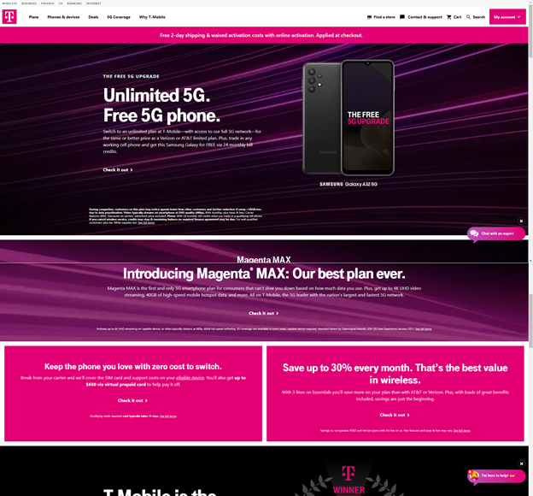
Bad Design vs. Good Design
Excellent use of color palette, even for such “odd” colors
Placement and weighting of elements
“Grouping” elements to convey sense of commonality
Use of White Space to create border effects
Intuitive interface
Notes:
T-Mobile.
First off, everyone should automatically have an idea in their head when they hear “T-Mobile.” Mine is the jingle as well as the colors they use in their ads.
Here, you see all of that branding put together in what would originally be thought of as – UGH! Purples, pinks, and hues of those? Really? But look at how this all works together to form something professional and well-designed.
Use of fonts, colors, and layout. Structure of the page and how each element works. Even the use of contrasting coloring – in this case, the black with the vibrant colors of T-Mobile’s brand.
GOOD DESIGN!
<CLICK>

Slide 19
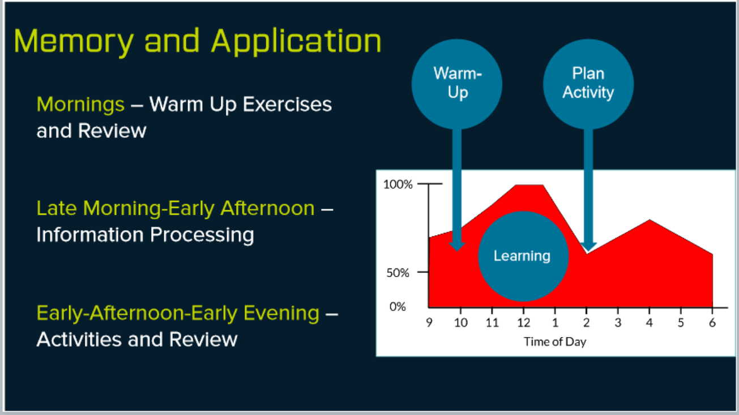
Bad Design vs. Good Design
Excellent use of color palette
Placement and weighting of elements
Use of White Space to create importance
Placement and use of Space for Revision and Copyright information
Intuitive interface
Notes:
And now to my bias personal designs.
Minimalist and clean, streamlined and modern. Using FSI’s blue as a baseline, and then creating gradients and shades of that blue to enhance the visual quality.
Aligned elements that bring to attention and draw the eyes in an up-to-down movement.
Space used to provide information and design that information so that the user immediately knows what they are doing, what is being provided.
The required revision and copyright information is there, but not overpowering, only there for regulatory purposes because, let’s face it…do you REALLY care about what revision you’re seeing or the copyright?
Good Design.
<CLICK>

Slide 20

Bad Design vs. Good Design
Excellent use of color palette
Placement and weighting of elements
Use of White Space to create importance
Use of Grouping to infer commonality
Intuitive interface
Notes:
And finally, a “meat” portion of the module.
Again, the use of FSI’s blue as the background. A high-quality image related to the content being presented. Limited information on the screen without overloading the user with tons of text.
Standard fonts are used and the colors and styles are aligned with the overall feel of the presentation.
The subsidiary and secondary image and button do not take attention away form the content and again, draw the eye in a natural order.
Now that we’ve seen both good and bad designs, let’s start by diving into the elements of design, beginning with the most common and basic to deal with…color.
<CLICK>

Slide 21
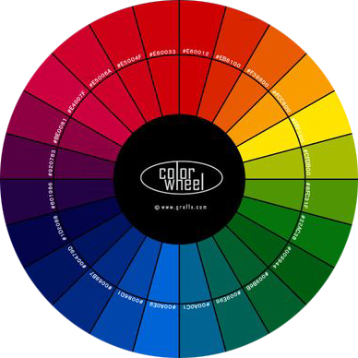
Visual Design – Color
Color wheel, a color palette generator | Adobe Color
Use color to direct attention
Use colors strategically to enhance and enforce
Improve readability with color
Use colors based on their meaning
Choose the right color combinations
Notes:
I choose this as my first element because it is one of the simplest to address and integrate at the onset of any project.
Understanding how colors work, and how they can be used to direct, enhance, and generate emotions, can lead you to design truly powerful presentations.
Colors are also used for BRANDING purposes and companies usually require a color specification in their deliverables. This is important to remember when designing for such enterprises.
Clicking on the Color Wheel will open the website Shift eLearning and their article on color use in eLearning development.
<CLICK>

Slide 22
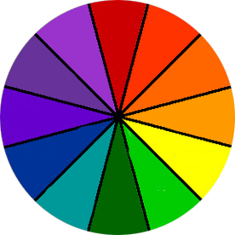


The Color Wheel
Color wheel, a color palette generator | Adobe Color
CMYK Black (0/0/0/100)
RGB Black (0/0/0)
Primary Colors (Red, Blue, Yellow)
Secondary Colors (Primary + Primary)
  Violet, Green, Orange
Tertiary (Between Primary and Secondary)
Notes:
We all pretty much know what the Primary Colors are. These colors – Red, Blue, and Yellow – and their combinations make up all of the visible colors we use. It is important to note here that there are TWO “aspects” of colors we need to remember.
<CLICK>
CMYK
<CLICK>
RGB
<CLICK>
CMYK – Cyan, Magenta, Yellow, and Black – is the color aspect to use for PRINT.
<CLICK>
RGB – Red, Green, Blue – is the color aspect to use for ELECTRONIC delivery. Look at the color shapes for details here. One – the RGB – is “richer” than the other. CMYK is what is called a SUBRACTIVE process while RGB is an ADDITIVE. We don’t need to know what that actually means, but it’s important to remember that, if you are designing and creating your own images or artwork to include in your deliverables, you utilize the right color aspect for the job.
<CLICK>

Slide 23
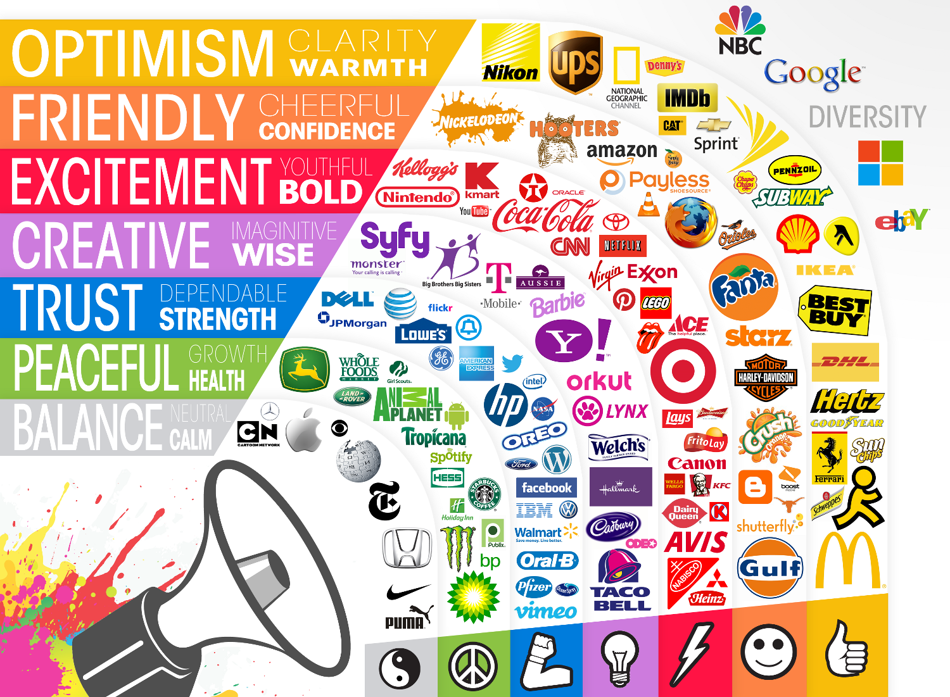
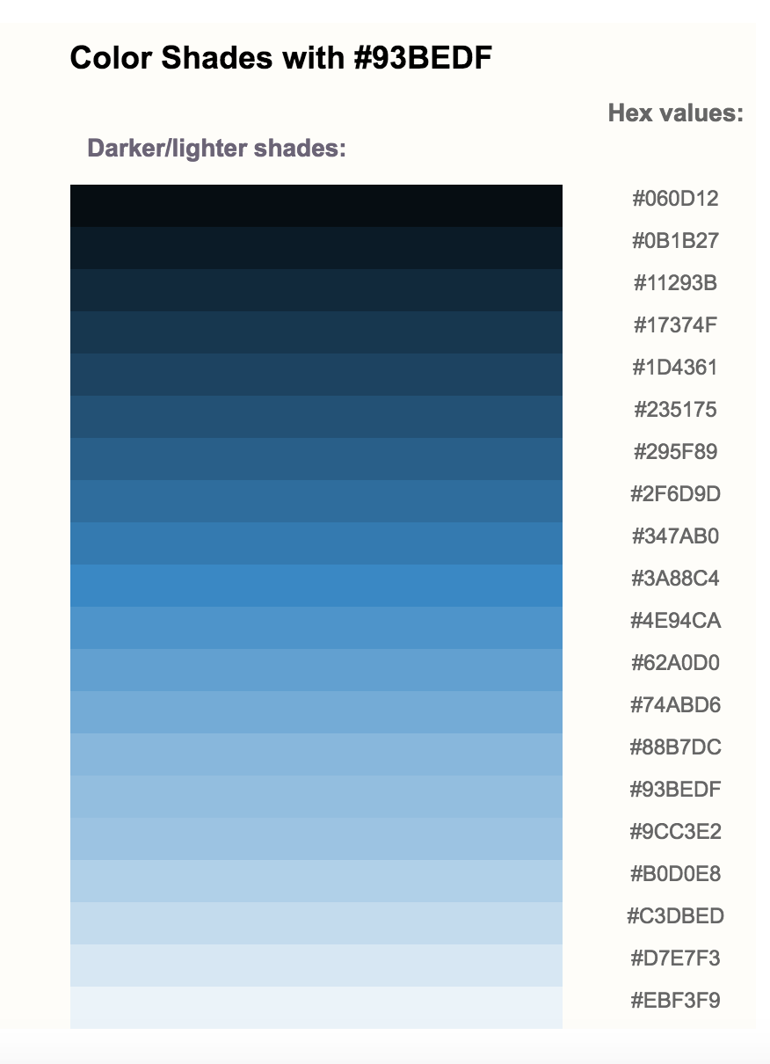
Color Use
The Do's And Don'ts of Infographic Color Selection
Notes:
We should also know that colors invoke emotions or represent specific qualities. While this link is concerned about the use of colors in infographics, the same holds true for solid design theory in color use for instructional materials.
Notice the logos shown. Have you ever thought about the colors used? Probably not. You probably thought, like I did, it’s just something they picked out…and now, you simply associate that brand with that color. But look at the emotional qualities associated with specific colors and then the brand logos utilizing those colors. Does it now make more sense?
Same when choosing colors for your instructional materials. Use colors that match the concept or audience you are designing for. Pinks and purples in senior leadership meetings for a construction company are probably not going to be taken seriously. However, oranges, specifically hazard yellow-orange, and blacks/greys would be suitable.
<CLICK>
And remember shade and tints. If you have a strong color palette that works – and remember, you should only stick to a couple of colors MAX – you can fall back on shades or tints of that color in your design and not break the rule!
Also remember color schemes and contrasting colors when using colors. And use sparingly and consistently. If you use icons and colors, make sure that you maintain consistency throughout and use the same colors – and icon styles – in your materials.
<CLICK>

Slide 24

Color Use
Notes:
When choosing colors for your design, there are a few things to keep in mind.
Black text on White backgrounds IS NOT good unless that background has some sort of soft image to break it up. Black text/White background creates unnecessary eye fatigue and can cause the user to focus more on looking away – or seeking aspirin – than actually being engaged with your presentation.
Black text on a light grey background is acceptable…just not all white. Studies have shown that WHITE TEXT on DARK BACKGROUNDS actually reduces eye fatigue and allows the user to focus longer on the presentation. Thus, many of my eLearning modules follow what you see above. T-Mobile also follows this practice as seen from their website.
<CLICK>

Slide 25

Visual Design – Media
Free Vectors, Stock Photos & PSD Downloads | Freepik
Use clean, professional images that are relevant to the concept
Avoid using overpowering images
Remember bandwidth considerations and limitations
When possible, modify images prior to using in presentation
Remember copyright rules!
Notes:
The next element I hit in my design are the media objects.
When using media, including audio, video, animations, and static images, there’s a lot to keep in mind.
Always use high-quality, high-resolution images whenever possible. Avoid compression and low-resolution images as they will appear pixelated and amateurish.
Avoid overpowering images! Media should be used to enhance; rarely are they THE learning concept or topic. In such cases, ensure that there is enough white space used to enforce the media concept.
Remember, not everyone has high-speed internet. This also goes for internal deliverables. If your intranet and network structure is anything like ours, you will notice lag. When pushing over the internet, you really must consider bandwidth and buffering.
Whenever possible, manipulate and edit your images PRIOR to inserting into your presentation. Modifying within the presentation can lead to anomalies and reduction in quality.
<CLICK>

Slide 26
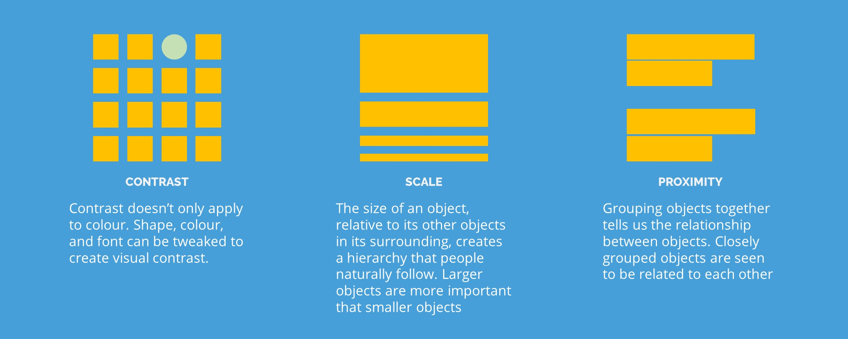
Visual Hierarchy
Capture Attention With Visual Hierarchy
Notes:
When people look at media, they look in a specific order…
Irregular images, color images, video, and size are observed FIRST
Regular shapes, B&W images, and text are observed second/last
Use this to your advantage to draw attention as needed
Using contrast (colors and shapes), scale, and proximity can direct the user’s eyes and attention to areas that you want them to focus on or notice first.
And always remember copyright rules!!
<CLICK>

Slide 27


Visual Elements and Audience
9 Visual Elements EVERY Online Training Course Must Have
Know your audience…use appropriate elements
Use the right element for the right delivery for the right audience
Know Your Audience!
Younger Learners – OK!
Adult Learners – Not OK!
Adult Learners – OK!
Younger Learners – Maybe Not OK!
Notes:
When planning on visual elements such as images and infographics, remember your audience. You will see and hear me mention this several times throughout this lesson.
KNOW YOUR AUDIENCE!
<CLICK>
Use the right visual elements for your audience. Think about how your audience will receive your visual elements.
<CLICK>
Would a board of directors be impressed with this image? Wouldn’t it make the overall presentation – which more than likely is professional and high-level – seem childish? Just ONE mistake and your presentation loses credibility.
<CLICK>
And again, if your presentation is geared towards younger children, would this image be suitable for that general audience?
Remember who you are designing and developing for.
<CLICK>

Slide 28
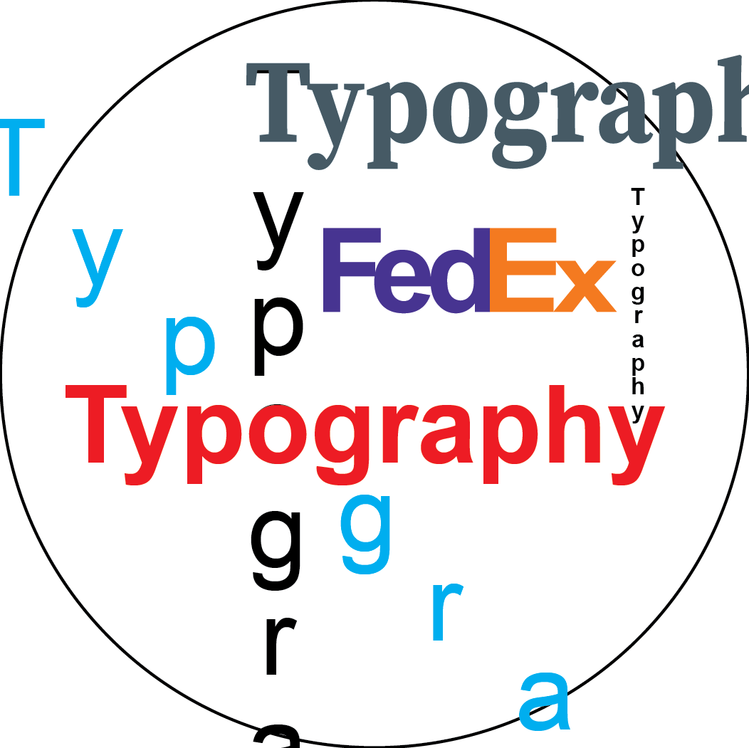
Visual Design – Typography
Typography In eLearning: 5 Key Tips For eLearning Professionals
Know your audience…use appropriate fonts
Utilize and maintain consistency throughout
Stick to standard and web-safe fonts
Aim for readability
Understand typography etiquette
Notes:
When you hear the word “typography” you may automatically fall into a graphic design mode of thinking.
Traditionally, typography is the use of fonts in a design fashion to draw attention to or enforce a design idea or concept.
In instructional design, however, we’re talking about using appropriate fonts, maintaining consistency, relying on commonly accessible fonts, readability, and etiquette.
<CLICK>

Slide 29

Typography - Use
Typography In eLearning: 5 Key Tips For eLearning Professionals
Know your audience…use appropriate fonts
Use the right fonts for the right delivery
Use Serif fonts for printed delivery and professional printed correspondence.
Use Sans Serif fonts for electronic delivery, including PDFs, to reduce eye fatigue.
Corporate Revenue was down by 12% last quarter
Corporate Revenue was down by 12% last quarter
Corporate Revenue was down by 12% last quarter
Corporate Revenue was down by 12% last quarter
Notes:
Use
First point…know your audience and use fonts appropriate to the audience. You do not want to use cartoony fonts in an executive-level presentation.
Similarly, it IS appropriate to use fonts like Comic Sans or “stylized fonts” in presentations given to children.
It all comes down to knowing your audience.
Secondly, use fonts for the delivery method. Sans serif fonts for electronic delivery, serif fonts for printed materials. This is the traditional method of font use in delivery; however, if the deliverable is better suited using another method style, then use it. Just remember…use good design!
<CLICK>

Slide 30
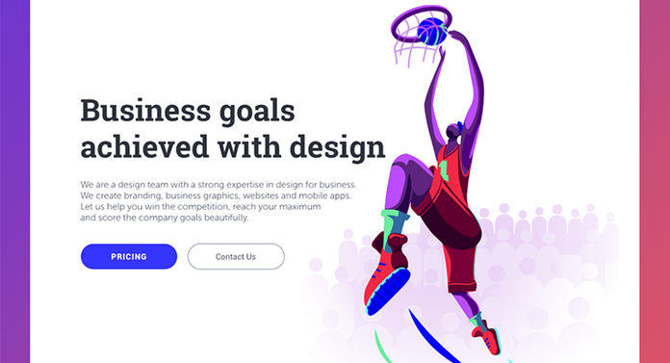
Typography - Consistency
Typography In eLearning: 5 Key Tips For eLearning Professionals
Consistency
  Placement
  Size
Notes:
Consistency
Ensure you maintain consistency throughout your presentation.
Notice how the Headings and Body text are all the same throughout the presentation so far. Use font faces and styles consistently throughout.
Also look at placement. While this slide is not aligned with the Transition slides, it IS aligned with the Content slides, meaning, the Heading and Body text blocks are placed in the same area throughout.
Notice how the Weblinks are always placed below the Heading and the color used.
Keep sizes consistent. Here, the Headings are 36pt, the Body is 24, and the Weblinks are 18.
When using Bullets, ensure the placement and spacing of the Bullet Points maintains consistency.
<CLICK>

Slide 31
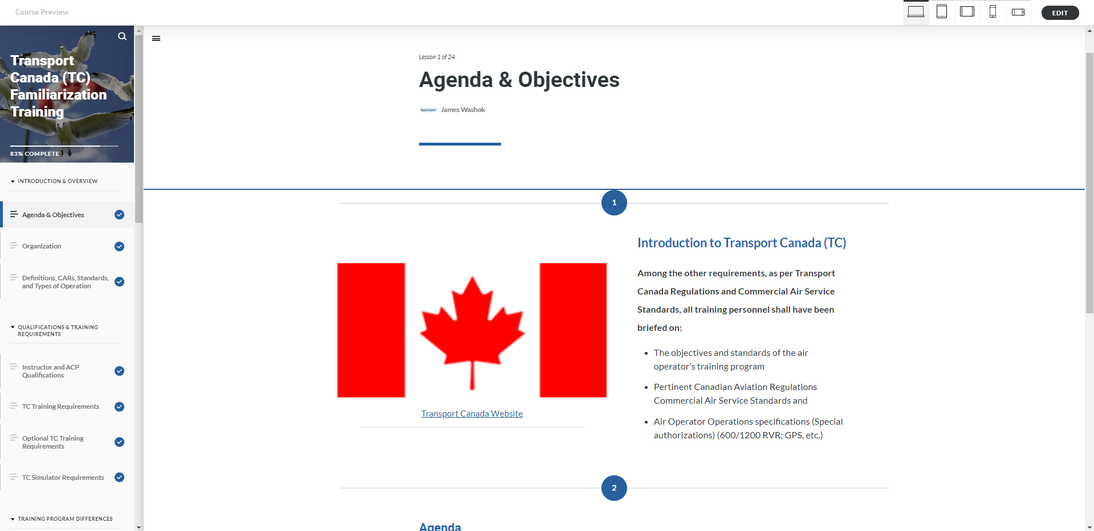
Typography – Use (Web) Safe Fonts
Typography In eLearning: 5 Key Tips For eLearning Professionals
Not used system-wide
Anomalies and errors
Size
Notes:
Use Web Safe fonts
Stay away from using non-traditional or odd fonts that need to be downloaded.
These fonts may not be on everyone’s system.
Leads to anomalies in delivery and errors in design presentation.
<CLICK>

Slide 32
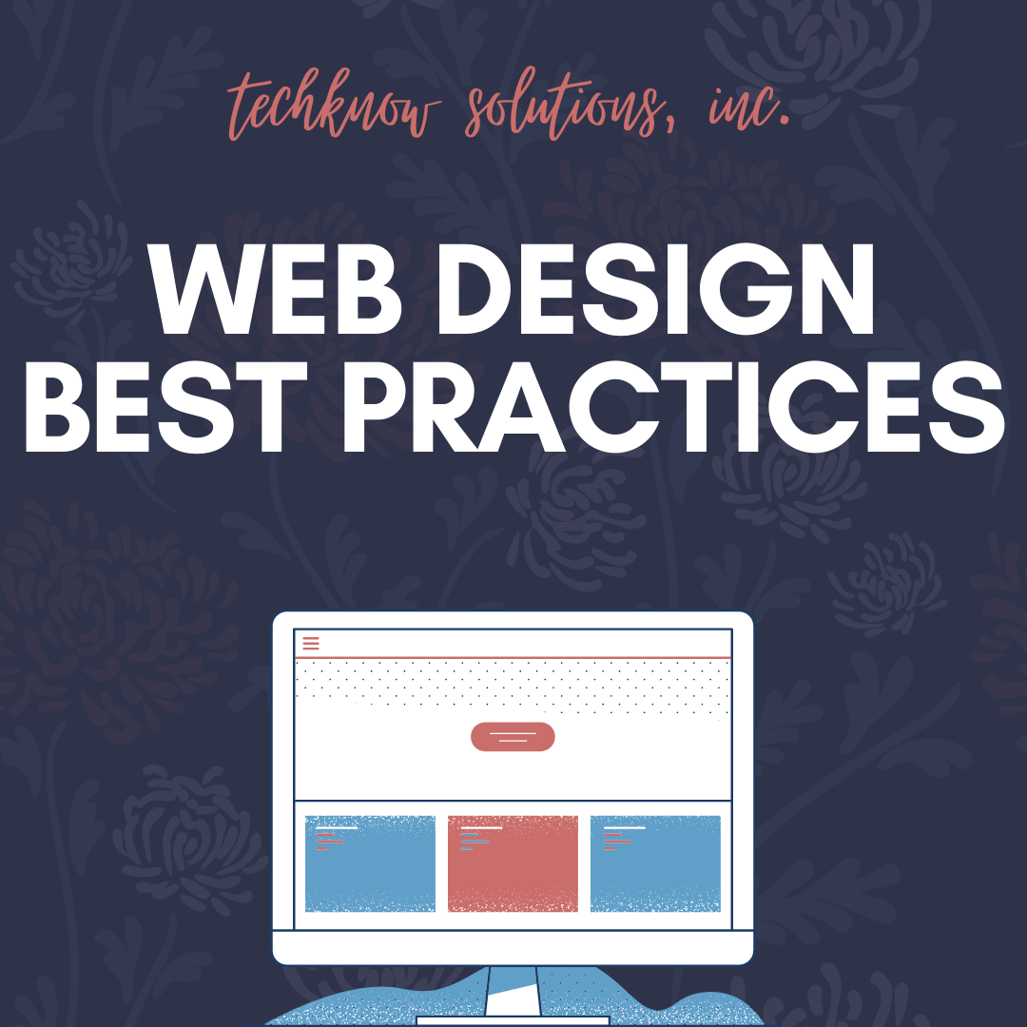
Visual Design – White Space
What's White Space Design? 5 Real Examples
“Empty” space around content and functional elements
Let’s your design “breathe” and reduces eye fatigue
Any space that serves as the background for content
Adds clarity to the overall design
Use white space to your advantage to draw attention and focus
Notes:
Contrary to popular belief, white space isn’t necessarily white! Yes, I had a reviewer actually state something like, “You asked if white space was used appropriately, but I didn’t see any white.”
And this comment was from someone in another business unit assigned as “eLearning content developer.” Wow.
So what is white space and what does it do? <CLICK for each bullet item>
White space is any space that surrounds content or the functional elements in your presentation. Think of it as “borders” for your stuff.
White space is there to allow your content and design to “breathe” and appear natural, thus, reducing eye fatigue.
White space is ANY space that serves as the background for the overall design.
White space adds clarity and “cleanliness” to your design, creating something that is logical and appealing rather than chaotic and haphazard. Yes…I used the work haphazard in a sentence. I win at Presentation Scrabble today.
And finally, use white space to your advantage. Use it to draw attention to or focus the user’s attention on key elements in your design.
Let’s see how this works.
<CLICK>

Slide 33
White Space – Typography
Typography In eLearning: 5 Key Tips For eLearning Professionals
White space makes text more readable
Adjust line height (vertical distance between lines)
  120%-145% of size
TOO TIGHT
“Mistakes are almost always of a sacred nature. Never try to correct them. On the contrary, rationalize them, understand them thoroughly. After that, it will be possible for you to sublimate them.”
- Salvador Dali
JUST RIGHT
“Mistakes are almost always of a sacred nature. Never try to correct them. On the contrary, rationalize them, understand them thoroughly. After that, it will be possible for you to sublimate them.”
- Salvador Dali
TOO LOOSE
“Mistakes are almost always of a sacred nature. Never try to correct them. On the contrary, rationalize them, understand them thoroughly. After that, it will be possible for you to sublimate them.”
- Salvador Dali
Notes:
Use white space to improve typography.
Using white space within typography – or line height and spacing of text – makes the text more readable.
Too tight, becomes harder to read and there’s no “breathing” room.
Too loose and the text loses “flow” and become disconnected.
<CLICK>

Slide 34

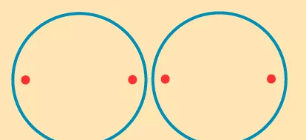


White Space – Creating Connections
Gestalt Laws of Perceptual Organization
Gestalt Laws
  Closure
  Common Region
  Proximity
  Figure and Ground
Notes:
Use white space to create connections.
Create connections using white space based on Gestalt Laws. <CLICK for each example and Law>
Closure, including negative space (FedEx arrow). We perceive elements as belonging to the same group if they seem to complete some entity and our brains fill in the gaps.
Common Region states when elements are located in the same closed region, they are part of a group.
Proximity states that things that are close together seem more related than things that are farther apart. Here, the top text and image are together due to their proximity while the bottom text and button are together.
Figure and Ground where FIGURE is the object we are focused on and GROUND is the background the object rests upon.
<CLICK>

Slide 35
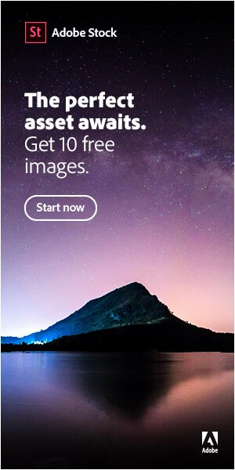
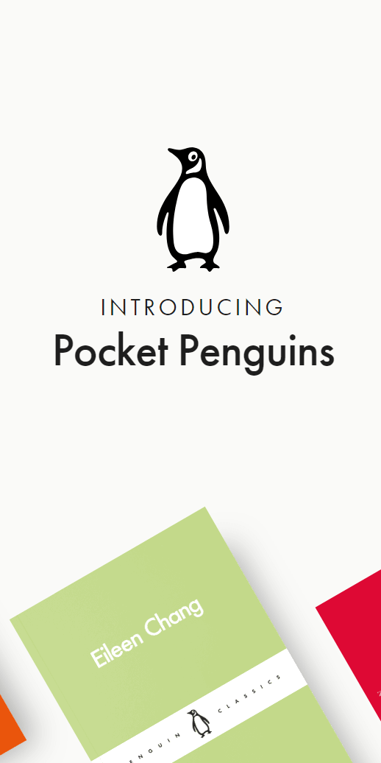
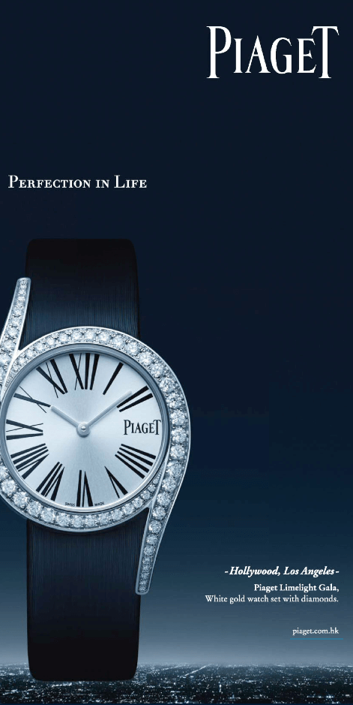
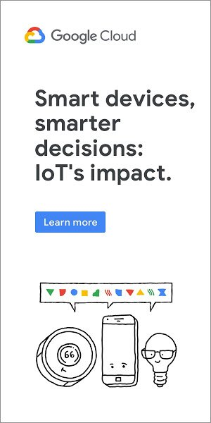
White Space – Examples in Design
White Space In Graphic Design: Guidelines & Examples
Passive white space (typography)
Active white space (logo)
Macro white space (logo)
Micro white space (typography)
Use white space to create
brand and element focus
Effective use to focus and
draw attention
Notes:
Examples in Design
Click for each Element and explain/discuss as desired.
<CLICK>

Slide 36

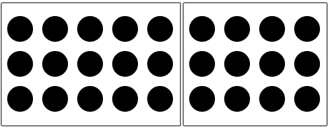

Gestalt Principles
7 Gestalt Principles of Visual Perception: Cognitive Psychology for UX
Closure
Common Region
Proximity
Notes:
More on Gestalt Principles
Since we mentioned Gestalt Principles, I think it’s important to go over these in a little more detail with some strong examples.<CLICK for each example and Law>
We’ve discussed Closure. Here’s another example. <CLICK> What do you see? <CLICK>
We’ also covered Common Region whereby elements located in the same closed region, are perceived as part of a group. Here’s another example. <CLICK> Although the dots are all the same size and aligned, by placing a box around groups of them, we perceive them as individual groups rather than a collection of dots.<CLICK>
Proximity stated that things that are close together seem more related than things that are farther apart. Here’s another example. <CLICK> While we are again presented with a series of dots, this time of differing colors, we tend to “group” them together due to the closeness of the elements. This shows that proximity can even supercede other visual elements such as color.
<CLICK>

Slide 37
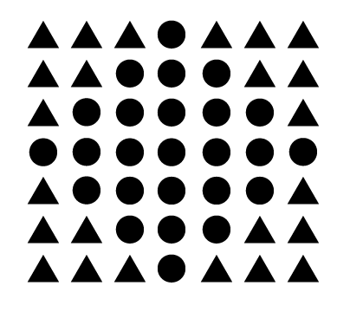
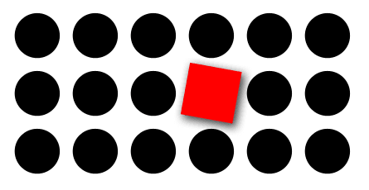
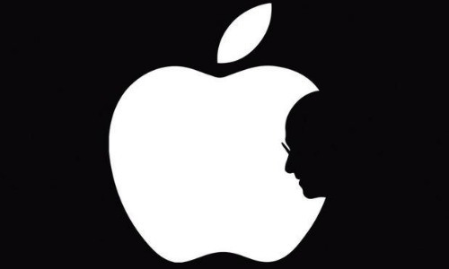
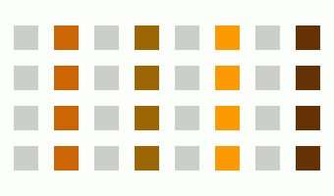
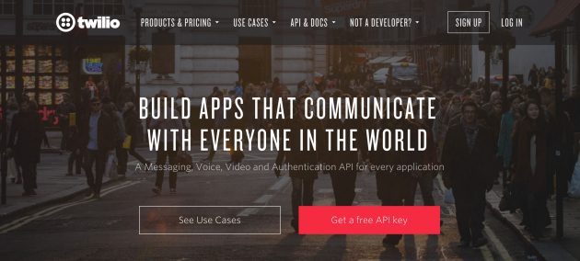
Gestalt Principles
7 Gestalt Principles of Visual Perception: Cognitive Psychology for UX
Figure - Ground
Similarity
Focal Point
Notes:
More on Gestalt Principles
Figure and Ground where FIGURE is the object we are focused on and GROUND is the background the object rests upon. <CLICK> What do you see? <CLICK>
Similarity states that when appear to be similar to one another, we tend to make groups of them.. <CLICK> While there are only two shapes shown – a triangle and a circle – our eyes tend to create a group of them according to their placement. What do you see?<CLICK> Here’s another example. Even though the squares are all the same size, this time, it is the similarity of color that “groups” the elements together. <CLICK>
Focal point is a very important principle. It states that whatever stands out visually will capture and hold the viewer’s attention FIRST. Admit it, the first thing you FOCUSED on was the red square. Here’s another example and tell me…where were your eyes drawn to and focused on? <CLICK>
<CLICK>

Slide 38
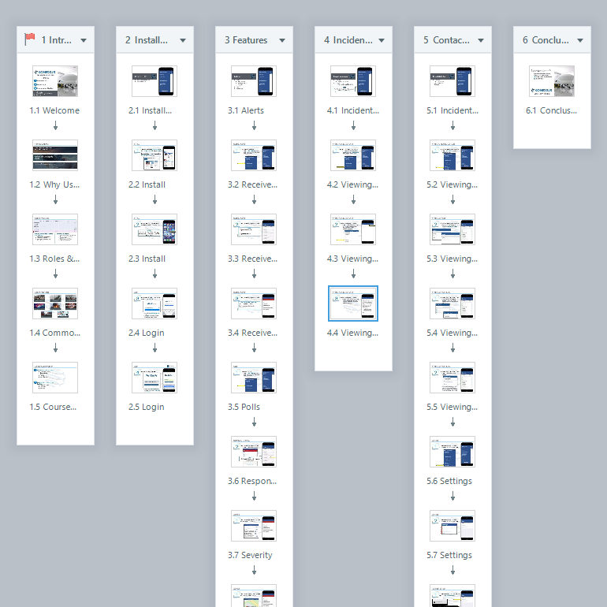
Visual Design – Layout
eLearning Design - 38 Slide Design Tips from the Pros
Design using “conversation”
Everything “speaks” to the user. Use content wisely.
Look for opportunities for active engagement
Adds clarity to the overall design
Use white space to your advantage to draw attention and focus
Notes:
Finally, we pull all of the individual elements into Layout. This is why I saved this elements for last as having an idea of the concepts we covered will assist in helping you layout your presentations effectively.
And I really want to stress this…there is NO PERFECT LAYOUT. Period. What I will be showing you are some of the methods as to how I approach laying out a course or lesson. But, these are based on a specific set of standards or requirements; yours will undoubtedly differ from mine. So all I CAN offer are some ideas on best practices and strategies in design layout.
<CLICK for each bullet item>
First off, I design as if I am having a conversation with the user.
Secondly, I must remember that everything – each element – “speaks” to the user.
Third, I try to not overload the user with elements, either visual or textual.
Fourth, I always look for appropriate points to introduce engaging activities or dynamic content to retain the user and assess their understanding.
And lastly, I do my best to ensure that the overall layout – the “story” – aligns with the goals, objectives, and outcomes that are necessary in the first place.
So let’s talk about each of these ideas.
<CLICK>

Slide 39
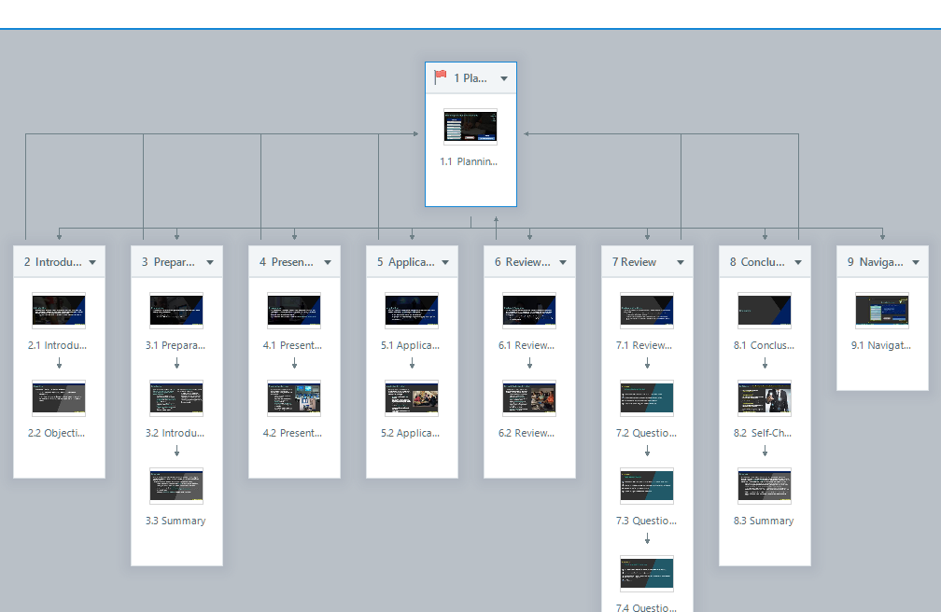
Macro-Layout
Flowcharts, Storyboards, and Rapid Prototyping
The OVERALL or “big picture” of your presentation
  Logically flow the content to address each of the learning objectives or outcomes
  Story > Chapter > Content
  Flowcharts and broad storyboards
Notes:
Before we dig into my layout process, I also look at layout in two ways.
Macro-Layout
Click for each Element and explain/discuss as desired.
This view is what I call the macro-layout. It provides a big picture of the project or lesson that I am working on and is usually developed directly within the authoring tool I am using. In this case, that tool is Articulate Storyline 360.
This is done in PowerPoint by creating Sections.
This is developed using a logical flow thought process, working from simple to complex or in an A+B+C=D mentality. Basically, WHAT do I need to address – or learning objectives and outcomes – and WHAT is the best path to address these in order to make sense in the user’s mind.
This is where it is sometimes better to NOT KNOW what the topic is about. Being a novice or having no experience in the topic allow you develop it in a manner that makes sense to you and therefore, hopefully, in a manner that makes sense to other non-experts.
In this broad picture, using SL 365, I look at this overall layout as Story (the working space shown in grey) which is made of Chapters (in SL they are your Scenes) with each Chapter/Scene consisting of Content.
You can also approach this using flowcharts and arrow diagrams; I try to consolidate the process to avoid overworking.
<CLICK>

Slide 40
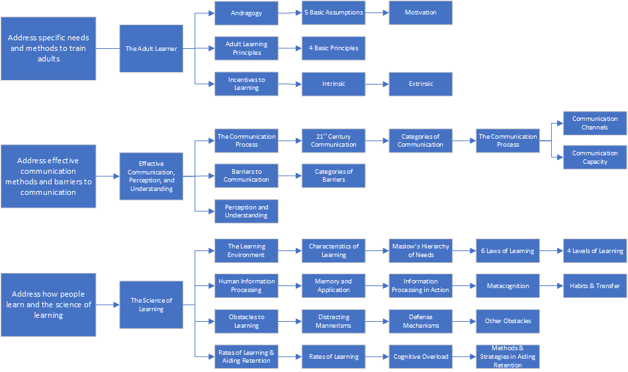
Macro-Layout – The Flowchart
Flowcharts, Storyboards, and Rapid Prototyping
Notes:
Flowchart Example
Flowchart Example from my current Master’s Course on three eLearning Modules I was presenting. <CLICK>
The Learning Outcomes on the LEFT represent the training requirements set forth by the organization as well as regulatory authorities. <CLICK>
This group represents the MODULES or Training Lessons that were being designed and developed to address that particular LO. <CLICK>
While the overall Modules consist of more Learning Objectives than shown here, these are the ones that directly relate to the organization’s and regulatory authorities' requirements. <CLICK>
This group represents the main Concepts that will be addressed or presented in order to meet those Learning Objectives. <CLICK>
And the process just keeps building out until a logical – and COMPLETE – overview is produced. At this point, you can not only start laying out the Project, but you have also produced a visual depiction of your training for Stakeholders. <CLICK>
<CLICK>

Slide 41
Micro-Layout
The “traditional” layout thought/vision
  Each element has a place and purpose
  Elements maintain consistent placement throughout
  Whitespace provides borders and grouping
  Effect and sound design takes into consideration content and elements and works to make them flow together
Notes:
Now, we look at what most people think of when we talk about layout, the Micro-Layout.
Micro-Layout
Click for each Element and explain/discuss as desired.
This is what most people think about or envision when “layout” is mentioned. It’s how the presentation elements are placed on a slide or storyboard.
Here you can see that each element has a place and a purpose. The placement of the elements are logical and almost intuitive; you eyes naturally flow left to right, top to bottom, and are drawn to the areas that I intended to focus on.
And, by using whitespace, I have achieved hitting several Gestalt Principles (continuity, hierarchy, connectedness) and also reduced eye strain.
<CLICK>

Slide 42


Design Using Conversation
Conversation and Instructional Design
Create content as if having a conversation with the user
  Helps me focus on content
  Helps me drive the design as to what is important and useful
  Keeps unneeded content out (usually)
  Think of the learning or training from the user’s perspective
  Using multiple voices for narration adds more “human” feel
Notes:
I design as if I am having a conversation with the user about the topic being discussed.
Click for each Element and explain/discuss as desired.
This helps me focus on the content provided and what I need to include
This allows me to focus on the design and inclusion of only important and useful information and content
This helps keep the clutter out and limits or reduces overload of the user
All of this is by thinking how the user will take the training and what they need to walk away with
When approaching narration, for longer courses – lasting more than 15 minutes – I try to introduce truly “conversational” tones by using two narrators who talk with the user
<CLICK>

Slide 43
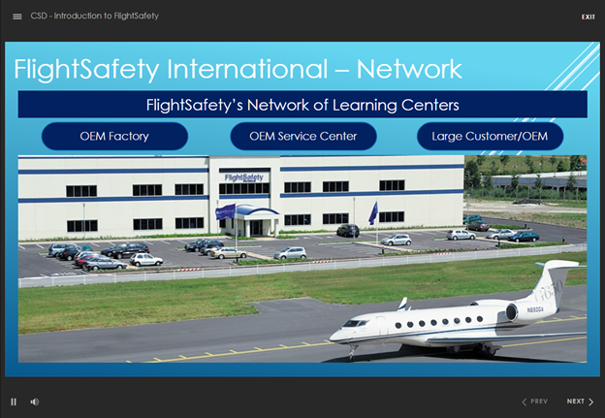
Using Content Wisely
Conversation and Instructional Design
Use content wisely and appropriately
  Avoid overload
  Remember what needs to be focused on
  Design thinking of where I want the user to start and end
  Provide “hooks” to grab attention
Notes:
When I’m laying out a slide, I think about what needs to be said and how best to say and support it.
Click for each Element and explain/discuss as desired.
My main concern is avoiding overload – either sensory overload due to too many or inappropriate visual elements, or cognitive by cramming too much content on a slide
This helps me focus on when needs to be delivered
Knowing this, I then think of HOW I want to direct the user, where do I want them to start and end…and it is logical.
Whenever possible, I try to use “hooks” to grab the user’s attention without distracting them
<CLICK>

Slide 44
Active Engagement Opportunities
Conversation and Instructional Design
When using authoring tools, look for opportunities to include active engagement with your content
  This could be as simple as clicking a button
  It could also be including hyperlinks in objects, such as this image linking to a webpage
  More engaging and interactive objects include drag and drops, formative assessments, and branching scenarios
Notes:
As I’m designing, I’m also thinking about the Objectives and Interventions I have written. I want to include opportunities for the users to ENGAGE with the content.
Click for each Element and explain/discuss as desired.
This could be a simple button that shows a layer when clicked. The layer can be animated or have animated elements.
It could include hyperlinks attached to objects or text. Here, clicking on the image will open a new tab in the user’s web browser where they can read the eBook.
However, the fun items are more interactive objects, like drag and drops, formative assessments, and branching scenarios. Those are all far too advanced and outside the scope of this, but I did want to include them.
<CLICK>

Slide 45
Working Examples & Images
The Adult Learner (SL360)
Normalization of Deviance
The Adult Learner (Rise 360)
Design Images
Core Skills & Competencies Alignment
E-Learning Heroes Examples
Notes:
The examples below are some of what I have worked on as well as other examples of what I would consider “GOOD” design.

Slide 46
Questions?
Notes:
Open for Questions

