Slide 1
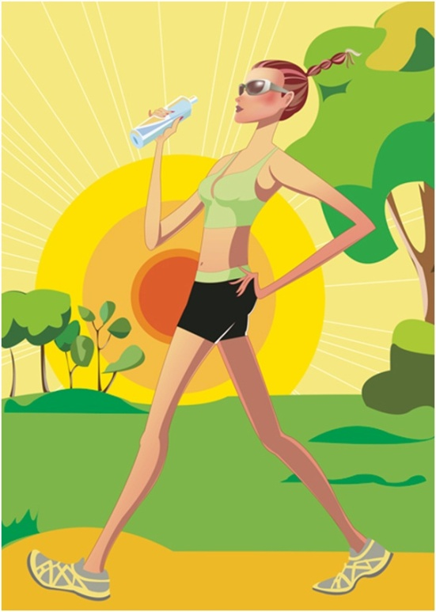
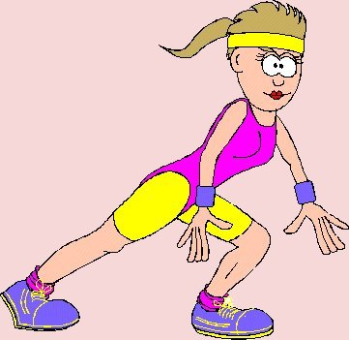
How to keep fit?
Вчитель: Барикіна Неля Миколаївна

Slide 2
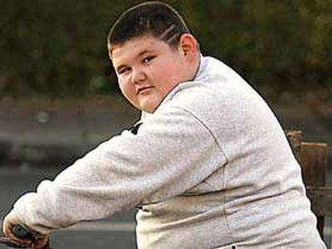
Parents and doctors are worried and rightly so. Today's kids are heavier than ever before. Heart disease, high blood pressure, diabetes are well known among teenagers.

Slide 3
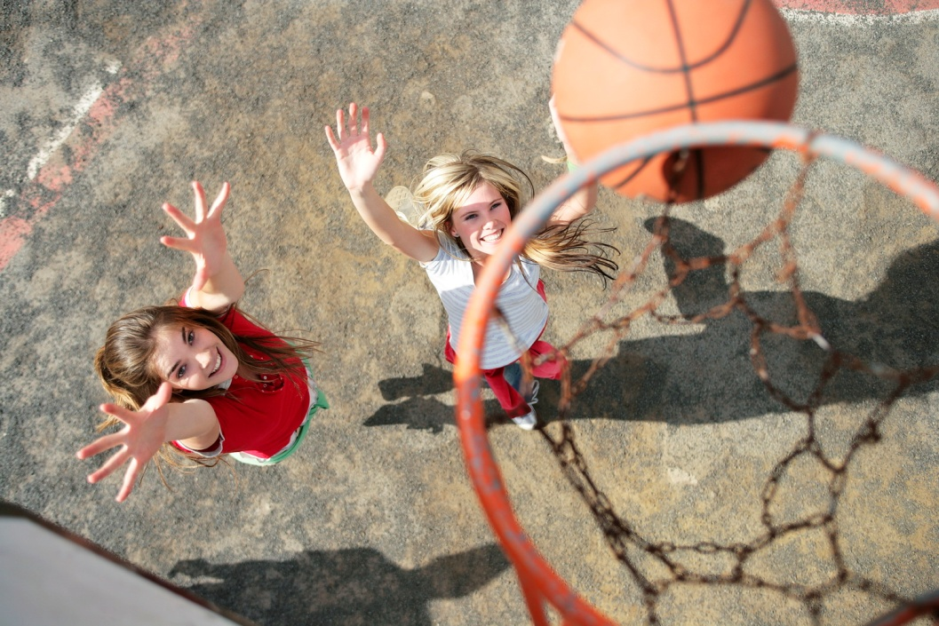
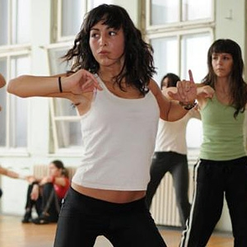
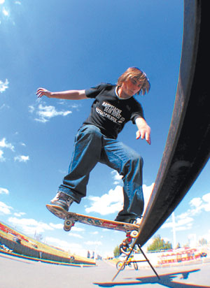
Experts recommend that teens get 60 minutes or more physical activity each day.

Slide 4
Here are some of the reasons:
Exercise benefits every part of the body, including the mind.
Exercise can help some people sleep better.
Exercising can help you look better.
Exercise helps people lose weight.
Exercise lowers the risk of diseases.

Slide 5
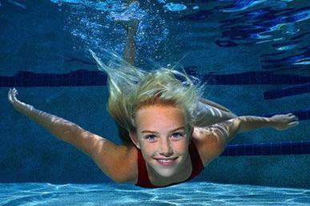
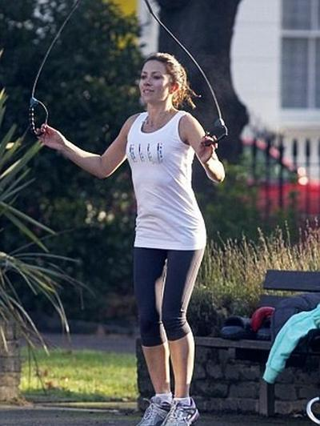
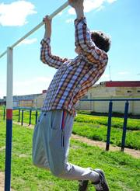
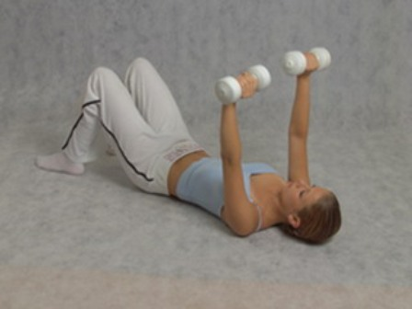
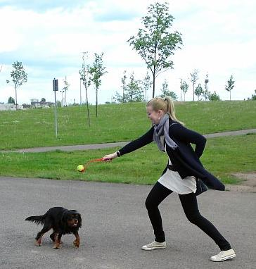
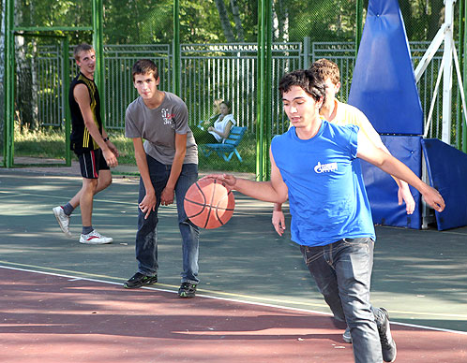
Exercise Do's
Vigorous Aerobic Exercise
Muscle-Strengthening
Regular Activity

Slide 6
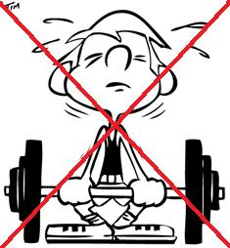
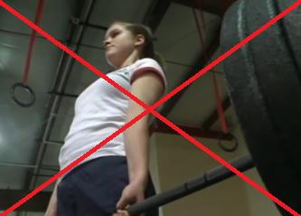
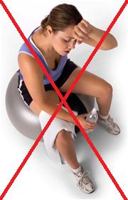
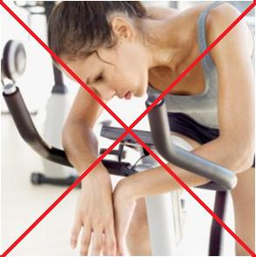
Exercise Don'ts
Power lifting
Excessive exercise

Slide 7
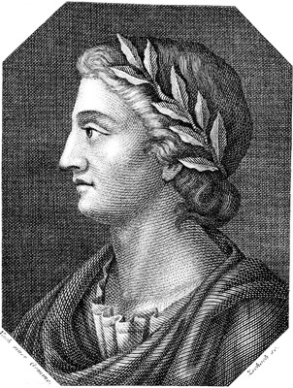
Proverbs and Sayings about health
"A healthy man is a successful man"
French Proverb
"He who has health has hope; and he who has hope has everything"
Arabian Proverb
"A man too busy to take care of his health is like a mechanic too busy to take care of his tool"
Spanish Proverb
"The greatest wealth is health"
Virgil

Slide 8
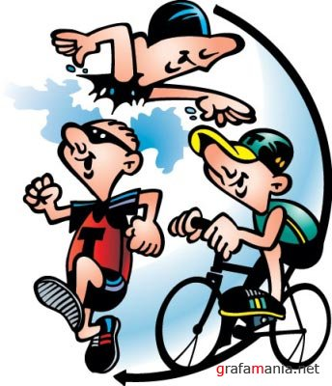
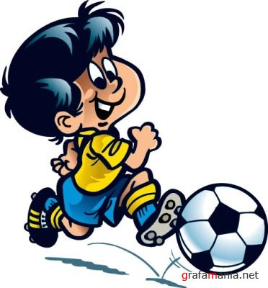
Summary
It seems obvious that we should all be physically active.
Everybody should understand the importance of staying active and fit.

Slide 9
Literature
http://exercise.about.com/cs/exercisehealth/a/teenagers.htm
http://www.kidsexercise.co.uk/thebenefitsofphysicalactivity.html
http://www.livestrong.com/article/365604-why-is-a-healthy-lifestyle-important-for-teenagers/

