Slide 1
Lesson 6
ENGLISH

Slide 2
Тема: “The MONUMENT TO DUCHESS OLHA. The Use of the Future Indefinite Tense and the Future PERFECT Tense”
Особливості вживання майбутнього неозначеного та перфектного часів. Пам’ятник княгині Ользі

Slide 3
Мета:
Удосконалювати знання студентів по вивчених темах.
Розвивати навички монологічного мовлення, читання, перекладу та аудіювання.
Практикувати студентів у вживанні вивченої лексики. Сприяти засвоєнню граматичного матеріалу.

Slide 4
Plan for this lesson.
1. Organizational part.
2. The theme and the aim of the lesson.
3. The main part of the lesson.
3.1. Warm up.
а) Listening.
3.2. Checking up home task.
а) Vocabulary.
b)Text.
c) Practice in Oral Speech. Monologue.
d) Grammar exercises.
e) Individual work with cards (grammar).
4. Oral Practice and Grammar Review.
a)Definitions of different parts of speech. Oral practice in Grammar.
b) The use of Future Tenses.
5. The Studying of new material.
5.1 Comparative description of the Future Indefinite and the Future Perfect Tenses.
5.2 Supporting notes.
6. Generalization and systematization of the studied material.
6.1. Test control.
6.2. Answering the questions.
7. Summarizing.
8. Homework.

Slide 5
План заняття:
1. Організаційна частина.
2. Повідомлення теми, мети та основних завдань заняття.
3. Актуалізація опорних знань.
3.1. Мовна зарядка.
a) Аудіювання.
3.2. Перевірка домашнього завдання.
a) Повторення лексичного матеріалу.
b) Робота з текстом.
c) Розвиток навичок монологічного мовлення.
d) Виконання граматичних вправ.
e) Письмова робота.
4. Мотивація навчальної діяльності.
a) Активізація вивченого граматичного матеріалу.
b) Використання майбутніх часів.
5. Вивчення нового матеріалу.
5.1 Порівняльна характеристика майбутнього неозначеного та
майбутнього перфектного часів.
5.2 Опорний конспект.
6. Узагальнення та систематизація вивченого матеріалу.
6.1 Тестовий контроль.
6.2 Відповіді на питання.
7. Підведення підсумків заняття.
8. Повідомлення домашнього завдання.

Slide 6
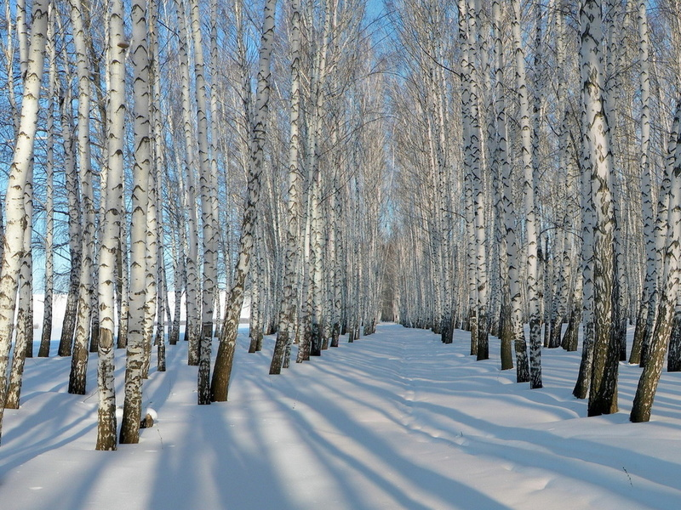
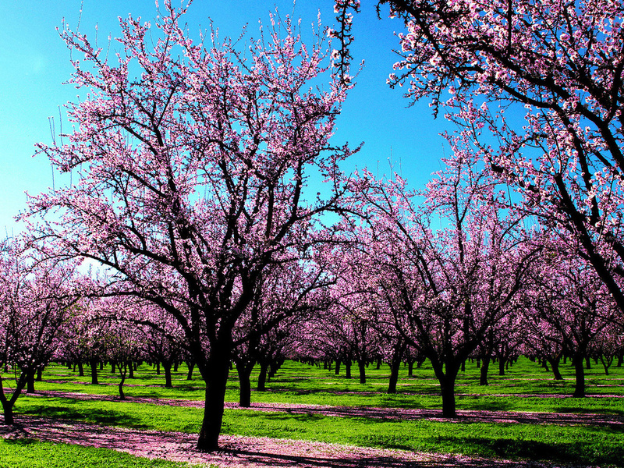
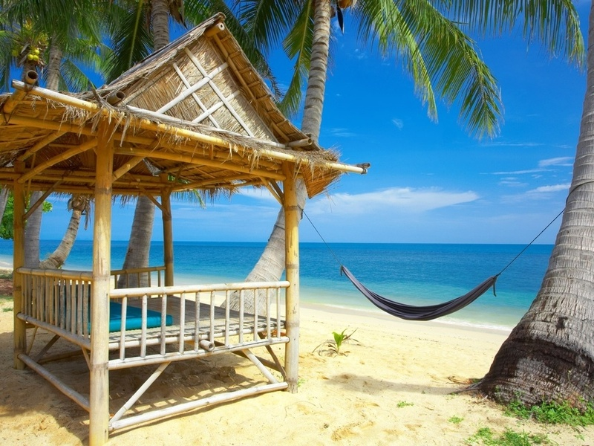
MY FAVOURITE SEASON

Slide 7
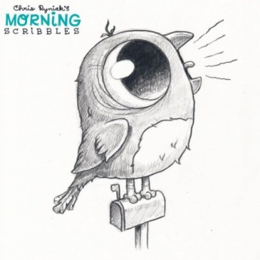
Аудіювання Listening

Slide 8
Аудіювання Listening
What historical places in Kyiv do you know?
Where is Kyiv situated?
Why is Kyiv a large scientific centre?
Where is the monument to T. Shevchenko?
What is the central street of Kyiv?
Why is Kyiv very beautiful in spring?

Slide 9
THE MONUMENT TO DUCHESS OLHA Words:
duchess
inhabitant
guest
reconstructed
dedicated
historical society
sculptor
to be erected
to ruin
to rebuild
on the left
on the right

Slide 10
THE MONUMENT TO DUCHESS OLHA
In May, 1996 inhabitants of Kyiv and the guests of the capital of Ukraine saw the reconstructed monument dedicated to the ancient Duchess Olha who reigned Kyiv Rus in the 10th century. This monument had a dramatic history.
The historical society collected money, and the sculptor Ivan Kavaleridze with his colleagues created the monument to Du­chess Olha which was erected on Mykhailivska Square in 1911.
In 1919 bolsheviks threw the monument out of its base and ruined it.
In 1995 archeologists found 17 pieces of the original statue, and it was decided to rebuild the monument.
Duchess Olha stands in the centre of a pink marble base. On her left apostle Andrii is pointing to the holy Kyiv hills, and on her right are seated Kyrylo and Mephodii, the enlighteners of Slavic people. A lot of people visit the monument every day.

Slide 11
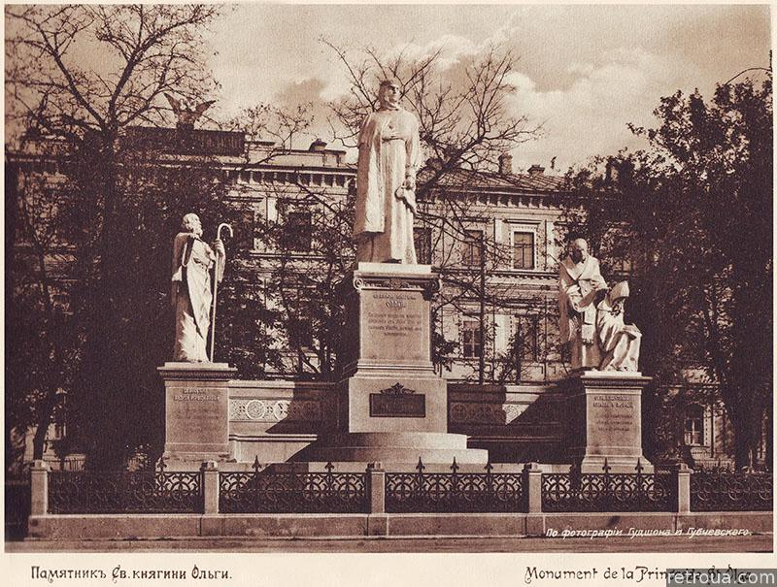
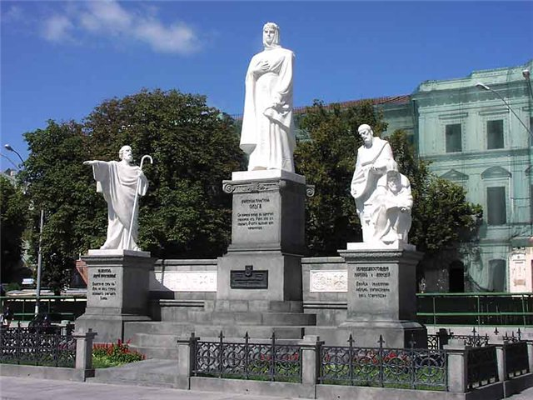
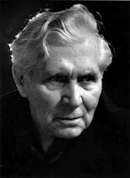
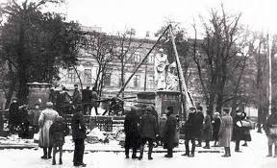

Slide 12
Answer the questions:
Who created the monument to Duchess Olha in 1911?
Who collected money for the monument?
Who destroyed the monument in 1919?
When was the monument rebuilt?
Who stands in the centre of the monument?
Who is on the left of Duchess Olha?
Who is on the right of Duchess Olha?
Who visits the monument every day?

Slide 13
Let’s revise the grammar material.
1) Коли вживається майбутній перфектний час?
2) З якими обставинними словами вживається майбутній перфектний час?
3) Яка загальна формула утворення перфектних часів?
4) Утворення стверджувальної, питальної та заперечної форм.
5) Open your books at page 257 ex. 109. Please, make up sentences.
Загальна форма утворення перфектних часів
To have + Participle II
Will have + Ved/3

Slide 14
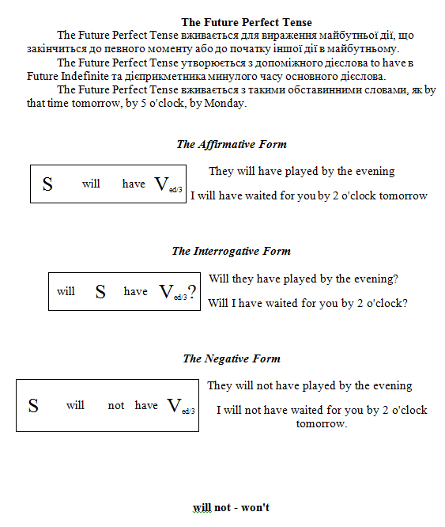

Slide 17
Task 1. Say that you’ll do or you’ll have done the same.
Model:
I’ll have watched TV by 7.
I’ll have watched TV by 7 too.
1. I’ll have gone home by 4 tomorrow.
2. I’ll have waited for my friends by 6.
3. I’ll visit my relatives in summer.
4. I’ll listen to music tomorrow.
5. I’ll wash up dishes after dinner.
6. I’ll have watered the flowers by that time tomorrow.

Slide 18
Task 2
Model: -What will you have done by tomorrow afternoon? (drive to the seaside)
- I'll have driven to the seaside.
- What will Nick do next week? (type business letters)
- He will type business letters.
1. What will Nell have had by 12 o'clock? (have classes)
Nell will have had classes by 12 o'clock.
2. What will you have done by this time next week? (bathe in the Black Sea)
I will have bathed in the Black Sea by this time next week.
3. What will Bob do tomorrow? (read a detective story)
Bob will read a detective story tomorrow.
4. What will Jane have done by 11 tomorrow? (do experiments in the lab)
Jane will have done experiments in the lab by 11 tomorrow.
5. What will Mary do in 3 weeks? (guide an excursion)
Mary will guide an excursion in 3 weeks.
6. What will he do on Monday? (work in the garden)
He will work in the garden on Monday.
7. What will Mary have done by tomorrow? (prepare for her exam)
Mary will have prepared for her exam by tomorrow.
8. What will Nick do during his holidays? (visit his relatives)
Nick will visit his relatives during his holidays.

Slide 19
Test Control
1. Jack ... his sister about this event on Monday.
a) will write
b) will have written
2. Alfred ... his work by tomorrow.
a) will do
b) will have done
3. Mary ... for you by that time on Tuesday.
a) will wait
b) will have waited
4. My sister ... at the department of Landutilization next year.
a) will study
b) will have studied
5. My uncle ... wheat and corn next year.
a) will grow
b) will have grown

Slide 20
Test Control
6. We … the report by 4 p.m.
a) will discuss
b) will have discussed
7. Mary ... this book from the library next week.
a) will take
b) will have taken
8. Dan ... for his exam in physics by Wednesday.
a) will prepare
b) will have prepared
9. Bob ... at the concert tomorrow.
a) will sing
b) will have sung
10. Mum ... dinner by that time tomorrow
a) will cook
b) will have cooked

Slide 21
TASK 3
Put the verbs in brackets in Future Indefinite or Future Perfect.
I (to wait) for you by 5 o'clock tomorrow.
I will have waited for you by 5 o'clock tomorrow.
2. By 10 o'clock tomorrow I (to have) an English lesson.
By 10 o'clock tomorrow I will have had an English lesson.
3. Tomorrow they (to sail) down the Dnipro river.
Tomorrow they will sail down the Dnipro river.
4. I hope the next mail (to bring) news from home.
I hope the next mail will bring news from home.
5. She (to return) from the library by 6 o'clock.
She will have returned from the library by 6 o'clock.
6. I not (to work) on Monday.
I will not work on Monday.
7. I (to work) on my report by Friday.
I will have worked on my report by Friday.

Slide 22
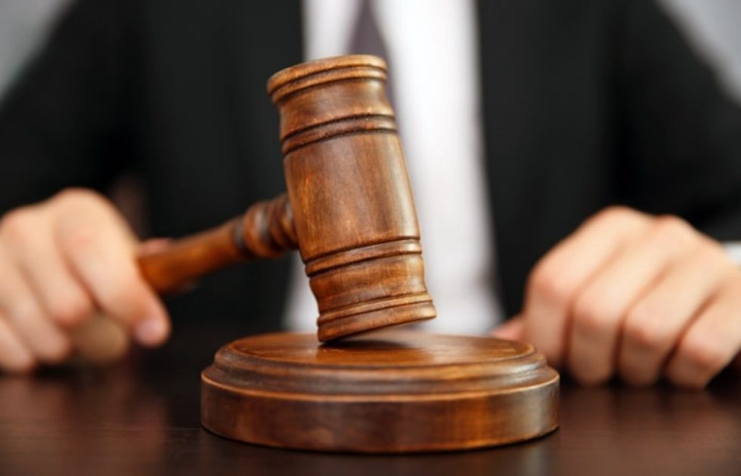

Slide 23
Homework
Make up 4 sentences in the Future Perfect and the Future Indefinite Tenses.
Learn and repeat Grammar rules.
Be ready to speak about the Monument to Duchess Olha.

Slide 24
Thank you for the lesson !!! The lesson is over. GOOD – BYE !

