Slide 1
ECONOMIC OF BIG BUSINESS OBJECTS AS A LEGAL STATE POLICY PROBLEM SETTING

Slide 2
«Business is a combination of war and sport.»
Let's talk about it.

Slide 3
Problem setting. To date, through the adoption of several laws in Ukraine began the stage play structures characteristic of a market economy. However, the post-Soviet specificity of these processes has led to the fact that through privatization and the effects of shadow capital held economic concentration and the formation of powerful financial-industrial groups. As a result, formed powerful organizations of big business with a monopoly position in the relevant markets, in different legal forms gain more and more influence. Given the above, the activity of big business needs a clear economic and legal support from the national legislation.

Slide 4
Recent research and publications analysis. Phenomenology of big business and its legal regime of functioning considered in the works Zadyhayla D.V., Stadnik K.A., K.V. Plavshudy.
However, it should be noted that this issue has received almost no comprehensive and targeted research, and potentially his research can be productive in terms of the provisions of scientific innovation, appropriate proposals to overcome the gaps in the economic legislation of Ukraine.

Slide 5
Paper objective. The purpose of this article is to study the economic and legal characteristics of business organizations of big business.

Slide 6
Paper main body. Admittedly, qualifications or criteria for the identification of economic organizations of big business or absent in law or celebrated its dysfunctionality. It is important also to "synchronize" the conceptual apparatus of the tax and economic legislation defines different economic organizations of big business. However, the state as a whole, there is no clear legal policy on economic organizations of big business. What is unacceptable given the weight, importance and controversial nature of the interaction of big business with other segments of the national economy and political subjects and information relations.

Slide 7
Ukraine's policy on the development of SMEs is not contrary to the need to form and pursue a policy of interaction with the organizations of big business. After all, big business has significant functional load for the economy because of strong exports orientation, innovative potential, competitiveness of products in the world markets, the positive social aspects of its activities. All this leads to considerable public interest of the state to these groups of companies.

Slide 8
Typically, big business economic organizations created in the form of holding associations. However, the legal regulation of economic organizations of holding type is not developed and in need of significant improvement. There remains an urgent problem of transformation of the economic power of powerful organizations of big business in political power and information. This trend requires action and effective regulation by government.

Slide 9
It should be said that small businesses business law Ukraine provides special management regime that due consideration of their functions in the national market economy. That is the state provides support to encourage the development of small businesses. Thus, the importance of small business ownership is high innovative capacity, implementation of which allows you to create a new market and gain a highly competitive even compared to large business entities; rapid market response; ensuring internal market in goods and services (in fact, companies large and medium-sized businesses are export-oriented, and the vector of small businesses aimed at the domestic market saturation keeps economic balance in the country); mobility of small business; promoting competition; rapid cost recovery market and freedom of choice; and the ability to quickly create jobs.

Slide 10
Thus, the advantages of small business caused great interest of the state to this category of enterprises. This was a prerequisite for the development of the legislation of strategies to support small business and the introduction of special modes of management with appropriate government support and incentives.

Slide 11
Consequently, the current economic and legal support for small business in Ukraine is widely integrated development. In fact, the Law of Ukraine "On the development and state support of small and medium business in Ukraine", which was adopted in 2012, provides a wide range of planned measures to stimulate small business development and the introduction of a special mode of operation for him. Thus, the state is actively working towards improving the regulation and promotion of small businesses. Also in this area is productive science, developing the methodological basis for the creation of an integrated economic and legal concept of state support of small business in Ukraine.
However, quite the opposite is the situation with the state policies of big business whose activity has a potentially progressive economic properties.

Slide 12
After all, large enterprises - frame national economy, its main representative on the world stage, the most important partner and opponent of the state during the conduct of industrial policy. These entities are producing the bulk of the total trade volume of certain sectors of the national economy. In addition, only large business organizations are able to organize the production of national product, which would be competitive and integrated world market. This is highly relevant today, in particular through Ukraine's aspirations to join the WTO. The economic benefits of the activities of big business is manifested in the presence of a powerful, concentrated capital and other assets; possibility of attracting significant foreign investment; creating a huge number of jobs; the impact on pricing in the country and so on.

Slide 13
So on the economic activity of big business can also indicate the presence of a number of specific public interest. However, we can say that today in Ukraine there is a vacuum in the law on the regulation of the operation of big business, and vacuum concepts of state support of large businesses Ukraine as an important factor in the development of market economy in our country. The reason for this, as is seen in the fact that the owners of large business organizations are subjects of economic power by which they are able to influence the legislation and lobby for their interests in state government. It becomes clear that big business to remain profitable in the shade to be had regulated economic phenomenon that explains the almost complete lack of development of this issue at the legislative level.

Slide 14
In addition, imperfect legal regulation of large undertakings reduces the efficiency and sometimes to prevent monitoring their activities. In particular, it is manifested in dysfunctional legal strengthening of economic and legal forms of functioning of big business. As the world practice and in Ukraine in particular, such a business is in the form of holding companies, which is the most effective tool for obtaining strategic and tactical business goals with powerful concentration of capital. However, the Law of Ukraine "On Holding relations in Ukraine" dated 15 March 2006 does not provide, as practice shows, the stability and transparency of holding relations.

Slide 15
This leads to a lack of understanding of what is really happening in the structure of holding chain. It seems that the attempt to provide a simulation of holding the interest of existing relations in Ukraine holding groups and created their own through their representatives in state authorities. For the exercise of state control in this area is necessary in law to impose restrictions so-called sub-holding relationships vertical holdings.

Slide 16
Thus, the problem of legal certainty, economic and legal policy to economic organizations of big business is extremely important. This question needs a clear legal definition of the status of big business and the criteria for selection of other entities.

Slide 17
Practice shows that the risk of private power macroeconomic owned by big business lies in the fact that it often translates into political and information, thereby affecting the state economic policy of the country. This is the oligarchs who established themselves at the turn of the century to the economic and political maps of the country, and later began to use their power to change the laws unfavorable to them for their own benefit and the benefit of their own business.

Slide 18
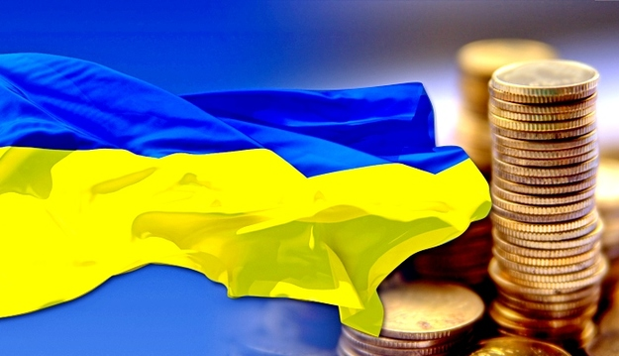
This situation led to the creation of a number of industries monopolistic structure of distribution of production capacity, which belongs to the owners of big business. By the dominant economic groups, dividing basic economic potential of the country, a significant share of bank capital and assets in services, etc. include, in particular, "SCM", with the main shareholder Rinat Akhmetov, "Eastone" - Viktor Pinchuk, "UPI "- Peter Poroshenko," YSD "- Sergei Taruta," TAS "- Sergei Tigipko, DCH - Alexander Yaroslavsky.

Slide 19
A clear example, as the Zadyhaylo DV, is the concentration of chemical companies within the group of Dmitry Firtash «Group DF». Obviously, according to the scientist, there is a tendency to monopolize all future metallurgical industry. Indeed, standards of global competitiveness requires extreme concentration of assets, at least to savings in production volumes allow to have an acceptable level of profitability, as well as to finance innovation and diversification of products for the world market .

Slide 20
Another example, but with the banking sector - a Private Bank, which has a de facto monopoly position (about a quarter of banking system assets), use it to not meet the requirements of the National Bank of Ukraine, which are the same for everyone. As you know, financial institutions, until recently, worked as pockets of oligarchs, providing loans to companies under their owners low, preferential rate and foreign borrowers - under the high market. As a result, big business gets cheap financing, and other businesses are forced to pay high interest rates to banks for the oligarchs no other alternatives exist.

Slide 21
The legislation of Ukraine legal training entities in various types contained in the Economic Code of Ukraine . According to paragraph 3 of Article 55 of the Civil entities depending on the number of employees and income from any activity during the year may belong to small businesses, including the micro, medium and large businesses.

Slide 22
Small business entities are: individuals registered as prescribed by law as individuals - entrepreneurs whose average number of employees during the reporting period (calendar year) does not exceed 50 people and annual income from any activity not exceeding the equivalent 10 million euros, determined by the average annual rate of the National bank of Ukraine; legal entities - entities of any organizational-legal form and ownership, in which the average number of employees during the reporting period (calendar year) does not exceed 50 people and annual income from any activity not exceeding the equivalent of 10 million euros determined by the average annual rate of the National bank of Ukraine.

Slide 23
The subjects as a kind of micro small business under the rules of the Civil Code of Ukraine is the individuals registered as prescribed by law as individuals - entrepreneurs whose average number of employees during the reporting period (calendar year) does not exceed 10 people and annual revenue of any of which does not exceed an amount equivalent to 2 million euros, determined by the average annual rate of the National bank of Ukraine; legal entities - entities of any organizational-legal form and ownership, in which the average number of employees during the reporting period (calendar year) does not exceed 10 people and annual income from any activity not exceeding the equivalent of 2 million euros determined by the average annual rate of the National bank of Ukraine.

Slide 24
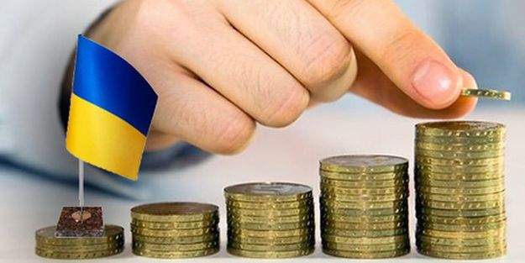
Subjects medium enterprises recognized individuals and legal entities - entities that occupy an intermediate position between the subjects of small and large businesses. The latter refers CC Ukraine entities of any organizational-legal form and ownership, in which the average number of employees during the reporting period (calendar year) exceeds 250 employees and annual revenue of any activities exceeding the equivalent of 50 million euros determined by the average annual rate of the National bank of Ukraine

Slide 25
Conclusions of the research. Thus, for improving the efficiency of economic processes of the state in which participating organizations of big business, it is necessary to improve the functioning of legal economic order and economic mechanism of regulation of the macroeconomic structures of power. These problems can be solved by improving the relevant sectoral legislation.

Slide 26
Thanks for watching!

