Slide 1
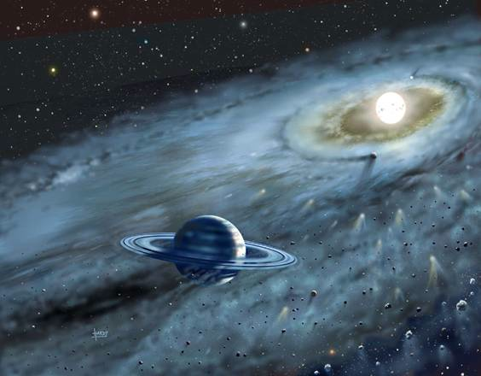


The Formation of Uranus and Neptune
(and intermediate-mass planets)
R. Helled
Tel-Aviv University
1 Dec. 2013

Slide 2
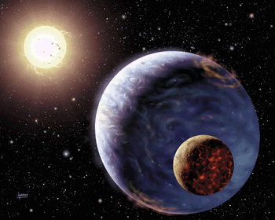
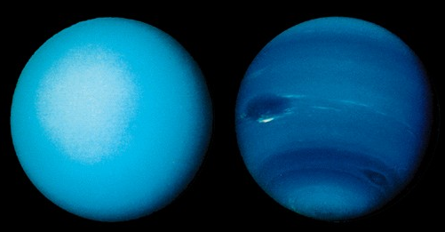
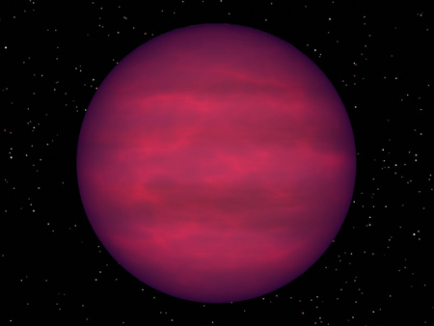
⬅➔
Improve our understanding of the origin of our own solar system and low-mass planets
  Planet formation
  Physical and chemical properties of protoplanetary disks
Uranus and Neptune are the Super-Earths/Mini-Neptunes of the Solar System

Slide 3
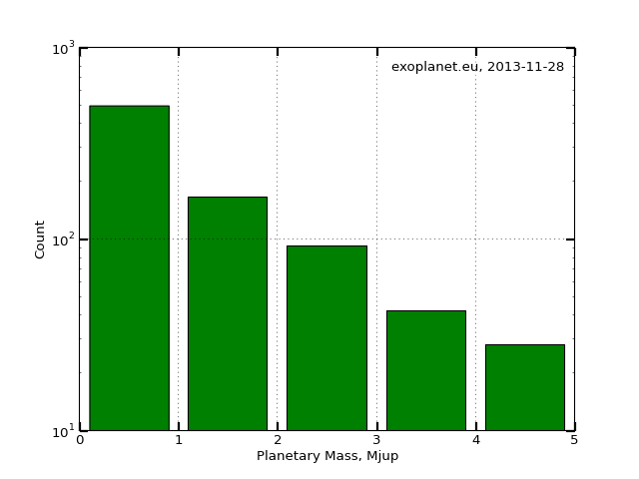
low/intermediate-mass planets are common
  What are they made of? How do they form? Where do they form?

Slide 4

How do planets like Uranus/Neptune form?
What are Uranus and Neptune made of?

Slide 5
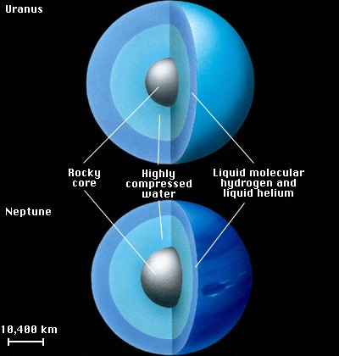
Uranus and Neptune: Internal Structure
Basic idea of interior models: observations as constraints
  more accurate measurements ➔ less freedom in modeling
‘Standard’ modeling icy planets: 3 layers
  Central Core (rocks)
  Inner Envelope (ices)
  Outer Envelope (‘atmosphere’ – H/He)

Slide 6
Basic Facts:
Uranus: 14.5 M⊕ @ 19.2 AU
Neptune: 17.1 M⊕ @ 30 AU
Composition: rocks, ices, H/He atmosphere
→ Composition provides constraints on (1) the conditions in the solar nebula, (2) the planetary formation location and (3) formation timescale.
Similarities: mass, radius, rotation, radial distance
Differences: flux, tilt, atmospheric composition, satellite system

Slide 7
Observational Constraints
Mass
Radius (usually equatorial)
Angular velocity ω
Gravitational Moments (up to J₆)
1 bar Temperature
Atmospheric composition (only sometimes…)
(shape, MOI, magnetic fields dynamos)
How well do we know those?

Slide 8
Making an interior model
Assumptions: spherical symmetry & hydrostatic equilibrium
Interior parameters: density, pressure, temperature, luminosity, EOS
Planetary basic equations: mass conservation, hydrostatic equilibrium, heat transport, energy conservation, EOS

Slide 9
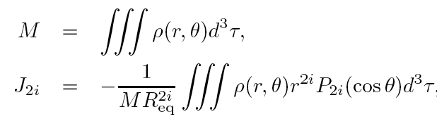
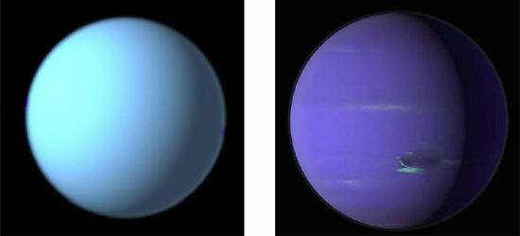
Uranus and Neptune
For Uranus and Neptune only J₂ and J₄ are available
Why are they different? composition? heat transport? formation/evolution?
The large error bars on J_{2n} allow a large range of possible internal structures.

Slide 10
Uranus and Neptune
For Uranus and Neptune only J₂ and J₄ are available
Why are they different? composition? heat transport? formation/evolution?
The large error bars on J_{2n} allow a large range of possible internal structures.

Slide 11
Remember (!):
  Constraints on the density profile of the planets
  High-order harmonics provide information on outer regions
Presence of a core is inferred indirectly from the model
The core properties (composition, physical state) cannot be determined

Slide 12
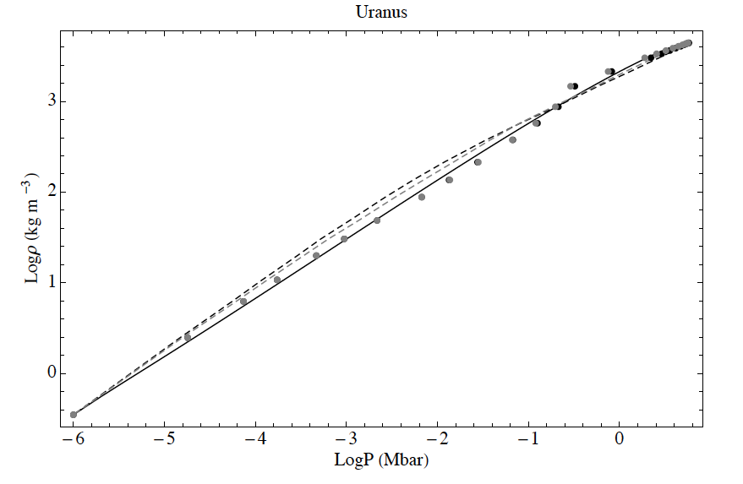
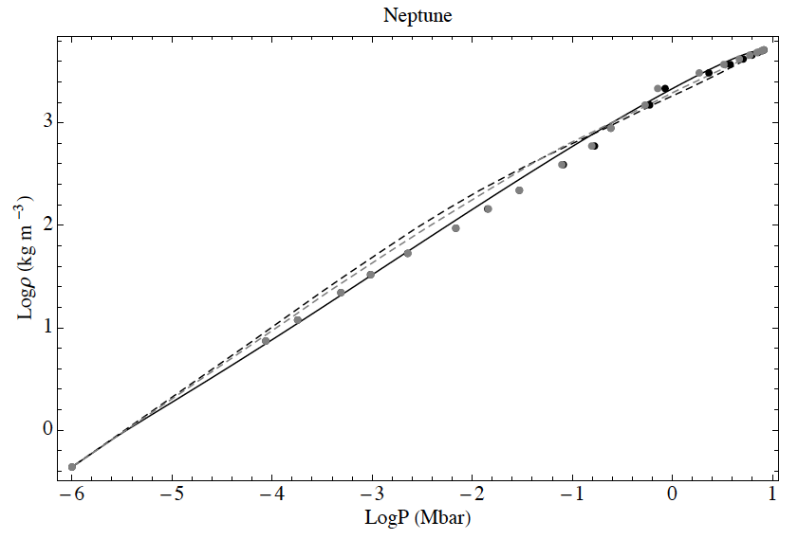
Uranus and Neptune: Composition
Gravity data is insufficient to constrain the planetary composition
gray: H₂O
black: SiO₂
Are Uranus and Neptune icy?
Helled et al., 2011
Reasons to believe they have water:
Magnetic fields
Water is abundant at these distances
– is it really?
– what about Pluto?

Slide 13
The Rotation Periods of Uranus and Neptune
What are the rotation rates of Uranus and Neptune?
  Complex multipolar nature of magnetic fields
  Where are the magnetic fields generated?

Slide 14
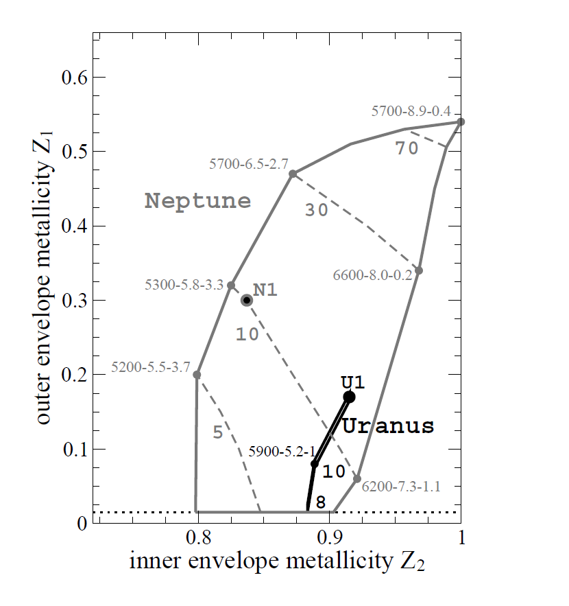
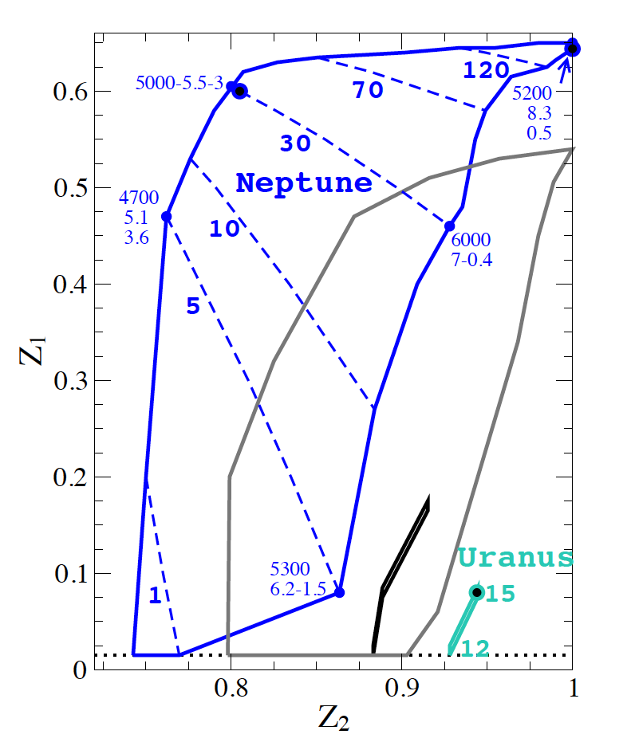
Interior models with modified rotation
Transition pressure (Gpa)
black/gray - Voyager
blue/turquoise - new P
T_{c} (K), P_{c} (Mbar), M_{core} /M_{Earth}
Mass fraction of metals in the outer envelope (Z₁) and in the inner envelope (Z₂) 3-layer models of Uranus and Neptune
Nettelmann, Helled, Fortney &
Redmer, 2013.

Slide 15

Maybe Uranus and Neptune are not “icy”
Uranus and Neptune might not be “twin planets”

Slide 16
Uranus and Neptune: Formation
Planet Formation
Disk mass and lifetime:
  Typical disk mass 0.01 - 0.1 M
  Disk observations: disk lifetime < 10 Myrs
Density decreases with radial distance…

Slide 17
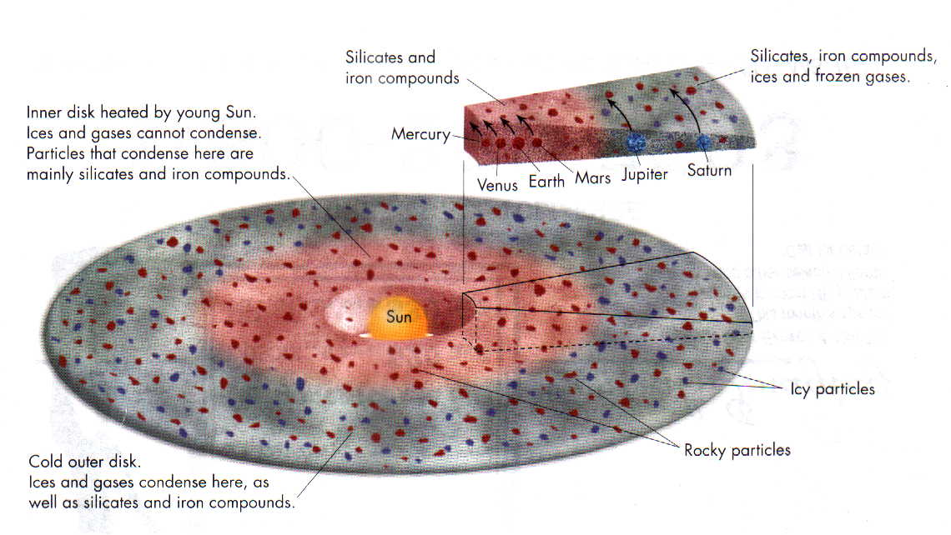
A typical protoplanetary disk

Slide 18
Formation of “Icy” Planets
Standard Formation Model:
  Core accretion (Pollack et al. 1996)
  dMc/dt goes like ΣΩ
Similar formation process like J&S but slower: “failed giant planets”
  On one hand have to form before the gas dissipates.
  On the other hand, should not become gas giant planets.

Slide 19
Formation via core accretion
Giant planet formation in three steps:
Accretion of dust particles and planetesimals: build a core of a few M⊕ and a low-mass gaseous envelope.
Further accretion of gas and solids: the envelope grows faster than the core until the crossover mass is reached.
Runaway gas accretion with relatively small accretion of solids.
see e.g. D’Angelo et al. 2011

Slide 20
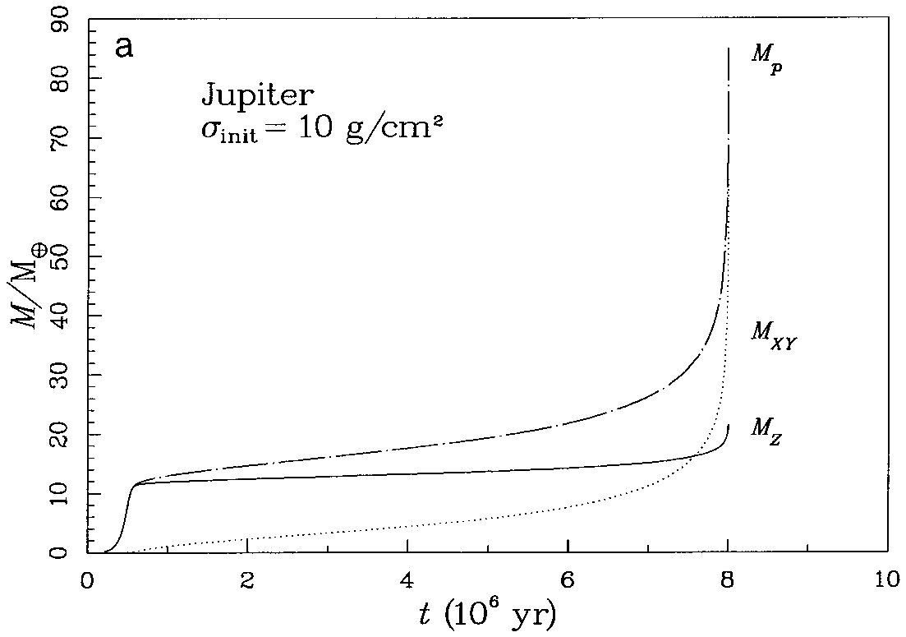
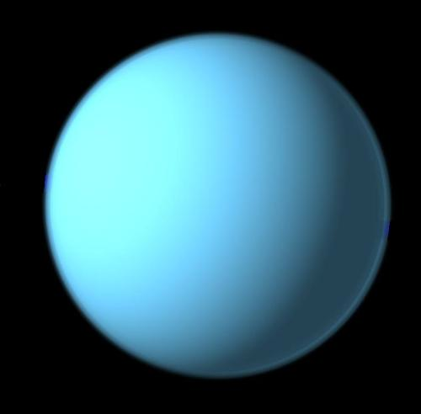
A standard core accretion model for Jupiter’s formation
@ 5.2 AU, Σ_{S}=10 g cm⁻²
phase 3
runaway gas accretion
Total Mass
@
phase 2
Gas Mass
phase 1
isolation mass reached
Core Mass
Pollack et al., 1996.

Slide 21
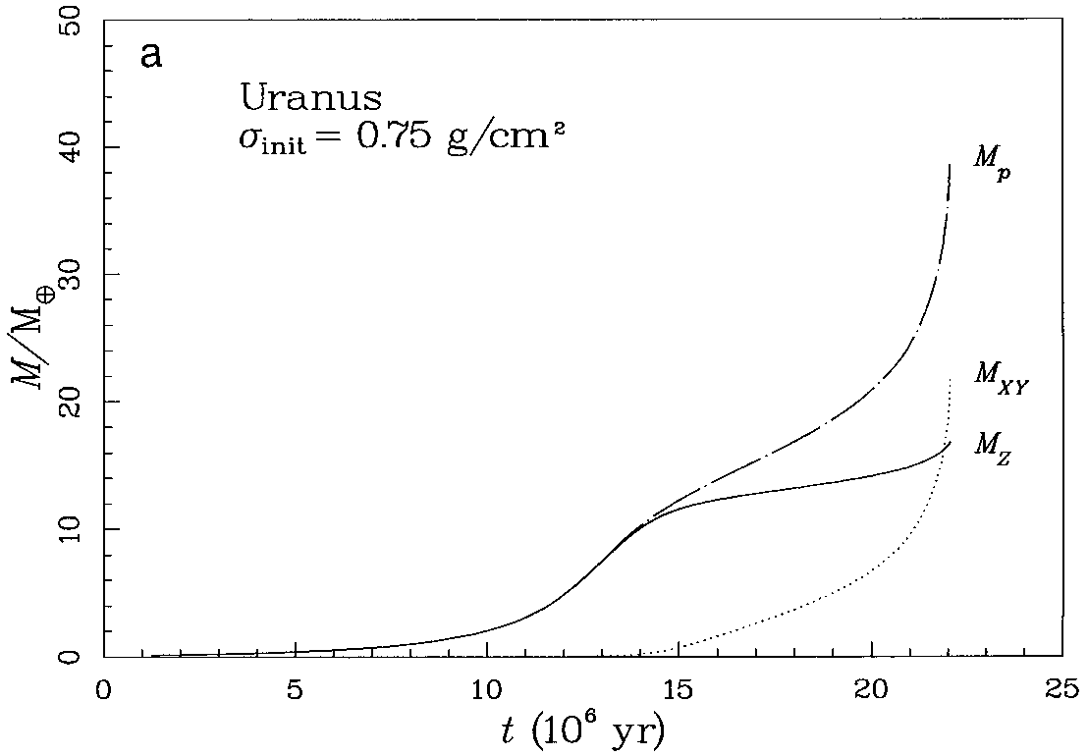
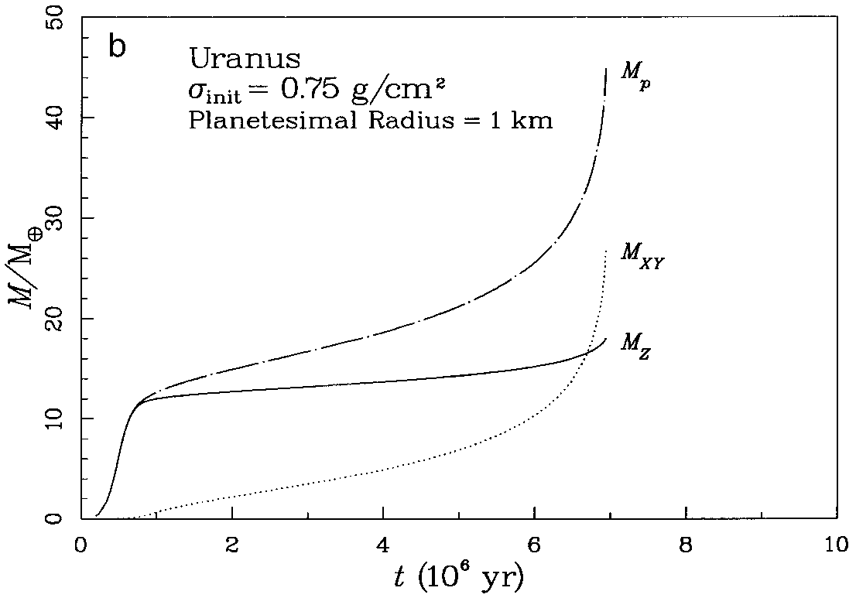
Note that:
formation timescale is long
M_{core} is 10 M⊕,
Planetesimal size
we don’t get the correct final mass
Final mass depends on the time of gas dissipation!
Pollack et al. 1996

Slide 22
Problems/Challenges:
Formation timescale for in situ formation
Getting Uranus-like final composition
Possible Solutions:
Formation closer to the sun (Nice Model)
Disk physics/chemistry – disk evolution, enhancing the solids
High accretion rates: dynamically cold planetesimal disk
A combination…

Slide 23
U&N Formation: The Nice Model
Formation at smaller radial distances → solves the timescale problem & consistent with some features of the solar-system
Difficulties:
  Cannot distinguish between Uranus and Neptune
  In many of the simulations the properties of the two outer planets (U, N) cannot be reconstructed
see e.g . Thomess et al. 1999; 2002; Morbidelli et al. 2005; Tsiganis et al. 2005

Slide 24
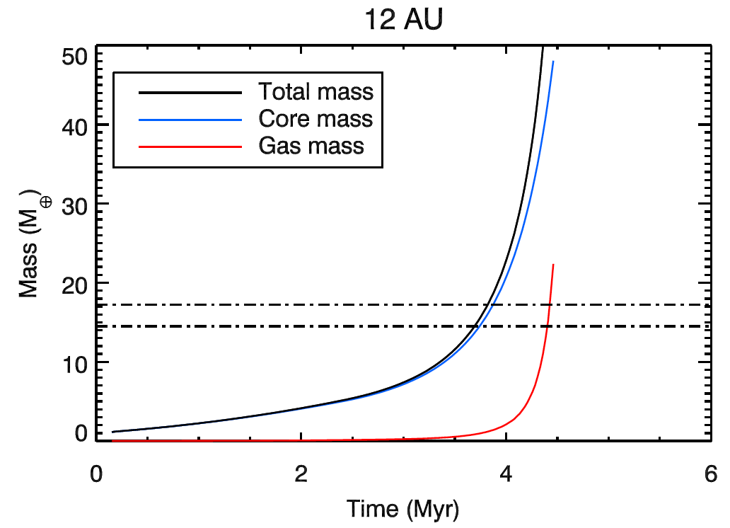
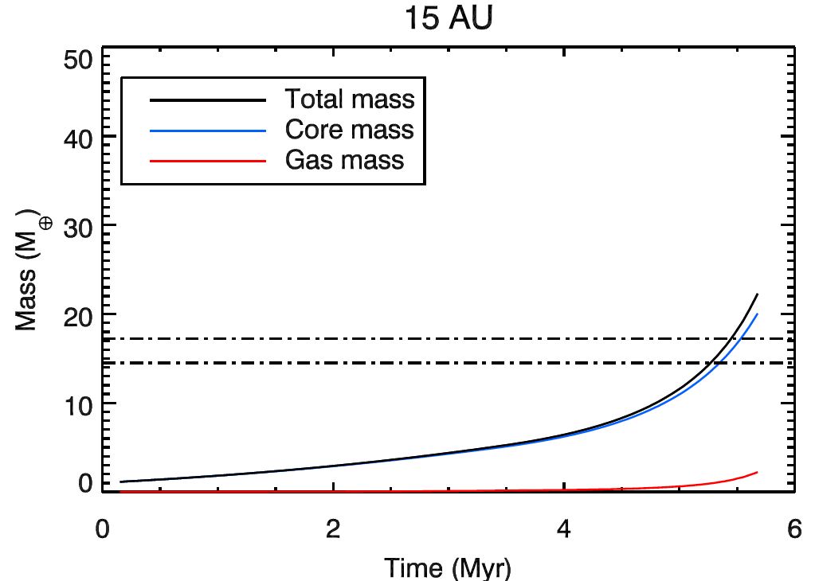
Formation at shorter radial distances + solid-rich disk
Formation during phase 1!
Formation at 12 and 15 AU
Dodson-Robinson & Bodenheimer, 2010

Slide 25
Formation in a “dynamically cold” disk
Fast growth if planetesimals are small.
R. Rafikov (but see also Goldreich et al. 2003; 2004)
The initially large planetesimals are unaffected by gas drag and beak into small planetesimals which can easily be accreted by a growing core ➔ high accretion rates also at large radial distances.

Slide 26
If accretion rates are high** can Uranus and Neptune form in situ?
Explore various disk densities, accretion rates.
**Rafikov, 2011; Lambrechts & Johansen, 2012

Slide 27
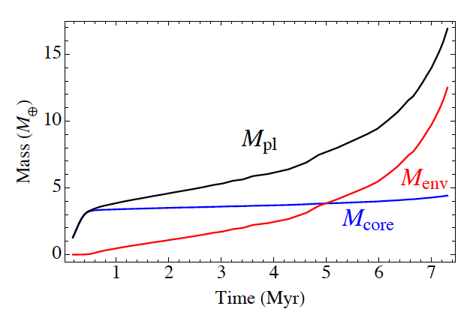
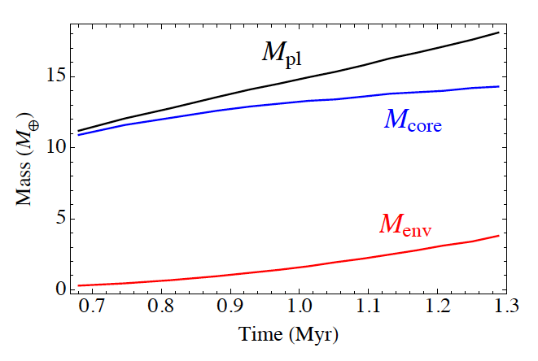
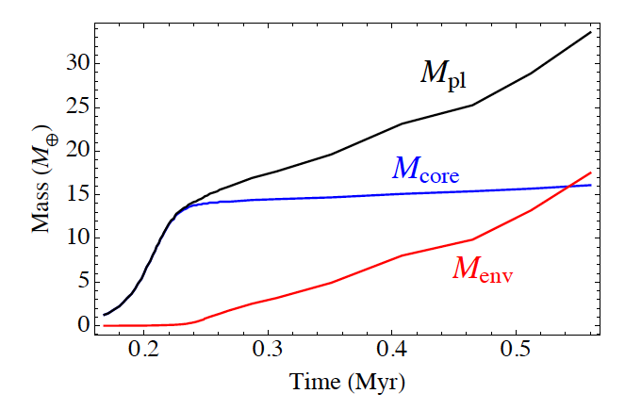
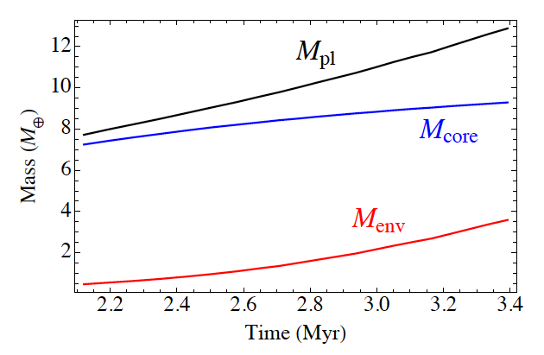
Preliminary results: 20 AU
Helled & Bodenheimer, in prep.
σ_{s}=0.35 g cm⁻²
σ_{s}=0.7 g cm⁻²
Σ_{s}=3.5 g cm⁻²
Σ_{s}=1.6 g cm⁻²; (dMc/dt)/20

Slide 28
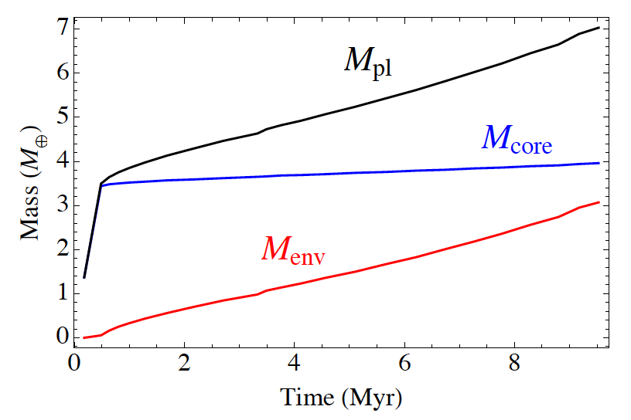
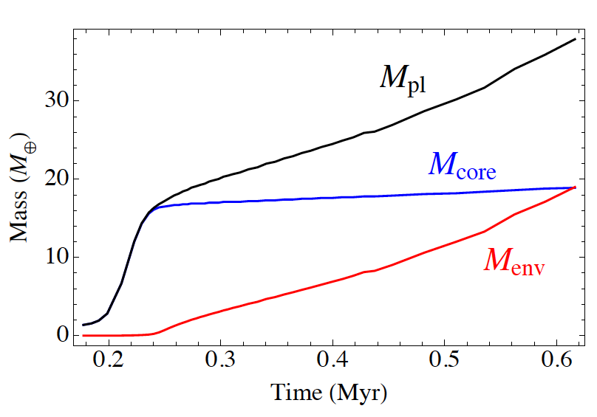
Preliminary results: 15 AU
Helled & Bodenheimer, in prep.
σ_{s}=0.55 g cm⁻²
Σ_{s}=5.5 g cm⁻²

Slide 29
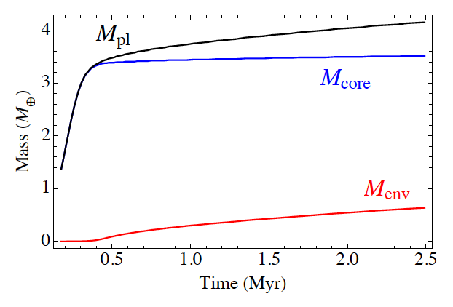
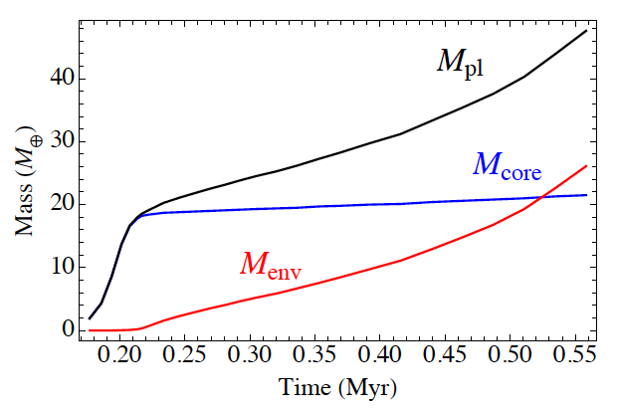
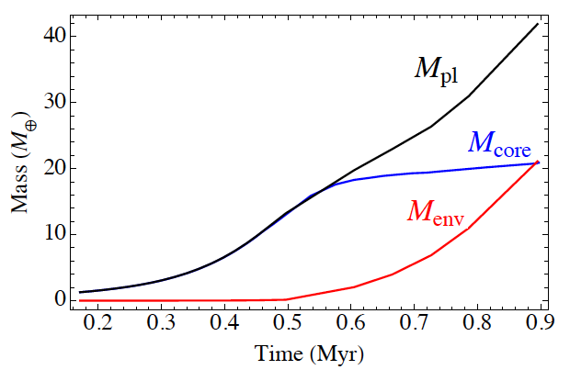
Preliminary results: 12 AU
Helled & Bodenheimer, in prep.
σ_{s}=0.35 g cm⁻²
σ_{s}=0.35 g cm⁻²
σ_{s}=0.35 g cm⁻²

Slide 30
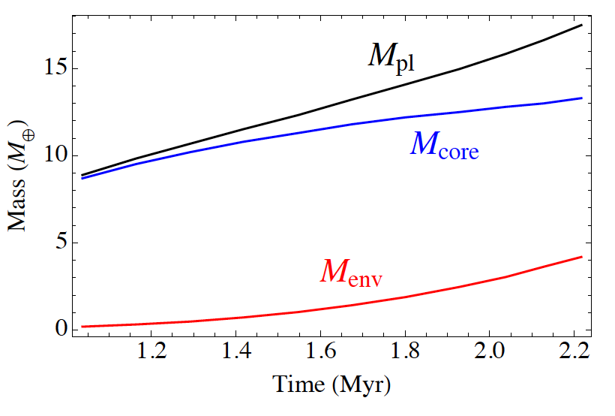
Preliminary results: 30 AU
Helled & Bodenheimer, in prep.
σ_{s}=0.35 g cm⁻²

Slide 31
(Preliminary) Conclusions
Uranus and Neptune could form in situ - the old timescale problem disappears!
The challenge is to keep Uranus and Neptune small and from accreting too much gas and/or solids.
Getting the correct gas-to-solid ratio is not trivial
Explains the diversity of intermediate-mass exoplanets
Helled & Bodenheimer, in prep.

Slide 32
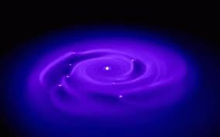
An alternative model
Formation by disk instability at large radial distance followed by core formation and gas removal (e.g., Boss et al. 2002; Nayakshin, 2011; Boley et al., 2011)
However
  Ice grains might not settle all the way to the center and in addition
  Strongly depends on grain size and the removal of the envelope
  Still work in progress…
L. Mayer

Slide 33
Connect Internal Structure with Origin
Despite the similar masses Uranus and Neptune they differ in other physical properties.
What are the causes for these differences?
    The difference could be a result of post formation events such as giant impacts.

Slide 34
Giant impacts: tilt, internal flux and atmospheric composition, satellite formation
Neptune: Radial Collision
Uranus: Oblique Collision
Enough energy to mix the Core: Mixed and adiabatic interior, efficient cooling
Angular momentum deposition: Core (MOI) convection is inhibited ➔ slow cooling, tilt
Podolak & Helled, 2012
Stevenson, 1986

Slide 35

Summary & Future Research
How do icy planets form? What are the compositions and internal structures of Uranus and Neptune?
Improved understanding of planetesimal formation and their properties; disk evolution
Connect interior models with planetary formation and evolution models
Space mission to Uranus and/or Neptune
Characterization of low-mass extrasolar planets

Slide 36
Thank You!

