Slide 1
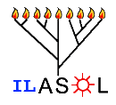
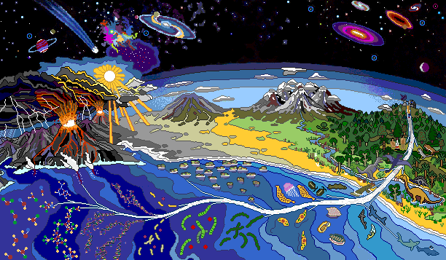
Perspectives on ILASOL Doron Lancet
NASA Center for Mars Exploration http://cmex.ihmc.us/vikingcd/puzzle/Evolife.htm

Slide 2
Perspectives on ILASOL
Comets
Extrasolar planets
Astrobiology
Reducing
Atmosphere
Oxygen emission
ILASOL
Clay
Metabolism
Stromatolites
Catalysis
networks
Protocells
Bacteria
Multicellularity
RNA
Lipids
Proto-ribosome
Monomers
Homochirality
Protocells
LUCA
Peptides
Comparative genomics
NASA http://cmex.ihmc.us/vikingcd/puzzle/Evolife.htm

Slide 3
Perspectives on ILASOL
Comets
Extrasolar planets
Astrobiology
Reducing
Atmosphere
Oxygen emission
ILASOL
Clay
Metabolism
Stromatolites
Catalysis
networks
Protocells
Bacteria
Multicellularity
RNA
Lipids
Proto-ribosome
Monomers
Homochirality
Protocells
LUCA
Peptides
Comparative genomics
NASA http://cmex.ihmc.us/vikingcd/puzzle/Evolife.htm

Slide 4
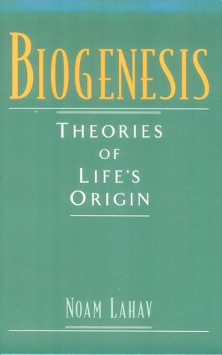
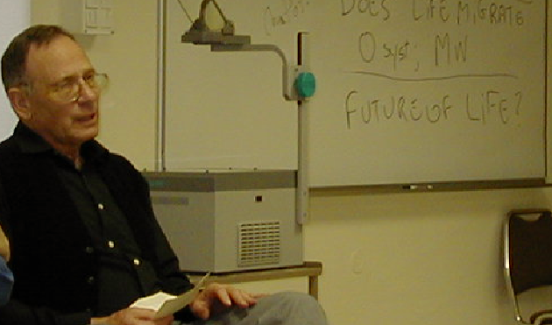
Perspectives on ILASOL
ILASOL founded & chaired 1987-2000 by Prof. Noam Lahav
Dept of soil and water sciences
Faculty of Agriculture, Food and Environment
Hebrew University

Slide 5
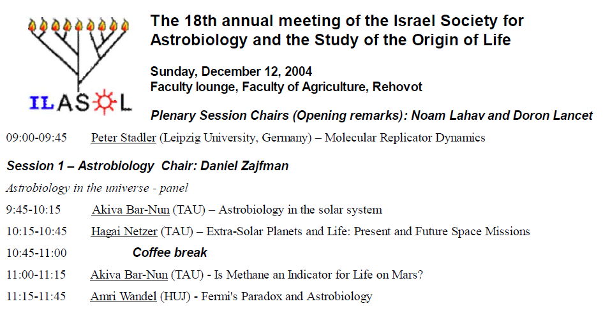
ILSOL→ILASOL
Astrobiology
2004
Joe Gale and Amri Wandel

Slide 6
ILSOL→ILASOL
Astrobiology
2004
Joe Gale and Amri Wandel
Daniel Zajfman

Slide 7
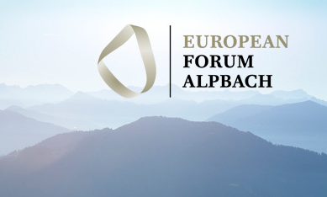
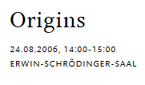

Daniel Zajfman: Life’s origin in the Universe
Doron Lancet: Lipid Origins of life

Slide 8
ILASOL 15
Akiva Bar-Nun (TAU)
“On the Contribution of Comets to the Volatile Inventory of Venus, Earth, Mars
and Jupiter.”
ILASOL 19
Akiva Bar-Nun (TAU) Methane on Mars and Deep
Impact Cometary Mission Updates
ILASOL 20
Akiva Bar-Nun (TAU)
a. How good is our understanding of comets.
b. Titan's Chemistry.
ILASOL 20
Akiva Bar-Nun (TAU) Surface Structures on the icy satellites of
the giant planets; Europa, Enceladus and Miranda.
ILASOL 22
Akiva Bar-Nun (TAU) Delivery of organics to the primitive Earth vs
in situ production of organic materials of biogenic importance
ILASOL 25
Akiva Bar-Nun (TAU) Contribution of Comets to Volatiles Inventory of the Primitive Earth
Comets and moons
Comets

Slide 9
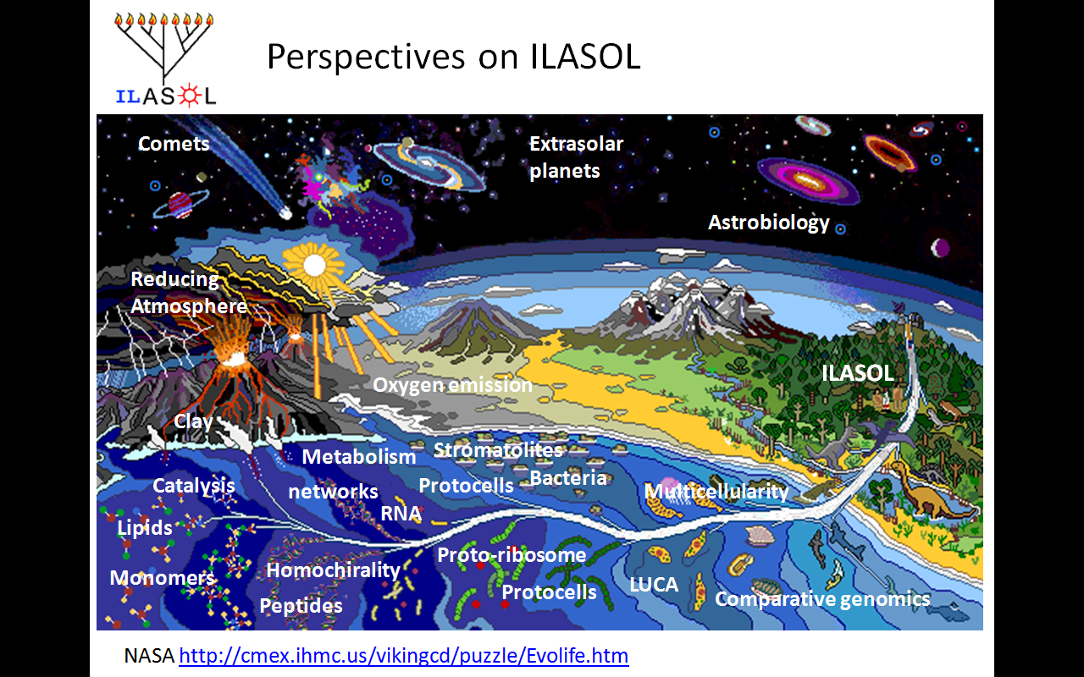
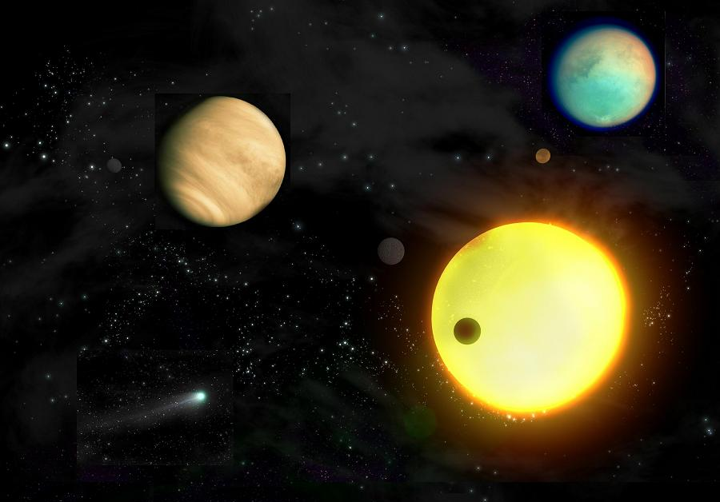
Extra-solar
planets
ILASOL 22
Shay Zucker (TAU) Extrasolar planets - current observational status
ILASOL 25
Tsvi Mazeh (TAU) Kepler and Corot mission (extrasolar planets)
Eran Ofek (TAU) Finding Extrasolar Planets Using Microlensing

Slide 10
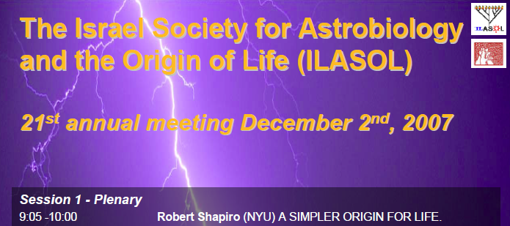
Perspectives on ILASOL
ILASOL 21: Robert Shapiro
“Monomer World”

Slide 11
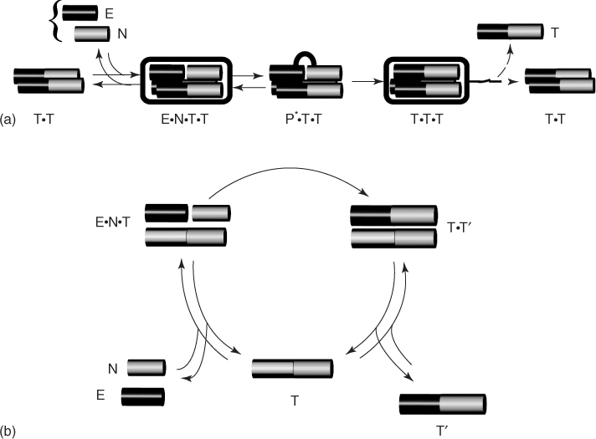
Perspectives on
ILASOL
Catalysis and mutual catalysis
ILASOL 15
Gidi Fleminger (TAU)
Catalytic Activity of Amino Acids and Small Peptides Formed on their Substrates
ILASOL 22
Gonen Ashkenasy (BGU) Thermodynamic and kinetic control of
replication processes in peptide networks
ILASOL 23
Ohad Carny and Ehud Gazit (TAU) Self-assembling short peptides: significance for
prebiotic molecular evolution
ILASOL 25
Dan S. Tawfik (WIS) Thoughts and Some Data on the Evolution of the Early Protein Forms

Slide 12
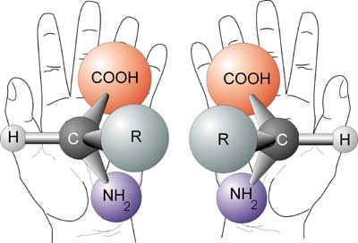
Perspectives on
ILASOL
Homochirality
ILASOL 15
Meir Lahav (WIS)
Chiral Amplification of Oligopeptides in 2-Dimensional Amphiphilic Crystalline
Self-Assemblies on Water
ILASOL 16
Meir Shinitzky (WIS) - Unexpected chiral enhancement in
racemic mixtures of D- and L-tyrosine
ILASOL 17
Meir Lahav (WIS) Generation of Homochiral Oligopetides via “Symmetry Breaking” Processes in Crystalline Arrays
ILASOL 18
David Avnir (HUJ) - The Elusive Nature of the Concept of Homochirality

Slide 13
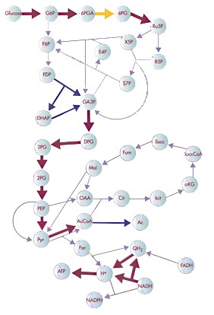
Perspectives on ILASOL
ILASOL 18
Daniel Segrè (Harvard Medical School)
Early and ontemporary Metabolism
ILASOL 20
Session 2: Plenary
Eörs Szathmáry (Collegium Budapest)
Metabolists, Geneticists, Compartmentalists, Unite!!!
ILASOL 22
Iris Fry (Technion)
On the “RNA-first” – “Metabolism-first” debate:
What is the debate about?
ILASOL 23
Peter Stadler (Leipzig University, Germany) Simulating the origins of metabolism
ILASOL 25
Omer Markovitch and Doron Lancet (WIS)
Network Motifs in Prebiotic Metabolic Networks
Metabolism

Slide 14
Perspectives on ILASOL
ILASOL 18
Daniel Segrè (Harvard Medical School)
Early and ontemporary Metabolism
ILASOL 20
Session 2: Plenary
Eörs Szathmáry (Collegium Budapest)
Metabolists, Geneticists, Compartmentalists, Unite!!!
ILASOL 22
Iris Fry (Technion)
On the “RNA-first” – “Metabolism-first” debate:
What is the debate about?
ILASOL 23
Peter Stadler (Leipzig University, Germany) Simulating the origins of metabolism →RNA
ILASOL 25
Omer Markovitch and Doron Lancet (WIS)
Network Motifs in Prebiotic Metabolic Networks
Metabolism

Slide 15
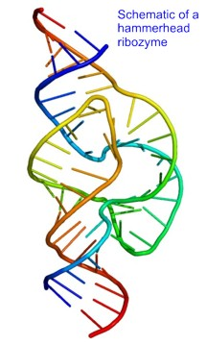
Perspectives on ILASOL
RNA world
ILASOL 19
11:50-12:20 Emmanuel Tannenbaum (BGU)
An RNA-Centered View of Eukaryotic Cells
ILASOL 19
Malcolm Schrader (HUJ)
Prebiotic Synthesis of RNA and Thermodynamic Feasibility
Paulien Hogeweg (Netherlands) Evolutionary dynamics of RNA replicator systems at high mutation rates
ILASOL 26
Raymond Kaempfer (HUJI)
From cyanide and water to RNA sensors of stress in human cytokine genes

Slide 16

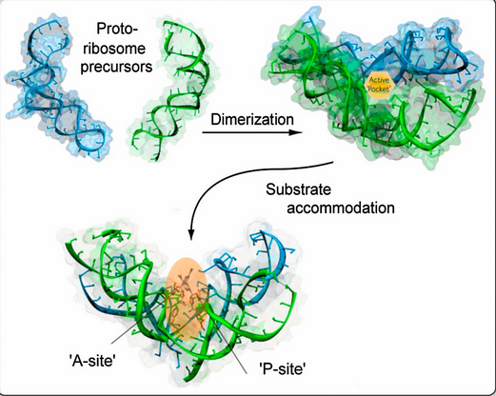
Perspectives on ILASOL
Proto-ribosome
ILASOL 25
11:05-11:45 Keynote speaker: Ada Yonath (WIS) A Vestige of an RNA
Apparatus with Bonding Capabilities Functions within the Modern Ribosome
ILASOL 22
Ada Yonath (WIS)
The evolving prebiotic translational machine
ILASOL 23
Ilana Agmon (TEC, HUJ) Identification of the prebiotic translation apparatus within the contemporary ribosome

Slide 17
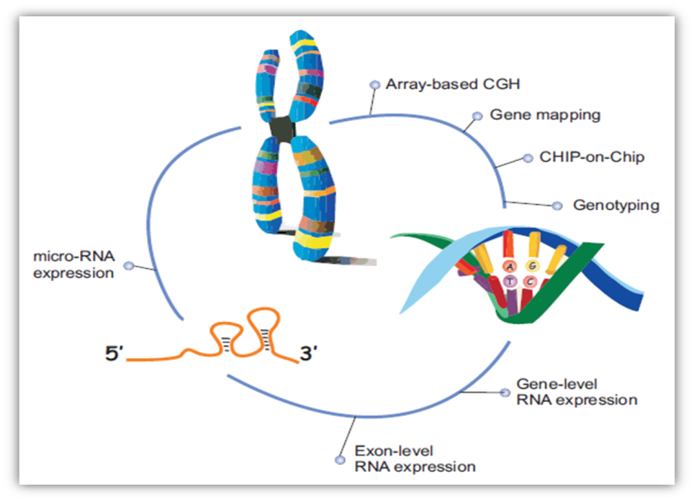
Perspectives on
ILASOL
Genomic Insights
ILASOL 19
Session 2 – Genomic Insights (chair: Yitzhak Pilpel)
Oded Beja (IIT) Environmental Genomics: New Ways to Harvest Light
Ed Trifonov (UH) Protein Chronology Scale - Generous Abiotic Start
ILASOL 22
Oded Beja (IIT) Metagenomics and the key to the origin of life
ILASOL 24
Edward N. Trifonov (UH) Everlasting Triplet Expansions: From the Origin of Triplet Code to Modern Genomes
ILASOL 23
Peter Gogarten (University of Connecticut, USA) Rooting the
ribosomal tree of life using the early expansion of the genetic code
ILASOL 27
Antonio Lazcano (UNAM, Mexico) Planetary evolution and biochemical adaptations: between contingency and determinism? (Comparative genomics)

