Slide 1

Compositional Assemblies Behave Similarly to Quasispecies Model
Renan Gross, Omer Markovitch and Doron Lancet
Department of Molecular Genetics, Weizmann Institute of Science, Israel
ILASOL, 01/12/2013

Slide 2
Outline
Main result: populations of the compositional assemblies of the GARD model behave in a way that is similar to that predicted by quasispecies theory.
Our plan today:
An overview of Quasispecies
An overview of GARD
Results

Slide 3
Introduction
Quasispecies are a cloud of genotypes that appear in a population at mutation-selection balance.
(J.J Bull et al, PLoS 2005)
- Theoretical model (equations and assumptions), with experimental support by RNA viruses.
Such dynamics are needed when mutation rates are high.
Early life is reasoned to have lived near error-catastrophe

Slide 4
Introduction
Why is this important?
  Further evidence that compositional inheritance can describe known population dynamics.
  As early life probably had little error correction, quasispecies applies to models for the origin of life.
  If complete correspondence between GARD and quasispecies model is achieved, we can move to a higher level of abstraction.

Slide 5
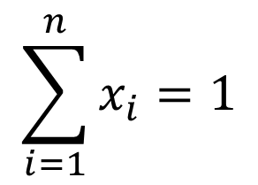
Quasispecies model
Basically a population model
n different genotypes / identities
Their relative concentration in the environment is denoted by the fraction x_{i}.
Goal: To find out how x_{i} behave as a function of time.
Reactor
$$\sum_{i=1}^{n}{x_{i}=1}$$

Slide 6
Quasispecies model
Each one replicates at a certain rate – how many offspring it has per unit time.
Some replicate faster than others.
This is called the replication rate, denoted A_{i}.

Slide 7
Quasispecies model
However, replication is not exact. Sometimes, the offspring is of another genotype.
The chance that a genotype j replicates into genotype i is denoted Q_{ij.}
Q₁₁ = 0.5
Q₂₁ = 0.2
Q₃₁ = 0.2
Q₄₁ = 0.1

Slide 8
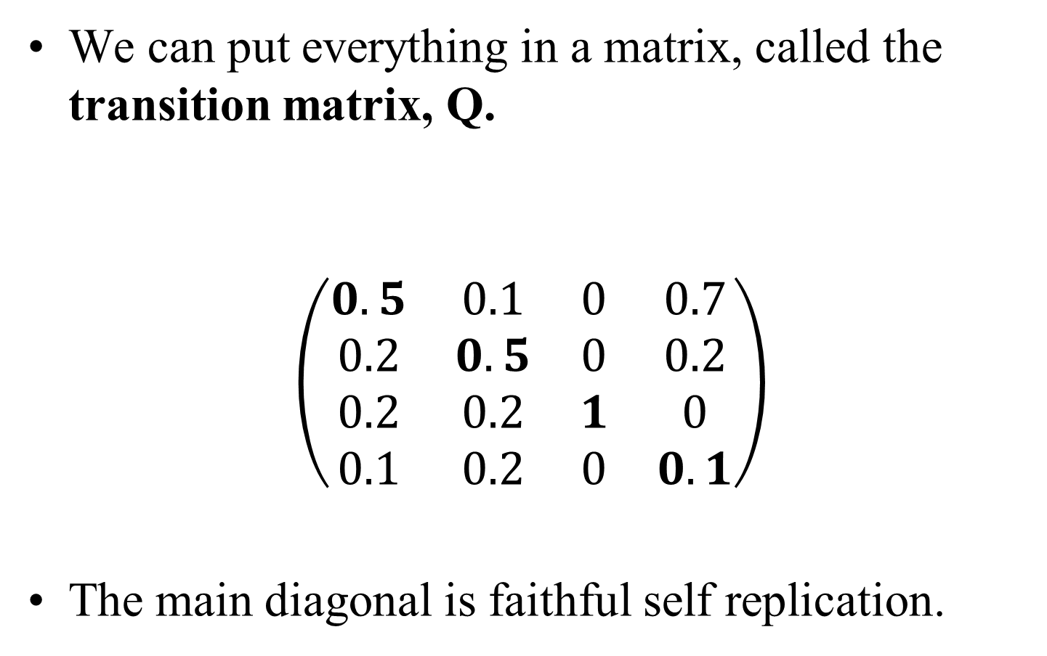
Quasispecies model
We can put everything in a matrix, called the transition matrix, Q.
$$\left(\begin{matrix}0.5 & 0.1 & 0 & 0.7 \\ 0.2 & 0.5 & 0 & 0.2 \\ 0.2 & 0.2 & 1 & 0 \\ 0.1 & 0.2 & 0 & 0.1\end{matrix}\right)$$
The main diagonal is faithful self replication.
From
To

Slide 9
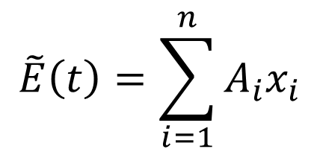
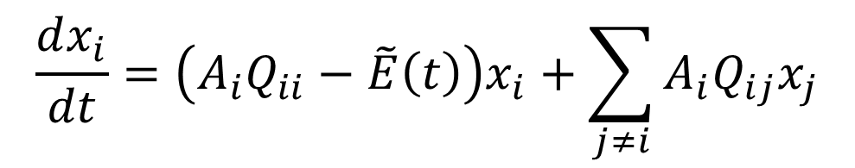
Quasispecies model
Under constant population assumptions, the transition matrix Q and the replication rates A are all that are needed in order to find out the concentration dynamics.
The Eigen equation (after Manfred Eigen):
Where E is the “average excess rate”
$$\frac{dx_{i}}{dt}=\left(A_{i}Q_{ii}−\tilde{E}\left(t\right)\right)x_{i}+\sum_{j≠i}{A_{i}Q_{ij}x_{j}}$$
$$\tilde{E}\left(t\right)=\sum_{i=1}^{n}{A_{i}x_{i}}$$

Slide 10
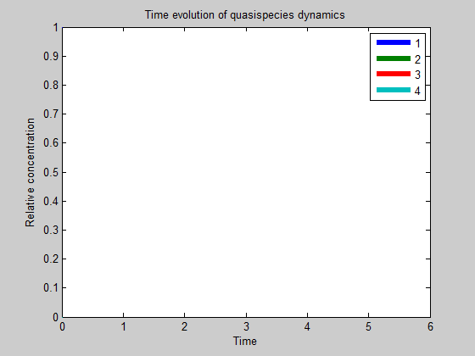
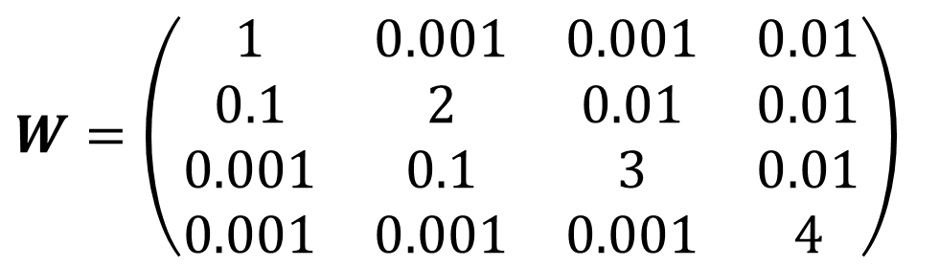
Examples:
$$W=\left(\begin{matrix}1 & 0.001 & 0.001 & 0.01 \\ 0.1 & 2 & 0.01 & 0.01 \\ 0.001 & 0.1 & 3 & 0.01 \\ 0.001 & 0.001 & 0.001 & 4\end{matrix}\right)$$
Initial conditions: x₁ = 1, all others are 0.

Slide 11
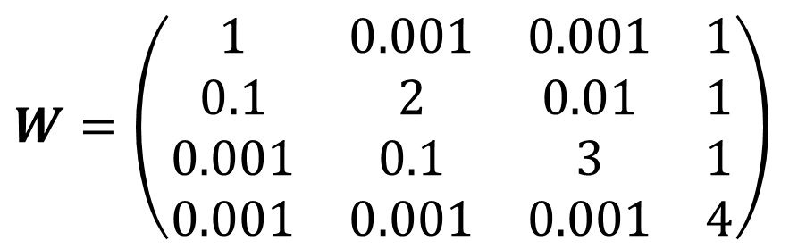
Examples:
$$W=\left(\begin{matrix}1 & 0.001 & 0.001 & 1 \\ 0.1 & 2 & 0.01 & 1 \\ 0.001 & 0.1 & 3 & 1 \\ 0.001 & 0.001 & 0.001 & 4\end{matrix}\right)$$
Initial conditions: x₁ = 1, all others are 0.

Slide 12
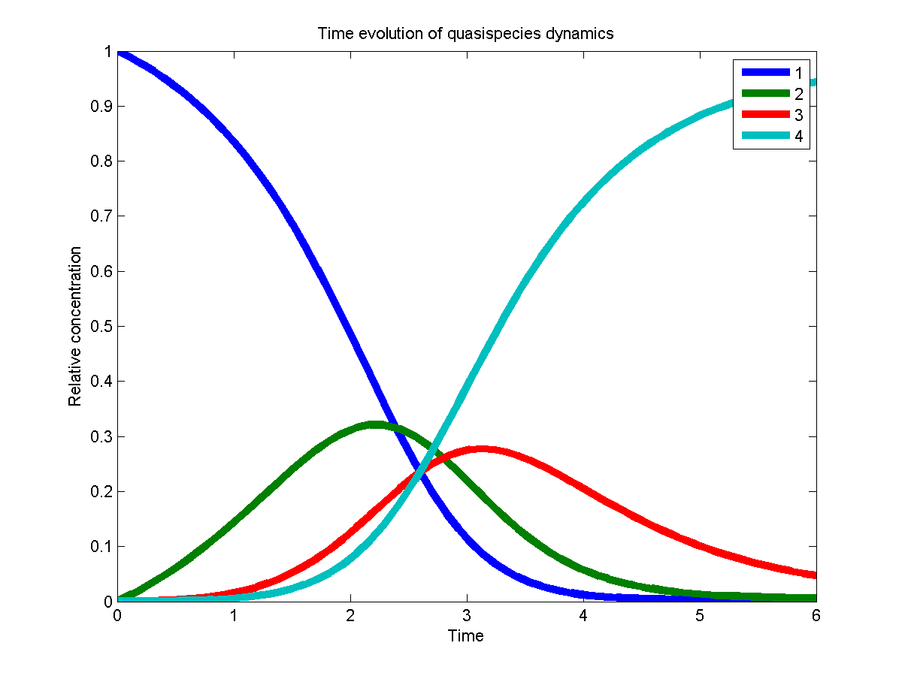
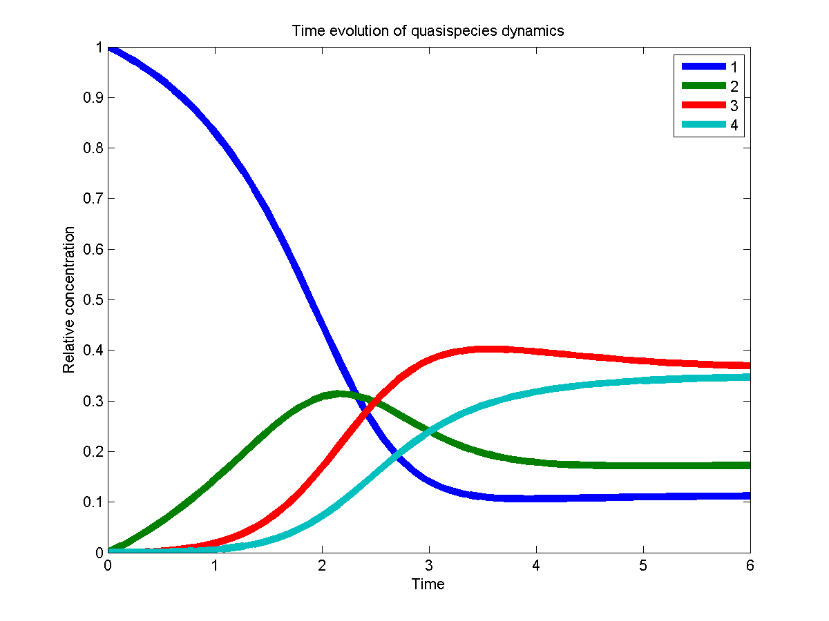
The steady state population distribution is called the quasispecies.

Slide 13
Quasispecies model
This is all theory. What happens for RNA based life forms?
The basic model deals with RNA strands of constant length v :
  There is a single genotype with highest replication rate: the master sequence
  Single digit replication: 0 ≤ q ≤ 1
  All mutations of the master sequence replicate slower according to the Hamming distance.
    Effectively, many genotypes are grouped together.
    Q and A are built only from q and v.
q
1
1
1-q
0

Slide 14
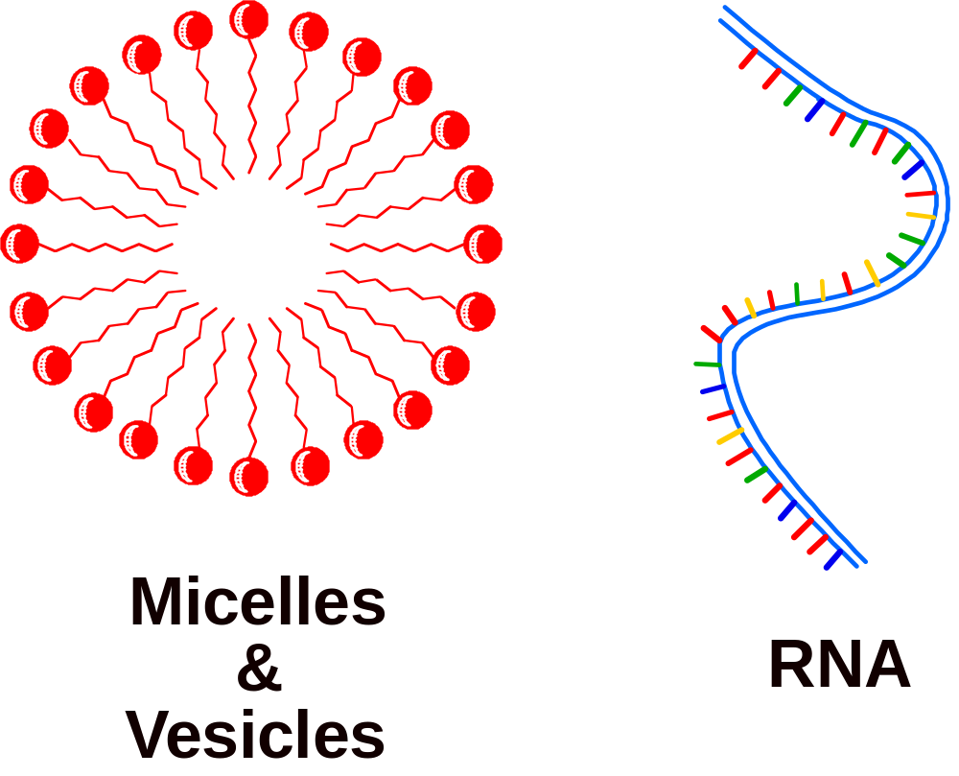
GARD model (Graded Autocatalysis Replication Domain)
RNA world
Lipid world
Assemblies / Clusters / Vesicles / Membranes → Composition
non-covalent bonds
DNA / RNA / Polymers → Sequence
covalent bonds
Segre and Lancet, EMBO Reports 1 (2000)

Slide 15
GARD model (Graded Autocatalysis Replication Domain)
Homeostatic growth
β
Fission / Split

Slide 16
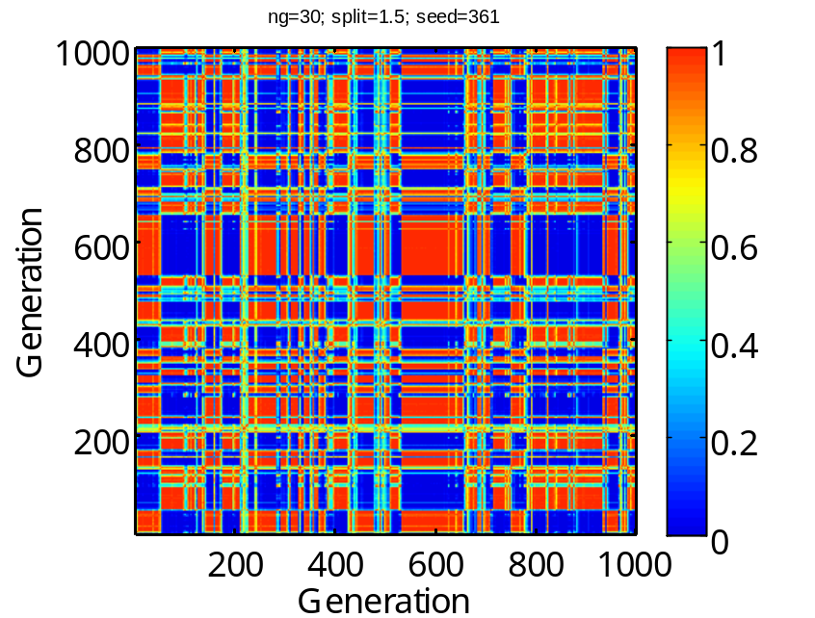
GARD model (Graded Autocatalysis Replication Domain)
Following a single lineage.
Similarity ‘carpet’
Compositional Similarity
Composome (compositional genome): a faithfully replicating composition/assembly.
Compotype (composome type): a collection of similar composomes.

Slide 17
GARD and Quasispecies
Do GARD population dynamics behave like the quasispecies model?
What we would like to do:
  For each assembly, experimentally find out the transition frequencies and replication rates.
  In other words: find Q and A.

Slide 18
GARD and Quasispecies
But, wait, isn’t it trivial?
  Shouldn’t every replicating-with-errors entity follow the quasispecies dynamics?
As we will be seen, the compotype is a “master sequence” candidate for GARD
  This is emergent from GARD dynamics, and is hence non-trivial
An effect similar to error catastrophe also occurs

Slide 19
GARD and Quasispecies
Back to finding Q and A:
Problem:
  With 100 different molecule types and maximum assembly size of 100, there are ~4∙10⁵⁸ different assemblies.

Slide 20
GARD and Quasispecies
Solution: group some assemblies together and treat them as one genotype.
We decided to group together by distances from the compotype.
N_{G} space (simplified to 2d)
3
Molecule 2
2
1
Compotype
Molecule 1

Slide 21
GARD and Quasispecies
Each assembly is split and its offspring grown.
  Q = to where did the assembly split?
  A = how long did it take the offspring to grow?
Offspring
3
Molecule 2
2
Random assembly
1
Molecule 1

Slide 22
GARD and Quasispecies
Example of a transition matrix:
<<Data removed from published version>>

Slide 23
GARD and Quasispecies
There is a constant number of assemblies in a population.
Each turn, a single molecule is added.
Upon split, the parent as well as a random assembly are replaced with the two children.

Slide 24
GARD and Quasispecies
The population simulation goes into steady state, concerning the frequencies of compotypes (as shown by O. Markovitch)
The distribution of distances from the eigenvector was calculated for the population steady state, and compared with prediction.

Slide 25
GARD and Quasispecies
<<Data removed from published version>>

Slide 26
GARD and Quasispecies
<<Data removed from published version>>

Slide 27
GARD and Quasispecies
Correlations
About 0.7 are above 0.8
<<Data removed from published version>>

Slide 28
GARD and Quasispecies
There is a dependence on the number of compotypes
<<Data removed from published version>>

Slide 29
GARD and Quasispecies
Dynamics
<<Data removed from published version>>

Slide 30
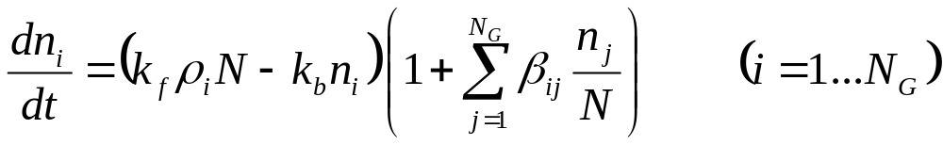
Error Catastrophe in GARD
The GARD equation:
Includes two parameters
How do k_{f} and k_{b} affect the population dynamics?

Slide 31
Error Catastrophe in GARD
The GARD equation contains two parameters which dictate how fast molecules flow in and out
How do k_{f} and k_{b} affect the population dynamics?

Slide 32
Error Catastrophe in GARD
What happens if you lower k_{f} ?
Run single lineage simulation with different k_{f} values.
<<Data removed from published version>>

Slide 33
Error Catastrophe in GARD
Since the most common compotype frequency decreases drastically, there is a high increase in drift → no composomes.
Conclusion: k_{f} and k_{b} affect replication fidelity.

Slide 34
Error Catastrophe in GARD
What happens in quasispecies model?
  We obtained Q and A for lower k_{f} values.
Two types of results:
Seed = 12 Seed = 15
<<Data removed from published version>>

Slide 35
Error Catastrophe in GARD
The difference seems to relate to the size of the compotype.
<<Data removed from published version>>

Slide 36
Conclusions
GARD constant population models give distance distributions that are similar to those generated by the quasispecies model.
GARD replication fidelity shows sensitivity to k_{f} and k_{b}. Low k_{f} results in loss of compotype dominance, just like high single digit error results in loss of master sequence.
∴ Compotypes/composomes behave similarly to quasispecies.

