Slide 1
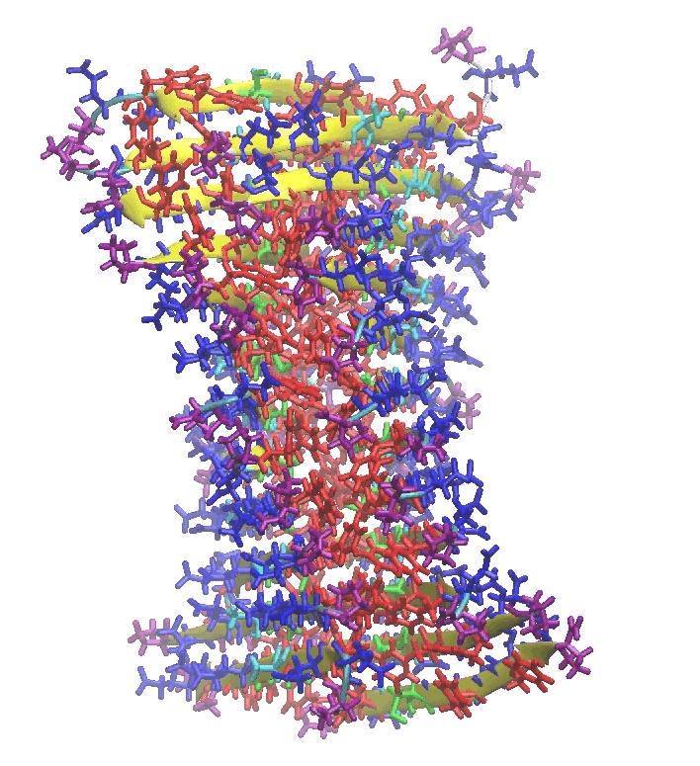
From Structure to Function: Possible Implications of β-Sheet Peptides to the Origin of Life
Boris Rubinov
Supervised by: Prof. Gonen Ashkenasy
Ben-Gurion University of the Negev, Beer-Sheva, Israel
ILASOL 27th meeting – Weizmann Institute of Science
01.12.13

Slide 2
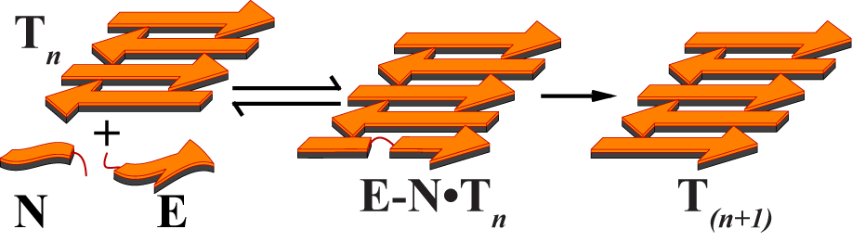
Goals
Design and investigation of a new class of self - replicating peptides, based on folding into β-sheet secondary structure.

Slide 3
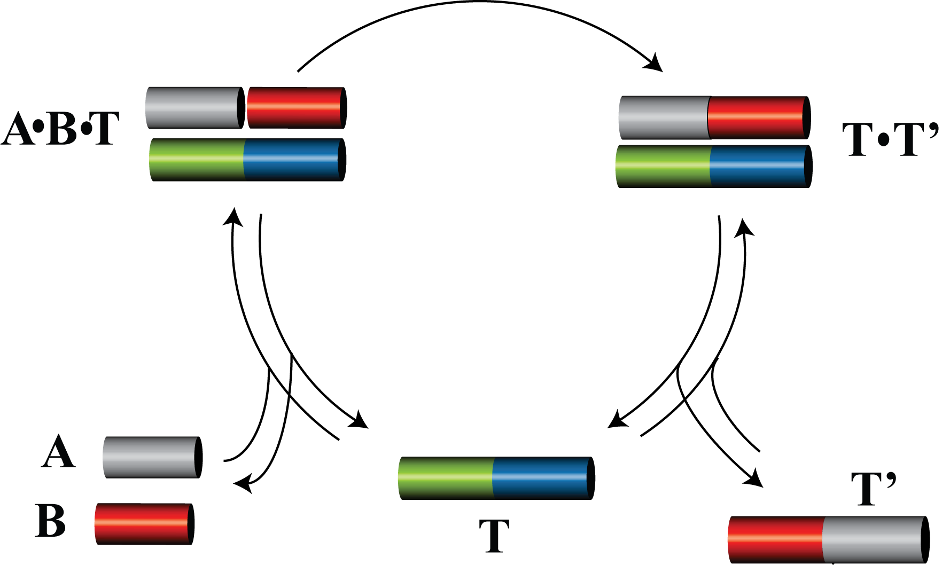
Minimal Self-Replication Systems
DNA
  L.E. Orgel; G. von Kiedrowski
RNA
  G. von Kiedrowski; G. F. Joyce
Abiotic organic molecules
  J. Rebek; D. Philp; I.O. Sutherland
Peptides – α helix
  M.R. Ghadri; J. Chmielewski; G. Ashkenasy
Dadon, Z., Wagner, N., and G. Ashkenasy, Angew. Chem. Int. Ed., 2008. 47(33)

Slide 4
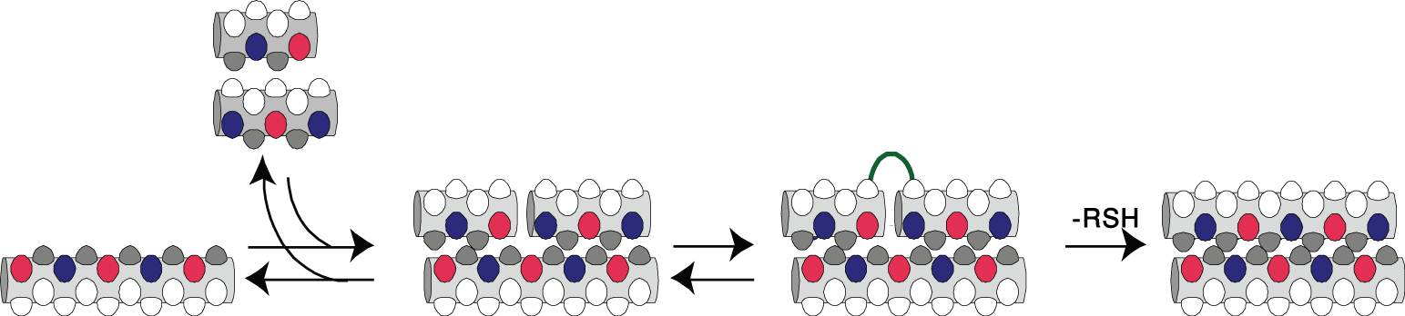

Self-Replication by Peptides
α-Helices:
  Long sequences: 28-40 a.a
  Specific sequences
  2 layers of recognition
  Product inhibition
β-Sheet:
  Short sequence: 10-13 a.a
  Simple sequences
  Assembly by H-bonds
  No product inhibition
B. Rubinov, N. Wagner, H. Rapaport, and G. Ashkenasy, Angew. Chem. Int. Ed., 2009. 48.
Notes:
4

Slide 5
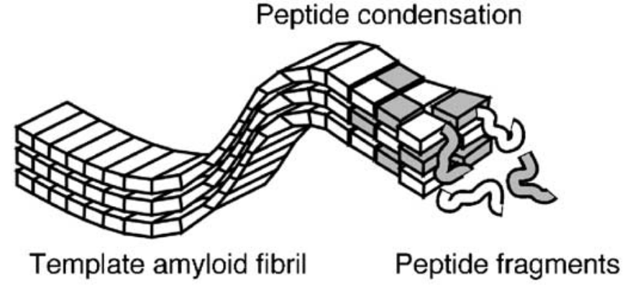
β-Sheet Peptides (possible implications to the Origin of Life)
Prebiotic condensation of amino acids to β-sheet peptides
  S.L. Miller; L.E. Orgel; A. Brack
High structural stability
  C.M. Dobson; A. Brack
Self-propagation/replication and information transition
  C.M. Dobson; C.P.J. Maury; H. Mihara
Enantioselective Peptides
  A. Brack; M. Lahav
Hydrolysis/formation of oligoribonucleotides
  B. Barbier, A. Brack
I. Weissbuch, R. A. Illos, G. Bolbach, M. Lahav, Acc. Chem. Res. 2009, 42
N. Wagner, B. Rubinov, G. Ashkenasy, ChemPhysChem, 2011, 12
H. Mihara et. al., Bioorg. Med. Chem., 2004
Notes:
5

Slide 6
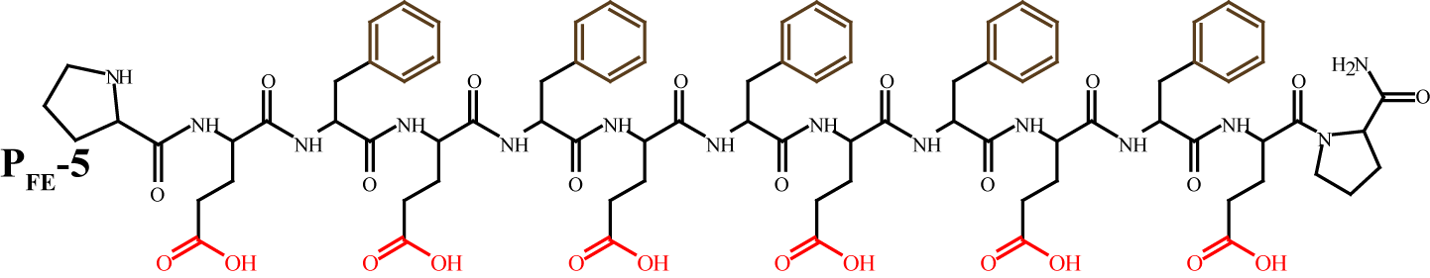
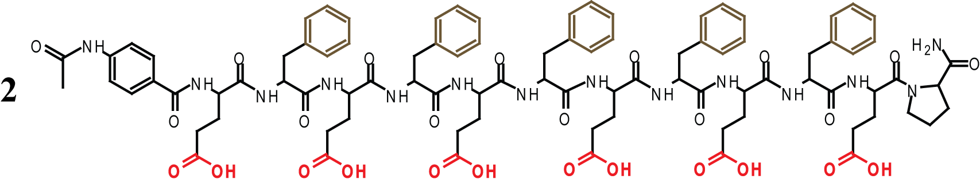
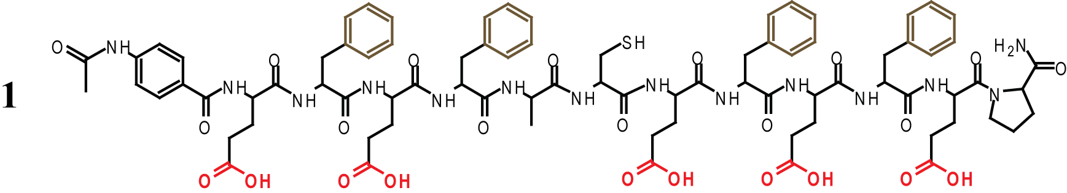
System Design – β-Sheet Peptides
Isenberg, H., K. Kjaer, and H. Rapaport, J. Am. Chem. Soc., 2006. 128(38)

Slide 7
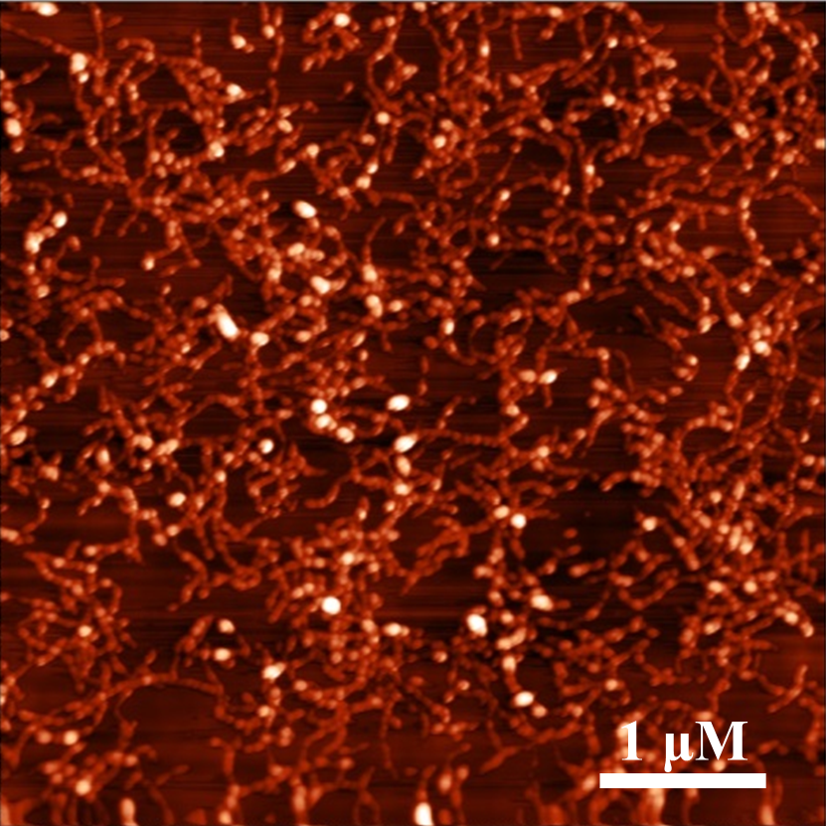
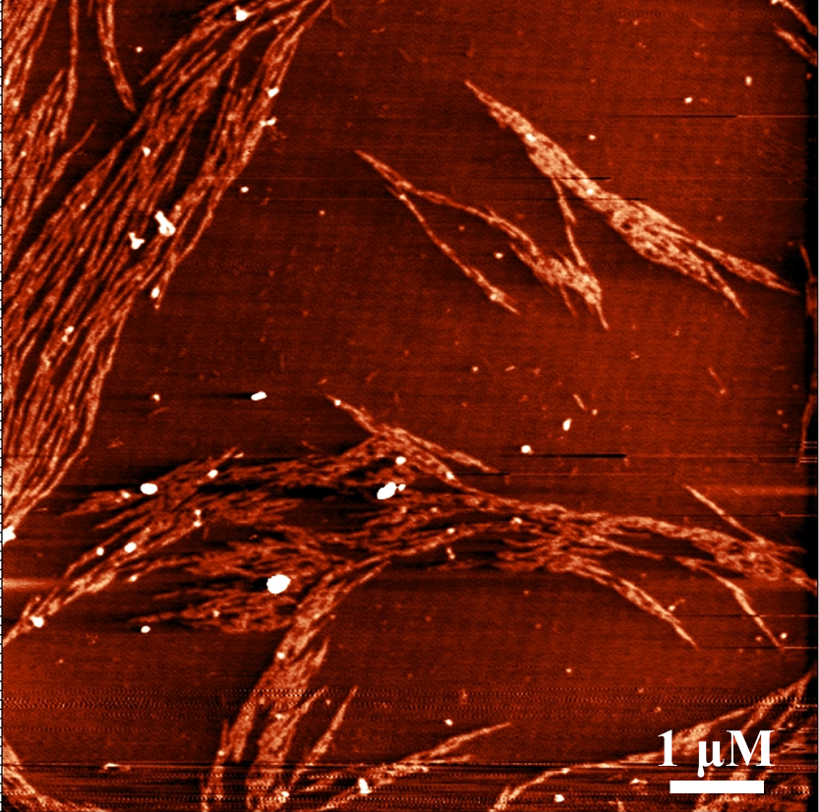
Structural Characterization
In aqueous solution
a
b
AFM topography images of 1 and 2 fibrils (a and b respectively, 100 μM), formed after 30 minutes of equilibration (z scale = 4 nm)

Slide 8
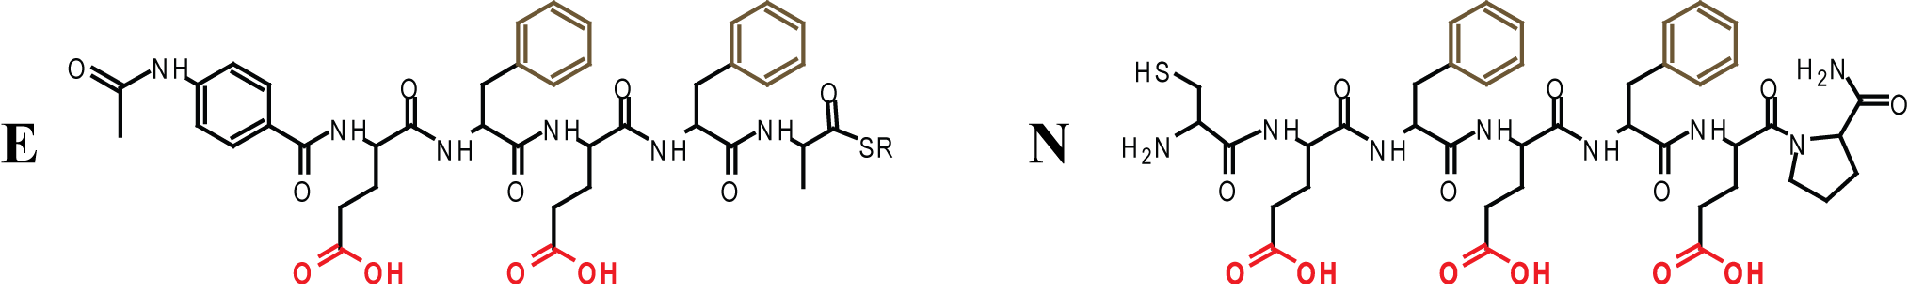
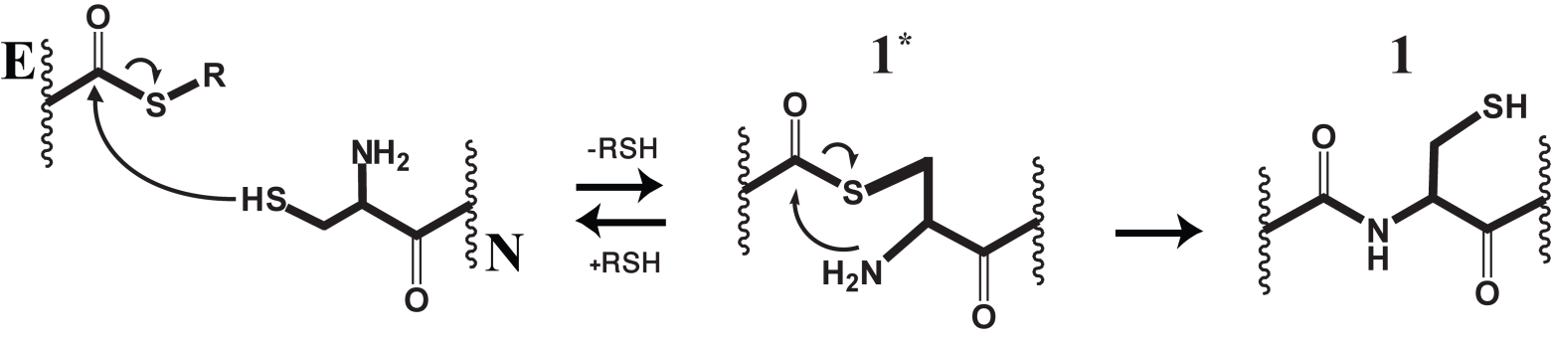
From Structure to Function
Design of replication system 1
1
1

Slide 9
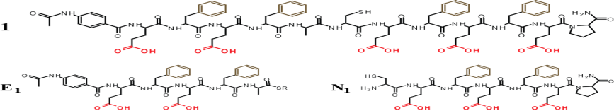
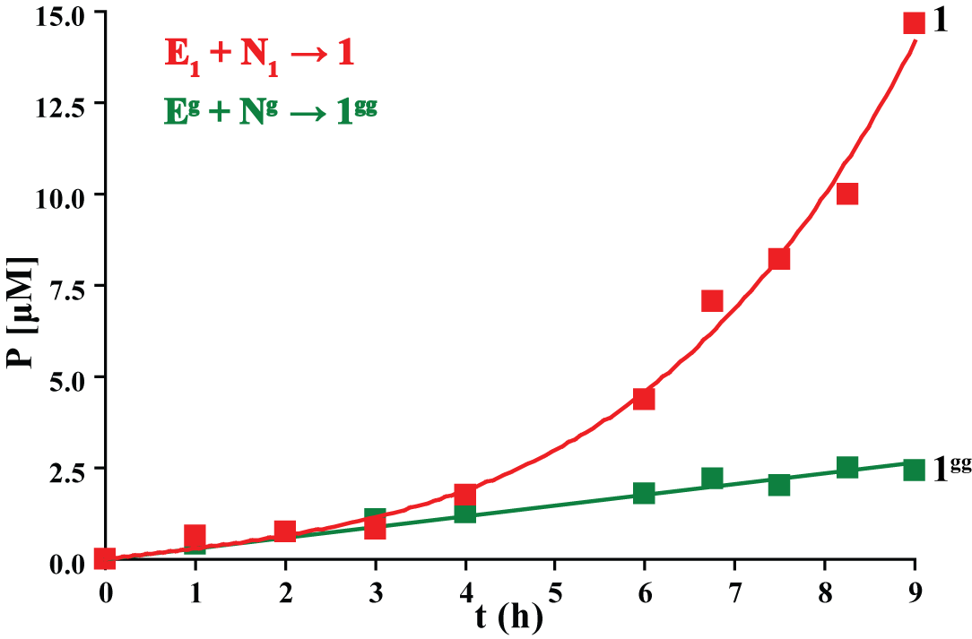
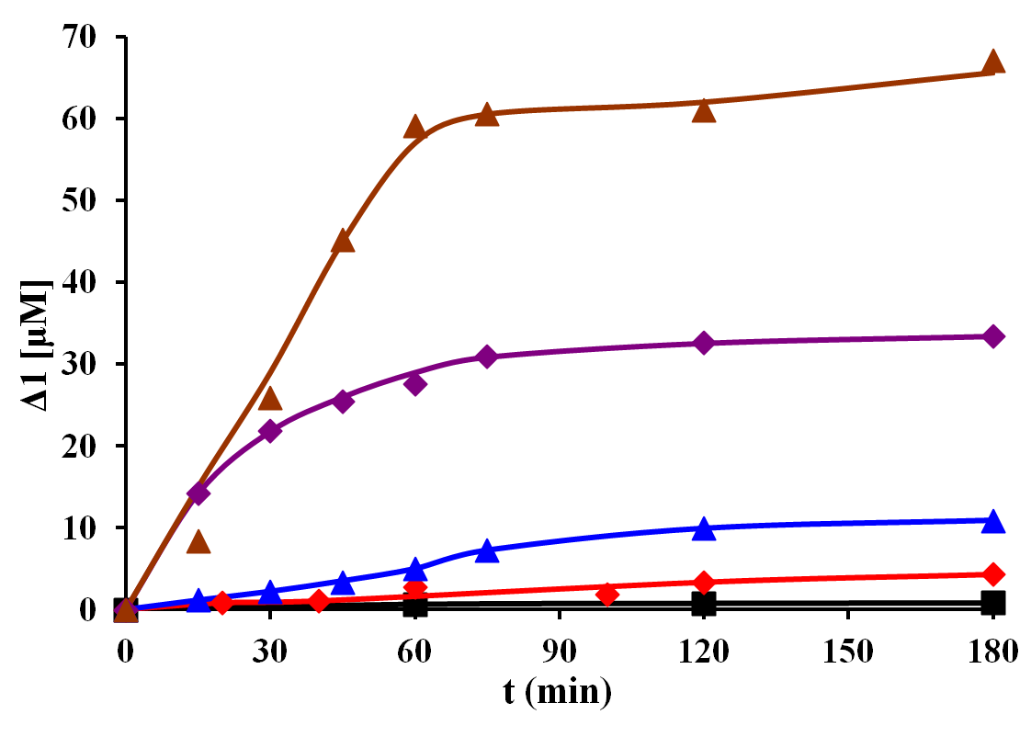
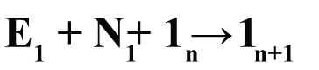
Kinetics Experiments of Replication System
116 μM
~100 - fold
41μM
12μM
9μM
0μM
[E₁]₀=[N₁]₀= 250±10 µM; pH = 7; TCEP; Δ1 = [1]_{t} – [1]₀
B. Rubinov, N. Wagner, H. Rapaport, G. Ashkenasy Angew. Chem. Int. Ed., 2009. 48.
Notes:
9

Slide 10
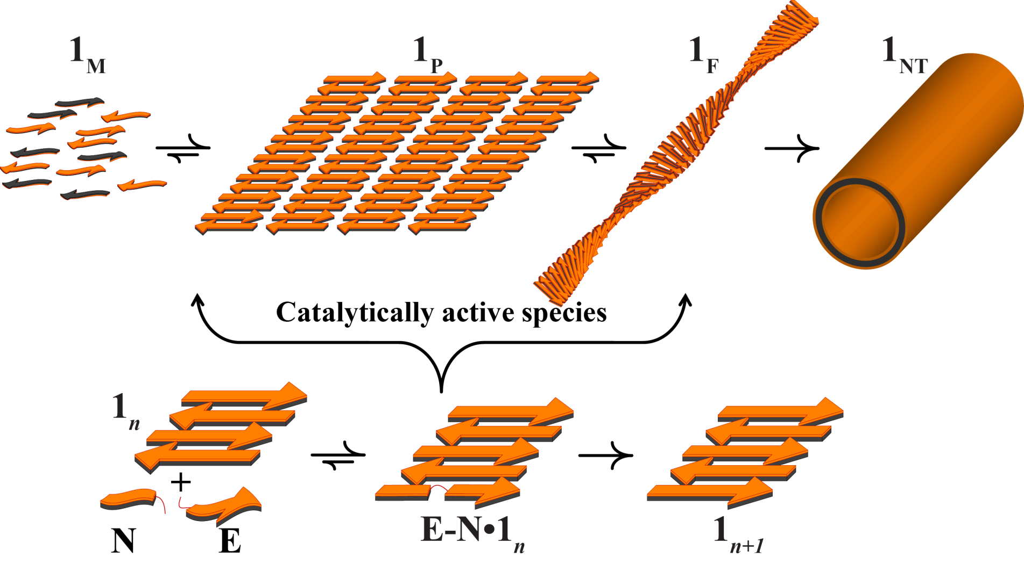
Full System Mechanism
Two parallel processes
B. Rubinov, M. Matmor, N. Wagner, O. Regev, N. Ashkenasy, G. Ashkenasy, ACS Nano 2012, 6(9)
Highlighted in Nature Nanotechnology 2012, 7, 549

Slide 11
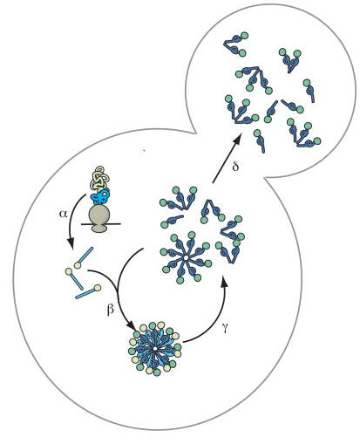
Replication mechanism
Prions are infectious agents responsible for a variety of neurodegenerative disorders, including scrapie in sheep, bovine spongiform encephalopathy (BSE) in cattle, and new variant Creutzfeldt-Jacob disease (CJD) and kuru in humans.
Molecular mechanism of PRION replication
For example: Sindi & Serio Curr. opin. Microbiol. 2009.
PrP^{c} → PrP^{Sc} | Synthesis | E + N → F
PrP^{c} + PrP^{Sc}_{n} → PrP^{Sc}_{n+1} | Catalysis | E + N + F_{n} → F_{n+1}
PrP^{Sc}_{n}→ PrP^{Sc}_{1n}+ PrP^{Sc}_{2n} | Fragmentation | F_{n} → F_{1n} + F_{2n}
PrP^{Sc}_{n} / PrP^{Sc} → PrP^{c} | Decay | F_{n} → NT
PrP^{Sc} = Scrapie form misfolded protein

Slide 12
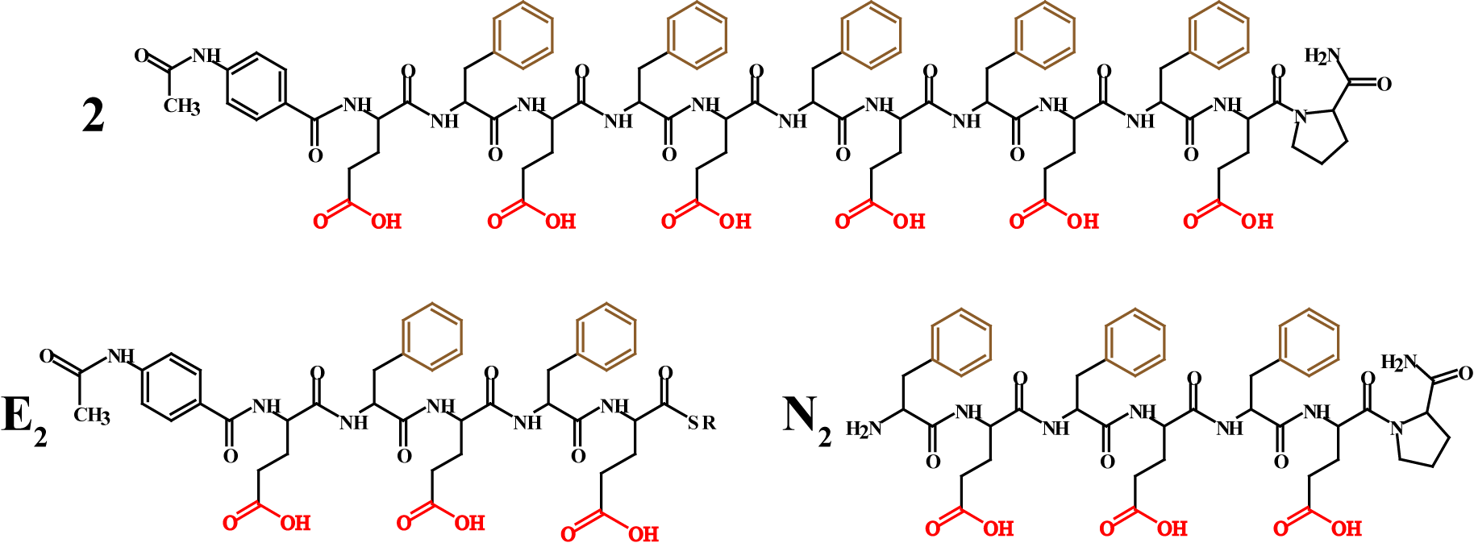
From Structure to Function
Design of replication system 2

Slide 13
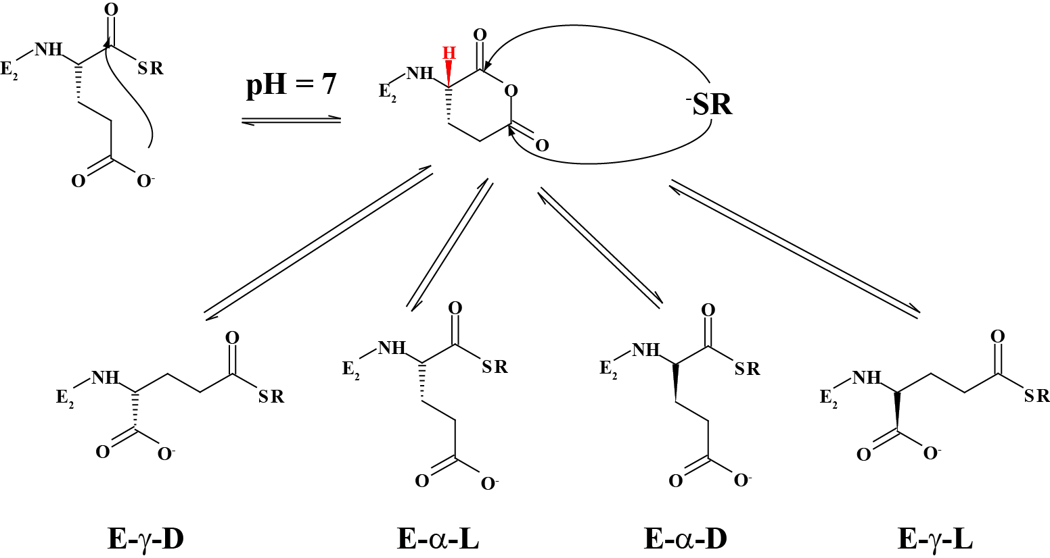
Epimerization & Isomerization of E₂

Slide 14
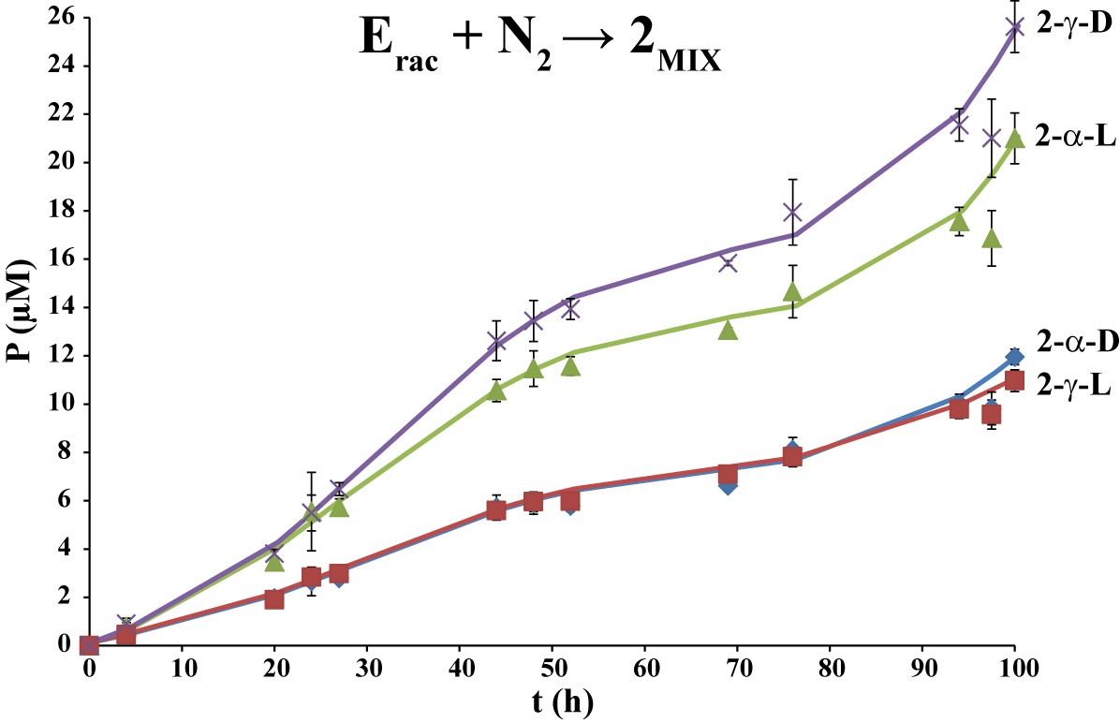
Kinetics Experiments of Replication System
Template free reactions – Background reactions
[E-α-L]=[E-α-D]=300±10 µM; [N₂]=600±10 µM; pH=7; Shaking @ 500-600 rpm
Notes:
14

Slide 15
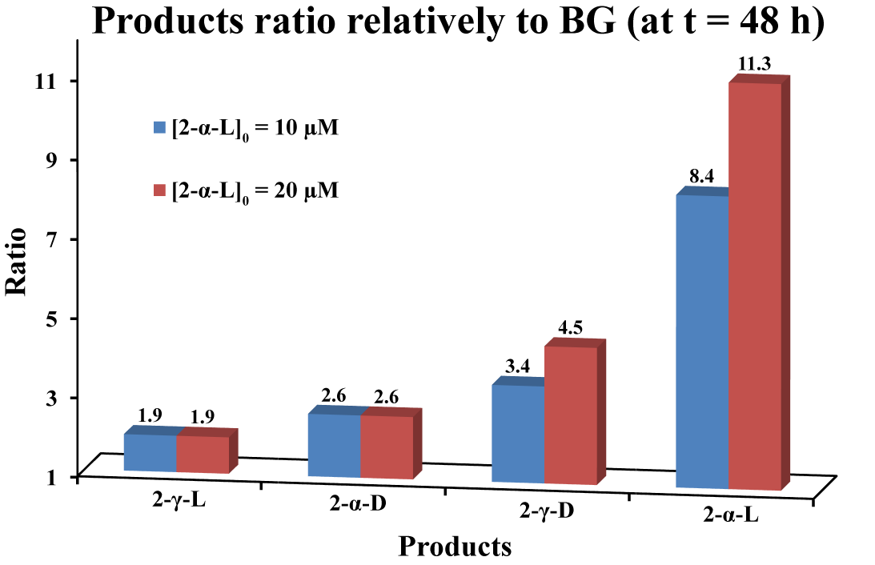
Kinetics Experiments of Replication System
Template assisted reactions – Self-replication reactions
[E₂]=[N₂]=250±10 µM; MOPS buffer (0.2 M) pH=7
Notes:
15

Slide 16
Summary of β-Sheet Replication
Peptides replication achieved using short & simple sequences.
Peptide ligation (condensation of amide bond) in mild conditions (pH 7, r.t.) is plausible.
The ligation reaction can be catalyzed by β-sheet structures through self-replication process.
The template-assisted reaction is regio- and stereo-selective.
β-Sheet structures may act as homochiral precursors in the origin of life.
Notes:
16

Slide 17
Acknowledgments
Prof. Gonen Ashkenasy
Dr. Nathaniel Wagner
Dr. Riky Cohen-Luria
Dr. Manickasundaram Samiappan
Dr. Jayanta Nanda
Zehavit Dadon
Inbal Shumacher
Lina Shepelevski
Samaa Alasibi
Denis Ivnitski
Rakesh Mukherjee
Chiara Glionna
Nadia Levin
Vered Zavaro
Tania Dronov
Anne Zebitz Eriksen
Collaborators:
Prof. Hanna Rapaport (GIXD)
Dr. Vladimir Vaiser
Dr. Shlomit Magidovich
Prof. Oren Regev (cryo-TEM)
Dr. Einat Roth
Eran Edri
Prof. Nurit Ashkenasy (AFM)
Maayan Matmor
Dr. Yifat Miller (MD)
Yoav Raz
THANK YOU
Notes:
17

