Slide 1
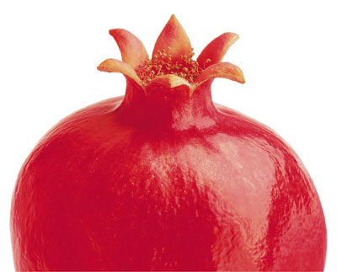
ISRAEL

Slide 2
Growing Pomegranate
and Producing Health
Products
ISRAEL

Slide 3

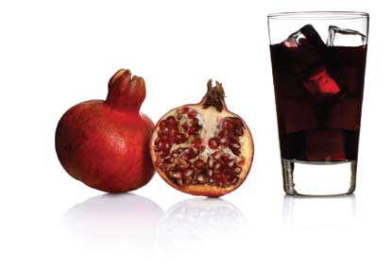
From M.D.HAI R&D projects
    High Tech Plantation Method for multiplied yield
    Latest technology for processing & preserving
    Knowhow for various end products
    Unique R&D facilities.

Slide 4
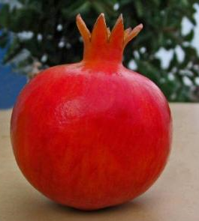
Pomegranate
One of the oldest fruits known to humanity,
Native from Iran to the Himalayas in Northern India & Was recognized in Egyptian Mythology.
Traditionally known among all civilizations for it’s high health value.

Slide 5
Pomegranate – Medical Results
Rappaport faculty of medicine, Israel - Pomegranate juice reduced cholesterol.
Technion, Israel – Pomegranate reverses cancer cell development.
University of Michigan - Seed oil aided in promoting regeneration of the epidermis.
American College of Cardiologists - Reduced Oxygen deficiency to the heart during exercise.
When mother drinks Increase immunity and brain development in embryo.
Notes:
Explain ???????

Slide 6
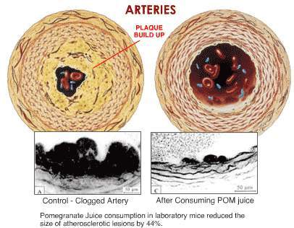
Recent biological studies have been proven that certain compounds in the pomegranate juice has been shown to:
Reduce blood pressure; Reduce LDL oxidation; Reduce the atherosclerosis formation
Moreover: Consumption of pomegranate juice can lead to reduction of the atherosclerosis lesion

Slide 7
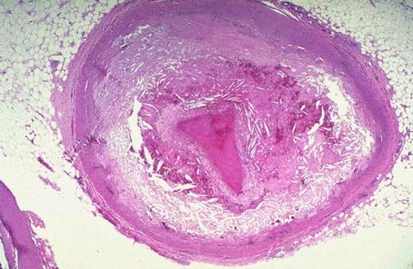
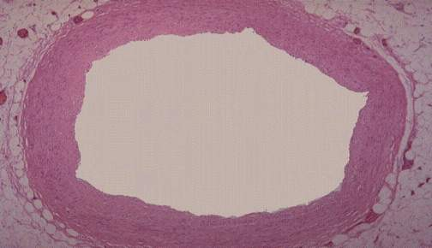
Pomegranate Juice Consumption by Patients with Carotid Artery Stenos is Reduces Carotid Intima-Media Thickness
A. Control
3
2
1
Carotid IMT (mm)
0
4
B. Pomegranate Juice
2
0
Baseline
After 1 year

Slide 8
Pomegranate
Studies have been completed by Major Medical and Scientific Institutions - Numerous health benefits have been reported
Benefit Summary
  Highest in Antioxidants
  Inhibits abnormal platelet growth
  Lowers cholesterol (LDL-Bad)
  Lowers Blood Pressure
  Promotes reversal of atherosclerotic plaque

Slide 9
Time for Pomegranate !
worldwide Production calendar
 | APR | MAY | JUN | JUL | AUG | SEP | OCT | NOV | DEC | JAN | FEB | MAR
SPAIN
INDIA
IRAN
CHILE
PERU
EGYPT
ISRAEL
CHINA
USA

Slide 10
Exporting from India, seasons 2001/2002 until 2007/2008, in Tons:
 | 2001/02 | 2002/03 | 2003/04 | 2004/05 | 2005/06 | 2006/07 | Change 05/6 06/7
Exports to Europe | 383 | 709 | 1,733 | 3,952 | 3,943 | 5,826 | 48%
Netherlands | 150 | 134 | 491 | 1,864 | 1,582 | 2,885 | 82%
England | 203 | 358 | 681 | 1,260 | 1,434 | 1,953 | 36%
Saudi Arabia | 172 | 235 | 777 | 357 | 870 | 1,909 | 119%
Russia |  |  |  | 18 | 114 | 661 | 482%
Germany | 20 | 34 | 74 | 280 | 21 | 237 | 1019%
Bahrain | 199 | 267 | 483 | 498 | 419 | 365 | -13%

Slide 11



Pomegranate in India today
Pomegranate in India TOMOROW
Big fruit
High quality
Beautiful & Attractive
High yield
High technology in all levels of process
Small size fruit
High rate of damaged fruit
Rough and unattractive peal
Low yield
Outdated ways for fruit handlings
From M.D.HAI R&D projects

Slide 12
Who are we?
A group of Agronomies, mechanical engineers, food engineers and irrigation experts, directed by inventor – Mr. Mizrahi, exploring the wide potential of pomegranate
Aiming to create high quality healthy products according to latest market analysis and academic researches.

Slide 13
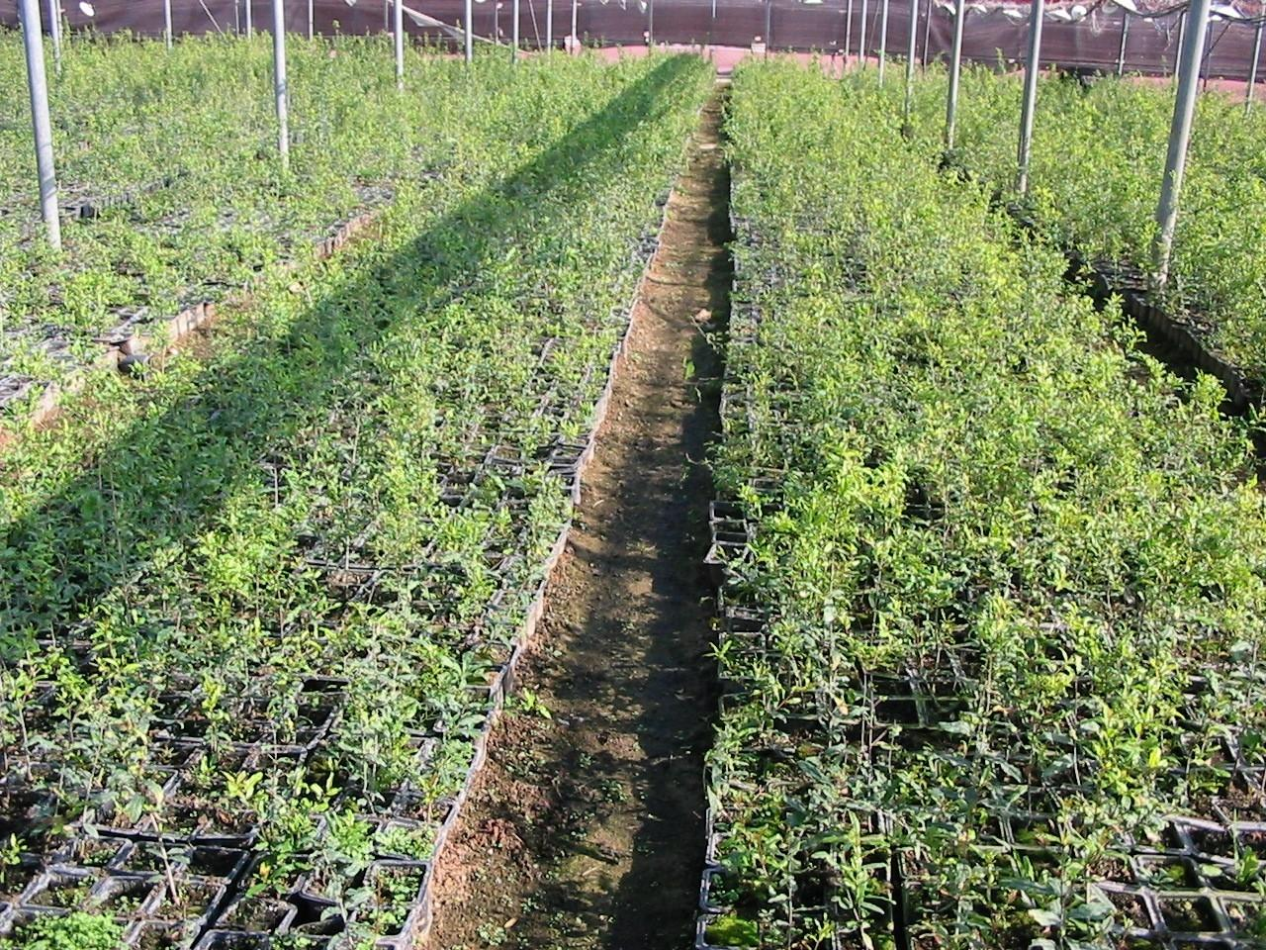
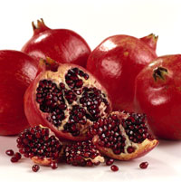
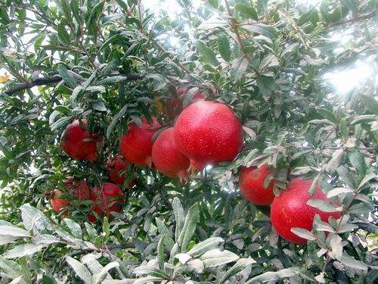
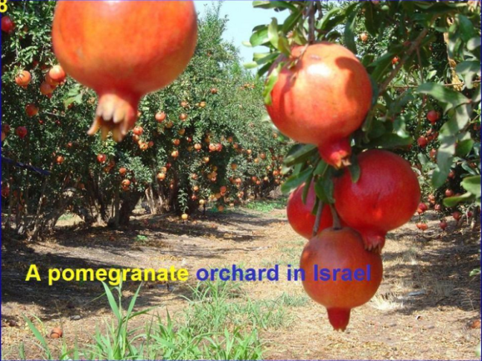
Agriculture
Improved variety of fruit:
Taste, Shape & Quality
Higher yield
20 tones/ acre
Structure of orchard
Enable easy manual harvest
Mechanized fruit-picking in future
M.D POM DEVELOPED A NEW & UNIQUE VARIETY OF FRUIT, FIT FOR INTERNATIONAL EXPORTS STANDARTS.

Slide 14
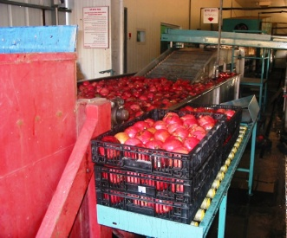
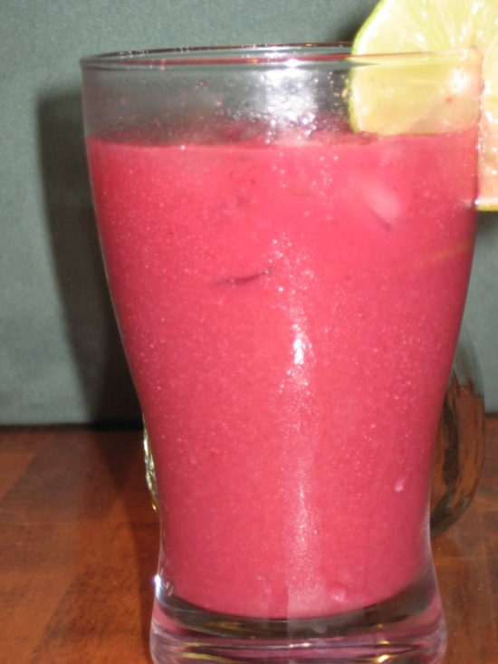
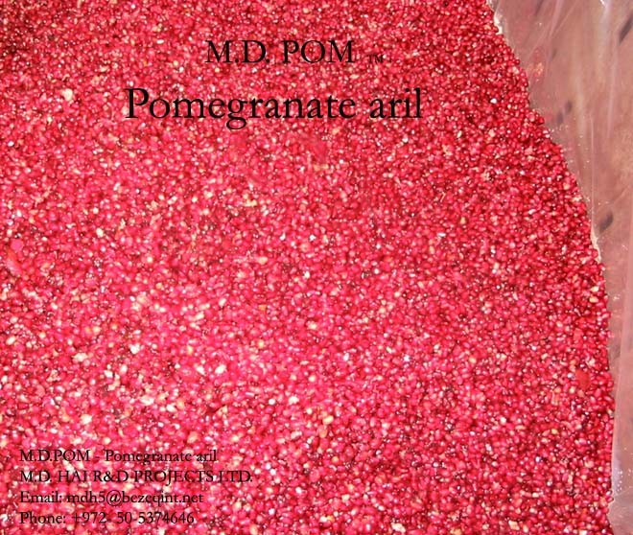

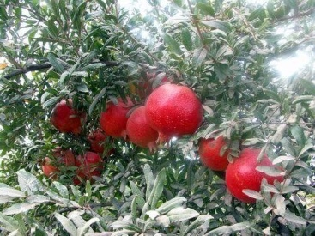


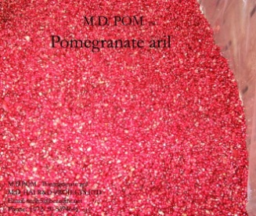
Production:
.
Agriculture
0% waste of fruit
No manual interference needed
High Capacity
Technology replaces preservatives
Cost effective upgrading of capacity
Various Products:
Aril, Juice, Seeds, Peal
Raw materials for various industries
Technology
Improved variety
High yield

Slide 15
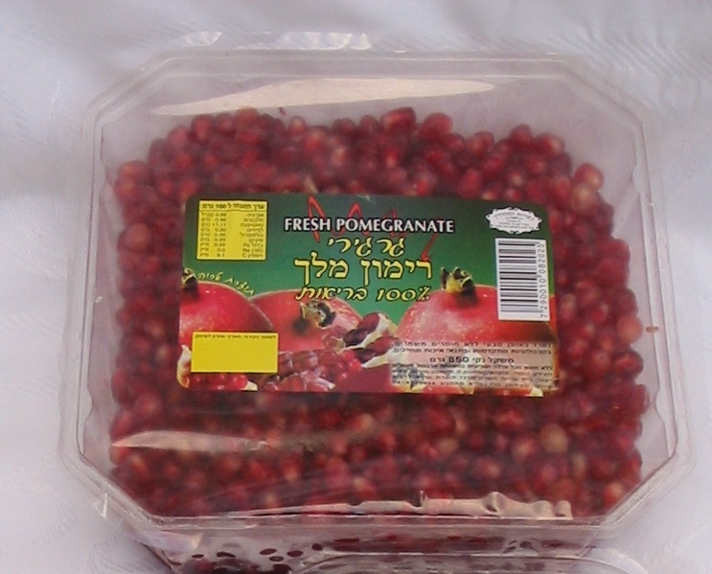

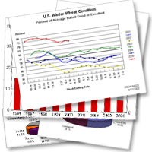
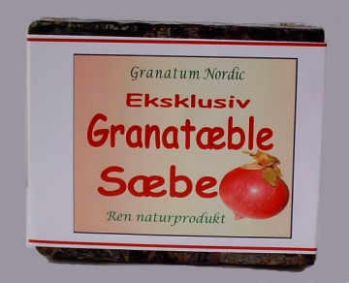
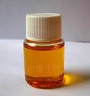
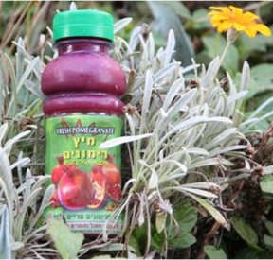
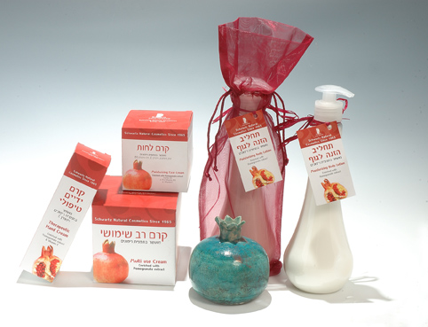

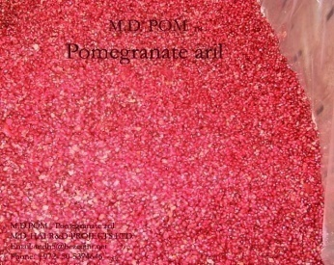
Market
Agriculture
Production
Market
Packing technology for longer shelve life (21 days!)
Research and markets studies are the base for development and products designing.
Improved variety
Wide market –
Raw materials & Technical knowledge
Packed juice. Packed arils. Oil. Pharmacology. Health food & products. Cosmetics. Wine. Confiture. Ice cream.
And more…
High yield
Products

Slide 16

Business model of success
Working production line
know-how for end products
Wide Market
Agro-technology
marketing
infrastructure
Investment
JV

Slide 17
From M.D.HAI R&D projects
  With higher yield, R&D facilities and The Latest technology for processing, M.D.HAI R&D projects is giving a whole solutions for pomegranate, making the process easy and cost-effective for different top quality products!

Slide 18


Slide 19
M.D. HAI R&D Projects ltd.
  Thank you

