Slide 1
The supply chain network

Slide 2
Competitive advantage and the ‘Three Cs’
Customers
Needs seeking benefits at acceptable prices
Value
Value
Assets and utilisation
Cost differentials
Assets and utilisation
Company
Competitor
Source: Ohmae, K., The Mind of the Strategist, Penguin Books, 1983

Slide 3
The experience curve
Real costs per unit
Cumulative Volume

Slide 4
Logistics and competitive advantage
High
Value
advantage
Low
Low
High
Cost advantage

Slide 5
Supply chain excellence
High
Relative
Differentiation
Low
High
Low
Relative Delivered Cost

Slide 6
Gaining competitive advantage through logistics
The goal: superior customer value at
less cost
Value Advantage
Logistics Leverage Opportunities:
Tailored service
Reliability
Responsiveness, etc
Cost Advantage
Logistics Leverage Opportunities:
Capacity utilisation
Asset turn
Schedule integration

Slide 7
The value chain
Firm infrastructure
Support
activities
Human resource management
Technology development
Procurement
Margin
Inbound
logistics
Operations
Outbound
logistics
Marketing & sales
Services
Primary activities
Source: Reprinted with the permission of The Free Press, a division of Simon & Schuster, Inc. from Competitive Advantage by Porter, M.E. Copyright © 1985 by Porter, M. E. All Rights reserved

Slide 8
Logistics management process
Materials flow
Suppliers
Procurement
Operations
Distribution
Customers
Requirements information flow

Slide 9
Achieving an integrated supply chain
Stage One: Baseline
Material
flow
Customer
service
Purchasing
Material
Control
Production
Sales
Distribution
Stage Two: Functional Integration
Material
flow
Customer
service
Materials
Management
Manufacturing
Management
Distribution
Stage Three: Internal Integration
Material
flow
Customer
service
Materials
Management
Manufacturing
Management
Distribution
Stage Four: External Integration
Material
flow
Customer
service
Suppliers
Internal Supply
Chain
Customers

Slide 10
Investing in process excellence yields greater benefits
100
Product excellence (%)
Revised emphasis
Current emphasis
100
Process excellence (%)

Slide 11
Demand and supply uncertainty
High
Demand uncertainty
Low
Low
High
Supply uncertainty

Slide 12
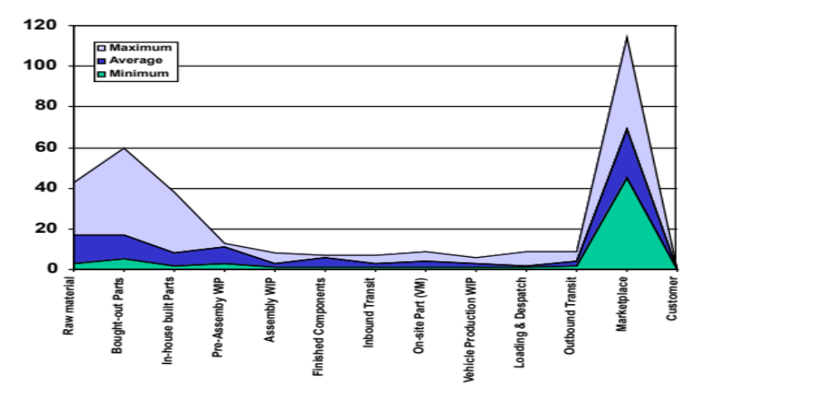
Inventory profile of the automotive supply chain
(UK 1999 Figures, Volume Car Stock Levels
First Tier
Supplier
Inbound
Logistics
Vehicle
Manufacturers
Outbound
Logistics
Distribution
& Retail
Days of Inventory
Source: Holweg, M. and Pil, F.K., The Second Century, MIT Press, 2004

Slide 13
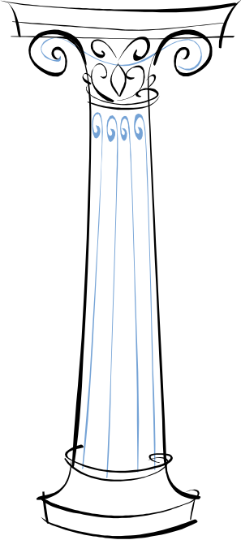
The four pillars of supply chain excellence
Supply Chain
Excellence
Responsiveness
Reliability
Resilience
Relationships

Slide 14
Managing the ‘4Rs’
Responsiveness : Time-based competition is now the norm. The focus is on agility.
Reliability : Unreliable processes create uncertainty and variability. Equally, lack of visibility adds to uncertainty.
Resilience : Today’s turbulent and volatile markets require supply chains that are capable of dealing with the unexpected and the unplanned.
Relationships : As supply chains become more complex and as out-sourcing increases dependency on suppliers, the need for relationship management increases.

