Slide 1

Arts Integration
Lynne Cassidy
Carbondale Community School

Slide 2

What is Arts Integration?
Arts integration is an approach to teaching and learning
through which content standards are taught and assessed equitably
in and through the arts.
It is a strategy used to support learning objectives.

Slide 3
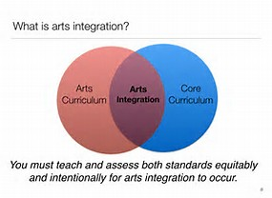
Art is being taught with the content area simultaneously.

Slide 4
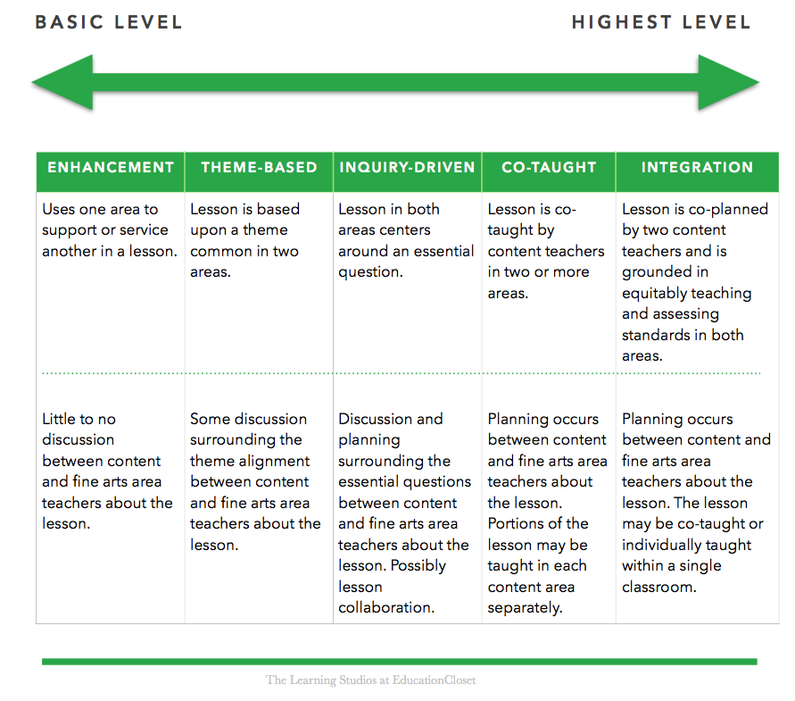
How does Ai work?

Slide 5
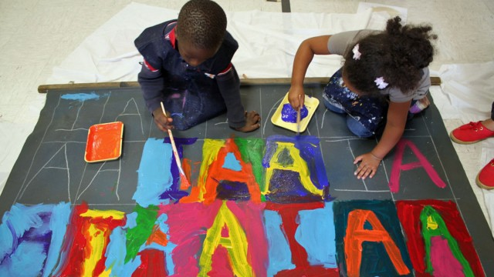
Why arts integration?
Arts Integration: Deepening Understanding of Core Content
https://youtu.be/IUsWCdu9Q_Q
Notes:
HANDOUTS: LC TOOLKIT, ARTFUL THINKING ROUTINES,

Slide 6
WHY arts integration?
The research shows that arts integration….
  Motivates students to engage more fully with their learning.
  Supports interdisciplinary curricula + project-based learning
  Cultivates systems thinking
  Offers differentiated instruction
  Challenges students academically
  Extends how learners process and retain information because it combines several learning modalities and thus reach a wider range of students. (Daniel R. Scheinfeld (2004)3
  Shown to improve long-term memory. (Rinne, Gregory, Yarmolinskaya, & Hardiman, 2011).
  Builds collaborative relationship between teachers.
Notes:
Motivates students to engage more fully with the related subject area.
Extends how learners process and retain information because it combines several learning modalities and thus reach a wider range of students.
(Daniel R. Scheinfeld (2004)3
Arts integration has been shown to improve long-term memory.
(Rinne, Gregory, Yarmolinskaya, & Hardiman, 2011).
Teachers benefit by building community + collaborative relationships, willing to experiment, innovate and take risks.
Cultivates systems thinking – Students recognize the interconnected networks, relationships and patterns that are present in the real world.
Interdisciplinary curricula - Provides faculty the opportunity to work together (cross disciplinary) to cultivate an integrated approach towards developing student learning opportunities.
Project-based learning
Differentiated instruction
Academically challenging

Slide 7
How can I fit this in?
Ask yourself:
What are the BIG CONCEPTS that are challenging for your students?
  Can Ai help my students connect to one of these concepts?
Are there interdisciplinary learning opportunities that naturally align with art and academic content standards?
Who can I work with to create an integrated lesson that teaches and assesses these standards equitably?
  Create only one or two Ai lessons for the entire year.
Take 5-10 minutes to talk with your teaching partner about
how you could fit Ai into your school year?

Slide 8




How do Ai strategies work?
Use as a starting point.
  Strategies are avenues into the arts; not full on Ai.
Easy to implement, immediate success and FUN!
Focus on the process of application, not the product.
  Kids will remember the process.
Notes:
HANDOUTS + REVIEW/DISCUSSION TIME

Slide 9
STRATEGIES FOR THE CLASSROOM
➔
➔
➔
➔
Visual Arts
VTS-See, Think Wonder
i(Notice)³
Theater
Tableau
Actor Toolbox
Music
Write a song
Sing a word
Dance
Mirroring
Sound-motion
Notes:
HANDOUTS: LC TOOLKIT, ARTFUL THINKING ROUTINES,

Slide 10
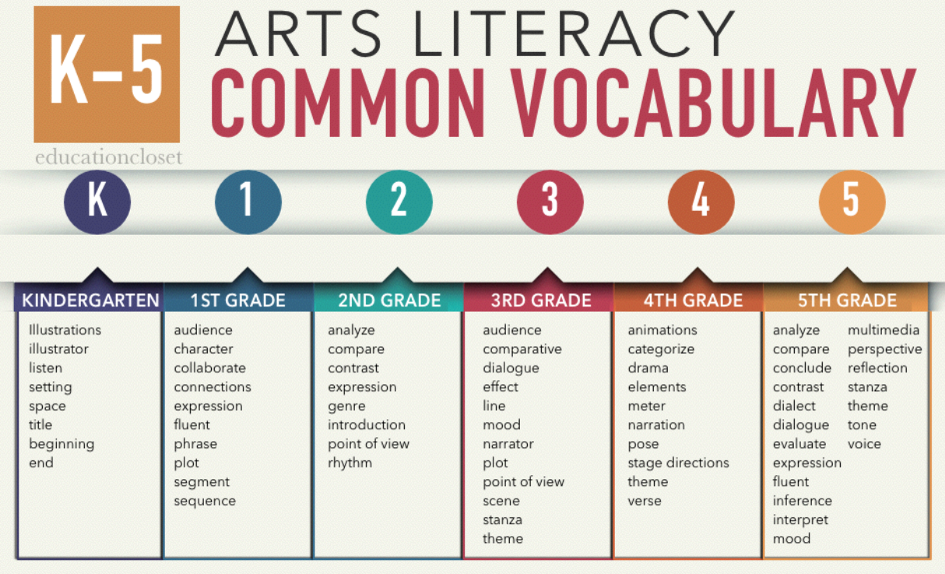
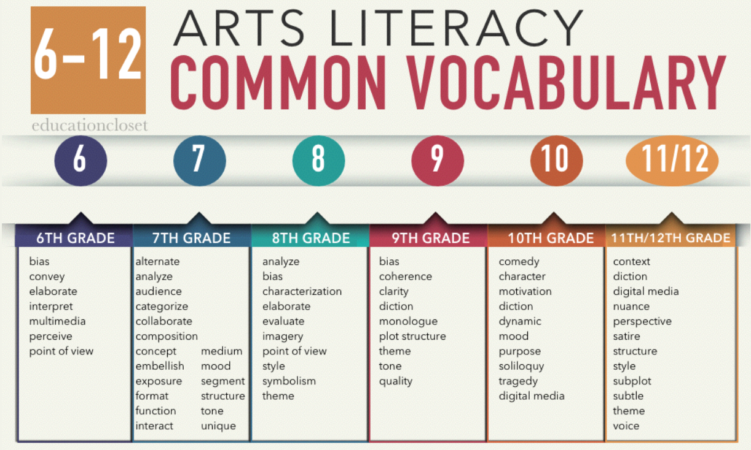
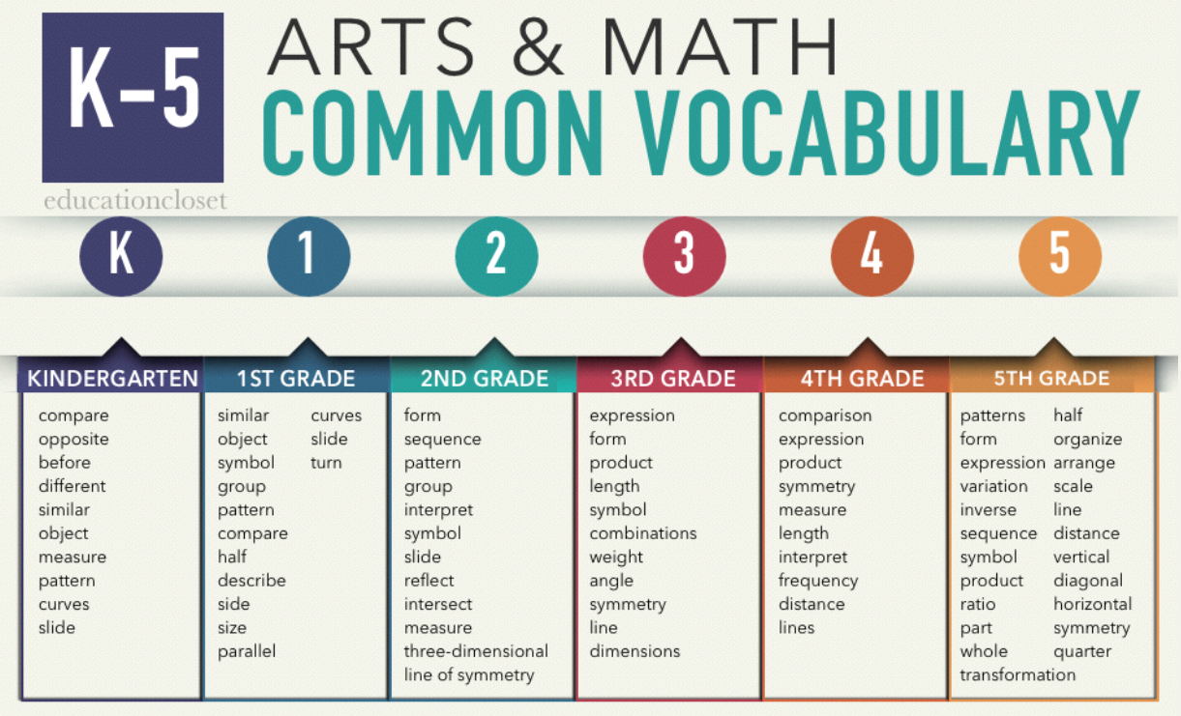
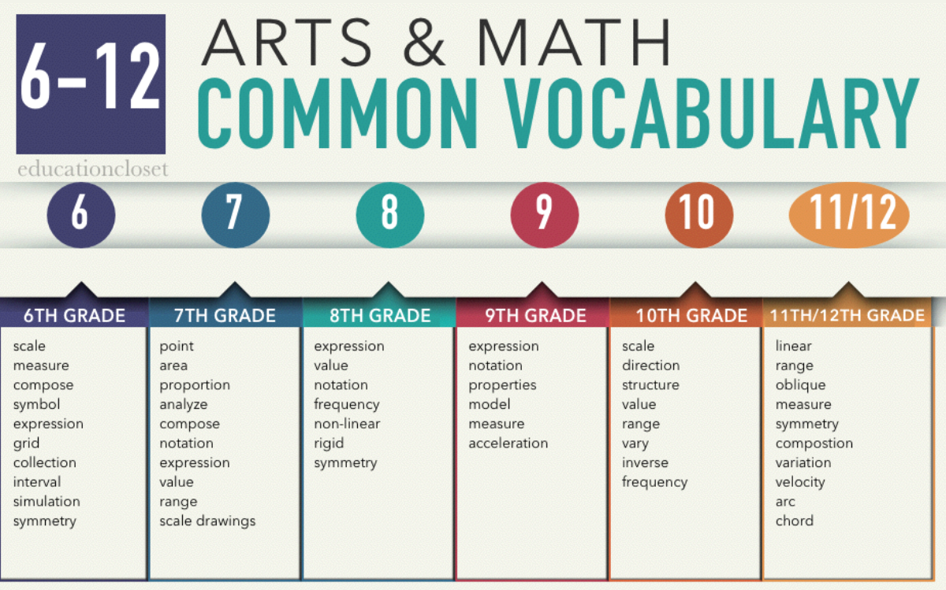
How to choose a strategy
You can use common vocab to help you choose the appropriate skill and strategy.

Slide 11
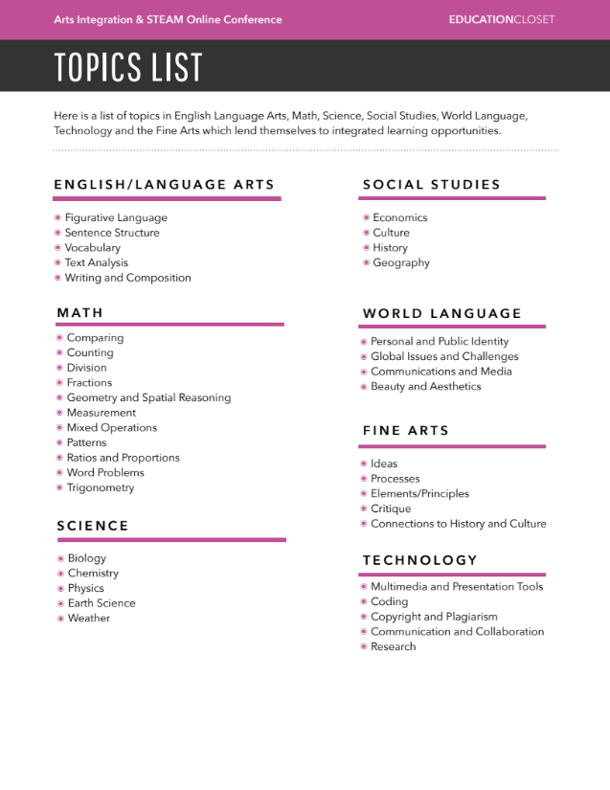

How to choose a strategy
Think about:
Do you have a lesson that you would want
to redesign.
Do you want to create a brand new lesson?
Who would you collaborate with to create
an Ai lesson?

Slide 12

Designing an Ai lesson
Notes:
Handouts

Slide 13
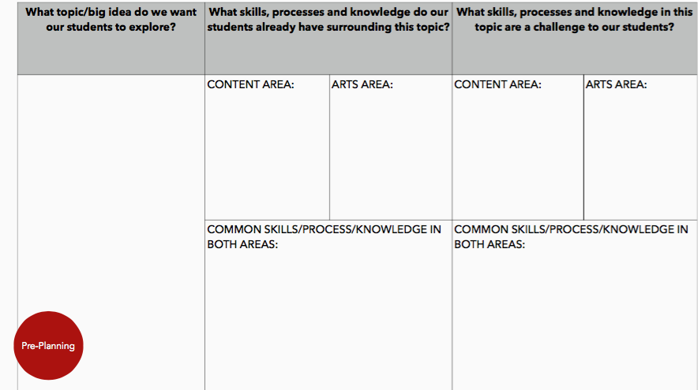
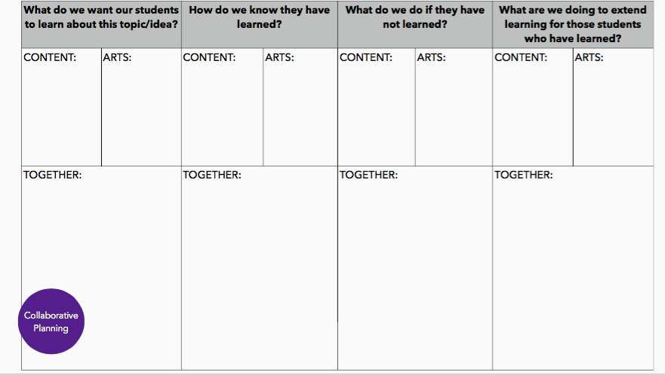
Start with Collaboration
Who are you going to work with?
Together brainstorm topic/big idea to explore.
What skills/concepts will students to learn?
Align 1-2 standards from both content areas.

Slide 14
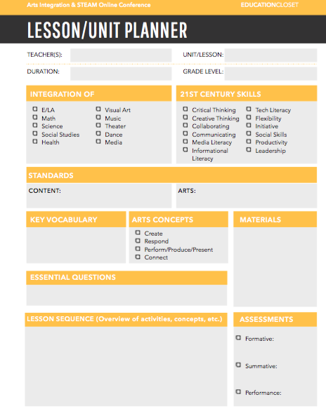
Writing the Plan
Understand concepts and skills you want to teach.
  Highlight common vocabulary
  Essential question aligns with both content + art area
Pick out standards and write standards side-by-side.
  Know where you are going.
Identify how you will assess BOTH standards equally.
  Assessments should align with your standards.
  Create the structure for your project by designing your assessment before picking your project.
Create your lesson sequence.

Slide 15
Time for Assessment
Diagnostic – Used to identify current knowledge.
  Pre & post assessments for learning.
Formative – Used to provide feedback during instructional process
  Viewing growth over time. Assessment for learning.
Summative – Used to sum up learning at the end of the instructional process.
  Assessing mastery and performance levels. Assessment of learning.
Resource: Education Closet, Assessment for Makers Course

Slide 16
Assessment List
Diagnostic
  Pre & Post tests
  Self-assessments
  Entry/Exit tickets
  Interviews
  Observations
  Polling
Formative
  Homework
  Reflection journals/sketchbooks
  Socratic discussions
  S/T conferences
  Peer reviews
  Informal presentations
  Portfolios – on-going
  Think/Pair/Share
  VTS
  Critiques
Summative
  High stakes tests
  Multiple choice
  Checklists
  Portfolio – culmination
  Rubrics
  Tests
  Essays
  Capstone projects
  Gallery show
Resource: Education Closet, Assessment for Makers Course

Slide 17

Reflection + Closing
What next steps are you going to take?
Notes:
What is your take away?
What support do you need to make Ai happen in your classroom?

Slide 18
Resources
Websites:
Education Closet
The Kennedy Center Arts Edge
Edutopia
George Rodrigue Foundation
PD
Education Closet - Online
The Kennedy Center Arts Edge
Think360Arts – Denver
Ai Strategies:
Visual Thinking Strategies
Artful Thinking
Edutopia
Ai + Steam Toolkit (by Education Closet.)

