Slide 1
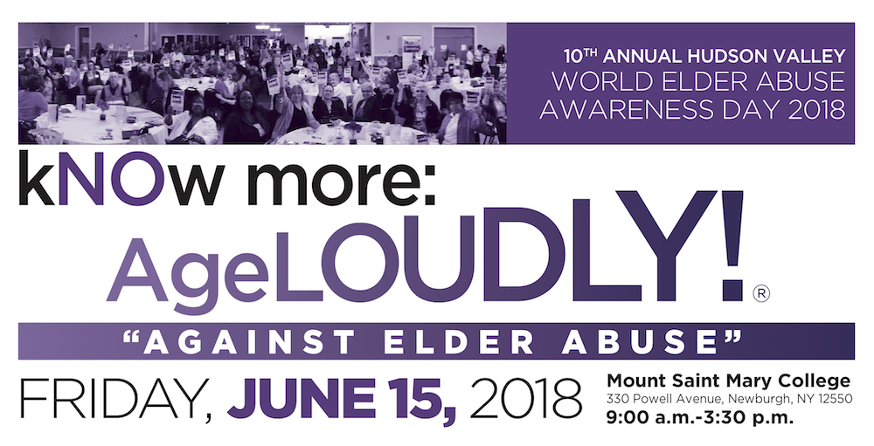
— Keynote —
Philip C. Marshall, Founder
Beyond Brooke
Notes:
Know More: Age loudly

Slide 2



world • elder abuse • awareness • day
—
weaad.org
with
beyondbrooke.org
Notes:
WEAAD —
2006, first coincided with our efforts to save my grandmother
12th year
In 2006 the International Network for Prevention of Elder Abuse (INPEA) designated June 15 as World Elder Abuse Awareness Day (WEAAD) and an increasing number of events are held across the globe on this day to raise awareness of elder abuse, and highlight ways to challenge such abuse.[4]
http://www.inpea.net
weaad.org

Slide 3
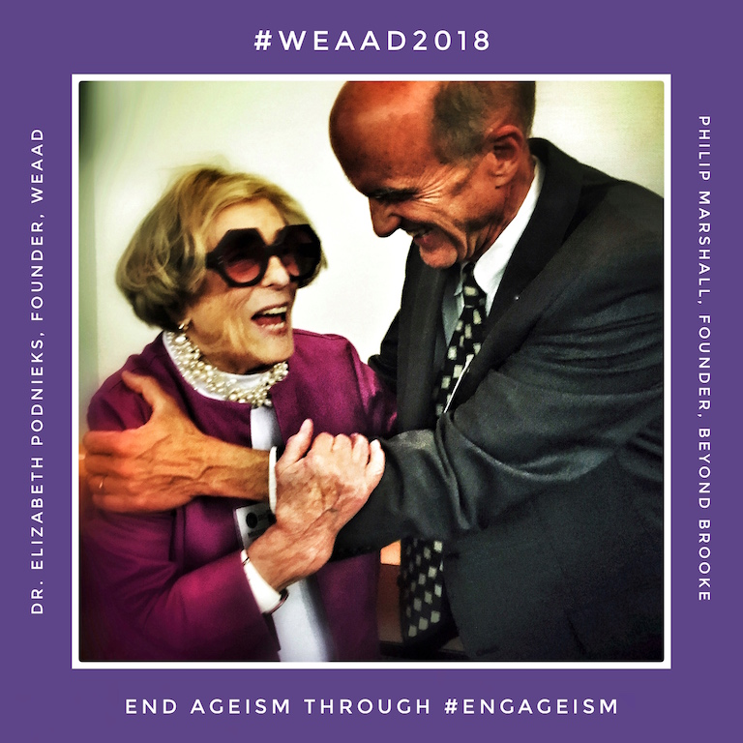
beyondbrooke.org
Notes:
Elizabeth Podneicks
"#Seniors may be 81, or 18. End #ageism through #engAGEism to gain #socialchange”— @philipcmarshall founder #beyondbrooke with #ElizabethPodnieks founder #WEAAD for #WEAADart #elderjustice #WEAAD2018 with @NCEAatUSC

Slide 4
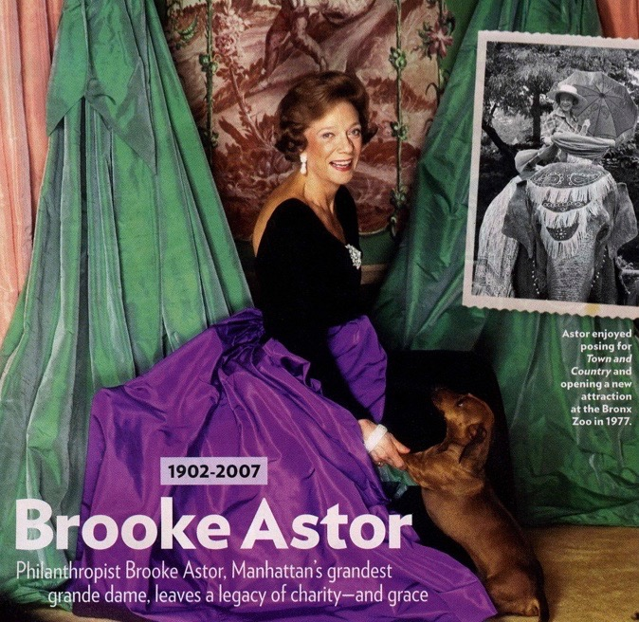
Brooke Astor. People Magazine. August 27, 2007
beyondbrooke.org
Notes:
Brooke Astor, 1902-2007
One of the greatest impediments to elder justice is ageism.
By example, my grandmother did so much to combat proactively this social impediment through the way she took on each day, year after year, decade after decade for forty years—all as a senior—as president of the Vincent Astor Foundation.
It is ironic, and so sad, that my grandmother’s ageless attitude did not protect her from abuse. The same can be said for millions of seniors.

Slide 5
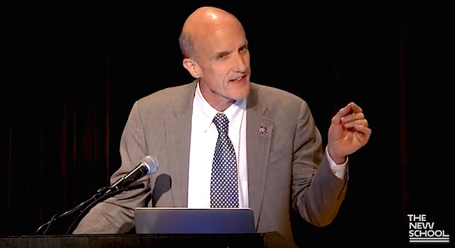
11th Annual NYC Elder Abuse Conference 2016. Philip C. Marshall. Keynote (starts at 24:51 minutes). The New School New York City, NY. June 15
beyondbrooke.org
Notes:
11th Annual NYC Elder Abuse Conference 2016. Philip C. Marshall. Keynote (starts at 24:51 minutes). The New School New York City, NY, June 15
https://www.youtube.com/watch?v=FaRPinxe10g

Slide 6
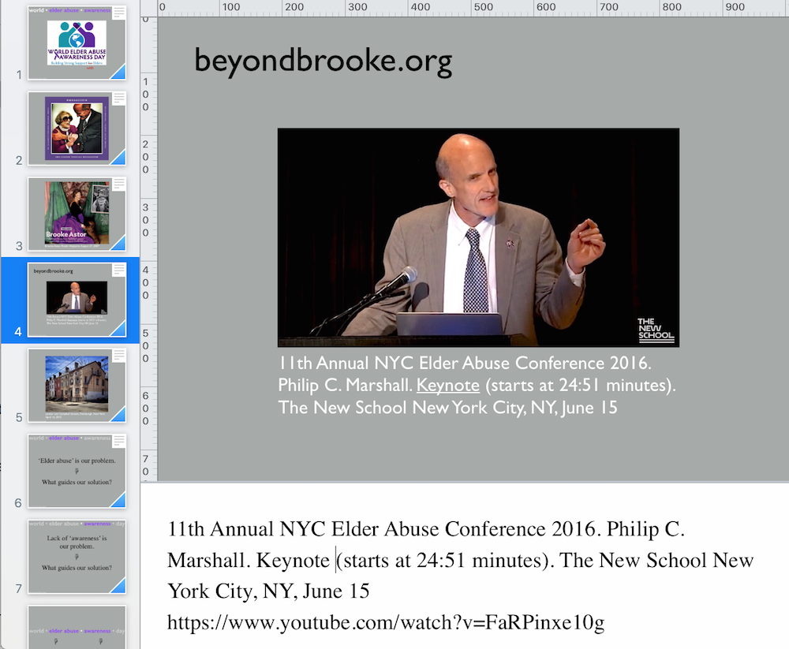
beyondbrooke.org — look for keynote under ‘past.’ The ‘speaker notes’ have many references.
beyondbrooke.org
Notes:
Keynote notes for distribution

Slide 7
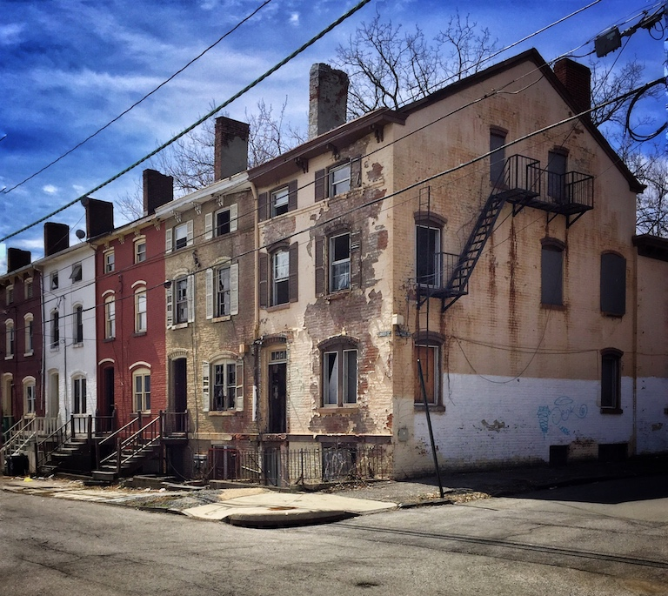
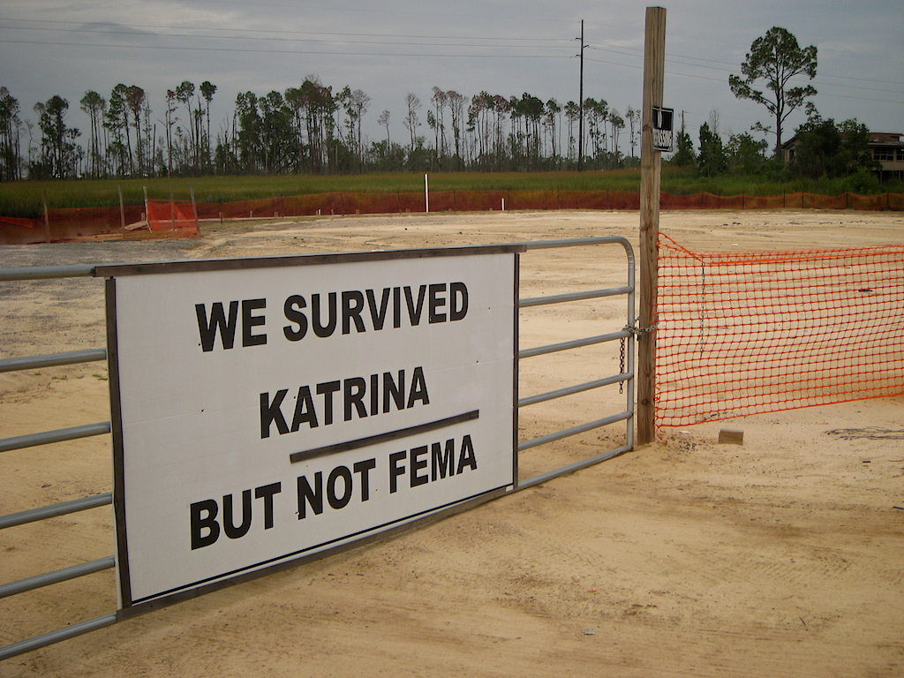
Gulfport, MS, 2008
Lander and Campbell Streets, Newburgh, New York. April 16, 2015
beyondbrooke.org
Notes:
ageless value • multi-disciplinary • community
Preservation and elder-justice > four reasons
Respect and protect the ageless value of that which i sold but may be discounted, sometime until it is too late
Multi-disciplinary approach to a system problem that demands a systems-based solution > seemingly disparate disciplines…including sciences, arts, business, public safety, and the law—knowing: preservation is not just a good idea, it’s the the law, s is elder justice.
Both address community concern and capacity, engaging and empowering those who serve and save seniors
Both must “pre-serve” or serve before…foremost through preventive maintenance, over damage control over the fact which is unacceptable.
Both know, at times interventions make matters worse
____
There are many parallels between my field, historic preservation, and elder justice
Historic preservation started out in response to the damage and destruction of our cultural resources; harm inflicted due to poor policies, practices, disinvestment—and a discount of their ageless value.
Early on preservationists were good at saving sites and structures that were victim to neglect, abandonment, maltreatment, theft, and inappropriate interventions. This work, which continues, is heroic, visible, and visceral.
Yet this work is reactive, not proactive and preventive—nor does it engage all community stakeholders, which we now choose to embrace and embolden.
In the same way, in working with those who are vulnerable and victimized (like older adults) we realize that proactive community concern and capacity are just as important as professional “restoration,” which is damage-control-after-the-fact – and which, for elder justice, does not address the full nature of strengths and vulnerability.
Damage-control, alone, is unacceptable. Older adults (and their circle of support) must be valued, protected, and empowered before abuse occurs, not just after.
We must prevent abuse, more. Our greatest resources and our first line of offense are our communities, coupled with New York State’s existing programs and services that can protect seniors at risk.
Yet, parts of these programs and services, themselves, are, at times, at risk….
Senior services and programs cultivate trust, relationships and awareness among elders, their circle of support, and other professionals. Should abuse occur, they demonstrate community concern and capacity, empowering individuals to come forward and act.
_____

Slide 8

beyondbrooke.org
Notes:
Advocates —
Advocates are our vanguard.
As they bring us, and themselves full circle, becoming whole, even holy.
Advocates, as wounded healers, command our attention – and our salute
_____

Slide 9
world • elder abuse • awareness • day
‘Elder abuse’ is our problem.
☟
What guides our solution?
beyondbrooke.org

Slide 10
world • elder abuse • awareness • day
Lack of ‘awareness’ is
our problem.
☟
What guides our solution?
beyondbrooke.org

Slide 11
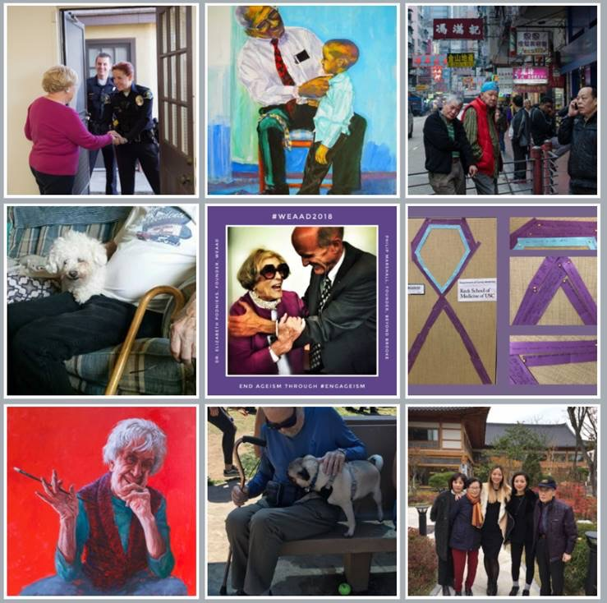

“To understand, prevent, identify or respond to elder abuse, neglect, or exploitation, we need...”
The Road to Elder Justice WEAAD Virtual Art Gallery, National Center on Elder Abuse,
USC Center on Elder Mistreatment. The Elder Justice Roadmap, 2014
upstandership.org
beyondbrooke.org
Notes:
https://eldermistreatment.usc.edu/weaad-home/gallery/
About the Elder Justice Roadmap
“To understand, prevent, identify or respond to elder abuse, neglect, or exploitation, we need...”
In 2014, 750 stakeholders and subject matter experts from around the country created The Elder Justice Roadmap, a national strategic resource that identifies the elder justice field’s most urgent needs in addressing the social issue of elder abuse. Shortly after the Roadmap’s publication, an Elder Justice Roadmap Steering Committee was created to develop and manage strategic partnerships, promote awareness and action, and encourage new programs that respond to the Roadmap’s priorities.
WEAAD Virtual Art Gallery
This World Elder Abuse Awareness Day (WEAAD), the Committee is promoting the Roadmap’s priority of Education in The Road to Elder Justice – WEAAD Virtual Art Gallery. This virtual art gallery invites people to create and submit art that provides an artistic representation of the aging process with one or all of the following themes: equality and justice, respect, empowerment, connections, engagement, community, and happiness. This gallery not only celebrates the Roadmap’s progress, but it also promotes public awareness of how building supportive communities as we age and combatting ageism (cultural biases against aging) can be a tool in preventing and addressing elder abuse. Participants will receive a certificate of appreciation.
_____

Slide 12
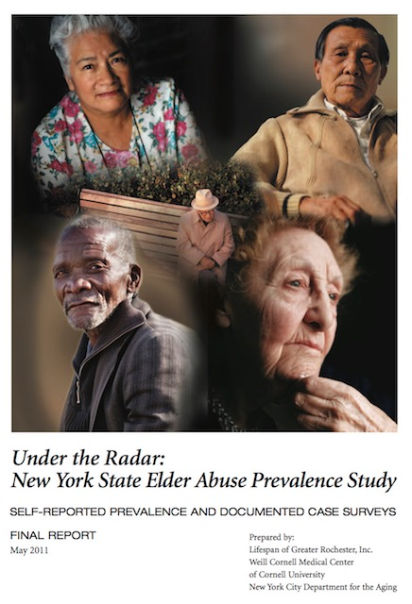
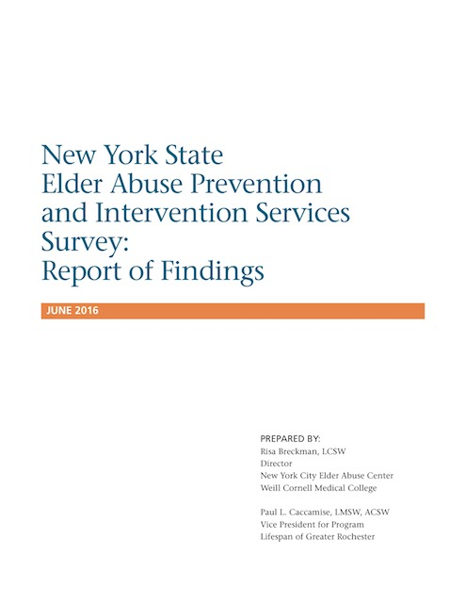
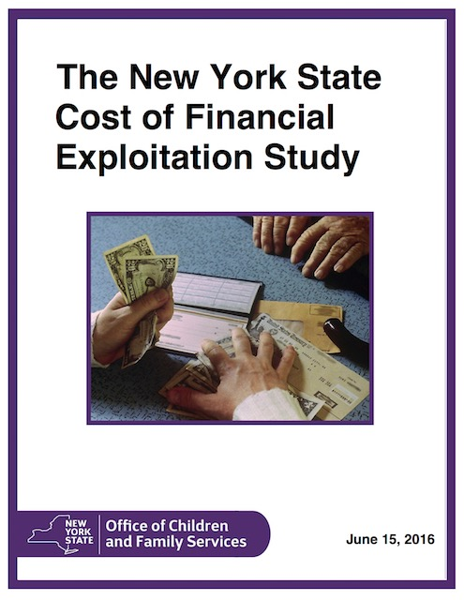
Under the Radar. Lifespan of Greater Rochester, Inc., Weill Cornell Medical Center of Cornell University, New York City Department for the Aging, 2011 ❂ Breckman and Caccamise. New York State Elder Abuse Prevention and Intervention Services Survey: Report of Findings. Lifespan of Greater Rochester Inc. and Weill Cornell Medicine’s NYC Elder Abuse Center, 2016 ❂ Huang and Lawitz. The New York State Cost of Financial Exploitation Study. New York State Office of Children and Family Services, 2016.
upstandership.org
beyondbrooke.org
Notes:
https://ocfs.ny.gov/main/reports/Under%20the%20Radar%2005%2012%2011%20final%20report.pdf
Under the Radar, 2011
Lifespan of Greater Rochester, Inc., Weill Cornell Medical Center of Cornell University, New York City Department for the Aging
_____
New York State Elder Abuse Prevention and Intervention Services Survey: Report of Findings, 2016. Lifespan of Greater Rochester Inc. and Weill Cornell Medicine’s NYC Elder Abuse Center
https://static1.squarespace.com/static/5851b8a715d5db7317addaca/t/591deeed15cf7d3dc13fdad2/1495133935950/FINALNYS+elder+abuse+prevention+intervention+survey+report+findings.pdf
_____
The New York State Cost of Financial Exploitation Study. NYS OCFS, 2016.
New York State Office of Children and Family Services
https://ocfs.ny.gov/main/reports/Cost%20of%20Financial%20Exploitation%20Study%20FINAL%20May%202016.pdf
_____

Slide 13
“The findings of the study point to a dramatic gap between the rate of elder abuse events reported by older New Yorkers and the number of cases referred to and served in the formal elder abuse service system.”
Under the Radar. Lifespan of Greater Rochester, Inc., Weill Cornell Medical Center of Cornell University, New York City Department for the Aging, 2011
upstandership.org
beyondbrooke.org
Notes:
https://ocfs.ny.gov/main/reports/Under%20the%20Radar%2005%2012%2011%20final%20report.pdf
Under the Radar, 2011
The findings of the study point to a dramatic gap between the rate of elder abuse events reported by older New Yorkers and the number of cases referred to and served in the formal elder abuse service system.
New York State Elder Abuse Prevention and Intervention Services Survey: Report of Findings, 2016
https://static1.squarespace.com/static/5851b8a715d5db7317addaca/t/591deeed15cf7d3dc13fdad2/1495133935950/FINALNYS+elder+abuse+prevention+intervention+survey+report+findings.pdf
_____
The New York State Cost of Financial Exploitation Study. NYS OCFS, 2016.
https://ocfs.ny.gov/main/reports/Cost%20of%20Financial%20Exploitation%20Study%20FINAL%20May%202016.pdf

Slide 14
“While many respondents deplored a shortage of elder abuse prevention and intervention services in their counties, other respondents noted that their programs are not currently at capacity.”
Breckman and Caccamise. New York State Elder Abuse Prevention and Intervention Services Survey: Report of Findings. Lifespan of Greater Rochester Inc. and Weill Cornell Medicine’s NYC Elder Abuse Center, 2016
upstandership.org
beyondbrooke.org
Notes:
Breckman and Caccamise. New York State Elder Abuse Prevention and Intervention Services Survey: Report of Findings. Lifespan of Greater Rochester Inc. and Weill Cornell Medicine’s NYC Elder Abuse Center, 2016
https://static1.squarespace.com/static/5851b8a715d5db7317addaca/t/591deeed15cf7d3dc13fdad2/1495133935950/FINALNYS+elder+abuse+prevention+intervention+survey+report+findings.pdf
_____

Slide 15

world • elder abuse • awareness • day
☟ ☟
Elder ecology™ ❂ Upstandership™
beyondbrooke.org
Notes:
What gets us from…
elder abuse > elder ecology
awareness > upstandership >

Slide 16
world • elder abuse • awareness • day
Elder abuse is, “a single, or repeated act, or lack of appropriate action, occurring within any relationship where there is an expectation of trust which causes harm or distress to an older person”
    — United Nations, World Health Organization
beyondbrooke.org
Notes:
Elder abuse occurs in a relationship where there is an expectation of trust
_____
United Nations and the World Health Organization define elder abuse as, “a single, or repeated act, or lack of appropriate action, occurring within any relationship where there is an expectation of trust which causes harm or distress to an older person”
http://www.un.org/en/events/elderabuse/background.shtml
http://www.who.int/ageing/projects/elder_abuse/en/
_____

Slide 17
world • elder abuse • awareness • day
(Elder) abuse is the betrayal
of trust.
beyondbrooke.org
Notes:
betrayal of trust

Slide 18
world • elder abuse • awareness • day
(Elder) justice is the provision
of trust, realized through our… relationships and responsibility
☟ ☟
Elder ecology™ ❂ Upstandership™
☟ ☟
Elder ecology™ ❂ Upstandership™
beyondbrooke.org
Notes:
ee > ground of our community relationships
up > articulated
expression
seven other vital steps
here…relationships are developed in the context of our communities…and ourselves—through ‘elder ecology’
here…our moral and legal obligations and of society and self and our personal agency—through ‘upstandership’
Trust, through
relationships and responsibility
elder ecology • upstandership
relationships >
anti-social > abusive
pro-social > transactional, transformational
_____
Skin in the Game
https://www.amazon.com/Skin-Game-Hidden-Asymmetries-Daily-ebook/dp/B075HYVP7C/ref=sr_1_1?ie=UTF8&qid=1529325556&sr=8-1&keywords=skin+in+the+game+taleb
“* To figure out why ethics, moral obligations, and skills cannot be easily separable in real life, consider the following. When you tell someone in a position of responsibility, say your bookkeeper, “I trust you,” do you mean that 1) you trust his ethics (he will not divert money to Panama), 2) you trust his accounting precision, or 3) both? The entire point of the book is that in the real world it is hard to disentangle ethics on one hand from knowledge and competence on the other.”
senior discount • elder abuse

Slide 19
world • elder abuse • awareness • day
world • elder abuse • awareness • day
—
with
beyondbrooke.org
The term ‘elder abuse’
re-victimizes elders,
again—through
guilt by association.
world • elder abuse • awareness
Notes:
WEAAD

Slide 20
world • elder abuse • awareness • day
Language shapes the way we think, and determines what we can think about.
— Benjamin Lee Whorf
beyondbrooke.org
Notes:
https://en.wikipedia.org/wiki/Benjamin_Lee_Whorf
Benjamin Lee Whorf (/wɔːrf/; April 24, 1897 – July 26, 1941) was an American linguist and fire prevention engineer.[1] Whorf is widely known as an advocate for the idea that differences between the structures of different languages shape how their speakers perceive and conceptualize the world. This principle has frequently been called the "Sapir–Whorf hypothesis", after him and his mentor Edward Sapir, but Whorf called it the principle of linguistic relativity, because he saw the idea as having implications similar to Einstein's principle of physical relativity.[2]
Throughout his life Whorf was a chemical engineer by profession, but as a young man he took up an interest in linguistics. At first this interest drew him to the study of Biblical Hebrew, but he quickly went on to study the indigenous languages of Mesoamerica on his own. Professional scholars were impressed by his work and in 1930 he received a grant to study the Nahuatl language in Mexico; on his return home he presented several influential papers on the language at linguistics conferences.
This led him to begin studying linguistics with Edward Sapir at Yale University while still maintaining his day job at the Hartford Fire Insurance Company. During his time at Yale he worked on the description of the Hopi language, and the historical linguistics of the Uto-Aztecan languages, publishing many influential papers in professional journals. He was chosen as the substitute for Sapir during his medical leave in 1938. Whorf taught his seminar on "Problems of American Indian Linguistics". In addition to his well-known work on linguistic relativity, he wrote a grammar sketch of Hopi and studies of Nahuatl dialects, proposed a deciphering of Maya hieroglyphic writing, and published the first attempt towards a reconstruction of Uto-Aztecan.
After his death from cancer in 1941 his manuscripts were curated by his linguist friends who also worked to spread the influence of Whorf's ideas on the relation between language, culture and cognition. Many of his works were published posthumously in the first decades after his death. In the 1960s Whorf's views fell out of favor and he became the subject of harsh criticisms by scholars who considered language structure to primarily reflect cognitive universals rather than cultural differences. Critics argued that Whorf's ideas were untestable and poorly formulated and that they were based on badly analyzed or misunderstood data.
In the late 20th century, interest in Whorf's ideas experienced a resurgence, and a new generation of scholars began reading Whorf's works, arguing that previous critiques had only engaged superficially with Whorf's actual ideas, or had attributed to him ideas he had never expressed. The field of linguistic relativity studies remains an active focus of research in psycholinguistics and linguistic anthropology, and continues to generate debate and controversy between proponents of relativism and proponents of universalism. By comparison, Whorf's other work in linguistics, the development of such concepts as the allophone and the cryptotype, and the formulation of "Whorf's law" in Uto-Aztecan historical linguistics, have met with broad acceptance.
__
Early interest in religion and language[edit]
Whorf was a spiritual man throughout his lifetime although what religion he followed has been the subject of debate. As a young man he produced a manuscript titled "Why I have discarded evolution", causing some scholars to describe him as a devout Methodist Episcopalian, who was impressed with fundamentalism, and perhaps supportive of creationism.[7] However, throughout his life Whorf's main religious interest was theosophy, a nonsectarian organization based on Buddhist and Hindu teachings that promotes the view of the world as an interconnected whole and the unity and brotherhood of humankind "without distinction of race, creed, sex, caste or color".[8] Some scholars have argued that the conflict between spiritual and scientific inclinations has been a driving force in Whorf's intellectual development, particularly in the attraction by ideas of linguistic relativity.[9] Some of Whorf's unpublished manuscripts on spirituality also suggest that he was influenced by the ideas of Helena Blavatsky the founder of the Theosophical Society who wrote about cosmic evolution, a belief that regards reincarnation to be the source of evolution of human races towards continuously higher forms.[10][11] Whorf said that "of all groups of people with whom I have come in contact, Theosophical people seem the most capable of becoming excited about ideas—new ideas.”[12]
Around 1924 Whorf first became interested in linguistics. Originally he analyzed Biblical texts, seeking to uncover hidden layers of meaning.[13] Inspired by the esoteric work La langue hebraïque restituée by Antoine Fabre d'Olivet, he began a semantic and grammatical analysis of Biblical Hebrew. Whorf's early manuscripts on Hebrew and Maya have been described as exhibiting a considerable degree of mysticism, as he sought to uncover esoteric meanings of glyphs and letters.[10]
_____

Slide 21
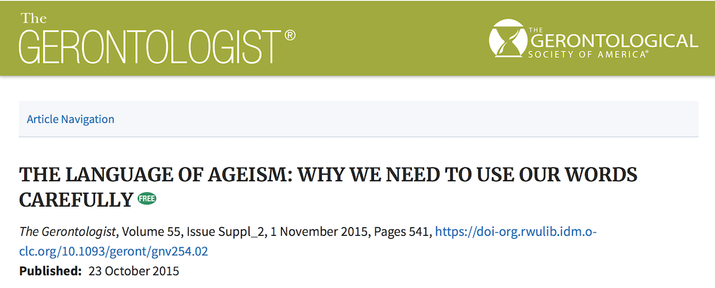
world • elder abuse • awareness • day
Gendron TL, Welleford EA, Inker J, White JT. The Language of Ageism: Why We Need to Use Words Carefully. Gerontologist. 2016 Dec; 56(6):997-1006.
beyondbrooke.org
Notes:
We need to come to terms with terminology…and the language we use everyday as they inform our attitude, actions and their effect
professional, personal
https://www.ncbi.nlm.nih.gov/pubmed/26185154
https://doi-org.rwulib.idm.oclc.org/10.1093/geront/gnv254.02
review
Gendron TL, Welleford EA, Inker J, White JT. The Language of Ageism: Why We Need to Use Words Carefully. Gerontologist. 2016 Dec;56(6):997-1006.
THE LANGUAGE OF AGEISM: WHY WE NEED TO USE OUR WORDS CAREFULLY
T. Gendron, E. Welleford, J. Inker, J. White, Virginia Commonwealth University, Richmond, Virginia
Ageism can be perpetuated through the common use of certain words and phrases that normalize age-based prejudice by turning discriminatory sentiments into culturally accepted, everyday discourse. Therefore it is essential to closely examine the patterns of discriminatory linguistic encoding in regards to age-based language. This presentation will describe a qualitative study of a twitter assignment for 236 students participating in a senior mentoring program. Three hundred and fifty four tweets were qualitatively analyzed to explore language-based age discrimination using a grounded theory approach. Twelve percent of the tweets (n = 43) were found to contain discriminatory language. Thematic analysis of the biased tweets identified eight themes: assumptions and judgments, older people as different, uncharacteristic characteristics, old as negative, young as positive, infantilization, internalized ageism and internalized microaggression. The language of ageism is rooted in both explicit actions as well as the expression of implicit attitudes which make it highly complex and difficult to identify.
© The Author 2015. Published by Oxford University Press on behalf of The Gerontological Society of America. All rights reserved. For permissions, please e-mail: journals.permissions@oup.com
_____
Language shapes our worldview and actions
Benjamin Lee Whorf
Discrimination, segregation – other (v. I- Thou, Buber), stigmazation(?)
The Language of Ageism: Why We Need to Use Words Carefully
The Gerontologist (2016) 56 (6): 997-1006 first published online July 16, 2015
http://gerontologist.oxfordjournals.org/content/56/6/997.full.pdf+html
https://academic-oup-com.rwulib.idm.oclc.org/gerontologist/article/55/Suppl_2/541/2488339/THE-LANGUAGE-OF-AGEISM-WHY-WE-NEED-TO-USE-OUR
World Health Organization
http://www.who.int/ageing/publications/Discussing_Elder_Abuseweb.pdf
The uses of the term “screening” are one expression of the differences between professions, each with their corresponding language or “jargon”, compounding the difficulty in determining where elder abuse belongs. Through the medicalization of terms, the hierarchical nature of health care becomes apparent; that is, the medical model used in public health is more dominant and more powerful than others. In order to advance interdisciplinary cooperation in line with the ecological model, communication and language are key elements that need to be clarified so that all the professionals involved understand what is at stake and can work together towards solutions.
_____

Slide 22
world • elder abuse • awareness • day
“elder i abuse”
“
❂
beyondbrooke.org
Notes:
The term ‘elder abuse’ re-victimizes elders, again—through
guilt by association.
Implicit bias (also known as implicit social cognition), unconscious (subliminal?)
senior discount
elder abuse
“Trim a life to fit the frame”— James Hillman

Slide 23
world • elder abuse • awareness • day
elder i abuser
❂
beyondbrooke.org
Notes:
elder • abuser

Slide 24
(Elder) justice is the provision
of trust, realized through our… relationships and responsibility
☟ ☟
Elder ecology™ ❂ Upstandership™
elderecology.org
beyondbrooke.org
Notes:
Elder Ecology

Slide 25



elder ec logy
micro-
meso-
exo-
macro-
Bronfenbrenner, Uri.
Ecological Model of Human Development
chrono-systems
elderecology.org
beyondbrooke.org
Notes:
‘Elder ecology’ applies an adaptation of the ecological systems theory of Urie Bronfenbrenner now advanced by Karl Pillemer, Cornell gerontologist and professor of human development.
First used for children, the theory has application for all ages – and, here, seniors – as we seek to realize social justice.
_____
Urie Bronfenbrenner… Ecological systems theory, also called development in context or human ecology theory, identifies five environmental systems with which an individual interacts. The person's own biology may be considered part of the microsystem; thus the theory has recently sometimes been called "Bio-Ecological Systems Theory.”
“Furthermore, an ecological approach to the study of human development requires a reorientation of the conventional view of the proper relation between science and public policy.
The traditional position, at least among social scientists, is that whenever possible social policy should be based on scientific knowledge. The line of thought I develop in this volume leads to a contrary thesis: in the interests of advancing fundamental research on human development, basic science needs public policy even more than public policy needs basic science. Moreover, what is required is not merely a complementary relation between these two domains but their functional integration.” (Brofenbrenner p.8) — reciprocal relation science and policy
In the context of Bronfenbrenner's ecological systems theory, this “requires a reorientation of the conventional view of the proper relation between science and public policy.” He notes that, “The traditional position, at least among social scientists, is that whenever possible social policy should be based on scientific knowledge.” What he counters is that, “basic science needs public policy even more than public policy needs basic science” with a “functional integration.” (Bronfenbrenner, date, p.8)
Specifically, five levels of environment--microsystem, mesosystem, exosystem, macrosystem, and chronosystem--will be utilized to organize and interpret existing research on the risk factors associated with elder abuse (Bronfenbrenner, 1979, 1986, 1997).
P. 42, “Some also suggest that research examining victims is less likely to be funded than other research. The fact that funding is restricted for white-collar crime research, victimology research, and family violence research stacks the cards against research examining elder abuse crime victims. The lack of funding initiatives for research examining senior citizens issues in criminal justice granting agencies compounds the problem even more.”
— Pp. 38, “Describing the way that political issues actually become issues is not an exact science. Rather, a certain amount of speculation is needed. Nonetheless, Cobb and Elder (1983) developed an agenda building framework that outlines the way that issues change, broaden, and become significant to the general public. According to Cobb and Elder, this model includes four levels: issue creation, issue awareness, agenda entrance, and issue resolution (see Figure 1). Applying this model to elder abuse helps demonstrate the way that history has affected the way that behavioral scientists have examined this area.”
_____
Bronfenbrenner, U. (1979). The ecology of human development. Cambridge, MA: Harvard University Press.
Deborah Norris PhD , Pamela Fancey MA , Erin Power MPA & Pamela Ross MA (2013) The Critical-Ecological Framework: Advancing Knowledge, Practice, and Policy on Older Adult Abuse, Journal of Elder Abuse & Neglect, 25:1, 40-55 [Critical ecological model]
Karl Pillemer, Director, Cornell Bronfenbrenner Center for Translational Research, College of Human Ecology, Cornell University, http://www.bctr.cornell.edu
_____
Urie Bronfenbrenner…
Ecological systems theory, also called development in context or human ecology theory, identifies five environmental systems with which an individual interacts. The person's own biology may be considered part of the microsystem; thus the theory has recently sometimes been called "Bio-Ecological Systems Theory.”
“Furthermore, an ecological approach to the study of human development requires a reorientation of the conventional view of the proper relation between science and public policy. The traditional position, at least among social scientists, is that whenever possible social policy should be based on scientific knowledge. The line of thought I develop in this volume leads to a contrary thesis: in the interests of advancing fundamental research on human development, basic science needs public policy even more than public policy needs basic science. Moreover, what is required is not merely a complementary relation between these two domains but their functional integration.” (Brofenbrenner p.8) — reciprocal relation science and policy
In the context of Bronfenbrenner's ecological systems theory, this “requires a reorientation of the conventional view of the proper relation between science and public policy.” He notes that, “The traditional position, at least among social scientists, is that whenever possible social policy should be based on scientific knowledge.” What he counters is that, “basic science needs public policy even more than public policy needs basic science” with a “functional integration.” (Bronfenbrenner, date, p.8)
Specifically, five levels of environment--microsystem, mesosystem, exosystem, macrosystem, and chronosystem--will be utilized to organize and interpret existing research on the risk factors associated with elder abuse (Bronfenbrenner, 1979, 1986, 1997).
____
Greg O'Neill
Managing Editor, Public Policy & Aging Report
— P. 42, “Some also suggest that research examining victims is less likely to be funded than other research. The fact that funding is restricted for white-collar crime research, victimology research, and family violence research stacks the cards against research examining elder abuse crime victims. The lack of funding initiatives for research examining senior citizens issues in criminal justice granting agencies compounds the problem even more.”
— Pp. 38, “Describing the way that political issues actually become issues is not an exact science. Rather, a certain amount of speculation is needed. Nonetheless, Cobb and Elder (1983) developed an agenda building framework that outlines the way that issues change, broaden, and become significant to the general public.
According to Cobb and Elder, this model includes four levels:
issue creation,
issue awareness,
agenda entrance, and
issue resolution (see Figure 1).
Applying this model to elder abuse helps demonstrate the way that history has affected the way that behavioral scientists have examined this area.”
_____
Ecology (and guardianship)
I wish to discuss ecology, the “study of home.”
In 2013, Norris and co-writers at Mount Saint Vincent in Nova Scotia, address the concepts of “ecological theory” and “critical theory.”
Ecological theory considers reciprocal exchanges to maintain equilibrium in a system—and in relationships. In this arena, your work with persons under guardianship provides us with an opportunity to reframe the ecology of elder justice.
Relationships are also informed by our understanding of power relations, as described by critical theory. As guardians, you have so much to bring to the table when we discuss such relationships.
While many people who address family abuse consider control and power in a pathological context, your effort as guardians help frame our work with elders in a considerate, constructive context, which is so needed and can be so transformative.
Abuse is the, “…violent manifestation of unequal power relations.” (Norris, 2013)
Through you, guardianships allow us to consider intentionally how we care for others when our conventional equilibrium of relationships, which are predicated on independence and interdependence, are no longer as relative or reciprocal.
____
Journal of Elder Abuse & Neglect
Publication details, including instructions for authors and subscription information: http://www.tandfonline.com/loi/wean20
The Critical-Ecological Framework:
Advancing Knowledge, Practice, and
Policy on Older Adult Abuse
Deborah Norris PhD a , Pamela Fancey MA a , Erin Power MPA a & Pamela Ross MA a
a Department of Family Studies and Gerontology , Mount Saint Vincent University , Halifax , Nova Scotia , Canada
Accepted author version posted online: 10 Sep 2012. Published online: 04 Jan 2013.
This article describes a critical-ecological framework as a means through which research, policy. and practice on older adult abuse can be advanced. Both the critical framework and the ecological framework have been applied successfully in the field of family violence. They offer integrative and structural insights into the causes and remedies for family violence. By reviewing what is known about family violence and how existing knowledge and practice in this field informs (or does not inform) what is known about the abuse of older adults, the rationale for a critical-ecological framework emerges. Following this assessment, the critical-ecological framework is presented as a holistic theory that can advance knowledge and practice on older adult abuse.
____
Our ‘elder economy’ is placed in the broader context of ‘elder ecology’— realizing that ecology is the “study of the household,” while economy translates as the “management of the household.”
This ecology can assess the “contextural risk factors” considered by Schiamberg and Gans (2000) in changing environments.
chronic stressors, acute shock, chronic stressors, + awareness… critical capacities
The following critical capacities pertain, first here, to elders; equally so to the rest of us; and, pertinent to today with an intentional realization that employs our digital domain (specifically big data) to prevent, predict and respond to elder financial exploitation—with our care for elders leading the way.
_____

Slide 26
elder ec logy
elder •
family friends neighbors •
• work play pray
professionals •
• community
over time, in different settings
elderecology.org
beyondbrooke.org
Notes:
Elder ecology is represented by concentric circles radiating out from seniors centered in a community context in multiple social environments and relationships over time.
Elder ecology addressed contextual risk factors and contextual supportive factors embracing senior’s ‘circles of support.’
_____
Just as elder ecology may address the contextual risk factors of elder abuse (Sciamberg and Gans, 2000), it also embraces senior’s ‘circles of support.’

Slide 27
•
elder ec logy
elder •
•
family friends neighbors •
• family friends neighbors
• work play pray
professionals •
• community
over time, in different settings
elderecology.org
beyondbrooke.org
Notes:
Among and between the circles

Slide 28
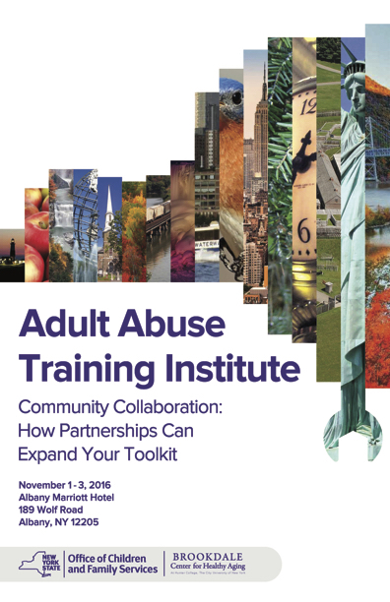
elder ecology
Adult Abuse Training Institute. Community Collaboration: How partnerships can expand your toolkit. Albany, NY. New York State Office of Children and Family Services, Brookdale Center for Healthy Aging. November 1-3, 2016.
elderecology.org
beyondbrooke.org
Notes:
Adult Abuse Training Institute. Community Collaboration: How partnerships can expand your toolkit. Albany, NY. New York State Office of Children and Family Services, Brookdale Center for Healthy Aging. November 1-3, 2016.
https://ocfs.ny.gov/main/psa/psanewsletter.asp?newsletter_number=63

Slide 29
elder ec logy
dyad
elder •
abuser
family friends neighbors •
• work play pray
professionals •
• community
over time, in different settings
elderecology.org
beyondbrooke.org

Slide 30
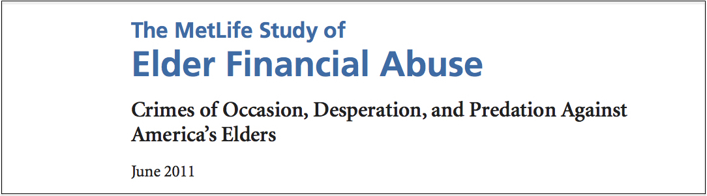
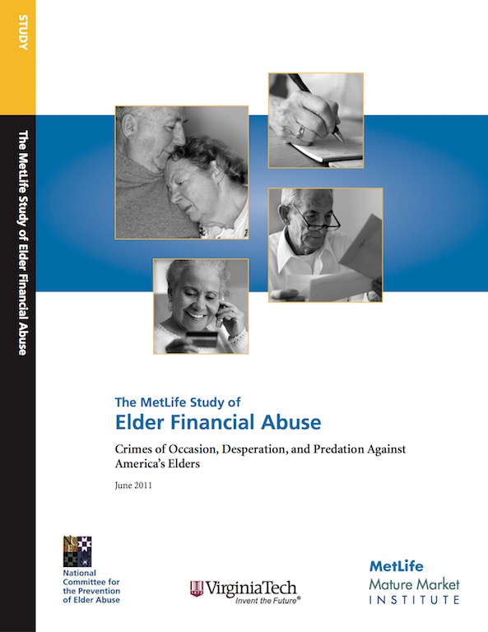
elder financial abuse
The MetLife Study of Elder Financial Abuse: Crimes of Occasion, Desperation, and Predation Against American Elders. NCPEA, Virginia Tech, MetLife Mature Market Institute. June 2011.
elderecology.org
beyondbrooke.org
Notes:
The MetLife Study of Elder Financial Abuse: Crimes of Occasion, Desperation, and Predation Against America’s Elders. The MetLife Mature Market Institute. June 2011
https://www.metlife.com/assets/cao/mmi/publications/studies/2011/mmi-elder-financial-abuse.pdf
Crimes of occasion, or opportunity, are incidents of financial abuse or exploitation that occur because the victim is merely in the way of what the perpetrator wants. The elder has money, assets, and the like, and an occasion presents itself for the perpetrator to avail himself or herself of the resource. The typical occasion scenario was seen in the case of the holiday crime in which a woman was electrocuted with a stun gun and robbed after allowing someone into her home whom she thought was a pharmacist delivering medications for her ailing husband. The occasion was the open door and a person she thought was one she could trust.
Conversely, crimes of desperation are typically those in which family members or friends become so desperate for money that they will do whatever it takes to get it. Many of these family members are dependent on the elder parent for housing and money. What exacerbates their desire for more money is often a heightened need for drugs, alcohol, their gender (i.e., men are frequently perpetrators of this in comparison to women), or some combination of the three. The exploiting family member or friend comes to believe that, in return for care (actual or perceived and however little that care may be), he or she is due compensation (money, possessions, etc.), and often on a continuing basis.
Finally, crimes of predation, or occupation, occur when trust is engendered specifically for the intention of financial abuse later. A relationship is built, either through a bond of trust created though developing a relationship (romantic or otherwise), or as a trusted professional advisor. The taking of assets is by stealth and cunning, by working his or her way into the trust and life of the elder only to take it all and leave the elder penniless and without a relationship that was important in his or her life.

Slide 31
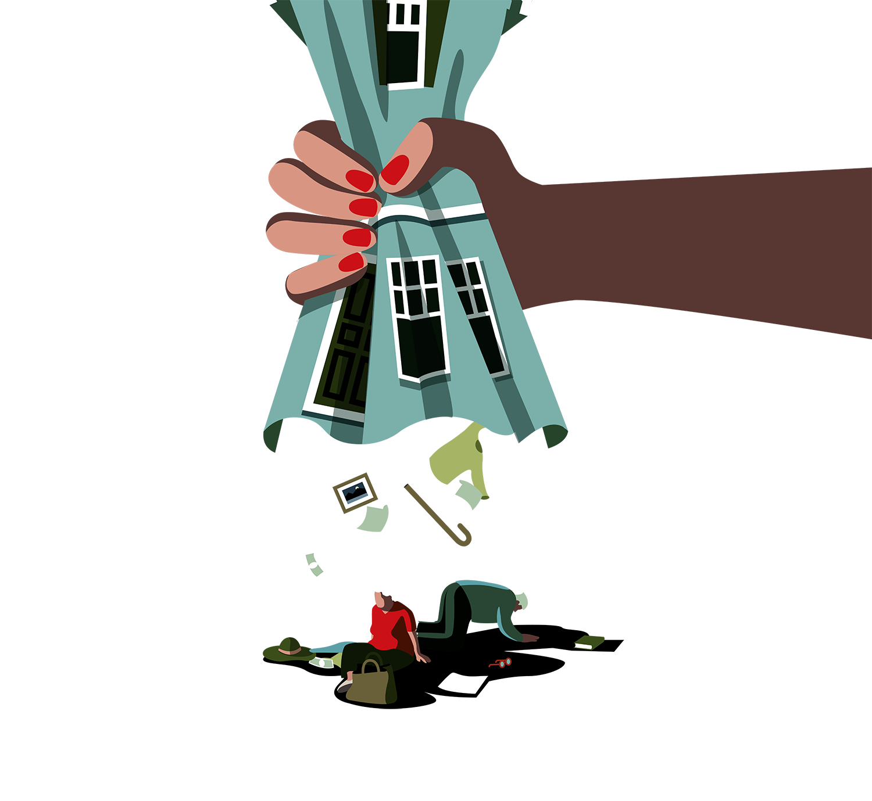
court-appointed
plenary guardianship
independence
in dependence
Aviv, Rachel. How the Elderly Loose their Rights. The New Yorker. October 9, 2017
beyondbrooke.org
Notes:
https://www.newyorker.com/magazine/2017/10/09/how-the-elderly-lose-their-rights —
How the Elderly Loose their Rights
October 9, 2017 issue, The Atlantic
S.178 - Elder Abuse Prevention and Prosecution Act (passed 10/3/17), Senator Grassley (IA)
https://www.congress.gov/bill/115th-congress/senate-bill/178
Substituted Decision-Making
Structured Decision-Making
nccd_structured_decision_making_system_for_adult_protection_DHS-6747-ENG.pdf
The Structured Decision Making® System
for Adult Protection
Guidelines and Procedures Manual
Manual Date: July 21, 2010 (updated November 15, 2012)
National Council on Crime & Delinquency
Structured Decision Making® (SDM) system: Assessment system comprised of research-based and structured assessments designed to provide workers with a simple, objective, and reliable framework to assess individuals involved in APS at critical decision points in the life of a case and to provide managers with information for improved planning, evaluation, and resource allocation.
______

Slide 32



routine activity theory
physical convergence in time and space
a
suitable
target
a likely
offender
a
motivated
likely
offender
•
the
absence
of a capable
‘guardian’
crime
Cohen and Felson. Routine Activity Theory. 1979
elderecology.org
beyondbrooke.org
Notes:
Ecological approach
one of the circles of support
realize their responsibility through Upstandership
…offers a frame of reference for concrete and individualized crime analysis and facilitates the application of real policies and practices aimed at altering the necessary elements that make the existence of a crime possible and thereby preventing it (Tilley, 2009).
Lawrence E. Cohen and Marcus Felson
_____
criminology + domestic abuse (including elder abuse)
Their hypothesis was that postmodernity had facilitated the convergence in space and time of likely offenders with the goal of committing crimes against suitable targets in the absence of capable guardians.
_____
The Impact of Social Relationships on Elder Financial Victimization—Theoretical, Empirical, and Practical Perspectives
https://vimeo.com/266895965
Routine Activity Theory 36:24
Seniors with mild cognitive impairment and no capable guardian….are more at risk of fraud
Seniors with advanced cognitive impairment and a capable guardian are less at risk of fraud…but if there is no ‘capable guardian’ but an abusive family/friend/caretaker, will be at risk
_____
180212_forbes_4 Risk Factors For Elder Financial Abuse.pdf
https://www.forbes.com/sites/johnwasik/2017/02/12/4-risk-factors-for-elder-financial-abuse/#2e924e05f934
Often the abusers are people who are friends and relatives. A 2010 national study found that "over 5% of Americans ages 60 and older were financially exploited by a family member in the past year, and in 2011, approximately 7% of adults ages 65-74, and 6.5% of adults age 75 and older were defrauded by strangers," notes SIFMA, the securities trade association,
-- Poor Physical Health. Those who are physically compromised are unlikely to be focused on financial matters. They are often vulnerable to swindles.
-- Cognitive Impairment. When the ability to do basic things like read a banking statement or balance a checkbook declines, that's when you have to pay attention. Those with declining math skills will not be asking important questions about new investing "opportunities."
-- Difficulty in Activities of Daily Living. If a person has trouble feeding themselves, bathing or shopping, that's a big set of red flags. That also means that they will have trouble managing money.
-- Social Isolation. Are they all alone? Then they won't have the support of a network of peers, who could warn about scams.
"Social isolation is not only a potential risk factor for financial victimization, it is also a tactic perpetrators use to manipulate their victims and hide acts of exploitation," Prof. DeLiema states.
The best safeguard against financial abuse? Getting your entire family and social network involved. Talk to your older relatives often. Have they been approached by "new" friends? Have they been offered a "unique" investment opportunity. If you listen closely enough, you'll be able to stop scams before they go too far.
_____
https://onlinelibrary.wiley.com/doi/pdf/10.1002/9781118517390.wbetc198
Routine Activity Theory
FERNANDO MIRÓ
Routine activity theory, first formulated by Lawrence E. Cohen and Marcus Felson (1979) and later developed by Felson, is one of the most widely cited and influential theoretical constructs in the field of criminology and in crime science more broadly.
In contrast to theories of criminality, which are centered on the figure of the criminal and the psychological, biological, or social factors that motivated the criminal act, the focus of routine activity is the study of crime as an event, highlighting its relation to space and time and emphasizing its ecological nature and the implications thereof.
In their initial formulation, Cohen and Felson postulated that changes in the structure of the patterns of daily activity of people in cities following World War II could explain the rise in crime that had occurred, according to leading studies at the time.
Their hypothesis was that postmodernity had facilitated the convergence in space and time of likely offenders with the goal of committing crimes against suitable targets in the absence of capable guardians.
From this they derived two apparently simple ideas with significant implications: first, that the opportunity for crime may depend on a configuration of distinct (though not disaggregated) elements of the aggressor or criminal; second, a correlate of the first, that the absence of either of the first two elements (aggressor and target) or the presence of the third (capable guardians) would be sufficient in itself to prevent a potential criminal event.
Routine activity theory is, in short, an attempt to identify, at a macro-level, criminal activities and their patterns through explanation of changes in crime rate trends (Cohen & Felson, 1979).
It is based on criminal events, on the distribution and grouping in space and time of the minimal elements that make them up, rather than on the search for offenders’ motives, and it thus offers a frame of reference for concrete and individualized crime analysis and facilitates the application of real policies and practices aimed at altering the necessary elements that make the existence of a crime possible and thereby preventing it (Tilley, 2009).
In their seminal article, “Social change and crime rate trends: A routine activity approach”, Cohen and Felson (1979) pointed out an important sociological paradox: while indicators of well-being and socioeconomic conditions, which had until then been considered causes of violent crime – such as poverty, lack of education, and unemployment – had generally improved in the 1960s, reports of crime rates indicated that there was a significant increase in crime during these years. To explain this contradiction, they focused on changes in structural patterns of people’s daily activity and how the new configuration provided greater criminal opportunities and, therefore, could influence the trends observed in rates of certain types of crime, in particular crimes against persons or property (Felson & Cohen, 1980).
The transformations in modern society to which the authors refer, revealed through various questionnaires and reports, lent a greater importance to activities away from the home. For example, women’s participation in the labor force and access to higher education, as well as an increase in vacation length, trips outside the city, or permanent relocation, increased contact with possible offenders and left homes empty and unprotected. In addition, technological advances during this period led to the appearance and consumption of small electronic appliances such as televisions, video recorders, and stereo equipment, with higher values and lower weights that made them very attractive and easy to remove and transport. Finally, the appearance of automated teller machines, an increase in bank transactions, deposits, and withdrawals, together with changes in daily activity related to the circulation of property, generally increased the mobility and visibility of consumer goods. In short, the growing number of available objects, the increased number of unguarded homes, and the greater possibilities of direct contact between persons or their property and offenders brought about an increase in suitable targets and a decrease in capable guardians to prevent crimes, and therefore an environment of greater opportunity.
…
Cohen and Felson not only identified the socio-environmental aspect of the crime event but also, by focusing on routine activities, offered a model with great expressive power to explain the “ecological” nature of crime and demonstrate how elements apparently unconnected to the illegal activity may shape and determine it (or its absence). Thus, for example, many technological advances for legitimate purposes, such as automobiles, electronic devices, highways, or telephones, may be used by offenders for their illegitimate activities. That is to say, the structure of routine legal activities also determines how crime is organized in society as well as where it will occur most frequently, with the important preventive consequences that flow therefrom.
Routine activity theory explains the criminal event through three essential elements that converge in space and time in the course of daily activities:
a potential offender with the capacity to commit a crime;
a suitable target or victim; and finally
the absence of guardians capable of protecting targets and victims.
The likely offender may be anyone with a motive [changed, later, to not include motive] to commit a crime and with the capacity to do so (Felson & Cohen, 1980), although it is most likely to be a young man, without stable employment, who has failed in school, and who has a record of traffic accidents and emergency room visits (Gottfredson & Hirschi, 1990).
Although in their initial formulation Cohen and Felson (1979) used the term “motivated offender”, in later works, particularly those of Felson (among others, Felson & Boba, 2010; Felson & Cohen, 1980) they avoided the term “motivated” in refering to the offender, as what they truly considered relevant was not disposition or motivation to commit a crime but rather the physical factors that made it possible for a person to be involved in crime.
What this approach contributed was an articulation of the need to divert attention away from the offender in order to understand the crime (Felson, 1995), given that the focus had been exclusively on him or her. Nevertheless, although it was necessary to pay attention to other aspects of crime in order to understand and prevent it (Felson & Clarke, 1998), this never meant leaving aside the “point of view” of the offender (Felson, 2008), given that, as we shall see, the very definition of the target as “suitable” is made through the understanding of the purposes and capacities of the aggressor in relation to intrinsic characteristics of the potential targets of crime.
The Encyclopedia of Theoretical Criminology, First Edition. Edited by J. Mitchell Miller. © 2014 Blackwell Publishing Ltd. Published 2014 by Blackwell Publishing Ltd.
DOI: 10.1002/9781118517390/wbetc198
_____
Tilley, N. (2009). Crime prevention. Cullompton, UK: Willan.
p. 120
Put this way the theory might seem to suggest, implausibly, that classes of likely offender, suitable target and capable guardian can be clearly marked out from one another. In fact, of course there are more and less likely offenders, more and less suitable targets and more or less capable guardians.
Moreover, guardian capability may be less important than guardianship credibility. A conscientious, fit, trained, and intelligent body-guard, for example, may provide pretty capable guardianship and make some crimes in practice very hard to commit. However, at least at some points in time and in some places, poorly functioning and dummy closed-circuit television appears to have had sufficient credibility, while no real capability, to provide adequate guardianship so far as many potential offenders go.
Less elegantly, but more accurately, routine activity theory may be restated in the following way: direct contact predatory crime requires the convergence in space and time of:
• A sufficiently likely offender;
• A suitable enough target; and
• Absence of sufficiently credible guardianship.
Later refinements to routine activity theory have added presence or absence of an ‘intimate handler’ to the conditions relevant to criminal acts (Felson 1986). An intimate handler is some significant other in front of whom a likely offender will be reluctant to commit a crime. A disapproving mother, for example, may comprise an intimate handler whose presence in conditions otherwise conducive to a criminal act will avert its commission because of her influence on the likely offender. The mother’s role is different from that of the credible guardian in that she does not prevent the crime by protecting the suitable target but rather by disapproving the behaviour of the potential offender who is concerned with her good opinion.
Intimate handlers may, of course, also provoke criminal action where undertaking it is deemed by the offender to increase the regard in which they are held. Peer groups members are liable to play this role where they egg on one of their number to behave criminally.
…
There is an old Slovenian proverb that has it that ‘even the bishop is tempted by the open strongbox’. Rightly or wrongly, this suggests that few if any pass a point in the scale of offender likelihood where no crime would ever be contemplated. Gabor (1994) provides a host of evidence to substantiate the spirit of the Slovenian proverb. This rather general potentiality for involvement in criminal acts may explain why proponents of routine activities theory have tended to concentrate on target suitability and guardianship in their discussions of prevention. And it is the supply, distribution and movement of suitable targets and credible guardianship that provides patterns of opportunity for crime.
There is, though, a further refinement to routine activity theory that is relevant to opportunity, which helps us get a little further in understanding what makes for a likely offender. This relates to the capabilities of the potential offender, which were mentioned earlier in this chapter (Ekblom and Tilley 2000). Some crimes require little or nothing by way of specific capability. The bishop faced by the open strongbox, requires no special tools or abilities. Some container to carry or to conceal the swag is all that might be needed. But other actions require capabilities of one sort or another, in order that the offender disposed to commit a crime is able to do so. One of the main reasons homicide rates are so much higher in the US than in England and Wales has to do with the much readier availability of firearms in the US, which substantially increases the capability for one person to murder another. It was the piping of toxic domestic gas to households that had supplied potentially suicidal folk in England and Wales with the ready wherewithal to take their own lives. The motor car provides both a target for and a useful resource improving the capability to commit many offences. Thus, to sufficiently likely offenders, suitable enough targets, absence of sufficiently credible guardian and absence of sufficiently significant and censorious handler, we need to add adequate capabilities as conditions enabling a predatory crime to take place. Moreover the supply, distribution and movement of all five will determine the patterns of convergence across space and time and hence the crime patterns generated. Furthermore, except for the disposition of the potential offender (what they would like to do or to get) they are all matters of contingent opportunity. At least in principle, policies and practices orientated to modifying these are possible and this is the point at which the theory meets situational crime prevention.
_____
A ROUTINE ACTIVITY APPROACH TO THE STUDY OF INTIMATE PARTNER VIOLENCE — A Thesis in Crime, Law, and Justice by
Maureen Curran Outlaw
https://etda.libraries.psu.edu/files/final_submissions/4002
Inquiry into the causes, correlates, and consequences of intimate violence victimization has been conducted almost entirely by feminist and family scholars rather than by criminologists.
In fact, some criminologists and victimization scholars (e.g., Miethe et al., 1987; Finkelhor, 1997) have all but claimed that victimization that occurs between intimate partners is out of the realm of traditional criminology because it reflects an inherently different phenomenon than does street crime.
As a result, few criminologists have attempted to examine intimate partner violence with the same approaches used to understand other types of violence (see Felson and Messner, 2000 for an exception).
At the same time, researchers examining intimate partner violence (e.g., Straus and Gelles, 1990; Dobash and Dobash, 1992) have largely ignored the situational factors that criminological theory highlights as related to criminal behavior and victimization risk.
The purpose of the present study is to build a bridge between these two literatures and thereby bring the study of intimate partner violence more fully into the realm of criminological inquiry.
Specifically, this examination will extend routine activity theory to intimate partner violence in order to 1) test the principles of routine activity theory in a context other than property crime, and 2) ascertain the utility of a situational approach to intimate violence. Such an extension would provide a more complete understanding of intimate partner violence and could serve to broaden our understanding of the applicability of criminological theory to seemingly distinct types of crime.
…
_____
https://www.ncjrs.gov/pdffiles1/Digitization/101287NCJRS.pdf
The authors of routine activity theory extend this notion of human interactions to criminology by reasoning that illegal activities performed by certain members of the population depend upon patterns of legal activities exhibited by others in the community. In other words, the variations and characteristics of legitimate routines result in situational exigencies that may inhibit or facilitate the likelihood that certain crimes will occur. The temporal and spatial organization of routine, legal activities therefore influences the location, frequency, and distribution of crimes.
The main thesis of the routine activity approach is that variations in the daily activities (e.g., work and leisure behavior) of individuals increase or decrease the likelihood that conditions necessary for the occurance of a victimization will converge in time and space.
…
Considerable evidence supports the proposition that situational opportunities encountered by offenders underlie a large percentage of crimes. Within this context, routine activity theory hypothesizes that five mediating variables account for the bivariate associations frequently found in studies of the relationship between crime and demographic characteristics. These mediating factors, which are actually risk factors that affect the likelihood of victimization, are exposure, guardianship, proximity to potential offenders, target attractiveness, and definitional properties of the crime. By taking criminal motivation as a given, the framework focuses on the interplay of these risk factors and considers how trends and changes in social conditions affect the convergence of a victimization event1s minimal components. It is therefore possible to construct an explanation of temporal trends in victimization rates.
The assumption which underlies this theoretical approach is that aspects of the ways in which members of a human population organize and interact to achieve legitimate social ends influence (positively and negatively) the opportunities for certain crimes to occur within that population. The result is that longitudinal tests of the theory have not specifically addressed the household or individual level manifestations of the causal relations set for.th in the theory. This research is designed to fill that void.
_____
AIM Abuse Intervention Model
mosqueda_et_al_2016_the_abuse_intervention_model.pdf
Vulnerable Elder Protection Team (VEPT)
WeillCornell Medicine with NewYork Presbyterian
Alyssa Elman 212.746.0473
for professionals to access.
_____
_____

Slide 33
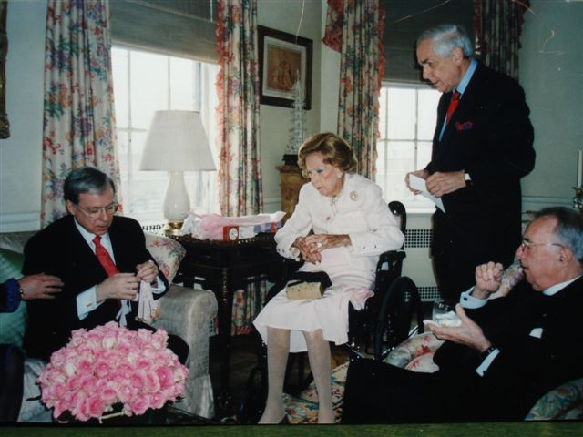
routine activity theory
Brooke Astor’s 102th birthday ‘party.’ From left: Charlene Marshall (hand), Francis X. Morrissey Jr., Brooke Astor, Anthony Marshall, Reverend Canon John Andrews. Photograph: Alec Marshall. March 2004
offender
target
offender
elderecology.org
beyondbrooke.org
Notes:
Brooke Astor’s 102th birthday ‘party.’ From left: Charlene Marshall (hand), Francis X. Morrissey Jr., Brooke Astor, Anthony Marshall, Reverend Canon John Andrews. Photograph: Alec Marshall. March 2004
_____

Slide 34
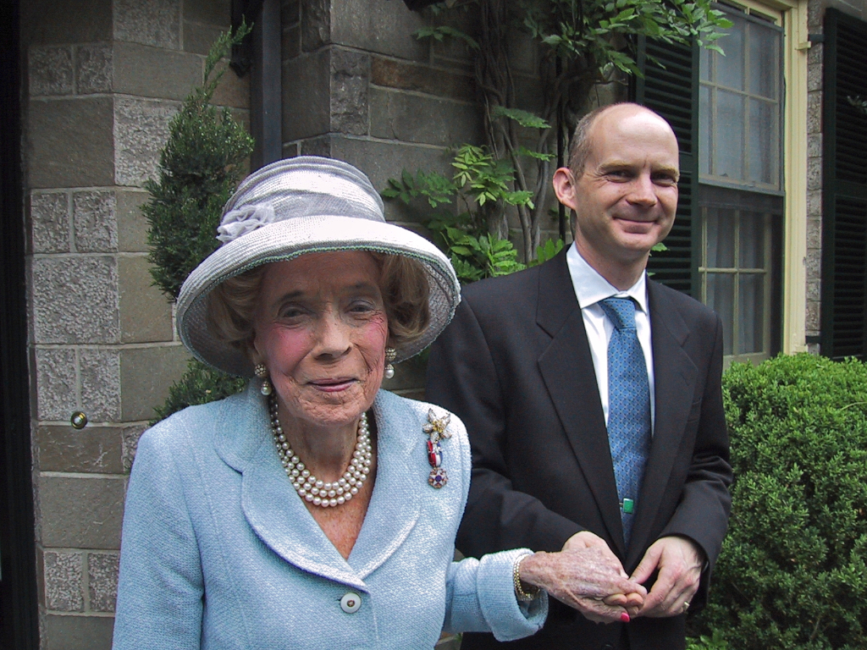
routine activity theory
capable guardian
(suitable)
target
Brooke Astor and Chris Ely, Briarcliff Manor, NY. 2003.
elderecology.org
beyondbrooke.org
Notes:
In my guardianship petition I sought to help my grandmother—and to help those who were helping her, yet whose efforts had been so compromised by my father.

Slide 35
•
a capable guardian cultivates Upstandership™
elder ec logy
dyad
elder •
abuser
triad + n
•
family friends neighbors •
• work play pray
• professionals
• community
over time, in different settings
elderecology.org
beyondbrooke.org
Notes:
https://en.wikipedia.org/wiki/Triad_(sociology)
Triad refers to a group of three people in sociology. It is one of the simplest human groups that can be studied and is mostly looked at by microsociology. The study of triads and dyads was pioneered by German sociologist Georg Simmel at the end of the nineteenth century.
A triad can be viewed as a group of three people that can create different group interactions. This specific grouping is common yet overlooked in society for many reasons. Those being that it is compared to the lives of others, how they shape society, and how communication plays a role in different relationships scenarios.[1]
It was derived in the late 1800s to early 1900s and evolved throughout time to shape group interactions in the present. Simmel also hypothesized between dyads and triads and how they may differ. A dyad is a group of two people that interact while a triad is another person added on to create more communicational interactions.[2] For example: adding an extra person, therefore creating a triad, this can result in different language barriers, personal connection, and an overall impression of the third person.[2]
Simmel wanted to convey to his audience that a triad is not a basic group with positive interactions, but how these interactions can differ depending on person to person.
_____
National Sheriffs' Association
https://www.sheriffs.org/programs/national-triad
Partnership
The National Association of Triads is a partnership of three organizations—law enforcement, older adults, and community groups. The purpose of Triad is to promote older adult safety and to reduce the fear of crime that older adults often experience. NATI assists at the grassroots level, helping you organize your Triad and providing a clearinghouse of programs and resources that can be implemented at a community level, and training materials for law enforcement, volunteers, and community groups.

Slide 36
•
a capable guardian cultivates Upstandership™
elder ec logy
dyad
elder •
abuser
triad + n
•
family friends neighbors •
courts •
• work play pray
law enforcement •
APS •
• professionals
• community
over time, in different settings
elderecology.org
beyondbrooke.org
Notes:
Among the circles

Slide 37
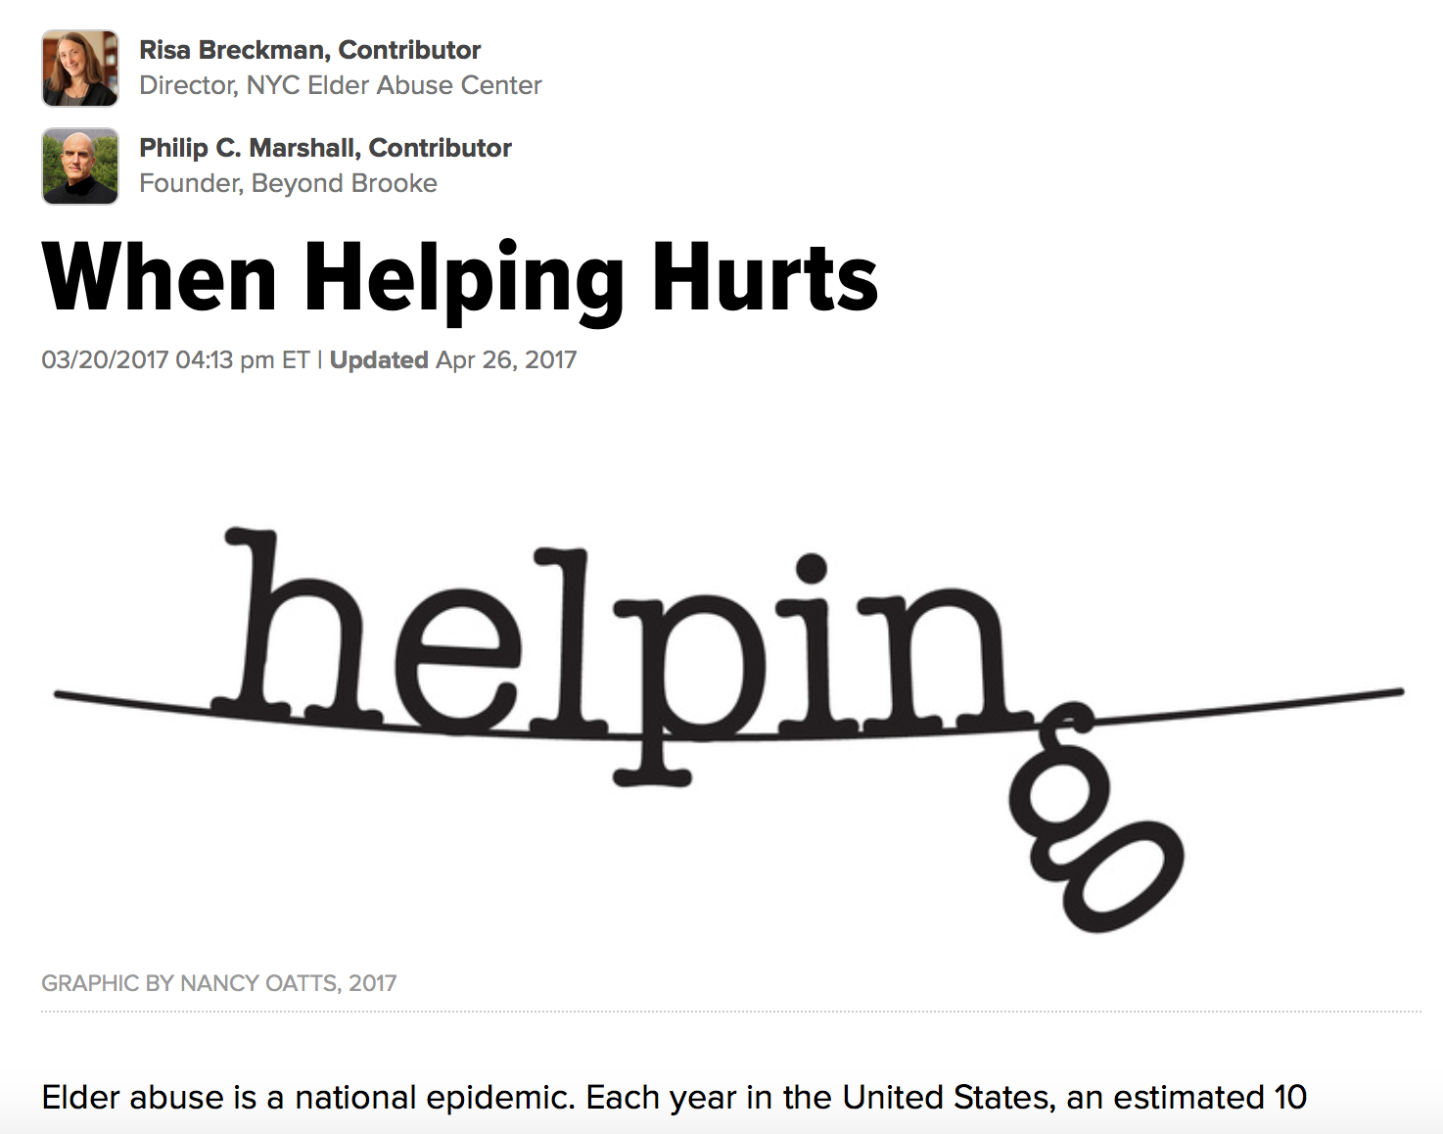
http://www.huffingtonpost.com/author/philip-c-marshall
elderecology.org
beyondbrooke.org
Notes:
Graphics: Nancy Oatts, Mrs. D, neighbor
https://nyceac.org/elder-justice-dispatch-it-became-love/
https://nancyoatts.wordpress.com
_____
http://www.huffingtonpost.com/entry/when-helping-hurts_us_58ceea26e4b0537abd957226
They show that when findings are extended to the general population (U.S. Census Bureau, 2016),
approximately 73 million adult Americans have had personal knowledge of a victim of elder mistreatment.
approximately 44 million adult Americans have become involved in helping an elder abuse victim.
over 32 million adult Americans, just knowing about an elder abuse situation is generally highly stressful.
Actually providing help to the victim tends to intensify this personal distress.
_____

Slide 38
•
a capable guardian cultivates Upstandership™
elder ec logy
elder •
abuser
•
family friends neighbors •
• work play pray
• professionals
• community
elderecology.org
beyondbrooke.org

Slide 39
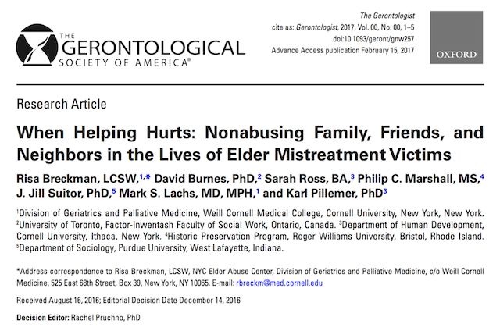
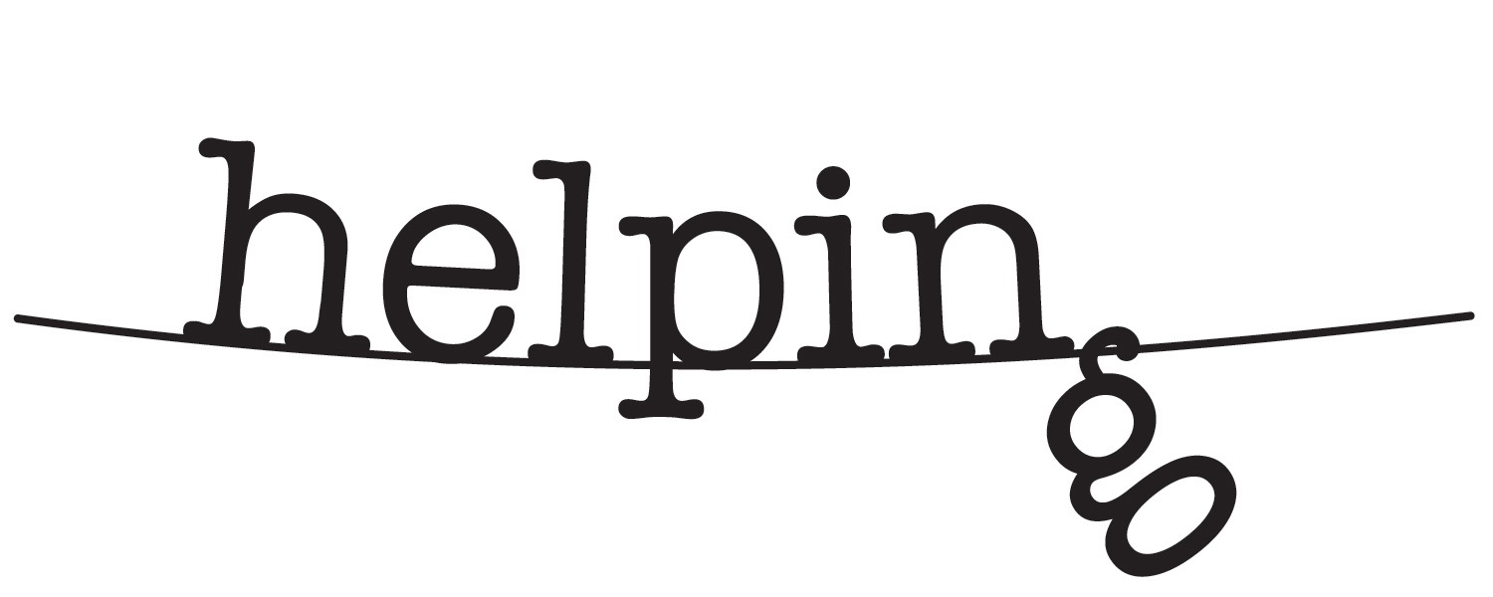
circle of support
Helping. Artwork by Nancy Oatts Nancy Oatts Design. Included in Huffington Post article by Breckman and Marshall. 2017
approximately 73 million have had personal knowledge of a victim
approximately 44 million have become involved in helping
for over 32 million adult Americans, just knowing is highly stressful
actually providing help to the victim intensifies personal distress
elderecology.org
beyondbrooke.org
Notes:
Seniors’ circles of support are so important, so unrecognized, and so traumatized, themselves.
Recent research findings on “when helping hurts” express the widespread distress for those individuals in a senior’s circle of support who need help, themselves, as they seek to help abused victims.
Spurred by these findings and a demonstrated need, NYCEAC will be launching a help line available for those individuals.
23:53
_____
…when findings are extended to the general population,
approximately 73 million adult Americans have had personal knowledge of a victim of elder mistreatment
approximately 44 million adult Americans have become involved in helping an elder abuse victim.
for over 32 million adult Americans, just knowing about an elder abuse situation is generally highly stressful. Actually providing help to the victim tends to intensify this personal distress.
_____
http://www.huffingtonpost.com/entry/when-helping-hurts_us_58ceea26e4b0537abd957226
Op Ed
When Helping Hurts…
By Risa Breckman and Philip C. Marshall
Elder abuse is a national epidemic. Each year in the United States, an estimated 10 percent of older Americans are injured physically, debilitated emotionally, exploited financially and/or neglected — often by an adult child, spouse, other relative or caregiver. Elder abuse victims have a three-fold risk of death compared to their non-abused counterparts. Frequently, an elder is isolated, their mistreatment hidden.
In 2006, newspapers around the country headlined the story that Brooke Astor, the legendary New York City philanthropist and socialite, was financially exploited and neglected by her son and attorney. The case attracted national attention as her grandson, with the help of others, sought elder justice – first, by petitioning for guardianship to help his grandmother and those who were (also) helping her, and second, to help bring some of her perpetrators (his father included) to justice. The Elder Abuse Unit of the New York County’s District Attorney’s Office indicted and convicted Brooke Astor’s son and attorney. Elder justice was realized.
That is rare. Most of the millions of elder abuse victims, their suffering shrouded in silence, do not receive justice. Only one in 24 elder abuse cases are reported to authorities. What is not rare is that, despite an almost total lack of support or resources, family, friends and neighbors step up to help. Yet helping hurts, as confirmed by new findings of our research.
Along with colleagues at Cornell University, University of Toronto and Purdue University, we utilized Cornell University’s Survey Research Institute’s omnibus survey to learn about these concerned persons who step up for elder abuse victims – a population that had never been assessed. The survey results were recently released in The Gerontologist. They show that when findings are extended to the general population (U.S. Census Bureau, 2016), approximately 73 million adult Americans have had personal knowledge of a victim of elder mistreatment. Further, approximately 44 million adult Americans have become involved in helping an elder abuse victim. And for over 32 million adult Americans, just knowing about an elder abuse situation is generally highly stressful. Actually providing help to the victim tends to intensify this personal distress.
We need more research to understand what specific aspects cause this distress. We do know from conversations with concerned persons that the path to assisting elder abuse victims is often fraught with challenges. Concerned persons may witness the decline in the victim's health and seek to obtain medical care, or provide what care they can themselves. They might feverishly focus efforts on trying to stop a financial exploiter from completely emptying bank accounts. They may try to lessen the victim’s despair. Often, they are often the only ones standing between the victim and the abuser, preventing the victim from slipping into total isolation.
Yet they are usually wholly unprepared for how this intervention might take a toll on they themselves. Relationships with friends they confide in and family may become strained, sometimes to the breaking point. They may suffer financial consequences. And seeing or confronting an abuser can be dangerous, so they personally risk becoming the target of abuse. Intervening can take real courage, and even more to remain involved. And it requires time, as elder abuse cases tend not to resolve quickly. It is not surprising that concerned persons can experience anguish, frustration and trauma. Yet like the victims they help, they are largely invisible: their deeds often not recognized, their needs unacknowledged.
What can communities do? A new program to be launched this spring in New York City is a beginning. The New York City Elder Abuse Center is launching a pilot helpline for concerned persons assisting elder mistreatment victims residing in New York City. Funded in part by the Fan Fox & Leslie R. Samuels Foundation, it will provide information, referrals and support. This is an important first step, but the need is great. Programs must be developed for concerned persons — and elder abuse victims — in every community. This will require support from foundations, private philanthropists, businesses and government. Brooke Astor fervently believed in a collectively expressed philanthropy, a “love of humanity.” Perhaps through the realization of her vision, in steps big and small, we will begin to achieve the elder justice Mrs. Astor didn’t live to experience herself.
Risa Breckman is the Executive Director, NYC Elder Abuse Center at Weill Cornell Medicine’s Division of Geriatrics and Palliative Medicine.
Philip C. Marshall is Professor of Historic Preservation, Roger Williams University, grandson of Brooke Astor, and elder justice advocate.
Graphic design by Nancy Oatts, owner of Nancy Oatts Design and a neighbor of an elder abuse victim she assisted.
https://nancyoatts.wordpress.com
_____
David Bornstein
Solutions Journalism
http://solutionsjournalism.org
https://www.nytimes.com/column/fixes

Slide 40
world • elder abuse • awareness • day
—
with
beyondbrooke.org

Slide 41
Lack of ‘awareness’ is
our problem.
☟
What guides our solution?
beyondbrooke.org

Slide 42
(Elder) justice is the provision
of trust, realized through our… relationships and responsibility
☟ ☟
Elder ecology™ ❂ Upstandership™
☟ ☟
Elder ecology™ ❂ Upstandership™
beyondbrooke.org
Notes:
Upstandership

Slide 43
“...the doctrines which men [sic] ostensibly hold do not become operative upon their conduct until they have generated
an imaginative symbolism.”
Stephen, Leslie. History of English Thought in the Eighteenth Century. London: Smith, Elder & Co, 1876, 329.
upstandership.org
beyondbrooke.org
Notes:
As Leslie Stephen observed,
“the doctrines which men ostensibly hold do not become operative upon their conduct until they have generated an imaginative symbolism.”
Stephen, Leslie. History of English Thought in the Eighteenth Century. London: Smith, Elder & Co, 1876, 329.
http://www.amazon.com/History-English-Thought-Eighteenth-Century/dp/0844614211
http://books.google.com/books/about/History_of_English_thought_in_the_eighte.html?id=gzYCAAAAQAAJ
Literature in to three classes: Chapter XXI, I
historical > “primary purpose to record facts, and to summarise or amplify existing knowledge”
speculative > “primary purpose to discuss the truth of various theories by which our knowledge is bound together”
imaginative > “primary purpose to utter the emotions generated in mankind by the conditions in which they are, or believe themselves to be, placed”
_________
http://en.wikipedia.org/wiki/Doctrine
Doctrine (Latin: doctrina) is a codification of beliefs or a body of teachings or instructions, taught principles or positions, as the body of teachings in a branch of knowledge or belief system. The Greek analogy is the etymology of catechism.[1] Often doctrine specifically connotes a corpus of religious dogma as it is promulgated by a church, but not necessarily: doctrine is also used to refer to a principle of law, in the common law traditions, established through a history of past decisions, such as the doctrine of self-defense, or the principle of fair use, or the more narrowly applicable first-sale doctrine. In some organizations, doctrine is simply defined as "that which is taught", in other words the basis for institutional teaching of its personnel internal ways of doing business.
_________
Clifford Geertz
Geertz became a "champion of symbolic anthropology", which gives prime attention to the role of thought ("symbols") in society. Symbols guide action. Culture, outlined by Geertz in his book The Interpretation of Cultures (1973), is "a system of inherited conceptions expressed in symbolic forms by means of which people communicate, perpetuate, and develop their knowledge about and attitudes toward life" (1973:89).
____________
also..
Symbolic Space: French Enlightenment Architecture and Its Legacy
By Richard A. Etlin
Published by University of Chicago Press, 1994
Richard A. Etlin explores the social and cultural hierarchies established in eighteenth-century France to illustrate how the conceptual basis of the modern house and the physical layout of the modern city emerged from debates among theoretically innovative French architects of the eighteenth-century. Examining a broad range of topics from architecture and urbanism to gardening and funerary monuments, he shows how the work of these architects was informed by considerations of symbolic space. For Etlin, the eighteenth-century city was a place in which actual physical space was subjected to a complex mental layering of conceptual spaces.
_____

Slide 44
mandorla
upstandership.org
beyondbrooke.org
Notes:
mandorla
Two equal circles, representing ‘opposites,’ overlap
with each circumference intersecting the other’s center....
..forming a mandorla, which is an ancient symbol for the place where opposites can meet to honor one another and recognize their interaction and interdependence.
This act realizes a reconciliation and healing that forges a new identity which is whole, holy.
The mandorla is liminal, a threshold in which all transformation occurs.
Becoming whole, even holy.
The term refers to the almond like shape: "mandorla" means almond nut in Italian.
Janus, threshold, hinge
_____
The mandorla is used to depict sacred moments which transcend time and space.
Overlap of heaven and earth: a reconciliation.
This is the place where you arrive after you leave one room and have not yet entered another.
Place to heal the contradictions of life.
Symbolizing the interactions and interdependence of opposing worlds and forces.
Binds together that which as torn apart and made unwhole—unholy. It is a prototype of conflict resolution.
_____
Mainstreaming Midwives: The Politics of Change
By Robbie Davis-Floyd, Christine Barbara Johnson
Contributor Robbie Davis-Floyd, Christine Barbara Johnson
Published by CRC Press, 2006
ISBN 0415931517, 9780415931519
559 pages
http://books.google.com/books?id=UYNPEGmDebIC
“The mandorla is an ancient symbol for the place where opposites can meet and honor one another, and in this reconciliation forge a new reality that is greater than the sum of its parts.” p. 472.
_____
http://www.kyrie.com/symbols/mandorla.htm
The space within the overlap is the place in which we are called to "remain", the "liminal space" Richard Rohr [not the same as Rorty!] speaks of.. This is the place where you arrive after you leave one room and have not yet entered another. In this place, you are living on the threshold...and this requires faith.
[Janus]
http://www.natcath.com/NCR_Online/archives/021502/021502k.htm
We need transformation, not false transcendence
By Richard Rorh
“The good news is that you eventually internalize community. The bad news is that you will never get to where you can handle it alone.” -- Robert L. Moore
I am convinced that without experiences of liminal space (that place where all transformation happens), there is no truthful perspective on life. Without truthful perspective, there is neither gratitude nor any abiding confidence. It is precisely this deep gratitude and unfounded confidence that I see most lacking in our people today, even the people of the church. It makes me wonder whether we are doing our job. We are not being initiated into the mysteries.
Victor Turner, in his classic study of initiation, The Ritual Process, says that some kind of “shared liminality” is necessary to create what he calls communitas, or what I would call church. Communitas in a spiritual sense does not come from manufactured celebrations or events. Haven’t we all tried that? It is forgotten the next day or even the next hour. It depends on artificial stimulants of food, drink, music, shared common space and energy. It is really lovely and probably necessary, but it does not transform. It merely sustains, and it is often unfortunately diversionary from the deeper task. True communitas comes from having walked through liminality together -- and coming out the other side -- forever different. The baptismal drowning pool was supposed to have ritualized just such an experience. But something happened along the way. Baptism became a pretty blessing of children.
The Mandorla
http://en.wikipedia.org/wiki/Mandorla#Mandorla
The term refers to the almond like shape: "mandorla" means almond nut in Italian.
In icons of the Eastern Orthodox Church, the mandorla is used to depict sacred moments which transcend time and space, such as the Resurrection, Transfiguration, and the Dormition of the Theotokos.
The symbol is also used in non-Christian contexts. In various religions the almond seed has been associated with divine virgin birth. For instance the virgin nymph Nana miraculously conceived of Attis by putting a ripe almond in her bosom.
The vesica piscis is a shape which is the intersection two circles of the same radius, intersecting in such a way that the center of each circle lies on the circumference of the other. The name literally means the bladder of the fish in Latin. The shape is also called mandorla ("almond" in Italian). http://en.wikipedia.org/wiki/Vesica_Piscis
____________
There is, it seems to us,
At best, only a limited value
In the knowledge derived from experience.
The knowledge imposes a pattern, and falsifies,
For the pattern is new in every moment
And every moment is a new and shocking
Valuation of all we have been. We are only undeceived
Of that which, deceiving, could no longer harm.
T.S. Eliot: Four Quartets
Quartet No. 2, East Coker
_____
Food for thought
Integrative thinking
The Opposable Mind by Roger Martin of University of Toronto
_____
Martin, Roger. The Opposable Mind: How Successful Leaders Win Through Integrative Thinking. Harvard Business Press, 2009. Amazon
http://www.amazon.ca/Opposable-Mind-Winning-Integrative-Thinking/dp/1422139778/ref=pd_bxgy_b_img_c
http://en.wikipedia.org/wiki/Integrative_thinking
Definition used by Roger Martin
Integrative thinking is a discipline and methodology for solving complex or wicked problems. That theory was originated by Roger Martin, Dean of the Rotman School of Management, at The University of Toronto and collaboratively developed with his colleague Mihnea C. Moldoveanu, Director of the Desautels Centre for Integrative Thinking.
The Rotman School of Management defines integrative thinking as:
"...the ability to constructively face the tensions of opposing models, and instead of choosing one at the expense of the other, generating a creative resolution of the tension in the form of a new model that contains elements of the individual models, but is superior to each."[1]
The website continues:
"Integrative thinkers build models rather than choose between them. Their models include consideration of numerous variables — customers, employees, competitors, capabilities, cost structures, industry evolution, and regulatory environment — not just a subset of the above. Their models capture the complicated, multi-faceted and multidirectional causal relationships between the key variables in any problem. Integrative thinkers consider the problem as a whole, rather than breaking it down and farming out the parts. Finally, they creatively resolve tensions without making costly trade-offs, turning challenges into opportunities."
Theory
Integrative thinkers differ from conventional thinkers among a number of dimensions. First, they tend to consider most variables of a problem to be salient. Rather than seeking to simplify a problem as much as possible, they are inclined to seek out alternative views and contradictory data. Second, they are willing to embrace a more complex understanding of how those salient features interconnect and influence one another, a more complex understanding of causality. Rather than limiting the possible causal relationships to simple, linear, one-way dynamics, they entertain the possibility that the causal forces may be multi-directional (i.e. circular) and complex. Third, integrative thinkers approach problem architecture differently. Rather than try to deal with elements in piece-parts or sequentially, they strive at all times to keep the whole of the problem in mind while working on the individual parts. Finally, when faced with two opposing options that seem to force a trade-off, integrative thinkers strive for a creative resolution of the tension rather than simply accepting the choice in front of them.[3]
Influences
Integrative Thinking is influenced by and connected to a number of intellectual traditions. Most notably, it is influenced by the pragmatism of Charles Sanders Peirce and his notion of abductive reasoning, the falsificationism of Karl Popper and the management theories of Chris Argyris and James March.
It is also related to the work of Thomas Kuhn, Imre Lakatos, Bertrand Russell, Ludwig Wittgenstein and others.
Desautels Centre for Integrative Thinking, Rotman School of Management
http://www.rotman.utoronto.ca/integrativethinking/default.aspx
_____
Salvation vs integrated wholeness
_____
Ven Diagram, statistics
Ken Wilbur in Up From Eden, p.8
[re religions that offer salvation, which Wilbur maintains has no part of the perennial philosophy.
“For the “religion” of the perennial philosophy is quite different from salvation. Since the Ultimate is here pictured as an integral Wholeness, the aim of this type of religion is not to be saved but to discover that Wholeness.
_____
In books on Medieval Christian theology...not a mandala (Tibetan, but a Sanskrit term)...cosmos
http://en.wikipedia.org/wiki/Mandala
Mandala: In practice, mandala has become a generic term for any plan, chart or geometric pattern that represents the cosmos metaphysically or symbolically, a microcosm of the Universe from the human perspective.
_____
Owning Your Own Shadow: Understanding the Dark Side of the Psyche
by Robert A. Johnson (Author) "Tree of Life and Death..." (more)
_____

Slide 45
mandorla
society
self
interdependence
upstandership.org
beyondbrooke.org
Notes:
society • self

Slide 46

upstandership
society
self
elder ecology
•
upstandership.org
beyondbrooke.org
Notes:
upstandership
society • self
elder ecology

Slide 47




u
•
•
•
•
•
•
•
•
Upstandership™
upstandership.org
beyondbrooke.org
Notes:
Upstandership describes those who are not abused being willing to be observant, informed, capable, and willing to take a position and take action.
_____
Upstandership assumes an approach that can be applied to many forms of social justice and, when being test driven in the realm of elder justice, is particularly pertinent to advances in the financial services industry.
Upstandership applies a strengths-based, articulated approach to help realize our social compact between society and self, including our future self.
Upstandership is not a single act, but – like stewardship – is a cultivation of intent and capacity that includes these eight interrelated steps, two of which I will focus on.
1. Attention
2. Awareness
3. Knowledge — For when we know be begin to notice, and through this knowledge we…
4. Acknowledge – alleged or actual abuse, and we acknowledge our personal and professional responsibility. Critically, next, our responsibility must be articulated with our collective…
5. “Response-ability” — or our ability to respond – through policy and protocol, community connections, supportive services, and legislative acts that permit, or mandate, us to act. And so then we…
6. Act — we report, refer, or intervene – and then
7. Mitigate — recover and heal, and
8. Advocate — to come full circle, becoming whole, and gaining others’ attention.
For fiduciaries, the articulation from individual responsibility to collective “response-ability” toward senior investor protection has been strengthened by FINRA, FinCEN, CFBP, NASAA, and others that, never grounded by the gravity of elder abuse, have helped elder justice realize greater heights.
Thirteen states (Montana, included; with HB 24) have enacted legislation or regulations based on the North American Securities Administrators Association (NASAA) Model Act to Protect Vulnerable Adults from Financial Exploitation, since adopted in January 2016. The Model Act includes a mandatory reporting requirement applicable to qualified individuals.
In February (2018) two FINRA rules will become effective: Rule 2165, Financial Exploitation of Specified Adults, allows a temporary hold on disbursements, and revised Rule 4512, Customer Account Information, which allows for the name of and contact information for a trusted contact person who may be contacted about the customer's account, to address possible financial exploitation.
The FINRA rules are two great steps forward on the path of elder justice. The former – “hold and report” – while reactive, will “stop the bleeding”; the latter – trusted contact – is proactive, and opens the door to preventive, constructive conversations with clients, framed in the context of your concern and the trust they hold for you.
Just as elder abuse is the betrayal of trust, elder justice is the provision of trust – your trust, through relationships and responsibility.
Trust is achieved face to face…and in the digital space.
Elder justice is in its infancy; so is big-data analytics.
Cradled in a “trust framework,” continued development in big-data can harness streaming analytics for detection and rapid response, and then sandbox warehoused analytics for proactive prevention of exploitation.

Slide 48
u
•
•
•
•
•
•
•
•
Upstandership™
upstandership.org
beyondbrooke.org
Notes:
Today, reflecting on my grandmother’s sad circumstances before I acted, I wonder how many trusted family, friends, neighbors, and professionals share a similar situation—yet do not know what to do, or who to turn to.
With the help of her staff, one January evening I was able to gain access to my grandmother – without alerting my father. I visited her for what I thought might the last time. On my way out, visibly shaken, I embraced her attending nurse. We realized we embraced an opportunity, to talk— just as another nurse appeared for her shift.
With my grandmother asleep, we three spoke at length, shared sad stories, concern, and support. This was the signal moment that spurred me to act.
So informed, emboldened, and empowered, I gave myself permission to act.
____

Slide 49
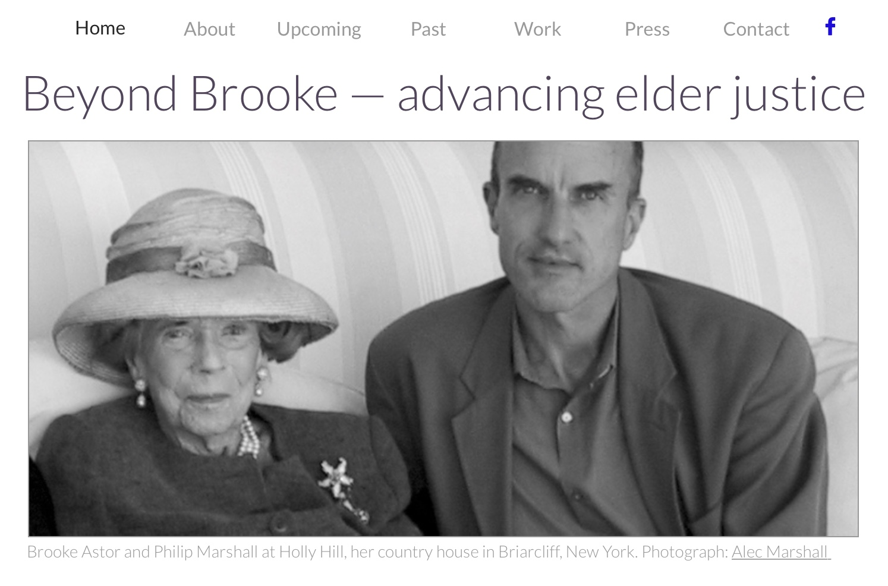
Beyond Brooke. www.beyondbrooke.org
upstandership.org
beyondbrooke.org
Notes:
act

Slide 50
trust
“The entire point of the book is that in the real world it is hard to disentangle ethics on one hand from knowledge and competence on the other.”
•
elder
your ‘self’
Talib, Nassim Nicholas. Skin in the Game: Hidden asymmetries in daily life. 2018
upstandership.org
beyondbrooke.org
reliability of knowledge • symmetry in human affairs • information sharing in transactions • rationality
Talib, Nassim Nicholas. Skin in the Game: Hidden asymmetries in daily life. 2018
Notes:
Nassim Nicholas Taleb. Skin in the Game: Hidden asymmetries in daily life. 2018
“Skin in the Game is about four topics in one: a) uncertainty and the reliability of knowledge (both practical and scientific, assuming there is a difference), or in less polite words bull***t detection, b) symmetry in human affairs, that is, fairness, justice, responsibility, and reciprocity, c) information sharing in transactions, and d) rationality in complex systems and in the real world. That these four cannot be disentangled is something that is obvious when one has…skin in the game.*
It is not just that skin in the game is necessary for fairness, commercial efficiency, and risk management: skin in the game is necessary to understand the world.
First, it is bull***t identification and filtering, that is, the difference between theory and practice, cosmetic and true expertise, and academia ”
“(in the bad sense of the word) and the real world. To emit a Yogiberrism, in academia there is no difference between academia and the real world; in the real world, there is.
Second, it is about the distortions of symmetry and reciprocity in life: If you have the rewards, you must also get some of the risks, not let others pay the price of your mistakes. If you inflict risk on others, and they are harmed, you need to pay some price for it. Just as you should treat others in the way you’d like to be treated, you would like to share the responsibility for events without unfairness and inequity.
If you give an opinion, and someone follows it, you are morally obligated to be, yourself, exposed to its consequences. In case you are giving economic views:
Don’t tell me what you “think,” just tell me what’s in your portfolio.
Third, the book is about how much information one should practically share with others, what a used car salesman should—or shouldn’t—tell you about the vehicle on which you are about to spend a large segment of your savings.
Fourth, it is about rationality and the test of time. Rationality in the real world isn’t about what makes sense to your New Yorker journalist or some psychologist using naive first-order models, but something vastly deeper and statistical, linked to your own survival.
_____
Nassim Nicholas Taleb. Skin in the Game: Hidden asymmetries in daily life. 2018
“* To figure out why ethics, moral obligations, and skills cannot be easily separable in real life, consider the following. When you tell someone in a position of responsibility, say your bookkeeper, “I trust you,” do you mean that 1) you trust his ethics (he will not divert money to Panama), 2) you trust his accounting precision, or 3) both? The entire point of the book is that in the real world it is hard to disentangle ethics on one hand from knowledge and competence on the other.”
_____
Introduced to Buber by Rabbi Bennett Blum MD (as we prepared for aapl.org course, workshop)
http://www.bennettblummd.com
https://en.wikipedia.org/wiki/Martin_Buber
Martin Buber (Hebrew: מרטין בובר; German: Martin Buber; Yiddish: מארטין בובער; February 8, 1878 – June 13, 1965) was an Austrian-born Israeli Jewish philosopher best known for his philosophy of dialogue, a form of existentialism centered on the distinction between the I–Thou relationship and the I–It relationship.
Buber's attitude toward Zionism was tied to his desire to promote a vision of "Hebrew humanism".[9] According to Laurence J. Silberstein, the terminology of "Hebrew humanism" was coined to "distinguish [Buber's] form of nationalism from that of the official Zionist movement" and to point to how "Israel's problem was but a distinct form of the universal human problem. Accordingly, the task of Israel as a distinct nation was inexorably linked to the task of humanity in general”.[10]
https://en.wikipedia.org/wiki/I_and_Thou
Ich und Du, usually translated as I and Thou, is a book by Martin Buber, published in 1923, and first translated from German to English in 1937.
Buber's main proposition is that we may address existence in two ways:
1 The attitude of the "I" towards an "It", towards an object that is separate in itself, which we either use or experience.
2 The attitude of the "I" towards "Thou", in a relationship in which the other is not separated by discrete bounds.
One of the major themes of the book is that human life finds its meaningfulness in relationships. In Buber's view, all of our relationships bring us ultimately into relationship with God, who is the Eternal Thou.
Buber explains that humans are defined by two word pairs: I-It and I-Thou.
The "It" of I-It refers to the world of experience and sensation. I-It describes entities as discrete objects drawn from a defined set (e.g., he, she or any other objective entity defined by what makes it measurably different from other entities). It can be said that "I" have as many distinct and different relationships with each "It" as there are "It"s in one's life. Fundamentally, "It" refers to the world as we experience it.
By contrast, the word pair I-Thou describes the world of relations. This is the "I" that does not objectify any "It" but rather acknowledges a living relationship. I-Thou relationships are sustained in the spirit and mind of an "I" for however long the feeling or idea of relationship is the dominant mode of perception. A person sitting next to a complete stranger on a park bench may enter into an "I-Thou" relationship with the stranger merely by beginning to think positively about people in general. The stranger is a person as well, and gets instantaneously drawn into a mental or spiritual relationship with the person whose positive thoughts necessarily include the stranger as a member of the set of persons about whom positive thoughts are directed. It is not necessary for the stranger to have any idea that he is being drawn into an "I-Thou" relationship for such a relationship to arise. But what is crucial to understand is the word pair "I-Thou" can refer to a relationship with a tree, the sky, or the park bench itself as much as it can refer to the relationship between two individuals. The essential character of "I-Thou" is the abandonment of the world of sensation, the melting of the between, so that the relationship with another "I" is foremost.
Buber's two notions of "I" require attachment of the word "I" to a word partner. The splitting into the individual terms "I" and "it" and "thou" is only for the purposes of analysis. Despite the separation of "I" from the "It" and "Thou" in this very sentence describing the relationship, there is to Buber's mind either an I-Thou or an I-It relationship. Every sentence that a person uses with "I" refers to the two pairs: "I-Thou" and "I-It", and likewise "I" is implicit in every sentence with "Thou" or "It". Each It is bounded by others and It can only exist through this attachment because for every object there is another object. Thou, on the other hand, has no limitations. When "Thou" is spoken, the speaker has no thing (has nothing), hence, Thou is abstract; yet the speaker “takes his stand in relation”.
What does it mean to experience the world? One goes around the world extracting knowledge from the world in experiences betokened by "He", "She", and "It". One also has I-Thou relationships. Experience is all physical, but these relationships involve a great deal of spirituality. The twofold nature of the world means that our being in the world has two aspects: the aspect of experience, which is perceived as I-It, and the aspect of relation, which is perceived as I-Thou.
Examples
Buber uses an example of a tree and presents five separate relations:
1 Looking at the tree as a picture with the color and detail through the aesthetic perception.
2 Identifying the tree as movement. The movement includes the flow of the juices through the veins of the tree, the breathing of the leaves, the roots sucking the water, the never-ending activities between the tree and earth and air, and the growth of the tree.
3 Categorizing the tree by its type; in other words, studying it.
4 Exercising the ability to look at something from a different perspective. “I can subdue its actual presence and form so sternly that I recognize it only as an expression of law”.
5 Interpreting the experience of the tree in mathematical terms.
Through all of these relations, the tree is still an object that occupies time and space and still has the characteristics that make it what it is.[1]
If "Thou" is used in the context of an encounter with a human being, the human being is not He, She, or bound by anything. You do not experience the human being; rather you can only relate to him or her in the sacredness of the I-Thou relation. The I-Thou relationship cannot be explained; it simply is. Nothing can intervene in the I-Thou relationship. I-Thou is not a means to some object or goal, but a definitive relationship involving the whole being of each subject.
Like the I-Thou relation, love is a subject-to-subject relationship. Love is not a relation of subject to object, but rather a relation in which both members in the relationship are subjects and share the unity of being.
The ultimate Thou is God. In the I-Thou relation there are no barriers. This enables us to relate directly to God. God is ever-present in human consciousness, manifesting in music, literature, and other forms of culture. Inevitably, Thou is addressed as It, and the I-Thou relation becomes the being of the I-Thou relation. God is now spoken to directly, not spoken about.
There is no world that disconnects one from God, a world of It alone, when I-Thou guides one’s actions. "One who truly meets the world goes out also to God." God is the worldwide relation to all relations.
_____
https://www.nytimes.com/2016/11/01/opinion/read-buber-not-the-polls.html
Read Buber, Not the Polls!
David Brooks NOV. 1, 2016
If America were a marriage we’d need therapy.
_____

Slide 51
trust is achieved through
relationships and responsibility
☟ ☟
Elder ™ ❂ Upstandership™
☟ ☟
ethics ❂ competence
☟ ☟
Elder ecology™ ❂ Upstandership™
beyondbrooke.org
Notes:
ethics • competence

Slide 52
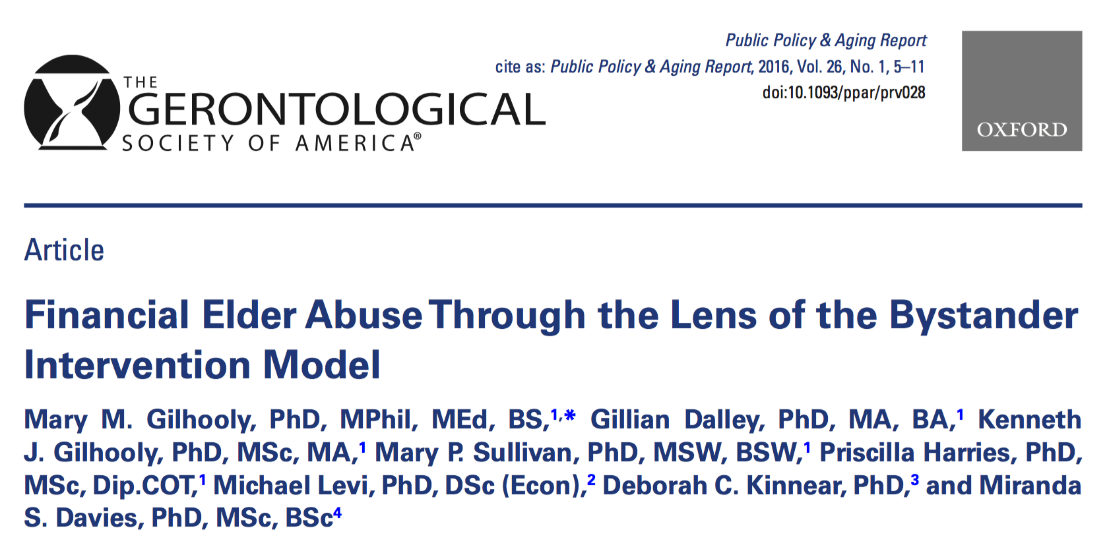
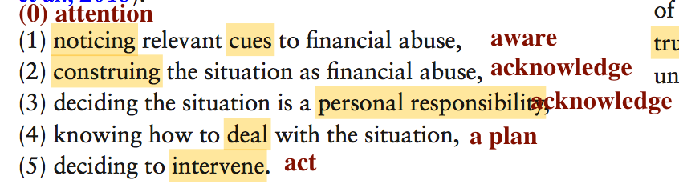
bystander intervention
Gilhooley et al. Financial Elder Abuse Through the Lens of the Bystander Intervention Model, 2016
beyondbrooke.org
Notes:
Financial Elder Abuse Through the Lens of the Bystander Intervention Model
Mary M. Gilhooly, PhD, MPhil, MEd, BS,1,* Gillian Dalley, PhD, MA, BA,1 Kenneth J. Gilhooly, PhD, MSc, MA,1 Mary P. Sullivan, PhD, MSW, BSW,1 Priscilla Harries, PhD, MSc, Dip.COT,1 Michael Levi, PhD, DSc (Econ),2 Deborah C. Kinnear, PhD,3 and Miranda S. Davies, PhD, MSc, BSc4
doi:10.1093/ppar/prv028
https://academic.oup.com/ppar/article/26/1/5/2593869
_____
Introduction
Over the years, there have been many calls for more research on the scope and severity of financial elder abuse (Pillemer, Connolly, Breckman, Spreng, & Lachs, 2015), as well as commentary on the need for society giving higher priority to prevention (Whitman, 2015). Perhaps more worrying than the paucity of research is concern that the quality of the research into elder abuse has advanced lit- tle in the decades since it first came to the attention of the research community around the world. Hafemeister (2003), acknowledging the poverty of intellectual debate in the field of financial elder abuse, has argued strongly for a more rigorous approach to developing concepts, definitions, and theory. Like Dessin (1999–2000), he argued that this research should be based on the specific and distinguishing characteristics of this type abuse, com- paring and contrasting theorizing in related fields as use- ful ways of advancing research in the subject of financial elder abuse.
In this article, we shall outline a model of decision making—the bystander intervention model—which has considerable potential as theoretical underpinning for research, as well as for developing training in relation to the detection and prevention of financial elder abuse. We shall draw on our own research to describe the potential of this model in detecting and intervening in cases of financial elder abuse (Davies et al., 2011; Davies, Gilhooly, Gilhooly, Harries, & Cairns, 2013; Gilbert, Stanley, Penhale, & Gilhooly, 2013; Gilhooly et al., 2013; Harries, Davies, Gilhooly, Gilhooly & Cairns, 2014a; Harries, Davies, Gilhooly, Gilhooly, & Tomlinson, 2014b)
_____

Slide 53
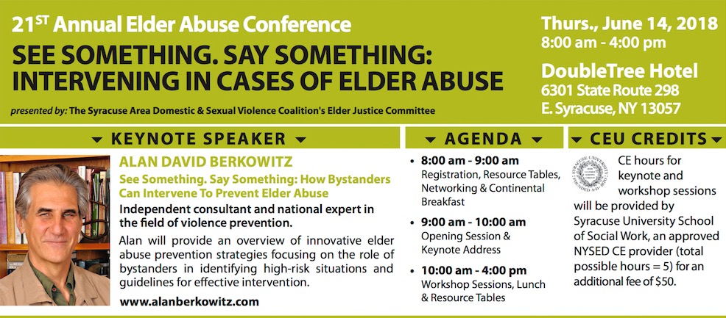
bystander intervention
21st Annual Elder Abuse Conference. See Something. Say Something: Intervening in Cases of Elder Abuse. Syracuse Area Domestic & Sexual Violence Coalition, Elder Justice Committee. East Syracuse, New York June 14, 2018
beyondbrooke.org
Notes:
21st Annual Elder Abuse Conference.See Something. Say Something: Intervening in Cases of Elder Abuse.The Syracuse Area Domestic & Sexual Violence Coalition's Elder Justice Committee. East Syracuse, NY. June 14, 2018
https://static1.squarespace.com/static/5851b8a715d5db7317addaca/t/5b047353f950b75de24dc17b/1527018325298/Syr+2018+Elder+Abuse+Conference+Flyer.FINAL.pdf
http://www.verahouse.org/coalition
http://www.alanberkowitz.com
21st Annual Elder Abuse Conference
See Something, Say Something: Intervening in Cases of Elder Abuse
Thursday, June 14, 2018
8:00 am - 4:00 pm
DoubleTree Hotel, East Syracuse, NY 13057
Keynote: Alan David Berkowitz, National Consultant in Violence Prevention
How Bystanders Can Intervene to Prevent Elder Abuse
https://static1.squarespace.com/static/5851b8a715d5db7317addaca/t/5b047353f950b75de24dc17b/1527018325298/Syr+2018+Elder+Abuse+Conference+Flyer.FINAL.pdf
Keynote >
Workshop A >
Best Practices in Elder Abuse Prevention
Presenter: Alan Berkowitz
An overview of best prevention practices drawn from the sexual assault prevention literature, with an emphasis
on the social norms approach (fostering of healthy underestimated norms) and bystander intervention, with a review of relevant theory, research and case studies.
_____
https://en.wikipedia.org/wiki/Social_norms_approach
The social norms approach is founded upon a set of assumptions that individuals incorrectly perceive that the attitudes or behaviors of others are different from their own, when in reality they are similar. This phenomenon is known as pluralistic ignorance.[6] It is largely because individuals assume the most memorable and salient, often extreme, behavior is representative of the behavior of the majority. This may lead individuals to adjust their behavior to that of the presumed majority by adhering to the pseudo-norms created by observing such memorable behavior. These exaggerated perceptions, or rather misperceptions, of peer behavior will continue to influence the habits of the majority, if they are unchallenged.[2] This means that individuals may be more likely to enact problem behaviors and suppress healthier practices, making support for healthy behaviors much less visible at an aggregate level. This effect has been documented for alcohol, illegal drug use, smoking, other health behaviors, and attitudes, such as prejudice.[6]
A phenomenon known as false consensus is closely related to the idea of pluralistic ignorance, and refers to the incorrect belief that others are similar, when in reality they are not. For example, heavy drinkers will think that most others consume as much as they do, and will use this belief to justify their behavior. Berkowitz,[6] an independent consultant who works full-time to promote these ideas, describes false consensus and pluralistic ignorance as "mutually reinforcing and self-perpetuating...the majority is silent because it thinks it is a minority, and the minority is vocal because it believes that it represents the majority" (p. 194).
These phenomena both have the potential to be addressed by a social norms intervention. Berkowitz[7] describes this possibility in relation to reducing alcohol use:
…social norms interventions have been found to be effective in changing the behavior of the moderate or occasional-drinking majority (pluralistic ignorance) as well as confronting and changing the behavior of the heavy drinking minority (false consensus) (p. 9)
Thus, the social norms approach predicts that an intervention which aims to correct misperceptions by exposing actual norms will benefit society as well as individuals, because it will lead people to reduce problem behaviors or increase participation in healthy behaviors.[6] There have been multiple studies which have indeed shown that social norms campaigns can have such positive effects on target populations. One study in particular, which utilized 18 different colleges over a three-year period, found that social norms campaigns were associated with lower perceptions of student drinking and lower consumption levels.[8] Oddly, when the results of this same study were reported at a conference of alcohol educators, DeJong reported that alcohol consumption increased' among both control participants and among the experimental group (those who got the social norms marketing treatment). This discrepancy in reported findings between a conference paper and published journal paper is difficult to reconcile.
Another intervention designed to reduce drinking amongst student athletes had similar results, reducing misperceptions of alcohol consumption. Also, within the time period of the intervention, there were declines in personal consumption, high risk drinking, and alcohol-related consequences.[9] When critiquing this study, one should ask how many dependent variables were assessed, as this group of researchers often assesses as many as 20 or more outcome variables and finds change in 2 or 3 and calls the program successful.
A recent trial of a live, interactive, normative feedback program in which students used keypads to input information had positive effects in terms of reducing misperceptions and drinking behavior.[10] There are many other examples of successful social norms campaigns, which cover various topics, population sizes, and media through which normative messages are conveyed.
Two types of norms are relevant to a social norms approach: descriptive norms and injunctive norms. Injunctive norms involve perceptions of which behaviors are typically approved or disapproved. They assist an individual in determining what is acceptable and unacceptable social behavior. This would be the morals of your interpersonal networks and surrounding community . Descriptive norms involve perceptions of which behaviors are typically performed. They normally refer to the perception of others' behavior. These norms are based on observations of those around you. Cialdini 2003.
"both kinds of norms motivate human action; people tend to do what is socially approved as well as what is popular. (105) When put together, these norms have a counterproductive effect. For example a campaign that focuses individuals on the frequent occurrences of an offense against the environment has the potential to increase the occurrence of that offense." Cialdani 2003[citation needed] These two norms are constructed from three sources: observable behavior, direct/indirect communication and self-knowledge. Miller and Prentice 1996
• Observable behavior: Observing others behavior is the easiest form of norm information. However it is susceptible to the fundamental attribution error. The fundamental attribution error is the tendency of individuals to view other's behavior as a trait rather than a factor influenced by situational variables (Ross 1997)
• Direct/Indirect: " direct (what words mean) and indirect (what words imply) communication, also has its flaws. Information may be distorted intentionally or unintentionally." Ross 1997
• Self: Personal attitudes and behaviors also have an influence over the perception of norms However it is highly susceptible to "the false consensus effect"
• The false consensus effect is when a person thinks that others think and act as they do. (Mullen and Hu)
• These different sources of information about norms can sometimes lead to inaccurate perceptions about other's behaviors and attitudes (Miller and Prentice 1996)
Borsari and Carey's[11]meta-analysis of studies showed that people misperceive injunctive norms more than they do descriptive norms, and that injunctive norms are more likely to predict drinking behavior and negative consequences of drinking. However, the use of both in social norms campaigns has shown that it is unclear which type of norm is more likely to change behavior.[7]
Assumptions[edit]
There are seven assumptions of the social norms approach:[6]
• Actions are often based on misinformation about or misperceptions of others' attitudes and/or behavior.
• When misperceptions are defined or perceived as real, they have real consequences.
• Individuals passively accept misperceptions rather than actively intervening to change them, hiding from others their true perceptions, feelings, or beliefs.
• The effects of misperceptions are self-perpetuating because they discourage the expression of opinions and actions that are falsely believed to be nonconforming while encouraging problem behaviors that are falsely believed to be normative.
• Appropriate information about the actual norm will encourage individuals to express those beliefs that are consistent with the true, healthier norm, and inhibit problem behaviors that are inconsistent with it.
• Individuals who do not personally engage in the problematic behavior may contribute to the problem by the way in which they talk about the behavior. Misperceptions thus function to strengthen beliefs and values that the "carriers of the misperception" do not themselves hold and contribute to the climate that encourages problem behavior.
• For a norm to be perpetuated it is not necessary for the majority to believe it, but only for the majority to believe that the majority believes it.
_____

Slide 54

strengths-based approach
Mount Saint Mary College, Center on Aging and Disability Policy
beyondbrooke.org
Notes:
Lawrence T. Force, PhD, LCSW-R
Jeffrey S. Kahana, J.D., PhD
The Center on Aging and Disability Policy located at Mount Saint Mary College was established in 2006. The Center on Aging and Disability Policy promotes an interdisciplinary perspective dedicated to excellence in research and scholarship in the field of gerontology and is a national resource for the Area Agencies on Aging (AAA’s).
Primary objectives of the Center on Aging and Disability Policy
• to carry out and implement the National Institute of Health (NIH) funded grant: Service Determinants of Preventive Service Provision by Area Agencies on Aging
• to promote student interest and leadership in the field of gerontology
• to provide opportunities to support student-faculty research in the field of gerontology
• to review current practices, program designs, and policies that are found within the aging network
• to stimulate research inquiries within the field of aging services and aging policy
• to analyze how aging networks are enhanced through the process of cross-system dialogue
• to explore, describe, and measure both formal and informal aging interventions of care within the public and private sector
• to encourage and sponsor student participation in local, state, and national professional aging and gerontological organizations
• to increase the knowledge-base of how aging programs and services in the public and private sector will meet the challenge of the “changing landscape of aging” on a national level
• to promote a deeper understanding of the collaborative relationship between aging research and aging policy with a focus on planning and measurement
Investigators:
Lawrence T. Force, PhD, LCSW-R
Jeffrey S. Kahana, J.D., PhD

Slide 55

beyondbrooke.org
To be complacent about (elder) justice is to be complicit in (elder) abuse.
Notes:
limbo threshold of transformation, ambiguity, disorient form ‘mainstream society’…especially during a rite of passage
_____
Sustain
As my grandmother, Brooke Astor, now rests in peace, I could have resumed my life as before.
For years my battle for my grandmother, and my battle against my father consumed my life – and consumed our family.
In 2009, after a six-month criminal trial and conviction of my father, a friend said, “Philip, you must be glad that’s all behind you.”
But, I realize: When elder abuse hits home, it hurts.
I realize: While my grandmother was emotionally and financially abused…and isolated, her case is far from isolated.
Today, there are millions of elder-abuse victims suffering similar injury.
I realize: The aftermath of elder abuse far exceeds any dollar amount. Most costs are irretrievable; some, compounded.
I realize: If my grandmother, Brooke Astor, can be victimized, elder abuse does not discriminate; any elder is vulnerable.
And I realize: To be complacent about elder justice is to be complicit in elder abuse.
Our silence……protects perpetrators, not their victims.
Today, victims of this crime may be strangers. Tomorrow, they may be our loved ones, or perhaps, in the future, ourselves. Seniors and society deserve more.
Our national negligence is a proximate cause of elder abuse—and an injury to our mores…and morality.
Negligence may be at personal, professional, and societal levels.
_____
When our elders lose their sight, it's natural;
when we turn a blind eye to their plight, it’s negligent.
When our elders lose their hearing, it's natural;
when we are deaf to their cries for help, it’s negligent.
When our elders lose their voice, it's natural;
when we choose not to voice our concerns, it's negligent.
And when our elder’s capacity is reduced, it's natural;
when their assets are reduced, without consent, it's criminal.
_____

Slide 56


❂
❂
attention
advocacy
•
awareness
•
u
•
•
justice
knowledge
•
•
•
•
response ability
•
responsibility
action
•
•
upstandership.org
beyondbrooke.org
Notes:
1 — Attention
As a preliminary, we must gain attention since daily displacement activities keep us away from this place, here and now—attending to our communities, ourselves, and our future selves.
2 — Awareness
Awareness fosters our connection with issues. Awareness is achieved by publically (re)framing social issues, developing narratives, and sharing stories to facilitate personal, (trans-) professional, and communitywide communication— aided by cognitive and social scientific findings—toward discourse and change through shared solutions.
Awareness is abstract (or even counterproductive, as it may “normalize” pathological patterns) unless personally relevant, rooted in shared values, and seen through the lens of humanity.
3 — Knowledge
When we know be begin to notice. Through knowledge we acknowledge alleged or actual injustice, victims and their needs, others in victims’ circles of support, contextual dangers, concern for safety, and community capacity.
community concert (we are concerned, it’s our concern
knowledge > knowledge > I of the beholder, not the eye of the belholder, vis Per of some bystander, but I Upstande
4 — Responsibility
We acknowledge our personal and/or professional responsibility to act, realizing: to be complacent about justice is to be complicit in abuse; and our silence protects perpetrators, not their victims. This compels us to…
5 — Act
Act—report, refer, or intervene. Reporting of actual or alleged criminal acts (such as abuse) may be mandated or permissive. Acute situations demand professional first responders—law enforcement and protective services. But many circumstances are informed by inadequate, circumstantial evidence. Even if evidence is available, it may be insufficient to arrest injustice. As frustrating as it may be, premature action without a plan and resources may be inadequate to help. It may be dangerous, too. Frequently, circumstances may get worse before becoming better.
With uncertainty and the risk of harm and failure at hand, action is realized through the relationship between upstanders, as trustors, who place their trust (and confidence) in those in their community who, as trustees, serve and save. Our action balances between our personal responsibility and community’s collective “response ability,” cradled in trust.
6 — “Response-ability”
Critically, toward achieving action, our responsibility must be articulated with our collective “response-ability”—our ability to achieve coordinated community response—through policy and protocol, community connections; supportive services; and legislative acts that permit, or mandate, us to act.
We need to know that when we choose to act, our community has our back—otherwise, our agency may be diminished and victims (primary and secondary) may be at greater risk.
7 — Justice
Justice is achieved by a survivor-centered response to address offender accountability with victim safety, trauma-informed care, restitution, and resiliency through parallel justice and transformative justice—starting with first responders (local law enforcement and adult protective services).
8 — Advocacy
It is through victim-defined advocacy, we can come full circle, becoming whole, too—with victims, who command our attention.
_____

Slide 57

causal powers
❂
attention
advocacy
•
awareness
•
u
•
•
❂
justice
•
•
knowledge
]
•
•
response ability
•
responsibility
•
•
action
❂
❂
•
❂
upstandership.org
beyondbrooke.org
Notes:
Causal powers

Slide 58
society
self
attention
advocacy
•
awareness
•
u
•
justice
•
•
knowledge
•
•
response ability
•
responsibility
action
upstandership.org
beyondbrooke.org
interdependence

Slide 59
society
•
self
liminality and communitas • society ❂ self
Victor and Edith Turner
advocacy
attention
awareness
u
justice
knowledge
•
response ability
responsibility
action
O
u
upstandership.org
beyondbrooke.org
Notes:
liminality and communitas • society ❂ self
limbo threshold of transformation, ambiguity, disorient form ‘mainstream society’…especially during a rite of passage
______
When bad things happen, good people get together.
In helping my fragile, abused grandmother I was not alone.
Her abuse galvanized a collective response by family, friends, staff, and caregivers all united by compassion and a common cause. Individuals-in-sum with a great mixed skill-set. The strength of our diversity contributed much to our success.
In helping our vulnerable, abused elders we are not alone.
Assembled today, and united by a common compassion, you represent the diverse skills and approaches required to meet the challenges of elder abuse—a complex, multifaceted condition that can only be transformed by a collaborative and coordinated response.
_____
brought together by this one cause, where we would never otherwise have tested our trust
(How can we take this common bond far beyond into other realms of our shared worlds?)
communitas >
In anthropology, liminality (from the Latin word līmen, meaning "a threshold"[1]) is the quality of ambiguity or disorientation that occurs in the middle stage of rituals, when participants no longer hold their pre-ritual status but have not yet begun the transition to the status they will hold when the ritual is complete. During a ritual's liminal stage, participants "stand at the threshold"[2] between their previous way of structuring their identity, time, or community, and a new way, which the ritual establishes.
The concept of liminality was first developed in the early 20th century by folklorist Arnold van Gennep and later taken up by Victor Turner.[3] More recently, usage of the term has broadened to describe political and cultural
Part of a series on
Anthropology of religion
Liminal phase of a rite of passage: Albert Anker's Die Ziviltrauung, "the Civil Marriage," 1887
Arnold van Gennep
Van Gennep, who coined the term liminality, published in1906 his 'Rites de Passage', a work that explores and develops the concept of liminality in the context of rituals in small-scale societies. Van Gennep began his book by identifying the various categories of rites. He distinguished between those that result in a change of status for an individual or social group, and those that signify transitions in the passage of time. In doing so he placed a particular emphasis on rites of passage, and claimed that “such rituals marking, helping, or celebrating individual or collective passages through the cycle of life or of nature exist in every culture, and share a specific three-fold sequential structure”.[8]
This three-fold structure, as established by van Gennep, is made up of the following components:[9]
preliminal rites (or rites of separation): This stage involves a metaphorical “death”, as the initiate is forced to leave something behind by breaking with previous practices and routines.
liminal rites (or transition rites): Two characteristics are essential to these rites.
First, the rite “must follow a strictly prescribed sequence, where everybody knows what to do and how”.[10]
Second, everything must be done “under the authority of a master of ceremonies”.[11] The destructive nature of this rite allows for considerable changes to be made to the identity of the initiand. This middle stage (when the transition takes place) “implies an actual passing through the threshold that marks the boundary between two phases, and the term ‘liminality’ was introduced in order to characterize this passage.”[12]
postliminal rites (or rites of incorporation): During this stage, the initiand is re-incorporated into society with a new identity, as a “new” being.
Turner confirmed his nomenclature for 'the three phases of passage from one culturally defined state or status to another...preliminal, liminal, and postliminal'.[13]
Van Gennep considered rites of initiation to be the most typical rite. To gain a better understanding of “tripartite structure” of liminal situations, one can look at a specific rite of initiation: the initiation of youngsters into adulthood, which Turner considered the most typical rite. In such rites of passage, the experience is highly structured. The first phase (the rite of separation) requires the child to go through a separation from his family; this involves
his/her “death” as a child, as childhood is effectively left behind. In the second stage, initiands (between childhood and adulthood) must pass a “test” to prove they are ready for adulthood. If they succeed, the third stage (incorporation) involves a celebration of the “new birth” of the adult and a welcoming of that being back into society.
By constructing this three-part sequence, van Gennep identified a pattern he believed was inherent in all ritual passages. By suggesting that such a sequence is universal (meaning that all societies use rites to demarcate transitions), van Gennep made an important claim (one that not many anthropologists make, as they generally tend to demonstrate cultural diversity while shying away from universality).
An anthropological ritual, especially a rite of passage, involves some change to the participants, especially their social status.;[14] and in 'the first phase (of separation) comprises symbolic behaviour signifying the detachment of the individual...from an earlier fixed point in the social structure.[15] Their status thus becomes liminal. In such a liminal situation, “the initiands live outside their normal environment and are brought to question their self and the existing social order through a series of rituals that often involve acts of pain: the initiands come to feel nameless, spatio-temporally dislocated and socially unstructured”.[16] In this sense, liminal periods are “destructive” as well as “constructive”, meaning that “the formative experiences during liminality will prepare the initiand (and his/her cohort) to occupy a new social role or status, made public during the reintegration rituals”.[17]
Victor Turner
Turner, who is considered to have “re-discovered the importance of liminality”, first came across van Gennep’s work in 1963.[18] In 1967 he published his book The Forest of Symbols, which included an essay entitled Betwixt and Between: The Liminal Period in Rites of Passage. Within the works of Turner, liminality began to wander away from its narrow application to ritual passages in small-scale societies.[19] In the various works he completed while conducting his fieldwork amongst the Ndembu in Zambia, he made numerous connections between tribal and non-tribal societies, “sensing that what he argued for the Ndembu had relevance far beyond the specific ethnographic context”.[20] He became aware that liminality “...served not only to identify the importance of in-between periods, but also to understand the human reactions to liminal experiences: the way liminality shaped personality, the sudden foregrounding of agency, and the sometimes dramatic tying together of thought and experience”.[21]
'The attributes of liminality or of liminal personae ("threshold people") are necessarily ambiguous'.[22] One's sense of identity dissolves to some extent, bringing about disorientation, but also the possibility of new perspectives. Turner posits that, if liminality is regarded as a time and place of withdrawal from normal modes of social action, it potentially can be seen as a period of scrutiny for central values and axioms of the culture where it occurs.[23] - one where normal limits to thought, self-understanding, and behavior are undone. In such situations, “the very structure of society [is] temporarily suspended”[24]
'According to Turner, all liminality must eventually dissolve, for it is a state of great intensity that cannot exist very long without some sort of structure to stabilize it...either the individual returns to the surrounding social structure...or else liminal communities develop their own internal social structure, a condition Turner calls "normative communitas"'.[25]
The work of Victor Turner has vital significance in turning attention to this concept, introduced by Arnold van Gennep, a main intellectual opponent of Durkheim, who subsequently was diverted out of anthropological and sociological thinking. However, Turner’s approach to liminality has two major shortcomings. First, partly due to criticism, Turner was keen to limit the meaning of the concept to the concrete settings of small-scale tribal societies, preferring the neologism coined by him, ‘liminoid’, to analyse certain features of the modern world, like theatre (Turner 1982). However, Agnes Horvath (2013) argues that the term can be applied to concrete historical events, and should be applied, as offering a vital means for historical and sociological understanding. Second, again staying too close to his own experiences, Turner attributed a rather univocally positive
connotation to liminal situations, as ways of renewal. However, liminal
situations can be, and in actual fact in modern era, rather quite different:
periods of uncertainly, anguish, even existential fear: a facing of the abyss in void.
Types
Liminality has both spatial and temporal dimensions, and can be applied to a variety of subjects: individuals, larger groups (cohorts or villages), whole societies, and possibly even entire civilizations.[27] The following chart summarizes the different dimensions and subjects of liminal experiences, and also provides the main characteristics and key examples of each category.
_____
https://en.wikipedia.org/wiki/Communitas
Communitas is a Latin noun commonly referring either to an unstructured community in which people are equal, or to the very spirit of community. It also has special significance as a loanword in cultural anthropology and the social sciences. Victor Turner, who defined the anthropological usage of communitas, was interested in the interplay between what he called social 'structure' and 'antistructure'; Liminality and Communitas are both components of antistructure.[1]
Communitas refers to an unstructured state in which all members of a community are equal allowing them to share a common experience, usually through a rite of passage. Communitas is characteristic of people experiencing liminality together. This term is used to distinguish the modality of social relationship from an area of common living. There is more than one distinction between structure and communitas. The most familiar is the difference of secular and sacred. Every social position has something sacred about it. This sacred component is acquired during rites of passages, through the changing of positions. Part of this sacredness is achieved through the transient humility learned in these phases, this allows people to reach a higher position.
Victor and Edith Turner
Communitas is an acute point of community. It takes community to the next level and allows the whole of the community to share a common experience, usually through a rite of passage. This brings everyone onto an equal level: even if you are higher in position, you have been lower and you know what that is.
Turner (1969, Pg.132; see also [2]) distinguishes between:
existential or spontaneous communitas, the transient personal experience of togetherness; e.g. that which occurs during a counter-culture happening.
normative communitas, which occurs as communitas is transformed from its existential state to being organized into a permanent social system due to the need for social control.
ideological communitas, which can be applied to many utopian social models.
Communitas as a concept used by Victor Turner in his study of ritual has been criticized by anthropologists. See John Eade & Michael J. Sallnow's Contesting the Sacred (1991)
Edith Turner, Victor's widow and anthropologist in her own right, published in 2011[3] a definitive overview of the anthropology of communitas, outlining the concept in relation to the natural history of joy, including the nature of human experience and its narration, festivals, music and sports, work, disaster, the sacred, revolution and nonviolence, nature and spirit, and ritual and rites of passage.
_____
Edith Turner, 2011
What is communitas? The characteristics of communitas show it to be almost beyond strict definition, with almost endless variations. Communitas often appears unexpectedly. It has to do with the sense felt by a group of people when their life together takes on full meaning. It could be called a collective satori or unio mystica, but the phenomenon is far more common than the mystical states. Communitas can only be conveyed properly through stories. Because it is the sense felt by a plurality of people without boundaries, there are number- less questions as to its form, provenance, and implications. To answer these, this book explores the findings among many branches of human activity and types of relationships.

Slide 60

society
•
self
advocacy
advocacy
•
upstandership.org
beyondbrooke.org
upstandership.org
beyondbrooke.org
Notes:
Advocate — to come full circle, becoming whole, and gaining others’ attention.
_____

Slide 61
❂
•
attention
advocacy
•
awareness
•
u
•
•
❂
❂
•
justice
knowledge
•
•
]
•
•
response ability
•
responsibility
•
•
❂
action
❂
•
upstandership.org
beyondbrooke.org
❂
Notes:
sunset

Slide 62
world • elder abuse • awareness • day
—
with
beyondbrooke.org
Notes:
In celebrating WEAAD we realize that by 2030 the U.S. will have over 70 million shades of gray, the work will have a billion (Maisano, 2014), each one with its own hue, value, and chroma to color our world far beyond that provided by the polarizing perceptions of a black-and-white approach to graying, to individuals, to aging, which should all have John Burroughs’s “light and color,” as expressed by Nora Super.
Our “global,” today, is our global, 360-365 perimeter protection and care of elder’s financial assets—and their lives, year round.

Slide 63






upstandership
upstandershop.org (to comment)
upstandership.org (Facebook)
@upstandership #upstandership
instagram.com/upstandership/
upstandership@gmail.com
508.951.8562 mobile
beyondbrooke.org
Notes:
Google Doc for Upstandershop
https://docs.google.com/document/d/1rFuSmNnov-62XwG4gN2Bh7hfiKf2PxxEcebVq_WadyQ/edit?usp=sharing
engagement
upstandershop – discuss, comments
upstandership.org (to Facebook page)
@upstandership #upstandership
instagram.com/upstandership/
upstandership@gmail.com
508.951.8562 mobile

