Slide 1

To access SCAC Employee Self Service
Start at our home page http://www.scacwv.org (Home page link not added at this time, will be added later)
You can also start at https://login.scacwv.org

Slide 2
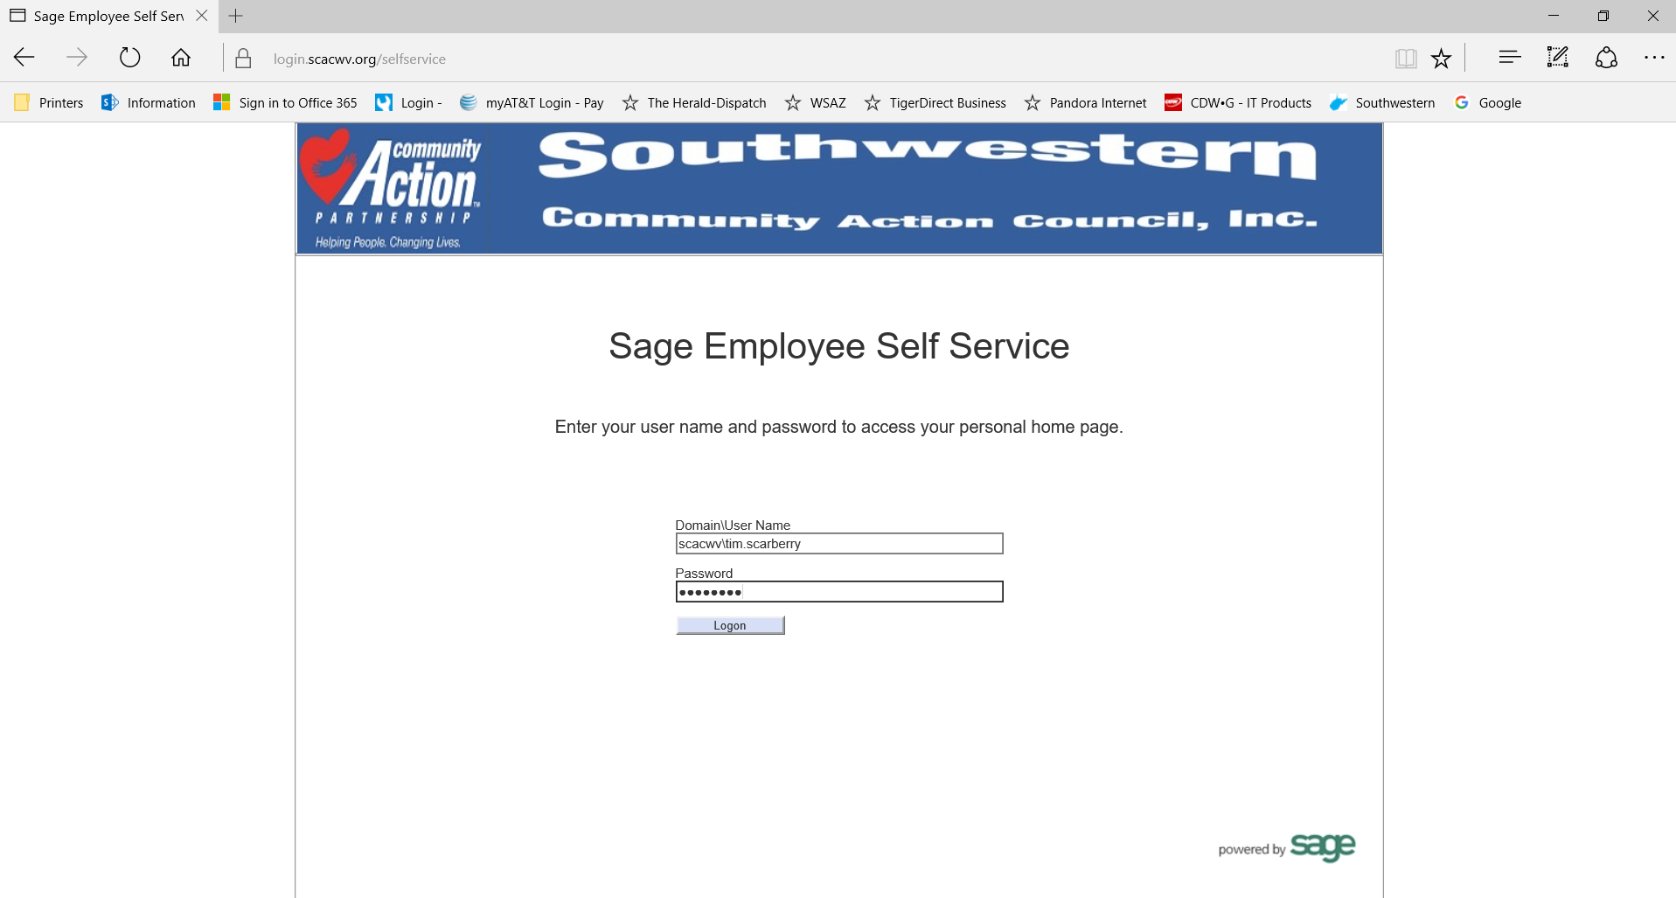
User ID
scacwv\first.last
Note the back slash (above the enter key)
PW is your computer PW if you work at 540, Monroe, Wx.
If your job site is not one of the above you may need to contact IT for your PW.

Slide 3
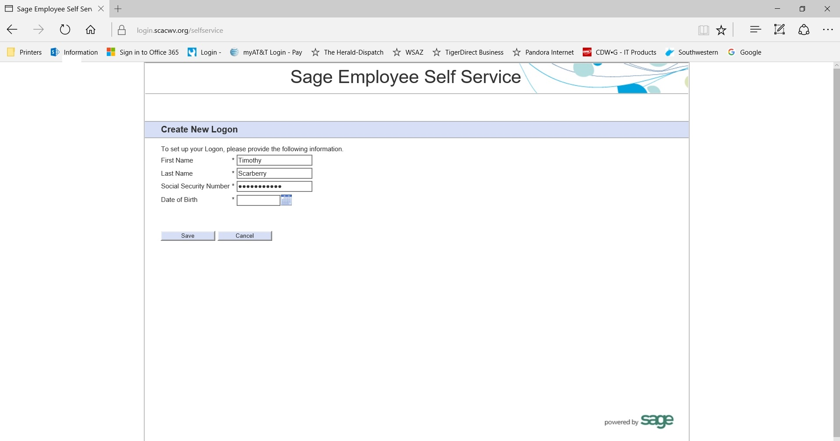
Your Social Security Number must include the dashes –
This page you will only have to complete the first time you utilize ESS. Once you have completed it once you will no longer see this screen.

Slide 4
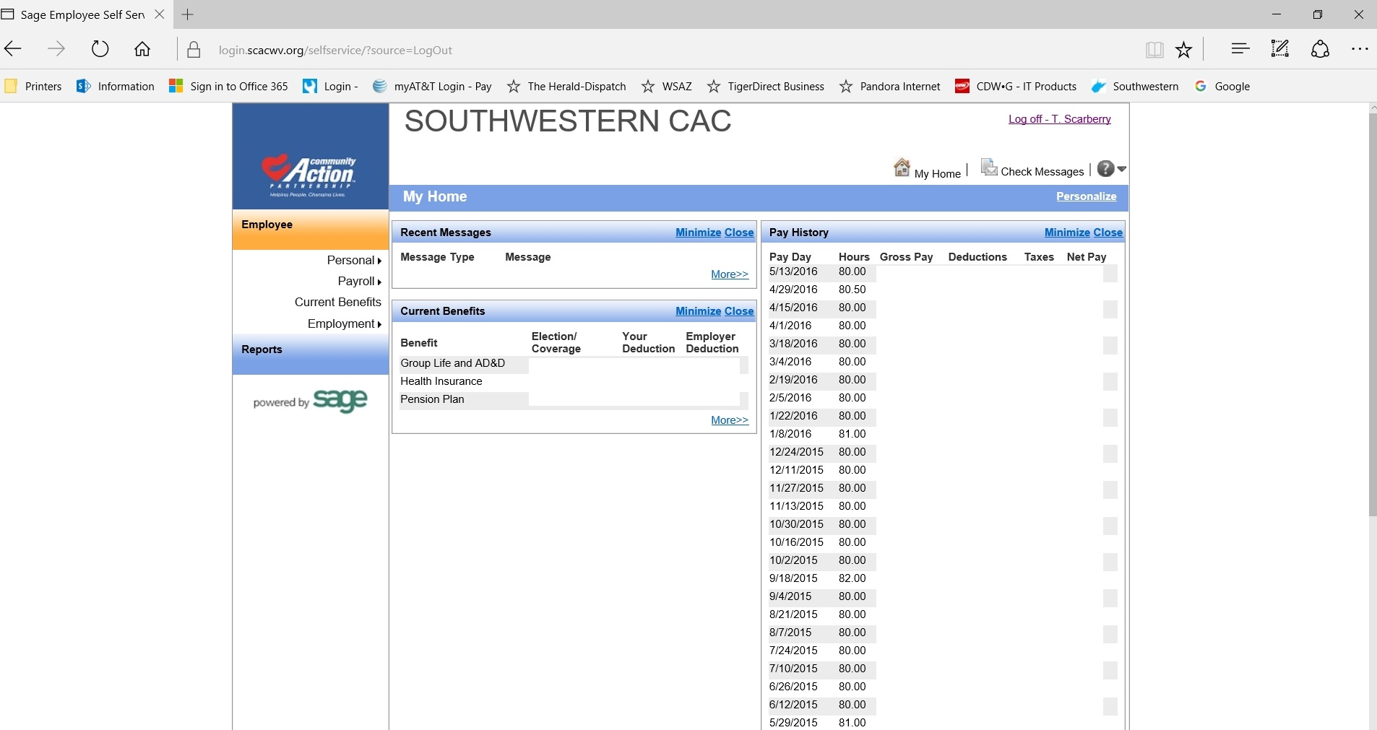
The ESS Home Page

Slide 5
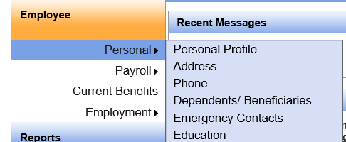
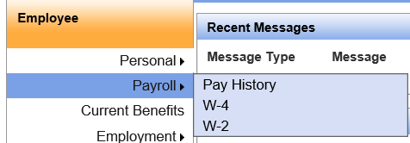
Screen shot of Personal
This section includes information about your name, address, telephone number, dependents/beneficiaries, etc…
Screen shot of Payroll
To view Pay Stubs
Payroll – Pay History
W-4 & W-2 are also available here.

Slide 6
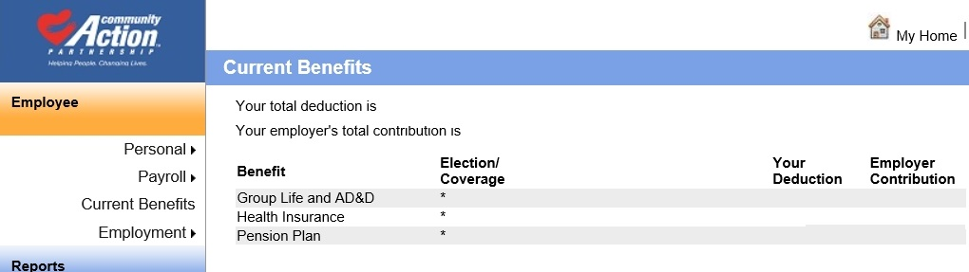
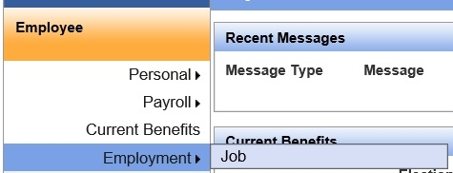
Screen shot of Current Benefits
Information on your current benefit election/coverage.
Screen shot of Employment
Employment section has some basic information about your job title, start date, manager, etc…

Slide 7
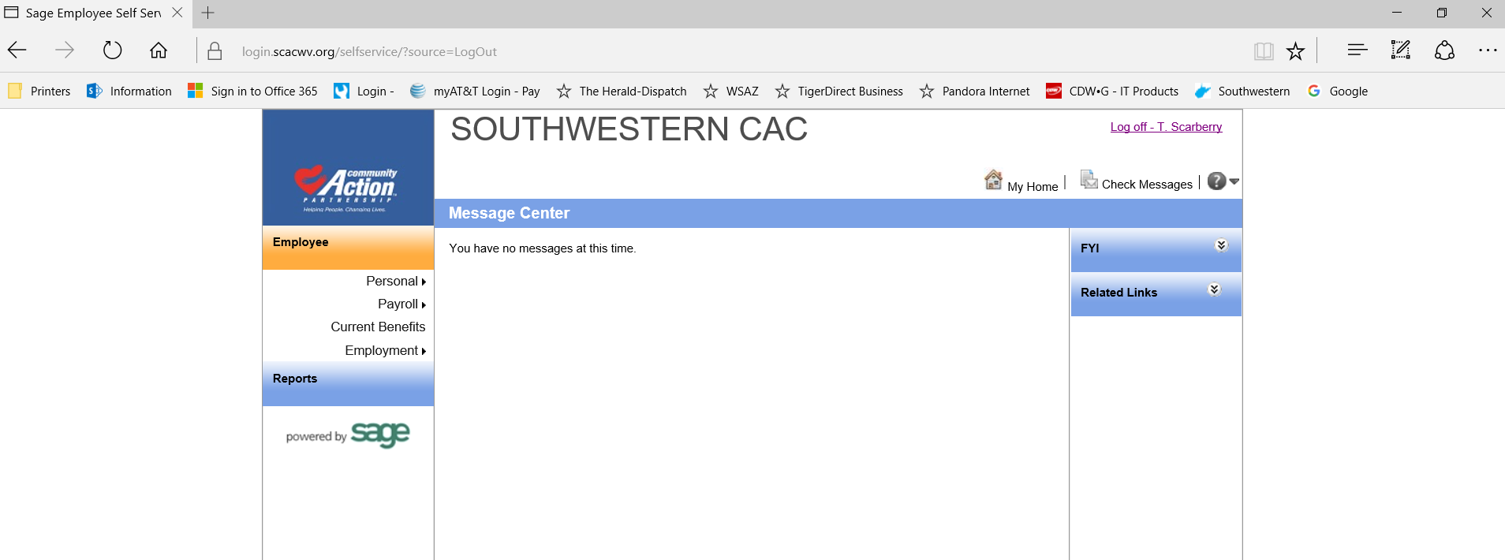
Check Messages is on the right hand side of the screen below Log Off – First Initial.Last
Check the Messages section for important information management may
wish to communicate.
Always remember to hit the “Log off – First Initial.Last” once you are done.

