Slide 1


Main Idea
And supporting details…

Slide 2

What is the main idea?
The words “main idea” mean what something is mostly about.
Look at this picture. What do you see the most of? A strawberry!
Even though there are seeds and a stem, and the color is red – the picture is mostly about the strawberry.

Slide 3

Hide & Seek
Finding the main idea in reading passages can sometimes be a little more tricky. Today we are going to learn some ways to help us spot and find the Main Idea –when it is hidden in a bunch of words!

Slide 4
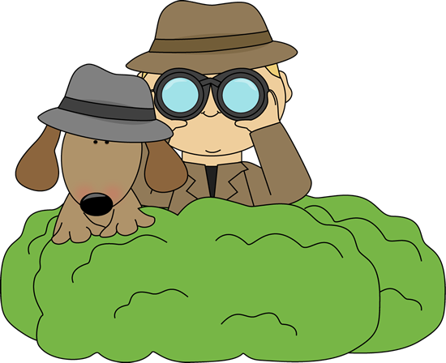
Be a Reading Detective!
Good readers will always look for clues to help them spot the main idea in a story.
Look at these 3 clues:
  The title
  The text
  The pictures

Slide 5
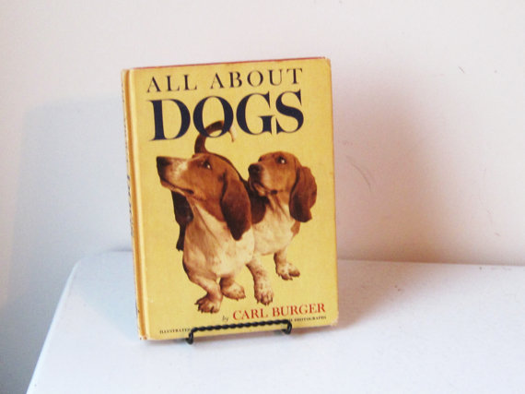
Look at the Title
The title is the name of the book or article. What words do you see in the title? One of those words will likely be part of the main idea!
The title of this book is All About Dogs
What is the main idea of the book? DOGS!

Slide 6

Look at the text!
The word “text” just means the writing on the page. Scan quickly through the passage or a few pages of the book. Are there any words that you see repeated?
If so, pay attention as that is a key clue to what the main idea might be.

Slide 7

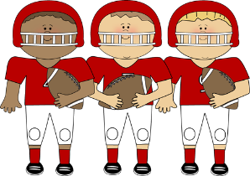
Look at the pictures!
The third and last clue when searching for the MAIN IDEA – is to look at any pictures, graphs or illustrations. They will give you a better idea of what the main idea of the story is about.
Football
What do you think is the main of this book?
What is it mostly about?

Slide 8
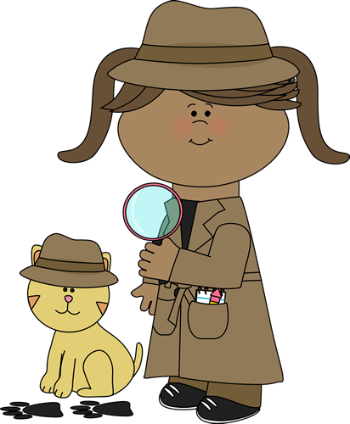
Give it a try!
Read this passage and try to spot the main idea. Remember, look at the title, text and pictures to give you some clues!

Slide 9
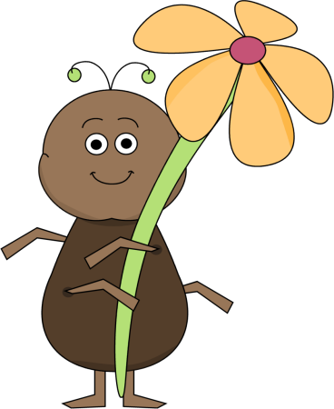
The Amazing Ant
Ants are amazing.
They live in large groups called colonies.
Most ants like to build their nests underground. Each ant nest will be full of tunnels. Sometimes ants will not live underground. You might find ants in dead trees, under rocks, or even in nests made of leaves.

Slide 10
What is the main idea of this passage?
What is the passage mostly about?
Clue #1 – The Title: The Amazing Ant
Clue # 2 – The Text:
The Amazing Ant
Ants are amazing. They live in large groups called colonies.
Most ants like to build their nests underground. Each ant nest will be full of tunnels. Sometimes ants will not live underground. You might find ants in dead trees, under rocks, or even in nests made of leaves.
Clue # 3 – The Pictures

Slide 11
Have you figured out the main idea of this passage?
Which one of these choices is the correct answer:
A. Large groups of ants are called colonies.
B. Rotting leaves make a nice nest.
C. Ants are amazing creatures.

Slide 12
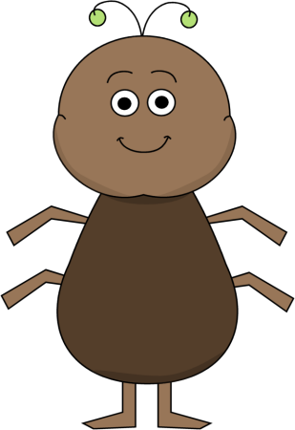
The correct answer is “C”
Ants are amazing creatures!

Slide 13
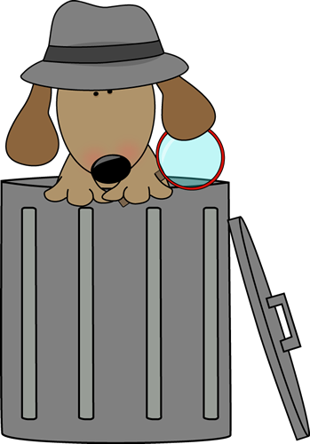
Another Practice Passage
Read the passage on the next slide and try to use the clues to identify the main idea. Good luck, detectives!

Slide 14
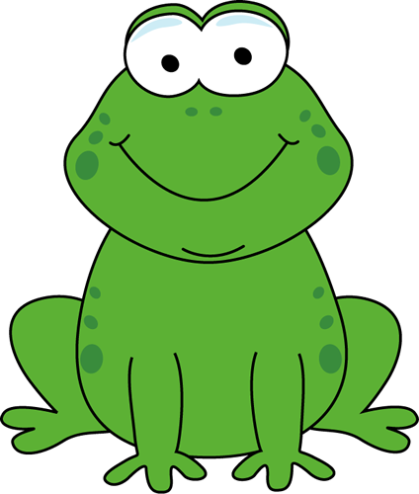
Frog Habitats
Frogs live in wet places such as ponds, lakes and rivers. Frogs love to swim and often can be found near water sources. Tadpoles are baby frogs. Tadpoles don’t look like frogs yet, and they only live in water. Frogs live all over the world, except for Antarctica.

Slide 15
What is the main idea of this passage?
Frogs, and where they mostly live
Tadpoles
Antarctica

Slide 16
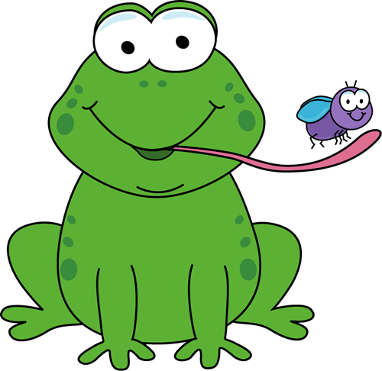
The answer is “A”
Go back and look at the title, text and pictures to review. Great job!

Slide 17
Frog Habitats
Frogs live in wet places such as ponds, lakes and rivers. Frogs love to swim and often can be found near water sources. Tadpoles are baby frogs. Tadpoles don’t look like frogs yet, and they only live in water. Frogs live all over the world, except for Antarctica.

Slide 18
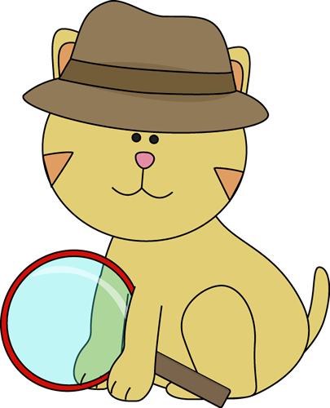
Supporting Details
Supporting details give the reader more information about the main idea.
While the main idea is the MOST IMPORTANT idea in the story, the supporting details help you to better understand the main idea. Let’s look closer at supporting details.

Slide 19
Supporting Details
Remember that supporting details describe or explain the main idea. While the main idea will cover the whole paragraph or article, the supporting details will likely be specific details in sentences.

Slide 20
Let’s Practice
Read the following passage and identify the main idea and the supporting details.
Shark Teeth
Sharks have many rows of sharp teeth. In its lifetime, a shark will go through more than 10,000 teeth! Sharks are always losing teeth, and growing new teeth. Each shark has a different set of teeth. Some are flat, some are long and spiky and some are jagged. Sharks will take a bite out of their prey before eating it.

Slide 21

What is this passage mostly about?
Find the main idea!
Sharks
Shark Teeth
Underwater animals
The correct answer is Shark Teeth

Slide 22
Now lets look at the supporting details…
These supporting details describe and help explain the main idea:
1. Sharks have many rows of teeth
2. Sharks are losing and growing teeth
3. Sharks will lose more than 10,000 teeth in their lifetime.
4. Shark teeth are flat, long and spiky.

Slide 23
Chart it out!
Graphic organizers can help you to identify the main idea and supporting details. Here is a sample:
Shark teeth are flat, jagged and spiky.
Sharks have
many rows
of teeth.
SHARK TEETH
Sharks lose and grow teeth during their life.
Sharks use up more than 10,000 teeth

Slide 24
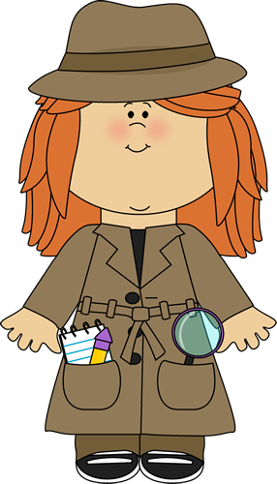
Practice Makes Perfect!
Learning how to pick out the main idea and supporting details of an article takes practice.
Just remember to look for the clues of title, text and pictures to find the main idea. Supporting details will be specific pieces of information that add to the main idea.

