Slide 1
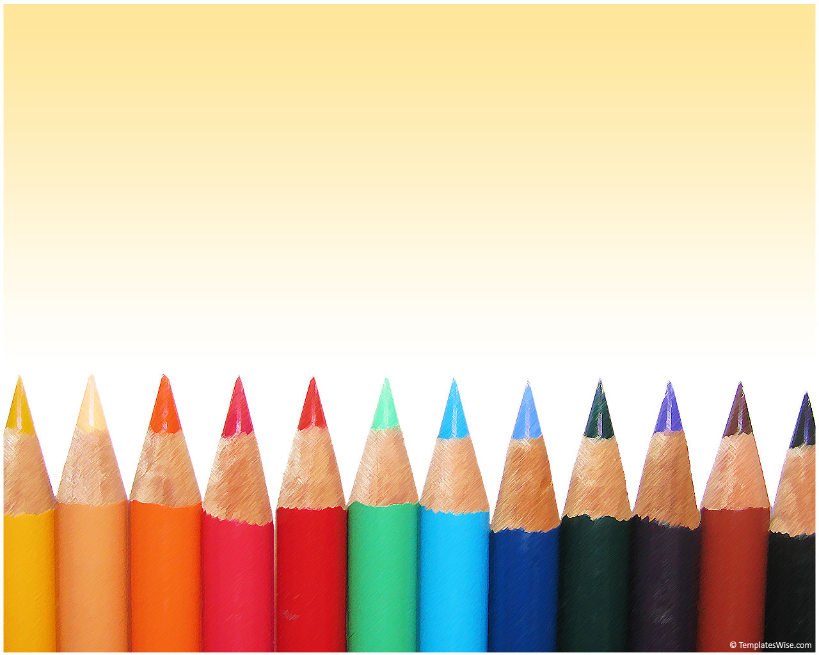
Timelines

Slide 2

What is a timeline?
A timeline tells a story.
It is a calendar of events that are recorded in order of when they happened.
It is a tool that helps us to know when important events have happened.

Slide 3
When do we Use a Timeline?
to show the events of a person’s life
to show important events in history
to sequence things that have happened

Slide 4
How do we Make timelines?
We think of important events.
We write them in the order that they happened.
We use labels that tell us when the events happened.
We include a relevant title.
We can include pictures or symbols.
We write as neatly as possible, and we are creative!

Slide 5
Ready to see some examples?

Slide 6
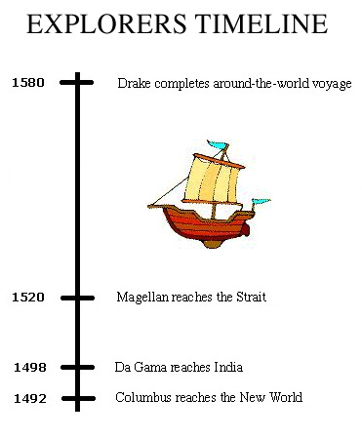

Slide 7
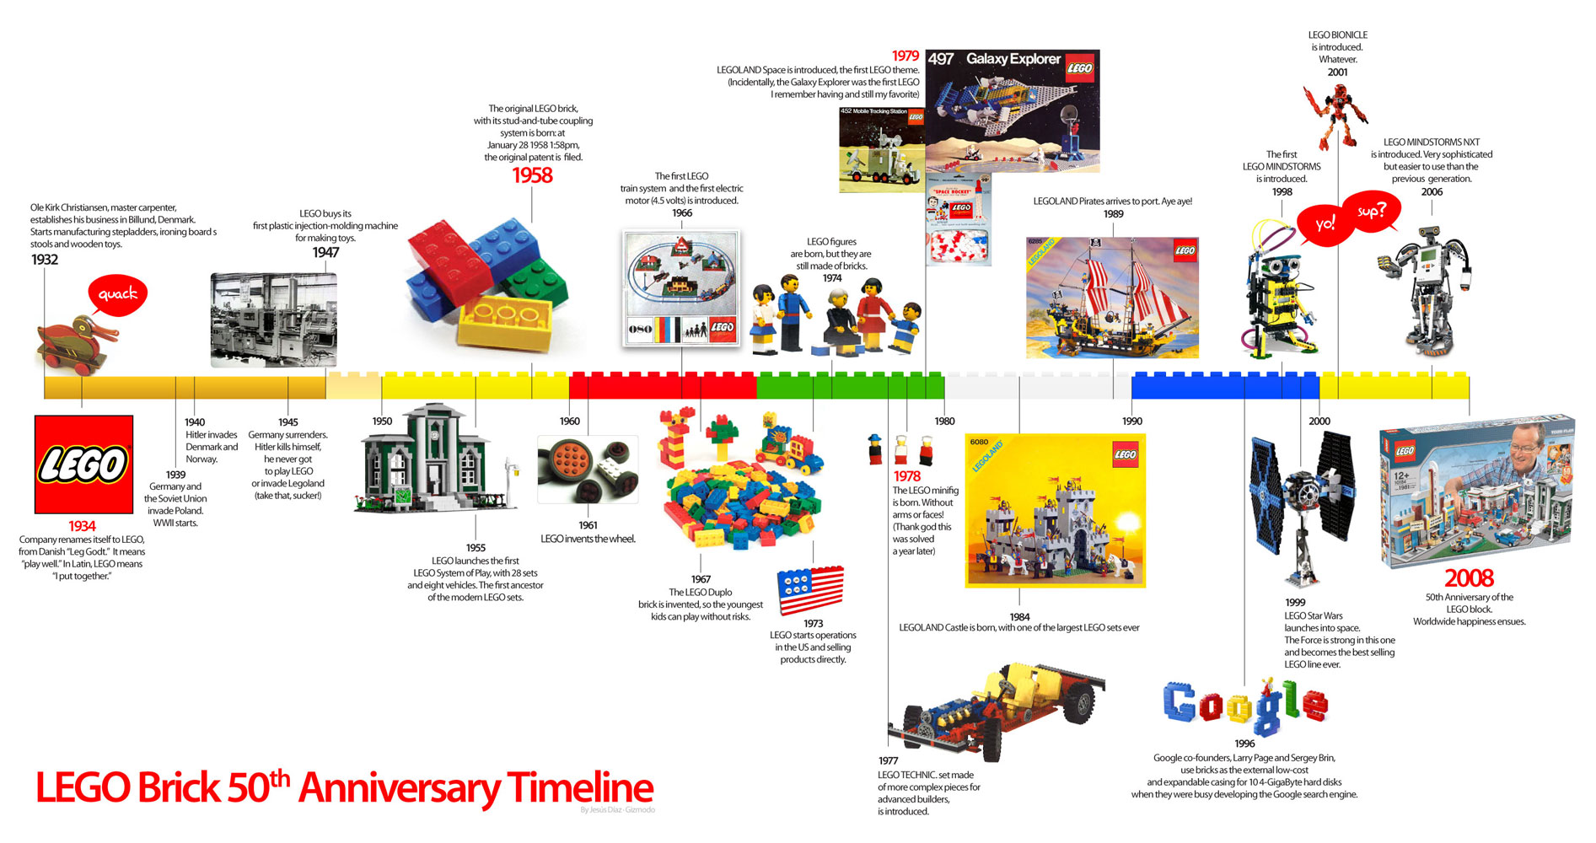

Slide 8
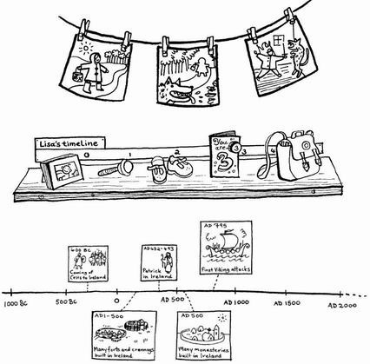

Slide 9
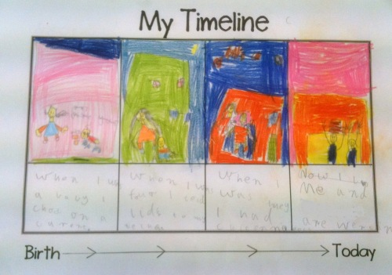

Slide 10
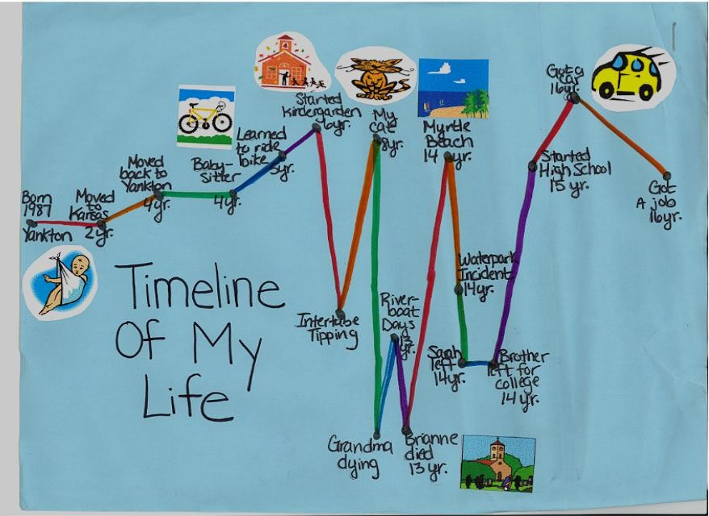

Slide 11
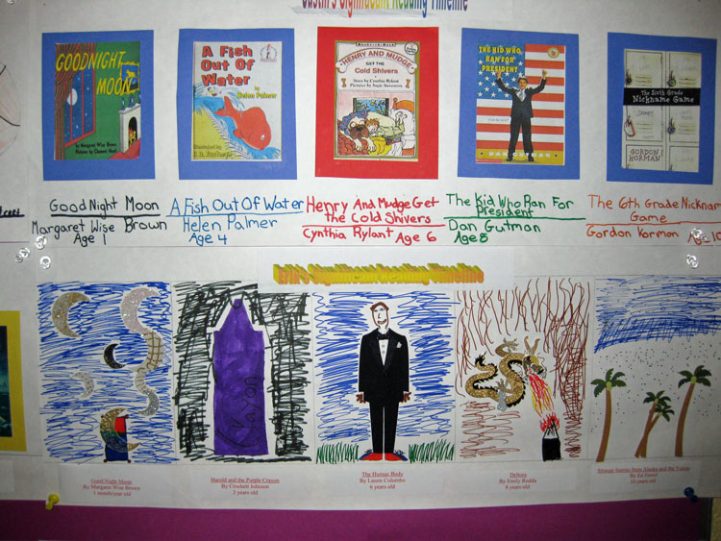

Slide 12
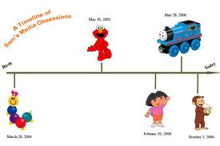

Slide 13
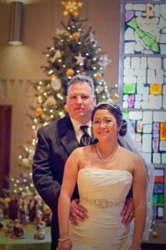
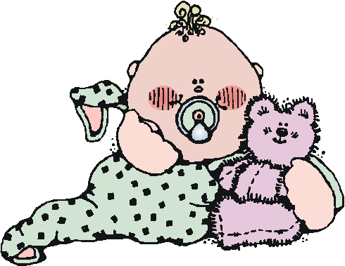
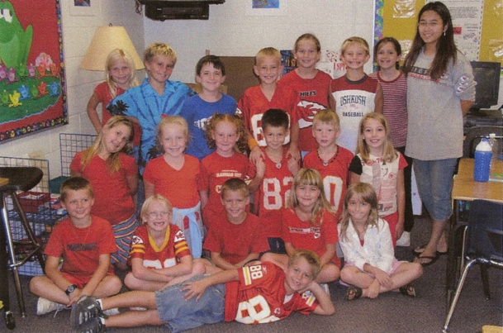
Mrs. Kilby is born. - 1984
Mrs. Kilby becomes a teacher and teaches her first class. - 2005
Mrs. Kilby gets married. - 2010
A Timeline of Mrs. Kilby’s Life

Slide 14
We will be creating lots of different kinds of timelines throughout this unit, and by the end of the unit, you will know how to use and make a timeline!

