Slide 1

MET-Certified Workshop
Risk reduction of Marine energy projects through internationally accredited testing and
certification under the IEC
MET-CERTIFIED Workshop – 24/10/2017

Slide 2

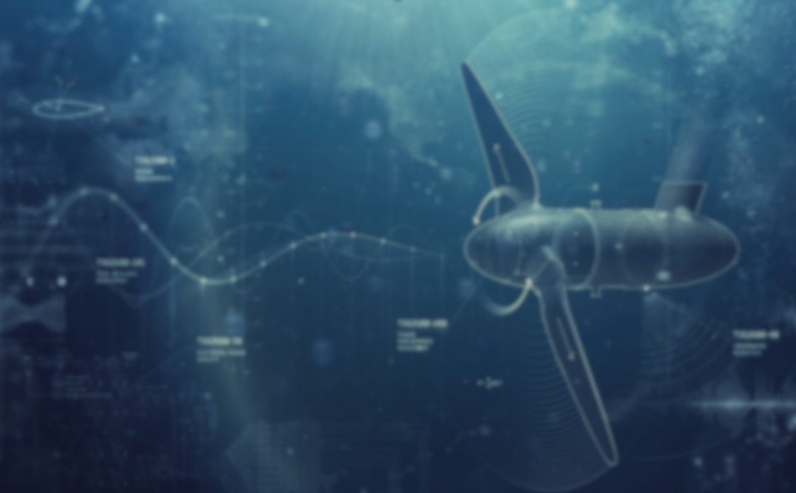
Agenda
Agenda
1
MET-CERTIFIED Project, Peter Scheijgrond, DMEC
2
Technical Specifications for marine energy convertors under IEC TC 114, Anna Southall, EMEC
3
Certification schemes under IEC RE ME OMC, Olivier Benyessaad, Bureau Veritas
4
Coffee break
5
Your activities, Your needs & How to get involved
6
Drinks reception and networking

Slide 3
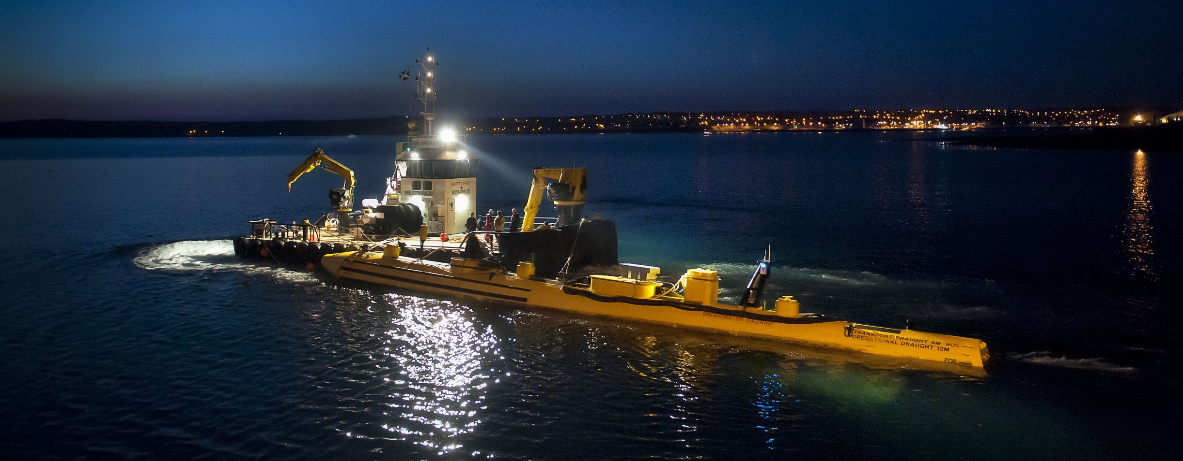

MET-CERTIFIED Project
1
2
Technical Specifications for Marine Energy Convertors under IECTC114
3
Certification schemes under IEC RE ME OMC
4
Your activities, Your needs & How to get involved
Peter Scheijgrond, Dutch Marine Energy Centre

Slide 4
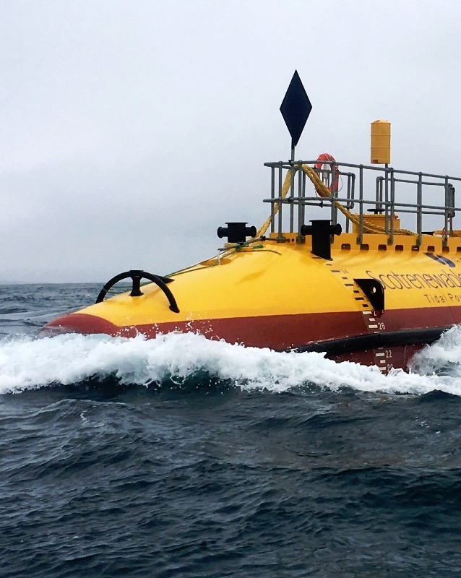
1
MET- CERTIFIED Project
Objective
MET-CERTIFIED aims to accelerate the adoption of insurable and bankable marine energy technologies.
This is done by advancing internationally recognised standards and certification schemes (under IEC)
and by applying them in eight test and verification cases.

Slide 5
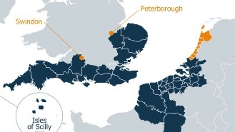
1
MET- CERTIFIED Project
Project
Details
Partners
10
Observers 13
Budget 10m EUR
Duration 3 years
(2017-2019)
Focus of activities in 2SEAS region but with International Outreach

Slide 6
1
MET- CERTIFIED Project
DMEC
Organisation
WP 3
Project Management
Power-Link
POM
WP 4
Communication & Business
Spin-Offs
EMEC
Tocardo
WP 1 Certification
WP 2 Build & Install Pilot
Lloyds
Register
DNV-GL
NEC
IFREMER
BV
Sub-
Contractors
PTEC/EMEC
Apply &
Develop Certification
Apply &
Develop Certification
Workshops
on
Certification
Test to
Certification Schemes
Certification
Fabrication
Site
Development
& Grid

Slide 7
1
MET- CERTIFIED Project
Eight
Test Cases
4
IFREMER at scale testing
Dam-integrated
Floating
Sub-merged
Semi-submerged
1
1
1
1
Against suite of IEC TC114 and
IECRE ME OMC tools under
development

Slide 8
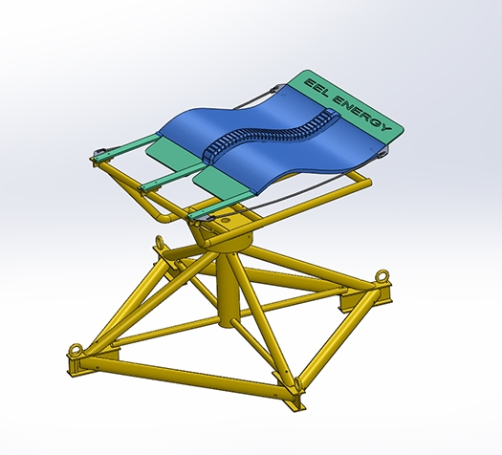
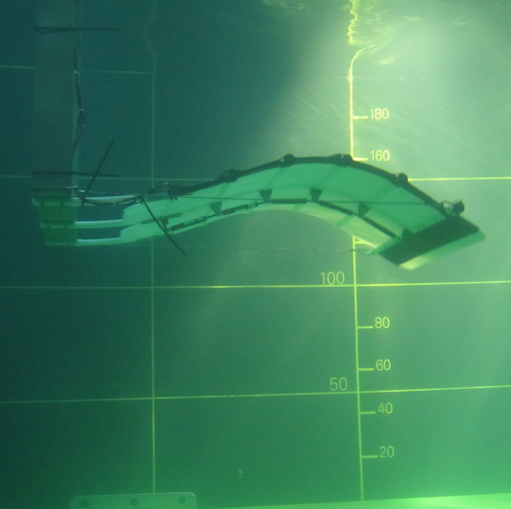
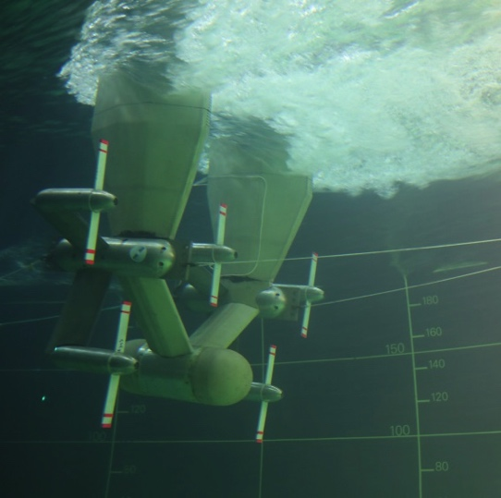
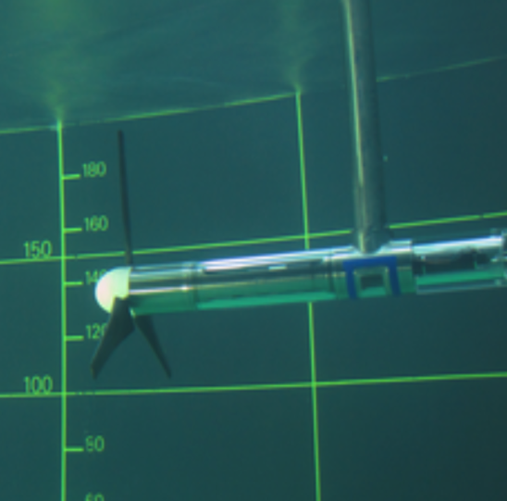
1
MET- CERTIFIED Project
4
Tests Cases
IFREMER controlled conditions
EEL Energy
Tocardo UFS
IFREMER HAT
4th TBD
4th Model Tests
Still to be
Determined
I dont’ know if the name of every photo is correct

Slide 9
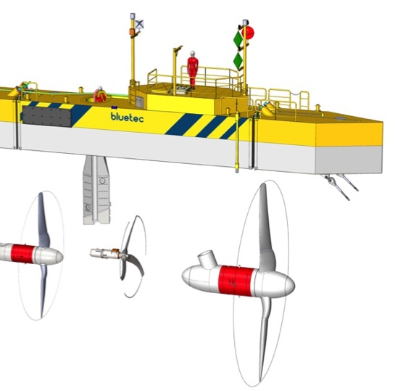
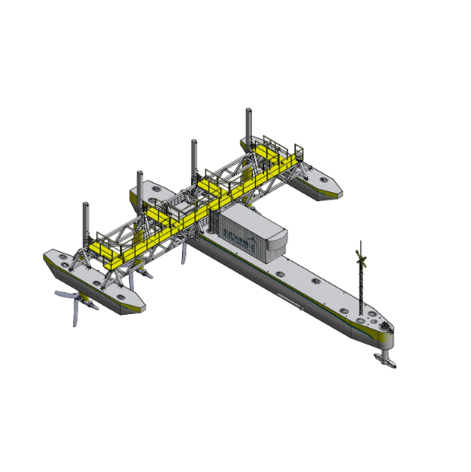
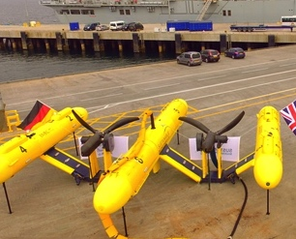
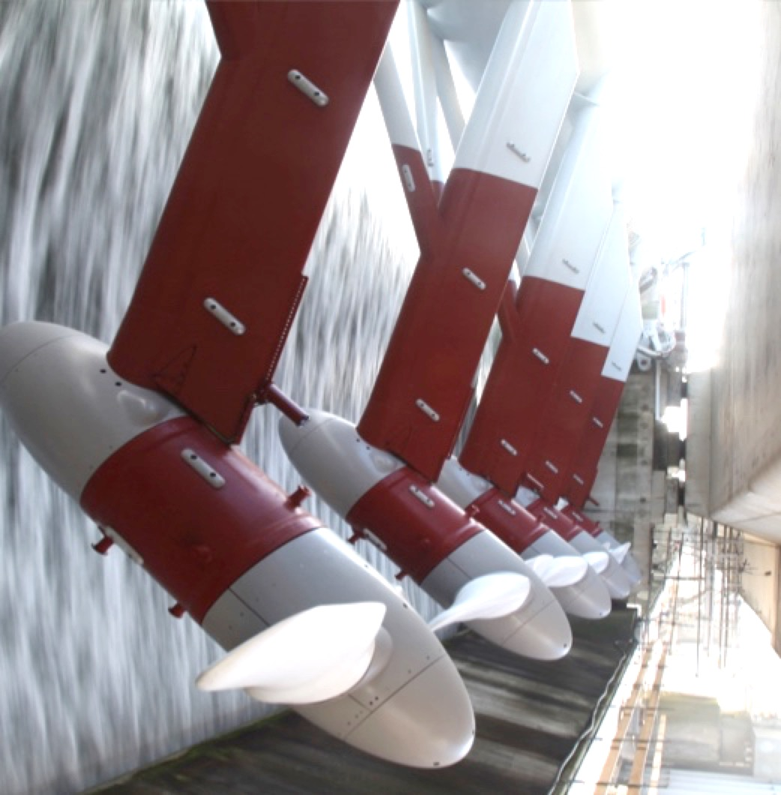
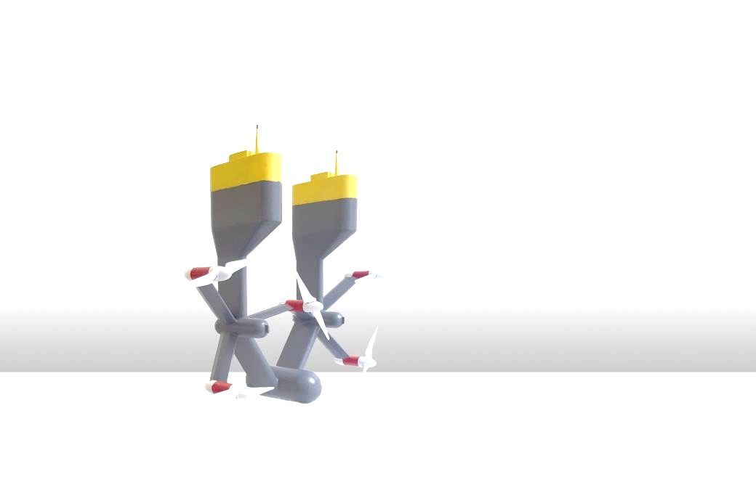
1
MET- CERTIFIED Project
4
Tests Cases
in Open Water
Blue TEC
Plat-I SME
Oosterschelde Project
Tocardo Universal Floating System

Slide 10
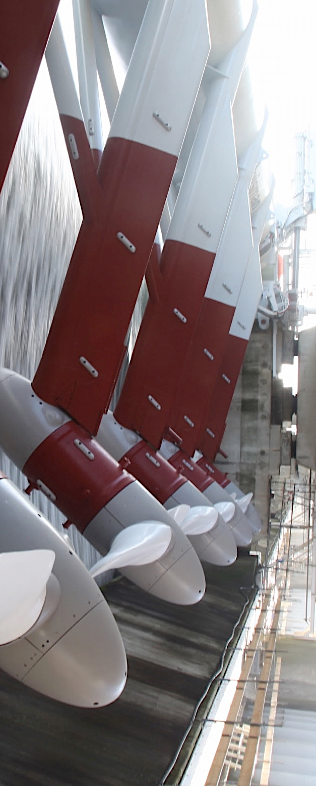
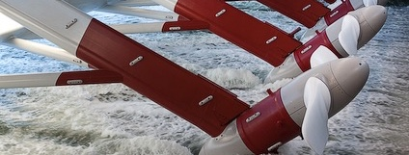
Technical Specifications
1
MET-CERTIFIED Project
2
IEC TC114 for Marine Energy Convertors
3
Certification Schemes under IEC RE ME OMC
4
Your activities, Your needs & How to get involved
Martijn Geertsen – NEC
Anna Southall– European Marine Energy Centre (EMEC)

Slide 11
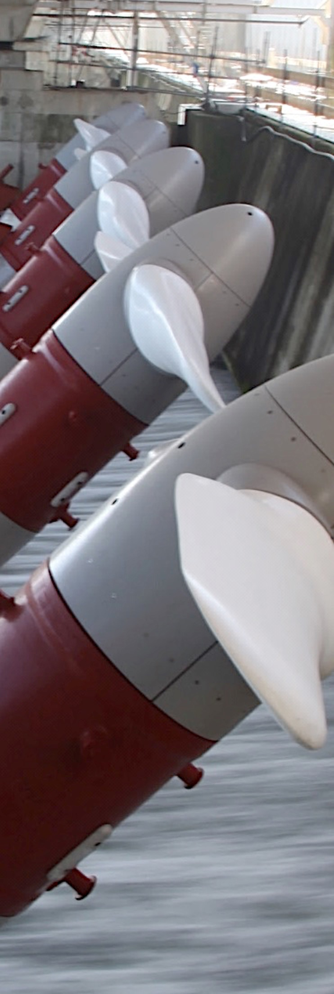
2
Technical Specifications
IEC
Mission
Leading platform for Standards and Conformity Assessment Systems
Facilitate international trade and enhance user value
Encourage national adoption of International Standards
Ensure technical and market relevance

Slide 12
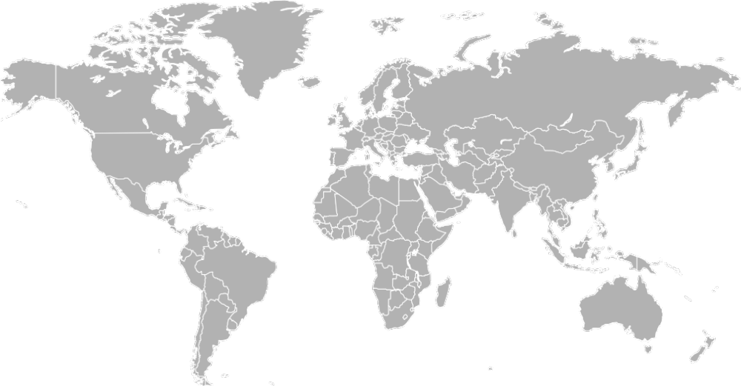
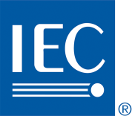
IEC Offices
2
Technical Specifications
IEC
Offices
IEC CO
Geneva
IEC-ReCNA
Boston
IEC-AFRC
Nairobi
IEC-LARC
São Paulo
IECQ-IECEx
Sydney
IEC-APRC
Singapore
Notes:
IEC headquarters are in Geneva and the IEC has five regional offices in Africa, Australia, Brazil, Singapore and the US.

Slide 13
2
Technical Specifications
Full members National Committees
COUNCIL
IEC
Management Advisory Committees
COUNCIL BOARD
Central Office
Executive Committee
SMB
Standardisation Management Board
MSB
Market Strategy Board
CAB
Conformity Assessment Board
Technical Committees
committees & sub-committees
Special Working Groups
IECEE
Technical Advisory Committees
ACART, ACEA, ACEC, ACEE, ACOS, ACSEC &ACTAD
IECEx
Strategic Groups
3 Strategic Groups
IECQ
Systems Work
3 Systems Evaluation Groups.3 Systems Committees
IECRE
Notes:
Structure of IEC
Why are these highlighted?
Technical Committees
IEC Renewable Energy

Slide 14
Tidal and other water current converters
2
Technical Specifications
TC 114
Marine Energy
Technical Committee 114 aim
To prepare international standards for marine energy conversion systems.
Focus on conversion of wave, tidal and other water current energy into electrical energy.
Tidal barrage and dam installations are excluded. They are covered by TC 4.
ewww.iec.ch/tc114

Slide 15
The standards produced by TC 114 will address:
2
Technical Specifications
TC 114
Scope
System Definitions
Management plan for technology and project development
Performance measurements of wave, tidal and water current energy converters
Resource assessment requirements
Design and safety including reliability
and survivability
Deployment, operation, maintenance and retrieval
Commissioning and decommissioning
Electrical interface, including array integration
and /or grid integration
Testing: laboratory, manufacturing and
factory acceptance
Measurement methodologies of physical
parameters of the device
Notes:
Re green ones pulled out for this project?

Slide 16
2
Technical Specifications
IEC TC
How
does it work?
National institutes have mirror committees in member countries to vote, comment and start projects.
Countries nominate experts to project teams.
Project teams write standards
Annual Plenary meetings
PTs have regular TelCons
Face-to-Face meetings (2x a year)
Notes:
National institutes have mirror committees in member countries to vote, comment and start projects.
Project teams write standards
(maintenance teams, ad hoc groups). Experts from a minimum of four
different countries are required to start a new project team.
Annual Plenary meetings
PTs have regular TelCons
Face-to-Face meetings (2x a year)

Slide 17
2
Technical Specifications
2
Technical
Specification
62600 series
Generic
Wave
Tidal
Rivers
OTEC
-1
-100
-200
-300
-20
Terminology
Performance
Performance
Performance
OTEC Design Assessment
-2
-101
-201
-201
Design Requirements
Resource
Resource
Resource
-10
-102
-202
Moorings
2nd Location
Scale Testing
-30
-103
Electrical
Power Quality
Scale Testing
-40
Acoustic Measurement
-xx
Published (TS)
Under development (pre-CD or CD1)
Loads Measurements
Notes:
Update status

Slide 18
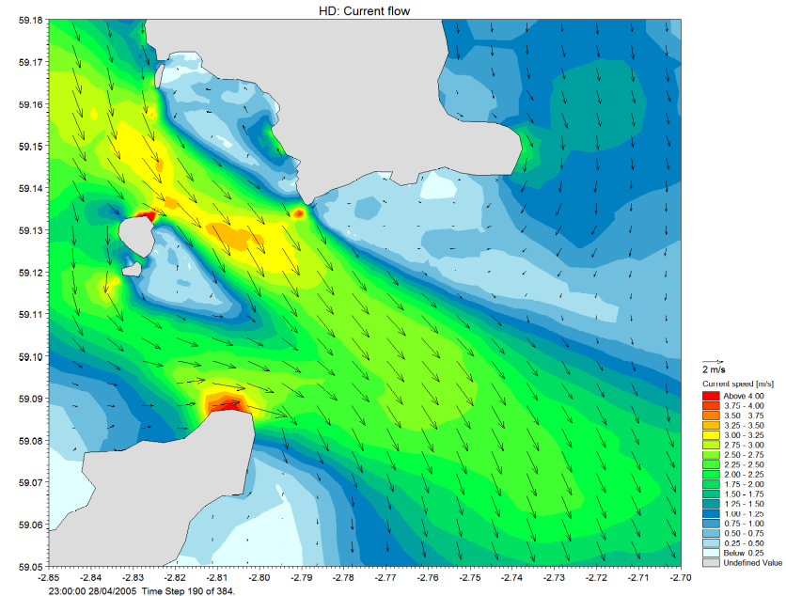
2
Technical Specifications
What will we learn through Met -Certified?
Applying the standards in practice on a range of devices
Resource data can be used to review numerical model uncertainty
Comparison of ADCP configurations
Evaluation of Power curves against -200 Tidal Performance
Notes:
consistency of terminology, clarity of definitions for a variety of devices and standards still under development

Slide 19
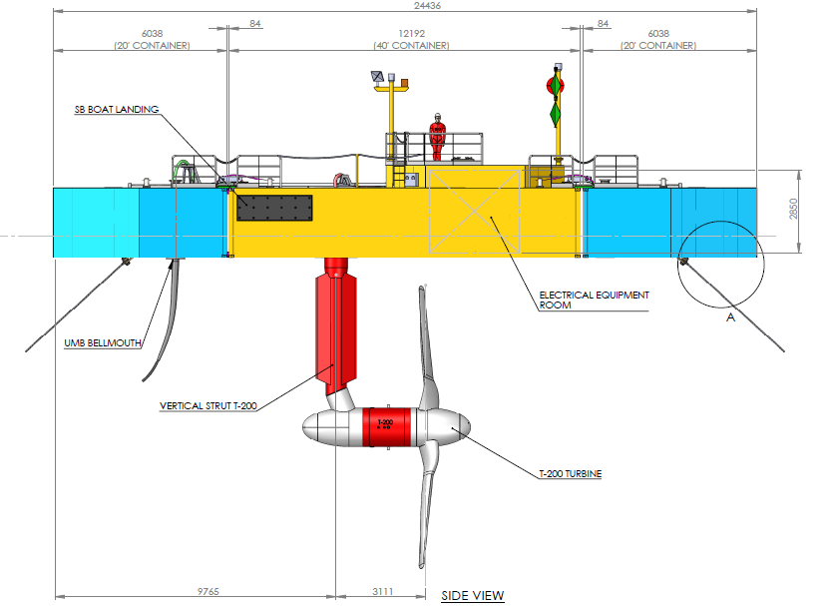
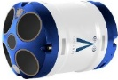
2
Technical Specifications
What will we learn through Met -Certified?
Applying the standards
Seabed and device mounted ADCP comparisons
Coverage of swept area
Vertical or horizontal profile captured
Ease/risks around deployment and recovery
Deployment duration and data access
Capturing wave data
Need to account for movement and/or interference
turbine mounted ADCPs
Seabed ADCP
Notes:
consistency of terminology, clarity of definitions for a variety of devices and standards still under development

Slide 20
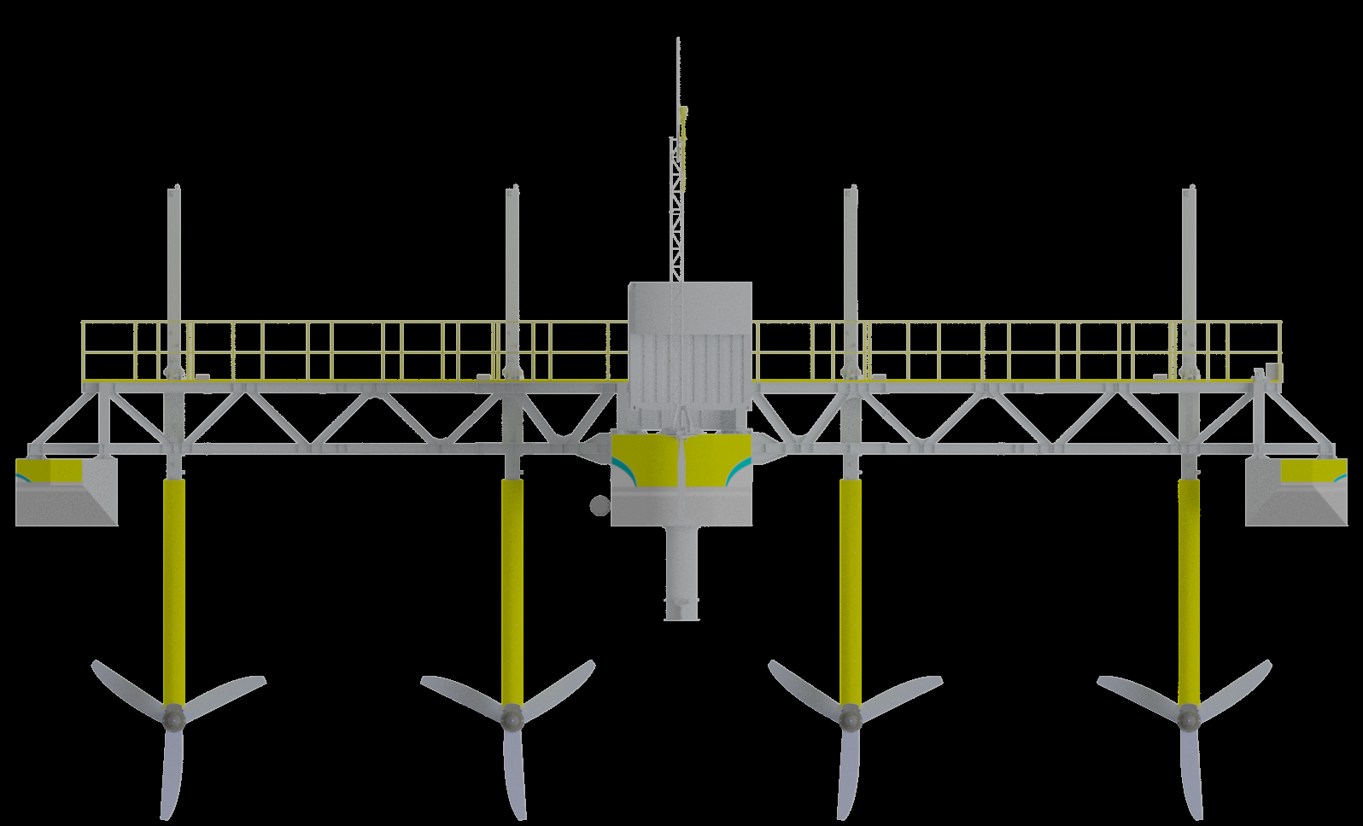
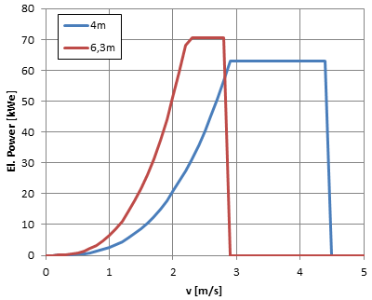
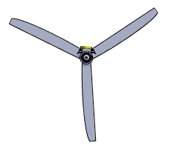
2
Technical Specifications
What will we learn through Met -Certified?
Applying the standards- Power curve verification
4m rotors
6.3m rotors
Notes:
consistency of terminology, clarity of definitions for a variety of devices and standards still under development

Slide 21
2
Technical Specifications
2
4
reasons
to get
involved
Ensure standards are practicable and relevant
Enable global export of your technology
Early market intelligence and focused innovation
Return on investment
Testing & Verification
Standards
Notes:
When experts participate in the standardization process, they are able to ensure that all relevant technologies are taken into account. Standards identify market differences which can then be built into a product at the development stage or streamlined at production. This helps to limit or group market variations that are otherwise costly and would reduce a company’s commercial flexibility.
All of the above allows to lower the cost of business through the elimination of duplication and of waste in terms of time and money.
Standards development and testing and verification are of equal importance in the IEC. Conformity assessment brings the written word in Standards to the real world. Companies want to sell their products to many countries, faster, more efficiently and they don’t want to waste time or money on duplication. Standards, testing and certification are the key stepping stones for market access.
Is this a conflicting message about taking into consideration all relevant technologies and limiting market variation?
Market intelegence- both about deployments impression of local markets, also feedback into standards
Return on investment reliability and maintainability.

Slide 22
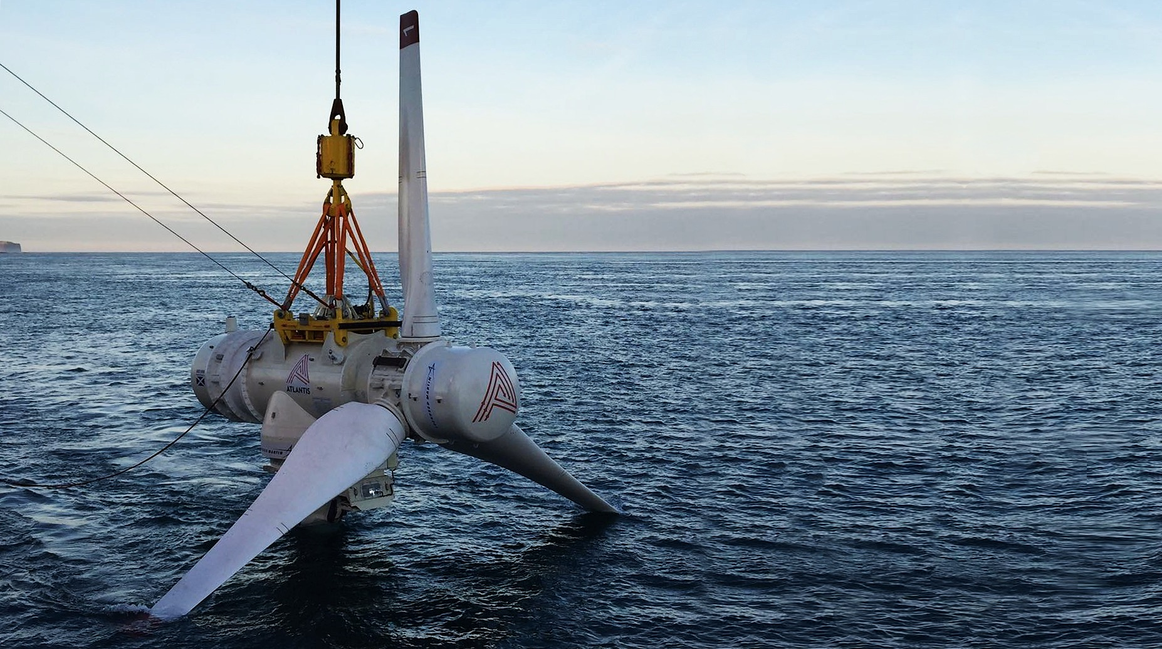
1
MET-Certified Project
2
Technical Specifications
IECTC114 for Marine Energy Convertors
Development of Certification
Schemes under IECRE ME OMC
3
3
4
Your activities, Your needs & How to get involved
Olivier Benyessaad, Bureau Veritas

Slide 23
3
3
Development of Certification
IEC CONFORMITY ASSESSMENT BOARD, CAB
Oversees IEC Conformity Assessment Policy and Systems, Eg IECEE, IECEx, IECQ, IECRE
Operational Structure of IECRE
System
IECRE Management Committee, REMC
Overall Management of the IECRE System
IECRE Secretariat
National Members (Countries)
Officers + Executive, Scheme Chairs, IEC Gen. Sec
Technical Support
Expert Working Groups ( WGs) – as Needed
Administration
WE OMC
Wind Energy Operational
Management Committee
Daily Management of WE Sector
ME OMC
Marine Energy Operational
Management Committee
Daily Management of ME Sector
PV OMC
PV Solar Operational
Management Committee
Daily Management of WE Sector
National Members
National Members
National Members
TC 88 + SC Liaison
TC 114 + SC Liaison
TC 82 + SC Liaison
Committees + WGs
Committees + WGs
Committees + WGs

Slide 24
3
3
Development of Certification
IECRE
System
Details
“
IEC System for Certification
to Standards Relating to Equipment for Use in Renewable Energy Applications (IECRE)
“
ME
Marine Energy
Operational Management Committee
OMC
Website: www.iecre.org

Slide 25
3
3
Development of Certification
IECRE
Membership
Member Bodies
China
India
Japan
Rep. of Korea
Egypt
Canada
US
Austria
Denmark
France
Germany
Hungary
Netherlands
Spain
UK
RECBs
Renewable Energy Certification Bodies
Renewable Energy Inspection Bodies
Renewable Energy Test Laboratories
REIBs
RETLs

Slide 26
3
3
Development of Certification
IECRE
System
Status
IECRE Management Committee (REMC)
System level issues
(Basic Rules, Rules of Procedure,
Peer, Assessment, Budget, etc.)
Officers
Chairman: Mr. Sandy Butterfield (US, BWC)
Vice-Chair: Mr. Qin Haiyan (China, CGC)
Treasurer: Dr. Lars Sitzki (Germany, TUV Nord)
Exec.Secretary: Kerry McManama (IEC CO)
WGs
WG001: Rules
WG003: Customer Testing Laboratories
WG004: Promotion & Marketing
WG006: Finances
WG007: Personnel Certification

Slide 27
3
3
Development of Certification
IECRE
System
ME-OMC
Operational Management Committees (OMCs)
ME-OMC, PV-OMC, WE-OMC
ME-OMC Officers
Jonathan Colby – ME-OMC Chair (US)
Dr. Rebecca Sykes – ME-OMC Vice-Chair (GB)
Kerry McManama – Exec. Secretary (IEC CO)
WGs
301: Rules of Procedure (GB Convener)
306: Finance (US Convener)
360: Scope of Certification (GB + NL Co-Conveners)

Slide 28
3
3
Development of Certification
IECRE
Cost to Participate
Annual Dues billed to Member Body
CHF 5,000 per IECRE Member Body
CHF 1,000 per declared Sector
CHF 500 per RECB, REIB and RETL
Application fees
CHF 2,000 per Member Body to the MB
CHF 1,000 per declared Sector to the MB
CHF 1,000 per RECB or RETL to the CB/TL
CHF 1,000 for a Scope Change to the CB/TL
Member Bodies assign internal dues differently

Slide 29
3
3
Development of Certification
Technology Qualification
Type Certificate
Reference
Documents
Deliverables
Output
Design Basis
Assessment
EMEC Guidelines for Design Basis (2010)
Conformity
Statement
Design
Assessment
Terminology (62600-1)
Design (62600-2
Moorings (62600-10)
OTEC (62600-20)
Conformity
Statement
Manufacturing
Assessment
EMEC Guidelines for Manufacturing, Assembly and Testing (2008)
Conformity
Statement
Type
Testing
Wave Performance (62600-100)
Tidal Performance (62600-200)
Loads (62600-3)
Test
Report
Conformity
Statement
Type Characteristic Measurements
Power Quality (62600-30)
Acoustics (62600-40)
Conformity
Statement
Final
Evaluation
Type
Certificate
optional

Slide 30
3
3
Development of Certification
Certification Scheme
for Tidal Under ME OMC
Project Certificate
Type Certificate
O&M Surveillance
OD310-2
OD310-10
OD300-x
OD300-200
OD300-30
OD300-40
Other C.S./ Test Reports
OD300-201
IECRE ME-OMC
IEC TC 114
IEC/TS 62600-2
Design Requirements
IEC/TS 62600-10
Moorings
IEC/TS 62600-x
Loads Measurement
IEC/TS 62600-200
Performance Assessment
IEC/TS 62600-30
Power Quality
IEC/TS 62600-40
Acoustics
Other standards
(none TC114)
*
IEC/TS 62600-201
Resource Assessment
Conformity Statements
Test Reports
*
e.g. manufacture evaluation

Slide 31
3
2
Development of Certification
Case Study
AiP of a WEC device
Context & Method
Main Outputs
A Wave Energy Converter developed on a floating barge basis
Establish the design code to comply with, verify design is suitable for use and contains no showstoppers
System pre-approved on a Classification based approach and additional IEC standards (IEC 60146…etc)
Development of the Concept Approval Approach as it is classically developed within the Classification Activities
Independent calculations and power cable to shore excluded from Scope of Work
Main items covered are the mooring system, the floating unit, the electrical system, the machinery and the safety systems
Open directly the project on series of prototypes to be installed worldwide
Notes:
Standards development and testing and verification are of equal importance in the IEC. Conformity assessment brings the written word in Standards to the real world. Companies want to sell their products to many countries, faster, more efficiently and they don’t want to waste time or money on duplication. Standards, testing and certification are the key stepping stones for market access.

Slide 32
3
2
Development of Certification
Case Study
Type Approval of Components
Context & Method
Main Outputs
Subsea equipment / component to be integrated in series in various MRE installations
Qualification of the new technology developed for the MRE purpose
Type approval certification of sub-components more mature to be integrated in the final product
Development of the Type Approval Certification as drafted in the IEC RE OMC scheme in development & BV MRE Certification Scheme NI 631
Integrate on-going tests on the prototype to strengthen the certificate
Main items covered are the mechanical & electrical systems as well as sub-components developed separately
Support the project in its commercial viability (Certification is a National requirement for the project)
Notes:
Standards development and testing and verification are of equal importance in the IEC. Conformity assessment brings the written word in Standards to the real world. Companies want to sell their products to many countries, faster, more efficiently and they don’t want to waste time or money on duplication. Standards, testing and certification are the key stepping stones for market access.

Slide 33
3
2
Development of Certification
Case Study
Type Approval of a MEC
Context & Method
Main Outputs
Floating platform based Marine & River Energy Converter system
Class requirements were deemed not necessary / relevant for the project
Development of the Type Approval Certification as drafted in the IEC RE OMC scheme in development to be completed by a Project Certification
Recommendation related to a common manufacturing plan to be developed for all manufacturers of the same items
Main items covered are the floater, the mechanical & the electrical systems
Power Curve Certification methodology adaptation to fit with River application
Bureau Veritas MEC guideline NI603 used for the design
Improvement of BV MEC Guidelines
Notes:
Standards development and testing and verification are of equal importance in the IEC. Conformity assessment brings the written word in Standards to the real world. Companies want to sell their products to many countries, faster, more efficiently and they don’t want to waste time or money on duplication. Standards, testing and certification are the key stepping stones for market access.

Slide 34
3
2
Development of Certification
Case Study
Power Curve Assessment
Context & Method
Main Outputs
Test site in France located on a river
Adaptation of the IEC 62600-200 for Power Curve Certification needs
Development of testing methodology for Power Curve Assessment based on existing IEC 62600-200 & draft 300
Standardization of the Power Curve Assessment within the test site for all type of MEC / REC
Test site will allow tests of several MEC / REC at the sametime connected to the grid
Improvement of the business model of the testing site by adding value to their services
Integration within a single package of all MRE developer testing needs
Notes:
Standards development and testing and verification are of equal importance in the IEC. Conformity assessment brings the written word in Standards to the real world. Companies want to sell their products to many countries, faster, more efficiently and they don’t want to waste time or money on duplication. Standards, testing and certification are the key stepping stones for market access.

Slide 35
3
2
Development of Certification
Case Study
Power Curve Certification
Context & Method
Main Outputs
MEC system without blades
Adaptation of the IEC 62600-200 for Power Curve Certification needs
Validation of the testing methodology for Power Curve Assessment adapted from the IEC 62600-200
Specific focus on the non-typical shape of the MEC and the pulling test
Pulling Test of the prototype in open sea
Support the project in its commercial viability to get additional investment for the next phase of development
Attendance to test and verification of tests results and calculations
Notes:
Standards development and testing and verification are of equal importance in the IEC. Conformity assessment brings the written word in Standards to the real world. Companies want to sell their products to many countries, faster, more efficiently and they don’t want to waste time or money on duplication. Standards, testing and certification are the key stepping stones for market access.

Slide 36
Coffee break
15:00 – 15:20

Slide 37
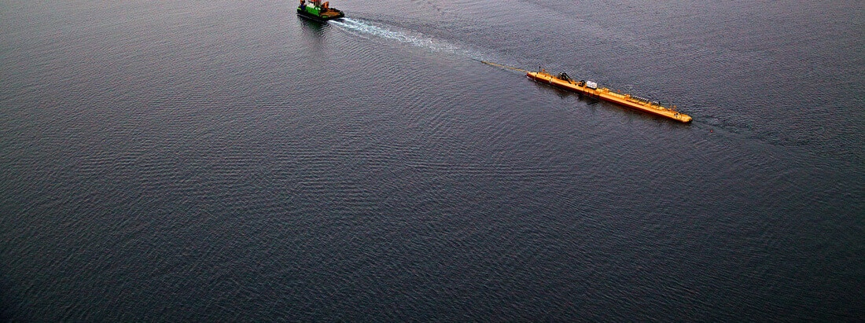
1
MET-Certified Project
2
Technical Specifications
IECTC114 for Marine Energy Convertors
3
Development of Certification Schemes under IECRE ME OMC
Your Activities, Needs &
4
How to get Involved
Notes:
----- Meeting Notes (12/05/17 12:45) -----
Long term production as a condition (part of -200 or )
Operational
Insurance:
- business
- warrentiesof the technologies
- assessment of the design willl help to get confidence
- Learn from mistakes in wind (offshore and onland)
- availability standard for individual and farm of turbines
- power yield curves ---still it is
- cost of the system to a small developer
-
Test Labs
-
Marnix
- worried about th cost of going thru the system
- scaled to the size of your project
Deltares
- strategic decision if it is part of
B2Bsure
- variety of test results, creates a lot of work if there is no standard.
-
TUD
- low TRL interest
- design tools specific to tidal
- lot of developers have their own software tools, TUD can help develop generic design tools, eg Tidal Bladed, coupling floating turbine to generti turbine.
-

Slide 38
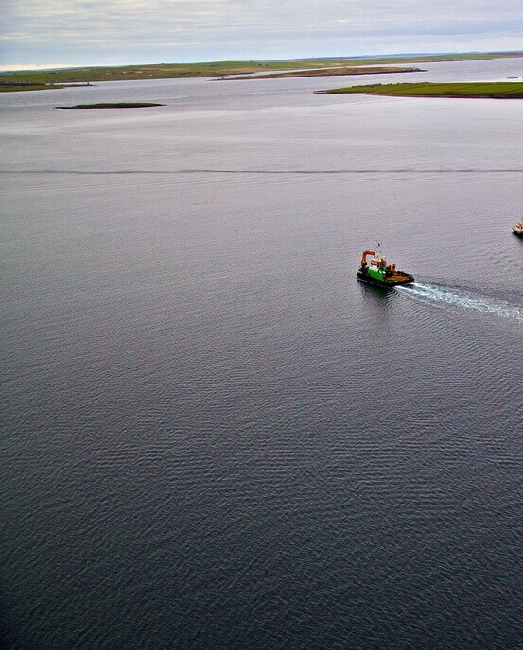
4
Involvement
4
Your
Activity
What is your role
Technology Developer, Certification Body, Test Laboratory, Project Finance, Insurance, Project Developer, etc.
Where are you in your development
TRL level, scale model, open water,
commercial applications, export.

Slide 39
4
Involvement
4
Your
Interest
Barriers to involvement
Needs to overcome barriers
Expectations from certification
What is your interest in certification
Apply them to my technology,
prescribe them in contracts or permits,
sell certification service

Slide 40
4
How to get Involved
4
How to get involved
in
TC114
Become Member of NEC114
(at NEN) €2280,- Annual Membership
Attend National Mirror Group Meetings
Comment on Committee Drafts
Join a PT, AHG, MT as Expert
Write proposals
Chair a PT as Convenor
Attend International Plenary as Observer

Slide 41
4
How to get Involved
4
How to get involved in
IECRE
ME OMC
Become Member of CBCE (at NEN)
€1500,- Annual Membership
Join a Working Group
Finance, Scope of Certification,
Rules of Procedure

Slide 42
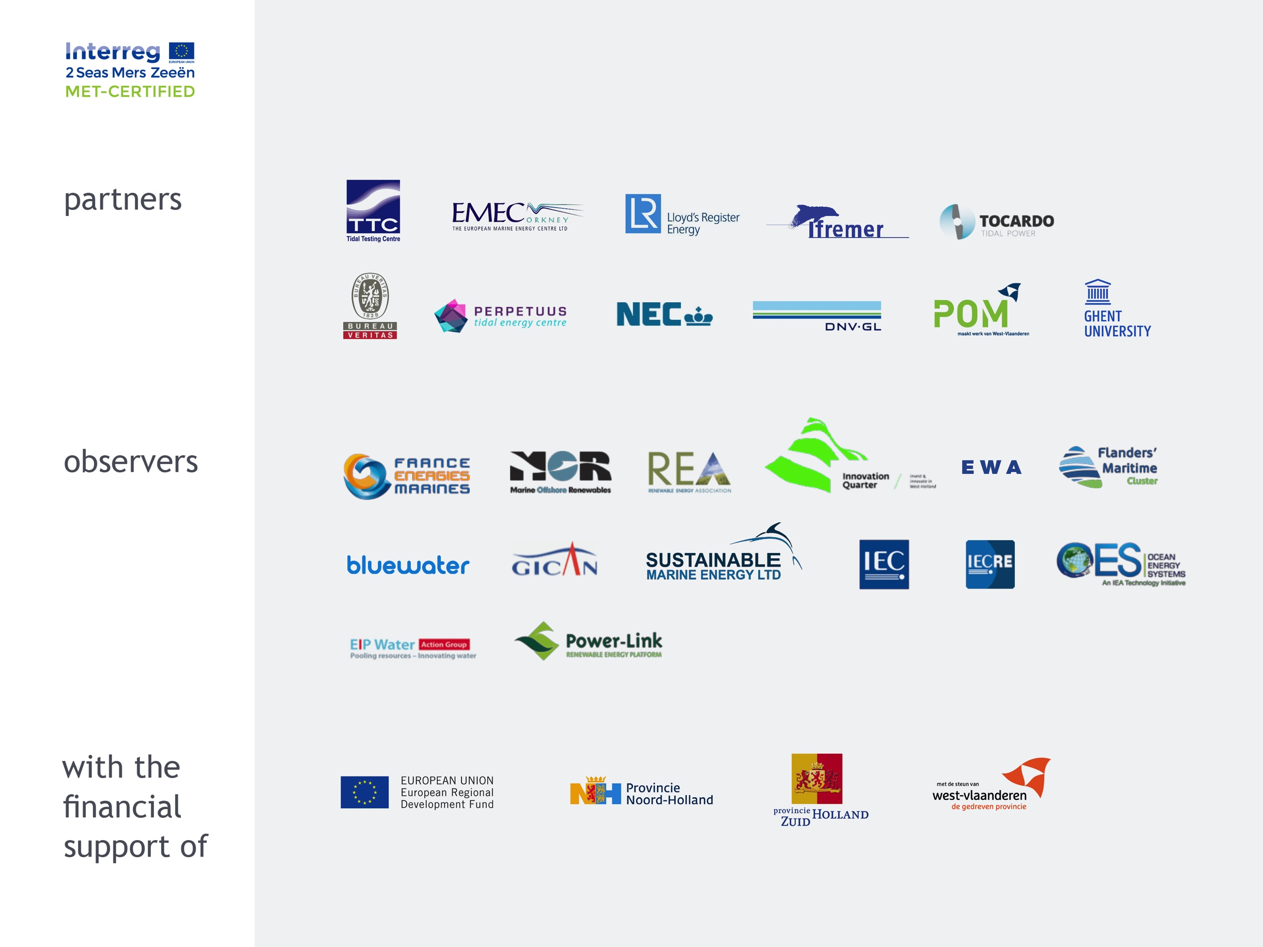




Slide 43
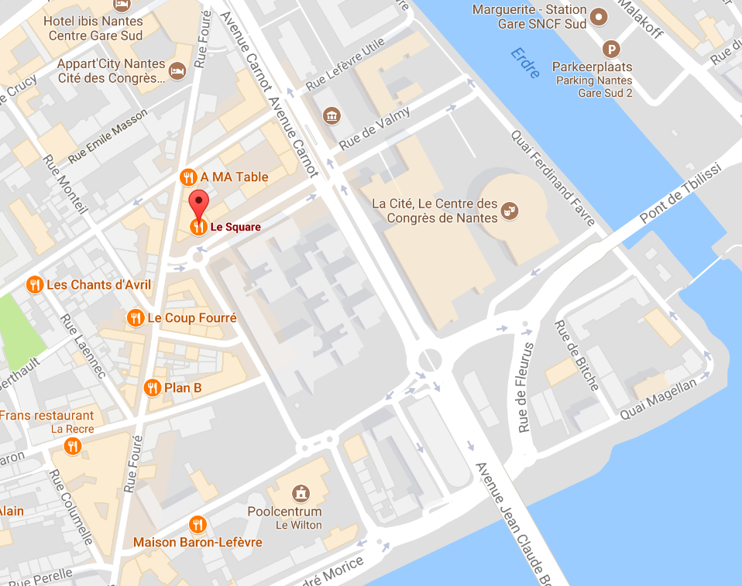
Thank you!
Please join us for diner at Le Square
14, rue Jemmapes, Nantes

Slide 44
4
How to get Involved
4
How
to reduce risks?
Risk reduction of Marine energy projects through internationally accredited testing and certification under the IEC
Standards for high risk issues like safety, reliability, performance comparison, resource assessment
A system to test and validate your converter
to these standards
State of the art
All parties concerned
Recognised by regulators, certification bodies, financiers and insurers world wide

