Slide 1
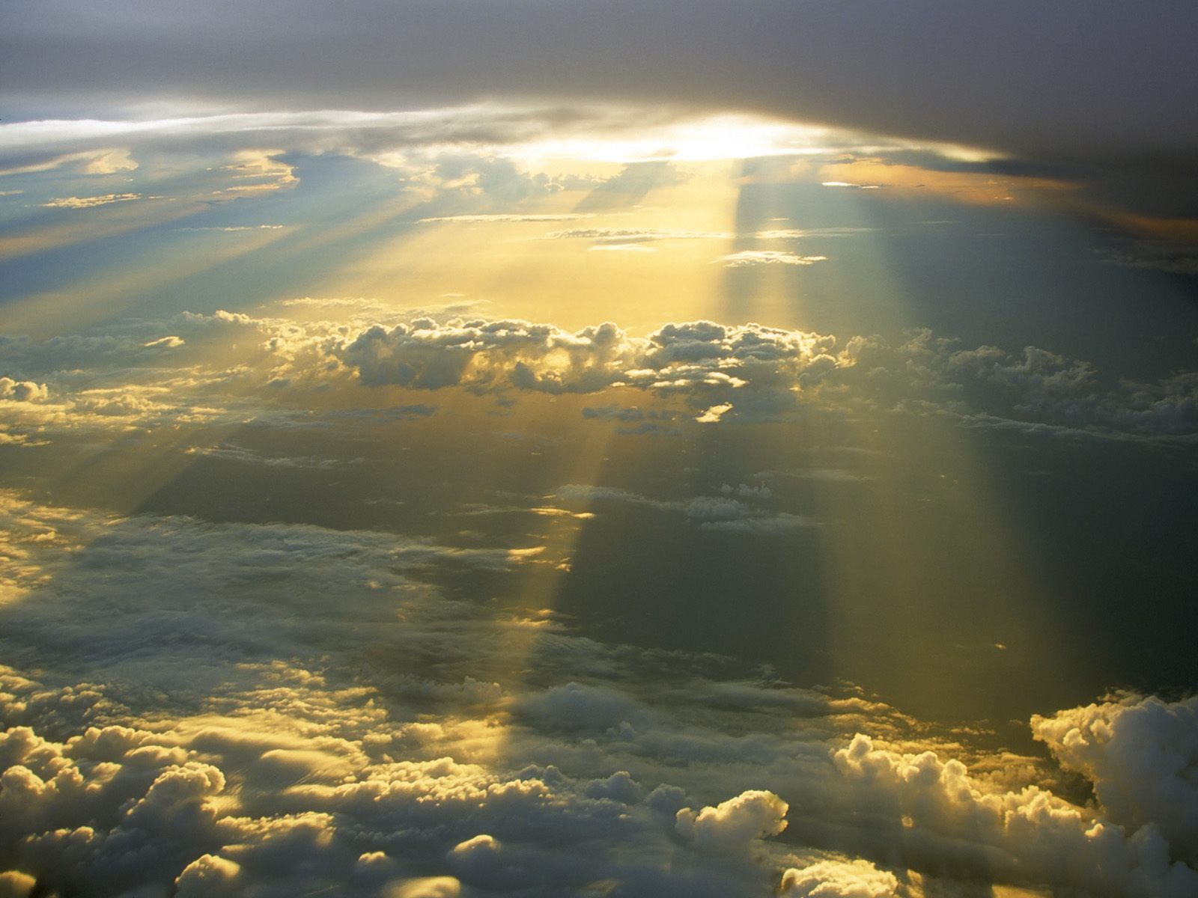
Temple and the
Presence of God
Notes:
Pre-session comments/questions:
I’d like to float an idea for next summer (the office likes us to plan far ahead).
Since these summer courses are replacements for our usual Bible Study, I’d prefer to keep them Scripturally focused.
Who might be interested in a course that addresses the idea of typology? Typology is the study of persons or events in the Old Testament that foreshadow someone or something greater in the New Testament. (We’ve encountered some examples of this in our current course.)
The word “typology” comes to us from St. Paul himself, in Rom 5:14, where he referred to Adam as a “type” of Christ. We would examine Jesus’ and the NT authors’ use of typology, as well as that given to us by some of the early Church Fathers.
If I can get agreement on such a course this summer, I can prepare it before next summer and we could offer it on consecutive weeks – how many to be determined.

Slide 2
The Temple: A Brief Review
The Cosmic Temple manifests God’s Presence in His Creation: one God, almighty but not isolated
He is holy, and because creation comes from His hands, it too is holy; all is dependent on Him
The Fall distorts man and world through disobedience and pride, separating man from God, whose love endures
God chooses Abraham and his descendants and forms His People through covenant and ongoing revelation
In time God chooses Moses to free His people from slavery, introducing the one Temple of Sinai
All revelation is a sign pointing to the true Temple, the world’s Savior, Son of God, Word Incarnate
A new order manifested in the Person of Jesus; God’s Glory is present in the Word of God who “dwelt among us.”

Slide 3
Presence of God: A Brief Review
God the Creator present in His work [Wisdom 11:25; Romans 1:20]
God the Savior present to His people [Exodus 19:4ff.]
God the Father present to His Son [John 8:29]
God the Father present to all whom the Holy Spirit enlivens and all who love Him [Romans 8:14,28]
God present at all times for he dominates time [Isaiah 44:6;48:12; Revelation 1:8,17;22:13]
God’s real presence immaterial but manifested through signs [Wisdom 11:24;Psalm 139; Acts 17:25-28]
God desires to be present even though man flees God through sin; the divine call pursues him: “Adam, where are you?” [Genesis 3,8ff.]

Slide 4
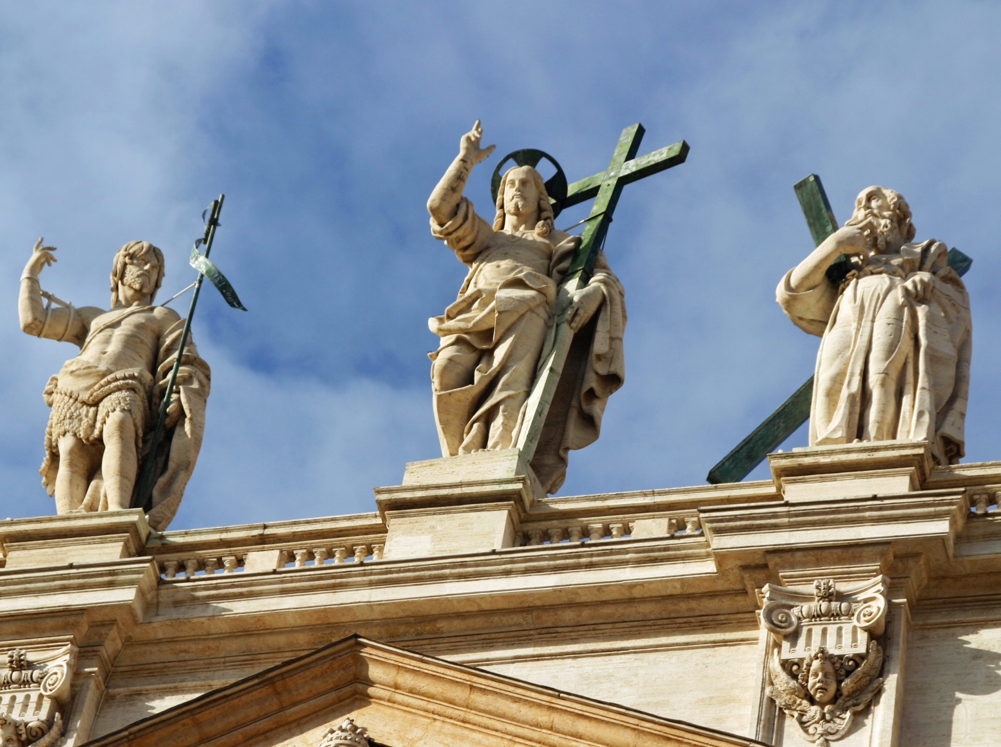
IV. The Temple of the Church
Notes:
From the beginning, it’s important to understand that Christ is His Church, He and the Church are inseparable. For this reason I choose this photo I took in Rome of the façade of St. Peter’s Basilica: Jesus flanked by John the Baptist and Peter. One is the last of the prophets of the Old Covenant, the other the first of the vicars of Christ in the New Covenant. Both point to Jesus who stands figuratively atop the Church he established.
But it is not a Church of Stone – the building is merely a figure, a sign pointing to the real Church, the Spiritual Church, the Body of Christ of which its members are the individual stones and Jesus is its head.

Slide 5
New Temple in Prophecy
The stone which the builders rejected Has become the chief corner stone [Psalm 118:22].
In Isaiah and other Old Testament prophets we find specific prophecy describing a New Temple, a Temple demanding faith, a spiritual Temple
The Psalmist echoes Isaiah describing the chief cornerstone as one rejected by the builders
Therefore, thus says the Lord God: See, I am laying a stone in Zion, a stone that has been tested, a precious cornerstone as a sure foundation; whoever puts faith in it will not waver [Isaiah 28:16].

Slide 6
New Temple in Prophecy
Look at the stone that I have placed before Joshua. On this one stone with seven facets I will engrave its inscription — oracle of the Lord of hosts — and I will take away the guilt of that land in one day. On that day — oracle of the Lord of hosts — you will invite one another under your vines and fig trees [Zechariah 3:9-10].
In Zechariah we find a prophecy of the “day of the Lord” when He will “take away the guilt.”
The “stone” is the high priest’s stone and the building stone – the rock that is the cornerstone
Notes:
Signs of things to come: the restoration of the priesthood is a sign of the expected restoration of the Davidic line. The Branch: a tree metaphor for the expected future ruler as a descendant of the Davidic dynasty. This imagery also appears in Is 11:1,10; Jer 23:5; 33:15 and Zec 6:12
Stone with seven facets: represents both the precious stones that were part of the high priest’s apparel and the building stone (see Ze 4:7,10) that initiated a major construction project. The seven facets (or “eyes”) indicate the totality of its role as an instrument of God’s vigilance and action. Inscription: can refer both to words engraved on the high priest’s apparel (Ex 28,9,11) and to words chiseled on a cornerstone.

Slide 7
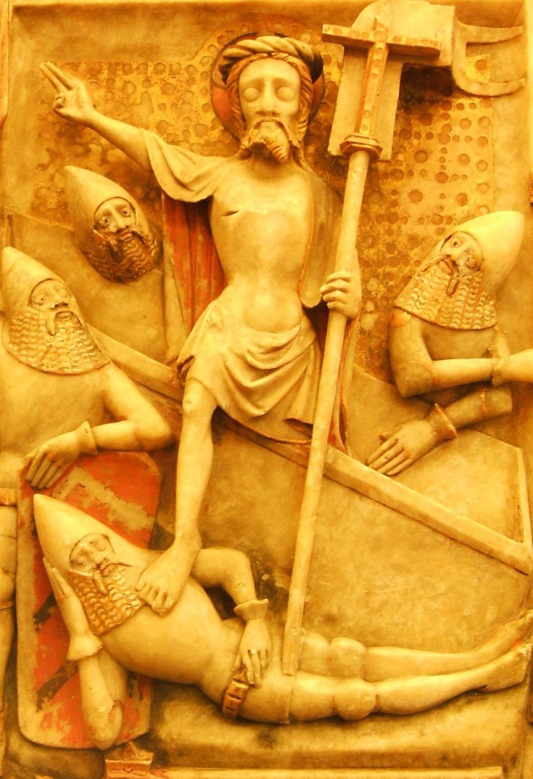
New Temple in Prophecy
In Daniel we find reference to Temple – made from a stone (a rock) that was hewn by no hand
Christ and His Church, the New Temple, fulfill this and overcome the ephemeral kingdoms of the world with their “iron and clay feet”
While you watched, a stone was hewn from a mountain without a hand being put to it, and it struck its iron and clay feet, breaking them in pieces. [Daniel 2:34].

Slide 8
New Temple in Prophecy
“…as once you were pleased to accept the gifts of your servant Abel the just, the sacrifice of Abraham, our father in faith, and the offering of your high priest Melchizedek, a holy sacrifice, a spotless victim. [Roman Canon]
In Genesis Mass and priesthood are foreshadowed by Melchizedek, the high priest of the Cosmic Temple, whose sacrifice becomes a sacrament [Genesis 14:18-20]
At Mass “Holy, holy, holy” of the high priest is restored to its true meaning [Isaiah 6:3]
At the Epiclesis the fire of the Holy Spirit comes down as it did on the altar of Elijah [1 Kings 18:38]

Slide 9
True Temple: Ancient & New
I do not want you to be unaware, brothers, that our ancestors were all under the cloud and all passed through the sea, and all of them were baptized into Moses in the cloud and in the sea. All ate the same spiritual food, and all drank the same spiritual drink, for they drank from a spiritual rock that followed them, and the rock was the Christ. [1 Corinthians 10:1-4].
Paul reminds us Christ is eternally present among God’s People
He was present during the Exodus when the people ate the heavenly bread (manna) and drank the water from the rock [Exodus 16-17]
The true Temple – Christ, the “spiritual rock” – followed them

Slide 10
Jesus Establishes His Church
Peter responds in faith when Jesus seeks the Apostles’ understanding of who He is
Jesus then proclaims the founding of His Church, with Peter as the “rock” of that foundation
The loosing and binding power of God, the keys to the Kingdom, are given to Peter
And so I say to you, you are Peter, and upon this rock I will build my church, and the gates of the netherworld shall not prevail against it. I will give you the keys to the kingdom of heaven. Whatever you bind on earth shall be bound in heaven; and whatever you loose on earth shall be loosed in heaven [Matthew 16:18-19].

Slide 11
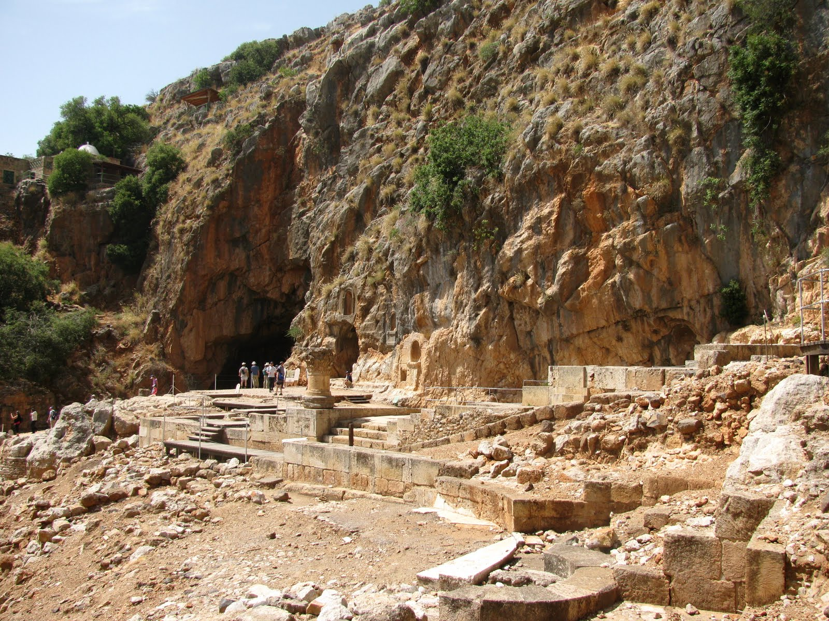
Jesus Establishes His Church
Jesus proclaims His Church at Caesarea Philippi, named for both Caesar Augustus and Herod the Great
He speaks at the foot of the rocky cliff, before the pagan temple to Pan and at the source of the Jordan
The new Temple of the Church replaces all that goes before it

Slide 12
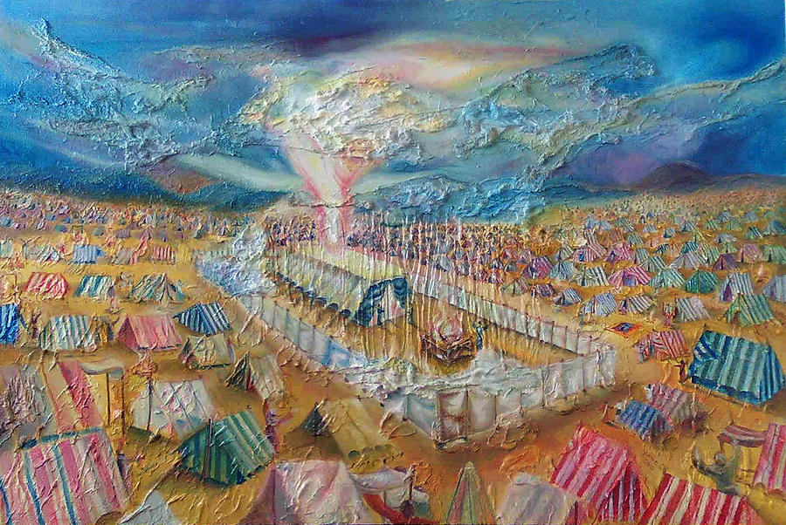
Church’s Jewish (Temple) Roots
One aspect of the Church’s Jewish roots are feasts
Jesus not only celebrated the feasts along with his countrymen, but in a sense fulfilled them
He suffered, died, and instituted the Eucharist on Passover
He sent the Holy Spirit to give birth to the Church on Pentecost
He used Tabernacles to give “Living Water”
Feast of Tabernacles
The great Jewish feasts have seasonal roots, in the Cosmic Temple
Notes:
Jesus has gathered the elements of the ancient feast and made them signs and sacraments into which He has breathed authentic life.

Slide 13
Passover
The Temple of the Church gathers the elements of Passover and gives them fresh significance – it is an image of what is to come.
Passover becomes the day of deliverance not from Egypt but from sin; the day the true Lamb is slain; the day the first-born among the dead is spared; the day when true unleavened Bread is distributed.
[See Exodus 12:1-28; 23:15]
The great Jewish feasts have their roots in the seasons
Passover – originally feast of first grains of barley
This is why unleavened bread is offered, loaves made before there was a new leaven of fermented yeast
Received its name “Passover” as the “passing over” of YHWH, the sparing of the Jewish first-born
Notes:
John 1:29 -- The next day he saw Jesus coming to him and said, "Behold, the Lamb of God who takes away the sin of the world!
Mark 4:12 -- On the first day of Unleavened Bread, when the Passover lamb was being sacrificed, His disciples said to Him, "Where do You want us to go and prepare for You to eat the Passover?“
1 Peter 1:19 -- but with precious blood, as of a lamb unblemished and spotless, the blood of Christ.
Revelation 13:8 -- All who dwell on the earth will worship him, everyone whose name has not been written from the foundation of the world in the book of life of the Lamb who has been slain.
Matthew 26:2 -- "You know that after two days the Passover is coming, and the Son of Man is to be handed over for crucifixion.“
Luke 22:7 -- Then came the first day of Unleavened Bread on which the Passover lamb had to be sacrificed.
Matthew 26:26 -- While they were eating, Jesus took some bread, and after a blessing, He broke it and gave it to the disciples, and said, "Take, eat; this is My body."

Slide 14
Pentecost
“You shall also keep the feast of the grain harvest with the first fruits of the crop that you sow in the field…” [Exodus 23:16; Numbers 28:26; Leviticus 23:16]
Pentecost – seven weeks after Passover is originally the feast of the harvest (Shavuot)
On Pentecost Jews recall one of the greatest events in history, God’s revealing of the law at Mount Sinai
For the Church it is the pouring out of the Spirit, in thunder and cloud, just as it occurred on Sinai
But the New Pentecost is not for the sake of dwelling in the Temple made with human hands, but in the New Temple which is the hearts of the faithful
Notes:
The day of first fruits: a unique term for this feast, which is usually called “the feast of Weeks” (seven weeks or fifty days); it was celebrated as a thanksgiving for the wheat harvest seven weeks after the barley harvest (Passover). In the time of Jesus it was commonly known by the Greek word “Pentecost,” that is, “fiftieth” (day after the Passover); see note on LV 23:16.
Among Jews the most popular name for this festival is the Feast of Weeks, or Shavuot, in Hebrew. When celebrating this festival, many Jewish people recall one of the greatest events in history, God’s revealing of the law at Mount Sinai.
But Pentecost doesn’t just picture the giving of the law; it also shows—through a great miracle that occurred on the first Pentecost in the early Church—how we can persist in living by the spiritual intent of God’s laws.

Slide 15
Tabernacles
On the last and greatest day of the feast, Jesus stood up and exclaimed, “Let anyone who thirsts come to me and drink. Whoever believes in me, as scripture says: ‘Rivers of living water* will flow from within him.’” He said this in reference to the Spirit that those who came to believe in him were to receive [John 7:37-38].
Tabernacles – is reflected only in the liturgy on what the Church once celebrated as Ember Days in September
The Jewish feast celebrates the long journey in the wilderness before entering the Promised Land
The event serves to replace the tents of the nomads with the dwelling of God in the Temple of Moses
Notes:
The Jewish Feast of Tabernacles – also known as Sukkot or Feast of Booths – (originally a harvest feast) was instituted by Moses to commemorate the years the Israelites wandered in the desert after their Exodus from Egypt. The feast fell within September or October (15th day of the month of Tishrei) commemorating the 40 year sojourn in the desert and dwelling in tents, including the temporary tabernacle for the dwelling of God until the permanent Temple was built by Solomon.
Ember Days were established “to thank God for the gifts of nature, to teach men to make use of them in moderation, and to assist the needy.” They consist of 3 days set apart for fasting and prayer. In Latin these days are referred to as Jejunia quatuor tempora (the fast of the four seasons) or “Ember Days” (from a corruption of the Latin word tempora). These special days of fasting were established very early on in the Church and consist of a Wednesday, Friday, and Saturday at the beginning of each season (Spring, Summer, Fall, and Winter)

Slide 16
Transfiguration & Tabernacles
Peter and his companions had been overcome by sleep, but becoming fully awake, they saw his glory* and the two men standing with him. As they were about to part from him, Peter said to Jesus, “Master, it is good that we are here; let us make three tents, one for you, one for Moses, and one for Elijah.” But he did not know what he was saying [Luke 9:32-33].
Did Transfiguration occur during Feast of Booths?
Peter’s comments would lead us to believe this
Peter points to the wrong thing – to stay – while Moses and Elijah (the Law and the Prophets) point to what must happen in Jerusalem
We now celebrate the feast of Transfiguration on August 6
Notes:
Feast of Booths: Some Scripture scholars theorize that the Transfiguration occurred during the Feast of Sukkot, or the Feast of Booths or Tabernacles. If this wasn't during the actual feast, the whole scene does hearken back to wandering in the desert and the revelation of the Covenant with the Jewish people. Understanding the context of the Feast of Booths or Tabernacles helps understand why Peter would even suggest erecting tents.
Remembering the tabernacles in the desert helps us see the foreshadowing of the Jesus in the Tabernacle. We do not see His glory here on earth, but we look forward to heaven when the veil will be removed and we enjoy the beatific vision of God.

Slide 17
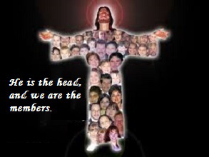
Jesus, the NewTemple
Jesus, His Body, His “Manhood”, is the New Temple, the Temple of the New Law
But this New Temple must be taken as a whole
It is the Mystical Body in its entirety, the complete and final Temple
Now you are the Body of Christ, and individually members of it
[1 Corinthians 12:27].

Slide 18
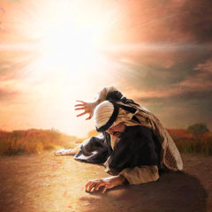
Jesus, the NewTemple
God’s dwelling is the Christian community; its Head is in heaven, and its members are still making their earthly pilgrimage
Saul, the early persecutor of the Church, discovered this when he was called by Jesus on the Road to Damascus.
And he fell to the ground and heard a voice say to him, “Saul, Saul, why do you persecute me? And He said, I am Jesus whom you persecute” [Acts 9:4-5].
Notes:
“I am Jesus whom you persecute.”
Jesus and His Church are one. Jesus and His disciples, those who become members of His Church through Baptism, are one.

Slide 19
Spiritual Temple
So then you are no longer strangers and sojourners, but you are fellow citizens with the holy ones and members of the household of God, built upon the foundation of the apostles and prophets, with Christ Jesus himself as the capstone. Through him the whole structure is held together and grows into a temple sacred in the Lord; in him you also are being built together into a dwelling place of God in the Spirit [Ephesians 2:19-22].
Under the Old Law, the Old Temple, was made of stone
Under the New Law the New Temple is a spiritual community, with Jesus Christ as its cornerstone
Its members – “living stones” – make up its structure

Slide 20
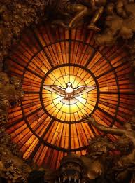
Spiritual Temple
The Community is God’s new dwelling place…in the Spirit
Jesus promised His Holy Spirit “…it remains with you, and will be in you.” [John 14:17]
Jesus prays that all who believe in Him will be one with Him and the Father [John 17:20-21]
Do you not know that your body is a Temple* of the Holy Spirit within you, whom you have from God, and that you are not your own? [1 Corinthians 6:19].
Notes:
1 Cor 6:19 – a true pro-life verse – your body is not your own; it is God’s, the Holy Spirit

Slide 21
Living Stones
Come to him, a living stone, rejected by human beings but chosen and precious in the sight of God, and, like living stones, let yourselves be built into a spiritual house to be a holy priesthood to offer spiritual sacrifices acceptable to God through Jesus Christ
[1 Peter 2:4-5].
The Church is the true Temple of which the Temple of stone was just a figure, a “type”
Jesus and those in His Church – the baptized – are living stones
Christ has given His Church a holy priesthood that will offer “spiritual sacrifices”
Notes:
[1 Peter 2:4-10] Come to him, a living stone,* rejected by human beings but chosen and precious in the sight of God, and, like living stones, let yourselves be built into a spiritual house to be a holy priesthood to offer spiritual sacrifices acceptable to God through Jesus Christ. For it says in scripture: “Behold, I am laying a stone in Zion, a cornerstone, chosen and precious, and whoever believes in it shall not be put to shame.”
Therefore, its value is for you who have faith, but for those without faith: “The stone which the builders rejected has become the cornerstone,” and “A stone that will make people stumble, and a rock that will make them fall.”
They stumble by disobeying the word, as is their destiny. But you are “a chosen race, a royal priesthood, a holy nation, a people of his own, so that you may announce the praises” of him who called you out of darkness into his wonderful light. Once you were “no people” but now you are God’s people; you “had not received mercy” but now you have received mercy.

Slide 22
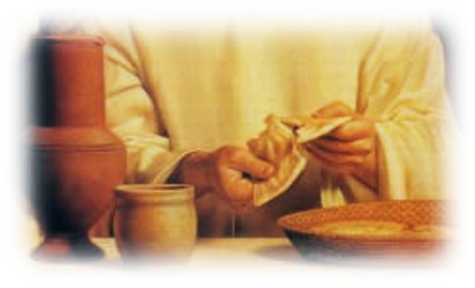
New Temple or New Synagogue?
The “church of stone” is not in every particular sense a succession of the Old Temple
In some ways it’s a new synagogue – an ecclesia, assembly, or meeting-place
They devoted themselves to the teaching of the apostles and to the communal life, to the breaking of the bread and to the prayers… Every day they devoted themselves to meeting together in the temple area and to breaking bread in their homes [Acts 2:42,46].
Notes:
They continued to meet in the Temple area, for in Jerusalem the Temple area also functioned as a meeting place, as a kind of synagogue. But the sacrifice of the Mass – the breaking of the bread – took place in their homes, for the Church is not a building but a community of believers.

Slide 23
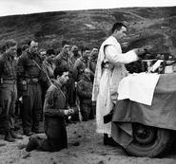
New Temple or New Synagogue?
The Church continues both Temple and synagogue since it is the normal place of sacrifice, but the church building is not necessary for celebration of sacrifice, the Mass
Mass requires the Church as Community but not the “stone” Church building
For where two or three are gathered together in my name, there am I in the midst of them [Matthew 18:20].

Slide 24
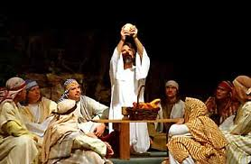
First Midnight Mass?
On the first day of the week when we gathered to break bread, Paul spoke to them because he was going to leave on the next day, and he kept on speaking until midnight…Then he returned upstairs, broke the bread, and ate; after a long conversation that lasted until daybreak, he departed. [Acts 20:7,11].

Slide 25
Temple As Community
“Therefore, if you bring your gift to the altar, and there recall that your brother has anything against you, leave your gift there at the altar, go first and be reconciled with your brother, and then come and offer your gift” [Matthew 5:23-24].
Offer your gift? What is the Mass if not an offering of gifts at the altar?
As Jesus instructs us in the Sermon on the Mount, the offering at the altar is acceptable only when it is made in charity, in love, in community
The Temple, then, is only in Community, the place where we come together in charity, in the Presence of God
Notes:
The Offertory – the Presentation of the Gifts – the Sign of Peace – a Community of Charity

Slide 26
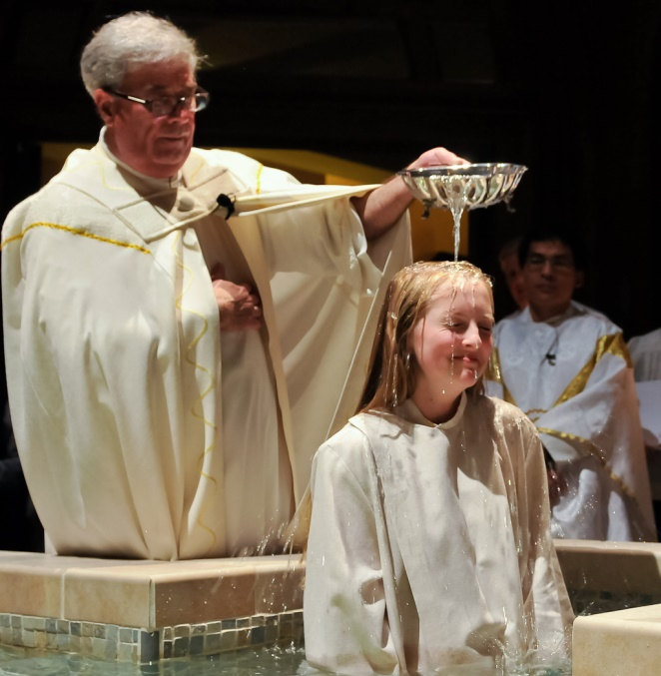
Temple As Community
God enters into relationship with the Community and with the souls that are part of the Community
Baptism: the entry into the “church of stone” is a figure of entry into the Community where God is met
Baptism, then, is the outward sign of entry into the Church and points to the reality of the Community
For we were all baptized by one Spirit so as to form one body — whether Jews or Gentiles, slave or free — and we were all given the one Spirit to drink [1 Corinthians 12:13].

Slide 27
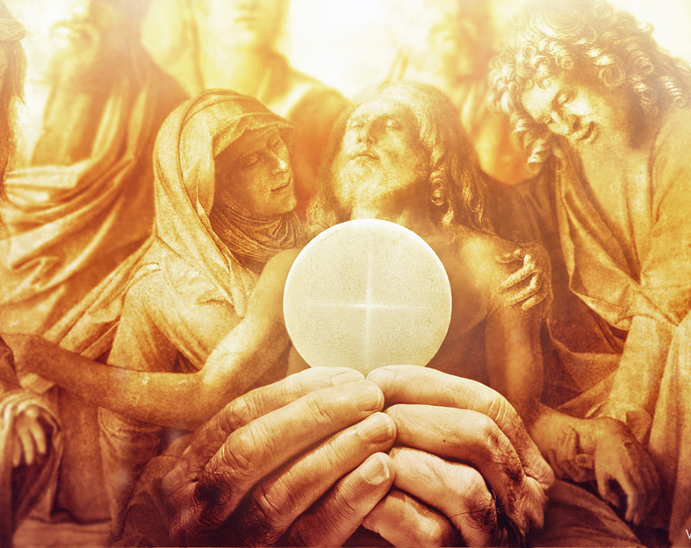
Temple As Community
The Eucharist is the permanent reality of the meeting with God
It is the sacrament of the Mystical Body and points to the Real Presence of Jesus
It also brings about union with God and strengthening of the bonds of Community, the bonds of charity
“For my flesh is true food, and my blood is true drink. Whoever eats my flesh and drinks my blood remains in me and I in him” [John 6:55-56]
[See 1 Corinthians 11:23-29).

Slide 28
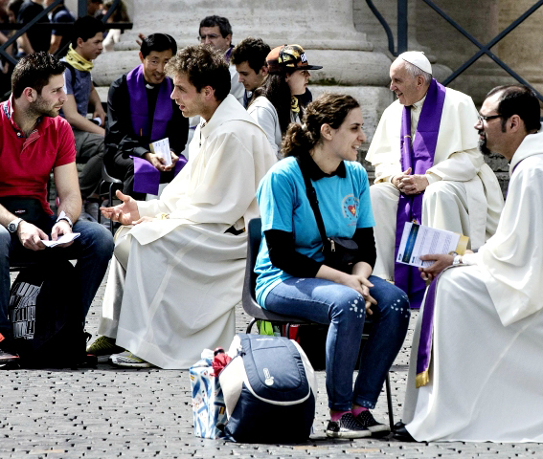
Sin, an Alienation
Sin alienates sinners from the Presence of God and separates them from the Community
Early Church excluded sinners from Community; reconciliation with God required the Community as intermediary
Confession: priest represents Community which itself represents God
“Receive the Holy Spirit. If you forgive the sins of any, they are forgiven; if you retain the sins of any, they are retained” [John 20:22-23].

Slide 29
Bound in Love
“…living the truth in love, we should grow in every way into him who is the head, Christ, from whom the whole body, joined and held together by every supporting ligament, with the proper functioning of each part, brings about the body’s growth and builds itself up in love. [Ephesians 4:15-16].
In the New Temple, the Community, God’s Presence is bound up in charity [1 John 4:12]
The Church is not a biological community
It is a Community of spiritual persons bound together by love – every member serves the others
Notes:
1 Jn 4:12 – “No one has ever seen God. Yet, if we love one another, God remains in us, and his love is brought to perfection in us.”
The Church is not a return to the beginning – it’s not a nostalgia for some earlier condition – but is a continuous creation of charity.

Slide 30
Love and Evangelization
For Love is strong as Death…Its arrows are arrows of fire, flames of the divine. [Song 8:6]
The proper work of love is the building of the New Temple; hence the Church’s primary mission is one of evangelization
Evangelization: a true act of love – to carry God’s love to others and to bring others into God’s love
But “Love is strong as Death.” Jesus reflects this: I have come to bring not peace but the sword [Mt 10:34]. The sword of His Word cannot be minimized or altered.
Notes:
True love is pitiless. It does not love weaknesses; it loves in spite of them and against them; it corrects them. But its strength is that of love; it is trust, help, support. Charity (love) is stronger than all the world’s hate, strong to others, but above all strong to itself – hard, lucid, transparent, penetrating to the depths. It is hard, but does not inflict pain. Love goes straight to the heart and heals the sufferer.
Love is patient. Like the father of the prodigal, it awaits the hour chosen by God. It is a faithful watchdog. It prays in silence.
It seeks no reward except the well-being of the one loved. It is forgetful of self. Loving the good for its own sake, it seeks only good, no matter who does it. Interested only in the fruits, it is not satisfied with words.
Always active, always busy, it knows nothing is impossible with God. Encouraged by its poverty, souls reveal themselves to it.

Slide 31
Build Up the Temple
Lord, I love the refuge of your house, the site of the dwelling-place of your glory [Psalm 26:8].
One thing I ask of the LORD; this I seek: to dwell in the LORD’s house all the days of my life, to gaze on the LORD’s beauty, to visit his temple [Psalm 27:4].
The Temple of the Church builds up slowly by the love of its members
It also is the fulfillment of the Mosaic and Cosmic Temples
It is no longer a far-off mountain, the desire of exiles
It is ever-present where we enter into ourselves to join the Communion of Saints

Slide 32
Church as Communion of Saints
The Church is also a “communion of saints”
Refers to the “holy things” (e.g., Eucharist) through which unity is brought about
Also the communion of “holy persons” in Christ who died for all
“…one body and one Spirit, as you were also called to the one hope of your call; one Lord, one faith, one baptism; one God and Father of all, who is over all and through all and in all” [Ephesians 4:4-6].
It is the communion of all the faithful, the pilgrims on earth, the dead being purified, the blessed in heaven

Slide 33
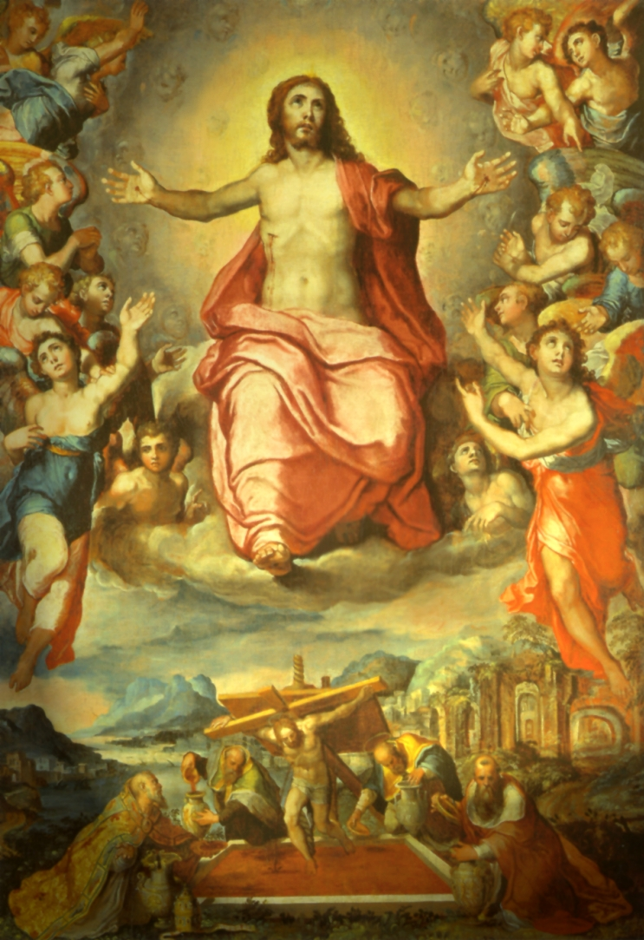
Church as Mystical Body
Paul, especially in his Letter to the Ephesians, describes the Mystical Body, with Jesus Christ as its head
With Jesus we, as members of His Body, are the Church [Ephesians 1:22-23]
Each member brings his gifts “for the work of ministry, for building up the Body of Christ” [Ephesians 4:12; Romans 12:4-5]

Slide 34
Church as Bride of Christ
This image, a theme of Christ as Bridegroom of the Church – prepared by the prophets; announced by John [John 3:29]
Jesus calls Himself the “bridegroom”
Paul: all members are, as a bride, “betrothed” to Christ to become one spirit with Him [2 Corinthians 11:2]
Jesus answered them, “Can the wedding guests fast while the bridegroom is with them? As long as they have the bridegroom with them they cannot fast. But the days will come when the bridegroom is taken away from them, and then they will fast on that day. ” [Mark 2:19-20].

Slide 35
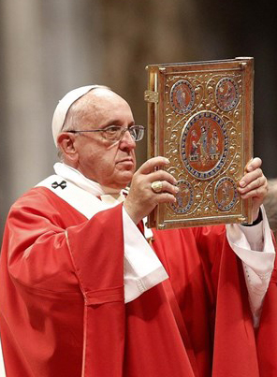
Church & the Word
The deposit of the living Word of God mysteriously dwells in the Church and continues the Incarnation
We come to faith by this living witness that is sustained and animated by Christ, through the teaching of the living Apostolic Church
We contact the living Christ through the operation of grace acting is all its fullness in the Sacraments
“…there is no prophecy of scripture that is a matter of personal interpretation, for no prophecy ever came through human will” [2 Peter 1:20-21].

Slide 36
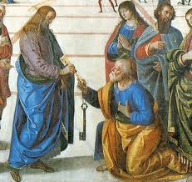
Christ’s Gift
After His Ascension, Jesus left a blessing, a home for faith and love to enjoy in spite of the world
He left His Church, our one true home provided by God, and His heavenly court where He dwells with angels and saints
We now worship in the true Temple, the spiritual Tabernacle
As a home for all creation, it fulfills not only the Jewish Temple, but also the Cosmic, the expectation of all
Notes:
As Blessed John Henry Newman wrote, “Though thou art in a body of flesh, a member of this world, thou hast but to kneel down reverently in prayer, and thou art at once in the society of Saints and Angels.”

