Slide 1
2016 PAEOP Presentation:
Teaching & Communication
Tools for Each Generation
By
Robert Messner

Slide 2
??????
2001-2016
Generation Z
1980-2000
Generation Y
1964-1979
Generation X
1946-1963
Baby Boom
What’s next?
Notes:
Transparent 3-D steps with labels
(Advanced)
To reproduce the bottom rectangle shape with text effects on this slide, do the following:
On the Home tab, in the Slides group, click Layout, and then click Blank.
On the Home tab, in the Drawing group, click the More arrow on the Shapes gallery, and then under Rectangles, click Rectangle (first option from the left). On the slide, drag to draw a rectangle.
Under Drawing Tools, on the Format tab, in the Size group, do the following:
In the Shape Height box, enter 1.5”.
In the Shape Width box, enter 3”.
On the Home tab, in the bottom right corner of the Drawing group, click the Format Shape dialog box launcher. In the Format Shape dialog box, click Fill in the left pane, and then do the following in the right pane:
Select Solid fill.
Click the button next to Color, and then under Theme Colors click White, Background 1 (first row, first option from the left).
In the Transparency box, enter 0%.
Also in the Format Shape dialog box, click Line Color in the left pane, and then select No line in the right pane.
Also in the Format Shape dialog box, click 3-D Rotation in the left pane. In the right pane, click the button next to Presets, and then under Parallel click Off Axis 2 Top (third row, second option from the left).
Also in the Format Shape dialog box, click 3-D Format in the left pane, and then do the following in the right pane:
Under Bevel, click the button next to Top, and then under Bevel click Circle (first row, first option from the left). Next to Top, in the Width box, enter 7 pt, and in the Height box, enter 7 pt.
Under Depth, click the button next to Color, and then under Theme Colors click White, Background 1 (first row, first option from the left). In the Depth box, enter 40 pt.
Under Surface, click the button next to Material, and then under Translucent click Clear (third option from the left). Click the button next to Lighting, and then under Special click Two Point (second option from the left). In the Angle box, enter 70°.
On the Insert tab, in the Text group, click Text Box, and then on the slide, drag to draw the text box.
Enter text in the text box, select the text, and then on the Home tab, in the Font group, select TW Cen MT Condensed from the Font list and then select 36 from the Font Size list.
On the Home tab, in the Paragraph group, click Align Text Right to align the text right on the slide.
Drag the text box and position it over the rectangle.
Under Drawing Tools, on the Format tab, in the WordArt Styles group, click the arrow next to Text Fill, and then under Theme Colors click White, Background 1 (first row, first option from the left).
Select the text box. Under Drawing Tools, on the Format tab, click Text Effects, then point to 3-D Rotation, and then click 3-D Rotation Options.
In the Format Text Effects dialog box, click 3-D Rotation in the left pane. In the right pane, click the button next to Presets, and then under Parallel click Off Axis 2 Left (second row, fourth option from the left).
To reproduce the background on this slide, do the following:
Right-click the slide background area, then click Format Background. In the Format Background dialog box, click Fill in the left pane, select Gradient fill in the right pane, and then do the following:
In the Type list, select Linear.
Click the button next to Direction, and then click Linear Diagonal (first row, third option from the left).
In the Angle box, enter 135%.
Under Gradient stops, click Add or Remove until two stops appear on the slider.
Under Gradient stops, on the slider, customize the gradient stops as follows:
Click on the left stop, and then do the following:
In the Stop position box, enter 0%.
Click the button next to Color, and then under Theme Colors click White, Background 1 (first row, first option from the left).
Select Stop 2 from the list, and then do the following:
In the Stop position box, enter 100%.
Click the button next to Color, and then under Theme Colors click White, Background 1, Darker 15% (third row, first option from the left).
On the Home tab, in the Drawing group, click the More arrow on the Shapes gallery, and then under Rectangles, click Rectangle (first option from the left). On the slide, drag to draw a rectangle.
Select the rectangle. Under Drawing Tools, on the Format tab, in the Size group, do the following:
In the Shape Height box, enter 0.33”.
In the Shape Width box, enter 10”.
On the Home tab, in the Drawing group, click the arrow next to Shape Fill, and then under Theme Colors click White, Background 1, Darker 15% (third row, first option from the left).
On the Home tab, in the Drawing group, click the arrow next to Shape Outline, and then click No Outline.
On the Home tab, in the Drawing group, click Shapes, and then under Basic Shapes, click Right Triangle (first row, fourth option from the left).
On the slide, drag to draw a triangle.
Select the triangle. Under Drawing Tools, on the Format tab, in the Size group, do the following:
In the Shape Height box, enter 1.33”.
In the Shape Width box, enter 10”.
On the Home tab, in the Drawing group, click the arrow next to Shape Fill, and then click White, Background 1, Darker 15% (third row, first option from the left).
On the Home tab, in the Drawing group, click the arrow next to Shape Outline, and then click No Outline.
Position the rectangle and the triangle so that the bottom edge of the triangle and the top edge of the rectangle are touching. Press and hold SHIFT and select both the rectangle and the triangle.
On the Home tab, in the Drawing group, click Arrange, and then do the following:
Under Group Objects, click Group.
Point to Align, and then click Align Center.
Point to Align, and then click Align Bottom.
On the Home tab, in the Clipboard group, click the arrow next to Copy, and then click Duplicate.
Under Drawing Tools, on the Format tab, in the Arrange group, click the arrow next to Rotate, and then click More Rotation Options.
In the Format Shape dialog box, on the Size tab, under Size and rotate, in the Rotation box, enter 180°.
On the Home tab, in the Drawing group, click Arrange, point to Align, and then do the following:
Click Align Center.
Click Align Top.
On the Home tab, in the Drawing group, click the arrow next to Shape Fill, and then under Theme Colors click White, Background 1 (first row, first option from the left).
To reproduce the original text and rectangle, do the following:
Press and hold SHIFT and select the original text box and rectangle. On the Home tab, in the Drawing group, click Arrange, and then under Group Objects click Group.
On the Home tab, in the Clipboard group, click the arrow next to Copy, and then click Duplicate. Repeat this step until you have a total of five groups of shapes.
On the Home tab, in the Editing group, click Select, and then click Selection Pane. In the Selection and Visibility pane, select each of the groups and drag on the slide to form a series of steps.
Also in the Selection and Visibility pane, press and hold CTRL and select all five groups of rectangles and text boxes.
On the Home tab, in the Drawing group, click Arrange, point to Align, and then click Distribute Horizontally.
On the Home tab, in the Drawing group, click Arrange, point to Align, and then click Distribute Vertically.
To change the text on the duplicate rectangles, click in each text box and edit the text.

Slide 3

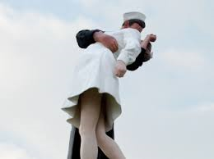
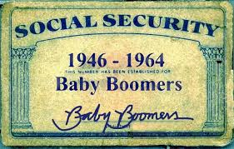



The Baby Boom
1946-1955
ENIAC – First computer 30’x60’
Univac – First commercial computer
1956-1960
First computer hard disk used
First commercial videotape recorder
1961-1963
First audio cassette tape
First computer game “Space war”
First home microwave (by Tappan)
Modem invented
Scientific Data Systems founded

Slide 4
The Baby Boom
Communications
Telephone
Written letters
Email
Finances
Pay their bills with checks
Only have a credit card for emergency
Keep some money in a bank safe deposit box (or under a mattress)
Technology
Familiar with a computer, unfamiliar with how it works
Familiar with the internet, unfamiliar with how it works
Familiar with a mobile device, unfamiliar with how it works
Return

Slide 5


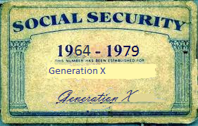

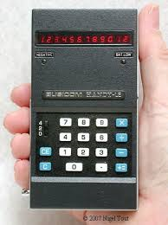
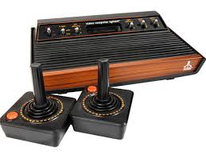
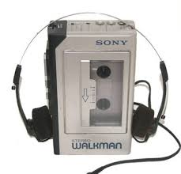
Generation X
1964-1967
Compact Disc (CD) created
UNIX computer operating system
1968-1970
RAM computer memory
ARPAnet (first internet)
Computer mouse invented
Handheld calculator
1970-1979
LCD display
Email
Computer printer, Atari 2600, Apple II, Intellivision

Slide 6
Generation X
Communications
Mobile phone
Word processors
Email
Instant messaging
Finances
Pay their bills with check cards
Use credit cards for points or cash back
Keep money in a bank, use an ATM for cash
Technology
Experienced users of computers and laptops
Experienced users with searching the internet
Experienced users with mobile phones
Return

Slide 7

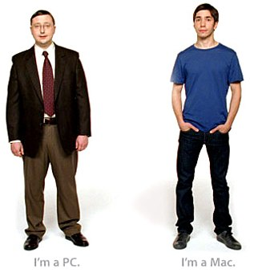




Generation Y
1980-1985
Apple Macintosh, IBM PC
Nintendo, Commodore 64,
1986-1990
Disposable Camera, Gameboy, Digital cell phone
Electric pocket calculator, Boombox
1990-2000
World wide web (internet), Google search engine
Java, Linux, Windows 95/98
MS-DOS, Windows operating system
High Definition displays
Hotmail.com (internet email), IM (AIM)

Slide 8
Generation Y
Communications
Mobile phone
Google doc’s/Office 365
Internet email (Gmail)
Text messaging
Finances
Pay their bills with credit cards or directly through their online bank account
Do not carry cash, use an ATM only when necessary
Perform online deposits using their mobile devices
Technology
Experienced users of mobile devices
Use the internet (cloud) for storage, processing, and file sharing
Expect internet access everywhere they are
Return

Slide 9
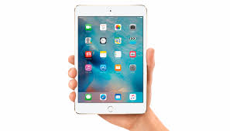
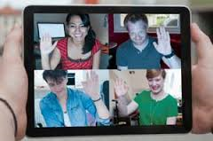
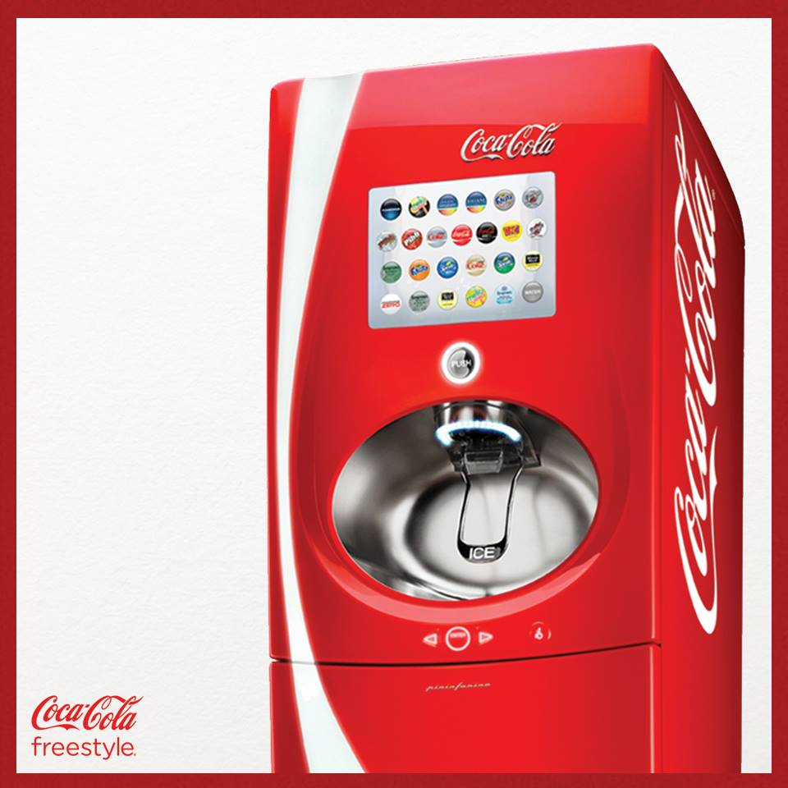

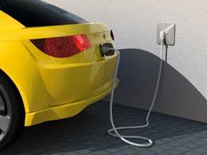
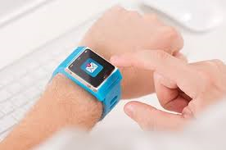

Generation Z
2000-2005
Apple iPod and iTunes, E-readers, DVR/TiVo, Xbox
Mobile broadband, USB flash drives
2006-2010
iPhone, Wii, Amazon Kindle
Portable GPS systems
2011-present
Handheld printer, Kickstarter,
Flipboard, Looxie, Apple pay/Square
YouTube, Skype & Facebook
Twitter, Google Chrome, iPad
Google driverless car, Google Glass

Slide 10
Generation Z
Communications
Mobile phone
Text messaging
Video chat
Finances
Will most likely perform all banking using mobile devices
Technology
Do not know a world without internet, video games, or mobile phones
Return

Slide 11
Cloud Tech & Collab Svcs.
Demo new free communication technology software:
Zoom Basic (http://zoom.us/)
Basecamp (http://basecamp.com/)
Question Pro (http://www.questionpro.com/)
Sitebuilder (http://sitebuilder.com)
PAEOP2016 Presentation webpage - (http://paeop2016.myfreesites.net/)
Learn to speak text messaging (take quiz)
Decode text messaging acronyms
(http://techland.time.com/2012/05/03/92-teen-text-terms-decoded-for-confused-parents/)
Adopt more cloud tools and services
Google Voice (http://google.com/voice)
Prezi (http://prezi.com)
Microsoft Virtual Academy (http://mva.microsoft.com)
Questions?

Slide 12
Text Messaging Quiz
What does the following text acronyms mean:
ATM
BFN
BOL
LOL
HAND
PAW
TIA
TMB
TIME
YW
Answers:
ATM – At the moment
BFN – Bye for now
BOL – Be on later
LOL – laughing out loud
HAND – Have a nice day
PAW – Parents are watching
TIA – Thanks in advance
TMB – Tweet me back
TIME – Tears in my eyes
YW – Your welcome
Examples:
“ATM driving”
“YW, BFN”
“LOL TIME”
“HAND BOL PAW”
“PLZ, TIA”
Return

Slide 13

Questions?

Slide 14
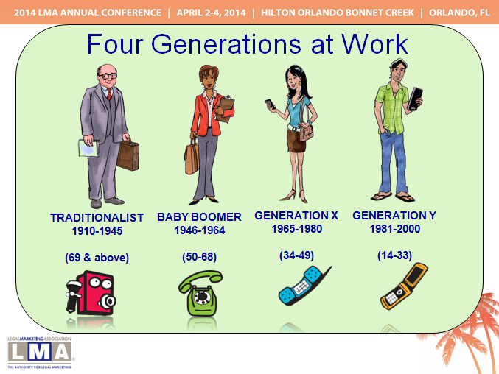



Thank you

