Slide 1
Lobby Stops the Loudoun Way
ABOS 2014
Virginia LaRocque

Slide 2
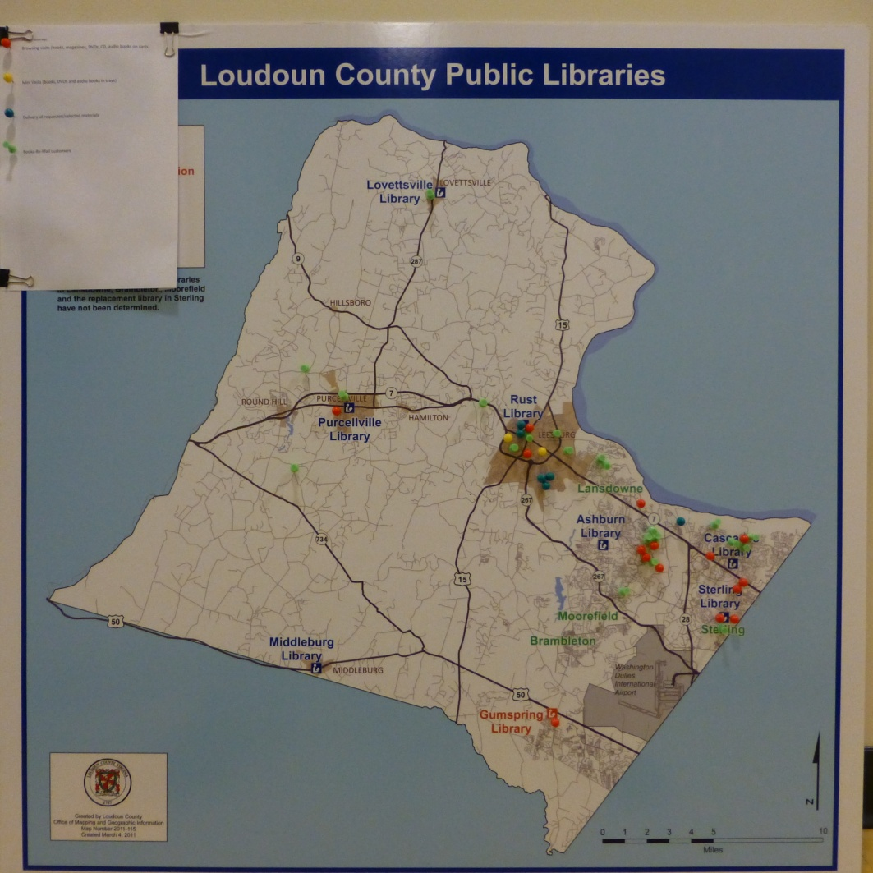
Loudoun County: 520 square miles, 350K population, home of the Internet & many government/tech companies

Slide 3
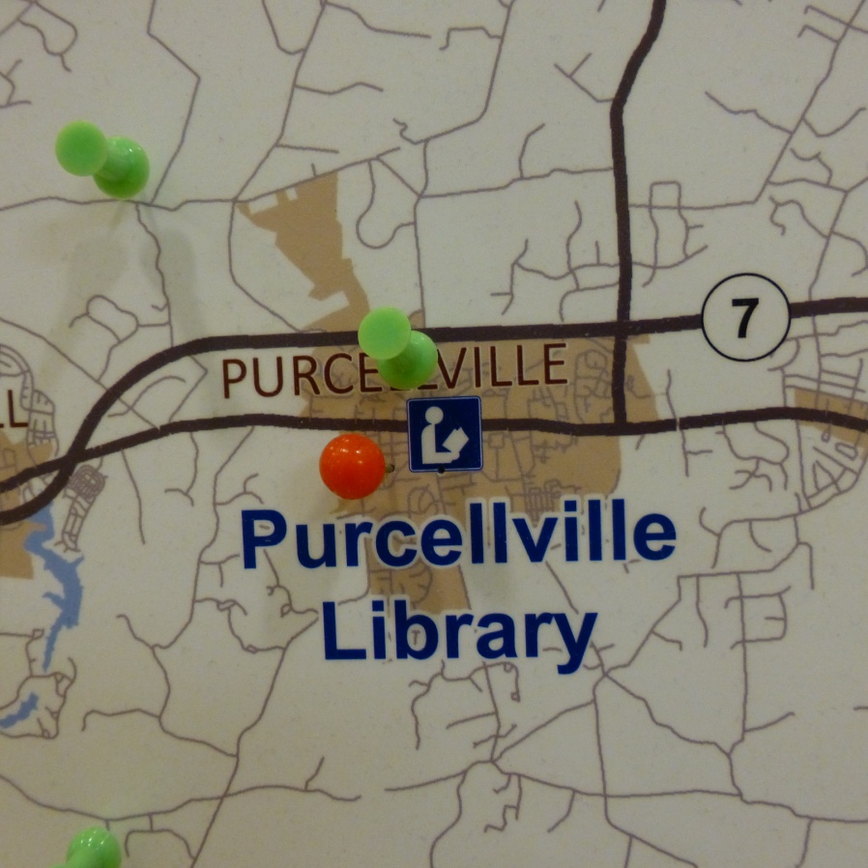
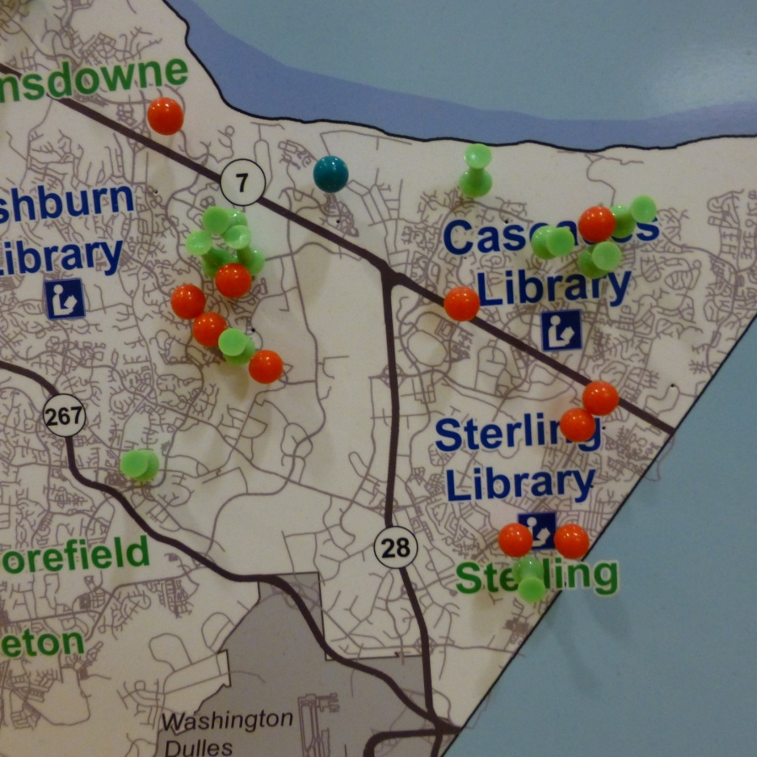
West is low density/rural
East is high density/suburban

Slide 4
1. We are the library / say it & show it all the time
2. Everything on wheels
3. Details are what we do / write it down!
Rules for us

Slide 5
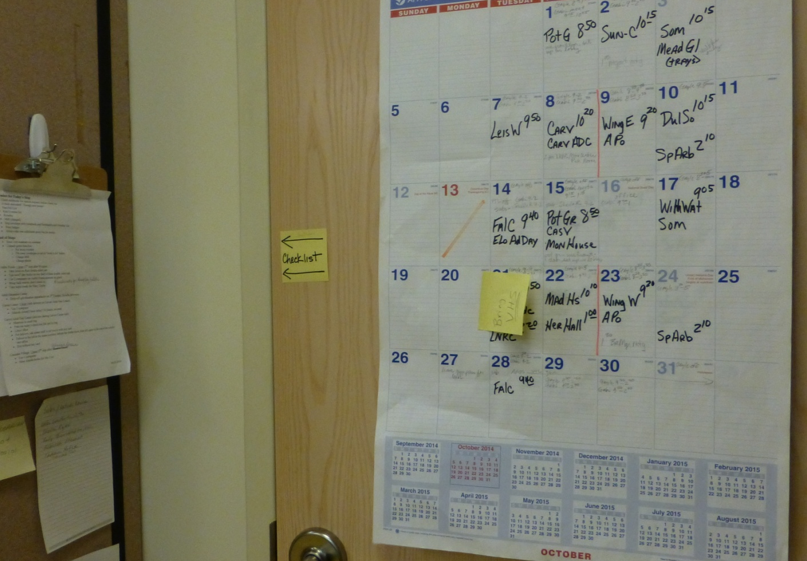
We start and end our day here
Calendar hanging on a closet door beside shelving unit

Slide 6
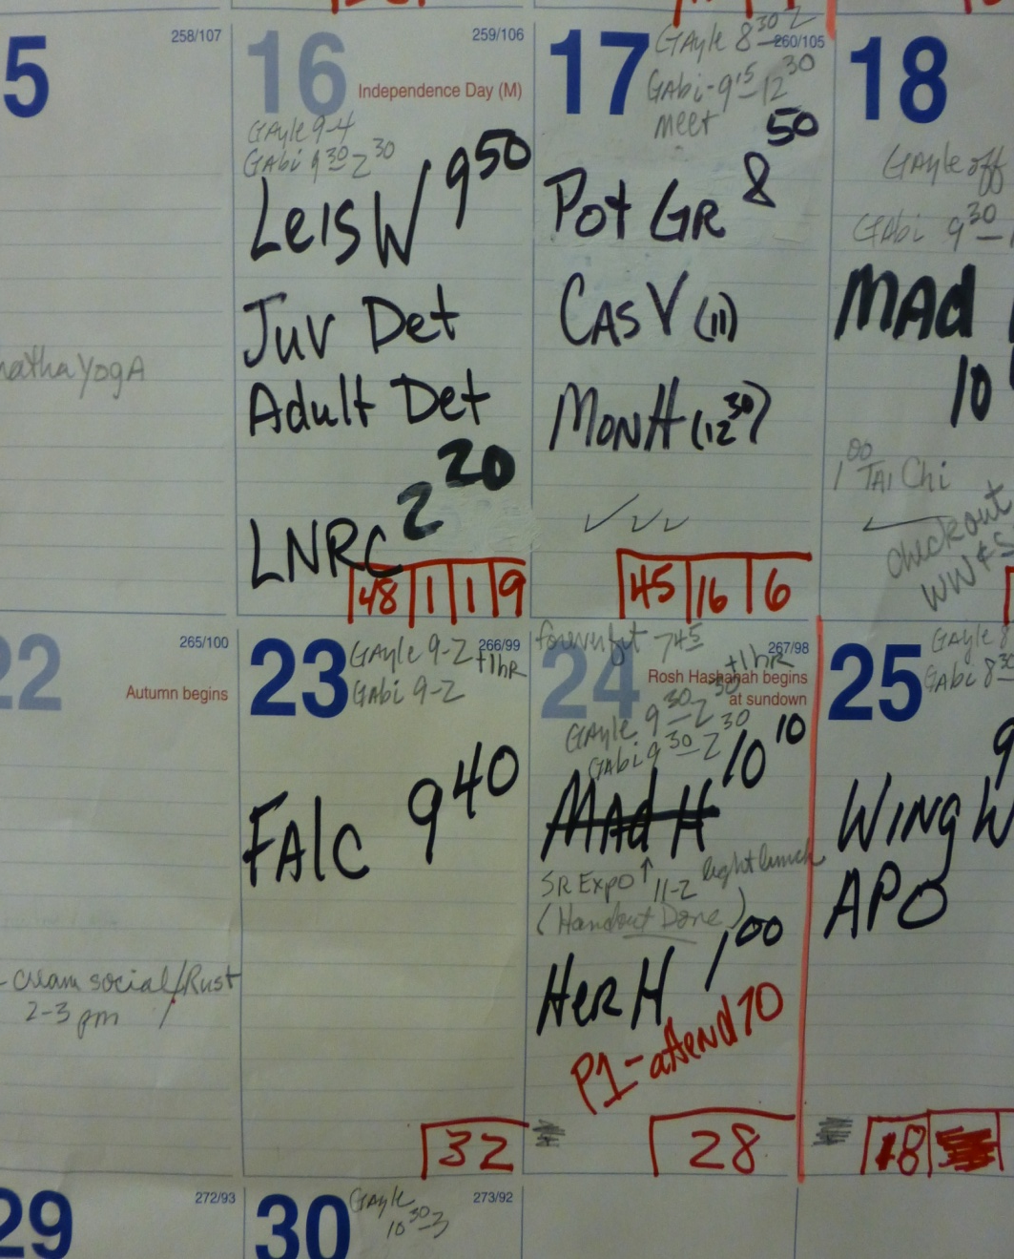
Our lives day by day
Where we go
What time we leave
Staff schedules
Meetings
Presentations
Bookmarks done √
Attendance at visit/stop
Even our exercise classes

Slide 7
Remember for Today’s Stop
Check notebooks for special requests before check out
Is truck restocked? Enough new books?
Run Pull List
Run Overdue List
MiFi (charged)
Rolodex
Stop envelope w/ Notebook & Bookmarks
Wear badges
One additional green bin & sign for returns
Our Checklist
Notes:
Special requests: craft books, sci fi, cook books, extra Playaways

Slide 8
Example
Ashby Ponds: 1 hour, 2nd stop after Wingler
Take holds on Rust double sided cart
Take new/7 day regular print on 1 shelf of Rust cart
Use 2 computers on Ashby Ponds network as guest
Bring back returns, don’t check in
Take horse books for Ms. T.
Our Checklist

Slide 9
Example
Falcons Landing: 1 hour
Use 2 computers
Take sign about holds not picked up
Take new/7 day regular print with sign
Take 2 bios, presidents or famous people, on audio CD for Mr. D
Our Checklist

Slide 10
2 types of Lobby Stop
Books on Carts
Books in Trays

Slide 11
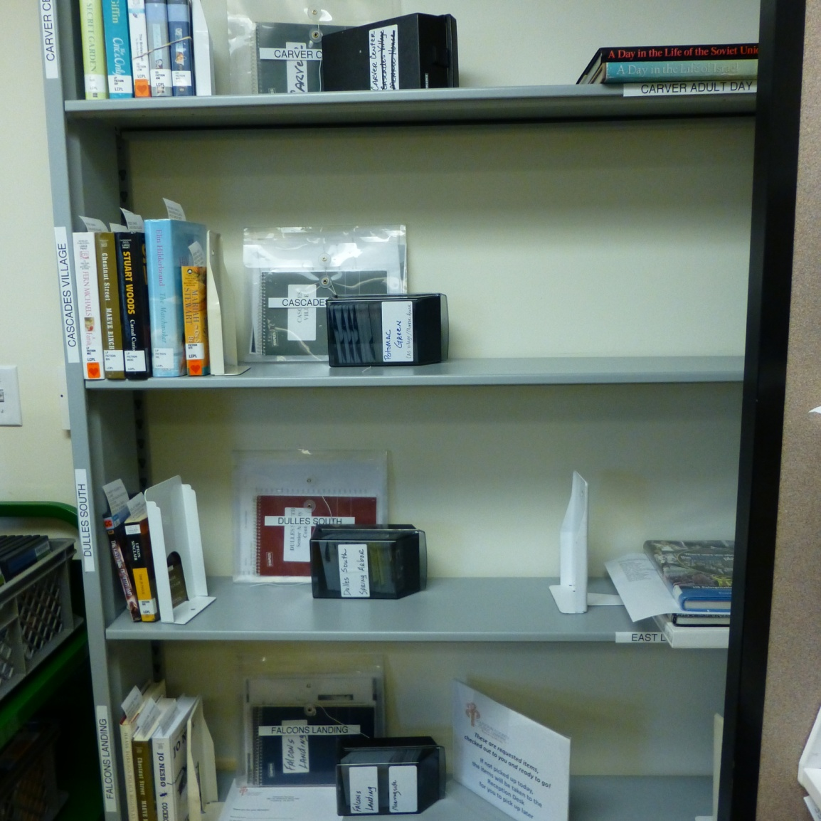
Pull holds for Today’s Visit
Visit/Stops are alphabetical around the room.
Holds, Rolodex and stop envelope together
Same day stops are in same Rolodex
Don’t forget the sign for pick up!
Notes:
Rolodexes have library cards or written bar codes, give your name, we check out your books

Slide 12
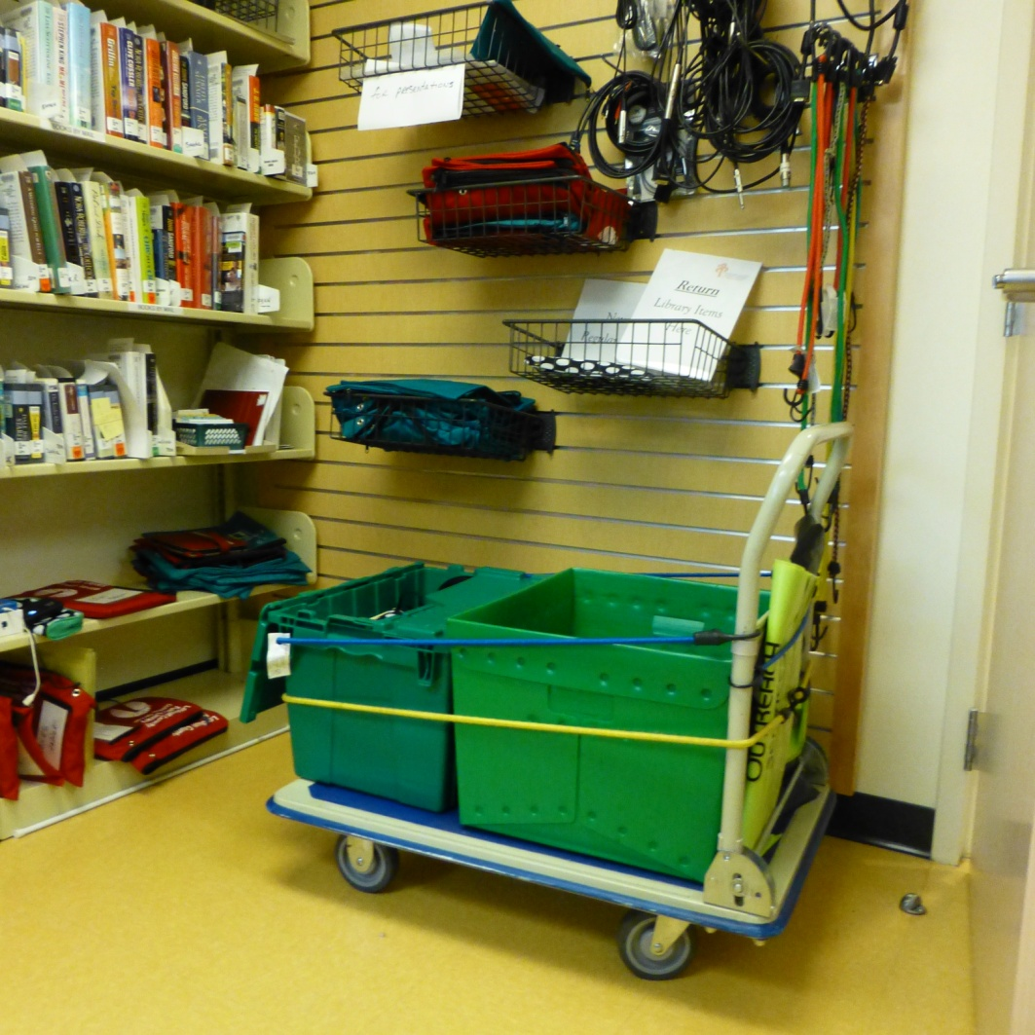
Pack the wagon’s bin w/ holds, box w/ MiFi, phone, laptops, add bin for returns (& sign), carry bags too!
Notes:
Charging station, kindles, tablets, CD players

Slide 13
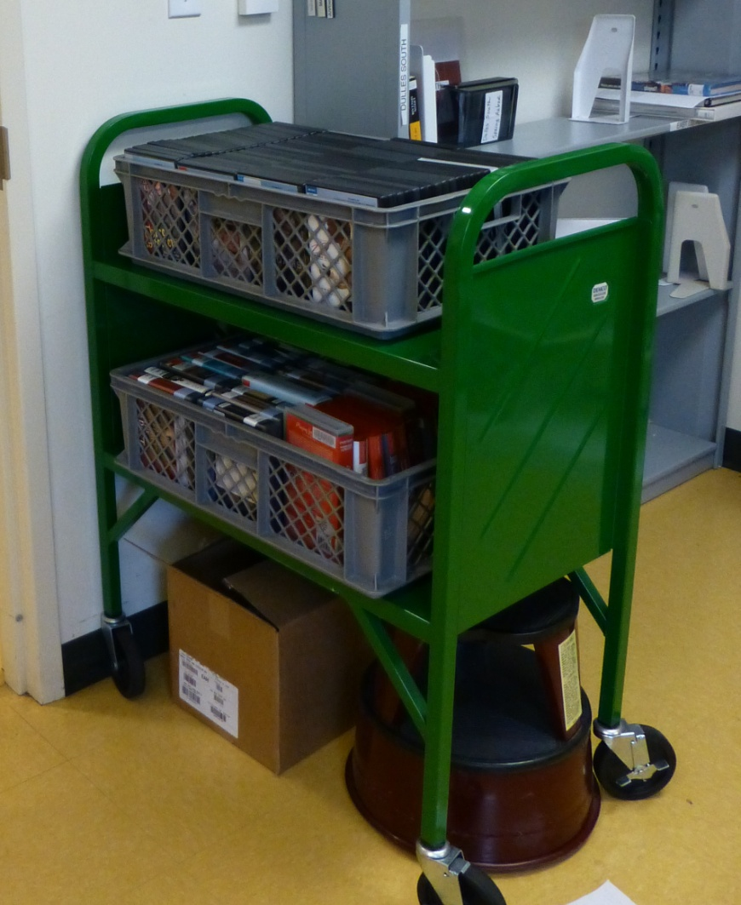
Storage cart for DVDs and Audio

Slide 14
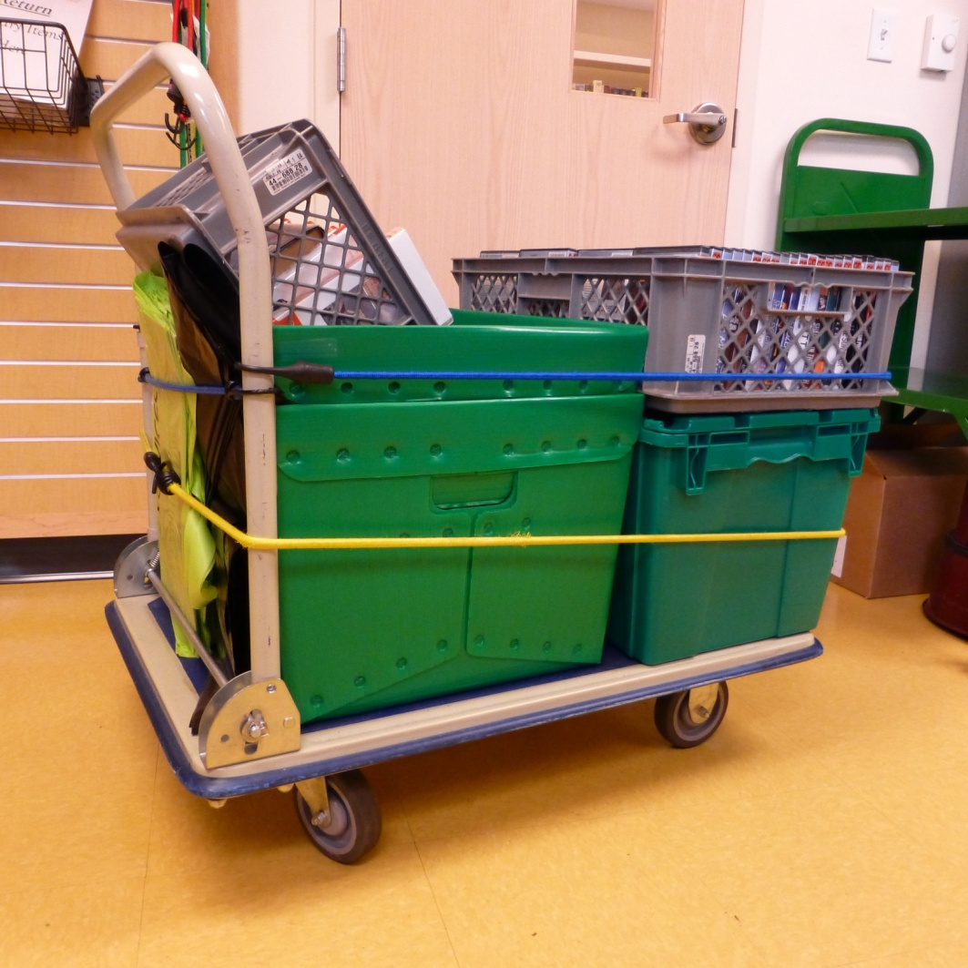
Ready to roll!

Slide 15
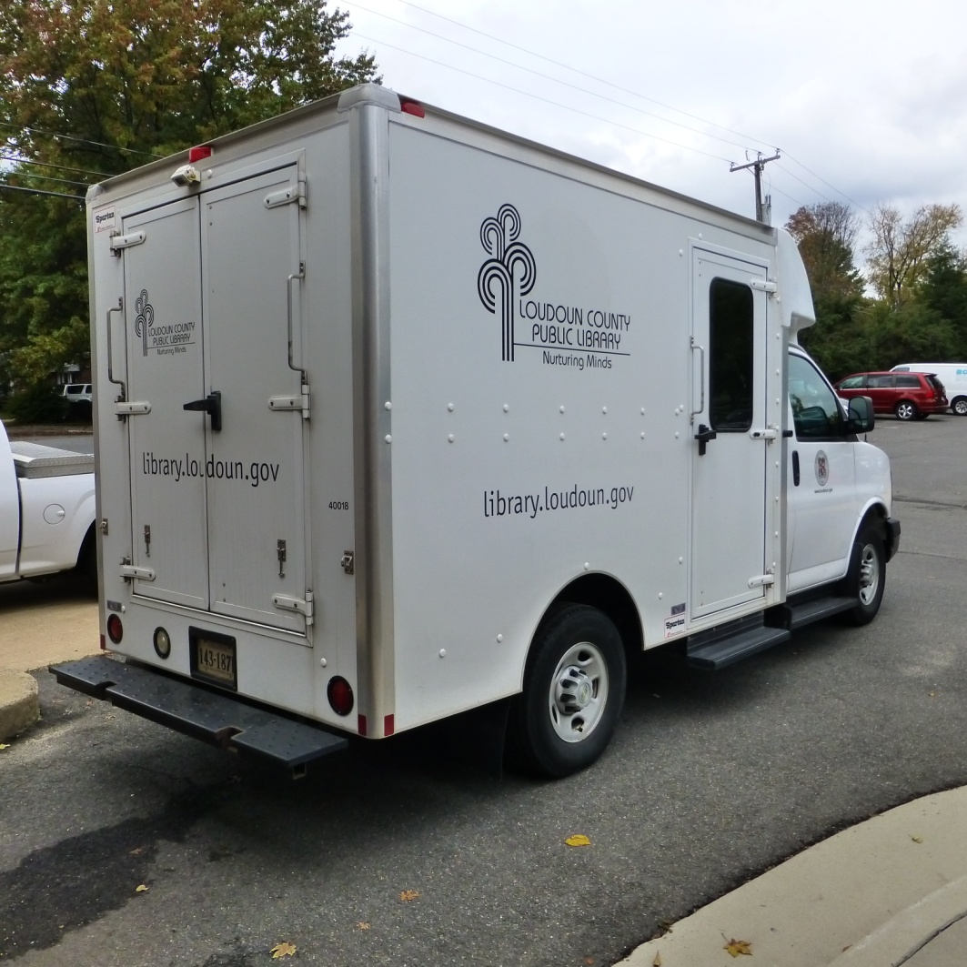
It’s all about Geometry!

Slide 16
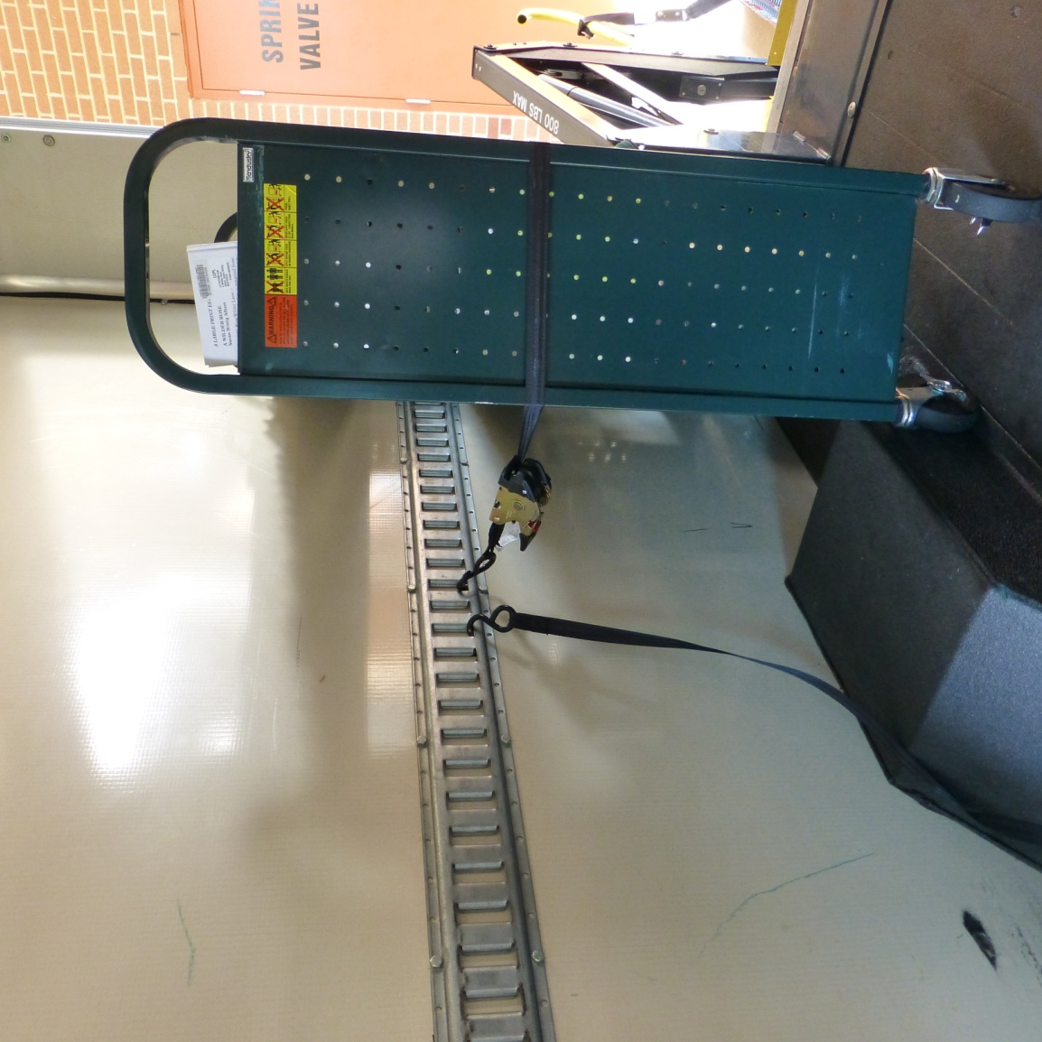
Here’s how we pack a little truck
Cart with E Track & tie-down straps

Slide 17
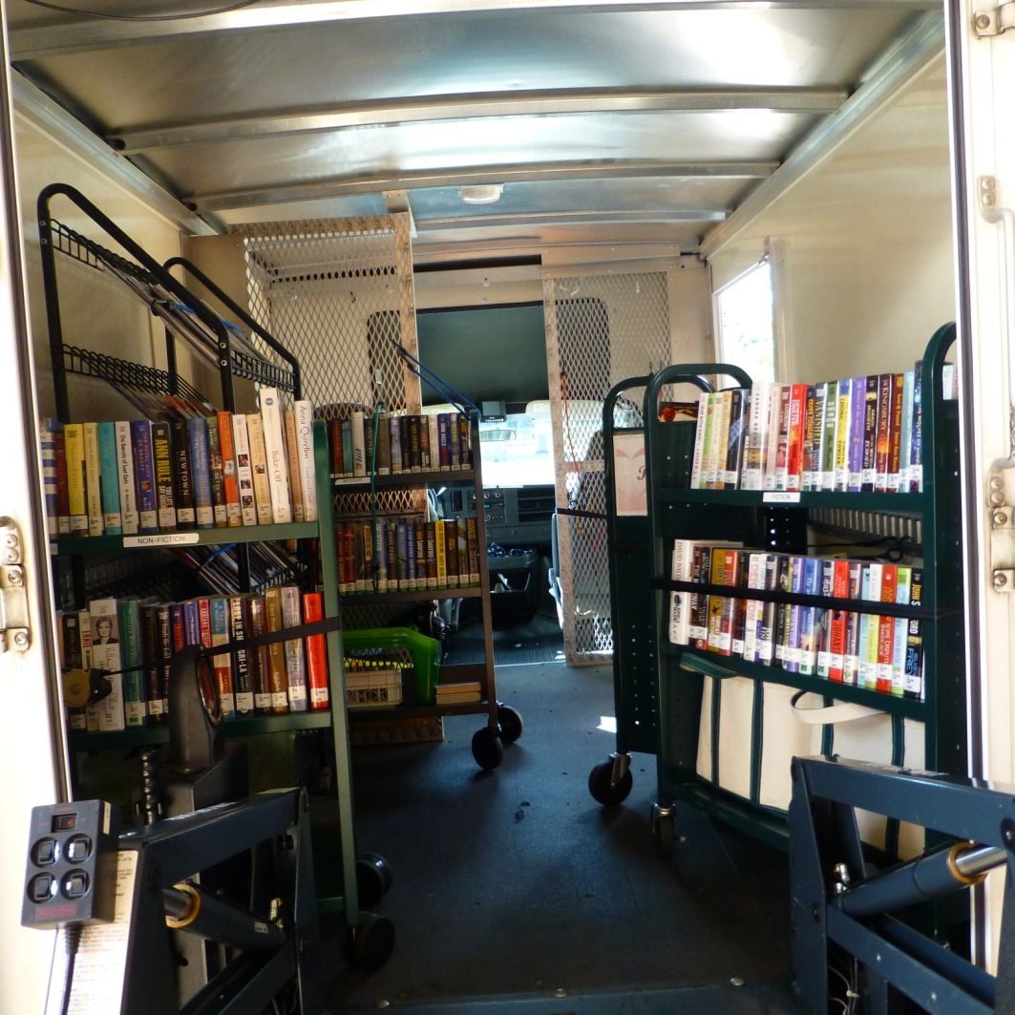
View from back of truck, LP Non Fic, magazines, LP mysteries, LP romance, LP fiction, wagon goes in the middle, extra cart goes in front fastened on safety grid

Slide 18
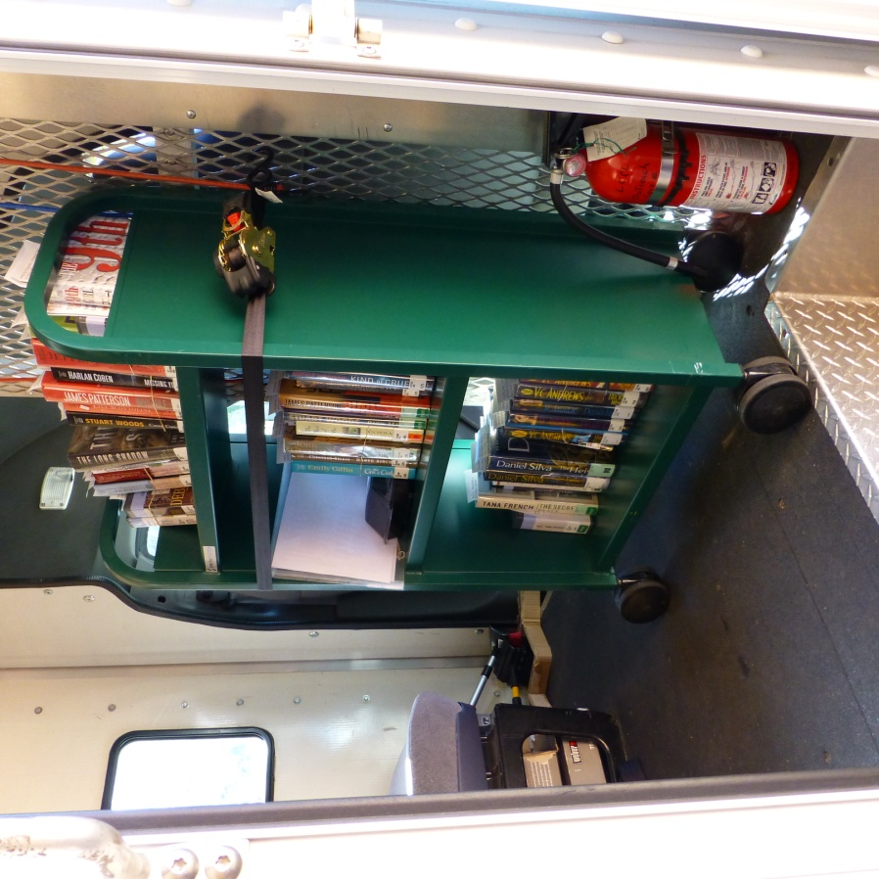
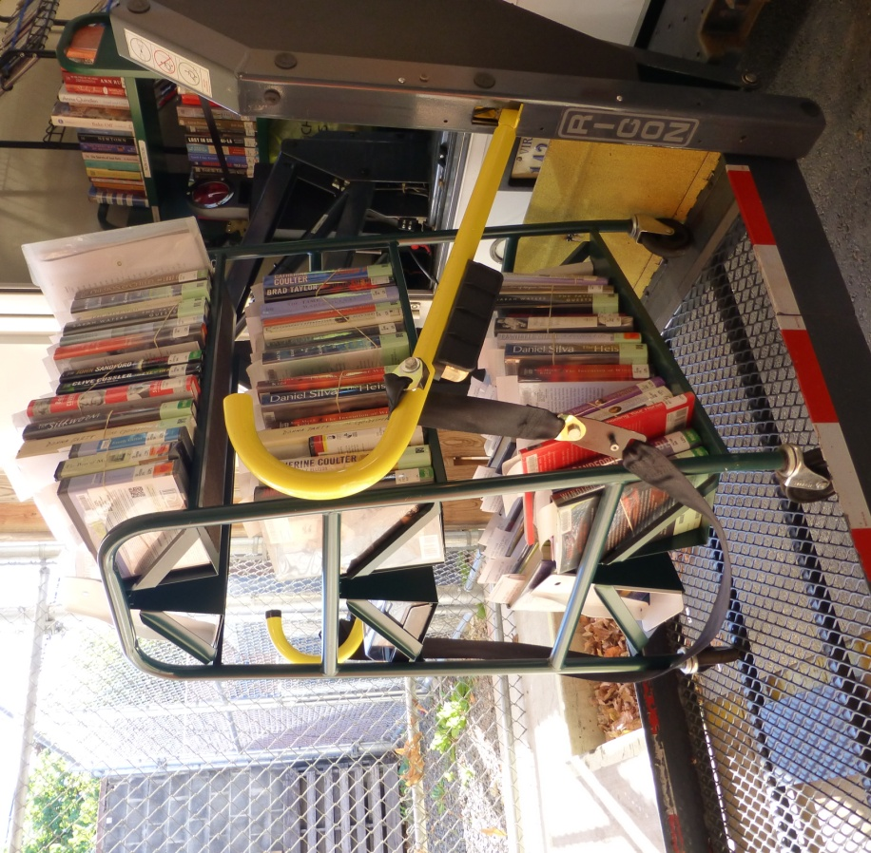
Leisure World holds cart on safety grid at front of truck.
Ashby Ponds holds cart goes on the side of truck, displaced cart is moved to safety grid at front

Slide 19
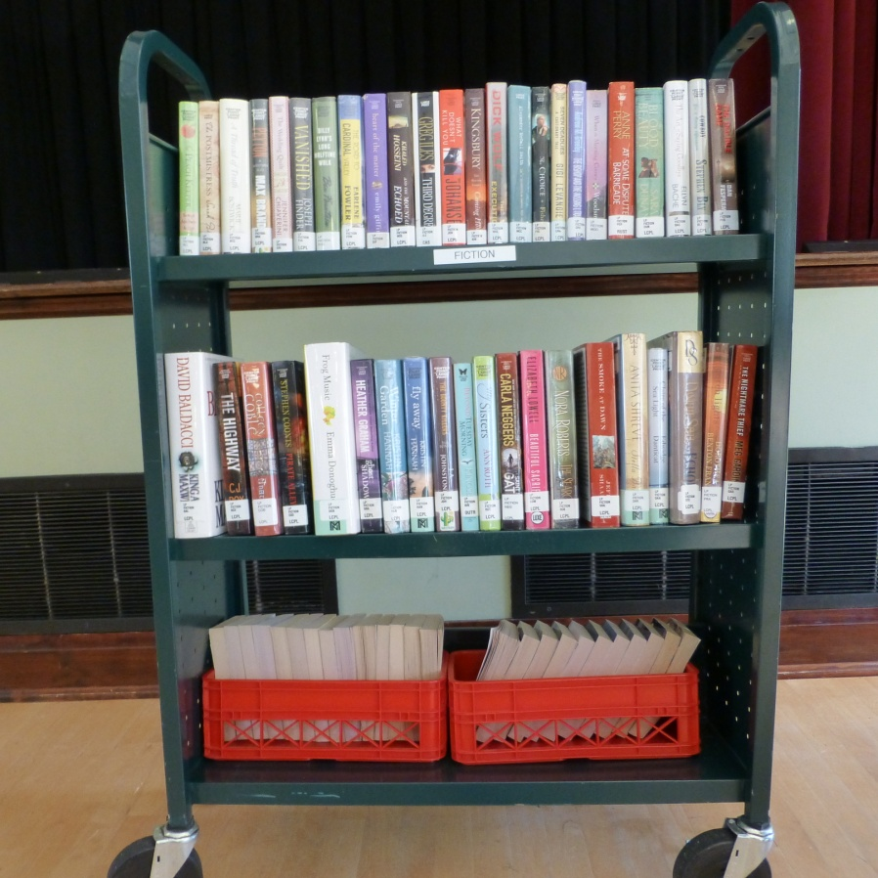
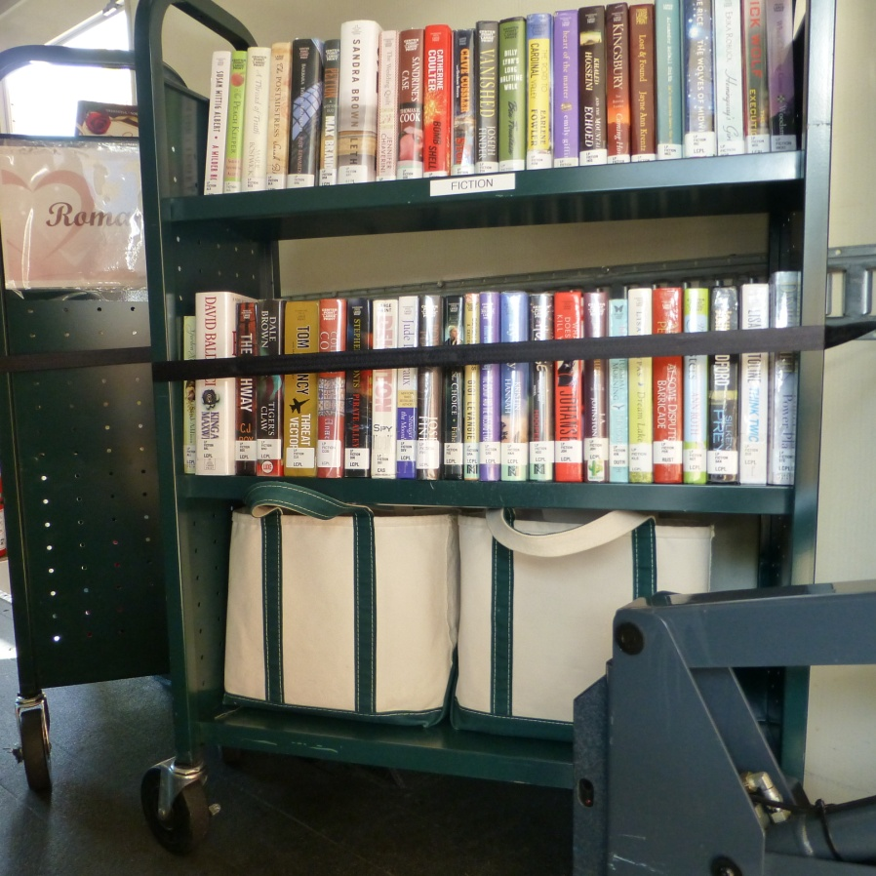
Trays of Harlequin Love Inspired & Suspense
New books & signs in canvas bags

Slide 20
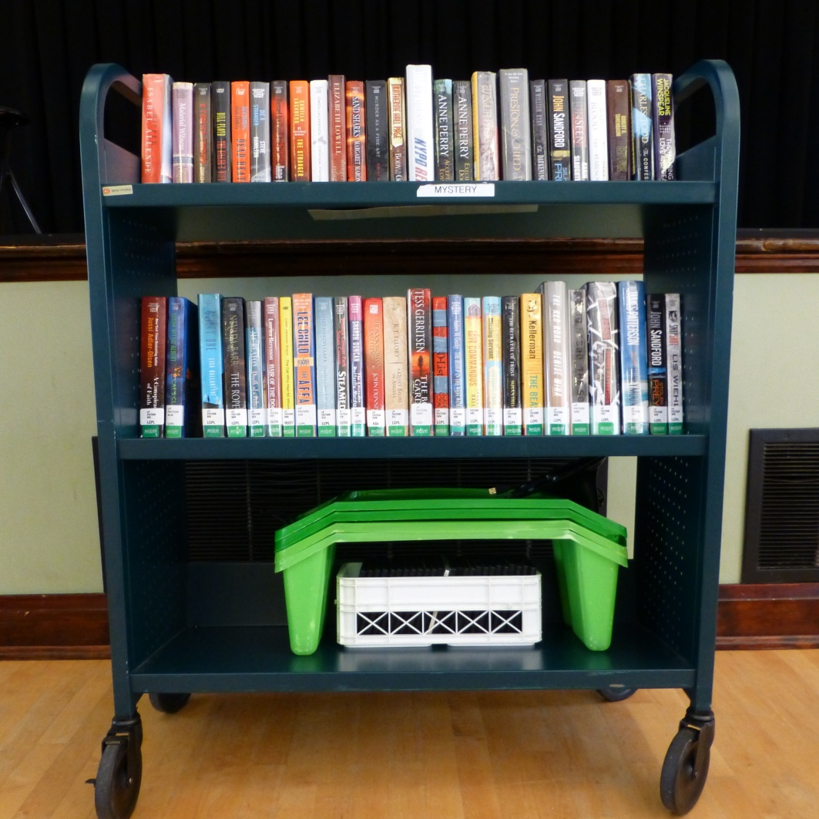
Mystery cart, almost too heavy for the lift, with green risers and tray of music CDs

Slide 21
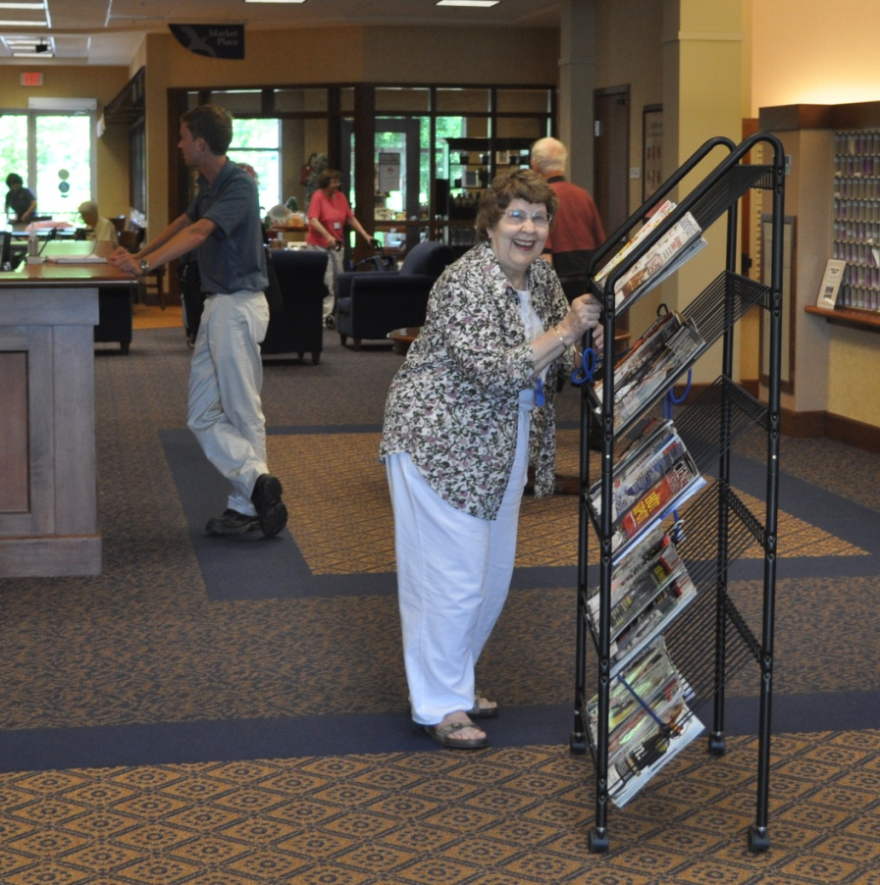
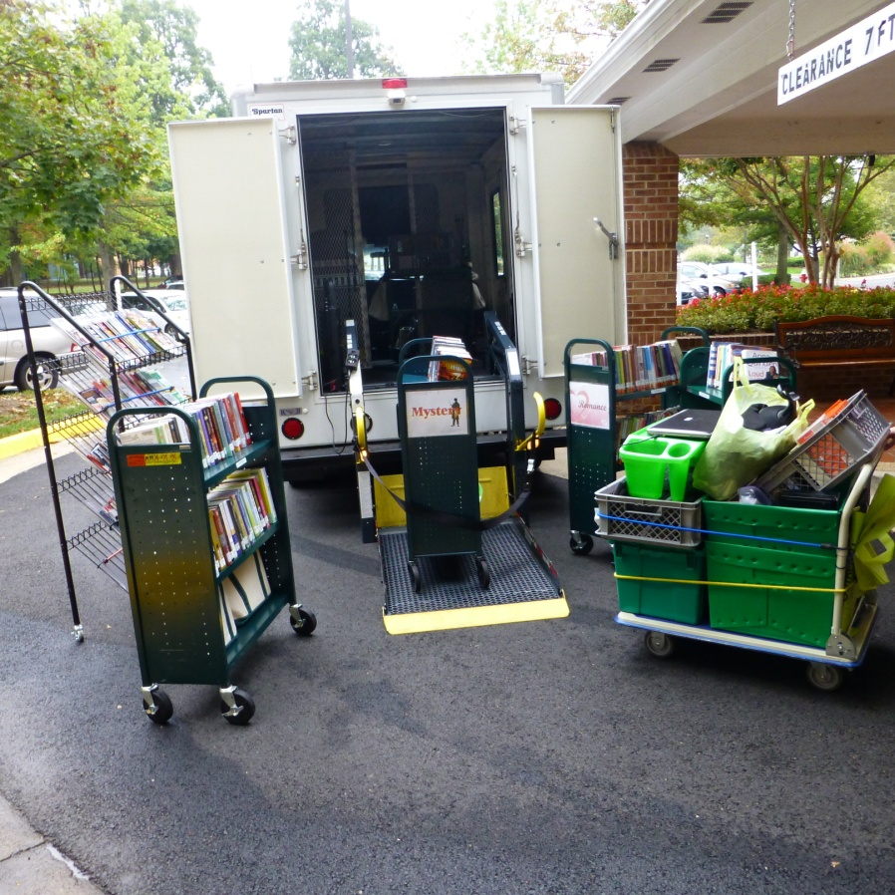
Sometimes we get help, sometimes we don’t

Slide 22
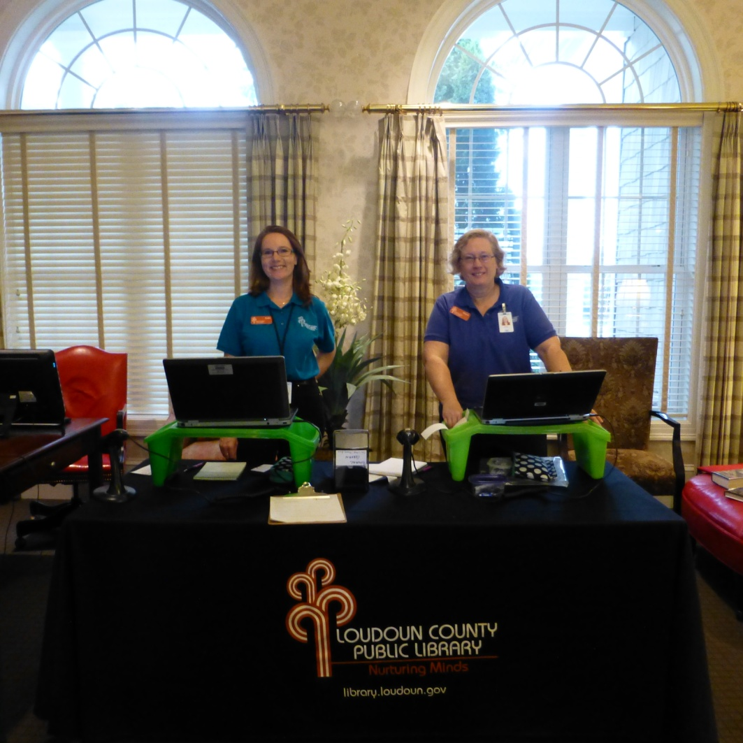
Ready for customers
Notes:
Laptops, scanners, Rolodex, notebooks, card applications

Slide 23
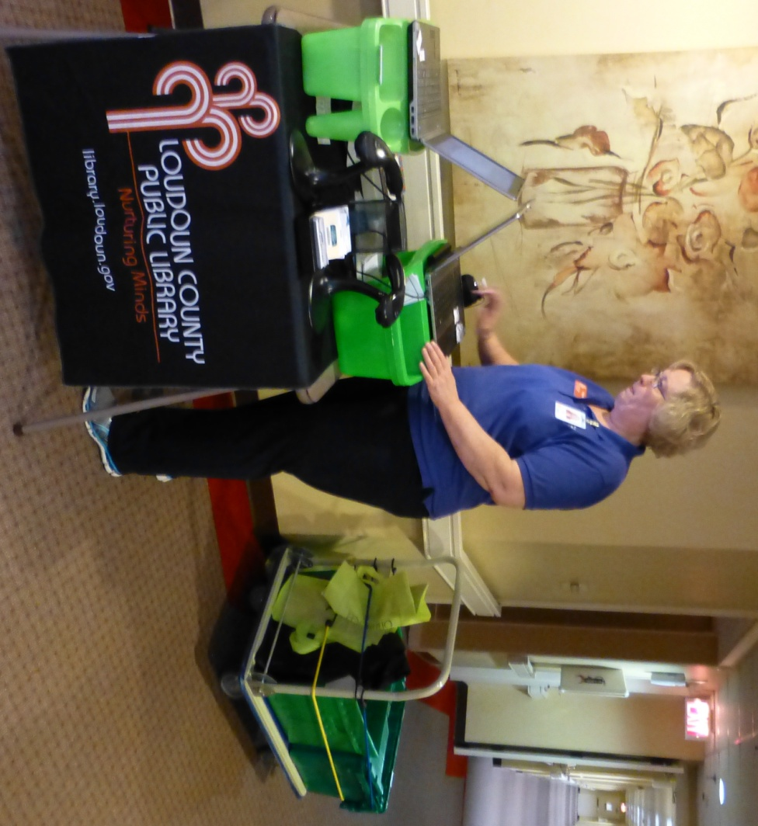
Ready for customers

Slide 24
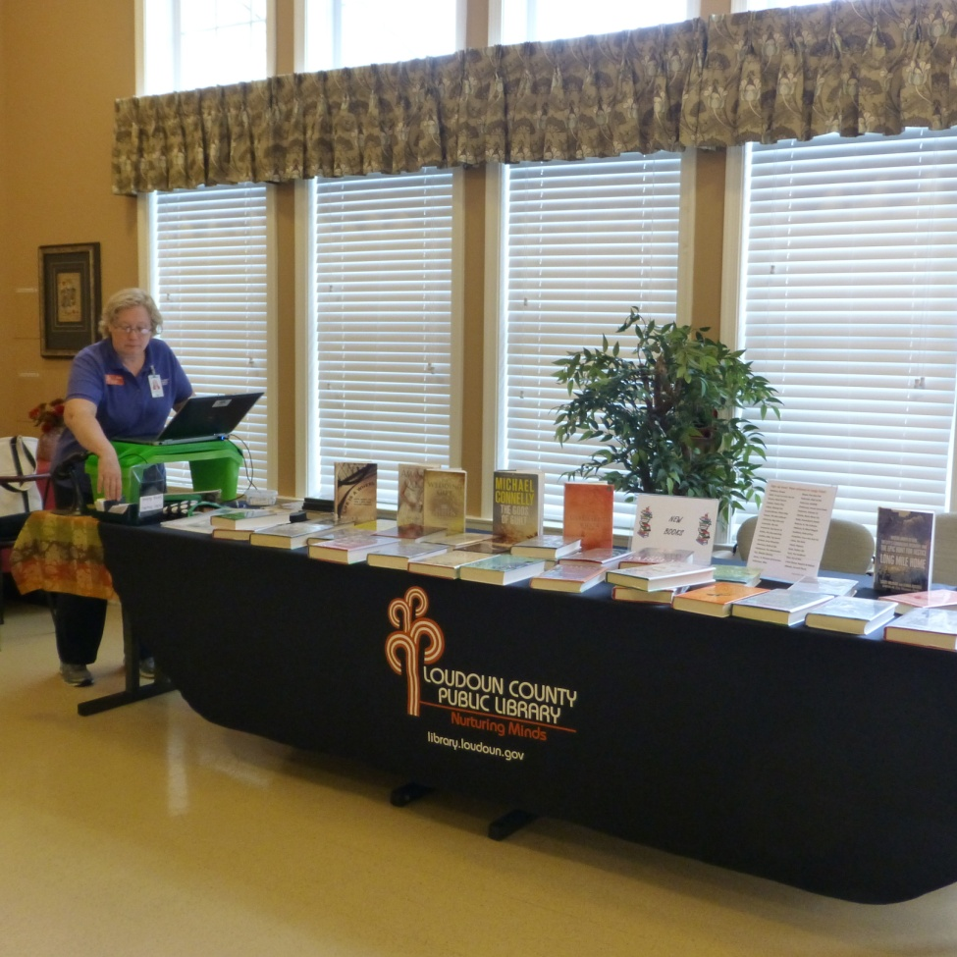
Ready for customers
Notes:
Sign up now list

Slide 25
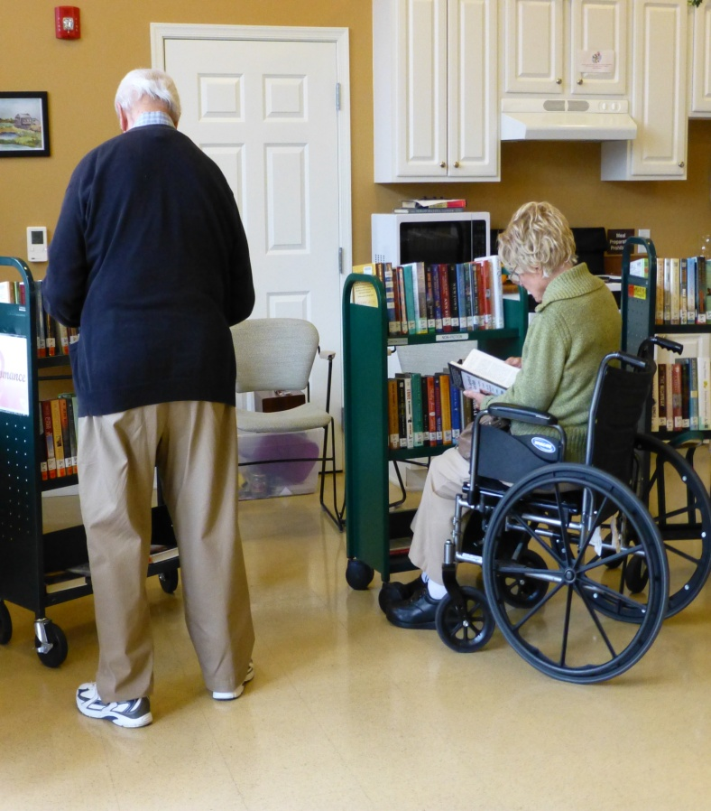
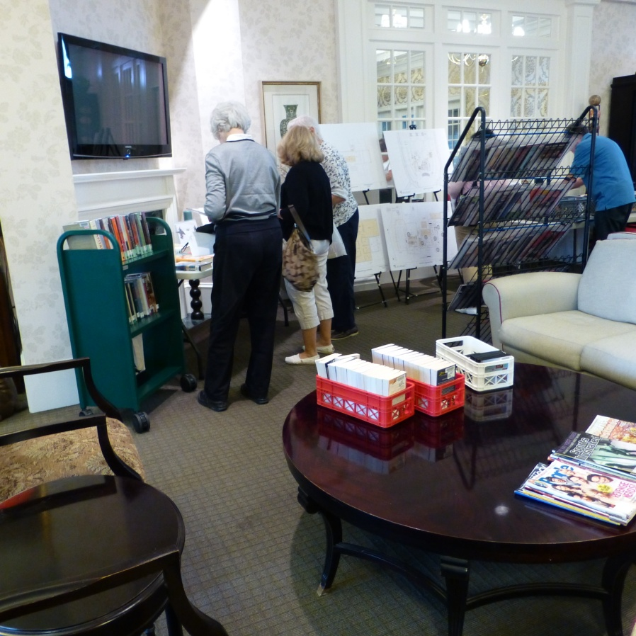
Different set up at each stop
Notes:
Single sided carts & different locations = maximum flexibility for limited mobility customers

Slide 26
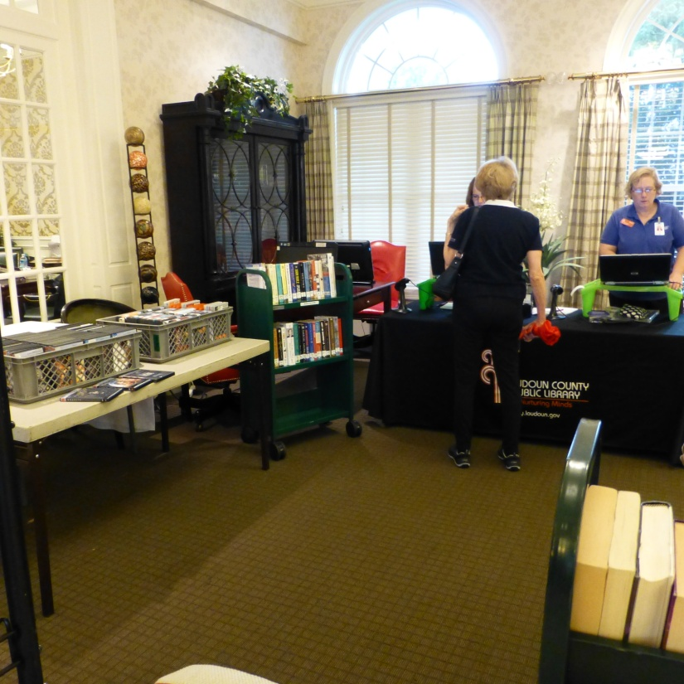
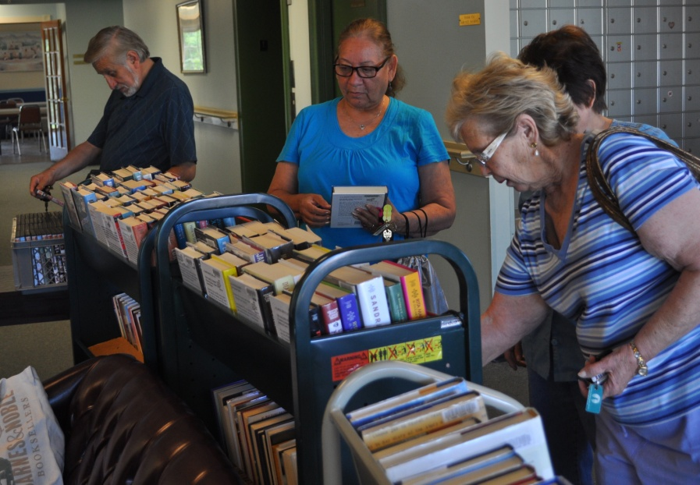
Different set up at each stop

Slide 27
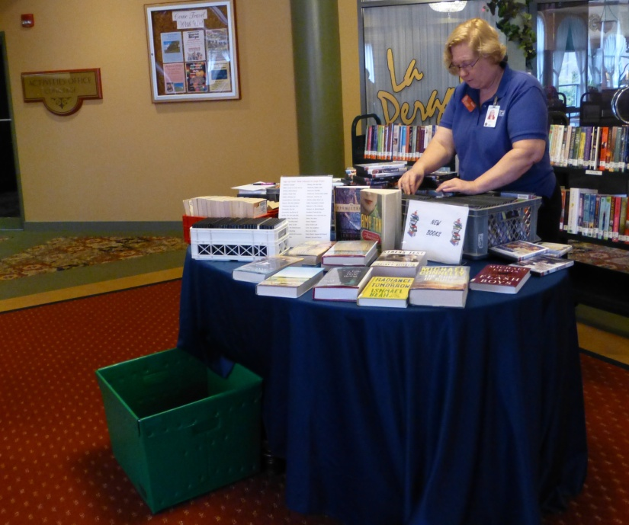
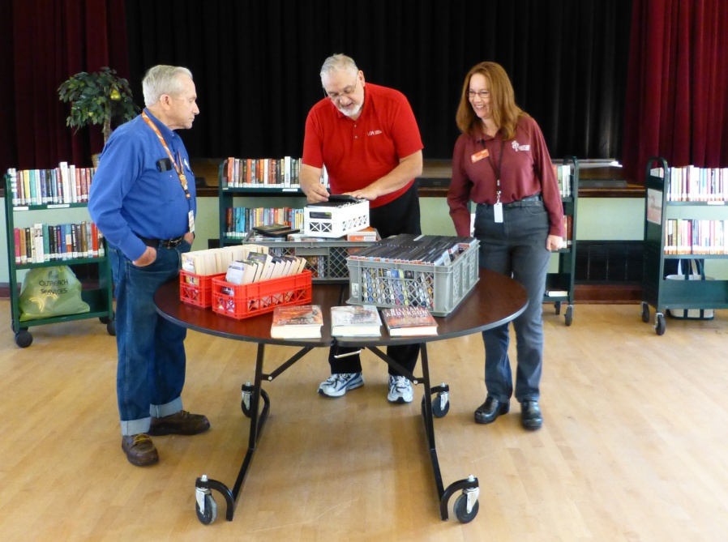
Different set up at each stop

Slide 28
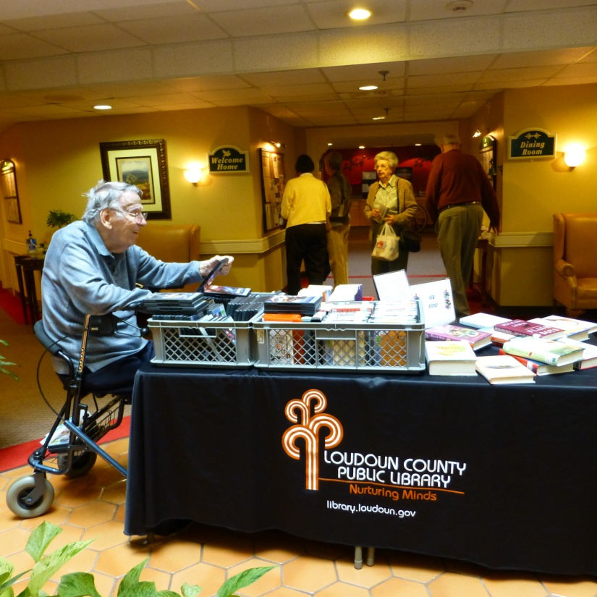
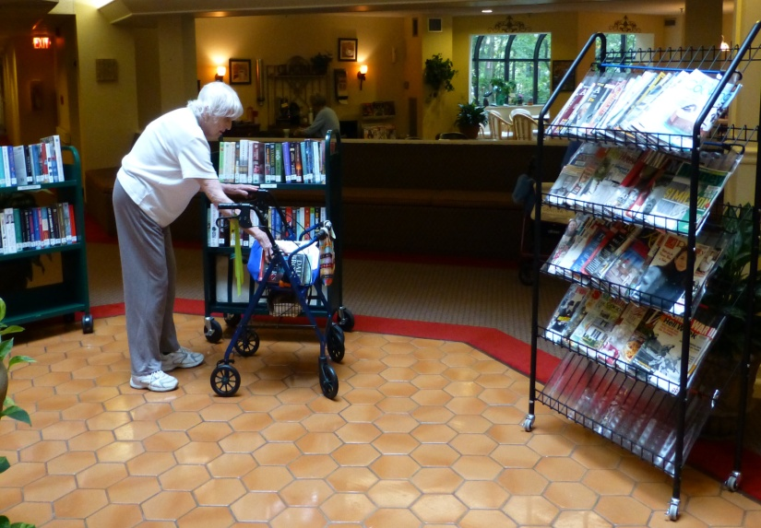
Different set up at each stop

Slide 29
2 types of Lobby Stop
Books on Carts
Books in Trays

Slide 30
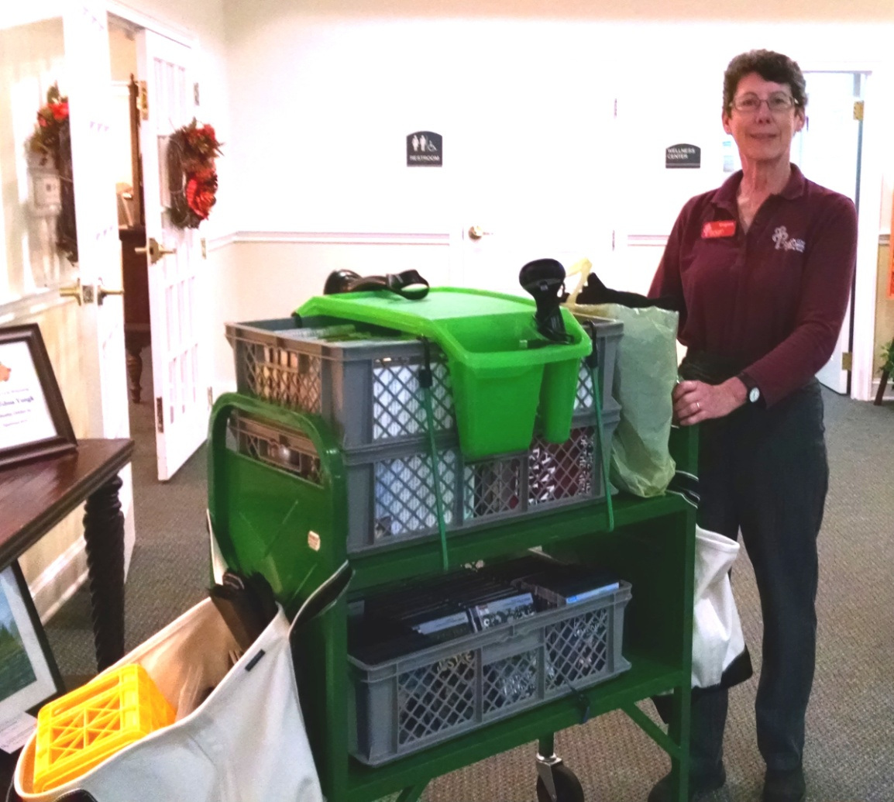
Lobby Stop w/ Trays
Assisted Living
End of lunch
New Large Print &
lots of DVDs
Notes:
Cart goes at front of truck on safety grid, tablecloth, extra DVDs, bags carry supplies and returned items

Slide 31
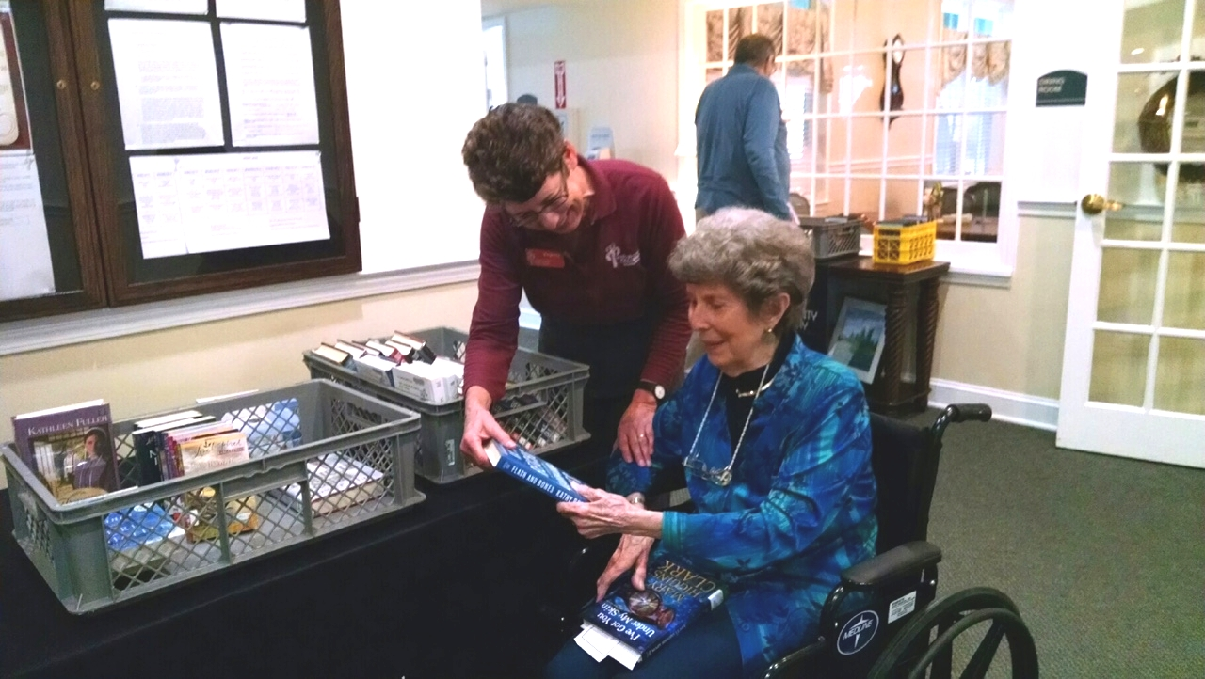
Ms. B. selects a book from the trays

Slide 32
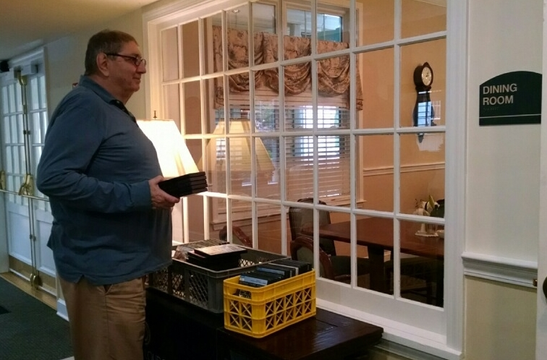
Mr. L. selects many DVDs from the trays

Slide 33
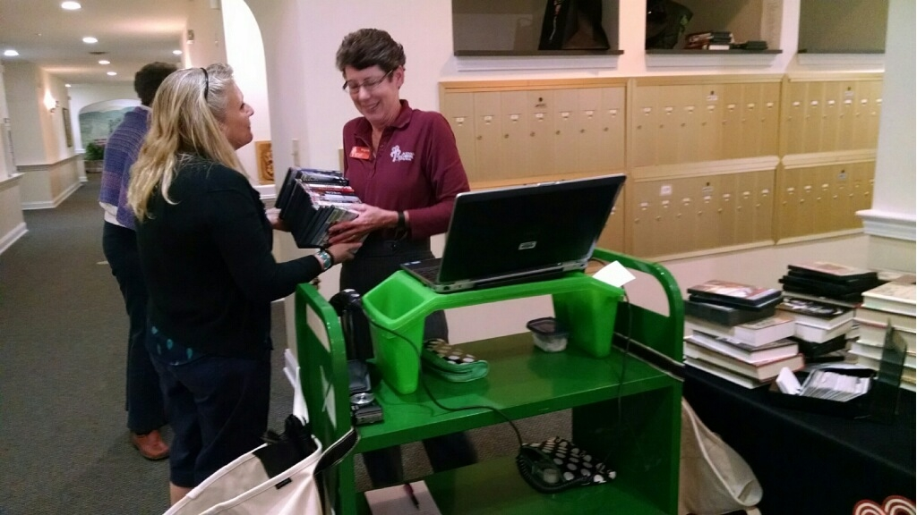
Checking out DVDs for Meadow Glen staff
Notes:
Explain Facility card, work closely to support programs

Slide 34
Adding a Stop or Reducing Service
New facilities are opening all the time
Offer Books-By-Mail
Big? Plan ahead for 2 visits a month
Facilities are losing readers all the time
Is it Staff or Customers using the service?
Quantity matters
Downsize to Books-By-Mail
Notes:
BBM is postage free mailing of LP/AV materials, must be certified

Slide 35
Questions?
Stuff & Equipment
Truck: Chevy Express van w/ back-up camera & E-Track
Polo Shirts: Port Authority
Coats: Lands End squall jackets
Canvas bags:
  LL Bean (unmarked)
  Lands End (LCPL logo, long handles)
Badges and magnetic sign: Signarama
Tablecloths/runners: Displayit
Bins and green box: Uline
Wagon: Uline handi-mover, 600 lbs., solid wheels
Retractable Tie-Downs: Home Depot
Green risers: Michaels crafts “lap desk”
MiFi: Verizon Jetpac (hot spot)
Virginia LaRocque
Manager, Outreach Services
Loudoun County Public Library
Leesburg, VA 20176
Virginia.LaRocque@Loudoun.gov

