Slide 1
Why Don’t We Make It On The Road
Translating Makerspaces Into Library Outreach

Slide 2
Makerspaces?
What are they? Why have them?
Collaboration
Access
Community
Creating
Problem Solving
Notes:
who has some form of maker materials in their library now? what do you use them for and do they stay in house?
Makerspaces are physical spaces where people from any walk of life have access to materials, mentors and other “makers.” Here they are encouraged to collaboratively make anything using available materials. In these places, people learn they have the ability to create without deferring to an expert. Makerspaces encourage self-sufficient problem solving.
Encourage collaboration
Encourage problem solving
Often provide a facilitator/mentor
Can be a permanent or temporary space

Slide 3
Why are makerspaces relevant and why should libraries care?
“Adopting a makerspace culture diversifies libraries’ long-outdated role as shushing book distributors. It redefines the library as a place of creation, not consumption, and it appeals across socioeconomic and geographical divides.”
- Kristin Fontichiaro from Library 2020: Today’s
Leading Visionaries Describe Tomorrow’s Library
Notes:
In a few words: community, problem solving, open source, building the future, open to all, new technology, collaboration, learning, teaching, STE(A)M
In a few words: community, problem solving, open source, building the future, open to all, new technology, collaboration, learning, teaching, STE(A)M
there is debate in the field between needs and wants in the library. still have to make sure needs are also met, and some libraries would put maker in wants, we put it in needs. discuss Miami-Dade issue.

Slide 4
How Meridian library district got our start
Where did we get the idea in the first place and who helped us get things started?
Notes:
first let’s look around the country then we’ll explain idaho

Slide 5
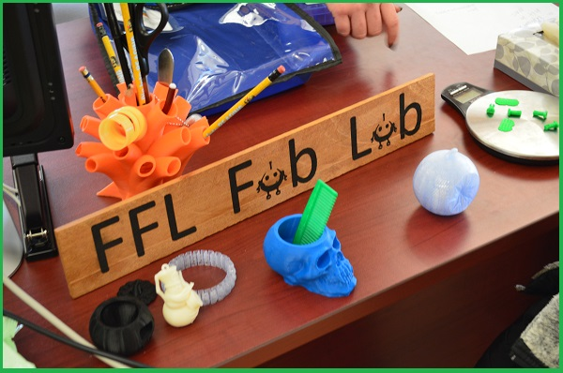
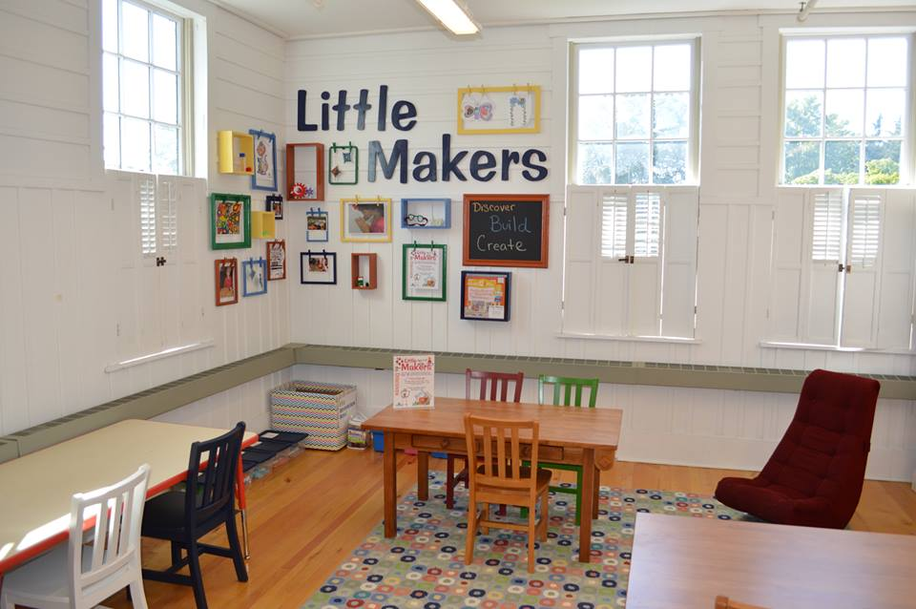
The Fayetteville Free Library “Fab Lab” in Fayetteville, New York
www.fflib.org/make/fab-lab

Slide 6
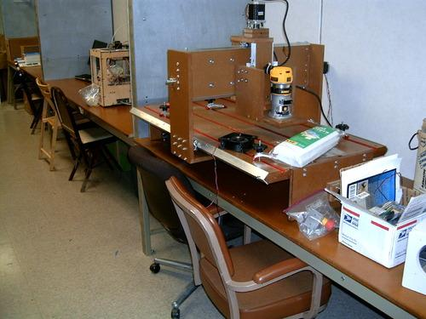
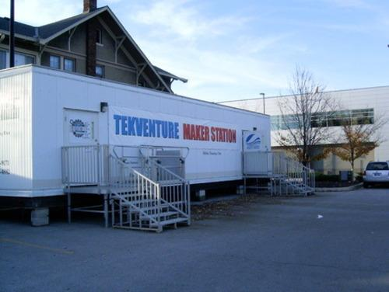
The Tekventure Maker Station in Fort Wayne, Indiana has partnered with the Allen County Public Library to provide library patrons with access to tools/training.
tekventure.org/maker-station

Slide 7
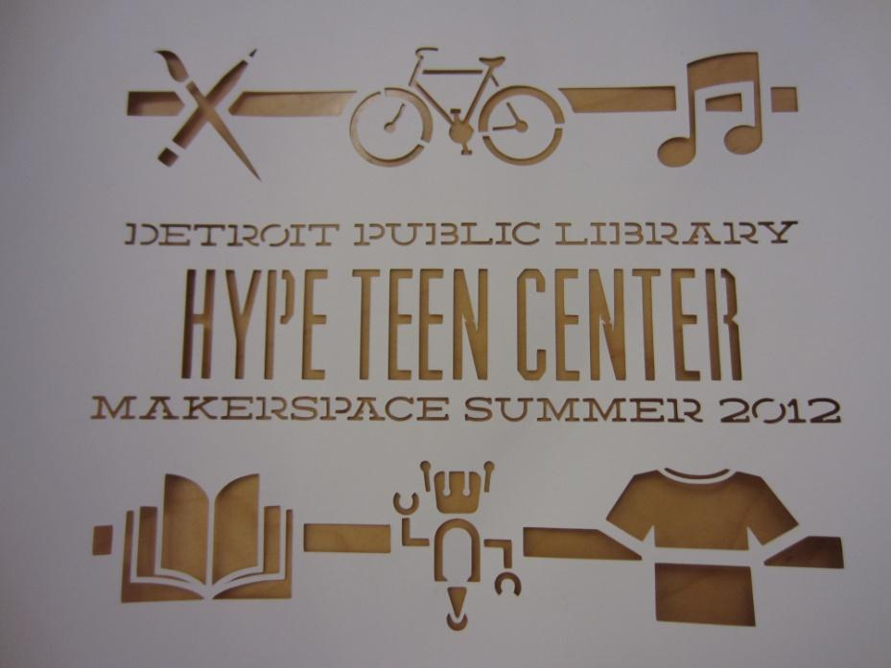
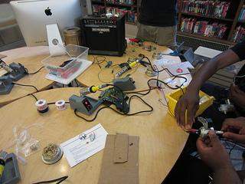
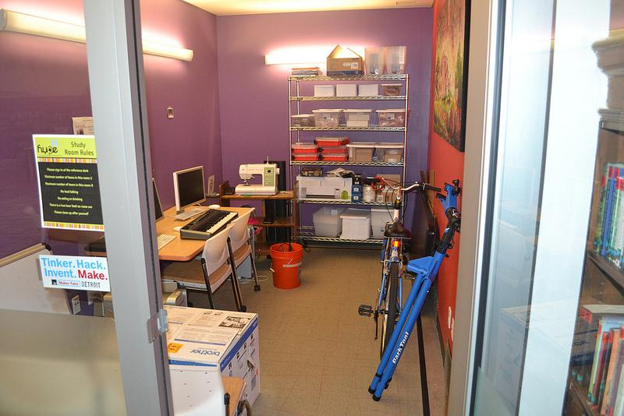
http://www.detroitpubliclibrary.org/hype/hype-makerspace

Slide 8
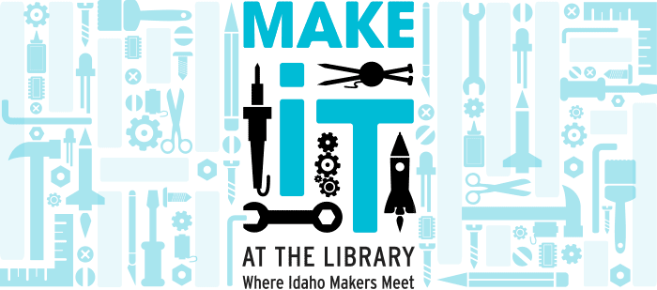
The Idaho Commission for Libraries started this project in 2012 to support the creation of Makerspaces in Idaho libraries.
libraries.idaho.gov
www.facebook.com/MakeItIdaho
Notes:
audra explains what icfl is and justin explains phases of project – icfl got the money from institute of museum and library services grant

Slide 9
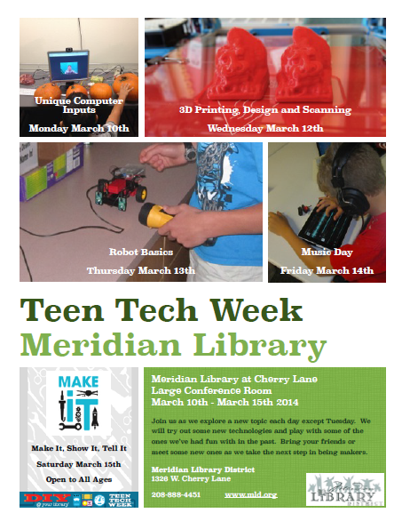
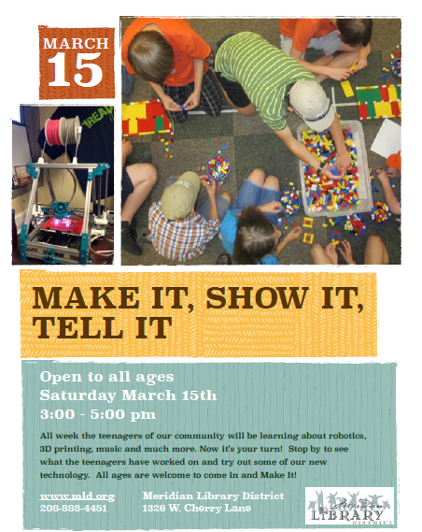
Notes:
examples of meridian

Slide 10
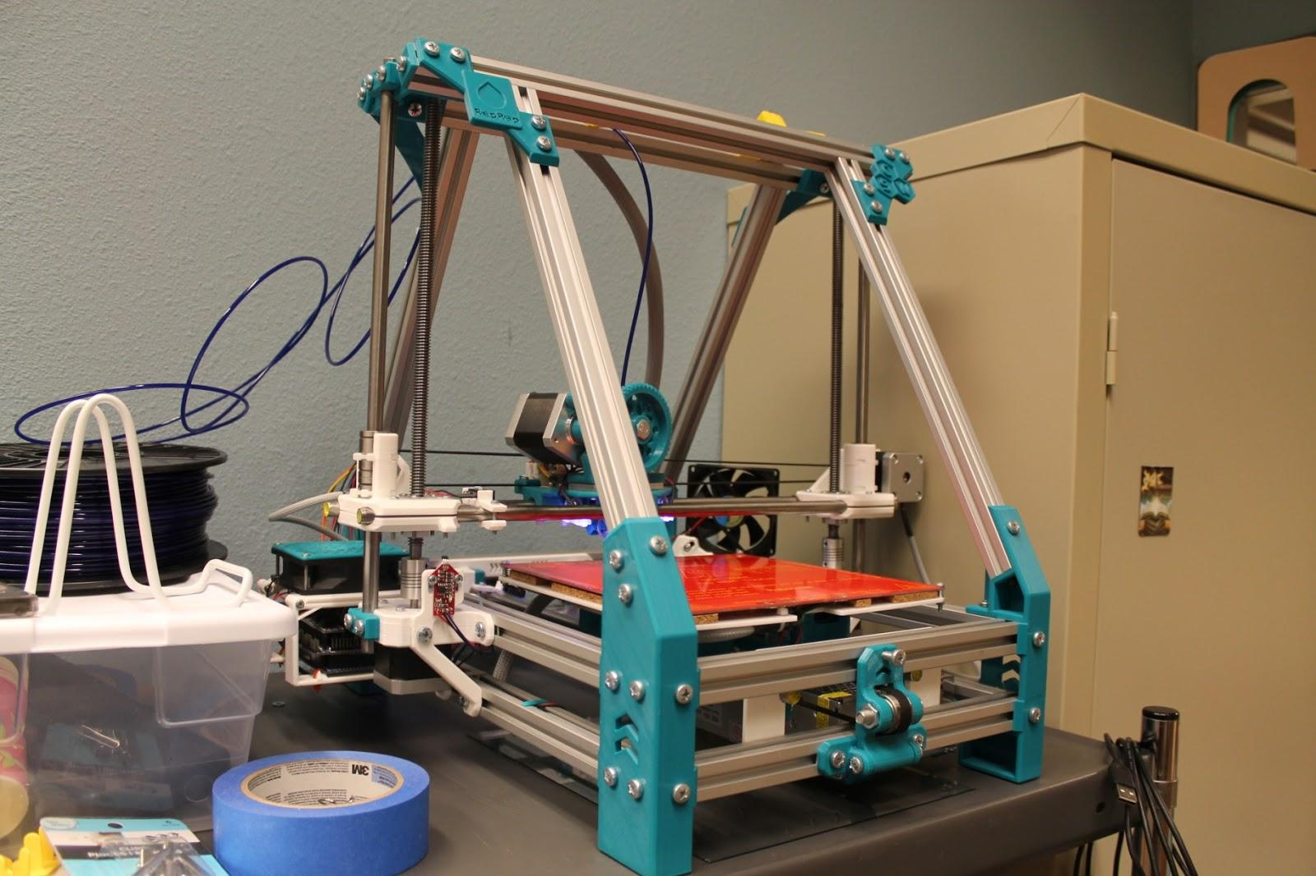

Slide 11
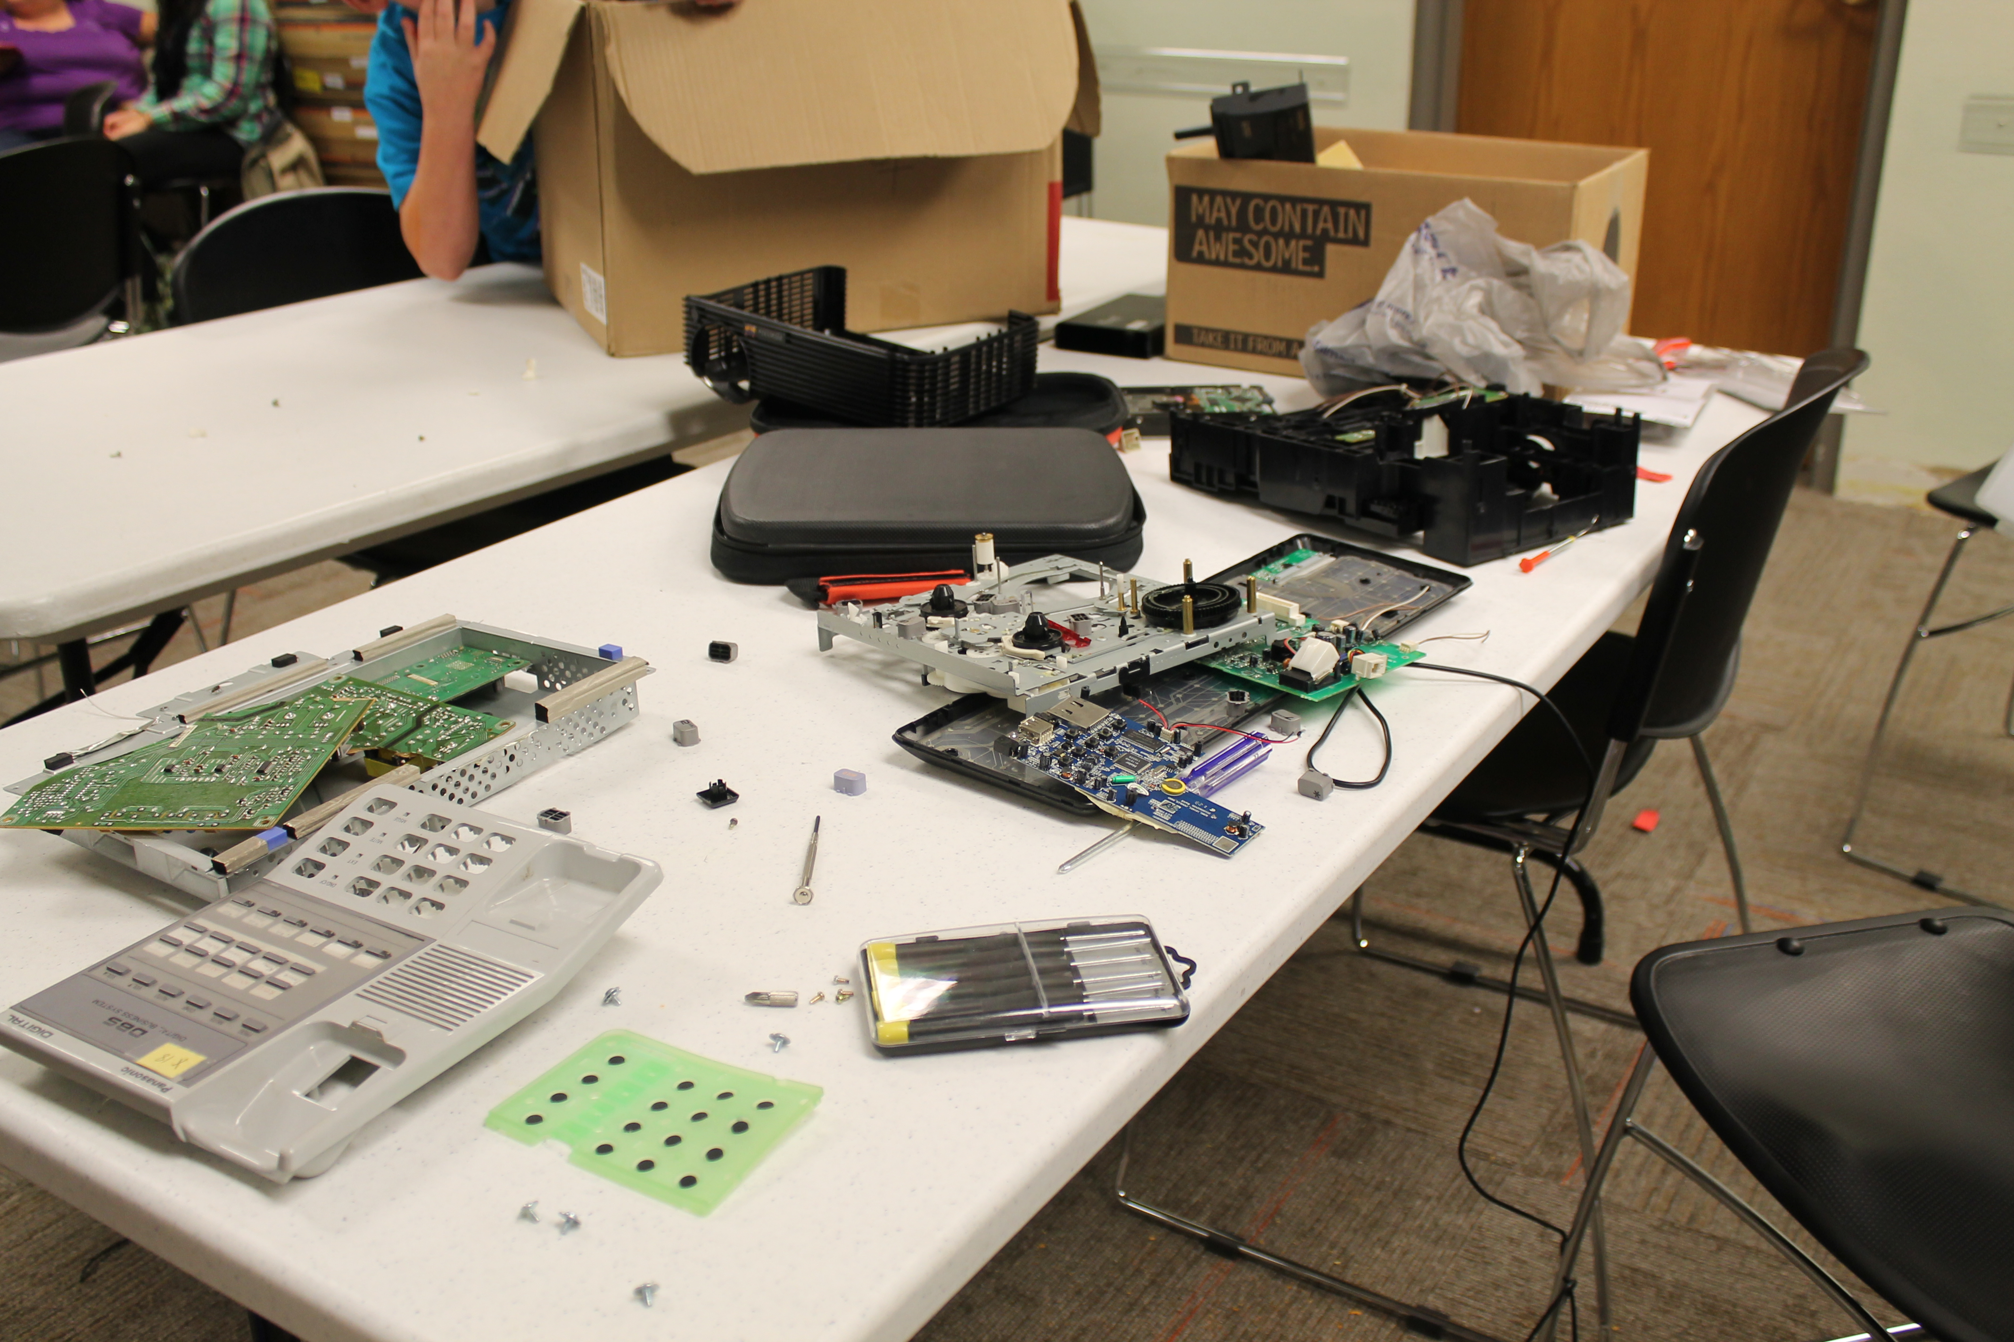
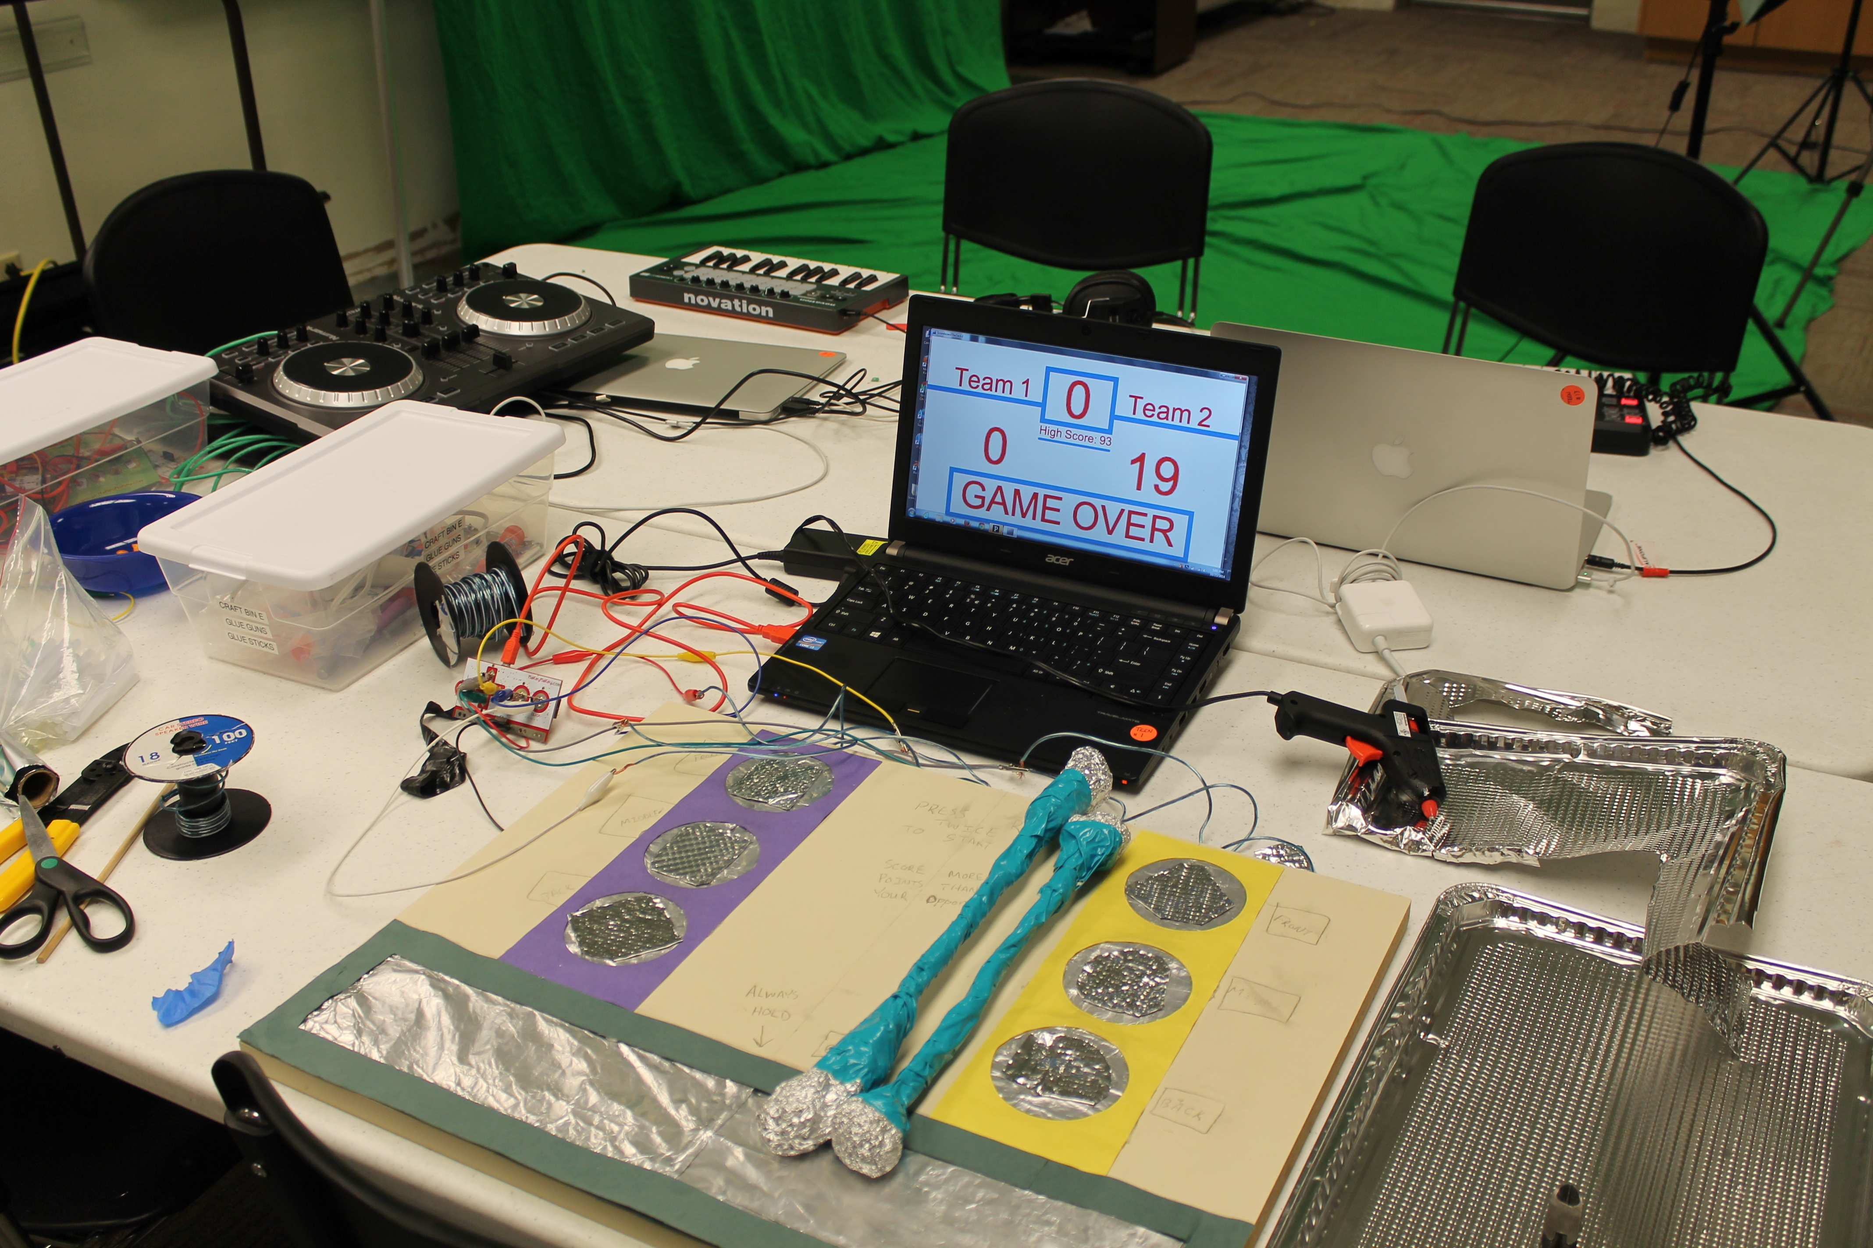
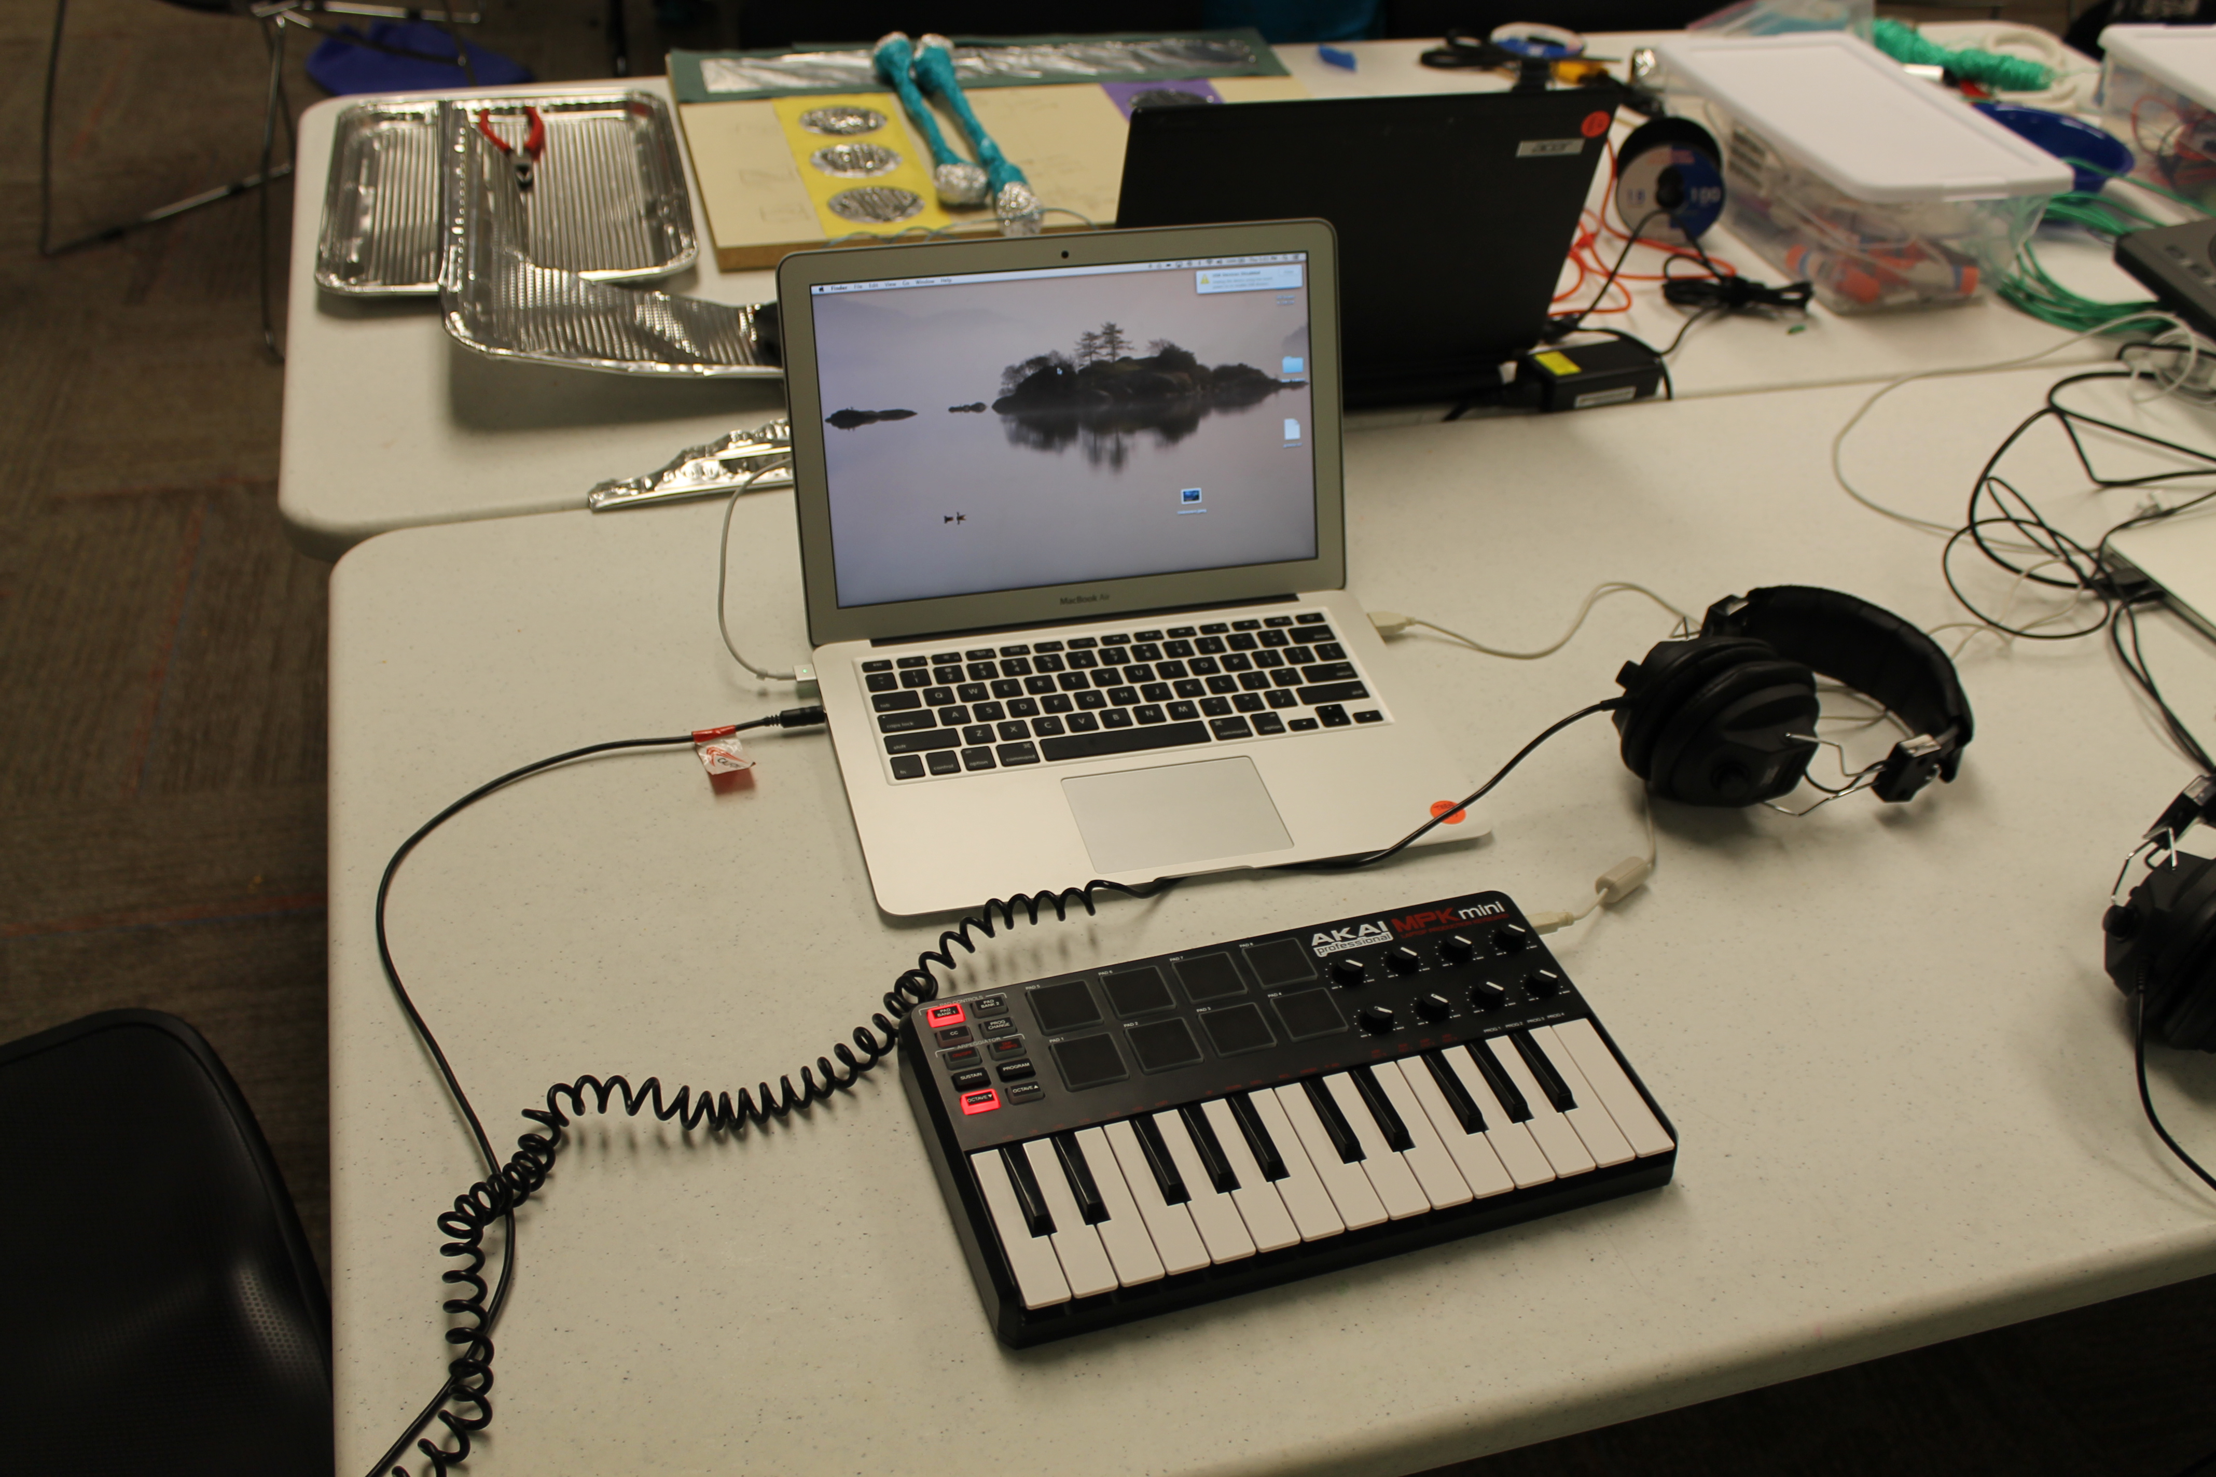

Slide 12
How do we get a makerspace of our own?
Tips and tricks for starting, funding, and “selling” your new makerspace.

Slide 13
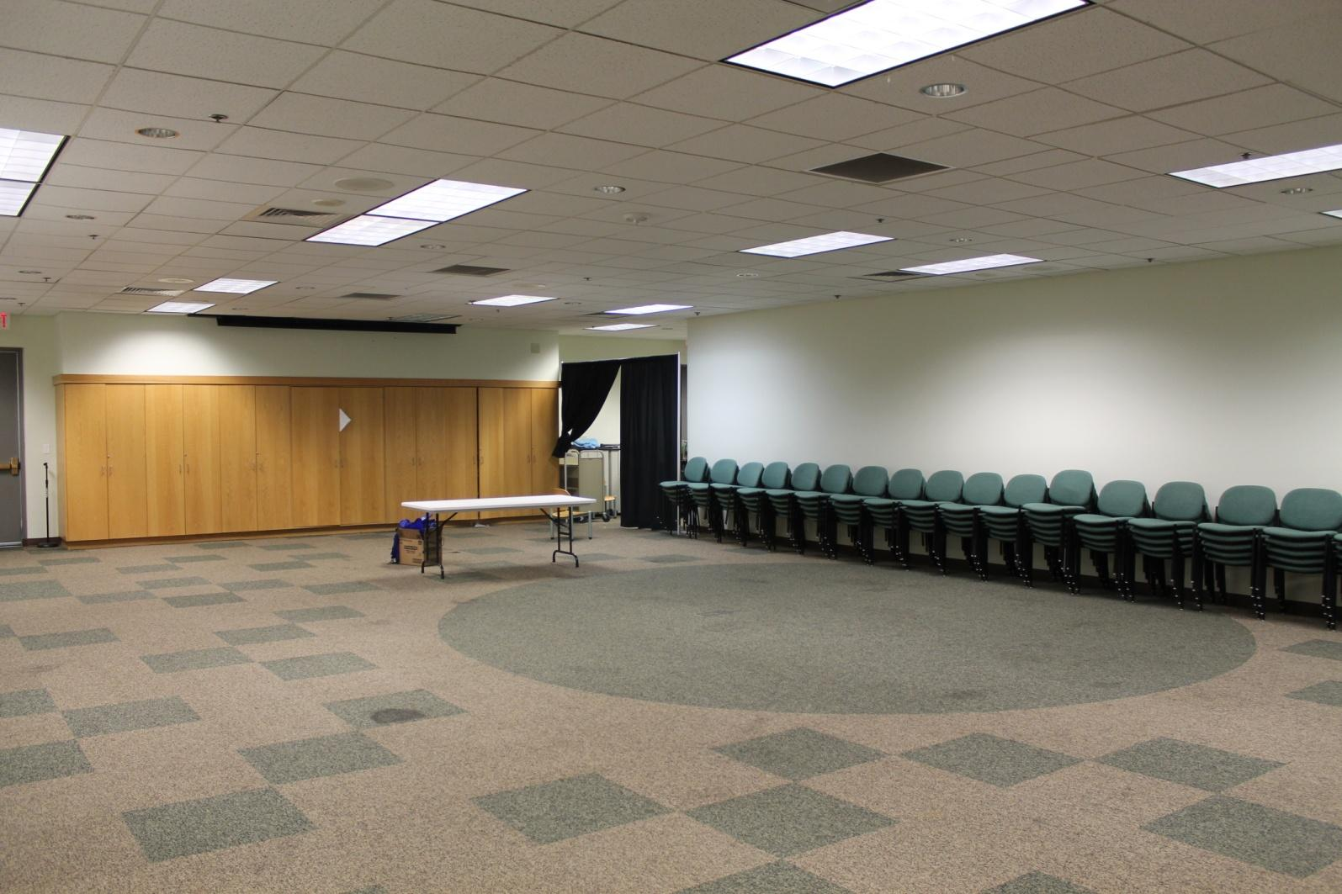
First you need a space that isn’t being used for anything else, at least not all the time.
Notes:
we know -- space is an issue everywhere. get creative. mld currently only at 41% of where we should be in terms of square footage -- so we store a lot of this stuff and have made it mobile.

Slide 14
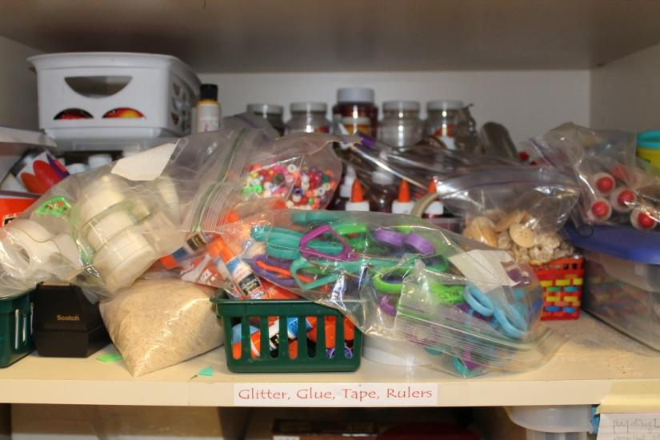
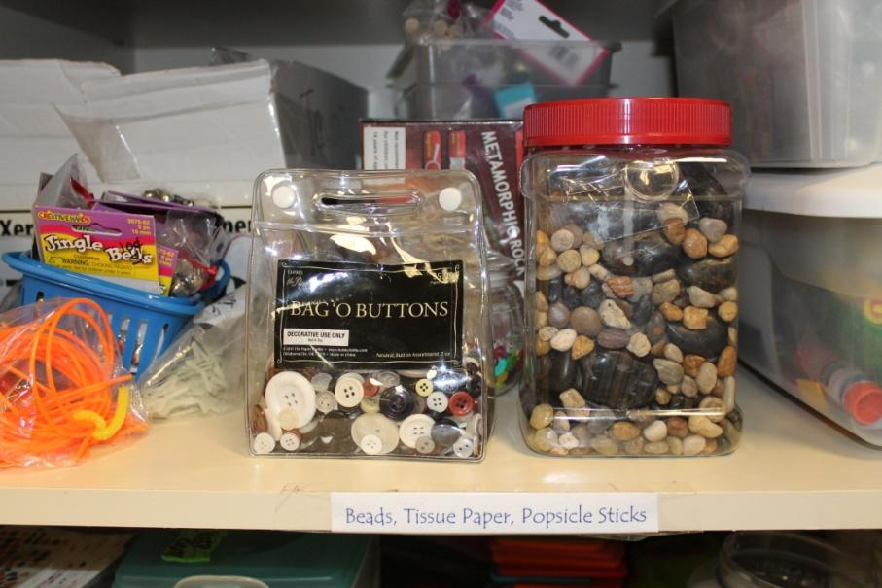
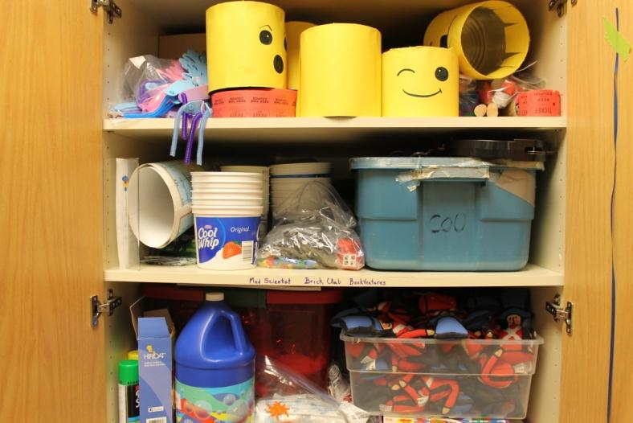
Next you need stuff to make stuff with
Chances are you already have an assortment of these…
Notes:
Pics of maker materials; Every library has craft supplies - makerspaces are that and a lot more; to start you don’t necesarily need to buy anything (a lot of it is how you present the program)

Slide 15
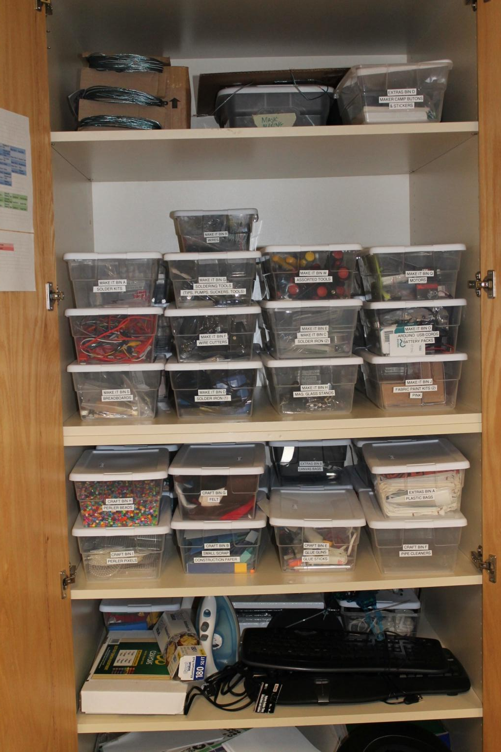
ORGANIZE
YOUR
STUFF!
Notes:
We learned this the hard way – we didn’t get organized for about a year after we got all our stuff – and just by organizing our stuff it is easy to take places for outreach

Slide 16
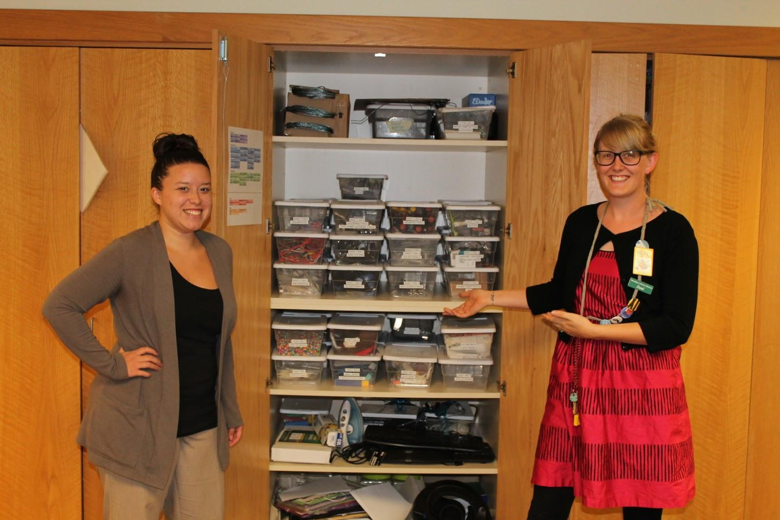
Trisha and Dani the organization wizards went through all of our makerspace materials and categorized them. It took them a week! Note: this is not all of our stuff.
Notes:
find the people that a) use the stuff and b) love to organize. they did this while no programs and library closed. in terms of cost and justifying public desk staff to work off desk, saved us a ton over long run.

Slide 17
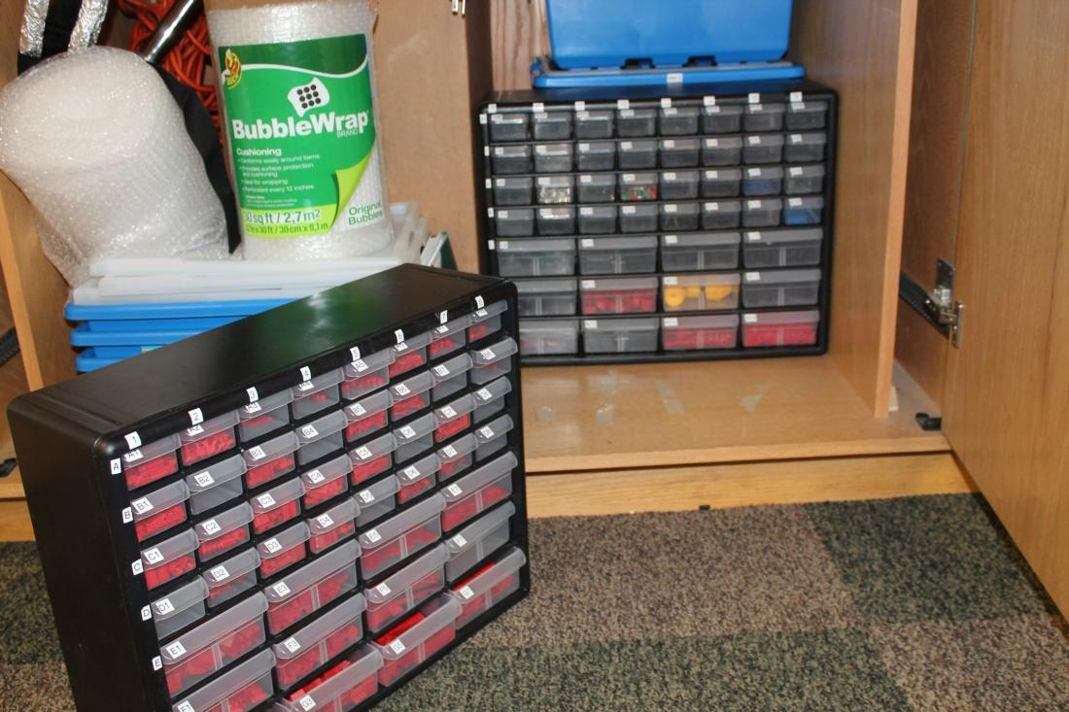
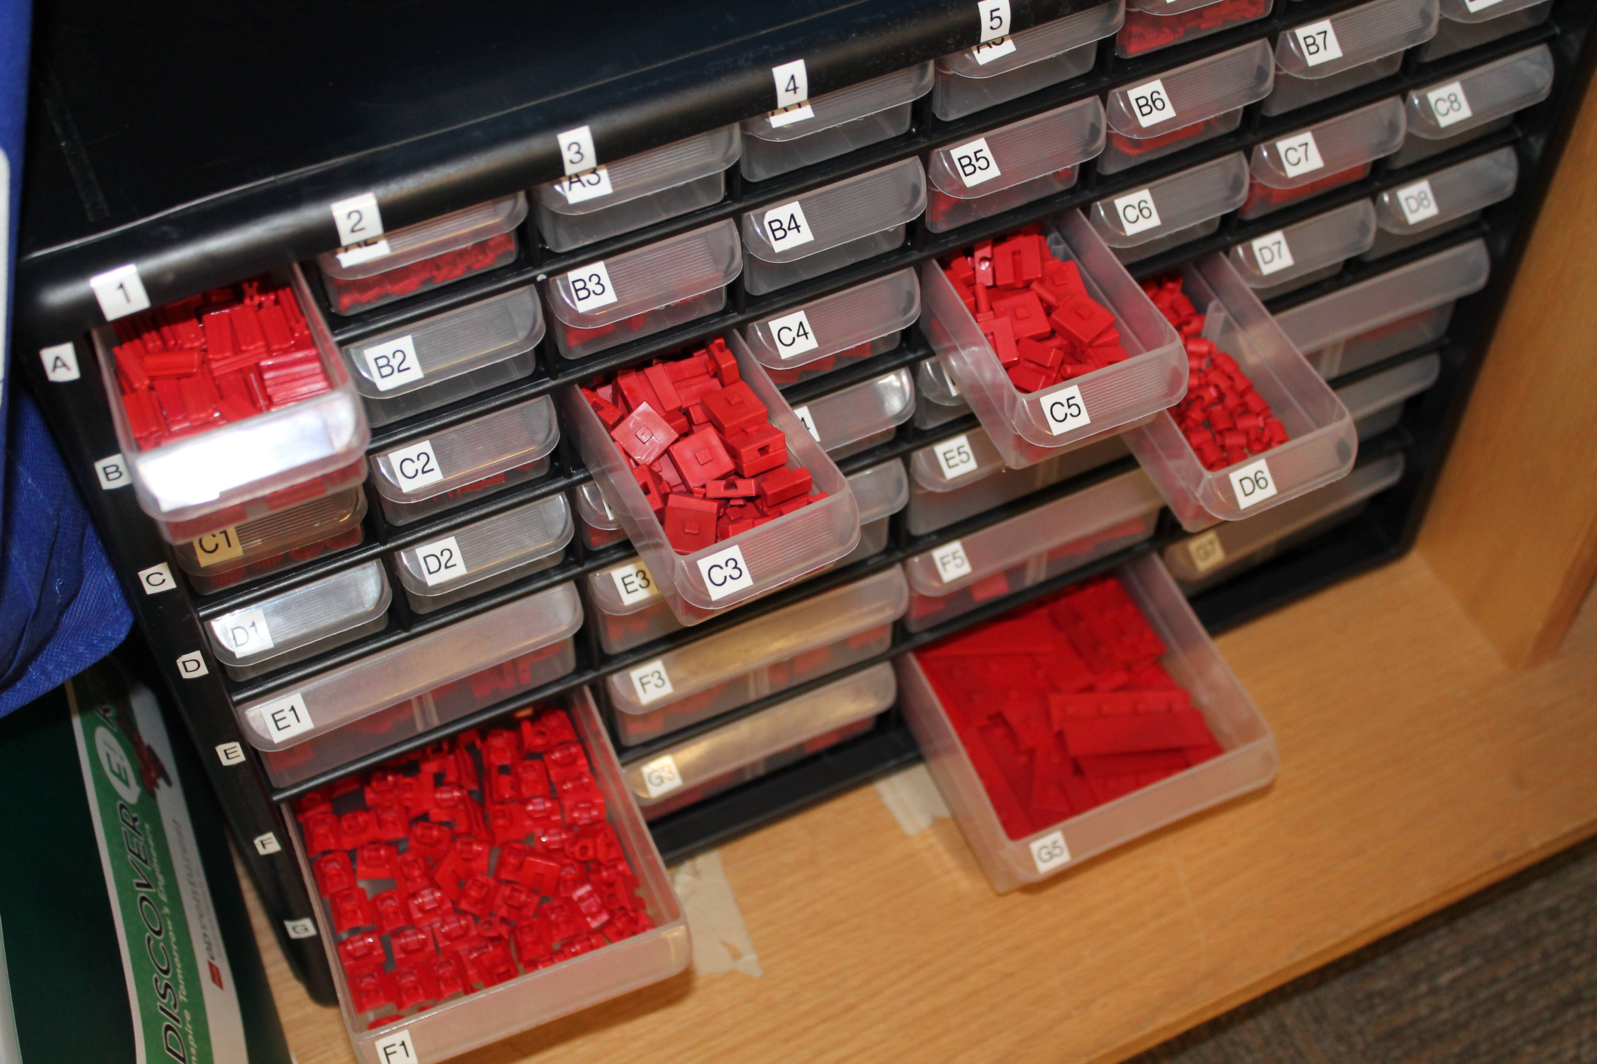
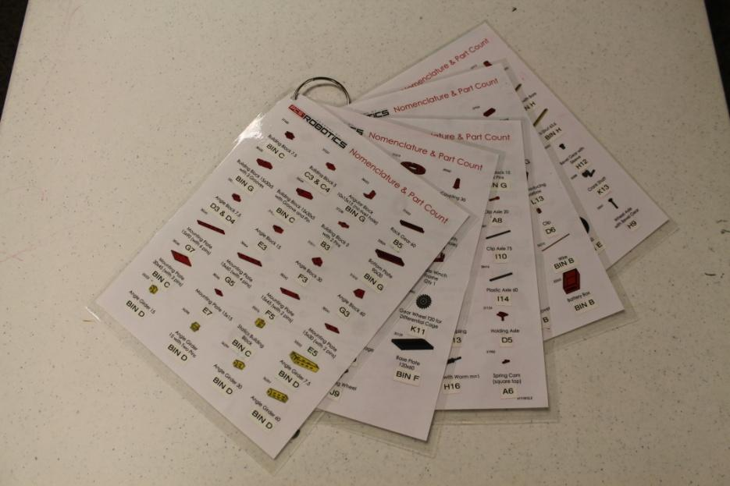
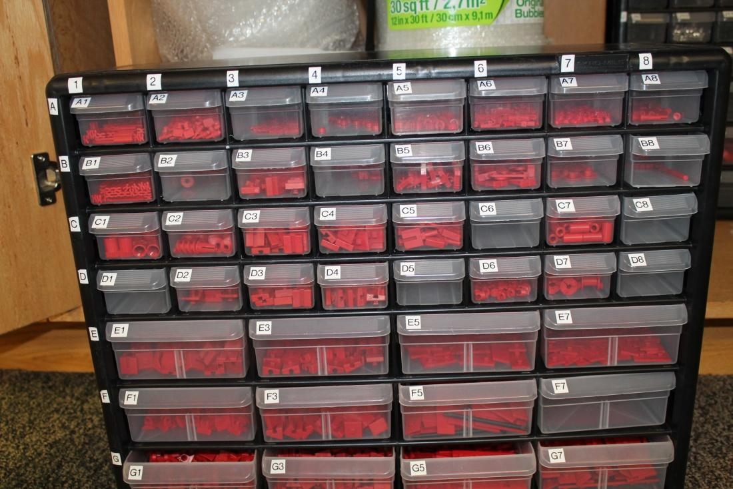

Slide 18
Funding options
Institute of Museum and Library Services www.imls.gov/applicants/default.aspx
www.americanlibrariesmagazine.org/article/manufacturing-makerspaces (great article from American library magazine)
youthserviceslibrarianship.wikispaces.com/Makerspaces (exhaustive resource)
Commercial tech industry
Local incubator (city-run or private entrepreneurial support space)

Slide 19
ADMIN/COMMUNITY BUY-IN
Highlight makerspaces potential for STE(A)M learning
How does a makerspace fit in with library mission?
Take makerspace materials into the community (city organizations, business collectives, etc…)
Partner with local school libraries
  get student and community member buy-in
  build on already existing partnerships
Notes:
Taking 3-d printer to Meridian chamber, which is good for our plan to open printing to public; if it supports the mission, admin will like it; library can help support poorly funded schools

Slide 20
Makerspaces and outreach
How do we stuff all that stuff on the bookmobile?
Why should we bother?
Notes:
Makerspaces are fundamentally about community
Promote library makerspace and maker programs
Engage community in current library happenings (show them what’s new at the library)
?

Slide 21
How does MLD take their makerspace on the road? Where do we go?
Small materials organized into mobile-ready containers
Shorter program times (do as much prep work beforehand as possible)
Take-away craft kits (spaghetti and marshmallow tower kits etc.)
Stealth programming
School visits
  Take makerspace stuff to schools to get kids interested. Invite schools to the library to see our makerspace in action and start getting involved
Community events
  Meridian Block Party
  Farmers market
We take the Bookmobile to schools and movies in the park during the summer. Pending weather we set up right outside.
Notes:
We have a good partnership with parks and rec so we’re always invited to events

Slide 22
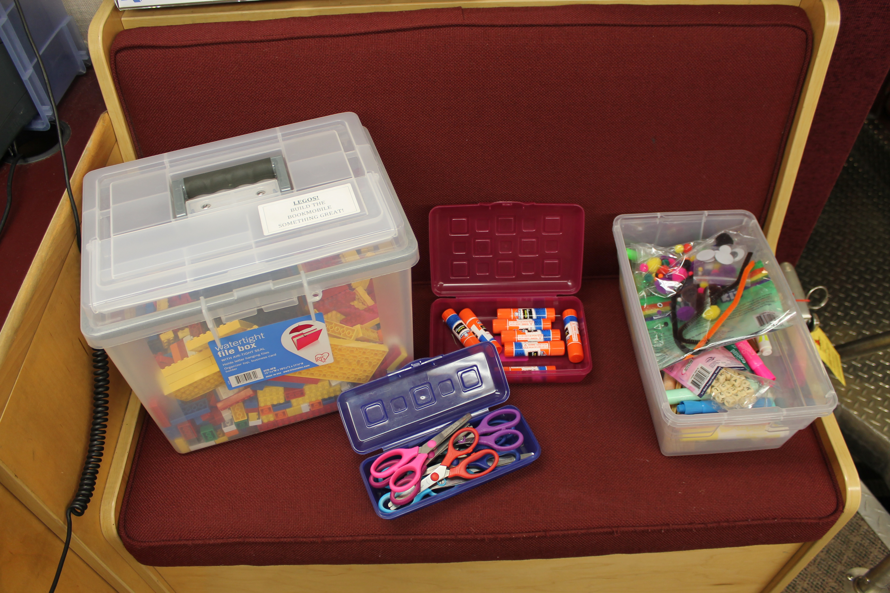
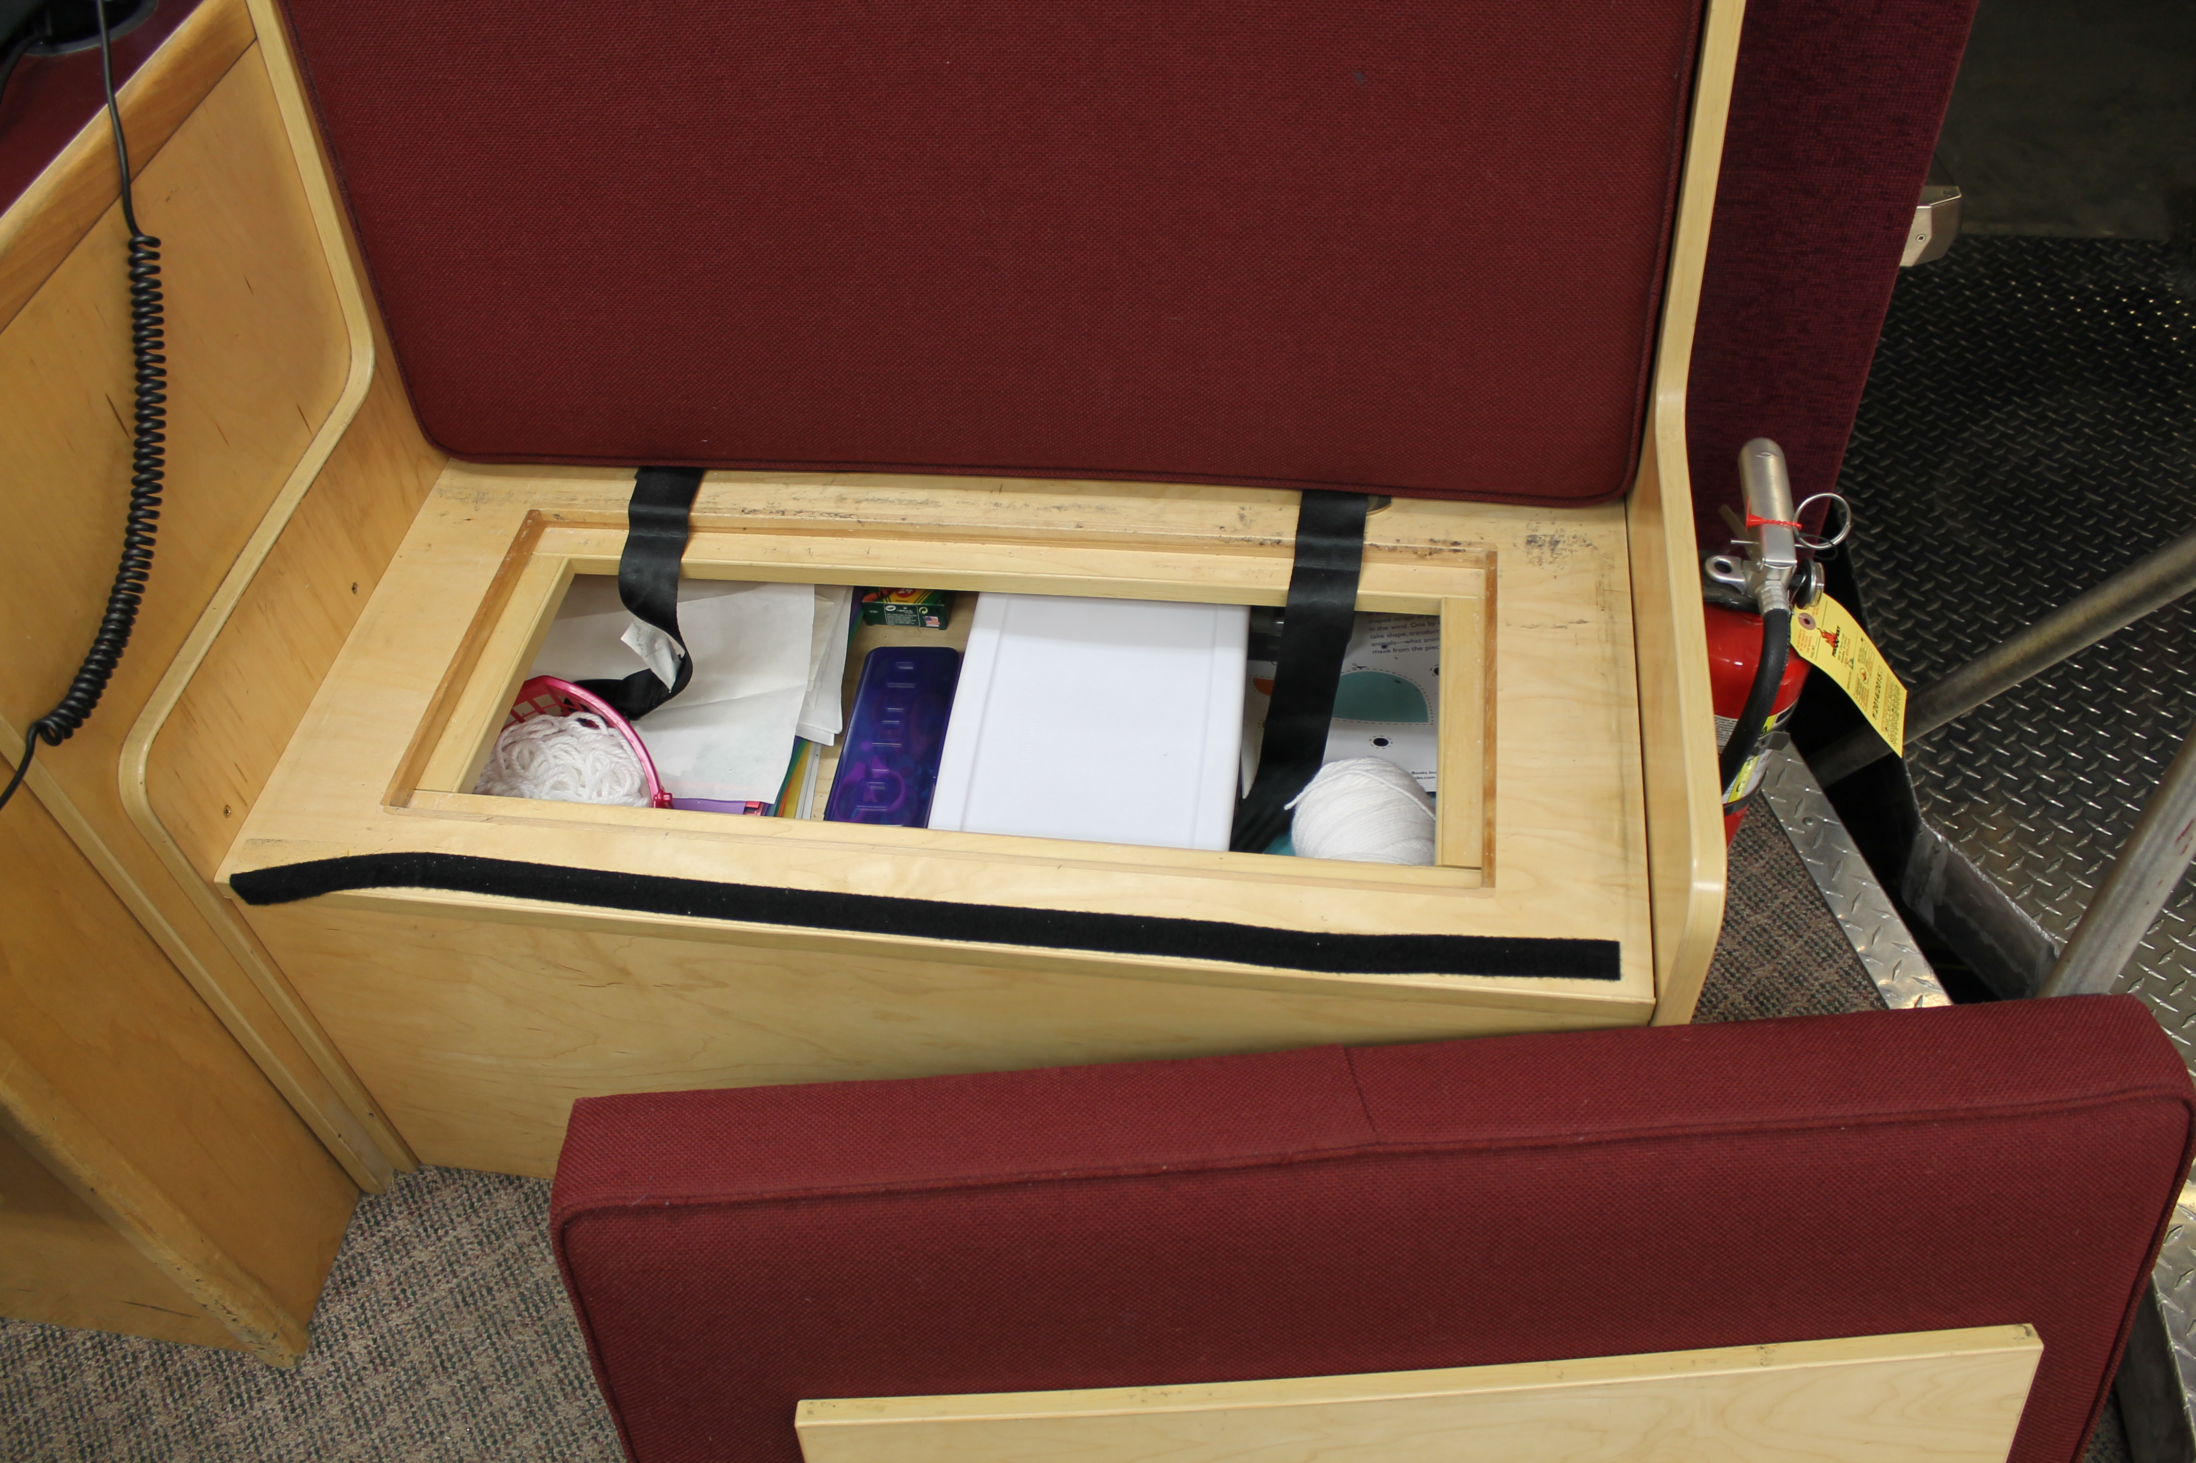
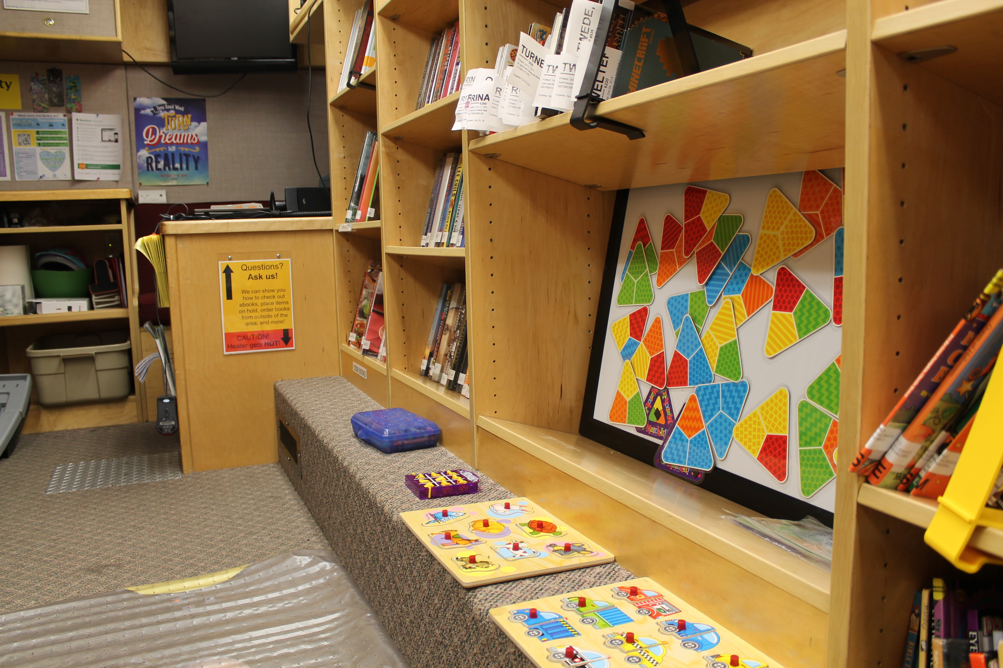

Slide 23
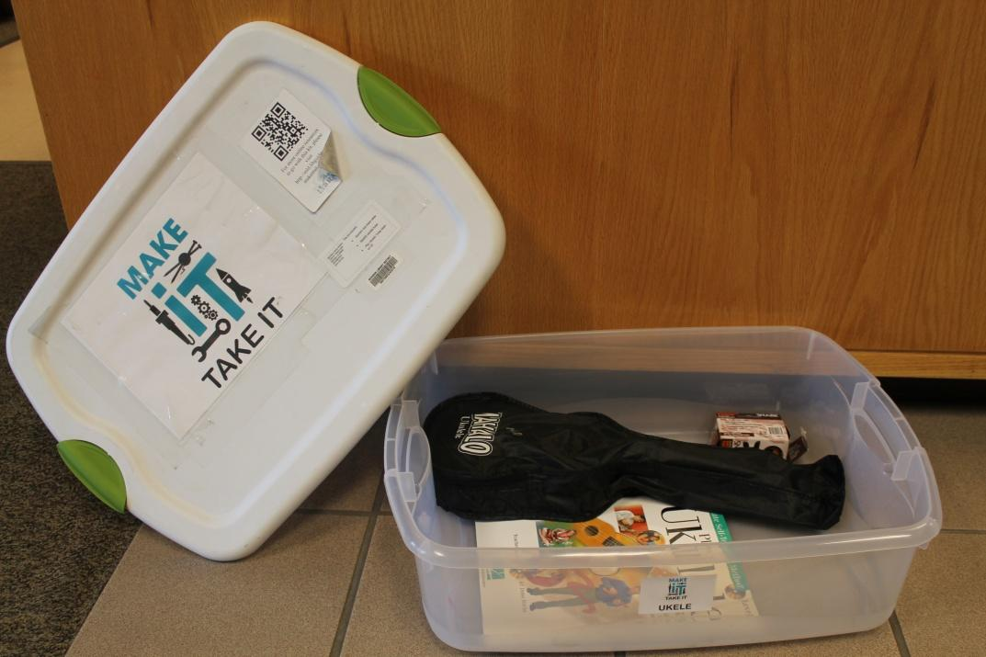
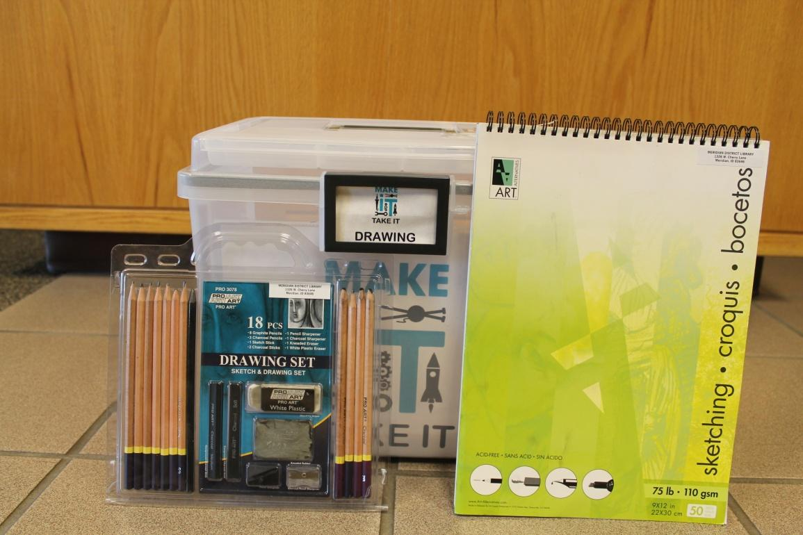
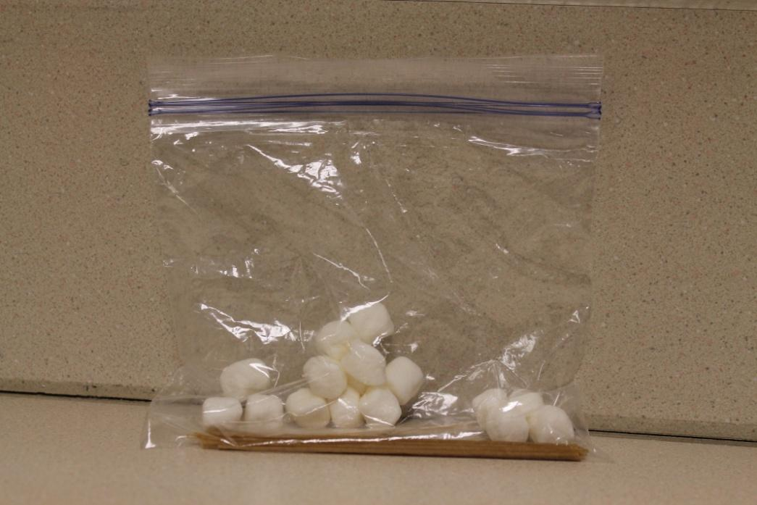
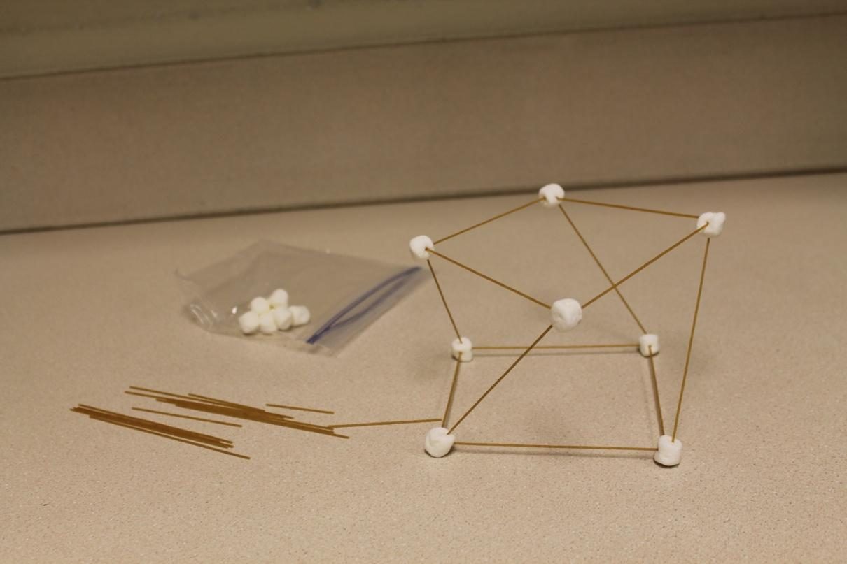

Slide 24
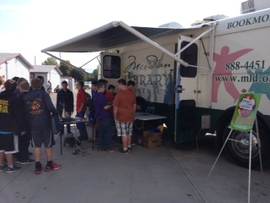
mobile makerspace programs: robotics, legos, oculus rift, etc…

Slide 25
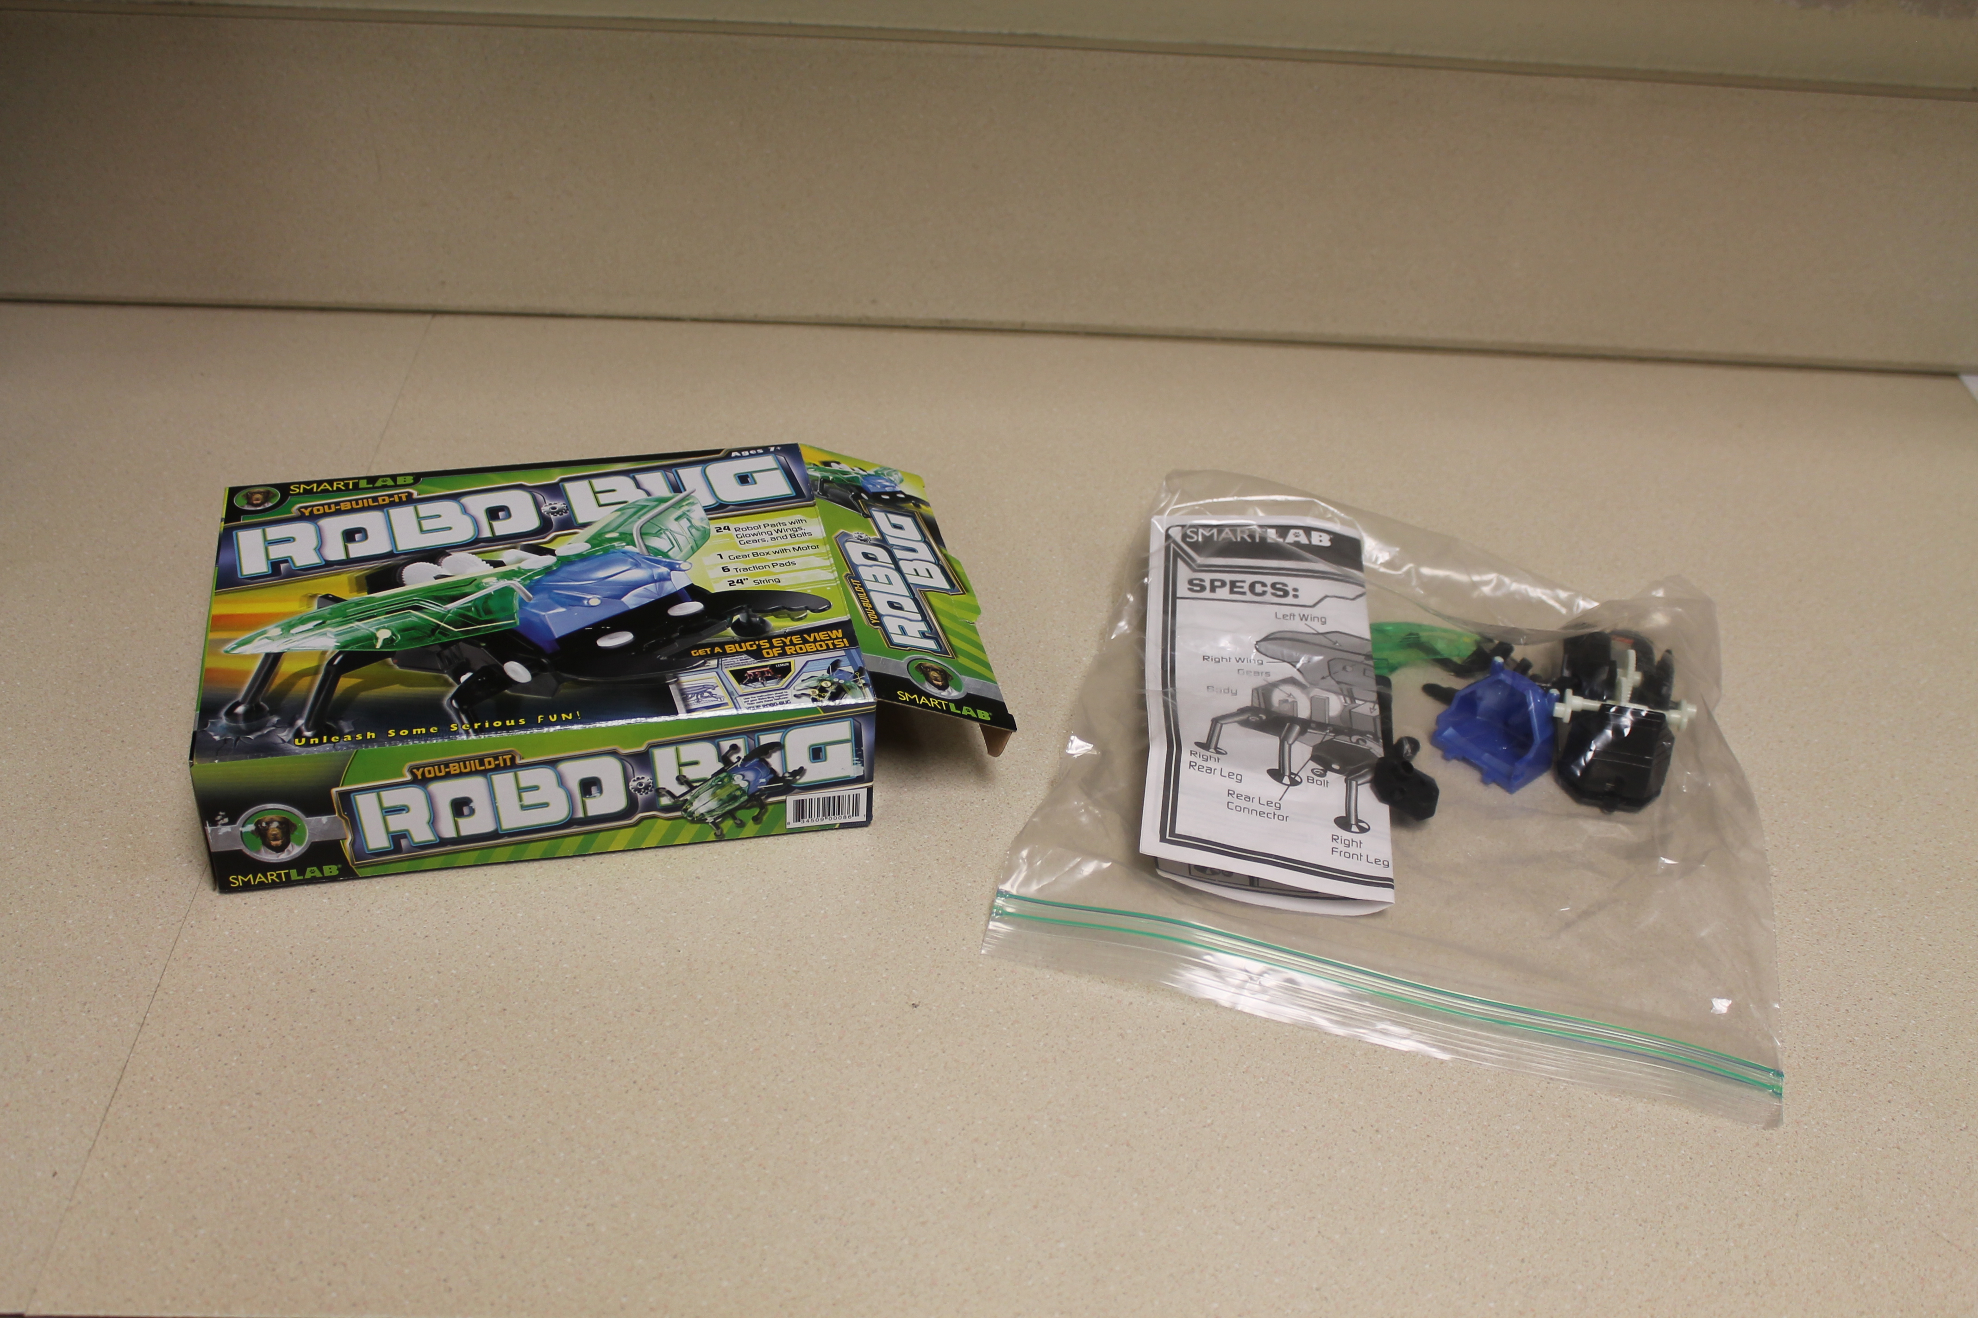
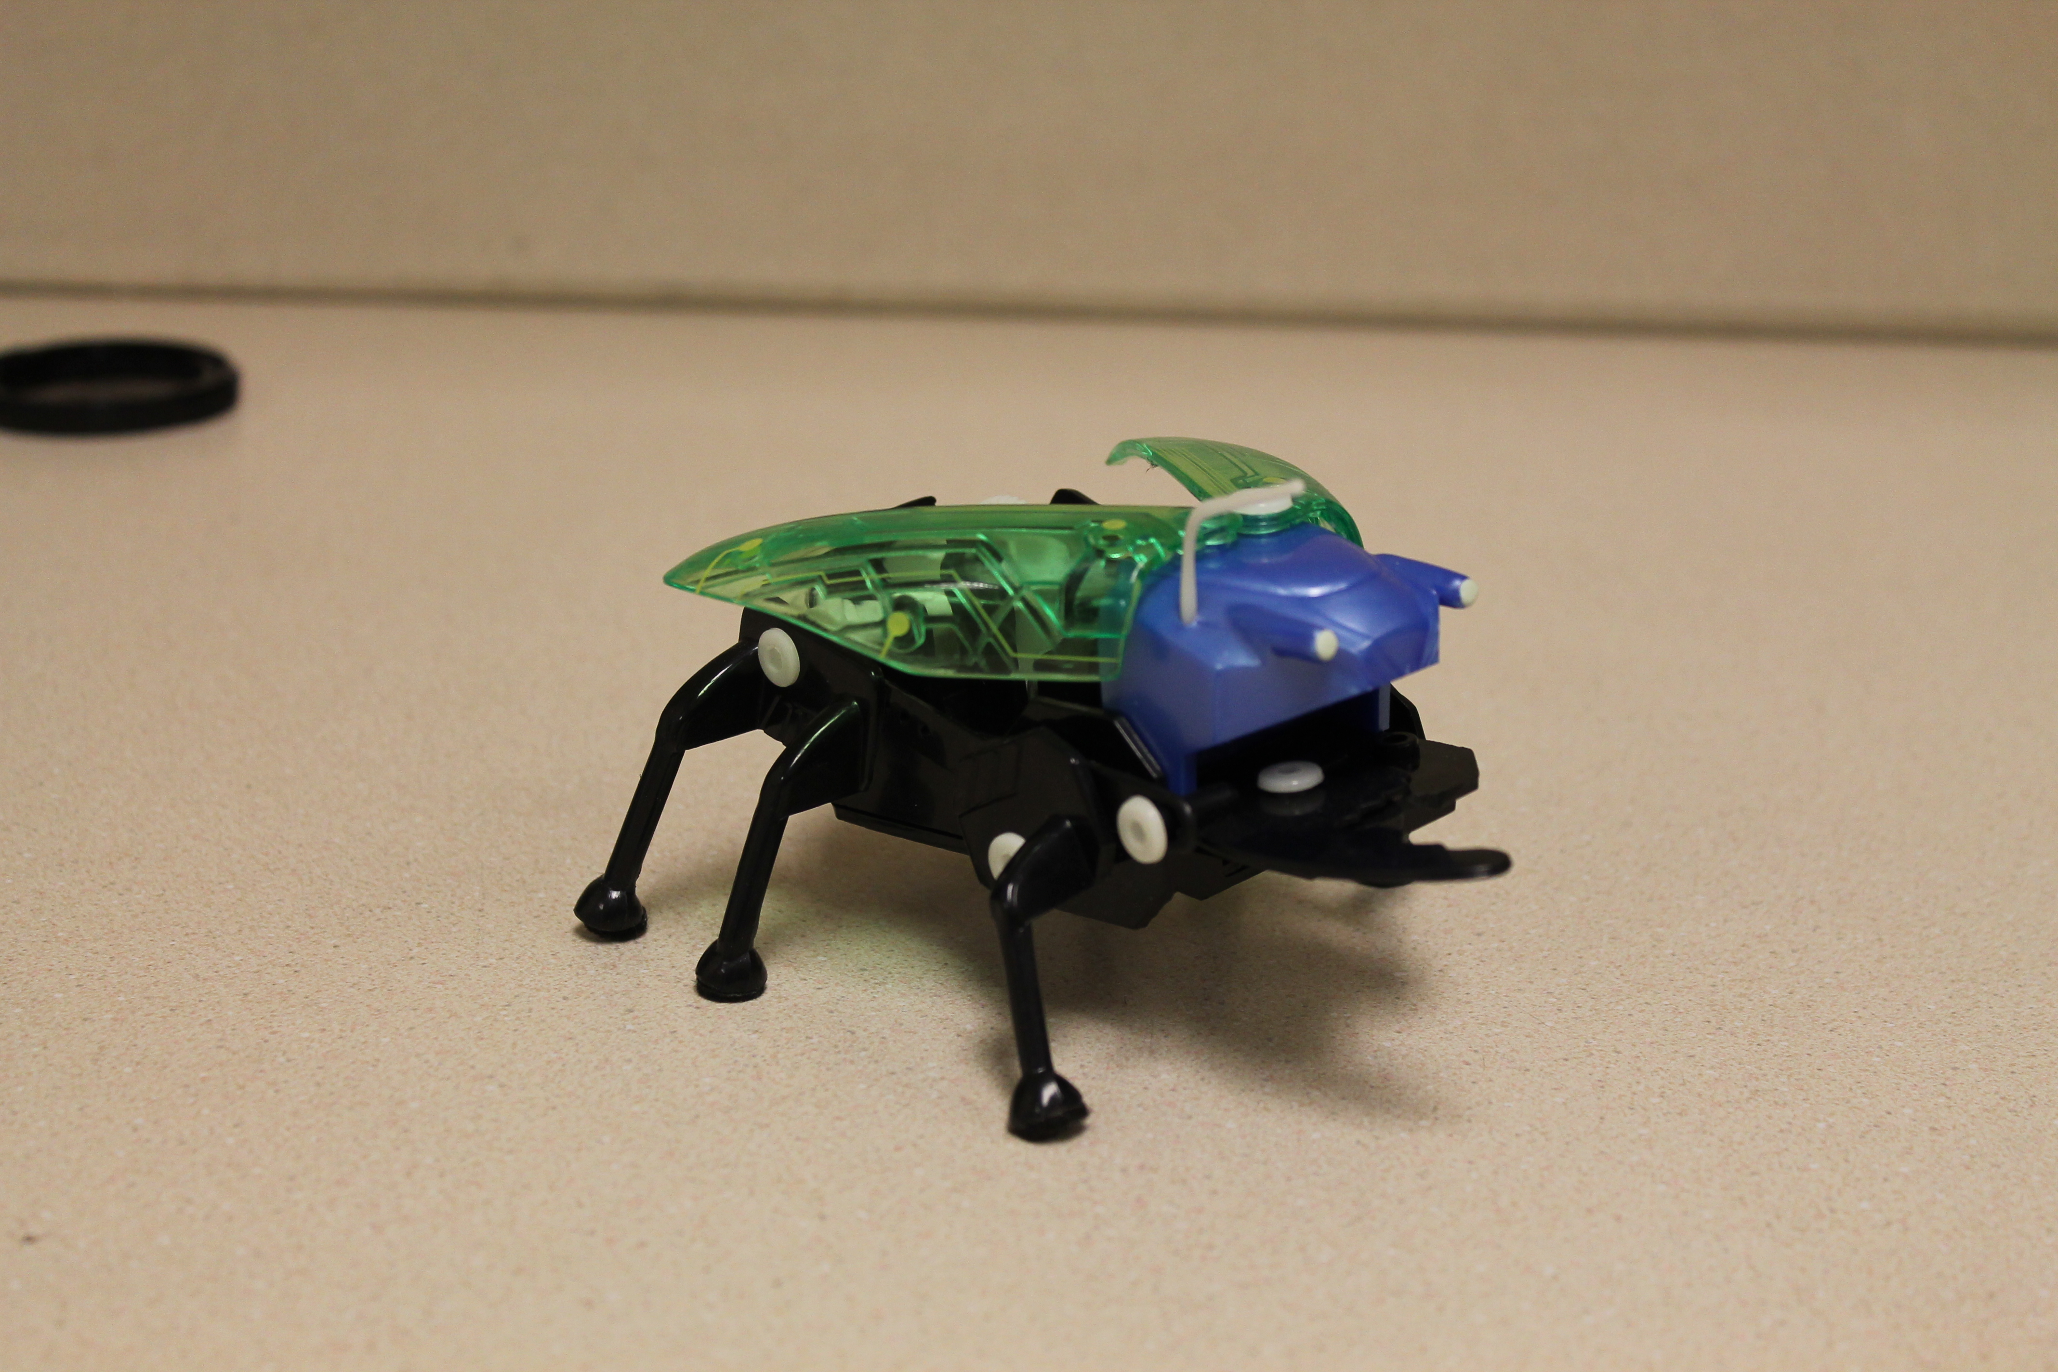
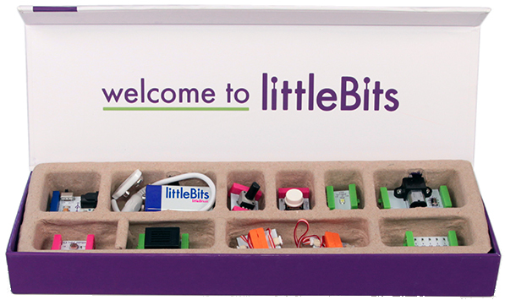
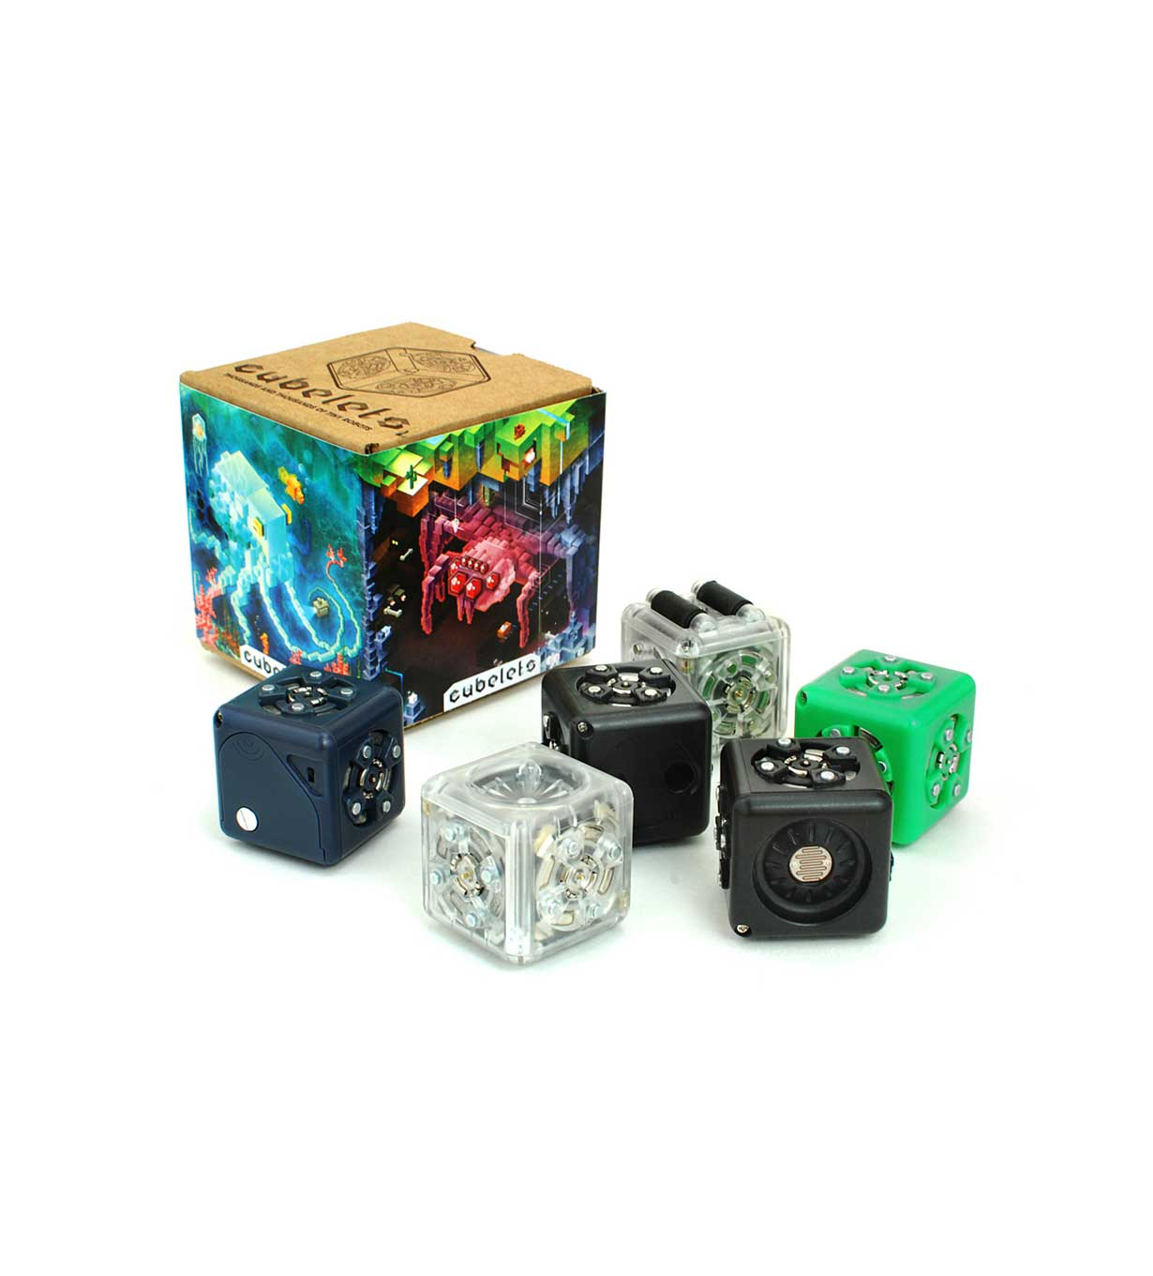
ROBOTICS
smartlabtoys.com/robobug.html
littlebits.cc
modrobotics.com/cubelets

Slide 26
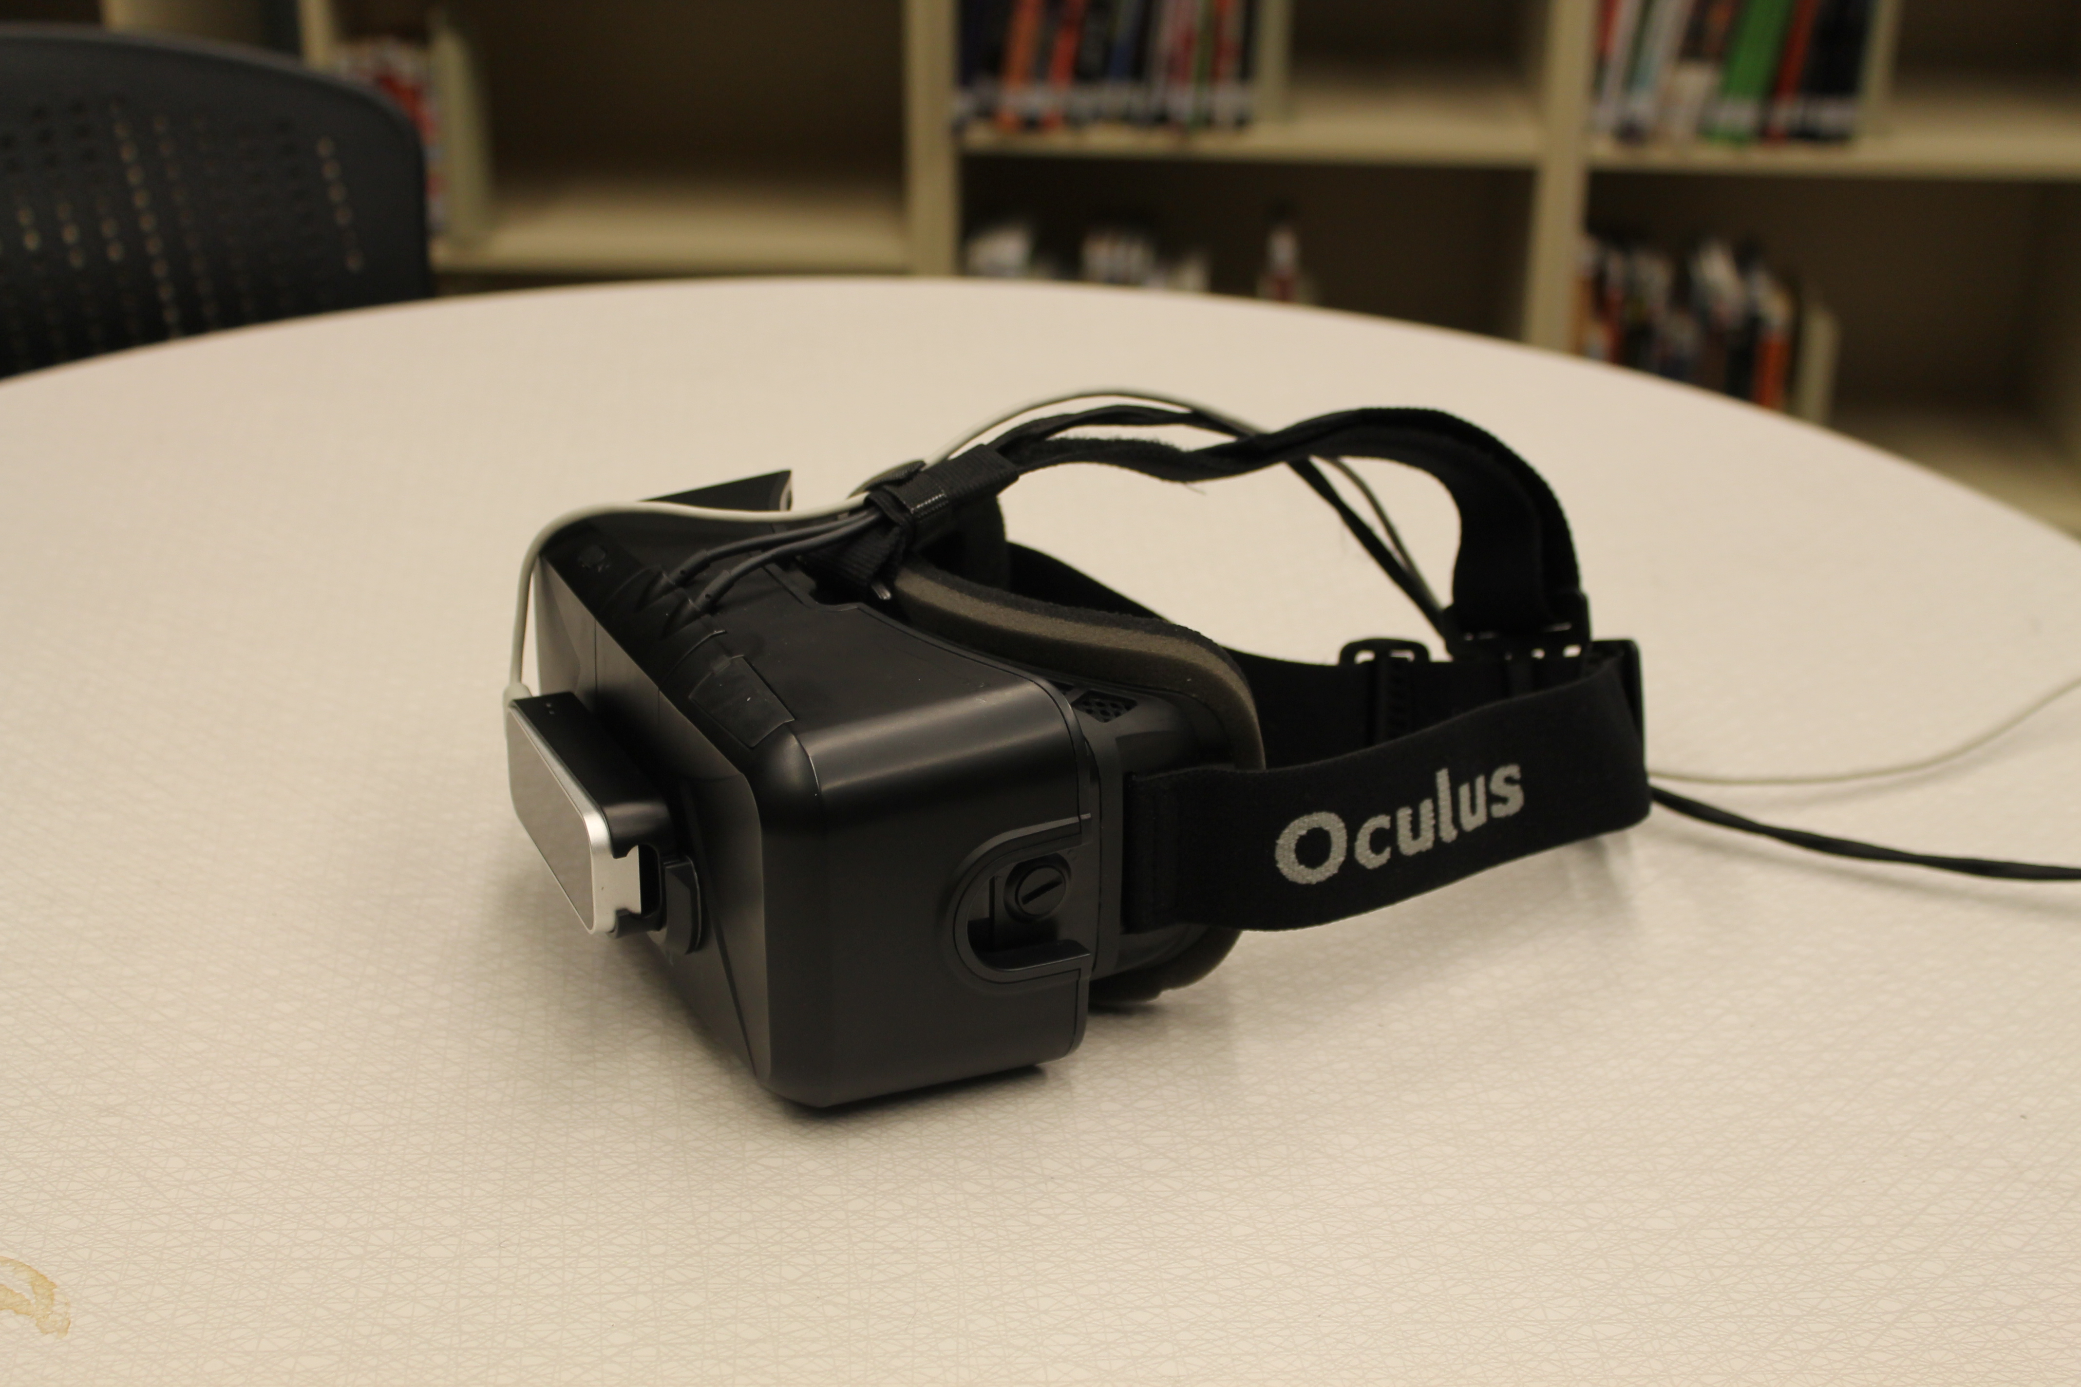
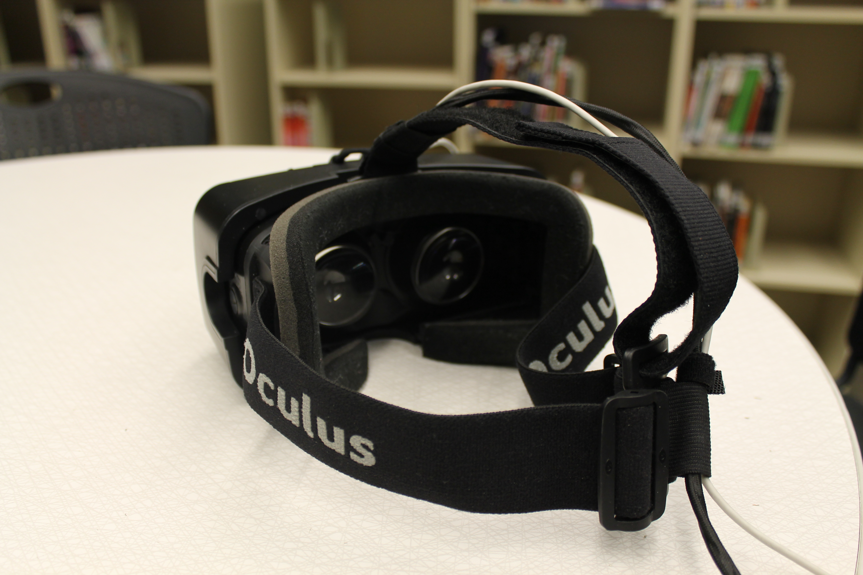
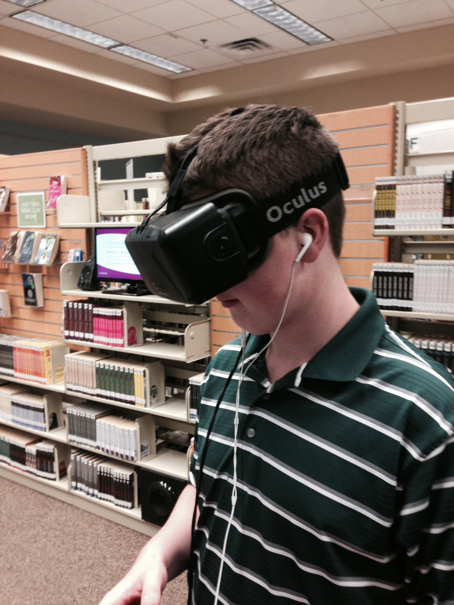
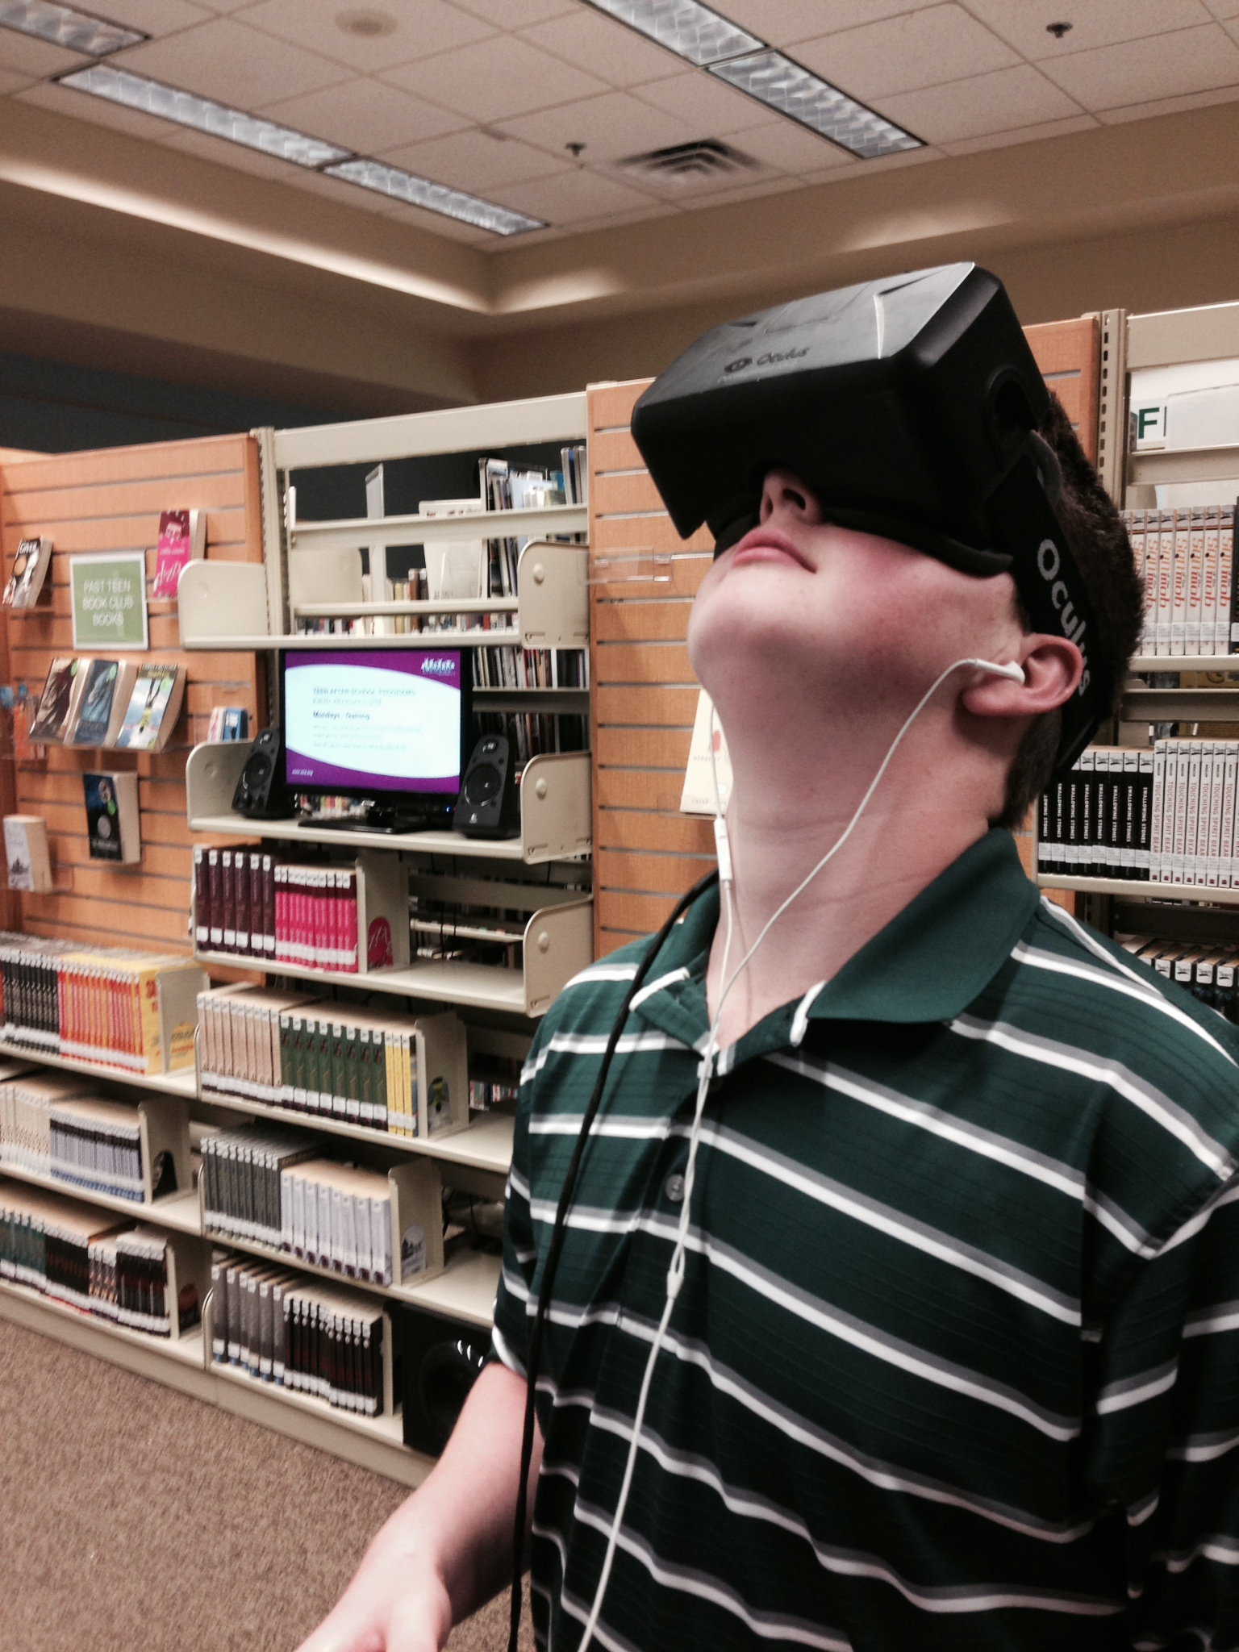
OCULUS RIFT

Slide 27
Bibliography/Works Cited
Fontichiaro, Kristin. "Chapter 2." Library 2020: Today's Leading Visionaries Describe Tomorrow's Library. Ed. Joseph Janes. Lanham: Scarecrow, 2013. 7-13. Print.

Slide 28
links
Idaho Commission for Libraries:
libraries.idaho.gov
facebook.com/MakeItIdaho
Other makerspaces:
www.fflib.org/make/fab-lab
tekventure.org/maker-station
www.detroitpubliclibrary.org/hype/hype-makerspace
chattlibrary.org/4th-floor
General info/funding resources:
www.imls.gov/applicants/default.aspx
www.americanlibrariesmagazine.org/article/manufacturing-makerspaces
youthserviceslibrarianship.wikispaces.com/Makerspaces
Makerspace toys:
smartlabtoys.com/robobug.html
littlebits.cc
modrobotics.com/cubelets

