Slide 1
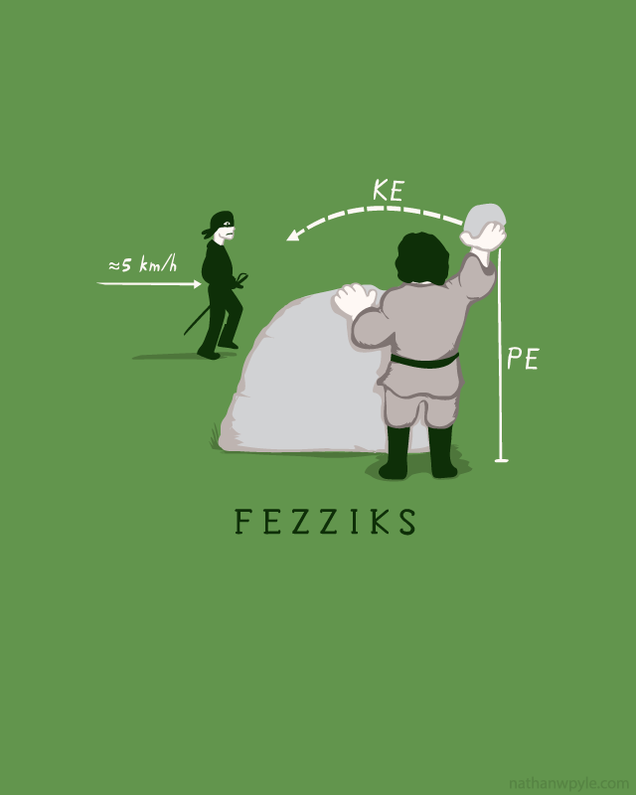
H Physics
Mr. Zahur
Class Introduction

Slide 2

Class Textbook
Read your Textbook!
Holt Physics Student Edition 2006

Slide 3
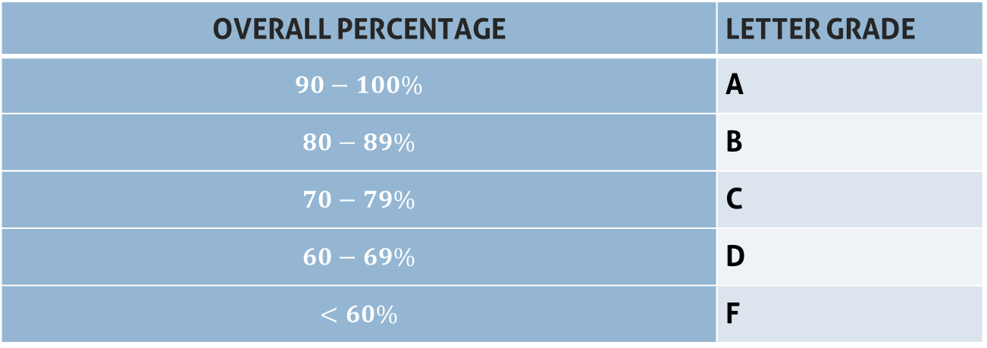
Overall Percentage | Letter Grade
$$90−100\%$$ | A
$$80−89\%$$ | B
$$70−79\%$$ | C
$$60−69\%$$ | D
$$<60\%$$ | F
TESTS | ASSIGNMENTS
Unit Tests | Homework
Projects | Classwork/Participation
Semester Final | Quizzes
 | Labs
 | Physics Club Activities

Slide 4
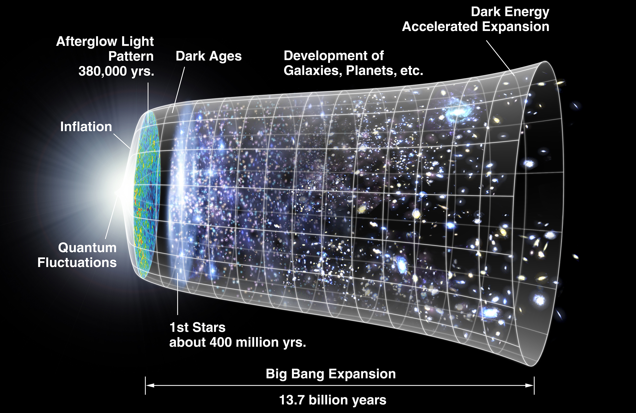
What is Physics?
Physics is the study of matter and energy.
It is concerned with how matter and energy relate to each other, and how they affect each other over time and through space.

Slide 5
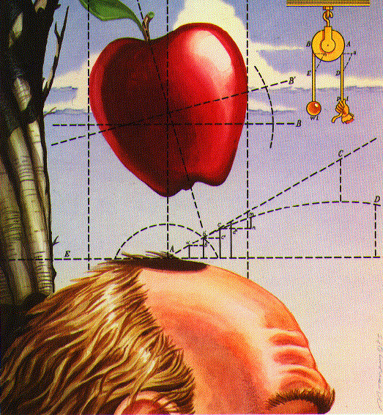
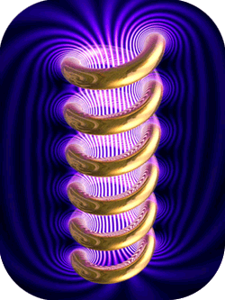
Classical Physics
Studies of Galileo and Newton on mechanics
Ampere, Faraday, Maxwell and Oersted in the fields of electricity and magnetism.
Objects which are neither too large nor too small*
Moving at “slow” speeds

Slide 6
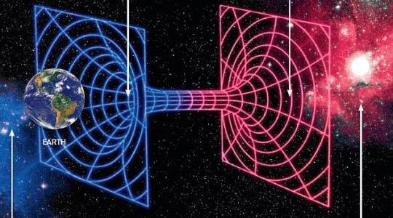
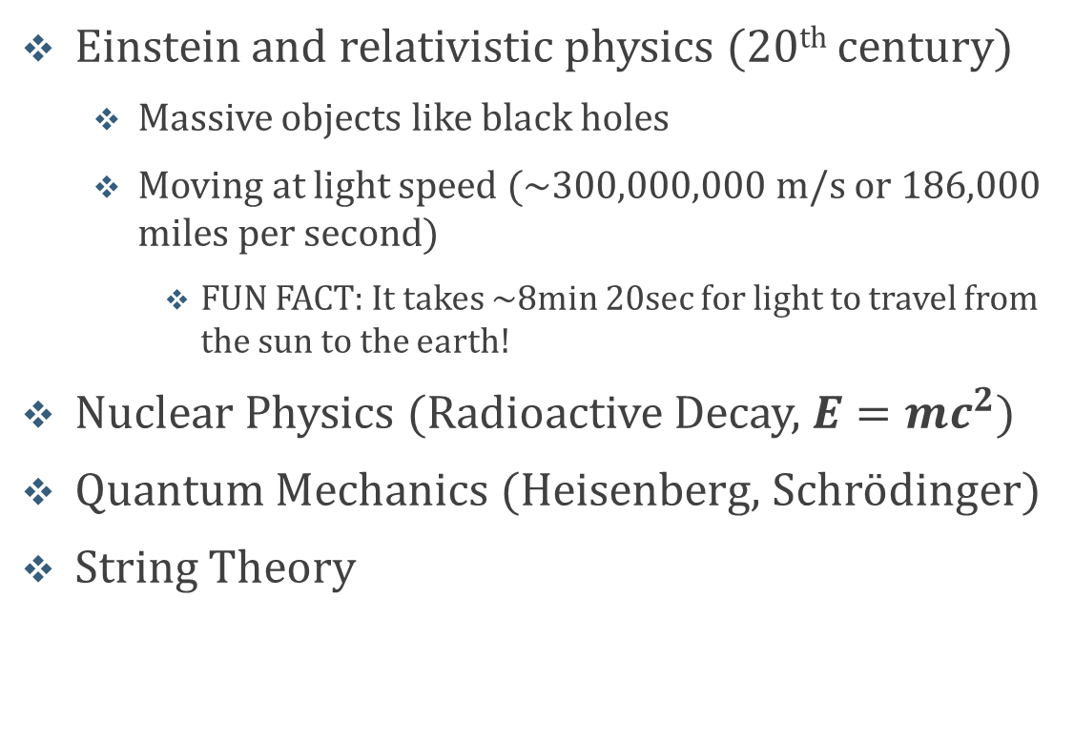
Modern Physics
Einstein and relativistic physics (20th century)
  Massive objects like black holes
  Moving at light speed (~300,000,000 m/s or 186,000 miles per second)
    FUN FACT: It takes ~8min 20sec for light to travel from the sun to the earth!
Nuclear Physics (Radioactive Decay, $E=mc^{2}$)
Quantum Mechanics (Heisenberg, Schrödinger)
String Theory

Slide 7
Class Content
Kinematics
1D/2D
Falling Motion
Dynamics
Newton’s Laws
Friction
Work and Energy
Conservation of Energy
PE/KE
Projectile Motion
Power
Momentum
Linear Momentum
Center of Mass
Circular Motion & Gravitation
Kepler’s Law’s
Collisions
Vectors
Orbits
Uniform Circular motion
Centripetal Force
Fundamentals of Physics
Sig-Figs
Unit Conversion
Metric System
1st Sem
SMH + Sound
Waves and Optics
Doppler Effect
Electricity
Electrostatics
Circuits
Ohm’s Law
Magnetism
Magnetic Fields
Pendulum
Spring
Standing Waves
Sound Waves
EM Waves
Light
Electric Fields
Series and Parallel Circuits
Induction
Right Hand Rule
Modern Physics
Nuclear Physics
Quantum Mechanics
2nd Sem

Slide 8
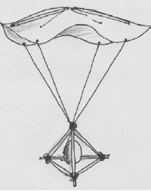
1st Quarter Project: Egg Drop

Slide 9
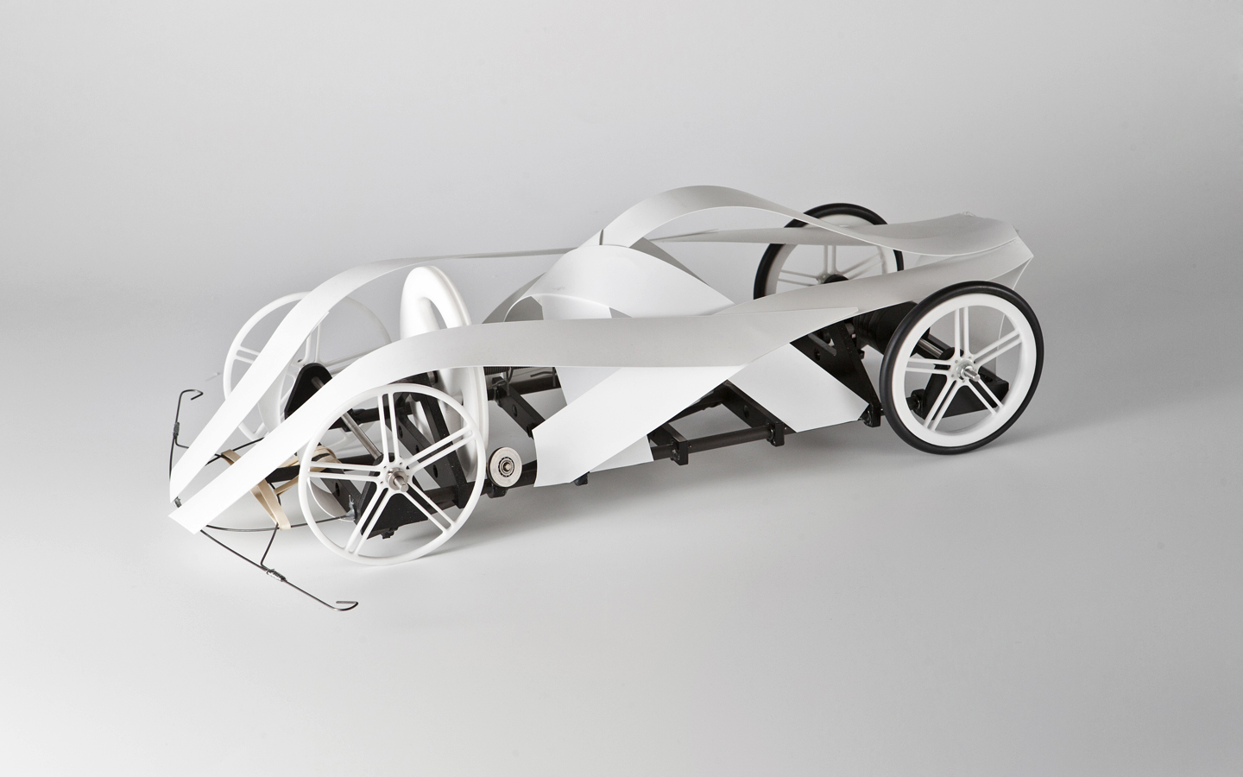
2nd Quarter Project: Mouse Trap Race Car

Slide 10
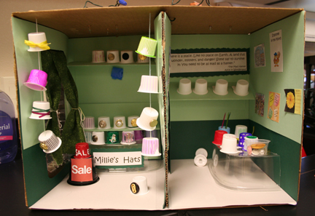
3rd Quarter Project: Electric Shoebox

Slide 11
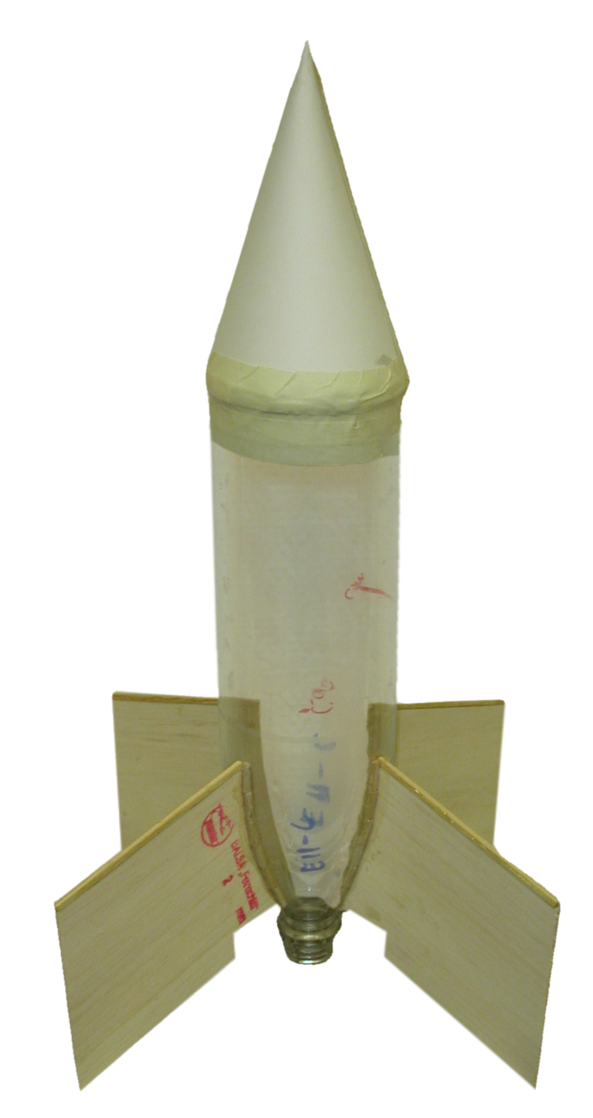
4th Quarter Project: Bottle Rockets

Slide 12
Circle Map
Your Future Career
Plans after HS
Your Interests
Use Images
Your Name
Your Interests
Your Interests
Make it colorful
Your Interests
Your Role Model
Your Dream Vacation

