Slide 1
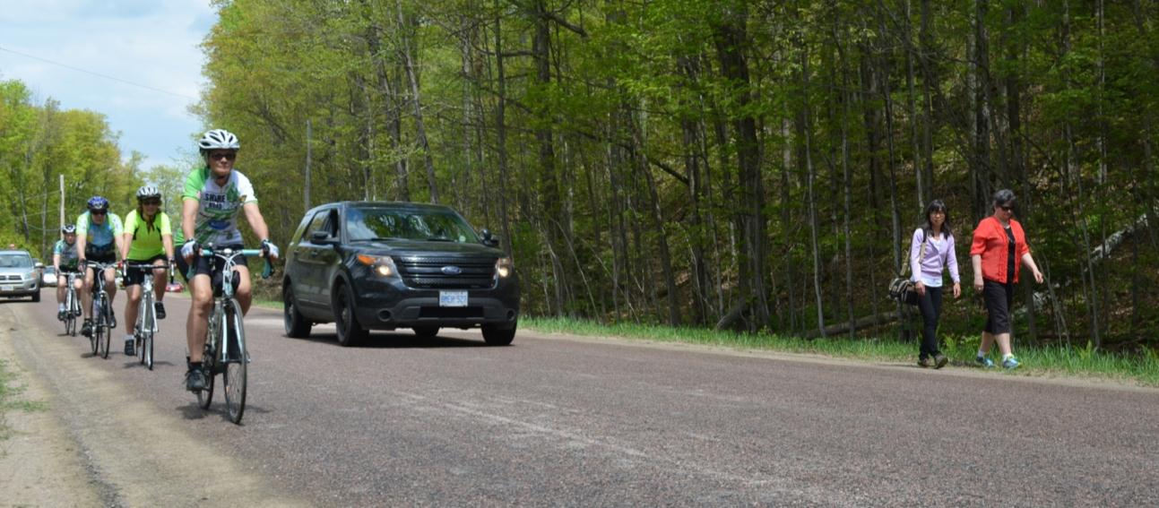
Building Capacity for
Active Transportation in the
Haliburton Highlands
Photo: Sue Tiffin, The Highlander

Slide 2
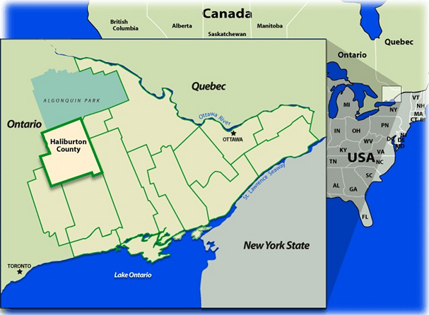

Haliburton County, Ontario
Notes:
Rural area of approx. 4,500 sq km (takes over an hour to drive east to west and north to south)
2 main village hubs, Haliburton and Minden
2 tiered gov’t
Year-round population approx. 16,500 (density 3.7/km²)
Seasonal pop. +45,000
Seniors

Slide 3

  Communities in Action Committee (CIA)
  Promotes active transportation as a way to create a healthy active community
We do this by:
Advocating
Building partnerships
Planning and research
Influencing policy
Community education and promotion
Evaluation
Notes:
The CIA has been the key player in bringing active transportation to the attention of both municipal decision makers and the general community. Rural municipalities don’t have the luxury of staff dedicated to cycling, walking or AT concerns. Having a group able to advocate, raise awareness, do education…has been critical bridging the knowledge gap, both for the public and with municipalities.
Presently includes reps from: public health, community economic development, trails, cycling, business (chamber of commerce)
over the years the CIA has accessed a variety of local and provincial grants to fund our work

Slide 4
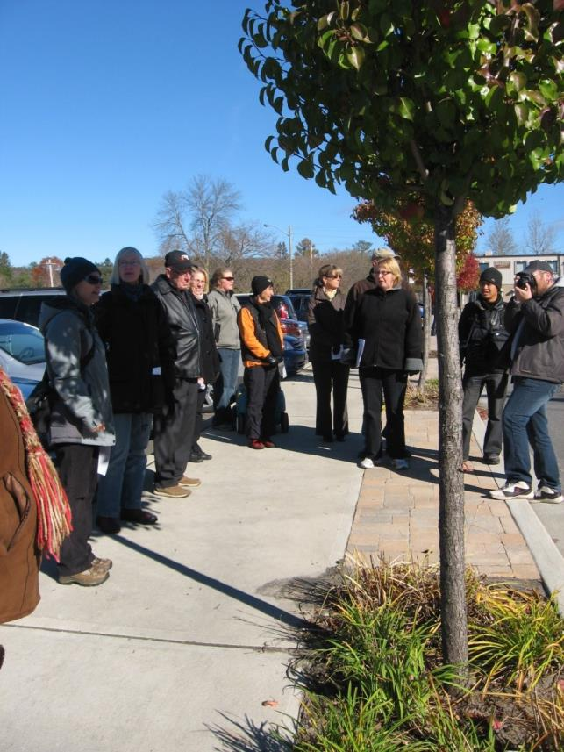
  Advocacy
The CIA doesn’t ‘do’ infrastructure, so we need to advocate for investment.
How?
Advocating for supportive land use policy
Communication with council
Engaging the community
Making the case
Notes:
Advocacy efforts target municipal elected officials.
Policy advocacy – participate in and contribute to Official Plan reviews
Communication: delegations to council, creating information briefs, writing letters, phone conversations with councillors
Engaging the community in…
Making the case e.g. raise awareness with county of multiple benefits of paving shoulders (not only cycling – also road life, safety, reduced maintenance cost, tourism)

Slide 5









Building Partnerships
Partnerships are key to addressing capacity issues that exist in rural communities.
Notes:
Primary focus of CIA has been to build positive relationships
A cross section of sectors who have been engaged demonstrates that AT is of interest to many – seniors, businesses, health, economic development, cycling, trails, tourism

Slide 6
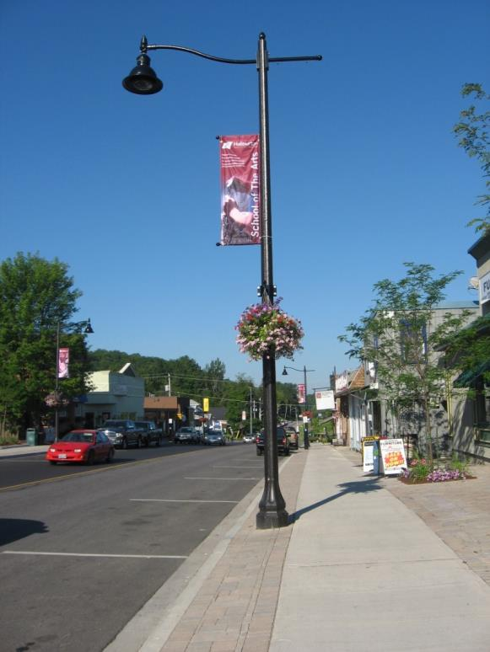
Municipalities are key partners!
You…
Create policy
Plan and design communities and transportation networks
Invest in infrastructure
We…
Communicate
Engage
Expand capacity
Notes:
Municipalities are key partners as you are the ones to create supportive land use policy, implement plans and on-the-ground changes; play important role in creating a healthy active community
Our communication:
How?
Communicating the benefits of AT through regular reports, updates and delegations to council, sharing meeting minutes
Staff – community liaison
Learn about municipal priorities
Engage municipalities by:
Hosting workshops and events with outside experts and inviting councillors and staff
Hosting community walkabouts
On-going conversation, not a “one-off”
Expand capacity - Community groups and public health are excellent resources to support your efforts and expand capacity, especially on new initiatives
We have expertise and knowledge, and access to additional supports (e.g. public health –refer to earlier info)

Slide 7
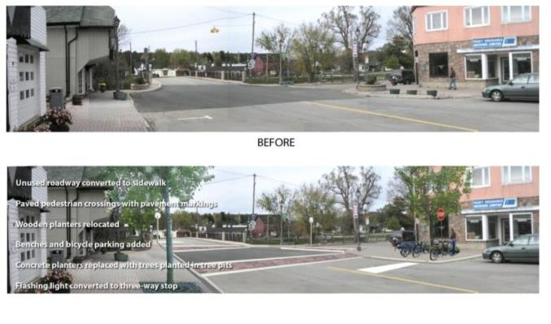
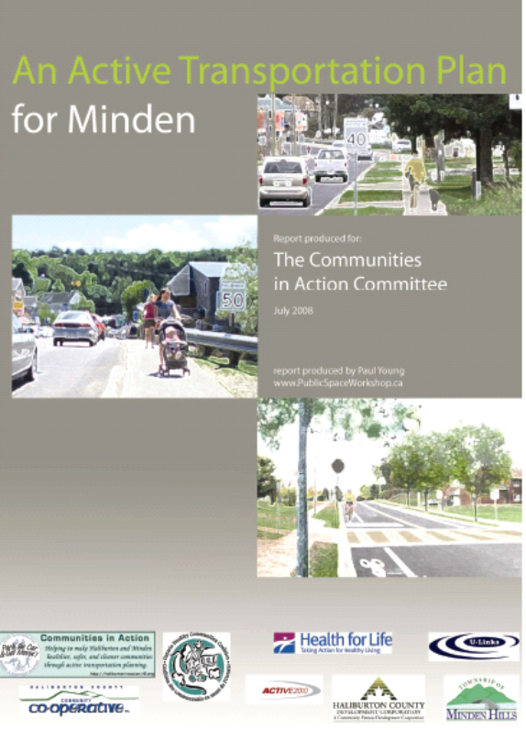
  Planning & Research
Built a strong, evidence-based
case, developed tools and resources.
How?
Developed active transportation plans – Haliburton & Minden
Helped create a vision
Conducted community based research
Tool for both municipality and CIA
Notes:
Planning and research – great example of expanding capacity
- Developed AT plans for both Haliburton and Minden. We presented these to council
AT plans include concept illustrations or photoshopping of problem areas to help create a vision of what could work better
these plans/reports were developed by the CIA, rather than commissioned by the county or municipality, which is more typical. Great example of how in a rural community, where the time and resources of municipal staff and council are limited, community groups can enhance the capacity to do new things, acting as partners to the work of the municipality
developed tools, but also builds credibility

Slide 8
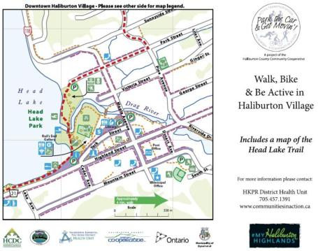
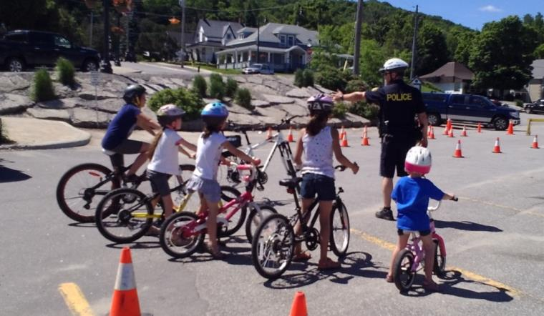

  Community Education and Promotion
Builds a base of community support, awareness and activity.
How?
Community-based research
Focus on village hubs
Awareness raising campaigns e.g. Share the Road
Events and activities
Maps
Media
Notes:
Important to build a base of community support, to demonstrate community interest in AT – more likely for policy and investment
Community based research is also an education strategy
We have focused planning and messaging on hubs rather than whole county – too big an area; more realistic
Messaging: Developed a ‘doable’ AT message for rural area – acknowledging that people need to drive to town due to distance, but encouraging them to then park and walk once they got there
Share the Road – since 2009, initiated w/ MTO grant – collaborative project between county, municipalities, CIA, public health, OPP. Signs, media, posters, print, magnets.
Events and activities to promote AT
Maps and signs to encourage walking in town
Media: PSA’s, articles, interviews, letters to editor – to maintain ‘community conversation’

Slide 9
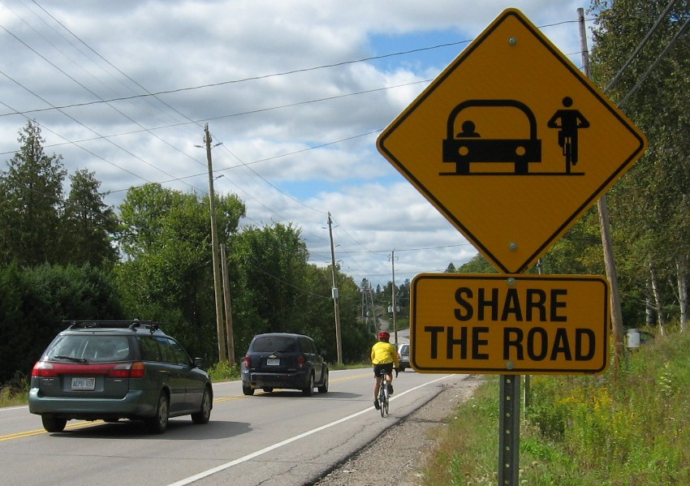
What does our community look like today? Evaluation
Notes:
In 2011 – 12 CIA did a comprehensive evaluation to measure changes in active transportation since 2005 and assess our contribution to these changes. The evaluation used these four approaches.
Inventory: policy and infrastructure changes
Survey: asked residents about their AT awareness and behaviour
Observational Study: manual counts of people walking and cycling
Key Informant Interviews
It provided us with quantitative and qualitative information to look at where we were, where we are, and what kinds of things contributed to getting us there.

Slide 10
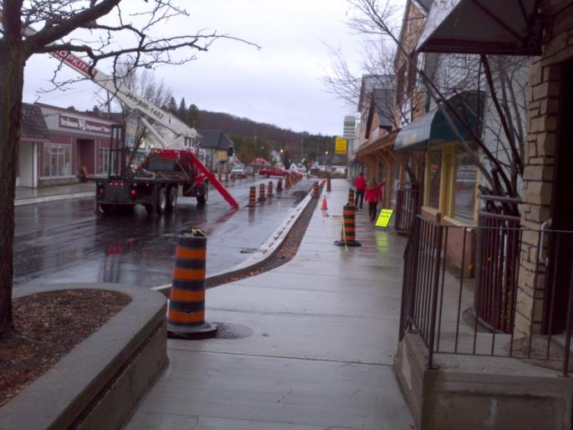
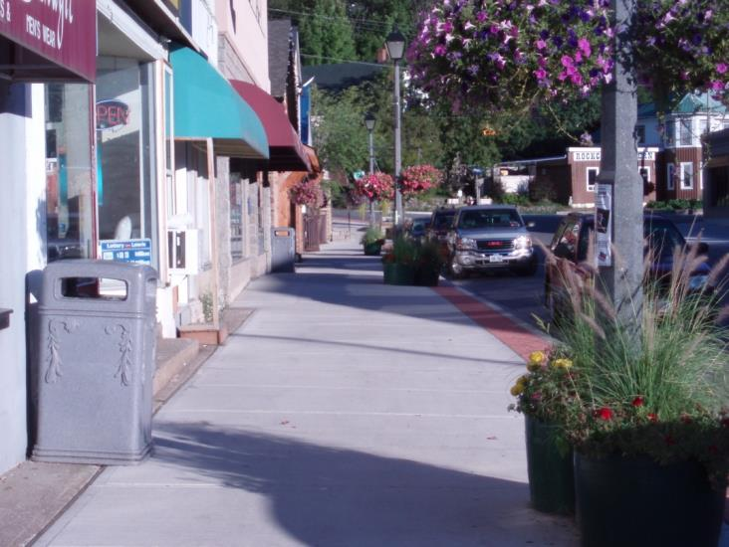
Minden – downtown streetscape
Notes:
Infrastructure: County and municipalities have made many improvements over the past 7 years.
In Minden:
Downtown Streetscape – widening sidewalks, coloured concrete, changes to planters
Downtown Improvement Plan – long range planning and vision that reflects several of the recommendations in the Minden Active Transportation Plan

Slide 11
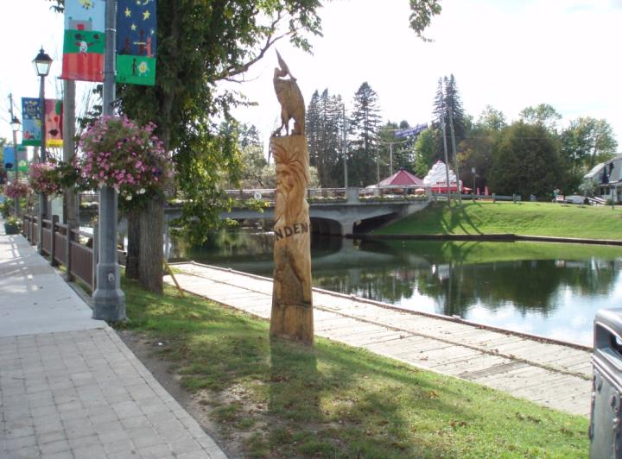
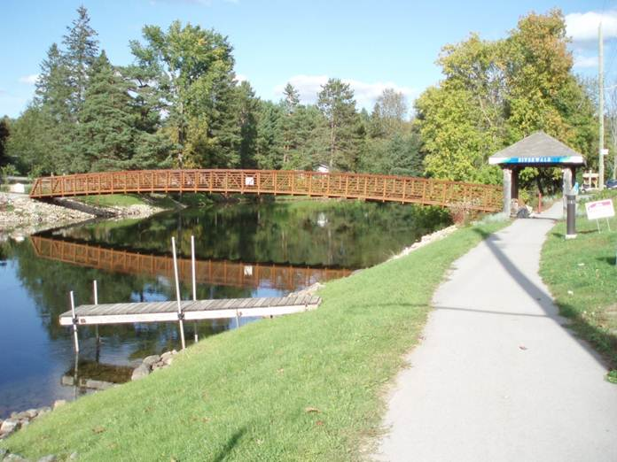
Minden - Riverwalk
Notes:
Completion of Riverwalk, including Logger’s Crossing bridge
Amenities: Sculptures, shelters, benches and lighting along the Riverwalk

Slide 12
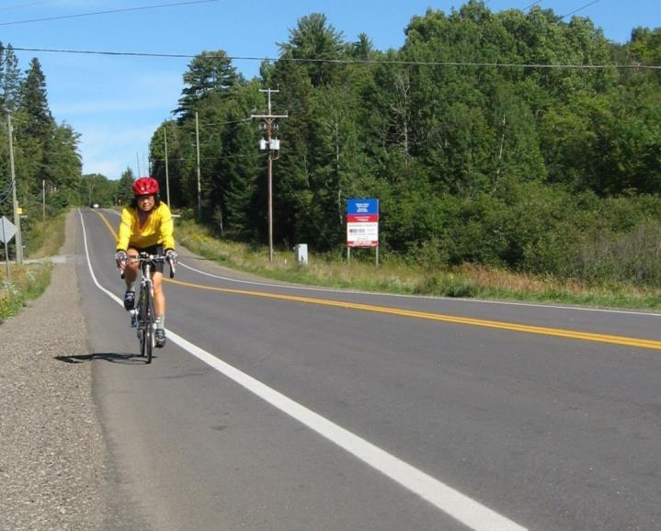
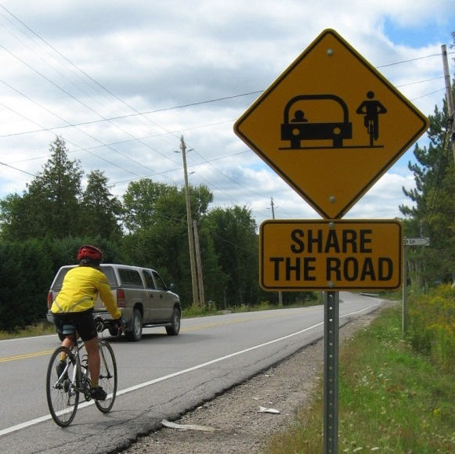
County Roads – paved shoulders
Notes:
The county has begun adding 1.2 m paved shoulders to major road projects since 2008, total approx 30.5 km
Paved shoulders included in major road projects – 4 yr Capital Works Plan for roads
Share the road signs (2009) installed across county

Slide 13
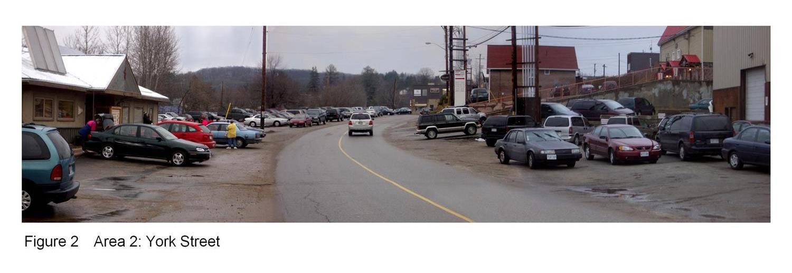
Haliburton – Phase 1 – York St.
York St before, 2008
Notes:
Haliburton Case Study: Two major projects:
Phase 1: York St. Streetscape
building on the left is food bank and second hand clothing store; on the right are some retail businesses and services
York St was identified in community consultations done by the CIA in 2005 as problem spots for AT.

Slide 14
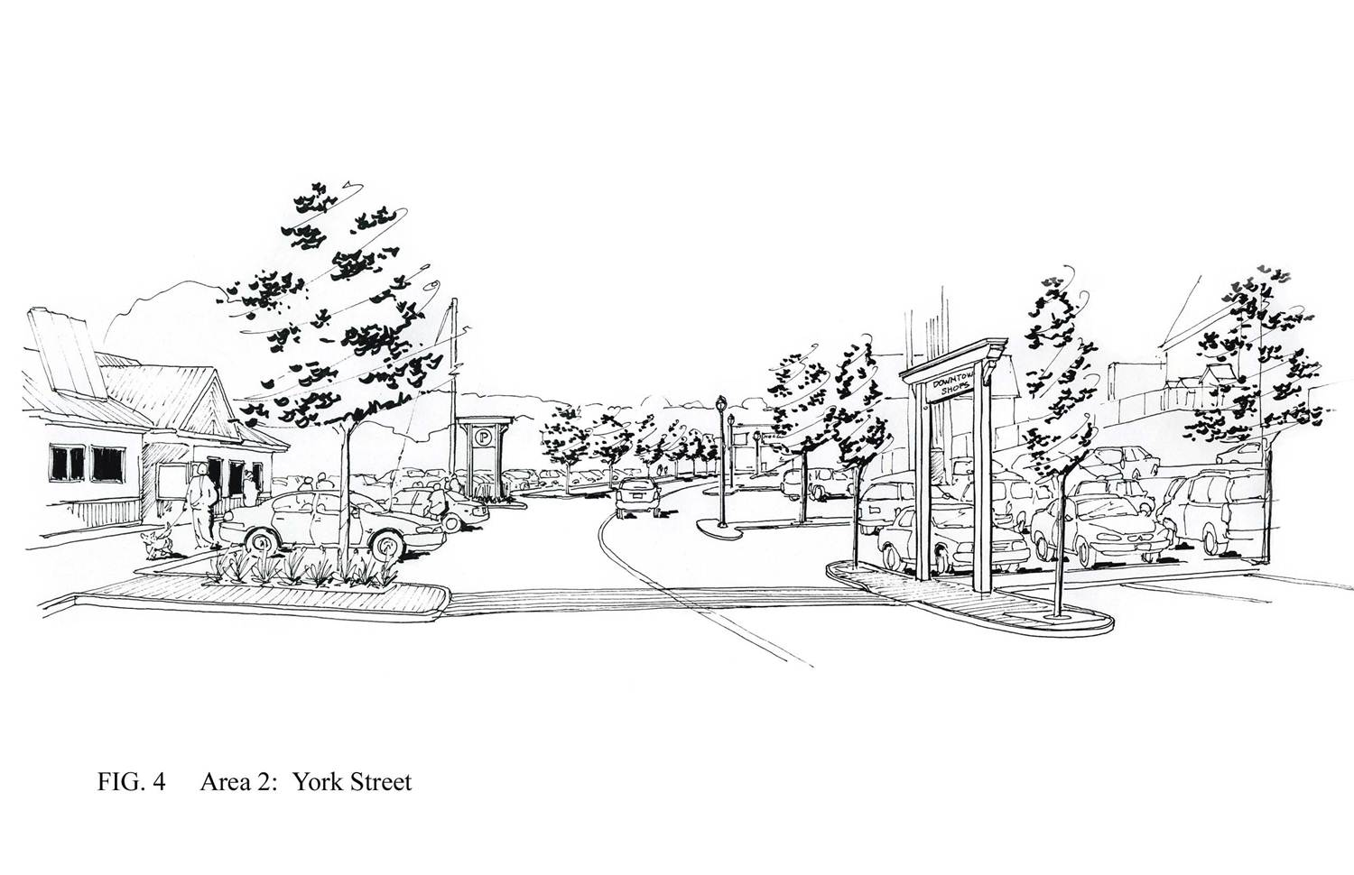
Notes:
In 2007 the CIA contracted a landscape architect to do illustrations for improving York St. These were presented to council and were included in the Haliburton AT Plan.

Slide 15
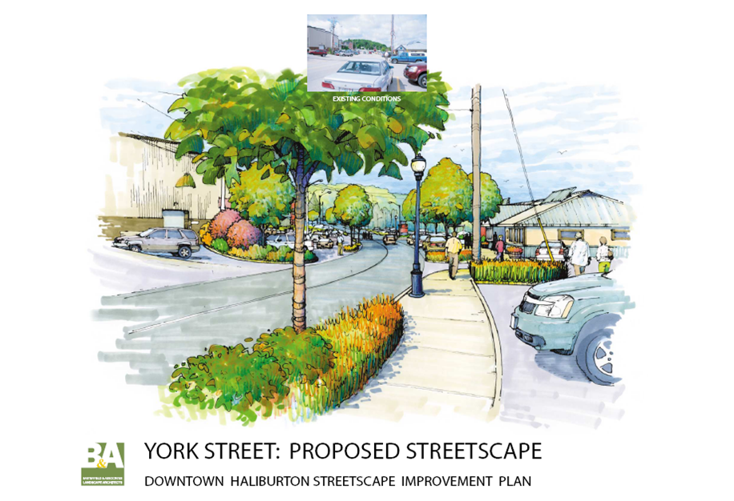
Notes:
In 2008, the municipality contracted the same landscape architect to do the full streetscape plan

Slide 16
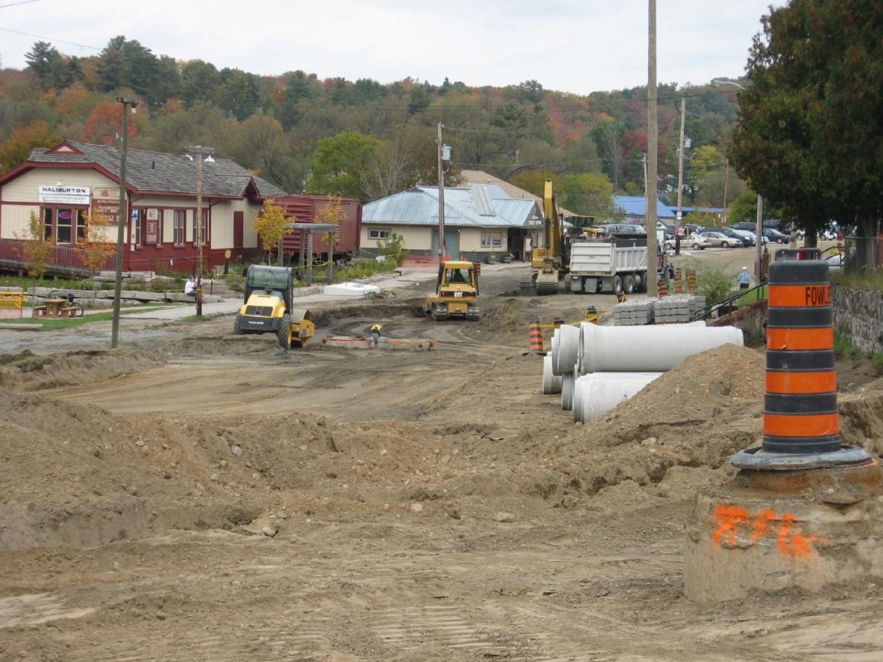
During

Slide 17
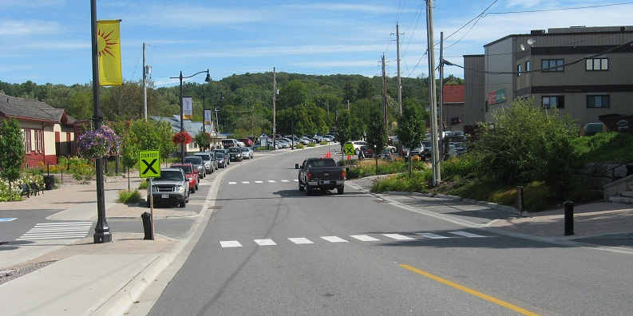
Done! York St, 2013
Notes:
New amenities: bike parking, sidewalks, crosswalks, buildouts, tree plantings and lighting
CIA’s efforts helped build community awareness and support, as well as adding momentum.

Slide 18
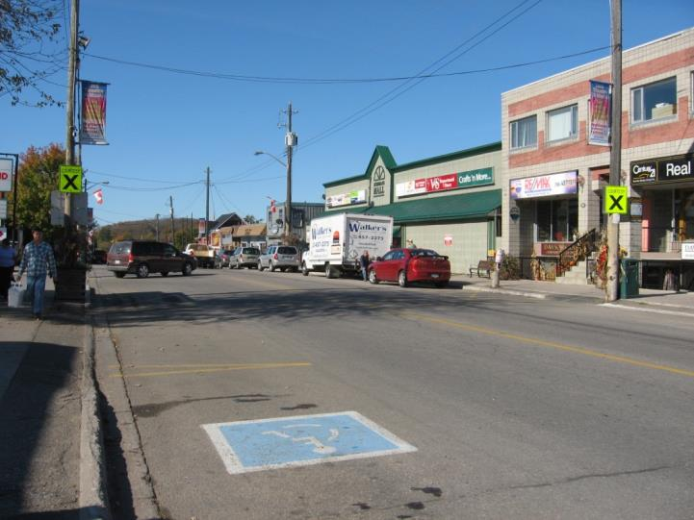
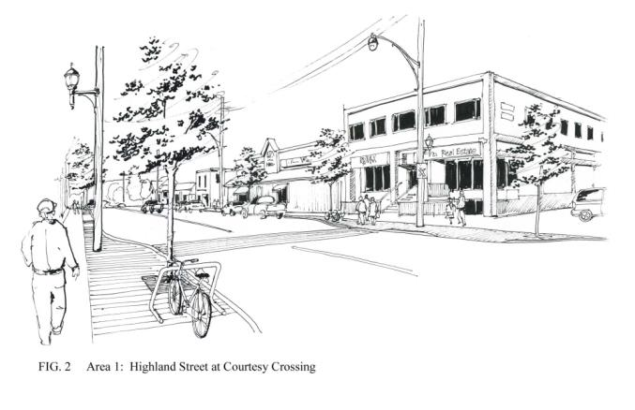
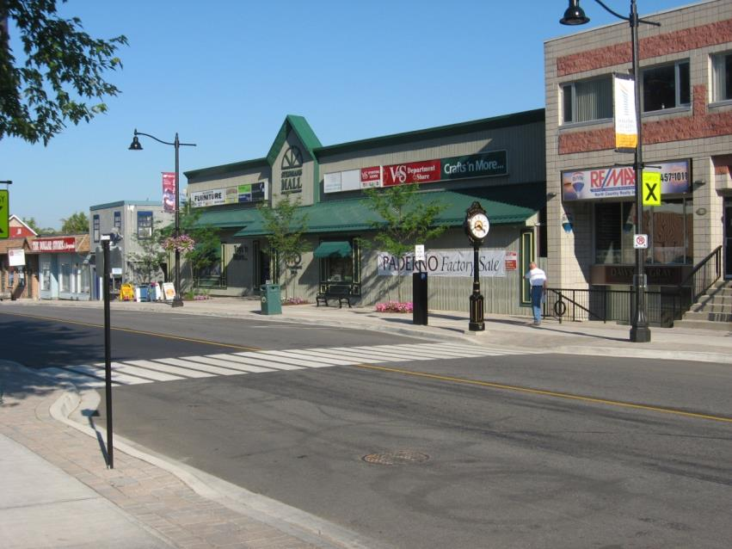
Haliburton –
Phase 2
Highland St.
Notes:
Phase 2: completed 2013, Highland St. Main downtown street
buried hydro lines, new sidewalks and paving stones, new light fixtures, benches, build outs at crosswalk and corners, post and ring bike racks
Improvements to York and Highland were on the municipal list of projects; the CIA’s efforts helped build community awareness and support, as well as adding momentum.
\- Cost approx. 1.7 million (not including the expenses paid by Hydro One)
Funded 1/3 Provincial government and 2/3 Dysart et al.
Partnership: Municipality, Hydro One, downtown businesses
The Municipality negotiated with Hydro One to bury the hydro lines, as Hydro One was already in the planning stages to upgrade their facilities along Highland Street. Hydro One agreed to invest in underground infrastructure, if they could coordinate activities with the Municipality's work. Hydro One invested approximately $5 - 600,000.00+ to bury the lines. The Municipality contributed an additional $35,000 to assist with trenching, covering, paving etc.
The Municipality conducted extensive public engagement as part of the project planning. The Public Works department worked closely with the local BIA. It was important to work directly with individual business owners and get them on-board because there is a strip of privately owned land between the municipal road allowance and the front of many stores. By engaging each business owner and getting their buy-in to the project, the Municipality was able to achieve a consistent look to the streetscape i.e. paving stones flowed seamlessly across the municipal road allowance and the abutting private land. Businesses had to contribute financially for pavers on their property.
The project also included installing new energy efficient (LED) street light fixtures; completing remedial work on the storm and sanitary sewer systems; paving the street; upgrading the sidewalk; installing brickwork; planting trees and shrubs; removing individual parking meters and installing “pay and display” units; and adding traditionally styled benches, garbage cans and other street furniture.
Timing of the work was challenging because the Municipality had to work around the summer tourism season, as well as the winter conditions. It was agreed with local business owners that work would proceed only from the spring thaw until the end of June and then again from Labour Day weekend until the winter snow. The hydro services were installed during the fall of 2011. Construction of the streetscape began in September 2012 and was 95% complete that fall. The final work was done in the spring of 2013.

Slide 19
New Policies
The County Official Plan provides broad policy direction:
“Land use patterns and development should promote energy efficiency, improved air quality, and allow for compact development that is designed in such a way to support and encourage active transportation…” (County of Haliburton Official Plan, 2010, 2.3.5.3)
The Dysart et al Official Plan, 2010 more specific policy direction:
Section 2.2.4: “Promotion of Recreation Opportunities”
Section 2.2.7: “Promotion of Liveable Settlements”
Section 3.2.2.3: “Municipal Roads”
Section 4.1: “Settlement Patterns”
Section 4.8: “Active Transportation and Recreation Trails”
Notes:
Prior to 2010 only one OP referenced cycling. Now, all have policies specific to cycling, active transportation, healthy communities, walking.
In some cases, our recommendations were included verbatim. In others, the “spirit” of our recommendations were captured in new policy.
The Dysart et al Official Plan includes several references to active transportation and healthy communities:
Section 2.2.4: “Promotion of Recreation Opportunities” provides direction to incorporate the principles of active transportation into municipal infrastructure projects; and encourages new private development to incorporate the principles of active transportation.
Section 2.2.7: “Promotion of Liveable Settlements” encourages healthy, active communities by applying the principles of good community design, active transportation, as well as, parks and recreation opportunities.
Section 3.2.2.3: “Municipal Roads” recognizes that the road network serves pedestrian and non-motorized vehicles in addition to vehicular traffic. It encourages the principles of active transportation in project design.
Section 4.1: “Settlement Patterns” recognizes that opportunities for intensification and redevelopment will incorporate the improvement and enhancement of facilities for active transportation.
Section 4.8: “Active Transportation and Recreation Trails” promotes development policies that encourage an active, healthy community; recognizes the Active Communities Charter; the Active Transportation Plan for the Village of Haliburton, 2009 and the Haliburton County Cycling Master Plan, 2008 ; encourages the development of pedestrian and bike access and linkages; supports protection of our local portages, the rail trail and other recreation trails and facilities.

Slide 20
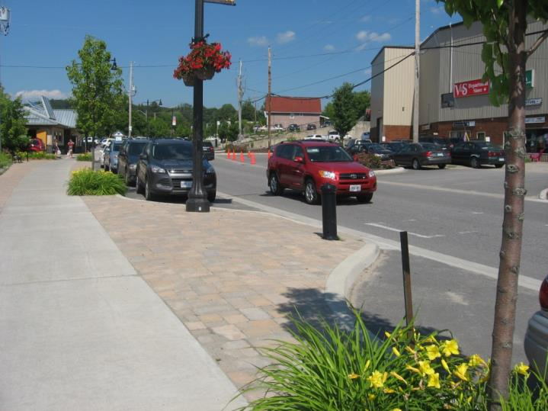
“The population is aging and so this (active transportation) has become an economic strategy for our municipality – making it a destination for retirees and creating places for walking has influenced our whole decision-making.”
“The CIA has been the main reason for us incorporating active transportation into our planning in the village.”
Notes:
Changes in the Culture
In 2004, active transportation was not part of anyone’s conversation, at a community or local government level.
The evaluation showed us that there has been a cultural shift over time, and recognition of the benefits of AT.
We also found that the CIA is recognized as a credible resource for municipalities, and that municipalities see us as expanding their capacity and contributing to the changes that have taken place.

Slide 21
Increased Awareness
“People now have a place to go to walk and they may even go further than they did before. Just having the infrastructure gets people out.”
“The increased use of York St. is huge! There are also more people cycling around town generally, especially to the college.”
“As a driver it is very helpful to have the Share the Road signs as reminders to look out for (and share the road with) cyclists.”
Notes:
Surveys gave us qualitative info indicating increased awareness in the community

Slide 22
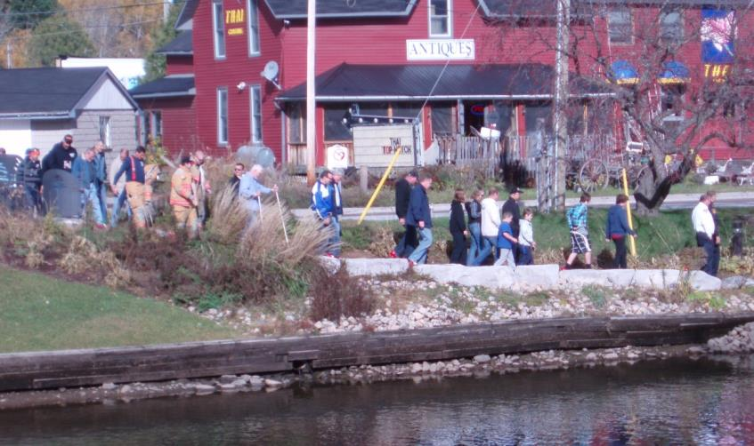
Changes in AT Levels
Haliburton
Minden
Highland St. |  | York St.
2005 | 2012 | 2005 | 2012
146 | 277 | 106 | 135
Pritchard Lane |  | Water St.
2007 | 2012 | 2007 | 2012
7 | 24 | 5 | 75
Notes:
There are more people walking – highlights from 2 locations observational studies.
Average numbers based on 3 hours of observation per site.

Slide 23
Benefits of Collaborative Planning for AT
Increases municipal capacity
Taps into community expertise
Provides additional funding opportunities
Achieves multiple goals and priorities
Provides grassroots forum for community to participate and engage in planning
More inclusive
Everyone (community and politicians) becomes more aware of needs and impacts of cyclists and pedestrians
Becomes part of community ‘fabric’
Notes:
- Increasing capacity – CIA work represented pre-planning
Multiple goals and priorities: e.g. needs of aging population, tourism and economic development, health, environment, quality of place, accessibility, safety.
Grassroots and Inclusive: community group (CIA) bringing to the community can be viewed as less threatening than if initiated by local government; helps to build level of community participation and buy-in

