Slide 1
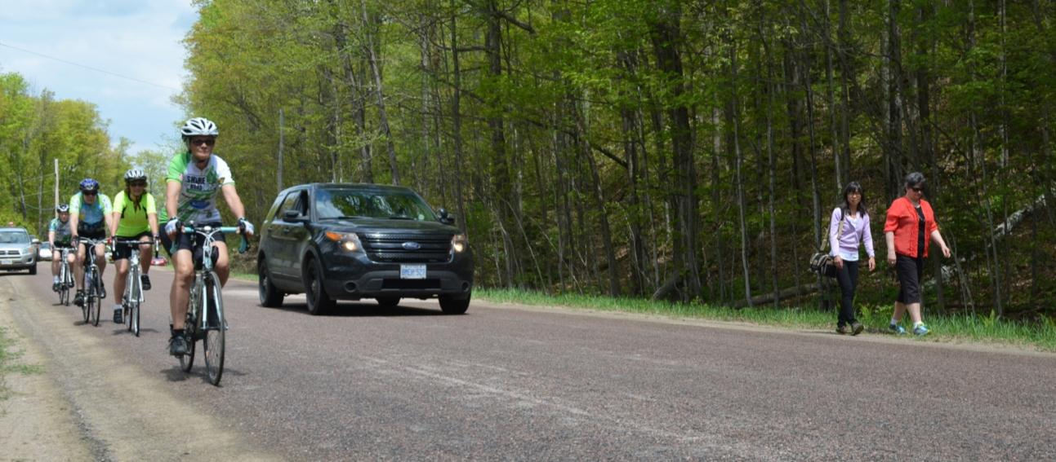
Building Capacity for
Active Transportation in the
Haliburton Highlands
Photo: Sue Tiffin, The Highlander

Slide 2
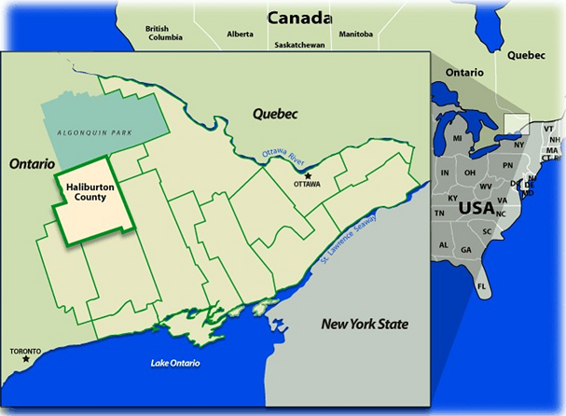

Haliburton County, Ontario, Canada
Notes:
Rural area of approx. 4,500 sq km (takes over an hour to drive east to west and north to south)
2 main village hubs, Haliburton and Minden
2 tiered gov’t
Year-round population approx. 16,500 (density 3.7/km²)
Seasonal pop. +45,000
Seniors

Slide 3
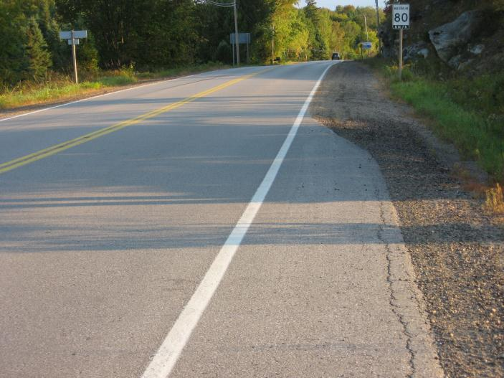
Active Transportation: Rural Challenges
Capacity – financial, human
Infrastructure – extensive road network
Geography – large distances, low density
Attitudes – rural “car culture”- transportation = roads = cars
Knowledge Gap – most evidence is urban based
Notes:
Capacity issues means AT is not necessarily a top of list priority – for infrastructure or for planning.
Distances plus low density mean separate facilities (e.g. separate bike paths) not feasible; also existing separate paths (rail trails) are multi-use and include motorized uses (part of rural culture), also no public transit

Slide 4
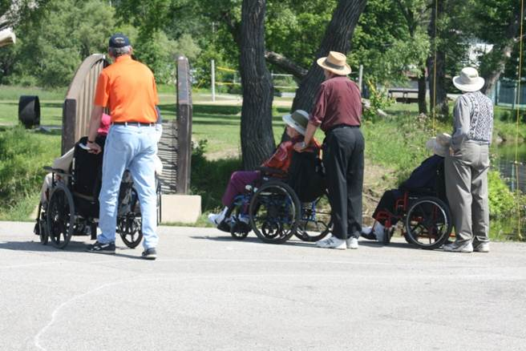
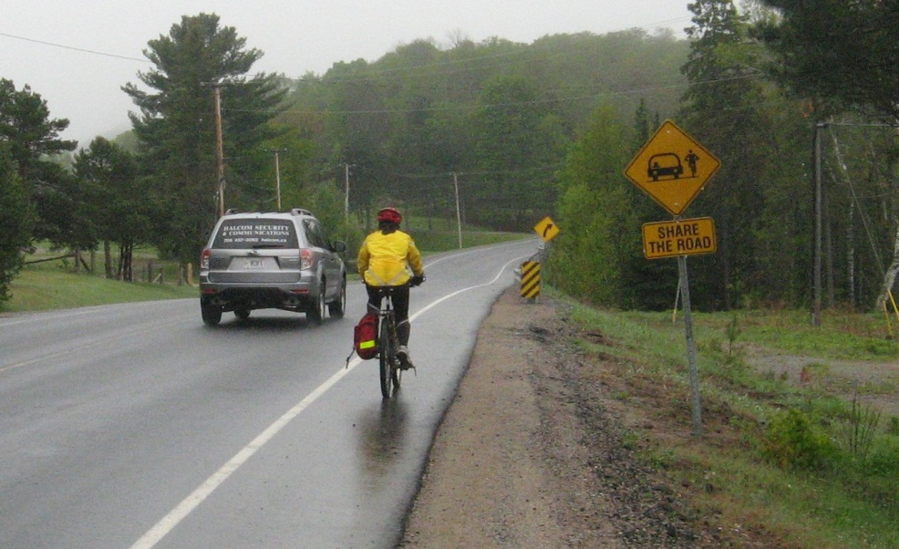
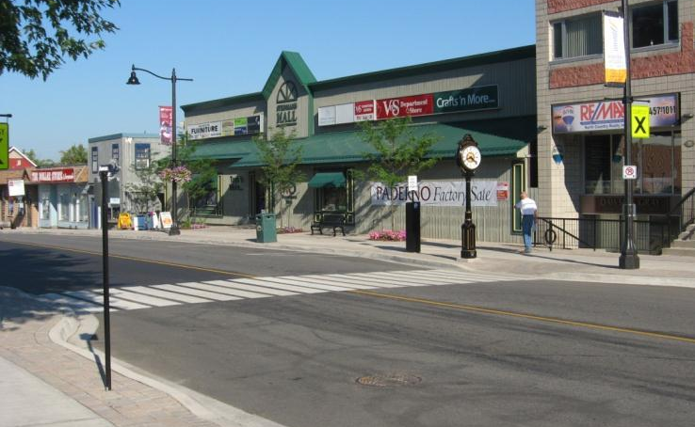
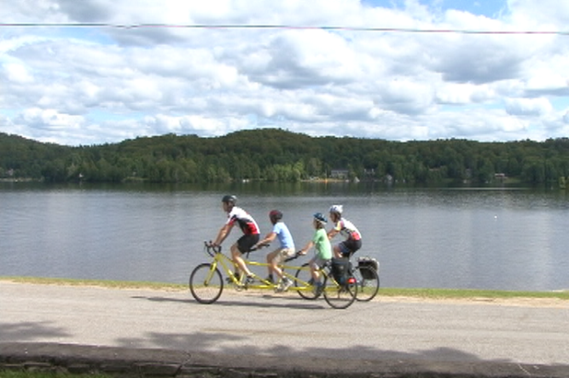
Good news: Implementation of cycling/AT initiatives IS achievable in small, rural communities!
Notes:
Our presentation: who, how, what, lessons learned

Slide 5

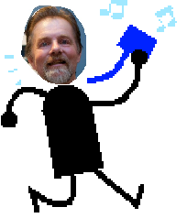

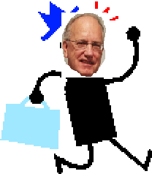

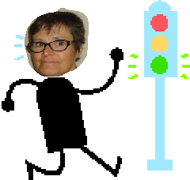

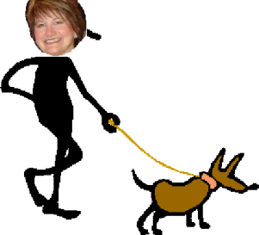








Communities in Action Committee
Notes:
2004 –Communities in Action Committee
A coalition of community stakeholders who wanted to increase physical activity opportunities by creating communities that were safe and healthy for people of all ages to get around in using active transportation.
Currently the CIA members represent:

Slide 6
Advocacy
New provincial policy direction
Availability of Funding
Planning and Research
Municipal Priorities
Other Influences
Official Plan policies
Partnership & Collaboration
↑ awareness and understanding –municipalities
Improved infrastructure
Increased AT activity
↑ awareness and understanding – community
Community Education and Promotion
CIA strategies
Observed and measured changes
Evaluation
External factors
Notes:
This figure provides a schematic of our strategies/actions over the years (purple), what we have been trying to influence (yellow).
Arrows indicate how our actions and other factors (green) influenced the outcomes, found through the evaluation.

Slide 7
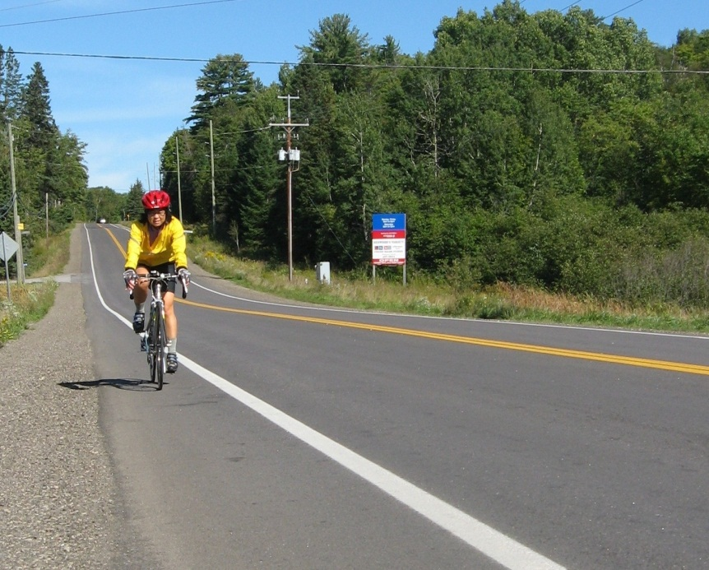
  Advocacy
The CIA doesn’t ‘do’ infrastructure, so we need to advocate for investment.
How?
Advocating for supportive land use policy
Communication with council
Making the case
Engaging the community
Notes:
Advocacy efforts target municipal elected officials.
Policy advocacy – participate in and contribute to Official Plan reviews
Communication: delegations to council, creating information briefs, writing letters, phone conversations with councillors
Making the case e.g. Paved shoulders: raise awareness with county of multiple benefits of paving shoulders (not only cycling – also road life, safety, reduced maintenance cost, tourism)
Engaging the community – paved shoulders
April 2014 – consulted by County roads dept on priority roads for cycling that need paved shoulders

Slide 8
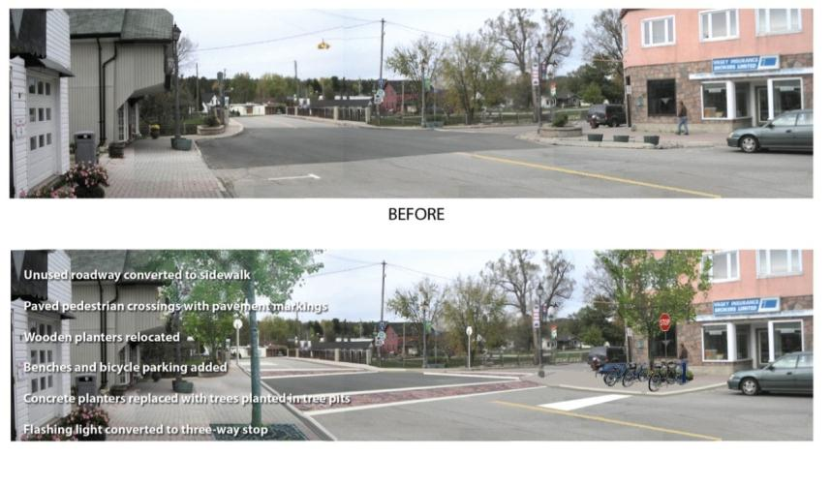
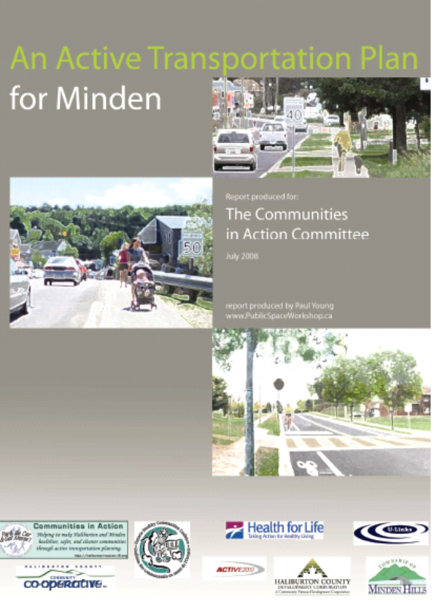
  Planning & Research
Built a strong, evidence-based
case, developed tools and resources.
Established CIA as a credible resource.
How?
Developed active transportation plans – Haliburton & Minden
Helped create a vision
Conducted community based research
Tool for both municipality and CIA
Notes:
Developed AT plans for both Haliburton and Minden. We presented these to council
AT plans include concept illustrations or photoshopping of problem areas to help create a vision of what could work better
these plans/reports were developed by the CIA, rather than commissioned by the county or municipality, which is more typical. Great example of how in a rural community, where the time and resources of municipal staff and council are limited, community groups can enhance the capacity to do new things, acting as partners to the work of the municipality

Slide 9
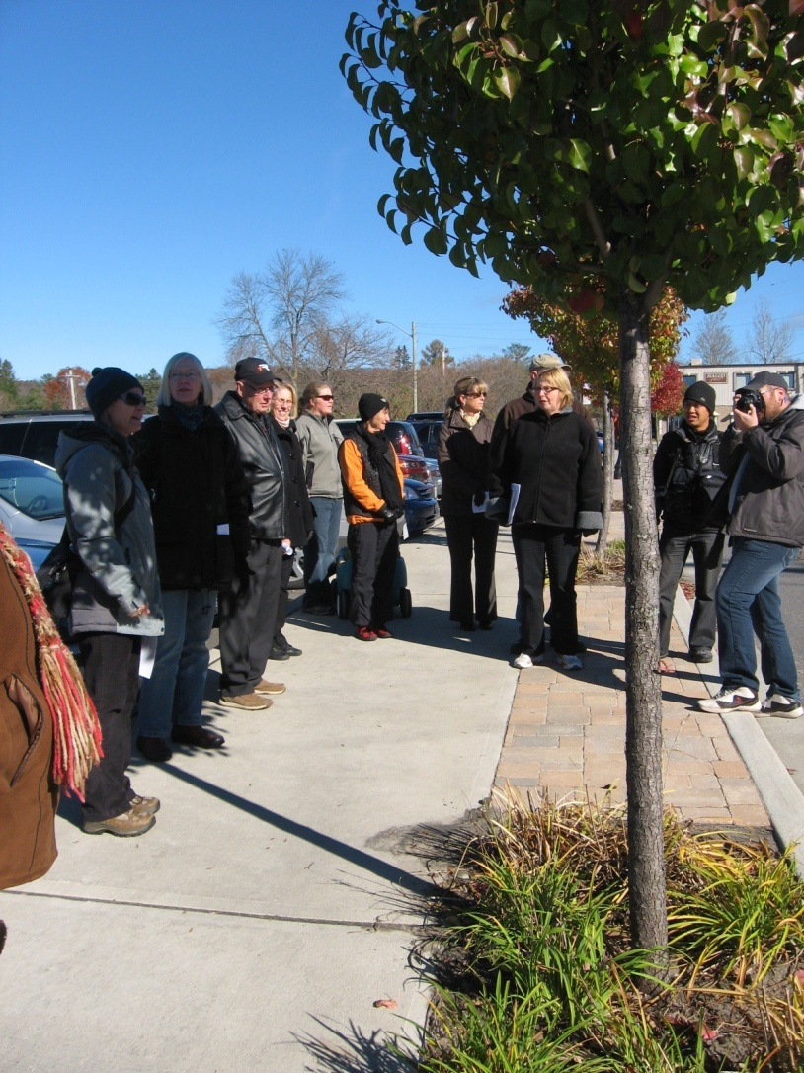
  Partnership and Collaboration
AT complements many initiatives
Health
Accessibility
Equity
Safety
Recreation
Environment
Social engagement
Economic development & tourism
Productivity
Notes:
In a small community, no one group can do this work alone. Engaging partners is critical.
Benefits: shared resources and work; Enhanced capacity and opportunities; Avoid duplication; Greater diversity; Synergy
AT benefits can be framed in many ways.
Opportunity to engage many other stakeholders adding weight and credibility to the message.
Really helps to demonstrate the multiple benefits of planning for and encouraging AT.

Slide 10
Municipalities are key partners
Raise awareness with municipal elected officials and staff about their role in creating a healthy, active community that includes active transportation.
How?
Communicating the benefits through regular reports, updates and delegations to council
Identifying WIIFT, speaking to their priorities
Hosting workshops and events and inviting councillors and staff
Notes:
Municipalities are key partners as they are the ones to impact land use policy, planning and on-the-ground changse
Therefore, it is critical that they recognize the benefits and their role in encouraging more AT
Purpose of delegations: provide updates, ask for input, raise awareness of their role; only very rarely ask for money
Our municipal priorities: tourism, ec dev’t/jobs, aging population…we need to connect the dots
Workshops with visiting ‘experts’ e.g. Walk 21 Roadshow, Mayor of Ajax spoke to Roads Committee, Gil Penalosa

Slide 11
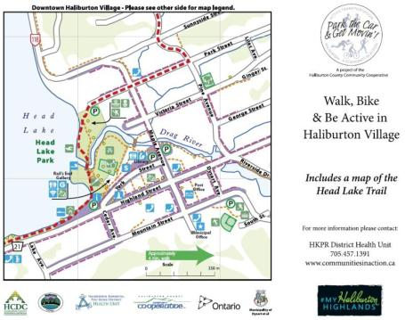


  Community Education and Promotion
Build a base of community support, awareness and activity.
How?
Community-based research
Focus on village hubs
Awareness raising campaigns e.g. “Park the Car and Get Moving”, share the road
Events and activities
Maps
Media
Notes:
If influencing decision makers and policy is a top-down approach, equally important are the bottom-up strategies: Community engagement and building a base of community support, because decision makers are more likely to respond to the interests of their constituents.
Community based research is also an education strategy
We have focused planning and messaging on hubs rather than whole county – too big an area; more realistic
Messaging: Developed a ‘doable’ AT message for rural area – acknowledging that people need to drive to town due to distance, but encouraging them to then park and walk once they got there
Events and activities to promote AT
Maps and signs to encourage walking in town
Media: PSA’s, articles, interviews, letters to editor – to maintain ‘community conversation’

Slide 12
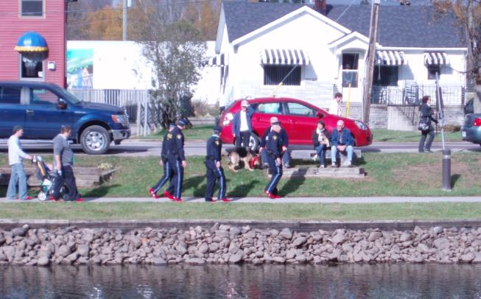
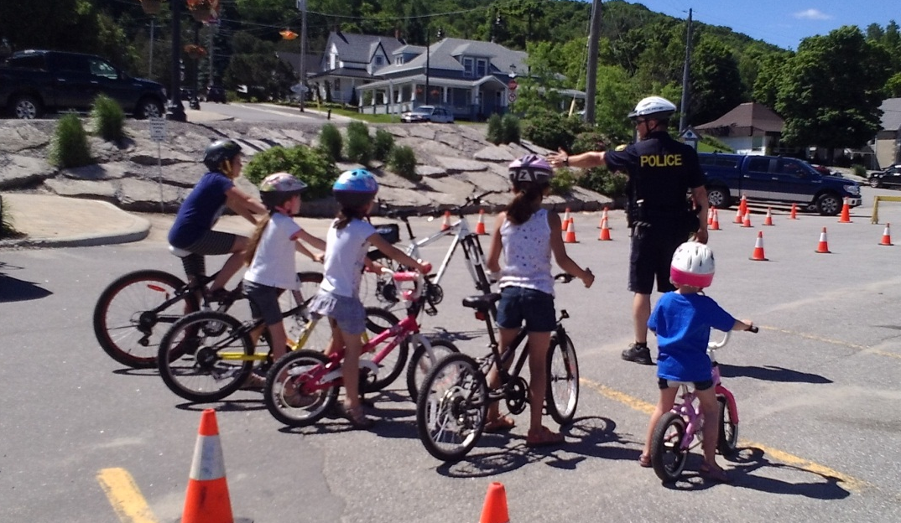
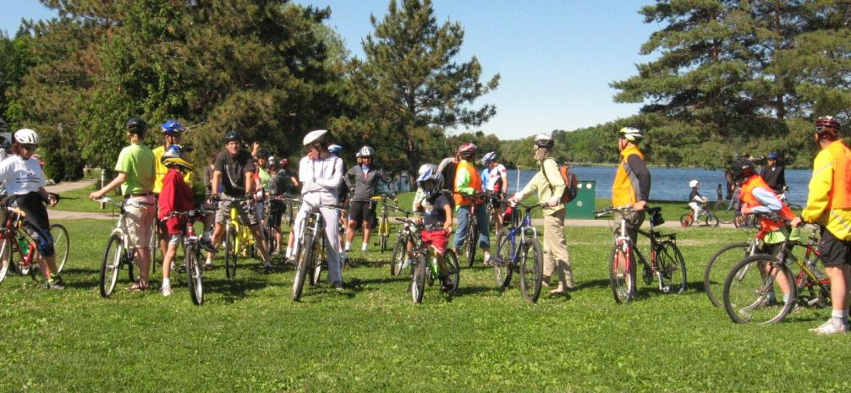
Events and Activities
Notes:
Events and activities over the years - e.g. Cycling Festival, Walk a Mile in Her Shoes, bike rodeos

Slide 13
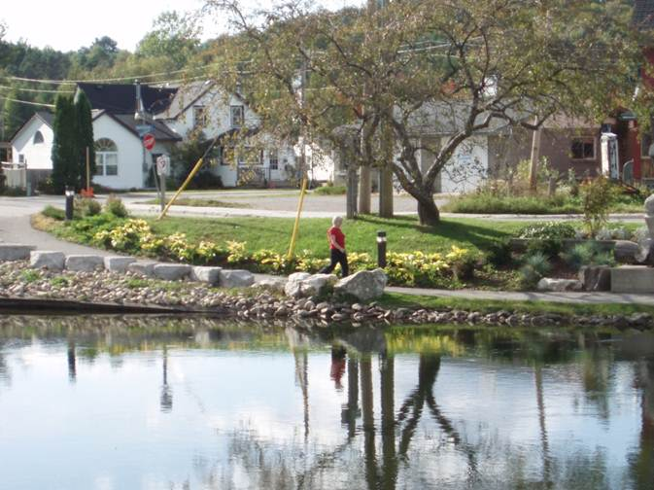
  Evaluation
Inventory: policy and infrastructure changes
Survey: asked residents about their AT awareness and behaviour
Observational Study: manual counts of people walking and cycling
Key Informant Interviews
Notes:
We know that the CIA isn’t responsible for ALL of the changes we’ve seen over the past 5 – 10 years. But we have contributed.
Got a grant to fund. Included project coordination
So, 2011-12 - Used a community-based approach to find out:
1. What has changed since the CIA began work on active transportation?
2. What has been our contribution to these changes?
3. How effective have we been?
The evaluation consisted of these four pieces. No time to go into detail, but each piece can be replicated with minimal funding and human resources – would be happy to share more info off-line.

Slide 14
Observed and Measured Changes:
Official Plan Policies
“Land use patterns and development should promote energy efficiency, improved air quality, and allow for compact development that is designed in such a way to support and encourage active transportation…” (County of Haliburton Official Plan, 2010, 2.3.5.3)
“It is an objective of this Plan to promote healthy, liveable and safe communities by:…encouraging healthy, active communities by applying principles of good community design, active transportation, as well as providing parks and recreation opportunities.” (Dysart et al. Official Plan, 2010, 2.2.7)
Notes:
From the Inventory:all OP’s now include language to support healthy, active communities in general and AT specifically.
In some cases, our recommendations were included verbatim. In others, the “spirit” of our recommendations were captured in new policy.
Only one OP previously contained any reference to cycling, and none of them used the term “active transportation”.

Slide 15
Observed and Measured Changes:
Community Awareness
“I think that there is more awareness of trails and the desire to use them. People are becoming more physically active as there is more public education around things like obesity and diabetes. Parents and kids are using them more for a healthy lifestyle and there are more trails systems overall.”
“As a driver it is very helpful to have the Share the Road signs as reminders to look out for (and share the road with) cyclists.”
Notes:
Surveys gave us qualitative info indicating increased awareness

Slide 16
Observed and Measured Changes:
Municipal Awareness
“Politicians are more aware of the needs and impacts of cyclists and pedestrians now.”
“(My role..) has been to ensure that we are all thinking about active transportation when making decisions regarding roads and sidewalks.”
“The population is aging and so this has become an economic strategy for our municipality – making it a destination for retirees and creating places for walking has influenced our whole decision-making.”
Notes:
Key Informants interviews revealed that there has been a cultural shift over time, and recognition of the benefits of AT. In 2004, active transportation was not part of anyone’s conversation, at a community or local government level.

Slide 17
Municipal Awareness of the CIA
“…to have them as an independent body to provide the municipal and county levels with direction and to highlight best practices and bring resources to the table is very effective.”
“The CIA has been the main reason for us incorporating active transportation into our planning in the village.”
“The CIA has been a great partner for council and for lobbying other levels of government. Lots of projects would not have been put into place if it weren’t for them.”
Notes:
Key informants also indicated that the CIA is recognized as a credible resource for municipalities, and that municipalities see us as expanding their capacity and contributing to the changes that have taken place.
Illustrates important role of community based groups in rural communities to move AT forward.

Slide 18
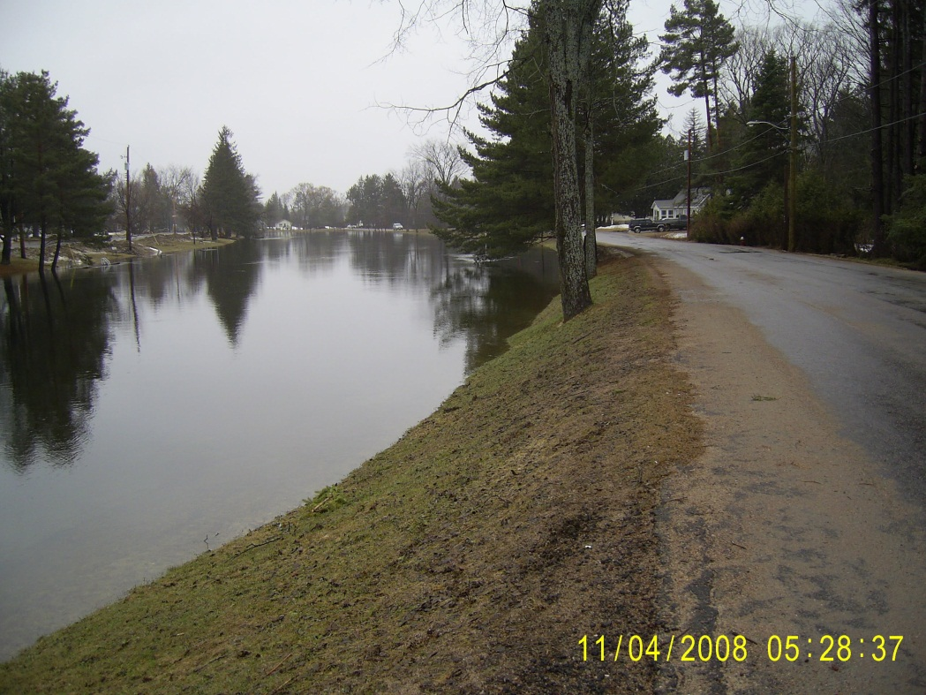
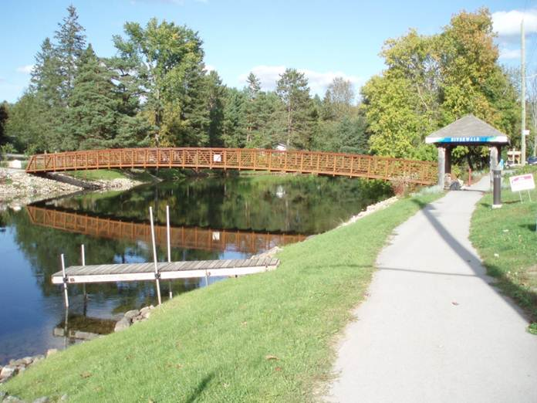
Observed and Measured Changes:
Improved Infrastructure
Minden Riverwalk
Notes:
Inventory documented changes that County and municipalities have made to infrastructure since 2005
Before and After of the Gull River, Minden 2008 to 2012
Completion of Riverwalk, including Logger’s Crossing bridge
Amenities: Sculptures, shelters, benches and lighting along the Riverwalk
CIA role: assisting with funding, promotion, evaluation

Slide 19
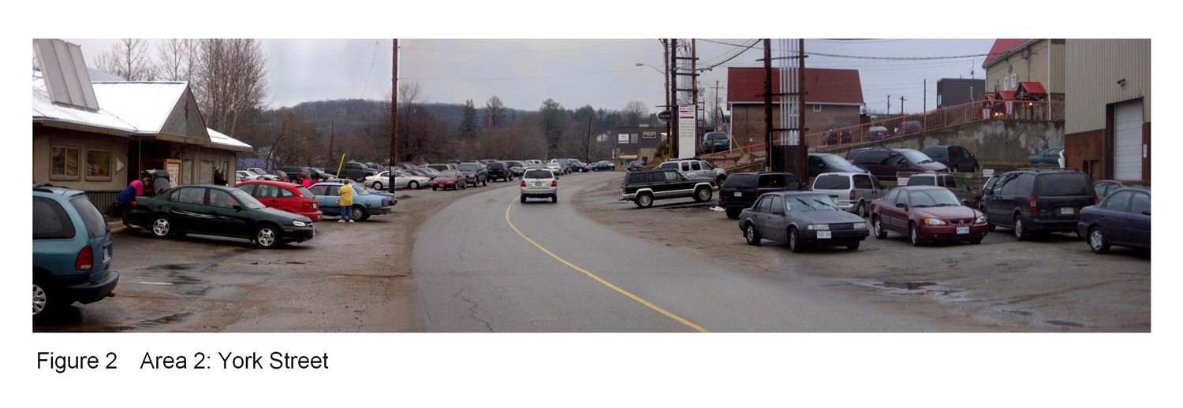
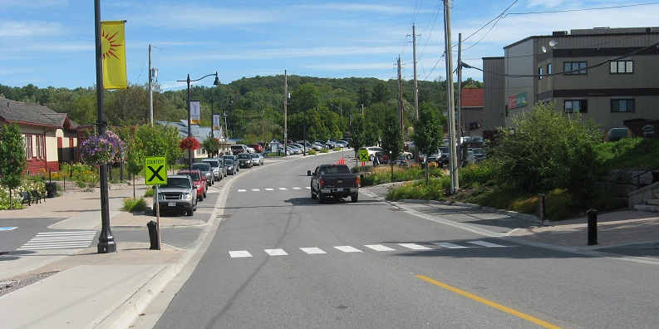
Haliburton, York St.
Notes:
In Haliburton: Two major projects (2011-12):
- Phase 1: York St. Streetscape
New amenities: bike parking, sidewalks, tree plantings and lighting
CIA contribution:
contracted a landscape architect to do illustrations to provide a vision for improvements. These were included in the Haliburton AT Plan. The municipality contracted the same architect to do the full streetscape plan.
CIA’s efforts helped build community awareness and support, as well as adding momentum.

Slide 20
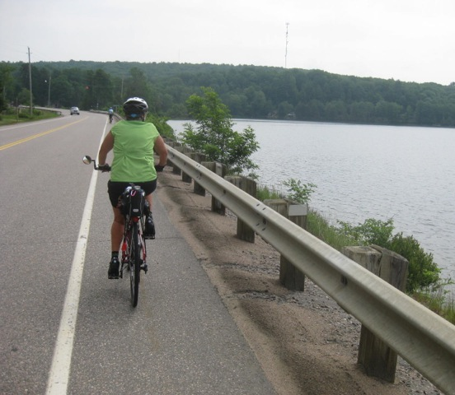
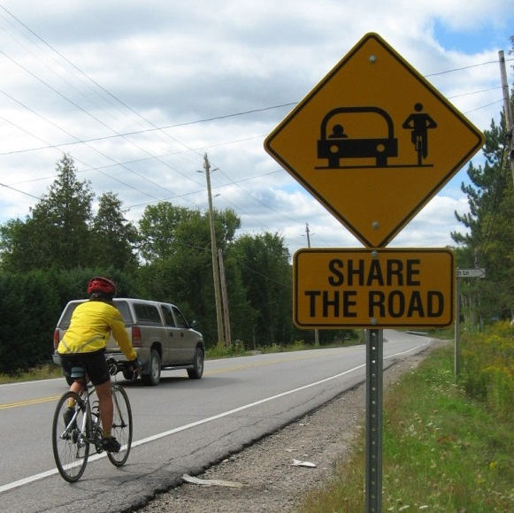
County Roads, paved shoulders
Notes:
The county has begun adding 1.2 m paved shoulders to major road projects since 2008, total approx 42 km
CIA role: advocacy, awareness raising.
Share the road campaign initiated 2009 CIA and Health Unit key partners in promotional aspects

Slide 21
Observed and Measured Changes:
Increased AT Activity
Invergordon Ave. |  | Pritchard Lane |  | Water St.
2007 | 2012 | 2007 | 2012 | 2007 | 2012
10 | 21 | 7 | 24 | 5 | 75
Minden
Highland St. |  | York St. |  | Courtesy Crossing
2005 | 2012 | 2005 | 2012 | 2005 | 2012
146 | 277 | 106 | 135 | 55 | 56
Haliburton
Average number of people using AT based on 3 hours of observation.
Notes:
Observational Study: General lack of hard data means we need to gather it
Evidence is needed in order to get and keep walking and cycling on the ‘radar’ - Builds the case and builds credibility
Used protocol from Alta Planning & Design for National Walking and Cycling documentation Project; could be replicated with minimal resources

Slide 22
Observed and Measured Changes:
Increased AT Activity
Self-reported frequency of AT use (from survey data)
Notes:
Self-reported responses from the survey indicated increases in self-reported active transportation activity. 2007 survey done in Minden.
Significantly more people reported using AT while in Minden in 2011, this included parking their car in one spot and walking, biking, etc. to get around.

Slide 23
Conclusions from the data
Awareness raising, promotion and improved infrastructure contribute to encouraging more walking and cycling
CIA activities contributed to observed changes in AT policy, planning, infrastructure and activity
The CIA added to the capacity of municipalities around AT planning; AT Plans were effective resources
The CIA’s participation in the review of official plans was an effective strategy to affect policy change

Slide 24
Implications
Implementation of AT initiatives is achievable in small, rural communities!
Leadership on AT can come from community groups and enhances municipal capacity
Increases in AT are achieved through many interventions implemented over time
Measurement, monitoring and evaluation of interventions are required to better understand the return on investment
Having and articulating a consistent vision is important
Community-based research is a valuable and effective approach to evaluation
Notes:
Rural communities lend themselves to AT promotion – settlements are usually small and services in close proximity and can be the focus of planning and promotion
Need a group that has AT as a priority and focus to keep it on the community and political radar. Community brings skills and expertise that can help municipalities to try new and innovative ways to create a healthy community. Neither group can do this work alone.
changing behaviour is complex, so a variety of strategies are needed. Many things contribute.
Evaluation helps you to know what kind of impact you are having. It also helps to make the case for continued investment. It may be difficult to draw direct cause and effect relationships between specific interventions and outcomes. But it can be helpful to measure what changes occur and what/who contributed
Once is not enough – be in it for the long haul.
You don’t have to hire an external consultant; using multiple data collection methods and triangulating results can provide valid information

Slide 25
Lessons Learned
Build partnerships with multiple sectors
Public Health is a key partner
Take evidence-informed action
Relate the message to municipal priorities
Top down and bottom up
Provide a visual
Identify manageable message and focus
How the message is delivered is as important as the message itself
Find opportunities for knowledge exchange

Slide 26
THANK YOU!
Sue Shikaze
sshikaze@hkpr.on.ca
Kate Hall
kvhall06@gmail.com
www.communitiesinaction.ca
www.cyclehaliburton.ca
www.hkpr.on.ca

