Slide 1
The US
Wearables/Wellness Tracking & Coaching Market
Recap of Secondary Research
January 28th, 2016

Slide 2
Presentation Outline
Objectives
Methodology
Setting the Stage
Technology Framework for Seniors
The Wearable Market
  Total Market
  US Market
    Demographics of Wearable Users
    Types of Wearables
  Healthcare
  Fitness

Slide 3
Presentation Outline continued
Leading Manufacturers of Wearable Technology
Telehealth/mHealth Leaders of Wearable Technology
Benefits of Telehealth/Wellness Tracking
Other Issues
Summary/Conclusions
Issues to Address
Next Steps
Appendix: Syndicated Research Reports Available for Purchase

Slide 4
Objectives of Secondary Research
Objectives of Research are:
Identify the major players for Wearable Technology sold to seniors 65+ Aging in Place
Determine usage of senior population of wearable technology for fitness
Identify any senior communities piloting or using this technology for wellness tracking
Obtain any other relevant/interesting information

Slide 5
Methodology
Intensive searching on google for a variety of terms
  Seniors, living at home, aging in place, senior community centers
  Wearable technology, fitness tracking, tele-health, mhealth, remote patient monitoring, wellness coaching, wellness tracking
  National Institute of Health, National Institute of Aging
  Aging In Place Technology Watch
  Market Research.com, emarketer
  Financial investment firms: Morgan Stanley and Goldman Sachs
Syndicated Research Firms (Databases): Frost & Sullivan, IDC, Gartner Research, Parks Associates, ABI Research, Mintel, Soreon Research, Global Industry Analysts, VisionGain, Statista
  Discussions with several groups

Slide 6
Setting the Stage
“It’s like the early days of the mobile phone, when the phones were bricks. We are at the early stages (of wearable technologies)”
  Ivo Stivoric Jawbone
  PWC focus group 2014
“In five years, we’ll have better population tools that support anticipatory care”
  Cris Ross Mayo Clinic
  Health Research Institute/PWC 2014
    Healthcare Delivery of the Future: How Digital Technology Can Bridge Time and Distance Between Clinicians and Consumers

Slide 7
Setting the Stage continued
56% of people believe average life expectancy will grow 10 years because of wearable enabled monitoring of vital signs
  HRI/CIS Wearables Consumer Survey 2014
90% of seniors plan to stay in their own home
  67% of caregivers want to use technology but only 10% currently use
  AARP Caregiver Innovation Frontiers Report 2016

Slide 8
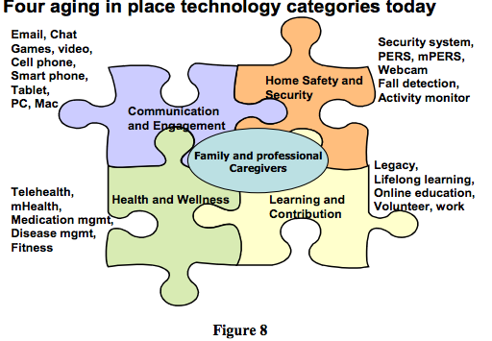
A Framework For Technologies for Seniors
Aging in Place Technology Watch 2015
PERS: Personal Emergency Reporting System
Technologies overlap and may converge

Slide 9
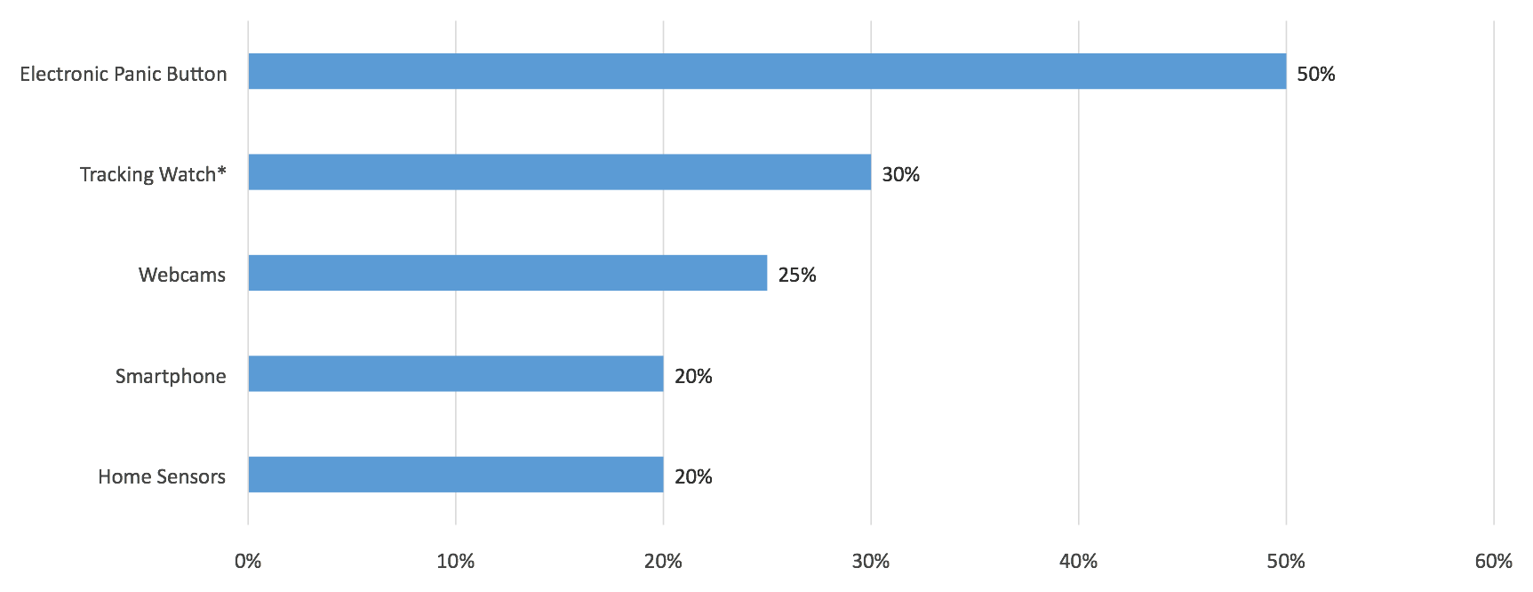
Snapshot of Technology Devices Used by US Seniors/Caregivers
Parks Associates Current and Future Caregiver Technology December 2014
Tracking watch: 30% of caregivers want panic button for emergencies; 8% of caregivers use watch to track activity

Slide 10
Personal Safety Monitoring US Market Forecast
AARP/Parks Associates 2016 Caregiving Innovation Frontiers
Hazard Prevention and Emergency Response
  $1.5 billion to $2.9 billion 2016-2020

Slide 11
Current and Projected Wearables Market

Slide 12
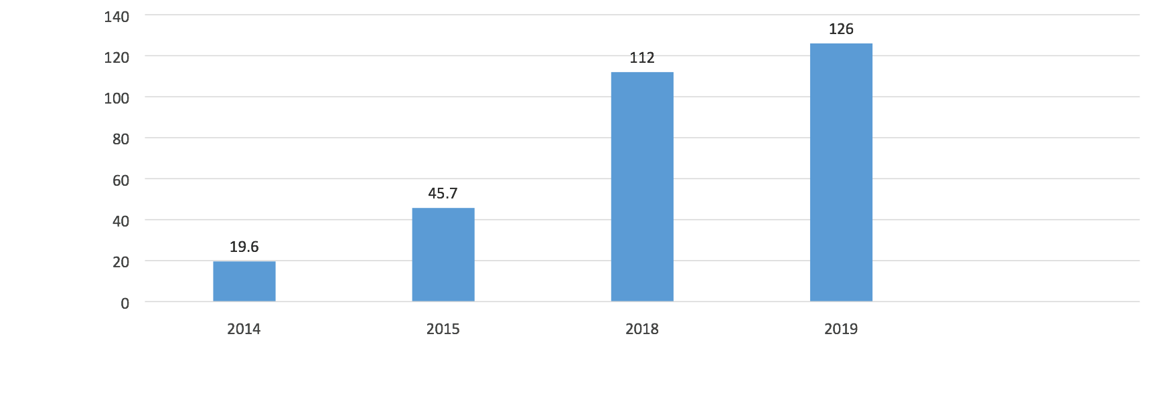
Estimate of Total Worldwide Wearable Market
In millions of units from IDC (International Data Corporation) 2014
World Wide Wearables will grow
2.5 times from 2015 to 2019

Slide 13
Demographics of US Wearable Users

Slide 14
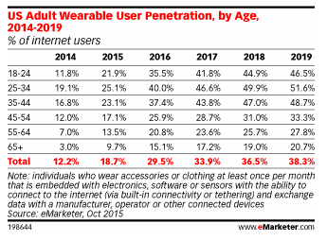
Projected Use of Wearables in US by Age Demographics
Source: emarketer.com and Soreon Research
Critical Chart
By 2019, 1 in 5 people 65+ years will be using a wearable

Slide 15
Current and Projected Sales By Type of Wearables

Slide 16
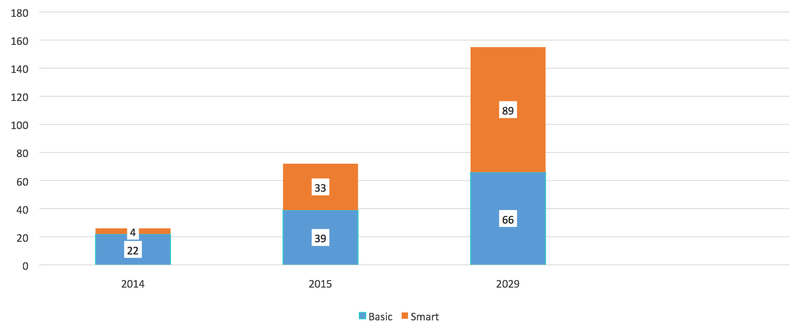
Projected Sales of Smart vs. Basic Wearables
IDC 2015 millions of units Worldwide
155
Smart (Internet/3rd Party) Wearables Will Overtake
Basic Wearables by 2029
72
26

Slide 17
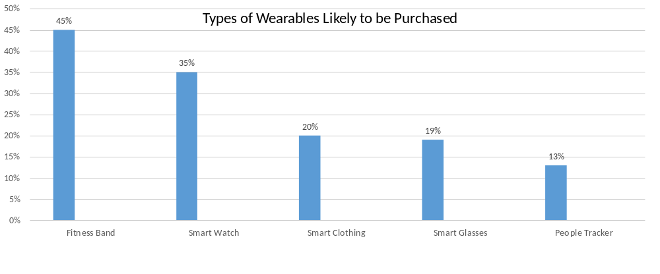
Percent of People Likely to Purchase Wearables by Type
PWC (PriceWaterhouseCoopers) All Ages Healthcare Wearables The Early Years 2014
Fitness bands and smart watches
are the most popular

Slide 18
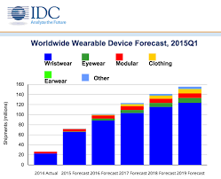
Worldwide Wearable Device Forecast
Source: IDC 2015
The dominant technology will continue to be wristwear devices
Modular is pendant

Slide 19
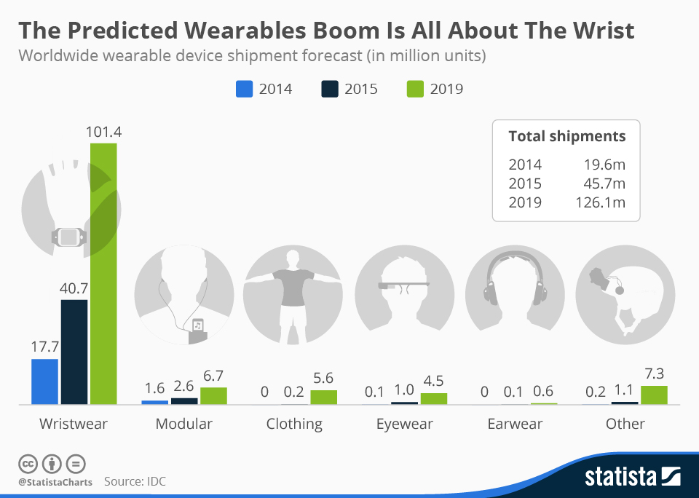
Projected Wearable Unit Sales by Type of Wearable
Source: IDC/Statista 2015
Wristwear is dominant

Slide 20
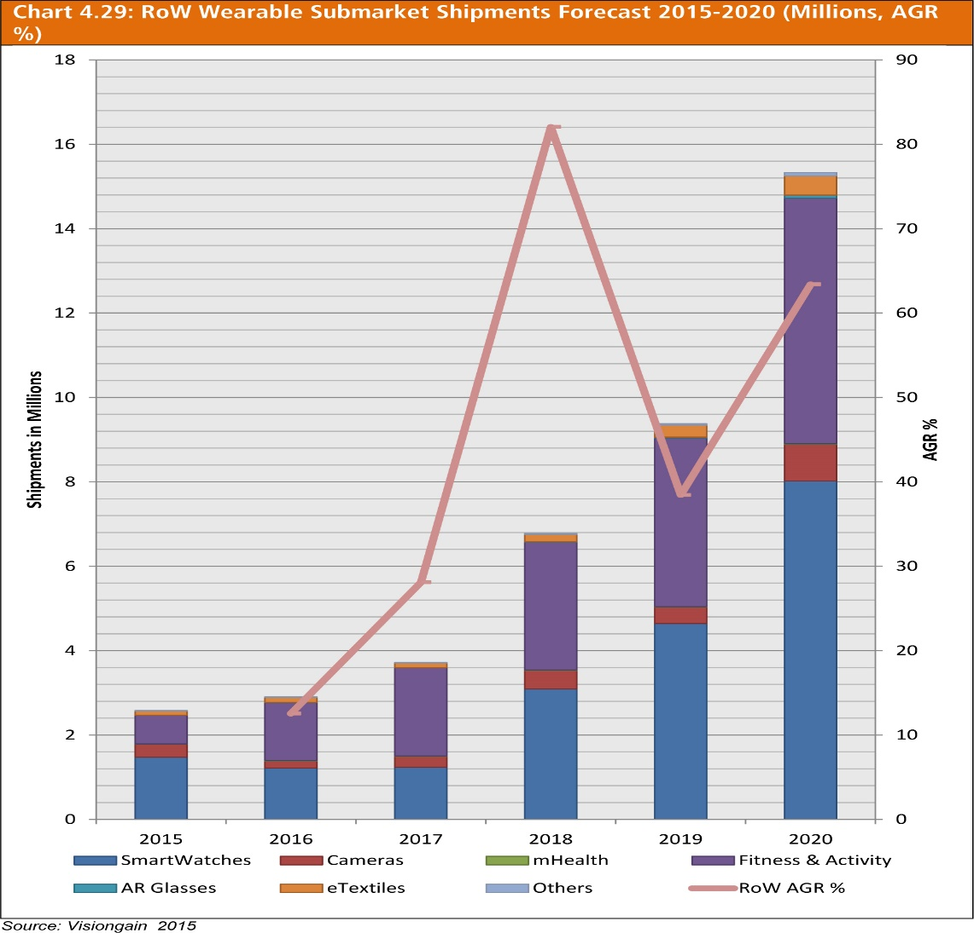
Forecast of Types of Wearable Products
VisionGain 2015
Smart watches and fitness devices will continue to dominate the market

Slide 21
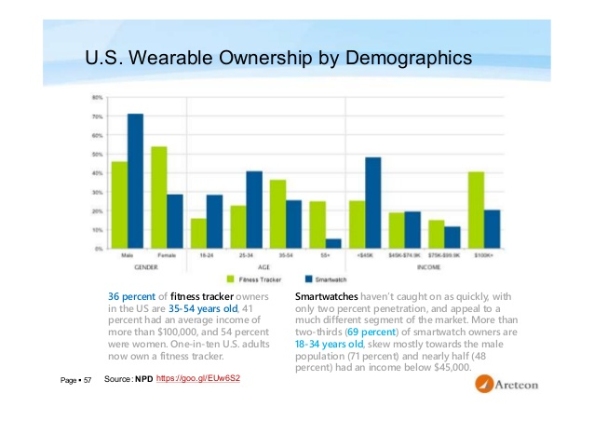
Type of Wearable by Demographics
Source: Aretcon
Critical Chart
Over 55 prefer a fitness tracker over a smart watch

Slide 22
Healthcare

Slide 23
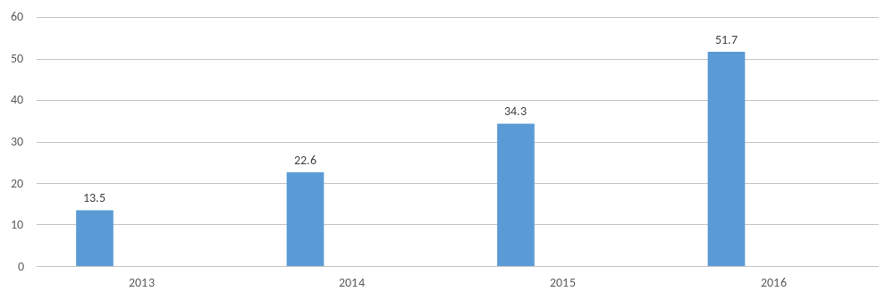
Estimate of Worldwide Healthcare Market
Source: Statista -- In millions of units
Healthcare Wearables Will Continue to Grow

Slide 24
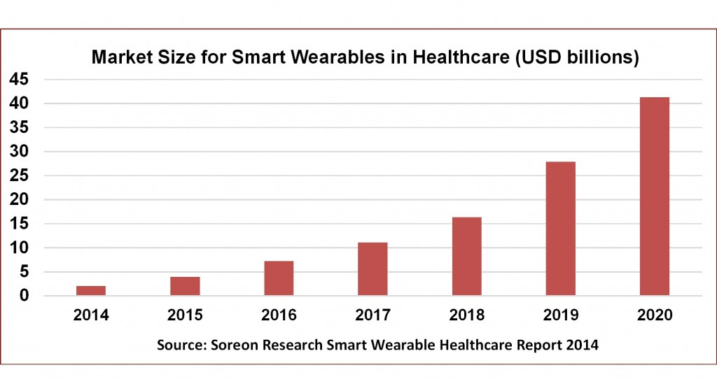
Projected Dollar Sales of Wearables for US Healthcare Market
Soreon Research Indicates 8 Time Growth
in US Healthcare Market from 2015 to 2020

Slide 25
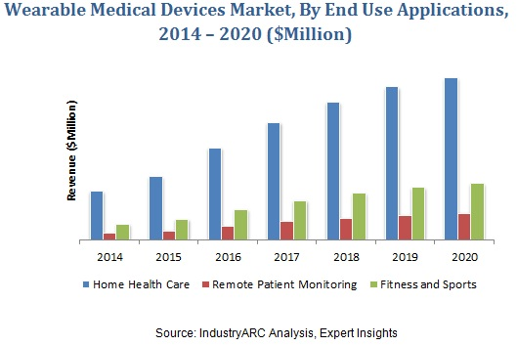
World Wearable Medical Device Market by Application
IDC 2014
Home Healthcare Has the Most Growth

Slide 26
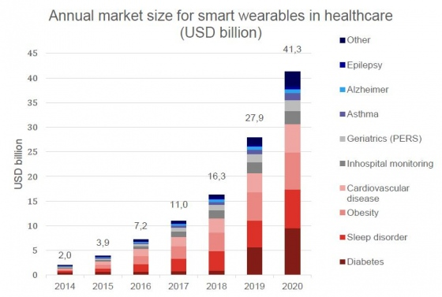
Projected Applications of Smart Wearables in US Healthcare Industry
Soreon Research
Several applications “overlap”
the geriatrics segment

Slide 27
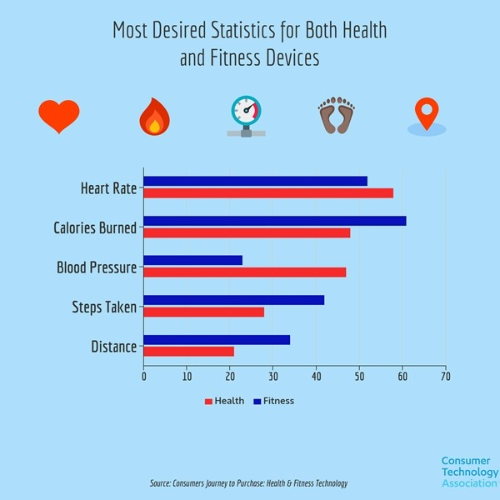
Desired Applications for Health and Fitness Wearables
Source: Consumer Technology Association
Fitness oriented consumers did
not view blood pressure as important
as health focused consumers

Slide 28
Leading Manufacturers of Wearable Devices

Slide 29
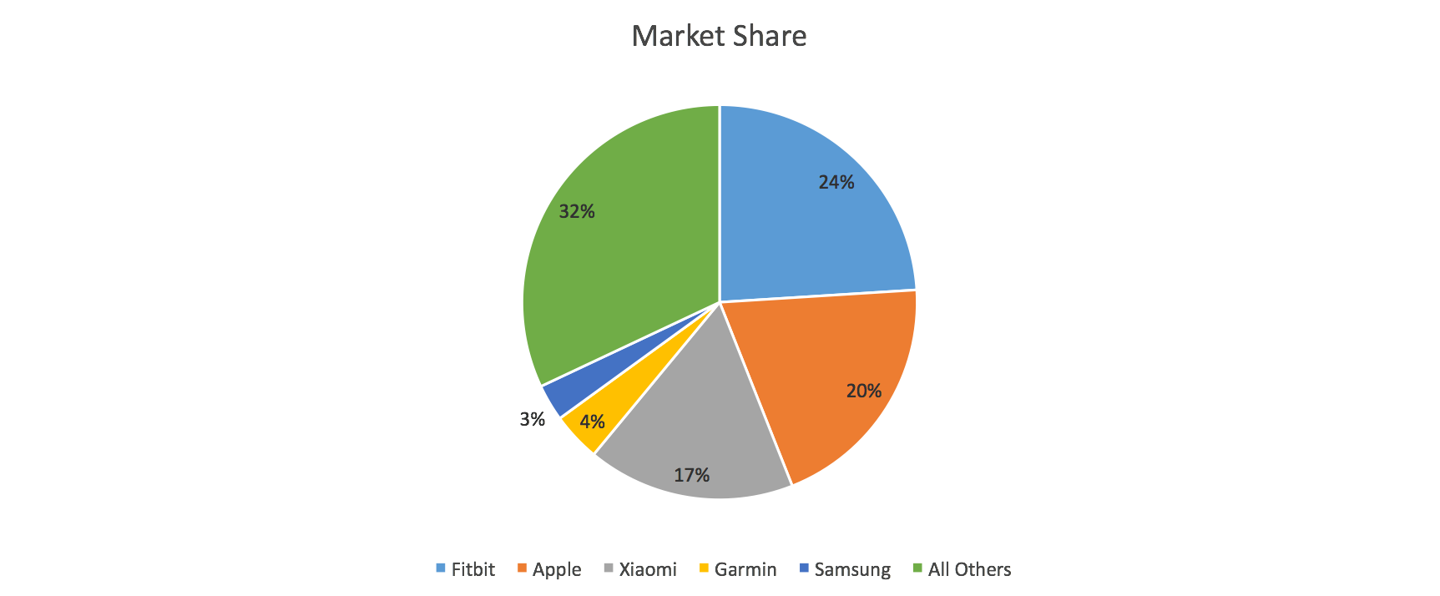
Market Share of Smart Wearables (3rd Party Applications)
IDC 2015 2nd Q Data Worldwide Shipments
Fitbit, Apple, and Xiaomi are the World Leaders
Others not broken out by
IDC without purchasing report

Slide 30
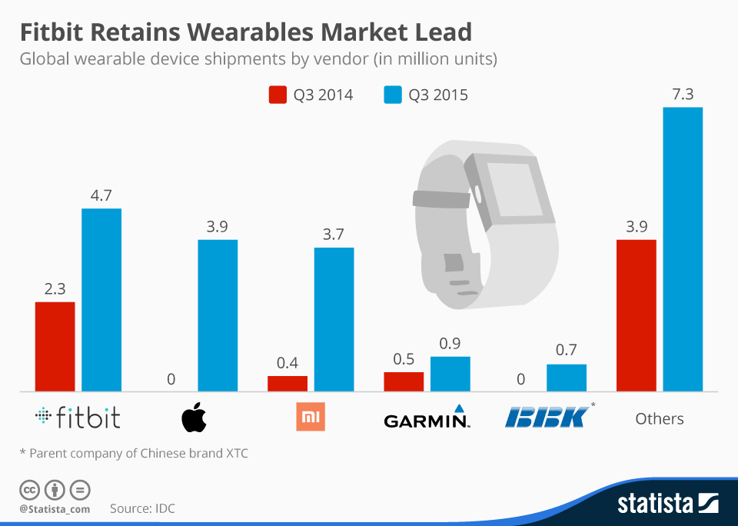
Global Leaders of Wearables
Source: IDC/Statista
*MI is brand of Xiaomi

Slide 31
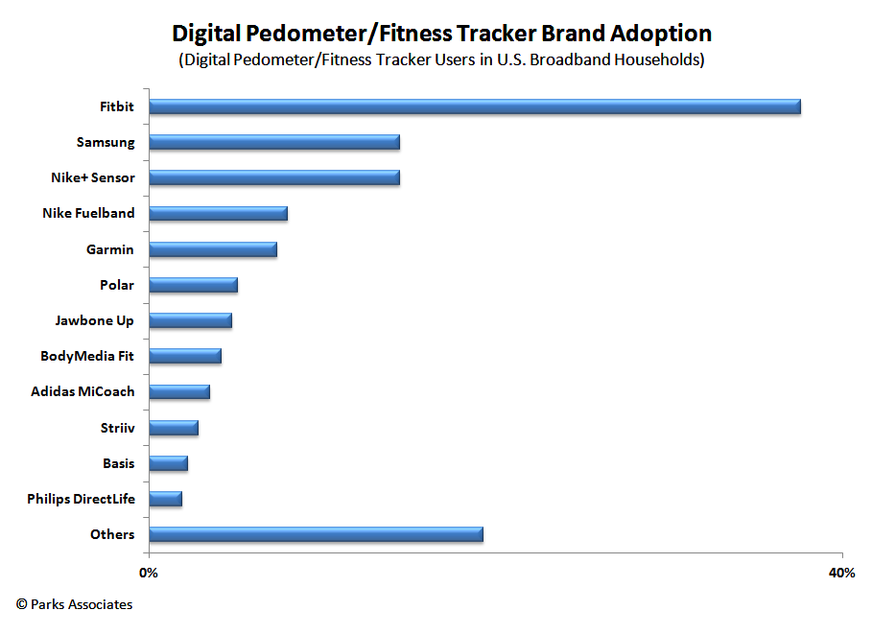
Brands of Fitness Trackers US
Parks Associates 2014
Fitbit is the leader in activity tracking, but the market is very fragmented

Slide 32
Tele-health/mHealth Fitness

Slide 33
US Telehealth Market
Source: AARP/Parks Associates -- Caregiving Innovation Frontiers Report 2016
  Telehealth Market is projected to be $1.0 to $1.6 billion
  Major criteria to be monitored
    Blood pressure and glucose levels
    Temperature and weight
Institute for Telehealth Consumerism 2015
  $6b 2013 to $9.6 billion in 2018
Health Research Institute/PWC Healthcare Delivery of the Future 2014
  15% of clinicians offer telehealth to patients
  28% are considering it
  50% receive payment for services

Slide 34
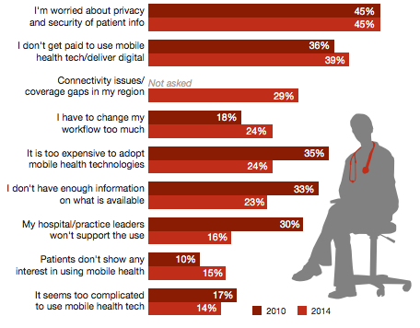
Top Barriers to Doctor Adoption for Mobile Health
Health Research Institute/PWC Healthcare Delivery of the Future 2014
Many barriers to adopting mobile
health
Top two are privacy/security of data and
doctors not being paid

Slide 35
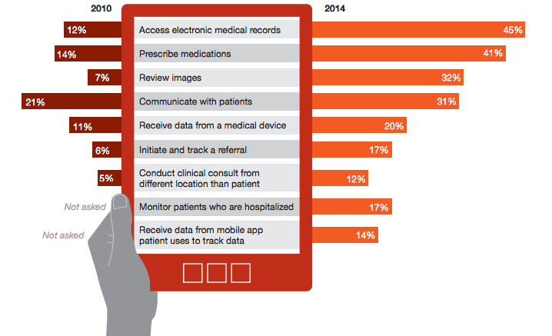
Physicians Reporting Healthcare Activities On A Mobile Device
Health Research Institute/PWC Healthcare Delivery of the Future 2014
20% use a medical device to receive data
14% receive data from a mobile app

Slide 36
Top 20 Health/Fitness Device Manufacturers
VisionGain2015
  AirStrip
  AliveCor
  Apple
  AT&T
  Athenahealth
  Boston Scientific
  CardioNet
  Cerner
  Epocrates
  Fitbit
Alphabetical order

Slide 37
Top 20 Health/Fitness Device Manufacturers
VisionGain2015
  Honeywell
  Jawbone
  Motion Computing
  Nike
  Qualcomm
  Sanofi
  Telcare
  Vodafone
  Voxiva
  Zephyr Technology

Slide 38
Telehealth Service Providers
AARP/Parks Associates 2016
Medical Providers in the Telehealth/Telemedicine Market
    Bright.md
    Circle Medical
    Curely
    Doctor on Demand
    Heal
    One
    Maven
    Plushcare
    Teladoc
    Medicast
    Pager
    Medzed
    MD Live
    Touchcare
Unclear if these organizations are
working with other groups

Slide 39
Results/Benefits in Using Wellness Monitoring

Slide 40
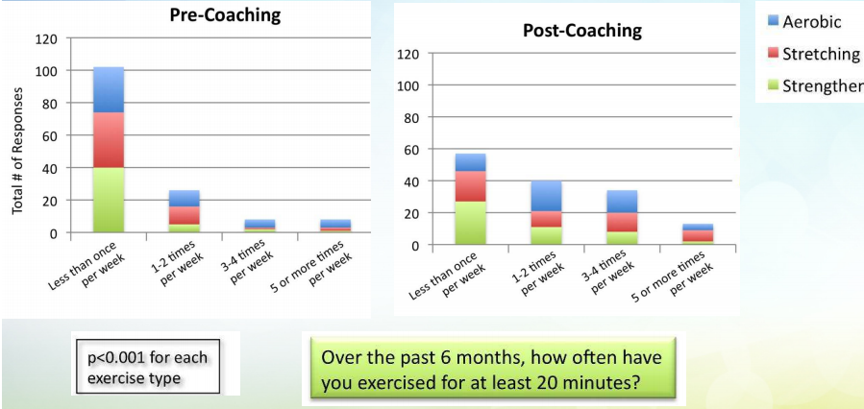
Change in Exercise Behaviors From Coaching
National Consortium for Credentialing Health & Wellness Coaches
154 Patients at ten month period
Patients increased frequency of exercise

Slide 41
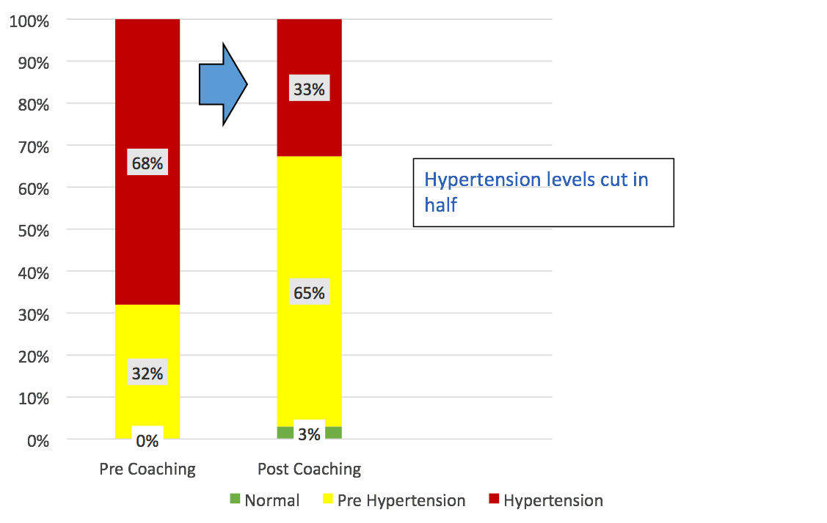
Change In Blood Pressure From Wellness Coaching
National Consortium for Credentialing Health & Wellness Coaches
Percent of People

Slide 42
Impact of Weight Loss By Coaching
Johns Hopkins/Kaiser Permanente/National Consortium: Coaching In Action
Twice as many patients lost weight in phone coaching –
almost as much as in person coaching

Slide 43
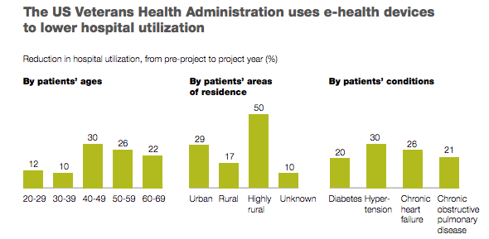
Percent Decrease In Hospital Admissions (VA)
McKinsey & Company Health International White Paper 2011
Seniors Had 22% Decline

Slide 44
Additional Results
Telemedicine: Promising Model for Senior Healthcare Agingcare.com
    Eliminated 387,000 trips to emergency room saving $327 million
    Eliminated 6.9 million transport trips to doctors saving $479 million
Trends in Telehealth NTT Data White Paper 2014 VA 2012
    53% fewer bed days; 30% fewer hospital admissions/readmissions
SWY Med 2015
    Reduced congestive heart failure patient admissions by 25%
    Would save US $10 billion
Brookings Institute
  How Mobile Devices Are Transforming Healthcare 2012
  Remote monitoring would save $197 billion in US over next 25 years

Slide 45
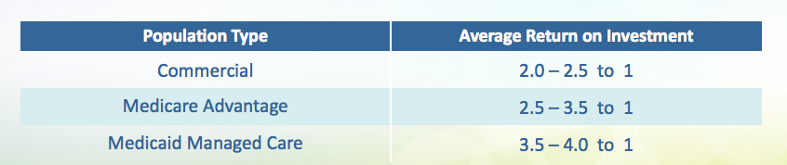
Return on Investment From Wellness Coaching
National Consortium for Credentialing Health & Wellness Coaches
Wellness Coaching is a Good Return

Slide 46
Other Issues

Slide 47
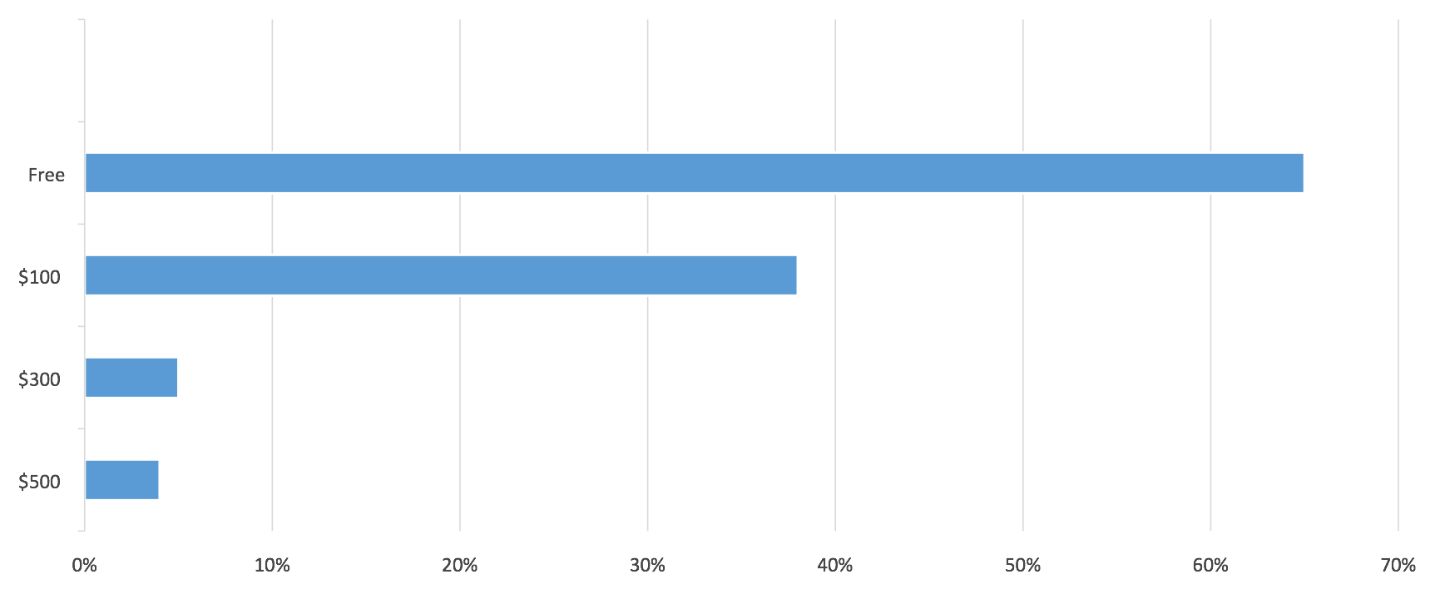
Likelihood of Purchasing Wearables by Price Point US
PWC 2014 Healthcare Wearables The Early Days
Less than $100 price point for wearable is key

Slide 48
Health Apps
Healthcare Information & Management Systems Society estimated that there are 100,000 mobile applications for health, fitness and medical
  Sold in over 60 application stores
  iHealthBeat January 21, 2014

Slide 49
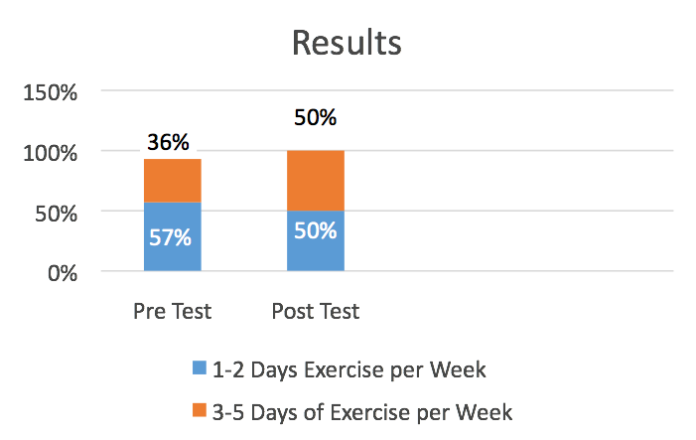
Senior “Communities” and Influencers Cited
Eskaton: Located in California with ten centers. They install sensors in assisted living centers to keep track of the client (not wander off), determine level of activity, and see if there could be UTI issues with frequent bathroom trips
Westchester and Pace University tested pilot programs using fitbits with seniors in the Carter Burden Center and the Kensington senior communities
  Students synched up units with each resident

Slide 50
Senior “Communities” and Influencers Cited
New Canaan Telehealth Program
  Two phases
    Phase One: 15 seniors
    Phase Two: 150 seniors
      Fitbit, digital scale, blood pressure/pulse monitor
      Vital signs sent to nurse
      Telehealth skype sessions with nurse
      Free to participant
    Results from 15 person phase
      73% lost weight
      53% reduced blood pressure
      Use caution in extrapolating results due to low sample base of patients

Slide 51
Senior “Communities” and Influencers Cited
Very few senior community centers identified in the secondary research
  Good Samaritan did not come up in all of secondary research review
AARP is doing pilot studies with groups on fitness trackers with seniors
  Findings: Senior wanted more comfortable, better sharing of information on goals that are important, more timely alerts, simple to set up, easy to maintain, more comfortable bands (for crepe skin condition), measure blood sugar and heart rate
    Requires a wearable device designed for seniors rather than forcing a current model on them
  Doing lots of joint research
  Just published 2016 Caregiving Innovation Frontiers Study

Slide 52
Summary/Conclusions/
Recommendations/Next Steps

Slide 53
Summary
The wearable market is poised for a large increase in sales both in total and the healthcare/fitness market from many reliable sources
  Medicare and FDA regulations could further explode market in healthcare
    Medicare believes remote monitoring will add cost not reduce overall cost
  Concern for privacy i.e. information being used by insurance companies
The usage rate for seniors 65+ using wearables in healthcare will jump from 3% in 2014 to 21% in 2019
The majority of users will wear a wrist device over other types of wearables

Slide 54
Summary continued
Seniors over 65 prefer a fitness tracker over a smart watch
  Fitness applications are heart rate, calories, blood pressure, steps and distance
  Falls and GPS also cited in literature
The market is fragmented, but Fitbit and Apple lead in the wrist wearable market
Minimal information found on senior communities using wearable fitness trackers

Slide 55
Summary continued
Wellness tracking/remote patient monitoring has many benefits
  Patients are healthier in glucose, weight management, congestive heart failure and other categories
  Leads to a higher quality of life
  Fits well with wanting to live in their own home as they age
Fewer admissions/re-admissions to hospitals, emergency rooms and doctor offices
  Billions of dollars in savings for patients and medicare
    Solution (technology and wellness tracking/coaching) has an opportunity to generate billions in costs savings – “bend the cost curve”
  Medicare acceptance is constraining the growth of this market
    Many grants/pilot programs being done by NIH (National Institute of Health)

Slide 56
Conclusions
The explosion in market growth for wearables for fitness applications and the lack of senior communities using them makes this an opportunistic time to position Good Samaritan as the technology leader for seniors
  Opportunity to be an early adopter which could mean market leader
  Good Public Relations benefit of helping seniors increase quality of life
Do you have the resources needed to execute a successful program?
  People and capital?
  Synchronize, train, and provide feedback to senior client base?
How does this initiative compare to others in terms of resources invested and return on investment?

Slide 57
Macro Issues
  Medicare is reluctant to cover as they feel this will add to costs not reduce overall healthcare costs
    Pilot studies by NIH to determine overall impact of cost
    When will Medicare embrace and authorize?
  Privacy concerns of the data: Who will have access to it? Insurance companies?
  Liability issues: If someone dies because the patient was not monitored correctly etc.
  Will there be a convergence of telemedicine and telehealth activity tracking functions i.e. glucose monitoring with activity tracking?
    Will that consolidate the number of devices?

Slide 58
Issues To Address
What are the best cost efficient ways to make the 65 plus market and other audiences aware of the technology?
  AARP has made Great Call (Jitterbug product) very well known in the community
  Public Relations campaign?
  Web site?
  Other?
How does the product get physically distributed? Amazon? Senior centers?
What is the process for setting it up and synchronizing the data?
  Fitbit is complicated and one of the complaints heard was that seniors needed help
  Do we need a portal for seniors and relatives to view (password)?
  Download reports and trends for family and doctors?

Slide 59
Issues To Address
How do the features and benefits get promoted to this audience?
  How do actual results get promoted to Medicare and insurance companies?
Why this is better than self tracking
Why this solution is worth $30 per month?
  When will Medicare pay this amount to save on total medical costs?
Prove the model works before making a huge fixed cost investment

Slide 60
Issues To Address
Will the selected partner remain viable in the market (the Lively example)
  Do they have the right financial resources for marketing and investment of research and development?
  Will their technology be relevant in the future?
  Will another player due to marketing/style take share from them in the market place (Apple iWatch vs. Fitbit)?
  Will they support this initiative to market to 65+? (Fitbit has an image of active people (mountain climbing etc.)
    Will they co-brand? Co market?
    Do they need a separate sub brand for senior audience and key influencers?

Slide 61
Appendix

Slide 62
Availability of Research Information
Topic | Availability of Information
Overall Wearable World Market
US Wearable Market
US Healthcare Market
US Healthcare for Seniors
US Tele-health for Seniors
US Fitness/Activity Tracking for Seniors
US Fitness/Telehealth for Seniors Aging in Place
Senior Communities Using Wearables
Lots of information
Some to little
information
Limited to no information

Slide 63
Syndicated Research Available
Organization | Report | Pros | Cons | Cost
ABI | Wearable Device Market share and Forecast 2015 | Lots of data Very strategic | Only 3 chapters on US Healthcare | $5000
Soreon Research | Wearables Disrupting Healthcare 2014 | Contains US Data and Healthcare | Based in Switzerland 10 person shop Not responsive | $1950
Mintel | Wearable Technology 2015 | Reputable firm | Only 200 65+ seniors talked to Can’t break out 65+ | $3995
Parks Associates | Wearable Products 2014 | Quoted by other sources/Several Reports | Only 2 chapters on Healthcare and Fitness | $3200
Global Industry Analysts | Assisted Living Technologies 2015 | Lots of data | One chapter US No healthcare/65+ | $4950
IDC | Customized Research | Solid well known co. | Not responsive | 5k to $8k

Slide 64
Syndicated Research Questions
Do you need additional information to make a decision to implement this initiative and develop a “Go-to-Market” strategy?
If the answer is yes, we would recommend purchasing Parks Associates report/reports
  They appear to be in tune with the needs of this market segment and give talks at conventions
  They work with the AARP in research for wearables for the senior market

