Slide 1
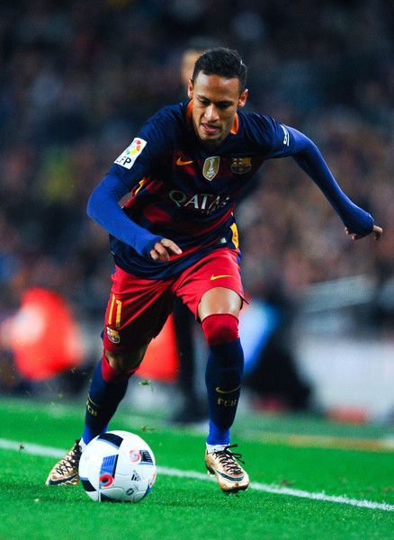
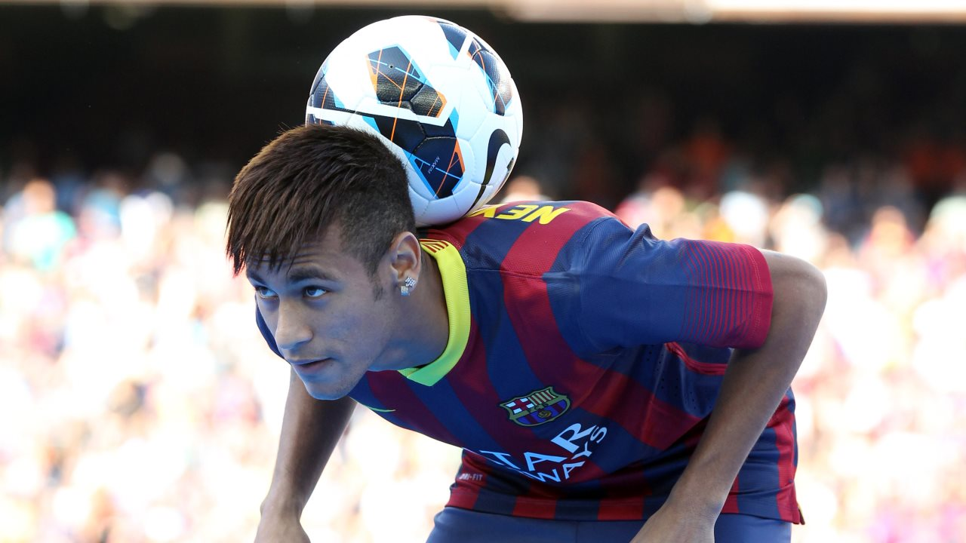
soccer PLAYER
the position I want is frontier the responsibilities play together the games

Slide 2

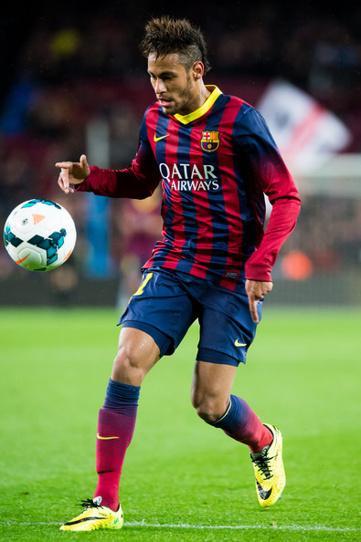

Work environment and condition
To surpass myself and to get to be a good player so that everyone would know I am

Slide 3



Education and training
In some countries you don’t need education to play soccer but you must be really good in order to play but in the U.S you must go to college in order to play in the big leagues and you must train every day

Slide 4

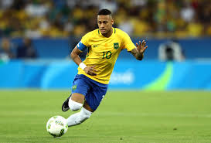

Opportunities for advancement
If I ever get to become a professional soccer my opportunity are that big clubs around the world can know my talent and if I ever get to play for a big club my opportunities are that my country will pick me to play with them

Slide 5



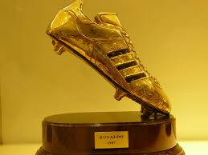

Salary and benefits
Beginning and lower-echelon players in Major League Soccer make a minimum of $35,125 a year, by far the lowest minimum salary of major professional team sports in America. As of the end of the 2013 season, 154 players made less than $50,000 a year. The average salary in the MLS, however, was $160,000, and the median salary was $100,000. About 45 percent of MLS players -- that's 249 -- made over $100,000.

Slide 6

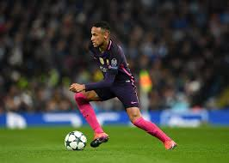
Aptitudes and values required
The natural abilities needed in order to become a soccer player is that most soccer players start playing when there little.
Values that are required in the sport is that you have to run fast have a good mind in order to play and have technique and the most import thing is your attitude you can be the greatest player

