Slide 1



Health IRL
What can we learn from social media?
Urmimala Sarkar, MD, MPH
Associate Professor
University of California, San Francisco
@UrmimalaSarkar

Slide 2
Roadmap
Brief introduction
Rationale: social media research to solve public health problems
Transdisciplinary collaboration
Case Study: Online Physician Ratings
Next steps

Slide 3

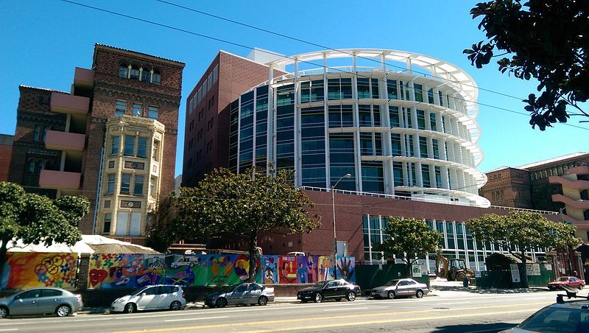


Slide 4
What we do
Applied research = “aims at finding a solution for an immediate problem facing a society, or an industrial/business organization, whereas fundamental research is mainly concerned with generalizations and with the formulation of a theory”¹
      I focus on evidence-based solutions for improving healthcare.
¹Kothari, C.R. (2008) “Research Methodology: Methods and Techniques” New Age International.

Slide 5
Areas of interest
Health behaviors
Patient safety
  Adverse medication events
  Missed and delayed diagnosis
Health information technology
  Who uses it?
  Does it improve health or health behavior?

Slide 6
Advantages of using social media
Provides immediate, real-time data
Minimal observation bias
Provides insights into health behaviors that are not usually shared in traditional methods of public health data collection
  “Behaviors that people might be reluctant to share with physicians are on full display on Twitter, including behaviors, opinions, and subpopulations that are otherwise difficult to track through traditional mechanisms, suggesting a whole new area of large-scale public-health research." (Dredze, 2012)
Dredze M. How social media will change public health. IEEE Intelligent Systems. July-Aug 2012, 27(4):81.84.

Slide 7
Uses of social media for public health
Promoting public health campaigns
Reporting real-time infectious disease trends
Recruitment of patients to online studies and clinical trials
“Contagion” of behavior via social media
Grajales FJ, Sheps S, Ho K, Novak-Lauscher H, Eysenbach G. Social Media: A Review and Tutorial of Applications in Medicine and Health Care. JMIR 2014 Feb 11;16(2):e13.
Cameron, A. M., Massie, A. B., Alexander, C. E., Stewart, B., Montgomery, R. A., Benavides, N. R., Fleming, G. D. and Segev, D. L. (2013), Social Media and Organ Donor Registration: The Facebook Effect. American Journal of Transplantation, 13: 2059–2065.

Slide 8
How can data from social media provide insight for public health?
Observational studies using social media data sources
Delivering cancer-relevant messages via online social media
Online social media interventions for cancer prevention behaviors

Slide 9
1. Observational studies using social media data source
Robust data source for behaviors that are difficult to characterize
Complements health data that is unavailable through traditional surveillance
Allows public health professionals to learn about public perceptions of prevention-relevant behaviors

Slide 10
1. Observational studies using social media data source
Examples
  Substance use¹
    Qualitative analysis showed various forms of opioid misuse on Twitter
  Body weight-associated stigma²
    Twitter and Facebook postings dominated by derogatory and misogynist sentiment, pointing to weight stigmatization
  Infectious disease surveillance³
    Using twitter messages to track influenza epidemic in real time
¹ Chan B, Lopez A, Sarkar U. The Canary in the Coal Mine Tweets: Social Media Reveals Public Perceptions of Non-Medical Use of Opioids. PLoS One. 2015;10(8):e0135072.
² Chou WY, Prestin A, Kunath S. Obesity in social media: a mixed methods analysis. Translational behavioral medicine. 2014;4(3):314-323.
³ Broniatowski DA, Paul MJ, Dredze M. National and local influenza surveillance through Twitter: an analysis of the 2012-13 influenza epidemic. PLOS One 2013 Dec 9;8(12) e83672

Slide 11
1. Observational studies using social media data source
Cervical cancer prevention discussions among young women on Twitter (Lyles, JCE, 2012)¹
    Women are willing to share publicly about their experiences with cervical cancer screening, encouraging peers to undergo screening as well
    User-generated health promotion messages useful for characterizing public sentiment and informing public health messaging content
¹ Lyles CR, López A, Pasick R, Sarkar U. "5 mins of uncomfyness is better than dealing with cancer 4 a lifetime": an exploratory qualitative analysis of cervical and breast cancer screening dialogue on Twitter.
J Cancer Educ. 2013 Mar;28(1):127-33. doi: 10.1007/s13187-012-0432-2.

Slide 12
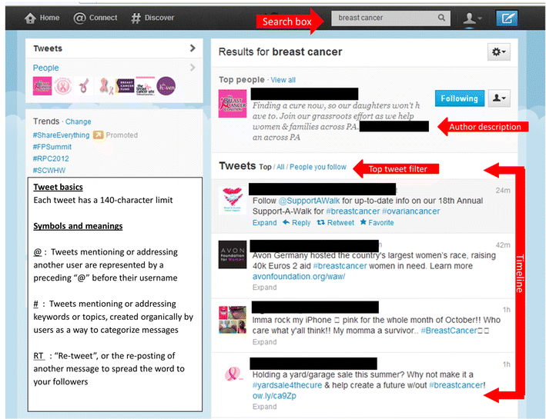
Studying social media

Slide 13
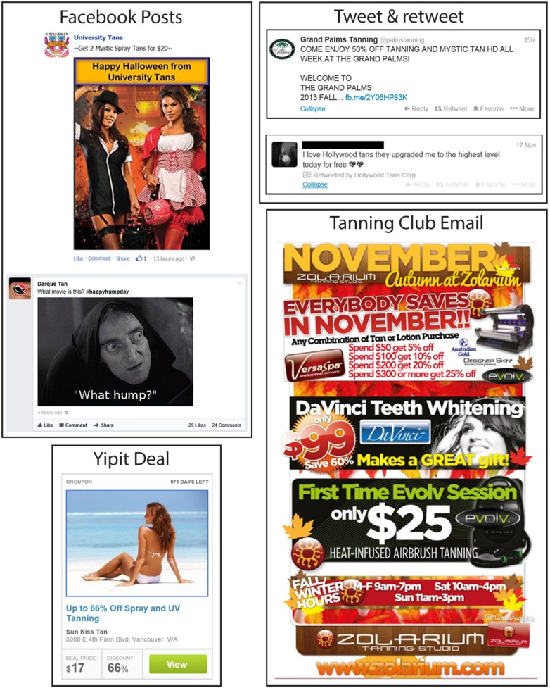
2. Delivering cancer-relevant messages via online social media
Social media = powerful advertising and marketing tool
Example: Indoor tanning industry’s use of social media as a strategy for maintaining relationships with customers and to offer pricing deals that promote high-frequency tanning¹
¹ Ricklefs CA, Asdigian NL, Kalra HL, et al. Indoor tanning promotions on social media in six US cities #UVTanning #tanning. Transl Behav Med. 2016;6(2):260-270.

Slide 14
2. Delivering cancer-relevant messages via online social media
  Skin cancer prevention example:
  Google AdWords to display skin cancer prevention messages on individuals’ search results page when users searched for tanning beds
    Messages displayed 200,000 times over 2 months
    Low-cost approach with significant reach
    ¹ Cidre Serrano W, Chren MM, Resneck JS, Jr., Aji NN, Pagoto S, Linos E. Online Advertising for Cancer Prevention: Google Ads and Tanning Beds. JAMA Dermatol. 2016;152(1):101-102.

Slide 15
3. Online social media interventions for cancer prevention behaviors
Social media = delivery platform for conducting intervention studies aimed at promoting health and wellness
Applied research using social media
We can harness the power of social media to solve public health problems
Efficient and cost-effective approach to reaching people where they are

Slide 16
3. Online social media interventions for cancer prevention behaviors
Example: The Tobacco Status Project (TSP)
  Facebook intervention for young adult smokers= messaging + peer-to-peer interaction + online counseling sessions + group cognitive-behavioral sessions
  72% follow-up rates and 18% rate of reported 7-day abstinence at 12 months (9% verified)
  High engagement with 92% participation over 3 months
  Results demonstrate that online social media platforms can be used to deliver behavioral interventions
    However, the content, mode of delivery, and network structure all require careful planning and evaluation

Slide 17
How transdisciplinary work happens:
Case Study

Slide 18
What Patients Say About Their Doctors Online: A Qualitative Content Analysis
Lopez A, Detz AL, Ratanawongsa NR, Sarkar U, Journal of General Internal
Medicine, 2012 June 27(6):685-692

Slide 19
Online physician ratings
Qualitative content analysis
N=712 online review from two rating websites
Purposive sample of 445 primary care doctors for 4 US urban regions (Atlanta, Chicago, NY, SF)
Data source: ratemds.com and Yelp

Slide 20
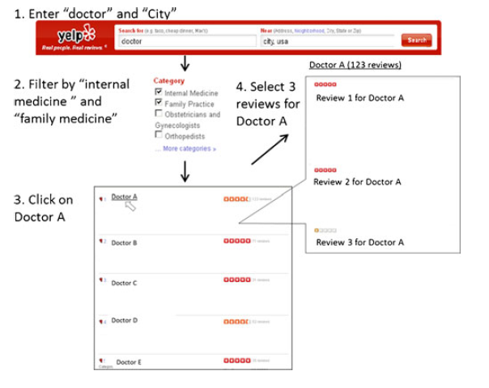
Methods

Slide 21
Examples
“Didn’t take me seriously when I knew something was wrong”
“Really listens and doesn’t watch the clock”
“Mis-prescribed a medicine I’ve been taking for years”
“I don’t have time to waste I will not go back”
“Makes embarrassing things not embarrassing”

Slide 22
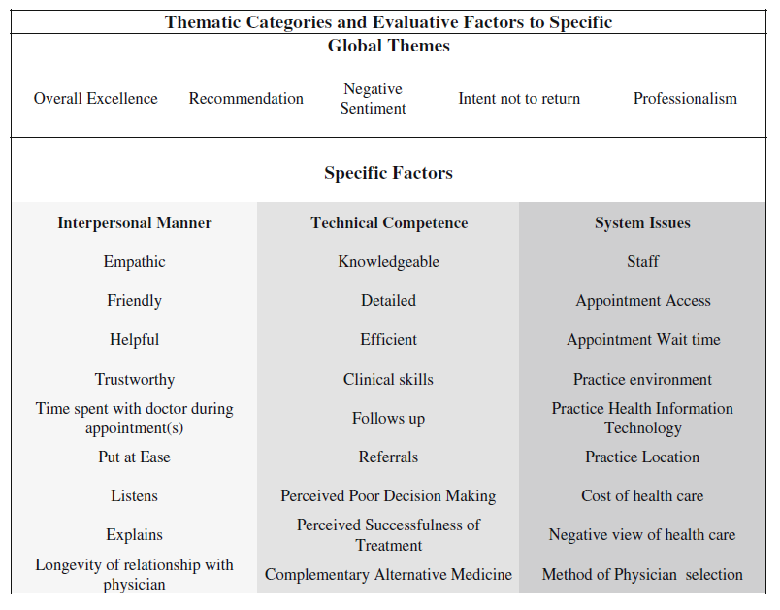
Results

Slide 23
Results and Conclusions
63% positive reviews recommending doctors
Global reviews vs. specific descriptions (e.g., interpersonal manners)
Specific reviews more positive than system-issues comments

Slide 24
Advancing the methodology using our data
Paul MJ, Wallace BC, Dredze M. What Affects Patient (Dis) satisfaction? Analyzing Online Doctor Ratings with a Joint Topic-Sentiment Model. AAAI Workshop on Expanding the Boundaries of Health Informatics Using AI (HIAI); 2013.
Main finding: using manually coded data compared to completely automated approaches performed better in identifying sentiment
Next step: do online ratings have any association with any real-life health outcome of interest?

Slide 25
A large-scale quantitative analysis of latent factors and sentiment in online doctor reviews
Wallace BC, Paul MJ, Sarkar U, Trikalinos TA, Dredze M.
A large-scale quantitative analysis of latent factors and sentiment in online doctor reviews. J Am Med Inform Assoc. 2014 Nov-Dec;21(6):1098-103. doi: 10.1136/amiajnl-2014-002711.

Slide 26

Methods
      Obtained data from RateMDs (http://ratemds.com)
        Platform for patients to review doctors across four dimensions of care: helpful, knowledge, staff, and punctual
        Scored on a Likert scale of 1 (low) to 5
      Sampled 58,110 reviews of 19,636 unique US doctors

Slide 27
Methods
      Analyzed a corpus of ~60 000 reviews Platform for patients to review doctors across four dimensions of care: helpful, knowledge, staff, and punctual
      Used state-of-the-art probabilistic model of text -- probabilistic generative model that captures latent sentiment across aspects of care (e.g., interpersonal manner)
      Performed regression analysis to assess whether model output improves correlation with state-level measures of healthcare

Slide 28
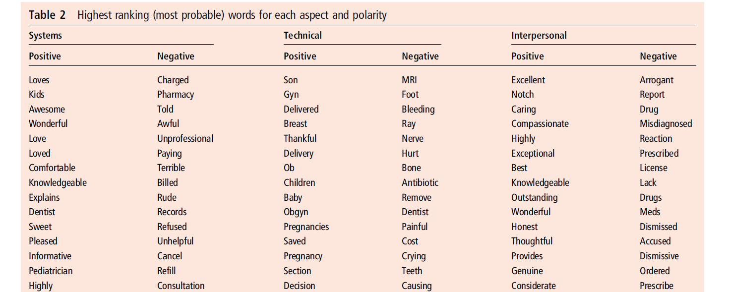
Results

Slide 29
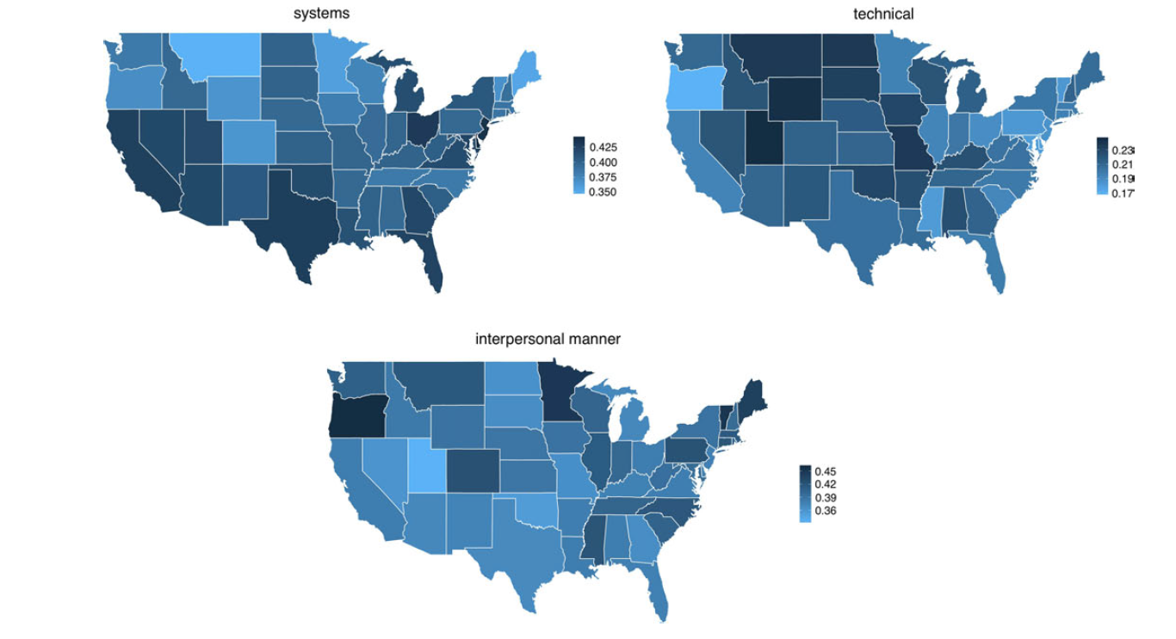
Results
Notes:
Blue= degree of positivity

Slide 30
Results
      Model output correlates with state-level measures of quality healthcare, including patient likelihood of visiting their primary care physician within 14 days of discharge (p=0.03), and using the proposed model better predicts this outcome (p=0.10)
      Similar results found for healthcare expenditures
      Main finding: Results showed that including f-LDA output in regression models improves correlations with state-level health outcome measures

Slide 31
Implications
      We each needed to conduct significant independent work before it could come together
      Potential of combining traditional qualitative analysis with large-scale quantitative modeling
      Ability to tie social media findings to real-world health outcomes requires collaboration
      Whole is greater than the sum of the parts

Slide 32
Opportunities for Collaboration
Much untapped potential for using applying social media research to public health problems
Demonstrated successful examples of transdisciplinary teamwork
Data / computer scientist provide unique expertise to solving public problems

Slide 33


Thank you

Slide 35
Implications
      Social media has the potential to:
        Provide insights into the types of misuse of opioids
        Aid public health efforts to reduce non-medical opioid use

Slide 36
Results
      375 (69%) tweets related to opioid behaviors
      316 (84%) originated from individual user accounts
      125 messages expressed personal experience with opioids
      Majority of personal messages referenced using opioids to obtain a "high", use for sleep, or other non-intended use

Slide 37
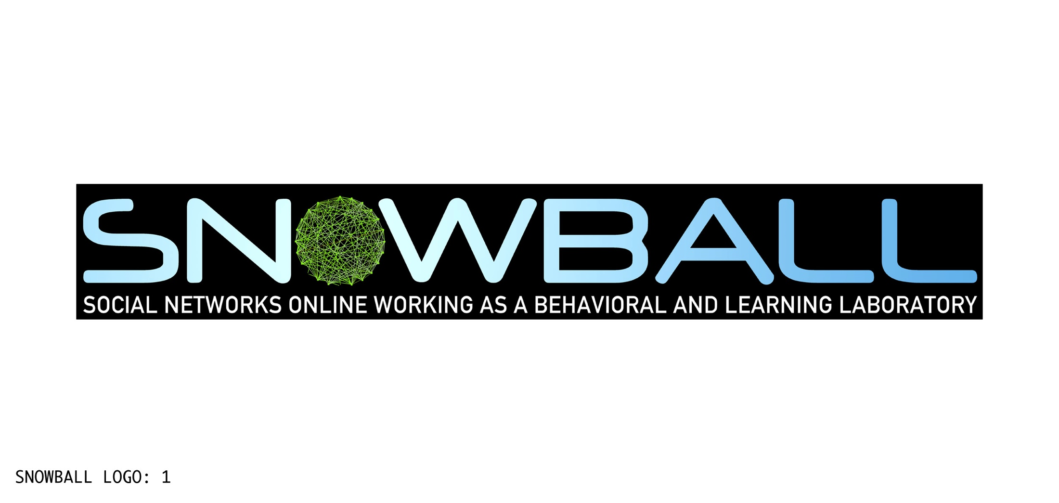


  Influencing cervical cancer prevention and detection online through social media
  National Cancer Institute R01CA178875 (Co-PIs: Sarkar & Centola)

Slide 38
Study Goal
Use a mixed-methods approach to online social media and social networks for enhancing understanding of cervical cancer screening to optimize the spread of health messages and behaviors within online social networks

Slide 39
SNOWBALL Team
Multi-disciplinary Team:
Urmimala Sarkar, MD, MPH: Lead PI
Damon Centola, PhD (UPenn): Co-PI, sociologist, social networking research
Byron Wallace, PhD (Northeastern University): computer scientist, machine learning methods
George Sawaya, MD (UCSF): obstetrics/gynecology, cervical cancer expertise
Rena Pasick, DrPH (UCSF): behavioral and qualitative research
Courtney Lyles, PhD (UCSF): health services research
Gem Le, PhD, MHS (UCSF): project manager, social epidemiology, cancer prevention

Slide 40
Specific Aims
Aim 1: To use machine learning techniques (i.e., large-scale computer algorithms) to identify and rank the key words related to cervical cancer screening and HPV vaccination in social media messages.
Aim 2: To categorize and validate the range of cervical cancer screening and HPV vaccination discussion on social media.
Aim 3: To create cervical cancer screening and HPV vaccination messages for social media and evaluate their effectiveness for increasing diffusion through online social networks.

Slide 41
Cervical Cancer Epidemiology
12,109 new cases of cervical cancer per year¹
Disparities by race/ ethnicity/ education¹
  Hispanic women have highest rates
  Women with < high school education have lowest rates of screening
19% of adolescent girls (ages 12-17) and 11% (ages 18-27) initiated HPV vaccination in 2007²
Ongoing need to bolster screening and prevention efforts
¹ CDC, http://www.cdc.gov/cancer/cervical/statistics/
² Tiro JA, Tsui J, Bauer HM, Yamada E, Kobrin S, Breen N. Journal of Women's Health. June 2012, 21(6): 656-665.

Slide 42
Tweeting about Pap Smears
“5 minutes of uncomfyness is better than cancer 4 a lifetime”
“Guys encourage your mothers, sisters, wives girlfriends 13 to have regular pap smear. Also encourage them to get the vaccine.”
“Took the afternoon off so I could get a pap smear and my car could get an oil change. :-/”
Lyles CR, Lopez A, Pasick R, Sarkar U. "5 mins of uncomfyness is better than dealing with cancer 4 a lifetime": an exploratory qualitative analysis of cervical and breast cancer screening dialogue on Twitter. Journal of Cancer Education. 2013;28(1):127-33.

Slide 43
SNOWBALL Data & Methods
Aim 1 work:
119,428,139 Twitter messages obtained from March 2014 (1% sample from all of Twitter)
Filtered messages matching our keywords of interest (e.g., pap smear, HPV, papillomavirus, pap test, cervical, cervix, cervical cancer, papanicolau, squamous, smear test, dysplasia)
Applied Sparse Principal Components Analysis (SPCA) to identify clusters of keywords that are mathematically grouped into topics

Slide 44
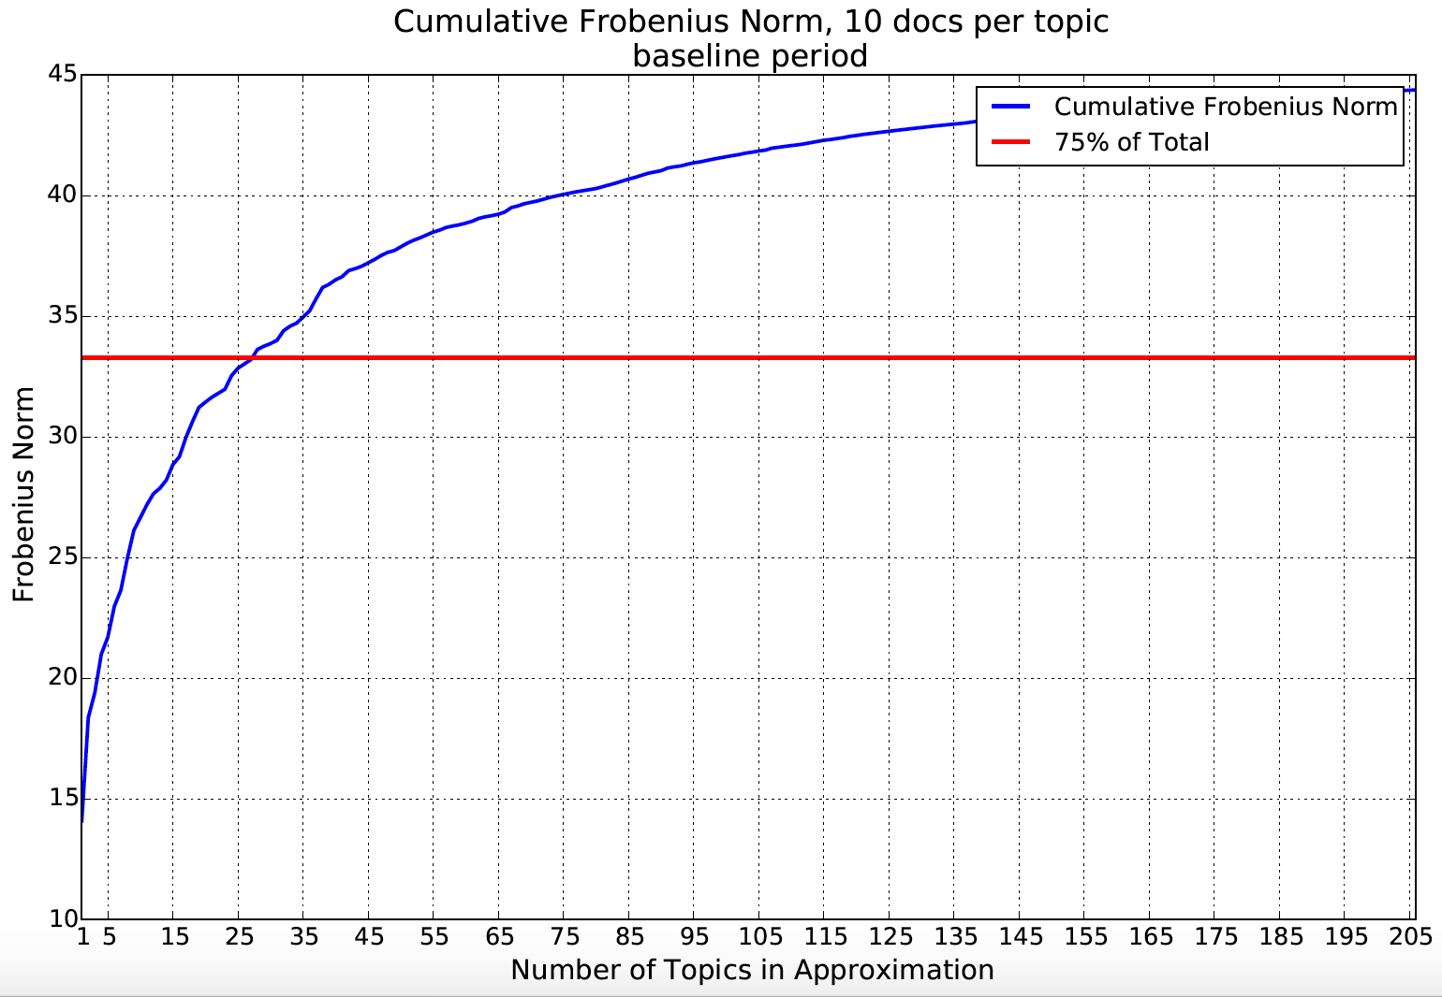

Slide 45
Tweets for One Topic
CBC News HPV Vaccine Funding Cut by Canadian Province; polyDNA Recommends that Canadian Doctors Learn About... http://t.co/QSn8Urev73
RT @gogreen18: the anti-vaccine movement scares the crap out of me. i have paranoid family members now opting out of HPV vaccines for theiƒ_Ý
Study: HPV vaccine working - The Human Papillomavirus vaccine has reduced the frequency of abnormal Pap smears and…http://t.co/X7bF0I8sYW
@positivegp is HPV vaccine only for girls/women? The lady mentioned genital warts on the penis as well, do men get vaccine?
Another Success for HPV Vaccine http://t.co/DEgvZIYyFb
.@CherylMHolmes on province set to stop funding HPV vaccine for some women: http://t.co/QVEjwlpSYB
RT @CherylMHolmes: Manitoba to cut free HPV vaccine program for young women on April 1. Are you worried about getting your shots?
#googlenews One dose of HPV vaccine may prevent cervical cancer - New Straits Times http://t.co/StYww0Cijl
RT @Rwanda_Post: Vaccine for Cervical Cancer Coming to Rwanda - http://t.co/sLWCpoqWLe #Rwanda #RWoT
@RTH2039: BMJ Press Release:HPV vaccine provides significant protection against cervical abnormalities http://t.co/t1nWLuIGzP @JulieLeask

Slide 46
Caveats in analyzing social media data
Socio-demographic characteristics
Subject to selection bias
Twitter users more likely to be young and non-white
Social media data viewed as MORE than “big data”
  Big data refer to very large datasets that can be analyzed or mined quantitatively to explore human behaviors and interactions
  Analysis of social media data need to incorporate mixed methods
    Should not rely on automated analysis alone (e.g., machine learning methods) for meaning analysis and interpretation of the data

Slide 47
Next steps
Identify impactful messages
Classify manually
Sample for experiment
Experiment
  Expose women to messages on experimental network
  Outcomes of message contagion
  Behavioral expectations (do they now plan to get Pap smear or vaccination?)

Slide 48
:
Social Media Perceptions of
Non-Medical Use of Opioids
Chan B, Lopez A, Sarkar U. The Canary in the Coal Mine Tweets: Social Media Reveals Public Perceptions of Non-Medical Use of Opioids. PLoS One. 2015;10(8):e0135072.

Slide 49
Misuse of Opioids
      Non-medical prescription opioid use is a growing public health concern
      Prescriptions for opioid medications doubled between 1994 and 2007
      Opioid prescription related deaths (14,800) made up 73.8% of the 20,044 prescriptions drug overdose deaths in 2008
      Social media can shed light on health attitudes, beliefs, and behaviors

Slide 50
Study Overview
      Exploratory, mixed-methods analysis of Twitter messages to characterize the nature of the content relating to opioid medications
      Described who uses social media to discuss opioid use or misuse, and what attitudes, themes, and behaviors social media users message about
      Hypothesis: Anonymity of social media allowed for more candid discussion of opioid misuse and abuse behaviors

Slide 51
Methods
      Cross-sectional sample of publicly available Twitter messages during a 2 week period in March and early April 2014
      Manually searched Twitter messages using the following search terms: 1) Duragesic, 2) Fentanyl 3) Hydrocodone, 4) Hydros, 5) Oxy, 6) Oxycodone, 7) Oxycotin, 8) Oxycotton, 9) Vicodin, 10) Vikes, and 11) Oxycontin
      N = 540 tweets

Slide 52
Analysis
      Conducted content analysis to code each Twitter message
      Developed codes deductively using commonly accepted definitions of prescription drug abuse and aberrancy behaviors, an existing opioid misuse tool, the Current Opioid Misuse Measure (COMM)
      Developed codes inductively, through a grounded theory approach, as additional themes arose not captured by existing thematic coding schemes

