Slide 1


AI-driven Approaches to
Data Integration for Deep Inference
John H. Holmes, PhD
University of Pennsylvania Perelman School of Medicine
Institute for Biomedical Informatics
Center for Clinical Epidemiology and Biostatistics

Slide 2
Outline for today
Background
Characteristics of biomedical data
Current practice in biomedical data integration
Electronic phenotyping as an approach to integration
Methods for integration through phenotyping
Discussion of opportunities and challenges

Slide 3
Background
Biomedical data comes from many sources
Biomedical data consists of many types
In order to get as full a picture of a biomedical phenomenon, data from many sources and of many types must be integrated for analysis and inference

Slide 4
Sources of biomedical data
Electronic medical records
Medical specialty systems
Spontaneous reporting systems
Patient portals
Social media
Environmental monitoring systems
Research studies
…

Slide 5
Types of biomedical data
Molecular and genomic data
Images
Structured clinical data
Unstructured clinical data
Self-reported data
Environmental data
…
Thus: highly heterogeneous, potentially difficult to obtain, and demanding of novel data management and analytic strategies

Slide 6
Challenges of biomedical data
Missingness
Secondary use
Availability
Privacy and confidentiality constraints
Heterogeneity

Slide 7
Current approaches in biomedical data integration
Just don’t do it- it’s too hard
Try it, but be willing to accept a noisy result
Implement and apply a common data model
Implement and apply ontologic middleware

Slide 8
An emerging approach:
Electronic Phenotyping

Slide 9
An emerging approach:
Electronic phenotyping
Using the EMR and any other machine-readable data to characterize an individual’s medical condition

Slide 10
How are phenotypes used?
Cohort identification
Clinical research studies
Surveillance
Administrative purposes
Proposed here: Data Integration

Slide 11
Prominent Electronic Phenotyping Initiatives
CICTR
  Cross Institutional Translational Research project
SHARP
  Strategic Health IT Advanced Research Projects
eMERGE
  Electronic Medical Records and Genomics network

Slide 12
The eMERGE network phenotyping initiative
https://phekb.org
https://phekb.org/phenotypes

Slide 13
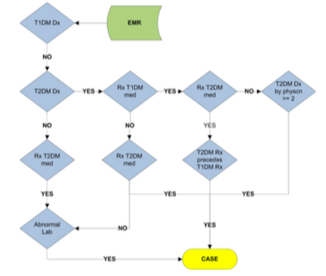
Phenotype algorithm for Type 2 Diabetes https://phekb.org/sites/phenotype/files/T2DM-algorithm.pdf

Slide 14
Biomedical Informatics Approaches to Phenotyping
Molecular
Epigenetics
Proteomics
Metabolomics
RNA-seq
MicroRNA
Endothelial progenitor cells
Wearables
Physical Activity
Geolocation
Sleep
Informatics Tools
Data acquisition
EHR data
Pulmonary vascular function
Drugs
Procedures
Diagnoses
Self-report modalities
Mobility
Cognition
Affective state
Social support
Social integration
Behaviors
Data Integration
Syntactic harmonization
Semantic harmonization
Data warehousing
Imaging
Cardiac MRI
Echo
Knowledge Discovery Analytics
Statistical methods
Machine learning methods
Natural language processing
Visualization methods
Built Environment
Housing
Neighborhood
Geolocation
In-home monitoring
Pulmonary vascular function
Other biomarkers
Deep Phenotype

Slide 15
Biomedical Informatics Approaches to Phenotyping
Molecular
Epigenetics
Proteomics
Metabolomics
RNA-seq
MicroRNA
Endothelial progenitor cells
Wearables
Physical Activity
Geolocation
Sleep
Informatics Tools
Data acquisition
EHR data
Pulmonary vascular function
Drugs
Procedures
Diagnoses
Self-report modalities
Mobility
Cognition
Affective state
Social support
Social integration
Behaviors
Data Integration
Syntactic harmonization
Semantic harmonization
Data warehousing
Imaging
Cardiac MRI
Echo
Knowledge Discovery Analytics
Statistical methods
Machine learning methods
Natural language processing
Visualization methods
Built Environment
Housing
Neighborhood
Geolocation
In-home monitoring
Pulmonary vascular function
Other biomarkers
Deep Phenotype

Slide 16
Data Acquisition Considerations
Information extraction
  Query development and application
Ontology
  Table and variable definition
  Variable standardization
Data integrity
  Range and logic checks
  Missing value characterization
Imputation (yes or no?)
Variable transformation
Identification of spurious relationships
  Association rule mining
  Visual data checks

Slide 17
Data Acquisition Methods
Feature selection
  Decision trees
  Correlational feature selection
  Stepwise methods
  Metaheuristic methods
Structure learning
  Directed Acyclic Graphs
  Bayesian networks
Expert input and validation!!!!

Slide 18
O₂
Blood
Physiology
Insulin/Glucagon secretion
Ca²⁺⁺ imaging
Electrophysiology
Islets
Single-cell RNAseq
RNAseq
α
β
δ
Organ Donor
T1D
Pre-T1D
Age-matched
Mol.
Pheno
Cells
ATACseq
Sort
Pancreas
CytoF
Methylome
mPOD
Case Study 1:
Pancreas characterization in diabetes mellitus
Co-PI: Ali Naji, MD and Klaus Kaestner, PhD
Tissue
FFPE
Lymph nodes
Cryo→2D CytoF
Patient info

Slide 19
Biomedical Informatics Approaches to Phenotyping
Molecular
Epigenetics
Proteomics
Metabolomics
RNA-seq
MicroRNA
Endothelial progenitor cells
Wearables
Physical Activity
Geolocation
Sleep
Informatics Tools
Data acquisition
EHR data
Pulmonary vascular function
Drugs
Procedures
Diagnoses
Self-report modalities
Mobility
Cognition
Affective state
Social support
Social integration
Behaviors
Data Integration
Syntactic harmonization
Semantic harmonization
Data warehousing
Imaging
Cardiac MRI
Echo
Knowledge Discovery Analytics
Statistical methods
Machine learning methods
Natural language processing
Visualization methods
Built Environment
Housing
Neighborhood
Geolocation
In-home monitoring
Pulmonary vascular function
Other biomarkers
Deep Phenotype

Slide 20
Challenges for Phenotyping and
Data Integration
Syntactic heterogeneity
  Different coding schemes
  Different variable names
Semantic heterogeneity
  Coding schemes mean different things
  Seemingly similar variables captured different concepts
“Big”
  Special storage and curation needs → warehousing

Slide 21
Addressing Heterogeneity:
Ontology Construction

Slide 22
Case study 2:
Clinical trial data integration
Cardiovascular Research and Education Foundation (CMREF)
PI: Steven Kawut, MD, MSCE
30 clinical trials of drugs used to treat pulmonary arterial hypertension
Goal
  Integrate all 30 trials into a single analytic dataset
Rationale
  Analysis of a single dataset → metanalysis
Problem
  30 different clinical trials!
  The clinical trial ontologies alone aren’t suitable

Slide 23
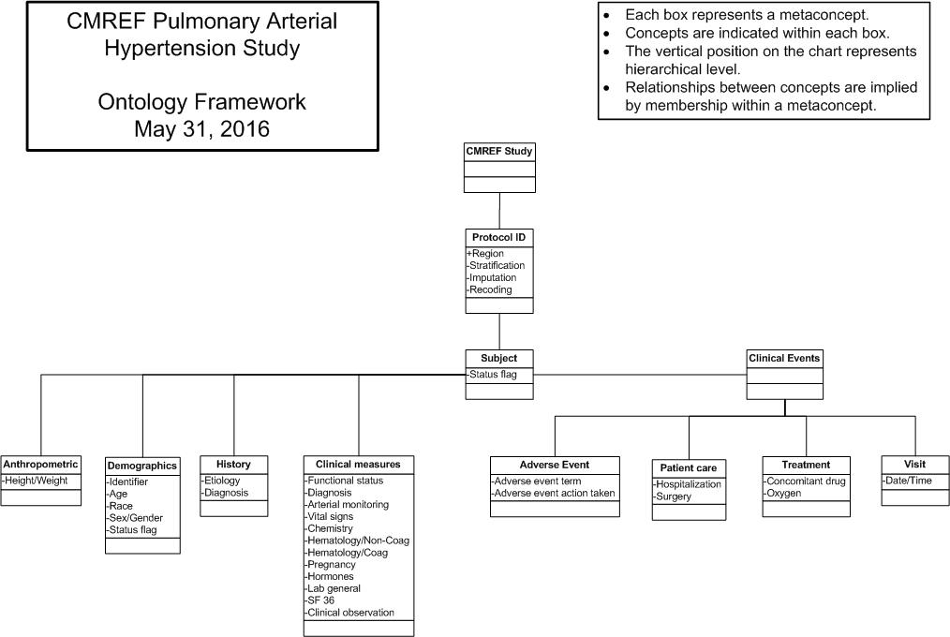
CMREF PAH RCT study ontology

Slide 24
Biomedical Informatics Approaches to Phenotyping
Molecular
Epigenetics
Proteomics
Metabolomics
RNA-seq
MicroRNA
Endothelial progenitor cells
Wearables
Physical Activity
Geolocation
Sleep
Informatics Tools
Data acquisition
EHR data
Pulmonary vascular function
Drugs
Procedures
Diagnoses
Self-report modalities
Mobility
Cognition
Affective state
Social support
Social integration
Behaviors
Data Integration
Syntactic harmonization
Semantic harmonization
Data warehousing
Imaging
Cardiac MRI
Echo
Knowledge Discovery Analytics
Statistical methods
Machine learning methods
Natural language processing
Visualization methods
Built Environment
Housing
Neighborhood
Geolocation
In-home monitoring
Pulmonary vascular function
Other biomarkers
Deep Phenotype

Slide 25
Analytics for Electronic Phenotyping
Shivade C, et al.: J Am Med Inform Assoc. 2014 Mar; 21(2): 221–230.
Rule-based systems
  Expert-derived rules or opinions
  Guidelines
  Automatically-generated rules
Natural Language Processing
  Term extraction
  Keywords
  Semantic web
Machine learning
Hybrid approaches

Slide 26
Phenotype discovery:
Structured data
Supervised methods
  Association rule mining
  Statistical classifiers
  SVMs, HMMs, Naïve Bayes
  Evolutionary computation
Unsupervised methods
  Clustering
  Visualization

Slide 27
Phenotype discovery: Text
Sources
  Clinical notes and reports
  Patient self-reports
  Social media
Methods
  Information extraction
  Keyword retrieval
  Topic modeling
  Sentiment Analysis

Slide 28
Phenotype discovery: Images
Sources
  Pathologic images
  Radiologic images
  Photographs
Methods
  Feature definition and assignment (tagging)
  Feature extraction
  Clustering methods
  Expert validation

Slide 29
Phenotype discovery: Environmental data
Sources
  Wearable devices
  Neighborhood data
  Housing characteristics
  Weather data
Methods
  Time series analysis
  Continuous-time Bayesian methods
  Deep learning

Slide 30
How are phenotypes validated?
“Complicated phenotypes”
  Manual review of clinical data
Quantitative phenotypes
  Accept structured data as valid
All phenotypes
  Inspect for outliers, logical inconsistencies, and missing data

Slide 31
Some complications for validation
Clinical data are temporal!
  Within-patient changes
  Changes to guidelines
  New therapies (especially drugs and devices)
Nomenclatures and taxonomies change
  ICD-9-CM → ICD-10 -> ICD-11 (?)
  SNOMED inconsistencies
Unstructured data highly qualitative

Slide 32
Case Study 3
Tools for using the Penn Biobank
The Ontology for Biobanking as Semantic Framework for Querying Biobank Data Within and Across Institutions
David Birtwell, MScEng
Director of Informatics, Penn Medicine BioBank

Slide 33
Penn Medicine Biobank: Goals
The Penn Medicine BioBank (PMBB) informatics team is exploring ontologies and graph databases as a solution to allow medical investigators to perform deep searches over BioBank donor phenotypic data.
Phenotypic data are exceedingly complex and typically stored in multiple independent data sources.
Traditional relational database technology lacks the expressivity and flexibility required for the representation of phenotypic data.
A high level of domain knowledge is required to effectively search over phenotypic data.
Notes:
In order for the specimens in the Penn Medicine Biobank (PMBB) to be useful to the research community, investigators must have a mechanism to find specimens of interest by searching the phenotypic information pertaining to the specimen donors.

Slide 34
Obtaining matched case/control cohorts
Query: Generate lists of potential cases and potential controls for given criteria.
Cases are patients with Type 2 diabetes that have taken a particular prescription statin on or around the time of recruitment/specimen collection and have an EDTA specimen available.
Controls have Type 2 diabetes and have no history of taking statins in any form and must have an EDTA specimen available. Controls are matched by gender, age at recruitment, and body mass index to the cases selected.
Non-trivial because it requires ad-hoc integration across medical records, prescription orders, case report forms, and specimen inventories.
Notes:
This competency question is based on an actual request from a researcher and follows a common pattern.

Slide 35
Creating an RDF Search System
1
?
?
?
?
?
4
Semantic Modelling
OBI
DRON
DOID
Application Ontology
Querying and Testing
2
R2ML
RDF Conversion
Software
RDF
3
R2RML
RDF Conversion
Software
RDF
Graph Database
Relational
Data
Data Mapping and Instantiation
OBIB
Ontology for Biobanking
DOID
Disease Ontology
DRON
Drug Ontology
Domain Knowledge Linking

Slide 36
Creating an RDF Search System: Step 1
1
?
?
?
?
?
4
With the help of local domain experts, OBO¹ Ontology experts generate an ontology model usin g OBIB that includes the portions of OBO ontologies relevant to the data sources.
OBI
DRON
DOID
Application Ontology
Querying and Testing
2
R2ML
RDF Conversion
Software
RDF
3
R2RML
RDF Conversion
Software
RDF
Graph Database
Relational
Data
Data Mapping and Instantiation
OBIB
Ontology for Biobanking
DOID
Disease Ontology
DRON
Drug Ontology
Domain Knowledge Linking

Slide 37
Creating an RDF Search System: Step 2
1
?
?
?
?
?
4
Semantic Modelling
OBI
DRON
DOID
Application Ontology
Querying and Testing
2
R2ML
RDF Conversion
Software
RDF
3
R2RML
RDF Conversion
Software
RDF
Graph Database
Relational
Data
For each data source, local data experts reference the ontology model to create an R2RML² file to map the relational data and their domain knowledge to a graph format. They instantiate the OBIB model reflecting the naming convention they used for data instances that might be shared among other data sources.
An RDF conversion tool uses the mapping file and the relational data to generate RDF triples.
OBIB
Ontology for Biobanking
DOID
Disease Ontology
DRON
Drug Ontology
Domain Knowledge Linking

Slide 38
Creating an RDF Search System: Step 3
1
?
?
?
?
?
4
Semantic Modelling
OBI
DRON
DOID
Application Ontology
Querying and Testing
2
R2ML
RDF Conversion
Software
RDF
3
R2RML
RDF Conversion
Software
RDF
Graph Database
Relational
Data
Data Mapping and Instantiation
OBIB
Ontology for Biobanking
DOID
Disease Ontology
DRON
Drug Ontology
The RDF data and any relevant OBO Ontologies are loaded into a graph database.
Data from the separate data sources are now related in accordance with the expert's domain knowledge via the ontologies.

Slide 39
Creating an RDF Search System: Step 4
1
?
?
?
?
?
4
Semantic Modelling
OBI
DRON
DOID
Application Ontology
Queries can be performed over the graph database by referencing the OBIB model.
No specific knowledge about the structure or format of the original data is necessary.
Any domain knowledge, standards conversions (i.e.SNOMED, ICD) or scientific knowledge in the OBO Ontologies is available to be queried and reasoned over, even if not in the original data sources.
2
R2ML
RDF Conversion
Software
RDF
3
R2RML
RDF Conversion
Software
RDF
Graph Database
Relational
Data
Data Mapping and Instantiation
OBIB
Ontology for Biobanking
DOID
Disease Ontology
DRON
Drug Ontology
Domain Knowledge Linking

Slide 40
Results: Overview
We were able to answer the competency question via an RDF search system as effectively as we were with a relational database.
We were able to capture our full biobank data set in all its complexity in the instantiated RDF data.
We had great success instantiating and linking with the domain knowledge encoded in OBIB, but limited success linking with a disease ontology due to limited coverage of ICD-9.
Adding a new data source is a relatively simple matter of generating the RDF data and loading them into the graph database.
Performance seems to be commensurate with that of a relational database.
After climbing the learning curve, implementation costs seem similar to a relational database.

Slide 41
Challenges and Opportunities for Data Integration through Electronic Phenotyping

Slide 42
Challenges encountered in electronic phenotyping
Availability of data
Data used for phenotyping are often temporal
Syntactic and semantic interoperability
Privacy and confidentiality
Phenotype interpretation

Slide 43
Opportunities for electronic phenotyping
Integration of more types of data sources
Real-time surveillance and cohort definition
Better integration of NLP
Decision support for clinicians
  “Patients like you” and “Patients like mine”
Decision support for researchers
  Intelligent cohort identification processes and workflows

Slide 44
Why use phenotyping as a means of data integration?

Slide 45
Knowledge,
Not Just Data Integration!!
Integration of findings with statistical analysis
  Statistical methodologists
Integration of findings with evidence
  Domain experts
Overall integration and development of final models
  Domain experts
  Statistical and informatics methodologists

Slide 46
Discussion

