Slide 1
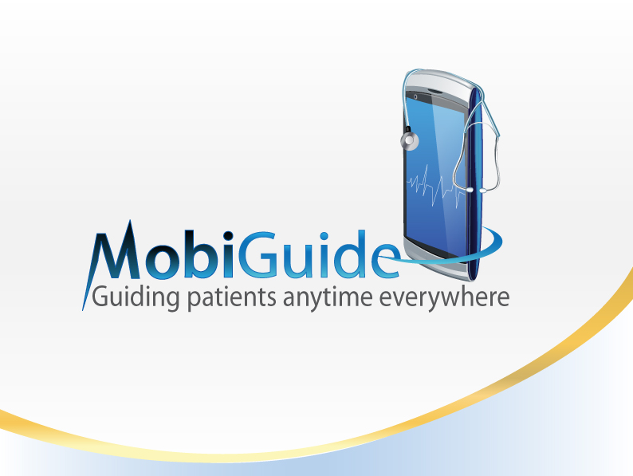
Engaging patients in their health care:
experiences from the MobiGuide Project
Mor Peleg
Dept. of Information Systems, University of Haifa
W3PHIAI workshop, February 5, 2017
Notes:
What Makes a Patient-centered Decision-support System Effective? Results and Lessons Learned from the MobiGuide Project

Slide 2
Outline
About MobiGuide
Personalization in MobiGuide
Patient engagement: participation and awareness
Evaluation of usage by patients and clinicians
Evaluation of compliance by patients and clinicians
Future opportunities to enhance the patient experience and involvement

Slide 3

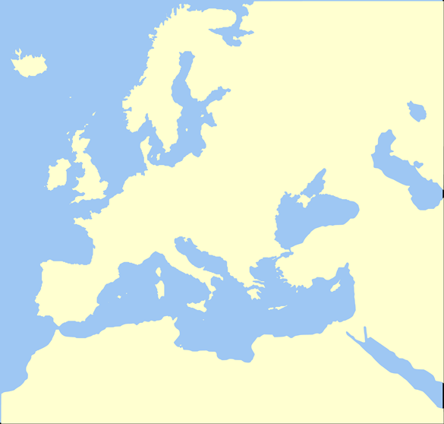













MobiGuide Consortium
UNIVERSITY OF HAIFA (HU), Israel
BEN-GURION UNIVERSITY OF THE NEGEV (BGU), Israel
UNIVERSITA DEGLI STUDI DI PAVIA (UNIPV), Italy
UNIVERSITEIT TWENTE (UT), Netherlands
TECHNISCHE UNIVERSITAET WIEN (TUV), Austria
MOBIHEALTH BV (MHBV), Netherlands
FONDAZIONE SALVATORE MAUGERI CLINICA DEL LAVORO E DELLA RIABILITAZIONE (FSM), Italy
UNIVERSIDAD POLITECNICA DE MADRID (UPM), Spain
CORPORACIO SANITARIA PARC TAULI DE SABADELL (CSPT), Spain
ATOS SPAIN SA (ATOS), Spain
BEACON TECH LTD (BTL), Israel
ZorgGemak BV (ZORG), Netherlands
ASSOCIACIO DE DIABETICS DE CATALUNYA (ADC), Spain

Slide 4
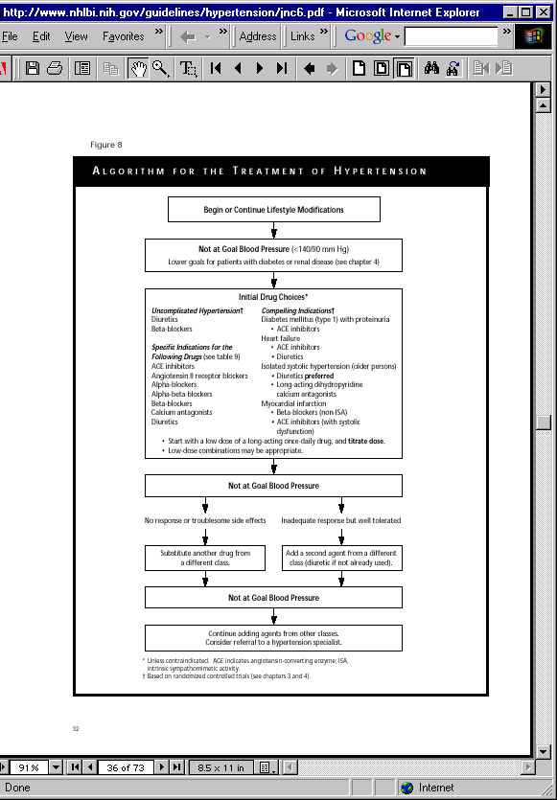
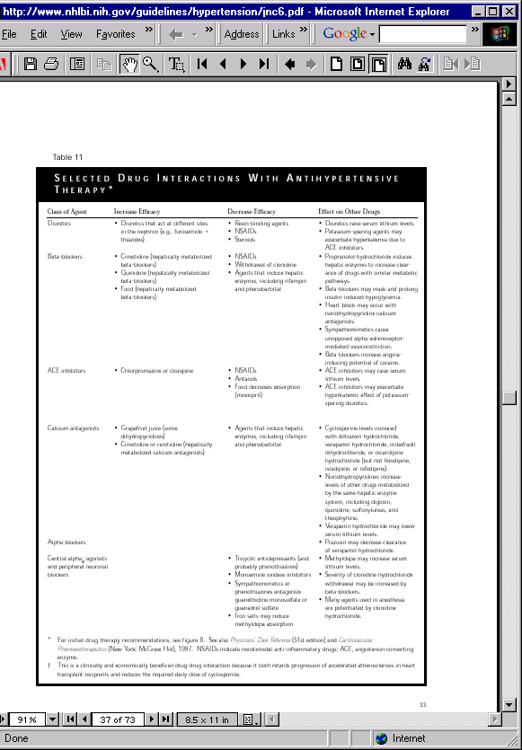
Evidence-based clinical guidelines
Computer-interpretable guidelines (CIGs)
Literature Review
Consensus Process
Evidence Evaluation
Guideline Creation,
Review, and Approval
Guideline Publication
(article or monograph)
Assume: Health care will benefit
Guideline Dissemination
Assume: Practitioners will internalize and thereby follow the guideline
Assume: Practitioners will read the guideline

Slide 5

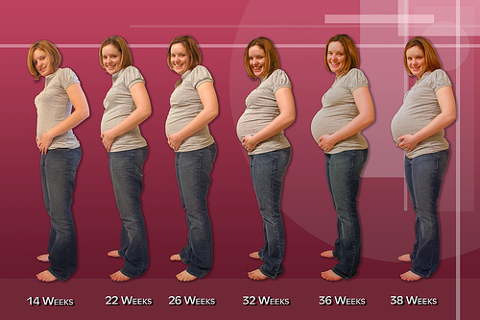
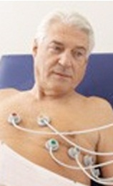

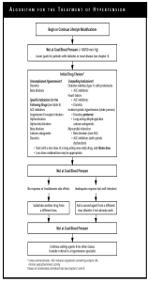
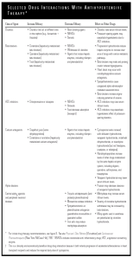

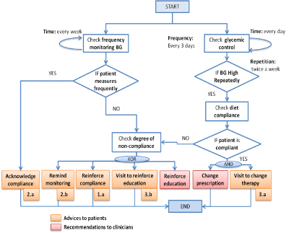
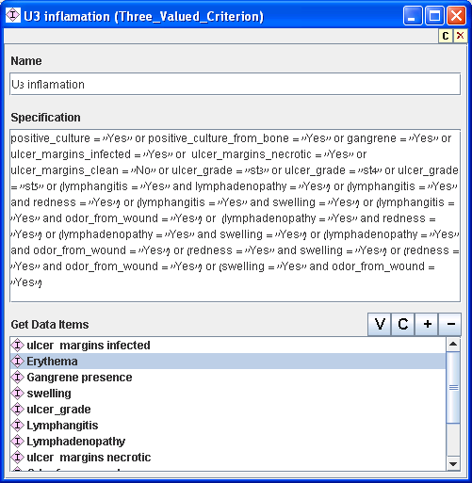


Guideline-based DSSs
: any time everywhere
What do patients want?
AI
BAN
Projection
&callback
DSS
Personalized
Data Analysis
PHR
EMR1
EMR2
Knowledge base of
Computer-interpretable guidelines (CIG)
(Parallel GLs)
5
Notes:
What do patients want?
The name MG

Slide 6

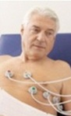

Generic architecture
-Person-
Knowledge engineering team
-Person-
Patients
-Person-
Caregivers
-Person-
System
Support team
-Person-
Researchers
User Interfacing
Patient Data
Acquisition (BAN)
Security &
Administration
Decision Support
Overall Data Collection
And Storage (PHR)
LB
DSS
Backend
DSS
Knowledge Collection
& Storage
-system-
EMRs
Notes:
Take my time here

Slide 7
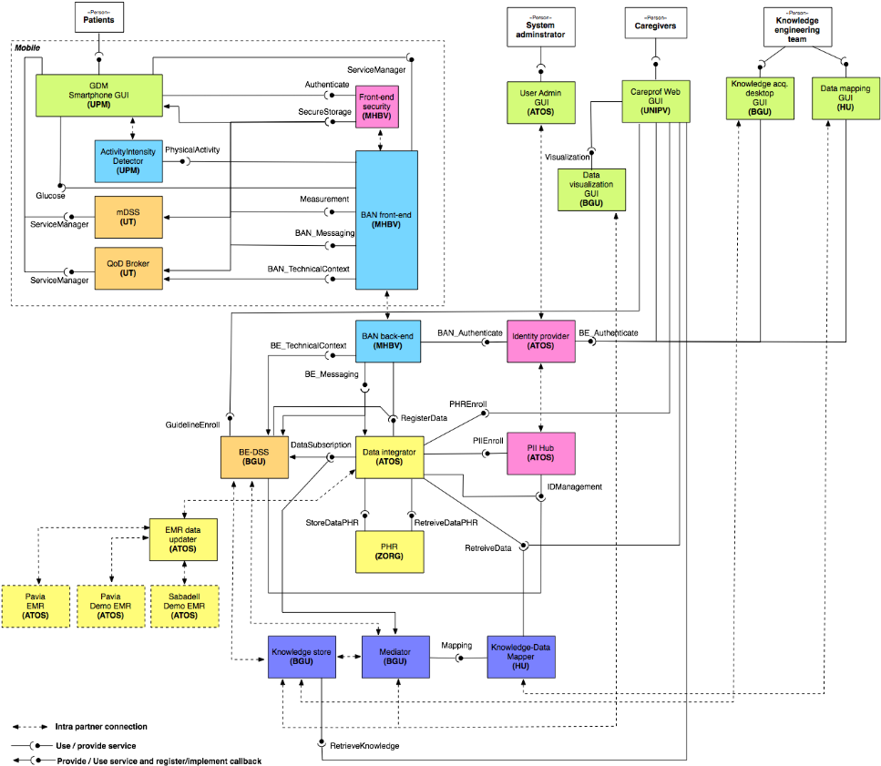
Architecture includes over 20 integrated components
7

Slide 8
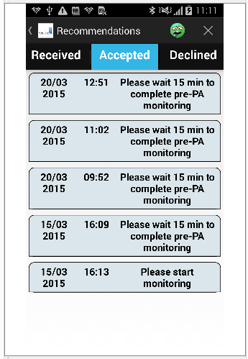
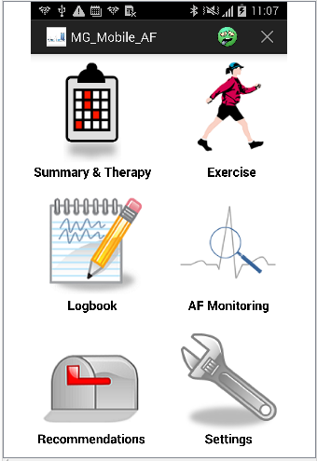
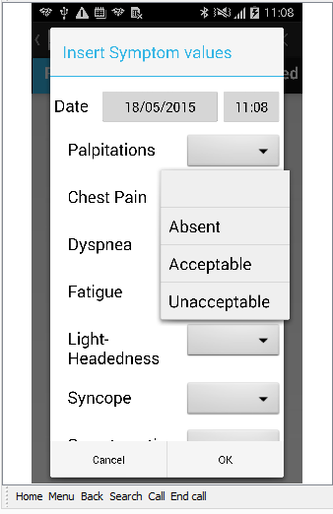
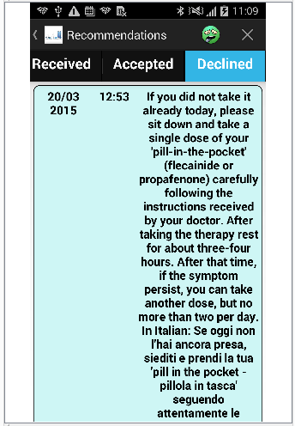
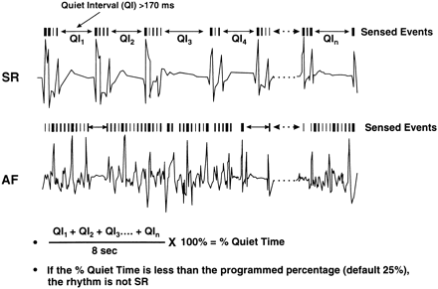

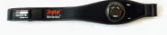
MobiGuide for Atrial Fibrillation
BAN collects ECG data and abstracts it to 1’ sessions.
Detected AF sessions stored in PHR.
DSS instructs t-Mediator to monitor for patterns of 2
or more sessions with AF in a period of 10’
8

Slide 9
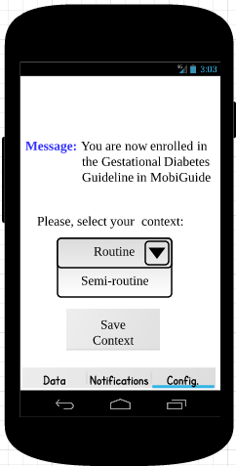
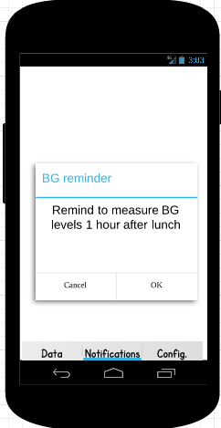

Gestational Diabetes Mellitus (GDM)
Day 1, 13:30
Montse measures blood glucose according to regular context for 2 weeks
System monitors compliance & metabolic control accordingly sets plans regarding diet, exercise, and measurement schedule
Personalized reminders
Feedback and education
Advice on adding carbs, seeing doctor
Notification to doctors
Feedback
Congratulations, you are following recommendations about blood glucose monitoring very well.
Regular
Holiday
9

Slide 10
Outline
About MobiGuide
Personalization in MobiGuide
Patient engagement: participation and awareness
Evaluation of usage by patients and clinicians
Evaluation of compliance by patients and clinicians
Future opportunities to enhance the patient experience and involvement

Slide 11
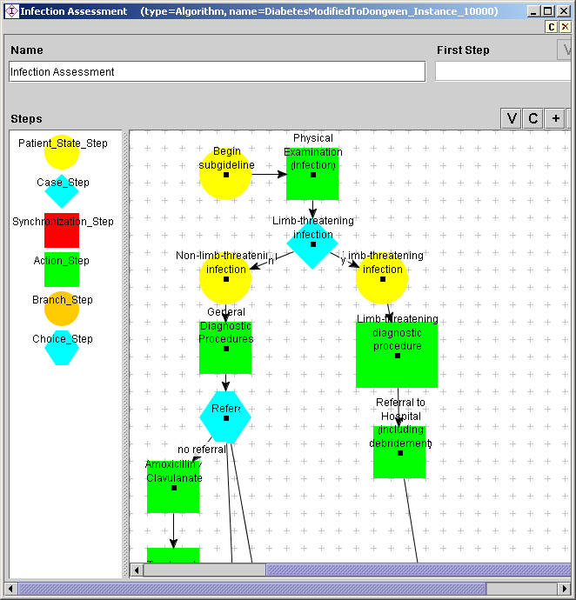
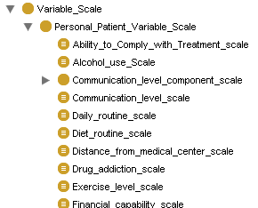
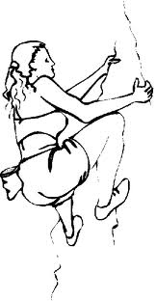


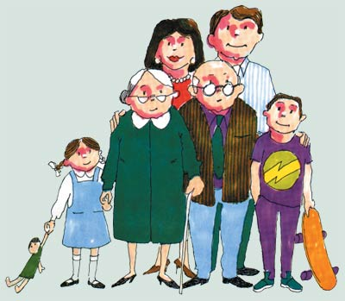
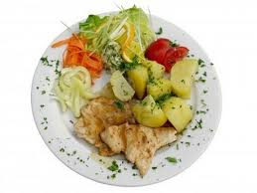

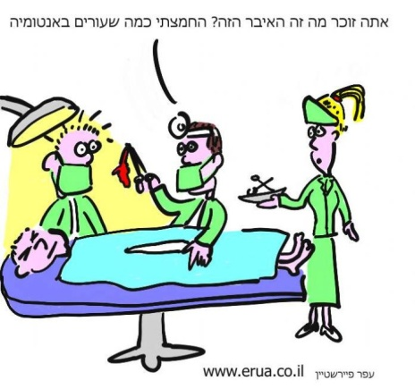
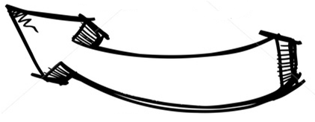


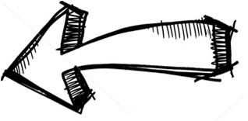
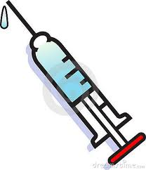
Customization for patient groups
4 stages towards better adherence
  CIG formalization
  CIG customization
  Personalization
  Execution
Customization = Add context external to GLs and recommendations for it
EBM Clinical considerations narrow space of treatment options
Personal context narrows them further
Knowledge acquisition
Patient +Physician
60 interviews
$
with Adi Fux, Pnina Soffer
11

Slide 12
Context external to guidelines - used in MobiGuide
Routine and semi-routine daily schedule
Increased physical activity
Patient under close watch by physician
Battery level too low to support upcoming scheduled exercise therapy session
Low quality of service which may reduce clinical data quality
12
Notes:
Nekane – anything to add?

Slide 13
CIG Customized Context (in KB)
Knowledge depends on context external to the guideline
Context | Affected object | Effect
AF and hypertension and Routine | BP measurement frequency | 1/day
 | ECG monitoring frequency | 1/day for 30 minutes
AF and hypertension and Semi-routine | BP measurement frequency | 2/day
 | ECG monitoring frequency | 1/day for 30 minutes
AF and hypertension and increased physical activity | BP measurement frequency | 1/day
 | ECG monitoring frequency | 2/day for 30 minutes
AF and hypertension and close monitoring | BP measurement frequency | 1/day
 | ECG monitoring frequency | Wear 24 h, 3 days a week
Contexts could be induced by:
  Patient’s measurable and self-reported data (e.g., AF and hypertension)
  Socio-demographic situation (e.g., routine schedule)
  Technology related situations (e.g., battery running out)
13
Notes:
Nekane – anything to add?

Slide 14
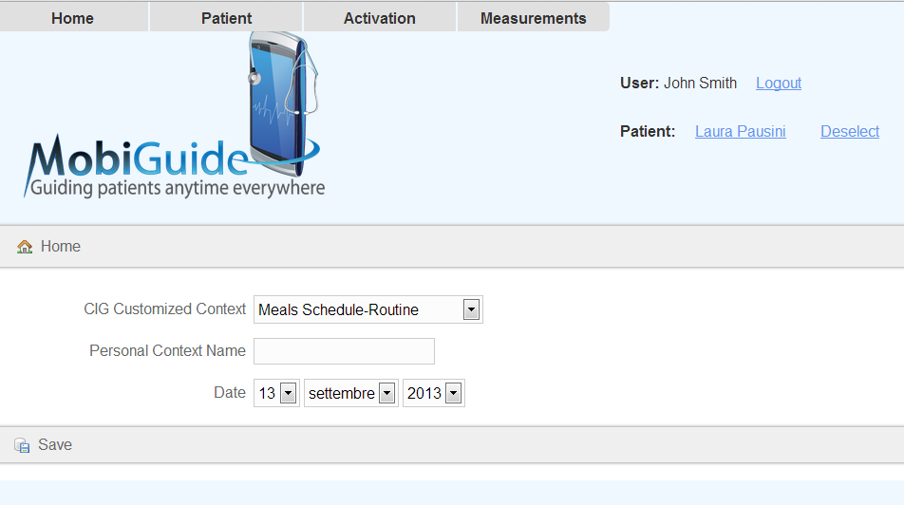
Personalization (stored in PHR)
Matching personal events to CCCs
  Personal events that are specific to each patients are added only during personalization
Regular schedule → Routine_diet_or_schedule
Holiday schedule → Semi-routine_diet_or_schedule
Patient global preferences (CIG branches)
Patient local preferences (e.g., meal times)
  Send measurement reminder 30 min before meal time
Notes:
However, personal situations specific to each patient are only added during the personalization phase.

Slide 15

Shared decision making:
antithrombotic treatment for Atrial Fibrillation
No Treatment
No other problem than AF
Stroke
NOAC
Disability
Patients at
low risk of stroke
VKA
Bleeding
Death
Antiaggregants

Slide 16
The detailed model
temporary
mild
Ischemic stroke
AF-only
Moderate- severe
death
temporary
mild*
Haemorrhagic stroke
MI
Moderate- severe*
death
Death
Minor extracranial bleedings
Major extracranial bleedings*
: Highest risk with no treatment, decreasing with aspirin, highly decreasing with warfarin
* If Warfarin → Aspirin
: Low risk with no treatment, increasing with Aspirin, highly increasing with Warfarin

Slide 17
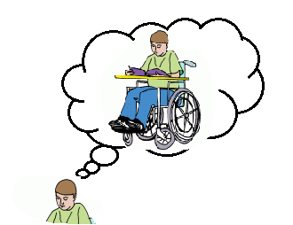

Model quantification
?
To solve the model we need:
  Transition probabilities from one health state to another one
  Patient’s feeling about the “value”
  of the various health states
  Patient’s out-of-pocket costs
No other problem than AF
Stroke
?
Disability
?
Bleeding
Death

Slide 18
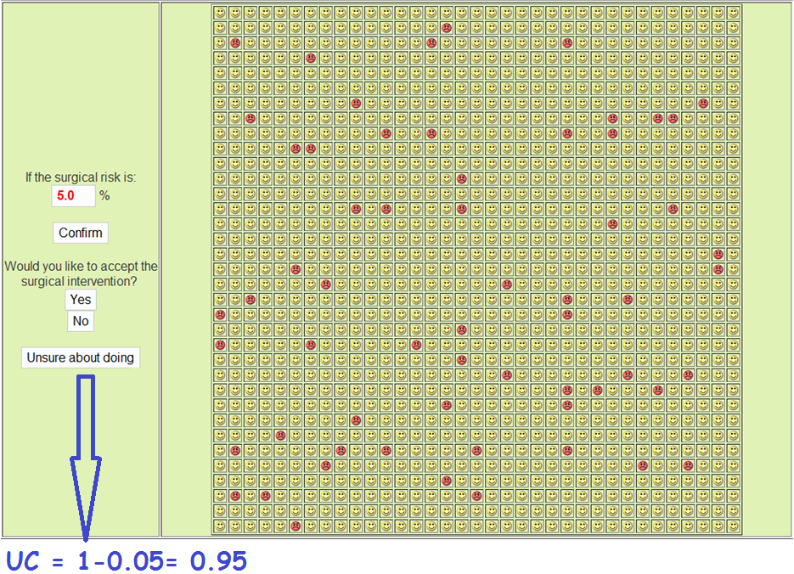
Standard Gamble
Utility Coefficient of the health state = 1 – 0.05 =0.95

Slide 19
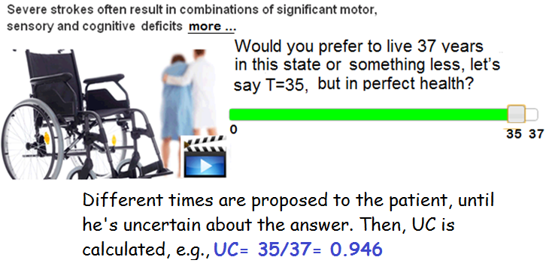
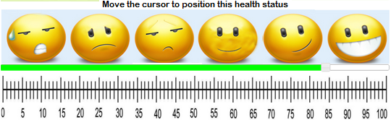

Time trade-off
Different times are proposed to the patient, until he’s uncertain about the answer. Then, UC is calculated, e.g.
Utility Coefficient=35/37=0.946
  Rating scale

Slide 20
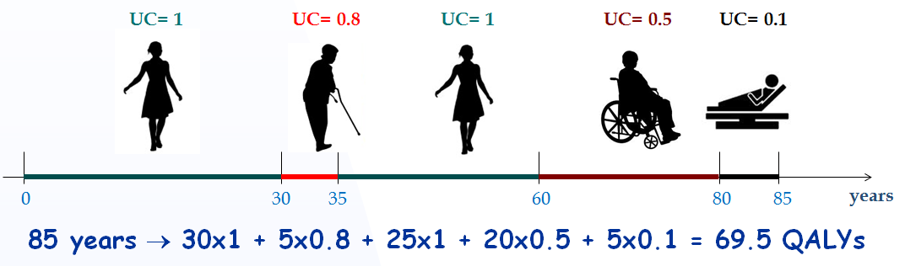
Quality-Adjusted Life Years (QALYs)
  Utility coefficients are used to adjust the life expectancy for quality
  There is also a tool for communicating results of the decision analysis to patients

Slide 21
Outline
About MobiGuide
Personalization in MobiGuide
Patient engagement: participation and awareness
Evaluation of usage by patients and clinicians
Evaluation of compliance by patients and clinicians
Future opportunities to enhance the patient experience and involvement

Slide 22


Our patients and how they were directed to use the system
Atrial Fibrillation
Routine
Gestational Diabetes Mellitus
Routine
ECG
BP (1/d,2/w)
Meds
BG (4/d; daily or twice weekly)
Ketonuria (daily or twice weekly)
INR
Weight
Exercise
BP (1-2/w)
Weight (1/w)
Exercise
Semi-routine
ECG
BP (2/d)
Meds
Close followup, excessive PE

Slide 23
What does the system do for AF patients?
awareness
Collects data (ECG inspection by nurse)
Allows patients to change context, report symptoms, meds non-compliance, report events of bleeding risk
Sends reminders for measurements and meds
Monitors temporal patterns of BP
  Changes monitoring frequency
Advice to patients in response to symptom reporting
  ECG monitoring, Pill-in-the-Pocket
Notes:
Awareness – what they should pay attention to

Slide 24
What does the system do for GDM patients?
Collects data
Allows patients to change context and report diet non-compliance
Sends reminders for measurements
Monitors temporal patterns of BG and ketonuria
  Changes monitoring frequency
  Asks patients about carbs, suggests adding carbs (ketonuria)
  Suggests seeing doctor

Slide 25
Outline
About MobiGuide
Personalization in MobiGuide
Patient engagement: participation and awareness
Evaluation of usage and compliance by patients
Evaluation of usage and compliance by clinicians
Future opportunities to enhance the patient experience and involvement

Slide 26
So, how did the patients use the system?
20 GDM patients and 10 AF patients (7 male)
Only 1 patient dropped out (GDM)
AF patients used MG for a mean of 18w (3-8.5M)
GDM patients used MG 89% of potential days; mean of 10w (3-24w)
#actions/week: AF 200.2±56.2; GDM 150.4±66.6
# patients who switched context: 5 AF; 8 GDM
#days mDSS functioned without BE-DSS: AF 24d; GDM 4d

Slide 27
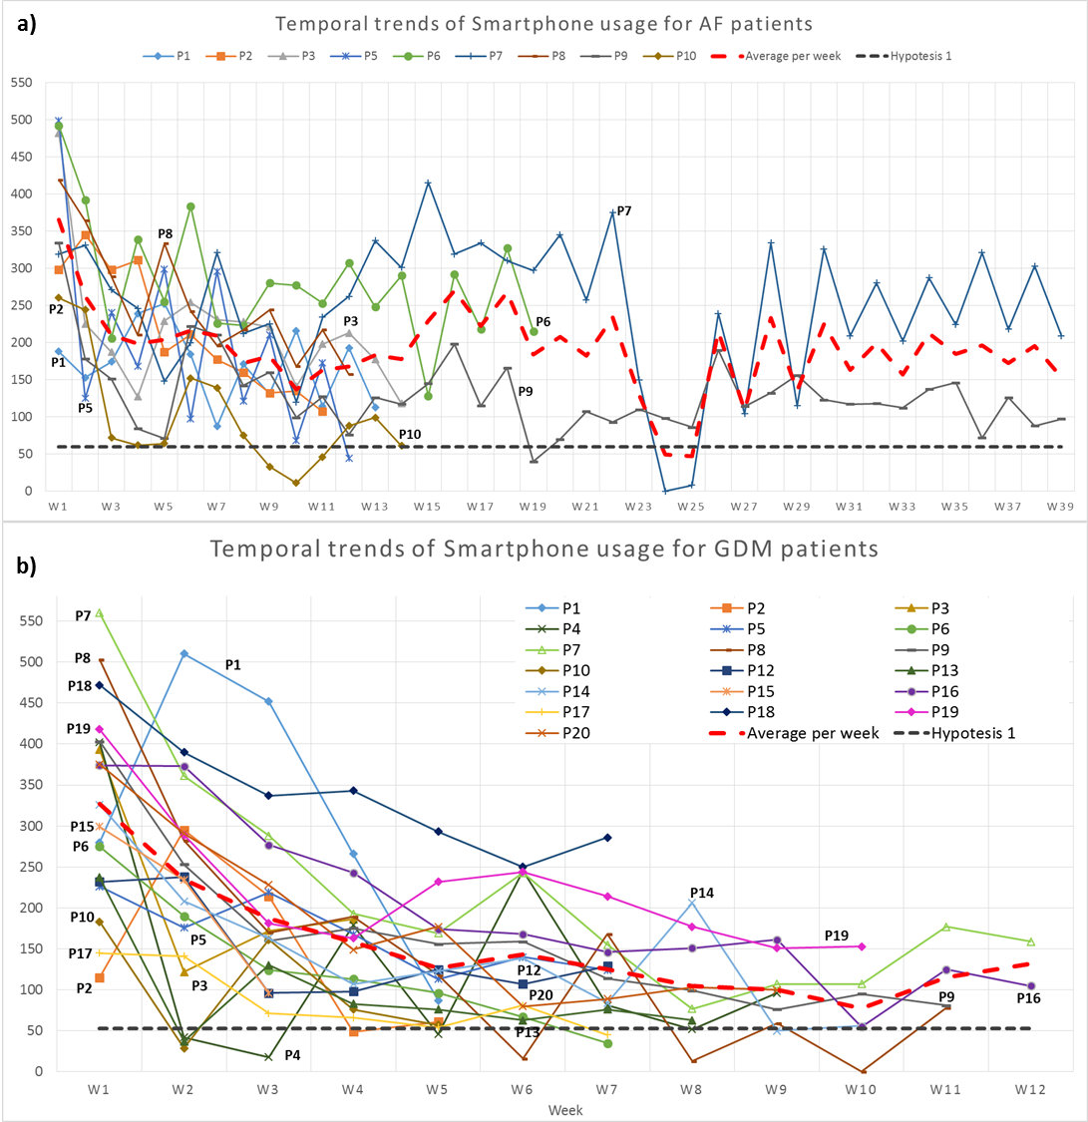

Slide 28
Top actions of AF patients:
-List recommendations
-View BG values

Slide 29
Top actions of GDM patients:
-View BAN session summaries
-View demographics
-View prescriptions
-View recommendations

Slide 30
Patients’ compliance
 | Atrial Fibrillation | Gestational Diabetes
Compliance to monitoring and drug prescriptions
Most important measurements | ECG: 0.65 (0.75) | BG 4/day 0.87 (1.01) BG daily/2 weekly 0.99 Ketonuria 0.98
Additional measurements | Blood pressure 0.75 (0.03) Medications 0.97 | Blood pressure 0.82
historical cohort: 0.87
Dom | Recommendation to patients | #patients | compliance
AF | Talk to your doctor about anticoagulants change (due to risky event) | 1 | 1
 | ECG monitoring due to symptom reporting | 7 | 0.56
Dom | Recommendation to at least 3 patients | #patients | compliance
GDM | Q: High BG (2 abnormal per week). Did you eat more than you should? | 19 | 0.3
 | 2 high BG in a week. visit your doctor | 4 | 0.5
 | Q: Have you been eating your prescribed amount of carbohydrates? (ketonuria) | 4 | 0.5
30

Slide 31
Patients’ opinions
C:\Users\mor\Dropbox\BMor\EU-MobiGuide\Talks\Michele interview-short.mp4
Question topic | AF | GDM
System increased patients’ confidence | 4 (50%) | 4 (47%)
System improved peace of mind on travel | 4 (75%) | Not asked
I like the system’s ability to adapt to context | 4 (43%) 5 (43%) | 4 (47%)
App did not complicate patients’ lives | 3 (44%) | 4 (59%)
System improved interaction with clinicians | 4 (62.5%) | Not asked
Recommending the system to other patients | 5 (100%) | 4 (53%)
Recommending the system to a friend | Y (100%) | Y (94%)
Continue to use the system | Y (89%) | Y (86%)
Paying for the system | Y (78%) | N (80%)

Slide 32
Outline
About MobiGuide
Personalization in MobiGuide
Patient engagement: participation and awareness
Evaluation of usage and compliance by patients
Evaluation of usage and compliance by clinicians
Future opportunities to enhance the patient experience and involvement

Slide 33
Benefits: care providers results
AF doctors changed diagnosis for 2 patients
Compliance of AF doctors to recommendations was perfect
  Cardioversion advice + view ECG
GDM Doctors started insulin early for 2 patients
Compliance of GDM doctors was lower (0.14 – 0.26)
  Start insulin, change diet prescription (BG or ketonuria)
  Patients saw doctors weekly; forgot to update insulin used
Questionnaire: found the system useful
  To identify priorities, increase productivity, QoD increases patient safety
  Effective visits due to availability of data
33

Slide 34
Usage by doctors
Comparing planned frequency of visits to actual clinicians’ views:
Clinicians used the system outside patient visits

Slide 35
Outline
About MobiGuide
Personalization in MobiGuide
Patient engagement: participation and awareness
Evaluation of usage and compliance by patients
Evaluation of usage and compliance by clinicians
Discussion

Slide 36
Discussion (1): it worked!
Possible to operationalize successfully a large-scale complicated system such as MobiGuide,
  distributed decision support
  innovative methodology for projection
  based on computer-interpretable clinical guidelines
  personalized to patient preferences and contexts
Generalizable to different clinical domains
Patients managed at home has economic benefits
  Good compliance, good clinical outcomes
  Saving visits and hospitalization
  Patients that require faster intervention are detected more quickly, enhancing the level of care

Slide 37
Discussion (2): Patient engagement
MobiGuide helped patients to participate in the care process
Helped them to be aware of what is necessary to follow up and what to communicate with clinicians
Assisted clinicians to utilize this participation in order to provide high quality and efficient personalized care

Slide 38
Discussion (3): Future work
Provide more feedback to patients and care takers about their compliance and health state
Motivate patients to increase their compliance and to self-report
Increase the role of patient self-reporting in care processes

Slide 39
Acknowledgements
UNIVERSITY OF HAIFA
Mor Peleg, Pnina Soffer, Arturo González Ferrer, Adi Fux, Guy Klebanov, Darian Shalev
BEN-GURION UNIVERSITY
Yuval Shahar, Erez Shalom, Denis Klimov, Ayelet Goldstein, Avner Hatsek
UNIVERSIDAD POLITECNICA DE MADRID
Elena Hernando, Gema García-Sáez, Iñaki Martínez Sarriegui
UNIVERSITA DEGLI STUDI DI PAVIA
Silvana Quaglini, Riccardo Bellazzi, Lucia Sacchi, Enea Parimbelli, Silvia Panzarasa, Paolo Tormene
UNIVERSITEIT TWENTE
Val Jones, Ing Widya, Hermie Hermens, Richard Bults, Nekane Larburu, Nick Fung
VIENNA UNIVERSITY OF TECHNOLOGY
Silvia Miksch, Katharina Kaiser, Anne-Lyse Minard, Paolo Federico
BEACON TECH LTD.
Yoram Lev-Yehudi, Yoram Bar-Zeev, Ira Mednikova
ATOS ORIGIN
Carlos Marcos, Alberto Crespo, Belen Gallego, Paz Gómez, Blanca Jordan, Carlos Cavero, Angel Palomares Mario Rodriguez, Manuel Perez, Pedro Soria-Rodriguez
MOBIHEALTH
Tom Broens, Daniel Knoppel, Willem Broekema
ZORG GEMAK BV
Jan-Marc Verlinden, Bert Verhees, Kevin Keene, Leo Simons
CORPORACIO SANITARIA PARC TAULI DE SABADELL
Mercedes Rigla, Belén Pons, Raquel Tirado, Assumpta Caixàs
FONDAZIONE SALVATORE MAUGERI
Carlo Napolitano, Daniele Segagni, Silvia Priori
ASSOCIACIO DE DIABETICS DE CATALUNYA (ADC)
Àngels Pallàs, Soley Crusellas Montserrat

Slide 40
Questions?
http://www.mobiguide-project.eu/
morpeleg@is.haifa.ac.il
40

