Slide 1
Screening for Brain Injury presented at
Brain Injury & the Criminal Justice
System Seminar
June 27-28, 2017
Claire Brownson, MA, LMHCA
Coordinator of Training & Education

Slide 2
Objectives
To define why screening is important
To train to use the TBI screening measure
  Identify various types of ABI
  Detect presence and determine severity
To optimize knowledge through presentation of Resource Facilitation case example

Slide 3
OSU-TBI-ID
Originally published in 2007 by John Corrigan, PhD
A standardized procedure for eliciting lifetime history of TBI via a structured interview
Strong psychometric properties
Corrigan, J.D., Bogner, J.A. (2007). Initial reliability and validity of the OSU TBI Identification Method. J Head Trauma Rehabil, 22(6):318-329.
Notes:
The OSU-TBI-ID was published in 2007 by John Corrigan. It was designed as a structured interview for health and social service professionals assessing the occurrence of TBI over the client/patient’s lifetime. The measure is particularly nice because it shows strong psychometric properties, yet only takes a few minutes to administer.

Slide 4
Why is Screening Important?
Because you might have patients/clients who have suffered a brain injury and you don’t know it yet.
  This is going to have an effect on outcomes (clinical, etc.)
    Often clients don’t know they’ve suffered a brain injury
    Brain injuries are usually not visible disorders
    Documentation may be lacking in medical records
    It might explain why he/she is less responsive to the treatment/services provided
Because understanding brain injuries and their effects can jumpstart recovery and healing.
  You can more easily tailor their treatment and/or rehabilitation

Slide 5
Why Self-Report?
“While self-report is not an ideal for determining how much compromise a person’s brain may have incurred as a result of lifetime exposure to TBI, it is for now the gold standard for both research and clinical uses.”
  We know self-report leaves much to be desired…
    However, a face-to-face interview conducted in a standardized manner by a trained interviewer is indeed the “gold standard” for determining lifetime history of TBI.
  Be warned:
    Self-report is vulnerable to under-reporting

Slide 6
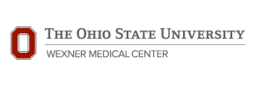
Ohio Valley Center for Brain Injury Prevention and Rehabilitation
Web-based Training Module: TBI Identification Method may be viewed on this site
  CEUs available here also
Can find information on “Background for the OSU TBI Identification Method” and “Federally Funded Projects Using OSU TBI-ID” there as well
http://ohiovalley.org/informationeducation/screening/index.cfm

Slide 7
Clinical and Research Resources for OSU TBI-ID
We utilize an adapted version of the OSU TBI-ID Short Version because:
  Of clinical, research or programmatic purposes
  It can typically be administered in 5 minutes
  It can be used free of charge, and
  It can be used without further permission from the authors as long as no changes are made to the provided version.
http://ohiovalley.org/tbi-id-method/

Slide 8
Benefits of Using OSU
“The OSU TBI-ID can be adapted for specific populations and situations; primarily via adaptation of the ‘probe’ questions that are intended to elicit injuries that may have been TBIs.”
  Versions can vary in length and can be customized for clinical screening, treatment planning, system administration or research applications.
We have adapted the Short Version to what we need:
  Ohio State University TBI Identification Method – Revised: A Screening Tool for the Identification of Acquired Brain Injury
http://ohiovalley.org/informationeducation/screening/index.cfm

Slide 9
Adapted ABI items
Introduced as a supplement to aid in identification of non-traumatic brain injury
  Stroke
  Loss of oxygen
  Lightning
  Infection
  Tumor
  Brain surgery
  Toxic exposure
Notes:
We recently added some items to the end of the original OSU-TBI-ID to allow for screening the causes of BI outside of TBI. These additional items assess the presence of ABI history. For example, stroke...

Slide 10
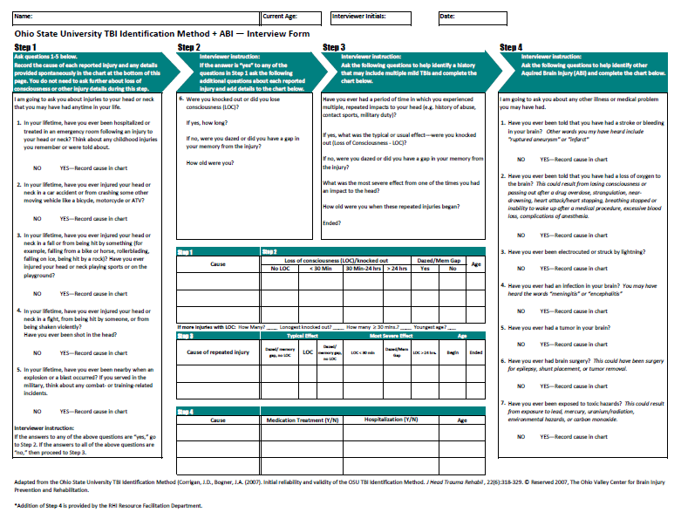
Notes:
This is the entire OSU-TBI-ID with the additional ABI items added at the end. Overall, with the addition of the new items, there are 4 steps, or components for this screening tool. Administration should take less than five minutes, but can take longer for clients with many injuries. Keep in mind this is a measurement tool we are introducing to help you in assessing brain injury. This is not required for an RF referral!!!

Slide 11
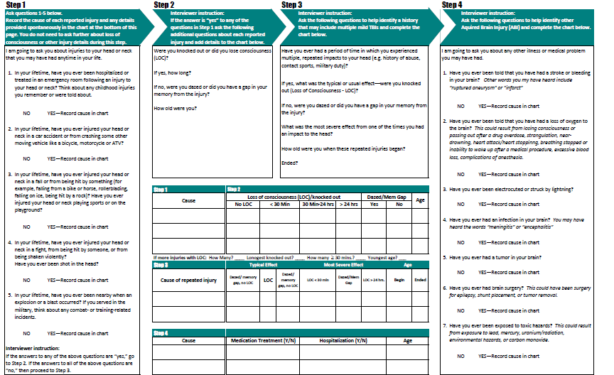
Step 1
Notes:
The first part of the interview consists of the following five questions:
As you can see, the responses are all yes/no. If a client responds “no,” you can simply move on to the next question. If they respond “yes” to any of the items, you will record more information in the step 1 table. We will show a couple of examples later to illustrate this process.

Slide 12
Step 1
In your lifetime, have you ever been hospitalized or treated in an emergency room following an injury to your head or neck? Think about any childhood injuries you remember or were told about.
No Yes – Record cause in chart
In your lifetime, have you ever injured your head or neck in a car accident or from crashing some other moving vehicle like a bicycle, motorcycle, or ATV?
No Yes – Record cause in chart
Notes:
Since the font is pretty small on the previous slide, I have copied the actual questions on the next few slides. Question 1 asks whether the client has ever been hospitalized or treated in an emergency room for a head or neck injury. If they respond “no,” just move on to the next slide. If they respond, “yes,” then you will go to the chart and write down the cause of the injury. For example, if someone says “yes,” then you would ask what happened. You record what caused the injury in the column labeled “step 1.” Again, we will go through an example later.
The remainder of step 1 all follows the same format.
Question 2 asks whether or not they have ever injured their head or neck from crashing a moving vehicle. You may notice that someone who reports “yes” on this question, also reported “yes” on question 1. If the incident they are reporting is the same incident, you do not need to report it in the table again. If it is a different incident they are talking about, you do need to report it in the table.

Slide 13
Step 1
3. In your lifetime, have you ever injured your head or neck in a fall or from being hit by something (for example, falling from a bike or horse, rollerblading, falling on ice, being hit by a rock)? Have you ever injured your head or neck playing sports or on the playground?
No Yes – Record cause in chart
Notes:
Question 3 asks whether the client has ever been injured in a fall or from being struck. It also asks about sports and playground injuries.

Slide 14
Step 1
In your lifetime, have you ever injured your head or neck in a fight, from being hit by someone, or from being shaken violently? Have you ever been shot in the head?
No Yes – Record cause in chart
In your lifetime, have you ever been nearby when an explosion or a blast occurred? If you served in the military, think about any combat- or training-related incidents.
No Yes – Record cause in chart
Notes:
Question 4 asks about violence. Whether or not the client has been injured in a fight, shaken, or shot in the head.
Question 5 asks about exposure to blasts or explosions.

Slide 15
Step 2
Notes:
After step 1, the first five yes/no questions, you will move on to step 2. If you received all “no” responses to step 1, then you can skip step 2.
Step 2 utilizes the table adjoining the step 1 table. It allows you to gather a little bit more information about the injuries recorded during step 1.

Slide 16
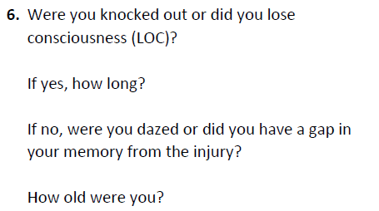
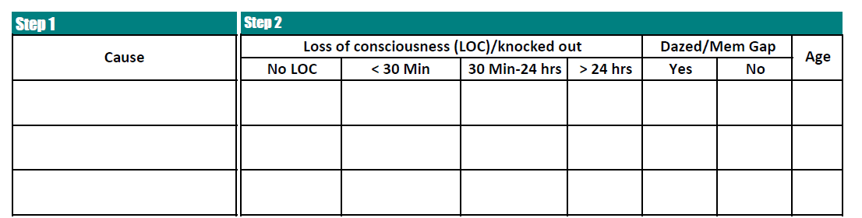
Step 2
Notes:
Zooming in to the top of form under “step 2,” you will see item 6. This item asks about whether or not the client lost consciousness and if so, how long. You will record the answer in the table. If they did experience a loc, you categorize the response in terms of length of LOC. You can select less than 30 minutes, between 30 minutes and 1 day, or greater than 1 day. If they did not report a LOC, you will ask if they were dazed or experienced a memory gap from the injury. Keep in mind you do not need to ask that if they reported a LOC.
Finally, you ask how old they were when they experienced their injury.

Slide 17
Step 3
Notes:
Step three is designed to assess a history of multiple head injuries. Similar to the previous steps, you will report the cause in the first column of the table and then answer questions in the remainder of the table if they report any injuries.

Slide 18
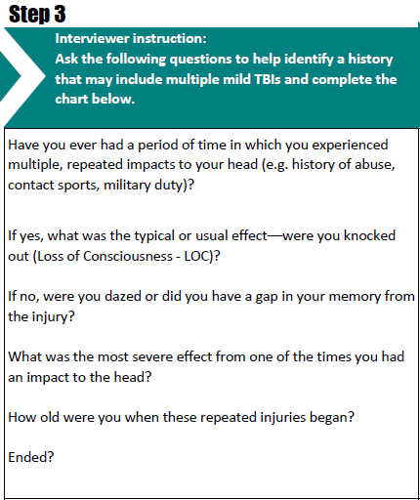
Step 3
Notes:
Zooming in to step 3, you will see the first question asking about multiple, repeated impacts to your head. If the client responds “no,” you are finished with this step and can move on to step 4. If they indicate that they have experienced multiple impacts, then, similar to the previous sections, you will record the cause in the step 3 table.
They may have more than one cause for the multiple impacts. If they do, you will record each cause in a new line of the table.
After recording the injuries, you will go back and ask some questions about them and finish the table.
First, you will ask what the typical effect was. Since this injury line item consists of many different events, you are trying to assess what happened most of the time.
Next, you will ask about the most severe effect from one of these injuries.
Finally, you will ask for the age when the repeated injuries began and when they ended.

Slide 19
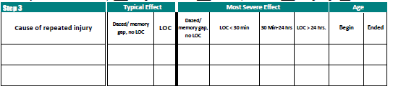
Step 3
Notes:
Here is a closer look at the step 3 table.
As you can see, the typical effect has two choices:
Dazed/Memory Gap: Yes or no
LOC: Yes or no
When asking about the most severe effect, you will ask the same questions, but you will also ask about the duration of LOC using the same categories as the first table.
Finally, you can see there you record the two ages.

Slide 20
New ABI items: Step 4
Notes:
Finally we come to the final set of questions. Step 4 includes the ABI items mentioned before. This part of the interview is similar to step 1. You will ask 7 yes/no questions and record the cause and some basic information in the step 4 table.

Slide 21
Step 4
Have you ever been told that you have had a stroke or bleeding in your brain? Other words you may have heard include “ruptured aneurysm” or “infarct”
Have you ever been told that you have had a loss of oxygen to the brain? This could result from losing consciousness or passing out after a drug overdose, strangulation, near-drowning, heart attack / heart stopping, breathing stopped, or inability to wake up after a medical procedure.
Notes:
I have copied the actual questions here so you can see a close up. Question 1 asks about stroke and ruptured aneurysm. One important thing to note with this question is that you aren’t asking about an aneurysm in general. You are only asking if it is ruptured.
Question 2 asks about a loss of oxygen to the brain. As you can see from the question details, many events can lead to a lack of oxygen so we provided several examples to help trigger this for the client.

Slide 22
Step 4
Have you ever been electrocuted or struck by lightning?
Have you ever had an infection in your brain? You may have heard the words “meningitis” or “encephalitis”
Have you ever had a tumor in your brain?
Notes:
Question 3 asks about lightning strikes
Four asks about brain infection
And question 5 asks about brain tumors

Slide 23
Step 4
Have you ever had brain surgery? This could have been surgery for epilepsy, shunt placement, or tumor removal
Have you ever been exposed to toxic hazards? This could result from exposure to lead, mercury, uranium/radiation, environmental hazards, or carbon monoxide
Notes:
Question 6 asks about brain surgery.
Question 7 asks about exposure to toxic materials. We have listed some common toxic hazards to help the client remember.

Slide 24
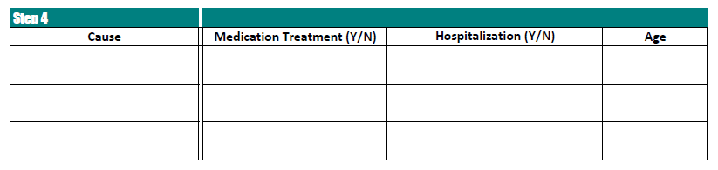
Step 4
Notes:
If the client responded “yes” to any of the step 4 ABI items, you would have recorded a cause in the step 4 table. After asking the remainder of the questions, you would go back and ask whether or not they received medical treatment, whether or not they were hospitalized, and their age at injury.

Slide 25
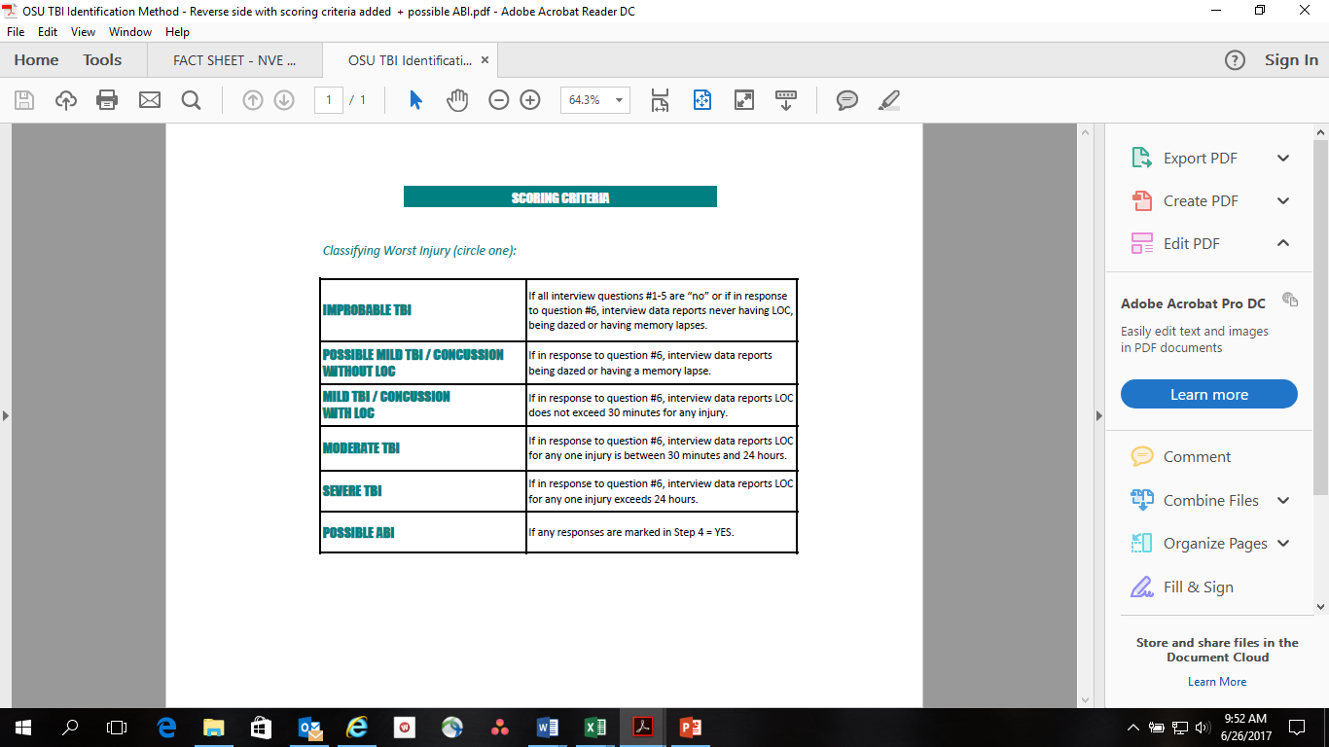
SCORING CRITERIA
Classifying Worst Injury (circle one):

Slide 26
When Scoring Step 4 Items…
We weigh those ABI questions in Step 4 differently than the first 3 TBI steps.
  Only TBI severity is quantifiable by LOC…
Score any Step 4 items marked as:
  POSSIBLE ABI

Slide 27
RF Case Example
Jennifer
  51 year old Caucasian female.
  Completed 14 years of school and worked as property manager
  Possible undiagnosed and untreated injuries from parental abuse from toddler to 9th grade.
    Unknown typical/most-severe effects
  Brain Injury (with brief LOC) in 8th grade from being assaulted by 5 females
  2014 - Motorcycle accident:
    Hospitalized
    LOC was moderate, but less than 1 day
    Memory and frontal lobe impairment; anosmia

Slide 28
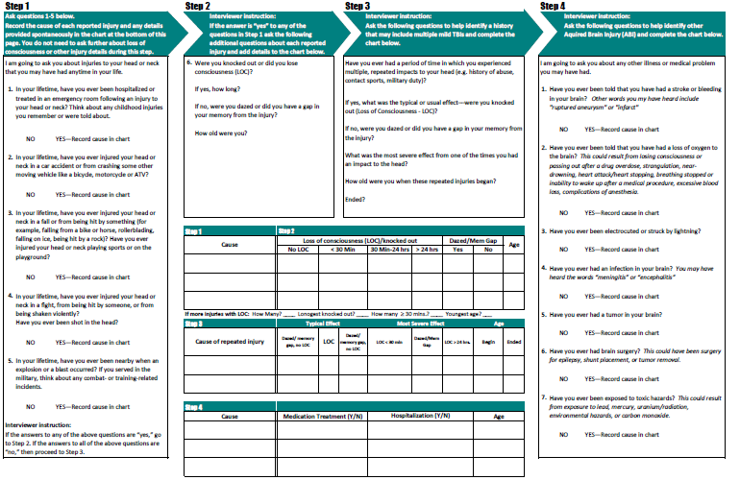
Case Example Screening
Potential abuse
MVA
X
X
48
Assault
X
13
Abuse
3
15
Notes:
Looking at Ms. Doe’s most severe injury (when she was hit by the car at age 8), reveals that she likely sustained a severe TBI.

Slide 29
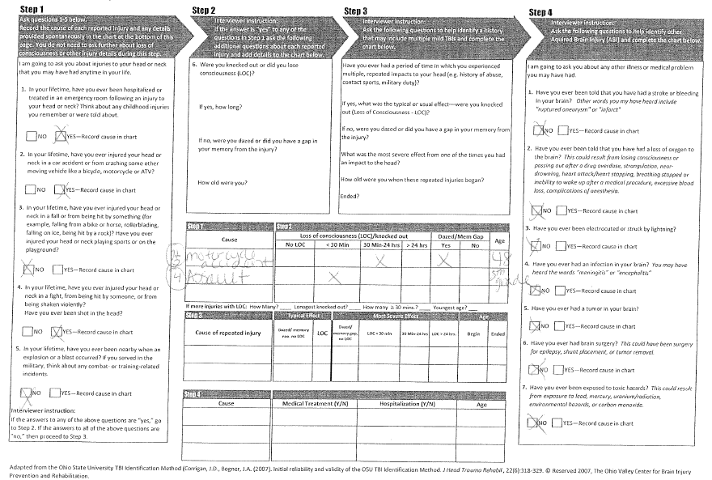
Real Results

Slide 30
SCORING CRITERIA
Classifying Worst Injury (circle one):

Slide 31
Now you should be able:
To define why screening is important
To use the TBI screening measure
  Identify various types of ABI
  Detect presence and determine severity
To optimize knowledge through other case examples

Slide 32
References
Corrigan, J. D., & Bogner, J. (2007). Initial reliability and validity of the Ohio State University TBI identification method. The Journal of head trauma rehabilitation, 22(6), 318-329.
http://ohiovalley.org/

Slide 33
Questions?
Contact:
THANK YOU!
Claire Brownson, MA, LMHCA
Coordinator of Training & Education
Claire.brownson@rhin.com
(317) 329-2262

