Slide 1
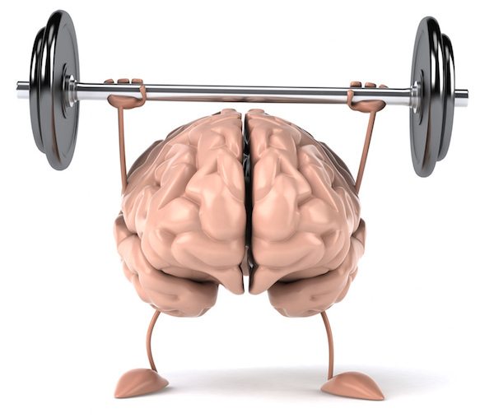
Managing Brain Injury as Chronic Condition
Flora Hammond, MD
Professor & Chair, PM&R
Indiana University SOM
Rehabilitation Hospital of Indiana
Indianapolis, IN

Slide 2

Indiana TBI Model Systems
Grant support to Indiana University School of Medicine from:
Traumatic Brain Injury Model Systems, National Institute on Disability Independent Living and Rehabilitation Research
Led by IUSM Dept Physical Medicine & Rehabilitation
Housed at the Rehabilitation Hospital of Indiana
Local Study: treatment for alexithymia
Multisite modules: alexithymia, caregiver needs & well-being; cognitive fxn overtime
National Database

Slide 3
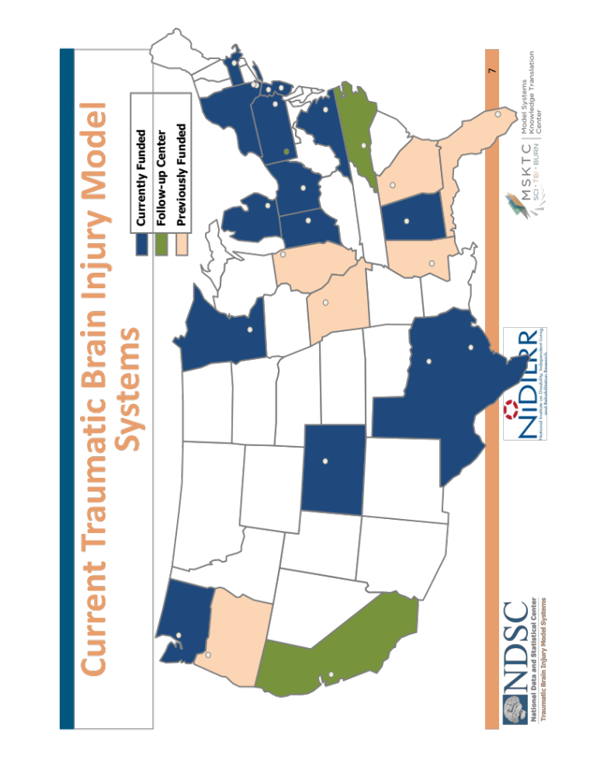
NIDILRR TBI Model System National Database
30 years with >16,000 database participants
Admitted to acute care within 72 hours of TBI & received inpatient rehabilitation
> 16 years of age
Complicated mild, moderate or severe TBI
  neuroimaging abnormality, PTA, LOC, or ED GCS score

Slide 4
A Radical New Perspective: TBI as a Chronic Condition & Implications

Slide 5
Objectives
Describe longterm outcome trajectories, as well as medical and psychosocial conditions following moderate-severe TBI
Understand brain injury is not an event; it is a life long condition that needs to be proactively managed
Apply chronic disease management approaches to transform BI care to prevent secondary complications and maximize outcomes
Identify what you and your organization can do to facilitate this transformation

Slide 6
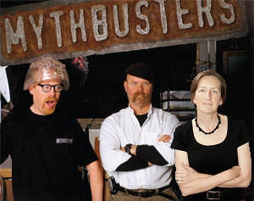
Exploring Myths About Brain Injury: Fact Versus Myth?
Severe TBI = poor outcome
No recovery occurs after 1st year post-injury
Brain injury is a dynamic & chronic condition
Many chronic conditions are managed proactively to optimize outcome
We have no control over the trajectory of recovery
Notes:
Engage my myth-busting friends, Adam & Jamie

Slide 7
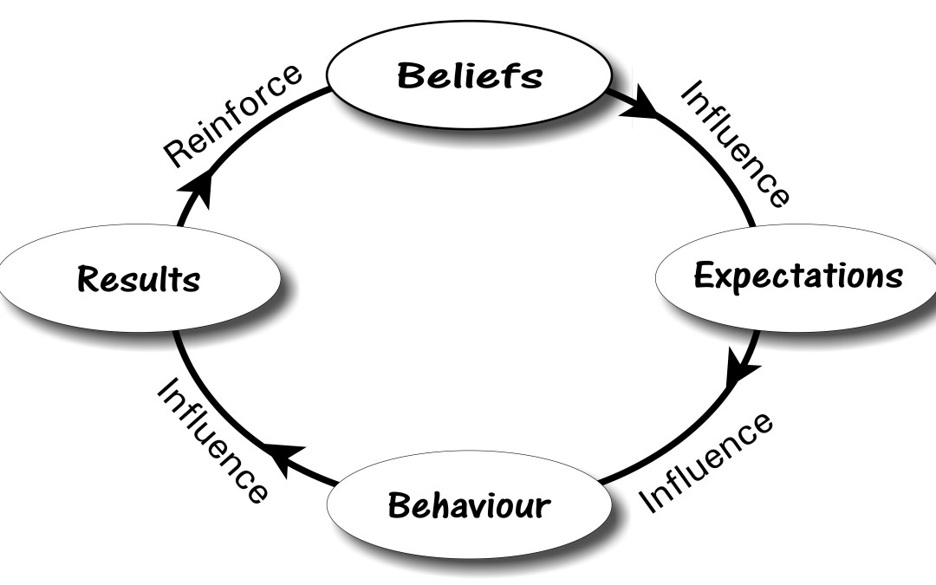
Why do Myths Matter?
Notes:
Myths are baked into our system of care and influence our care and outcomes

Slide 8

Miracle (mir·a·cle; mirək(ə)l)
an extremely unusual event, thing, or accomplishment
a surprising and welcome event that is not explicable by natural or scientific laws and is therefore considered to be the work of a divine agency

Slide 9
Exploring Myths About Brain Injury: Fact Versus Myth?
Severe TBI = poor outcome
No recovery occurs after 1st year post-injury
Brain injury is a dynamic & chronic condition
Many chronic conditions are managed proactively to optimize outcome
We have no control over the trajectory of recovery

Slide 10
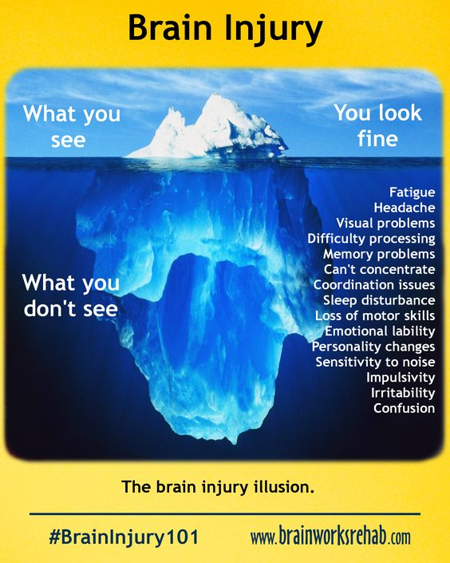
Comorbidities & Consequences
A Silent & Undermanaged Condition
Pain
Substance use
Social isolation
Incarceration
Reinjury
Psychiatric disorders
Neuroendocrine dysfunction
Seizure
Stroke
Dementia
Higher rates of diabetes, hypertension, myocardial infarction, cerebrovascular disease, peripheral vascular disease, chronic pulmonary disease, and renal disease
Dizziness
Imbalance
Incontinence
Spasticity

Slide 11
Premature Mortality with Moderate-Severe TBI
Harrison- Felix C, Whiteneck G, DeVivo MJ, Hammond FM, Jha A: JHTR 2006
Most Frequent Causes
> Expected for general population
Cardiovascular
Unintentional
Septicemia
Cancer
Pneumonia; Other resp
Digestive
Homicide
Suicide
Seizure
Seizure (37x)
Septicemia (12x)
Pneumonia & aspiration PNA (4x)
Other respiratory (3x)
Digestive (3x)
External (3x)
  Unintentional (3x)
    Accidental poisoning (4%)(11x)
      Opioids
  Homicide (3x)
  Suicide (1x)
7-year reduction in life expectancy
Causes of death vary over time post-injury
Association with older age and > disability at time of rehab discharge

Slide 12
IOM Report on Evidence for Effects of Brain Injury
Ishibe N, Wlordarczyk RC, Fulco C. Overview of the IOM’s committee search strategy and review process for Gulf War and health: long-term consequences of traumatic brain injury. J Head Trauma Rehabil 24:424–429, 2009.
Sufficient Evidence
Associations with: TBI associated with depression, aggression, and post-concussion symptoms Severe TBI associated with neurocognitive deficits Moderate-severe TBI associated with long-term adverse social-function outcomes (particularly unemployment and diminished social relationships), endocrine dysfunction (particularly hypopituitarism and growth hormone insufficiency), Alzheimer-type dementia and parkinsonism Moderate-severe TBI who receive inpatient rehabilitation or receive disability support associated with premature death Penetrating TBI associated with long-term unemployment and decline in function relevant to the region affected and volume of tissue lost Causal relationship: Penetrating, open & moderate-severe TBI with unprovoked seizures.

Slide 13
Change in FIM Years 1-10 among those NOT Following Commands at Rehabilitation Admit
Hammond, Sherer, Giacino, Tang, Whyte, Zafonte, Nakese-Richardson, Arciniegas
Severe TBI does not equal poor outcome
Fully independent:
    Cognition: 16% Y1; 25% Y10
    Mobility: 23% Y1; 70% Y10
    Self care: 56% Y1; 72% Y10
Late recovery occurs
  Gains at each epoch
  Many reached independence after Y1

Slide 14
Change in Function Over Time: Glasgow Outcome Scale (GOS-E)
Corrigan JD & Hammond FM Arch Phys Med Rehabil 2013
Change occurs after 1st year
BI is a dynamic condition
No Change:
- 39 - 48%
Improvement:
- 24 - 31%
Decline:
- 20 – 34%

Slide 15
5-year Rehabilitation Outcomes
Corrigan JD, Cuthbert JP, Harrison-Felix C, Whiteneck GG, Bell JM, Miller AC, Coronado VG, Pretz CR. J Head Trauma Rehabil 2014:29(6):E1-9.
TBI Model Systems participants who received rehabilitation October 2001 - Dec 2007.
Weighted for national population characteristics
  age, sex, race, race/ethnicity, marital status, primary insurance, FIM motor & cognitive score at rehab admit, and RLOS
Status 5 years post-TBI:
  84% known outcome
  10% lost to follow-up
  6% withdrew/refused/unknown
39% declined (GOS-E) Y1-2 → Y5
12% non-private residence at Y5
22% dead by Y5
From Y1 or 2 to 5:
2 in 10 died
3 in 10 deteriorated
Associated with older age

Slide 16
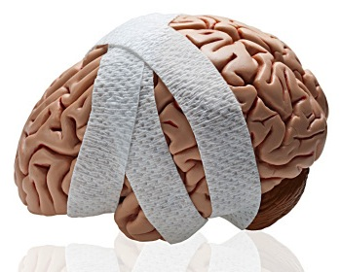
Chronic Brain Injury
2012 Galveston Brain Injury Conference
“Injury to the brain can evolve into a lifelong health condition termed chronic brain injury (CBI). CBI impairs the brain and other organ systems and may persist or progress over an individual’s life span. CBI must be identified & proactively managed as a lifelong condition to improve health, independent function and participation in society.”

Slide 17
Exploring Myths About Brain Injury: Fact Versus Myth?
Eventual outcome is known in the 1st days after brain injury
Severe TBI = poor outcome
No recovery occurs after 1st year post-injury
Brain injury is a dynamic & chronic condition
Many chronic conditions are managed proactively to optimize outcome
We have no control over the trajectory of recovery

Slide 18
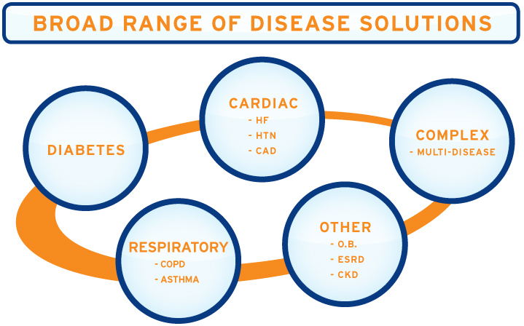
Many chronic conditions are managed proactively to optimize outcome

Slide 19
  On average, persons with chronic disability spend
  3 hours/year with health professionals … need to activate, empower, & build self-efficacy
Notes:
…. need to provide infrastructure, activate, empower, & build self efficacy

Slide 20
Chronic Disease Management Programs
Community
Build Public Policy & Resources
Health Systems
Delivery System :
Clinical teams
At-risk case management
Risk & need-based visits
Delivery System Design
Create Supportive Environment
Clinical Information Systems:
Registry
Performance metrics
Decision Support:
Supervision w/ specialist consultant
Guidelines
Seminars
Clinical Information Systems
Decision Support
Self-Mgmt Support:
Classes
Goal setting
Goal support
Record keeping
Action card
Webpage/app
Provide Self-Management Support
Notes:
Clinical Information Systems:
Chronic disease registry
Performance metrics
Decision Support:
Practice supervision with specialist consultant
Practice guidelines
Team seminars, webinars, podcasts
Delivery System Design:
Practice teams
At-risk case management
Planned visits based on risk and need
Self-Management:
Patient goal setting (list of possible goals; buddy or sponsor; )
Goal monitoring & support (guidance & approval)
Patient classes
Patient record keeping
Action card with advice for patients
Webpage, app, etc with information & guidance
Supportive environment:
Public Policy & Resources:

Slide 21
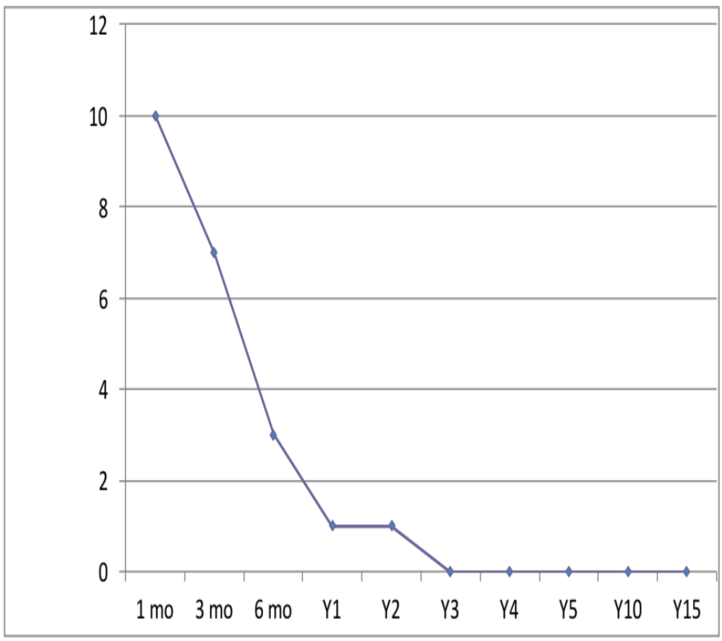
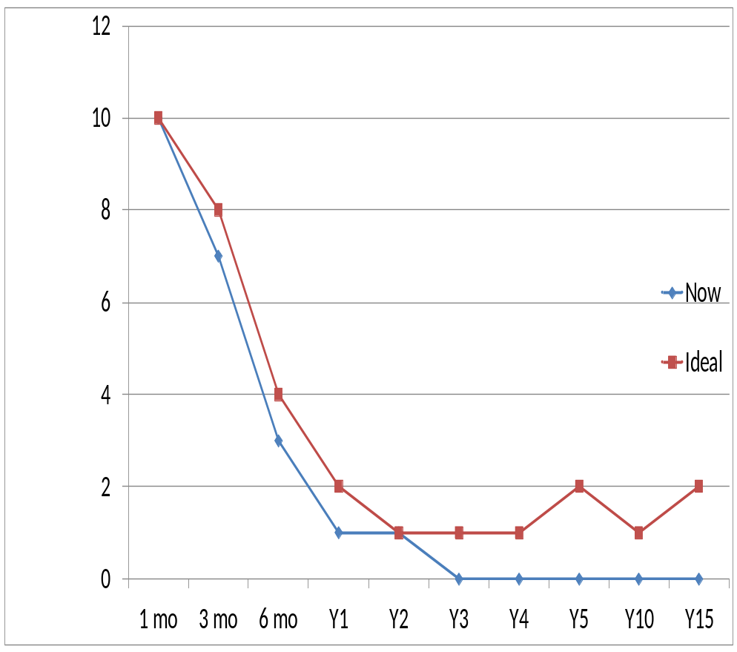

Current Usual BI Care is Inadequate
For those deemed appropriate, ready access to acute resuscitation & stabilization
Limited access to rehabilitation
  Provider expectations
  Restricted funding
  BI specialist shortage
Treatment & follow up inadequate
  Infrequent – non-existent
  Often patient-initiated & reactive
X
Intensity of Service over time

Slide 22
Primary Medical Care & Brain Injury
Harrington AL, Hirsch MA, Hammond FM, et al. Am J PMR 2009;88:852
People with BI less likely to have PCP
Reasons no PCP:
  no transportation
  $
  can’t find
  would not understand disability
  “don’t need one”
36% said “had to teach their PCP about disability”
3% reported physical access issues

Slide 23
Designing Disease Management Approach to CBI: Obstacles to Overcome
Changes needed:
    Infrastructure, informatics access, effort, planning, innovation
Provider issues:
  Availability, knowledge, expectations, resistance, attitudes, beliefs, incentives, compensation, work load, work flow

Slide 24
Designing Disease Management Approach to CBI: Unanswered Questions
Who will have what outcome trajectory?
What is modifiable? What does it take to decrease disease burden?
What conditions (pre-existing & post-BI) require management? Could be prevented, detected early or managed?
What conditions can/should be self-managed? Approach? Markers? Obstacles? Who can self-manage? Impact of BI deficits (memory, initiation, problem solving, initiation, appraisal)?
What is the ROI?
  Resource utilization, independence, employment, caregiving needs, longevity, suicidality, psychological well-being, symptom burden, aggression, substance use, incarceration/recidivism
  How can care access to medical care & rehabilitation and community-based resources improve outcomes & reduce institutionalization?

Slide 25
Exploring Myths About Brain Injury: Fact Versus Myth?
Severe TBI = poor outcome
No recovery occurs after 1st year post-injury
Brain injury is a dynamic & chronic condition
Many chronic conditions are managed proactively to optimize outcome
We have no control over the trajectory of recovery

Slide 26
We need a paradigm shift to influence outcome trajectories

Slide 27




Problem-driven, Risk-stratified Care
Systematic
Evidence-based
Individualized: pt goals, problems & risk
Checklists
  Education, screening & prevention
Treatment menu
Established follow up plan
Targeted level of care
  Supported self-management
  Shared care
  Intensive professional + case mgmt
Dynamic for changing needs
High risk, complex needs: intensive professional & case management
Some risk, increased need: shared care with self, close others, & professionals
Low risk: (70-80% of chronic disease population);
supported self-management
Self-management
Professional management
Target the right people with the right care & intensity

Slide 28
Access to CBI Care
Adjust provider expectations
  pursue recovery & keep open-mind
  educate other providers
Connect with those who never find out about rehab
Expand of use remote-delivery
Implement research into practice
Build & utilize resources in the community
  Start working with the criminal justice system & VR
  Advocate for insurance coverage & policy changes, Medicaid waiver to manage BI as chronic condition
Notes:
Many drop face of the Earth after acute care discharge …. Approximately 85% never meet PMR or neuropsych.

Slide 29
Self-Management of CBI
Examples: Behavior, mood, cognition, social interaction, fatigue, sleep, wellness, substance use, pain, seizure management
Relevant education (group vs. individual; learning styles)
  Activate
  How & what to monitor, how to treat, and when to call
Markers
Protocols
Behavioral support
Technology support & surveillance
  Apps

Slide 30
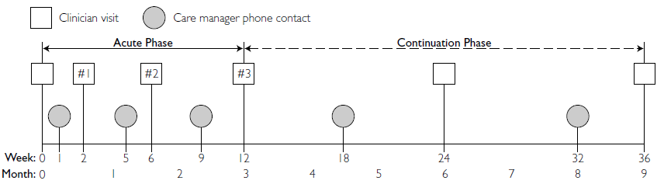
Proactive Case Management: Follow up & Intensity

Slide 31
Evidence-based Guidelines & Resources
Issue | Resource
Surveillance | Geriatric Medicine, ICF Core Sets for TBI
Case Mgmt | Case Management Society of America
Cognition | ACRM Cicerone Reviews Cognitive Rehab Manual; Warden 2005; Chew 2009
Headaches | AAN, Am Headache Society, International Society
Dep/Anxiety | American Psychiatric Assn; Warden 2005
Irr/Aggression | Warden 2005; Fleminger 2006
Function | American PT Association; OT Practice Guideline for Adults with TBI; American Speech Language & Association
Driving | Opinions of Expert Panel
Sleep | American Academy of Sleep Medicine
Social Supports | Best Practice Guidelines to Reduce Social Isolation in Elderly; Nat’l Family Caregivers Support; BIAA
General | Ontario Neurotrauma Foundation BI Guidelines

Slide 32
Resource Facilitation (RF)
An example of Supported Care Mgmt
9 months RF for RTW & School
  7 x more likely to RTW/School
  64% RTW/School with RF vs 36% for controls (p<.0001)
  Returned earlier & more often in RF group (p<.027)
  Less disability (p<.007)
  Decline in service utilization (p=.005)
Annual aggregate lifetime impact: $367 m/yr
  Wages and benefits = $2,49 million
  Revenue from taxes = $31 million
  Savings to SSDI/private disability = $80 million
  SNAP = $6.6 million
Now state-wide for ABI; funded through VR
RF = Collaborative Care Team + Care Manager
Vocational & community-based Services
e.g.: Employment Services
Follow-Up
Follow-Up
- - - - - - - - - - - - - Resource Facilitation
Follow-up
Follow-Up
Clinical Services
e.g.: Neuropsychology
Trexler LE, Parrott DR, & Malec JF. (2016). Replication of a Prospective RCT for RF to Improve Return to Work after Brain Injury. Arch Phys Med Rehabil 97(2), 204-210.
Trexler LE, Trexler LC, Malec JF, Klyce D, Parrott D. (2010). Prospective RCT of RF on community participation & vocational outcome following BI. JHTR 25(6), 440-446.
Trexler LE. Parrott DR (in press). Models of Brain Injury Vocational Rehabilitation: The Evidence for RF from Efficacy to Effectiveness. Journal of Vocational Rehabilitation.
Parrott DP, Ibarra SL, Trexler LE. (2018). Resource Facilitation: The patients, the process, and the outcomes. In Preparation.
Devaraj S, Hicks M, Patterson B (2017). Economic Impact of RF: Workforce Re-entry Following TBI. Center for Business and Economic Research, Ball State University.
Notes:
RF provides communication and coordination across service providers and community
…. Regarding how BI may influence treatment/service and how to compensate.
Employment services …. Substance abuse providers, Mental Health providers; Dept of Corrections
Neuropsychology …. PM&R, other ….

Slide 33
RF to Reduce Recidivism
Trexler LE & Parrott DR (in preparation). RF & the Prevention of Re-Incarceration.
60% screen + for BI in prisons vs 9% gen pop
95% screen + in Marion County Veterans Court
68% of veterans in Indiana prison screen + for moderate to severe TBI
RF decreased recidivism
Ex-offenders who did not get RF were:
    > 4 x as likely re-arrested at 6 months
    > 2x as likely re-arrested at 12 months
Among offenders released from prison: those with BI almost twice as likely to recidivate within a year compared to non-TBI offenders
Recidivism
Notes:
Money saved by decreasing recidivism.

Slide 34
Collaborative Care + RF for TBI Health Outcomes
Trexler and Hammond; Indiana ACL grant (2018 – 2021)
Goals:
  Improve health outcomes
  Prevent opioid misuse
  Prevent institutionalization, including incarceration
2 years RF
TBI-Coordinated Care Team (TBI-CCT): RF, PCP, Patient & Family, PMR & Neuropsychology
TBI-CCT develops care plan & surveillance metrics
Metrics managed/shared between TBI-CCT participants
Negotiate tx plan
Provide follow-up and treatment adjustment
Family Medicine
Consultants
PMR
Neuropsychology
Patient
Motivate adherence to tx
Monitor response to tx
Ongoing Assessment
Provide access to services and supports
Feedback to MD
Decision support
Care coordination
Resource Facilitator
Weekly case supervision
Treatment adjustment
Manage treat-to-target
Model adapted from J Fann and C Bombardier: Collaborative Care for Depression
Notes:
Indiana State Department of Health Lead Agency
Prospectively recruit 150 TBI from the trauma center and randomize 100 to RF
- Cohort metrics: e.g.: Mayo Portland q 6 months
- Specific metrics: Depression metric; Pain: # opioids
Few pts w/ TBI have a PCP & if they do have a PCP, they often don’t have expertise in BI & disability.
Immediate access
Consultation with experts
System & service navigator
Pain, opioid/substance use, depression, anxiety, behavior, …..

Slide 35

Exploring Myths About Brain Injury: Fact Versus Myth?
Severe TBI = poor outcome
No recovery occurs after 1st year post-injury
Brain injury is a dynamic & chronic condition
Many chronic conditions are managed proactively to optimize outcome
We have no control over the trajectory of recovery
Notes:
Severe TBI may have poor outcome, but more frequently good outcomes – living, loving, working, …

Slide 36
Self-fulfilling Prophecy of Poor Outcome
Severe TBI = Poor Outcome
Poor Outcome
Poor Outcome
Minimize Resources

Slide 37
Range of Outcomes Possible
Severe TBI = Varied Outcomes
Optimal Outcome
Range of outcomes possible
Prevention, Surveillance Treatment

Slide 38

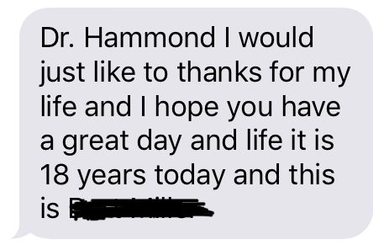
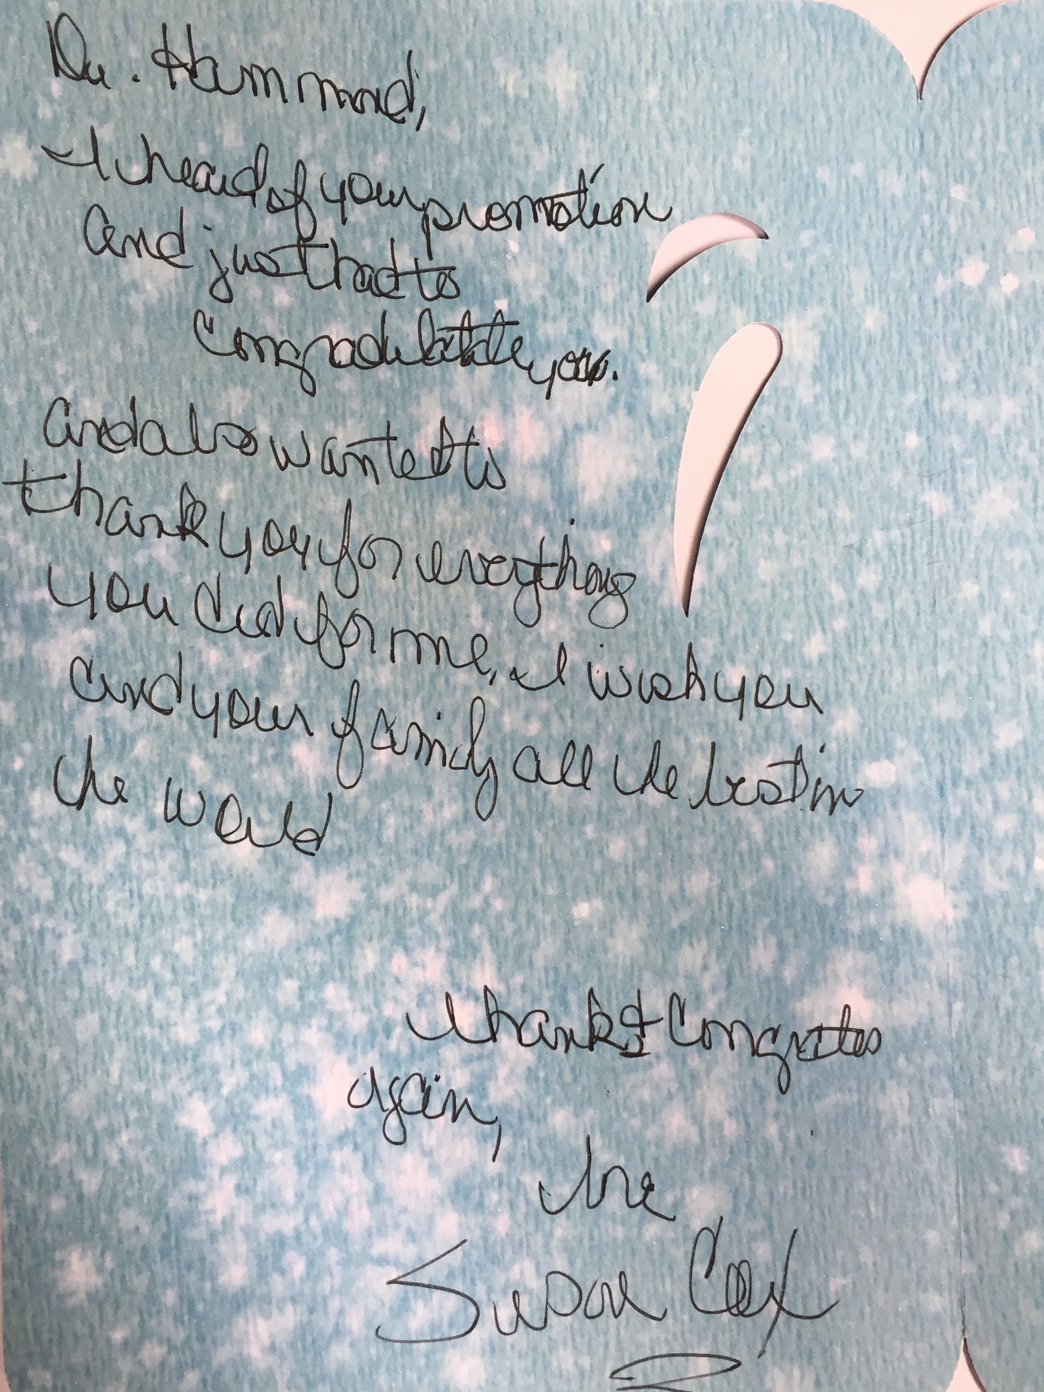
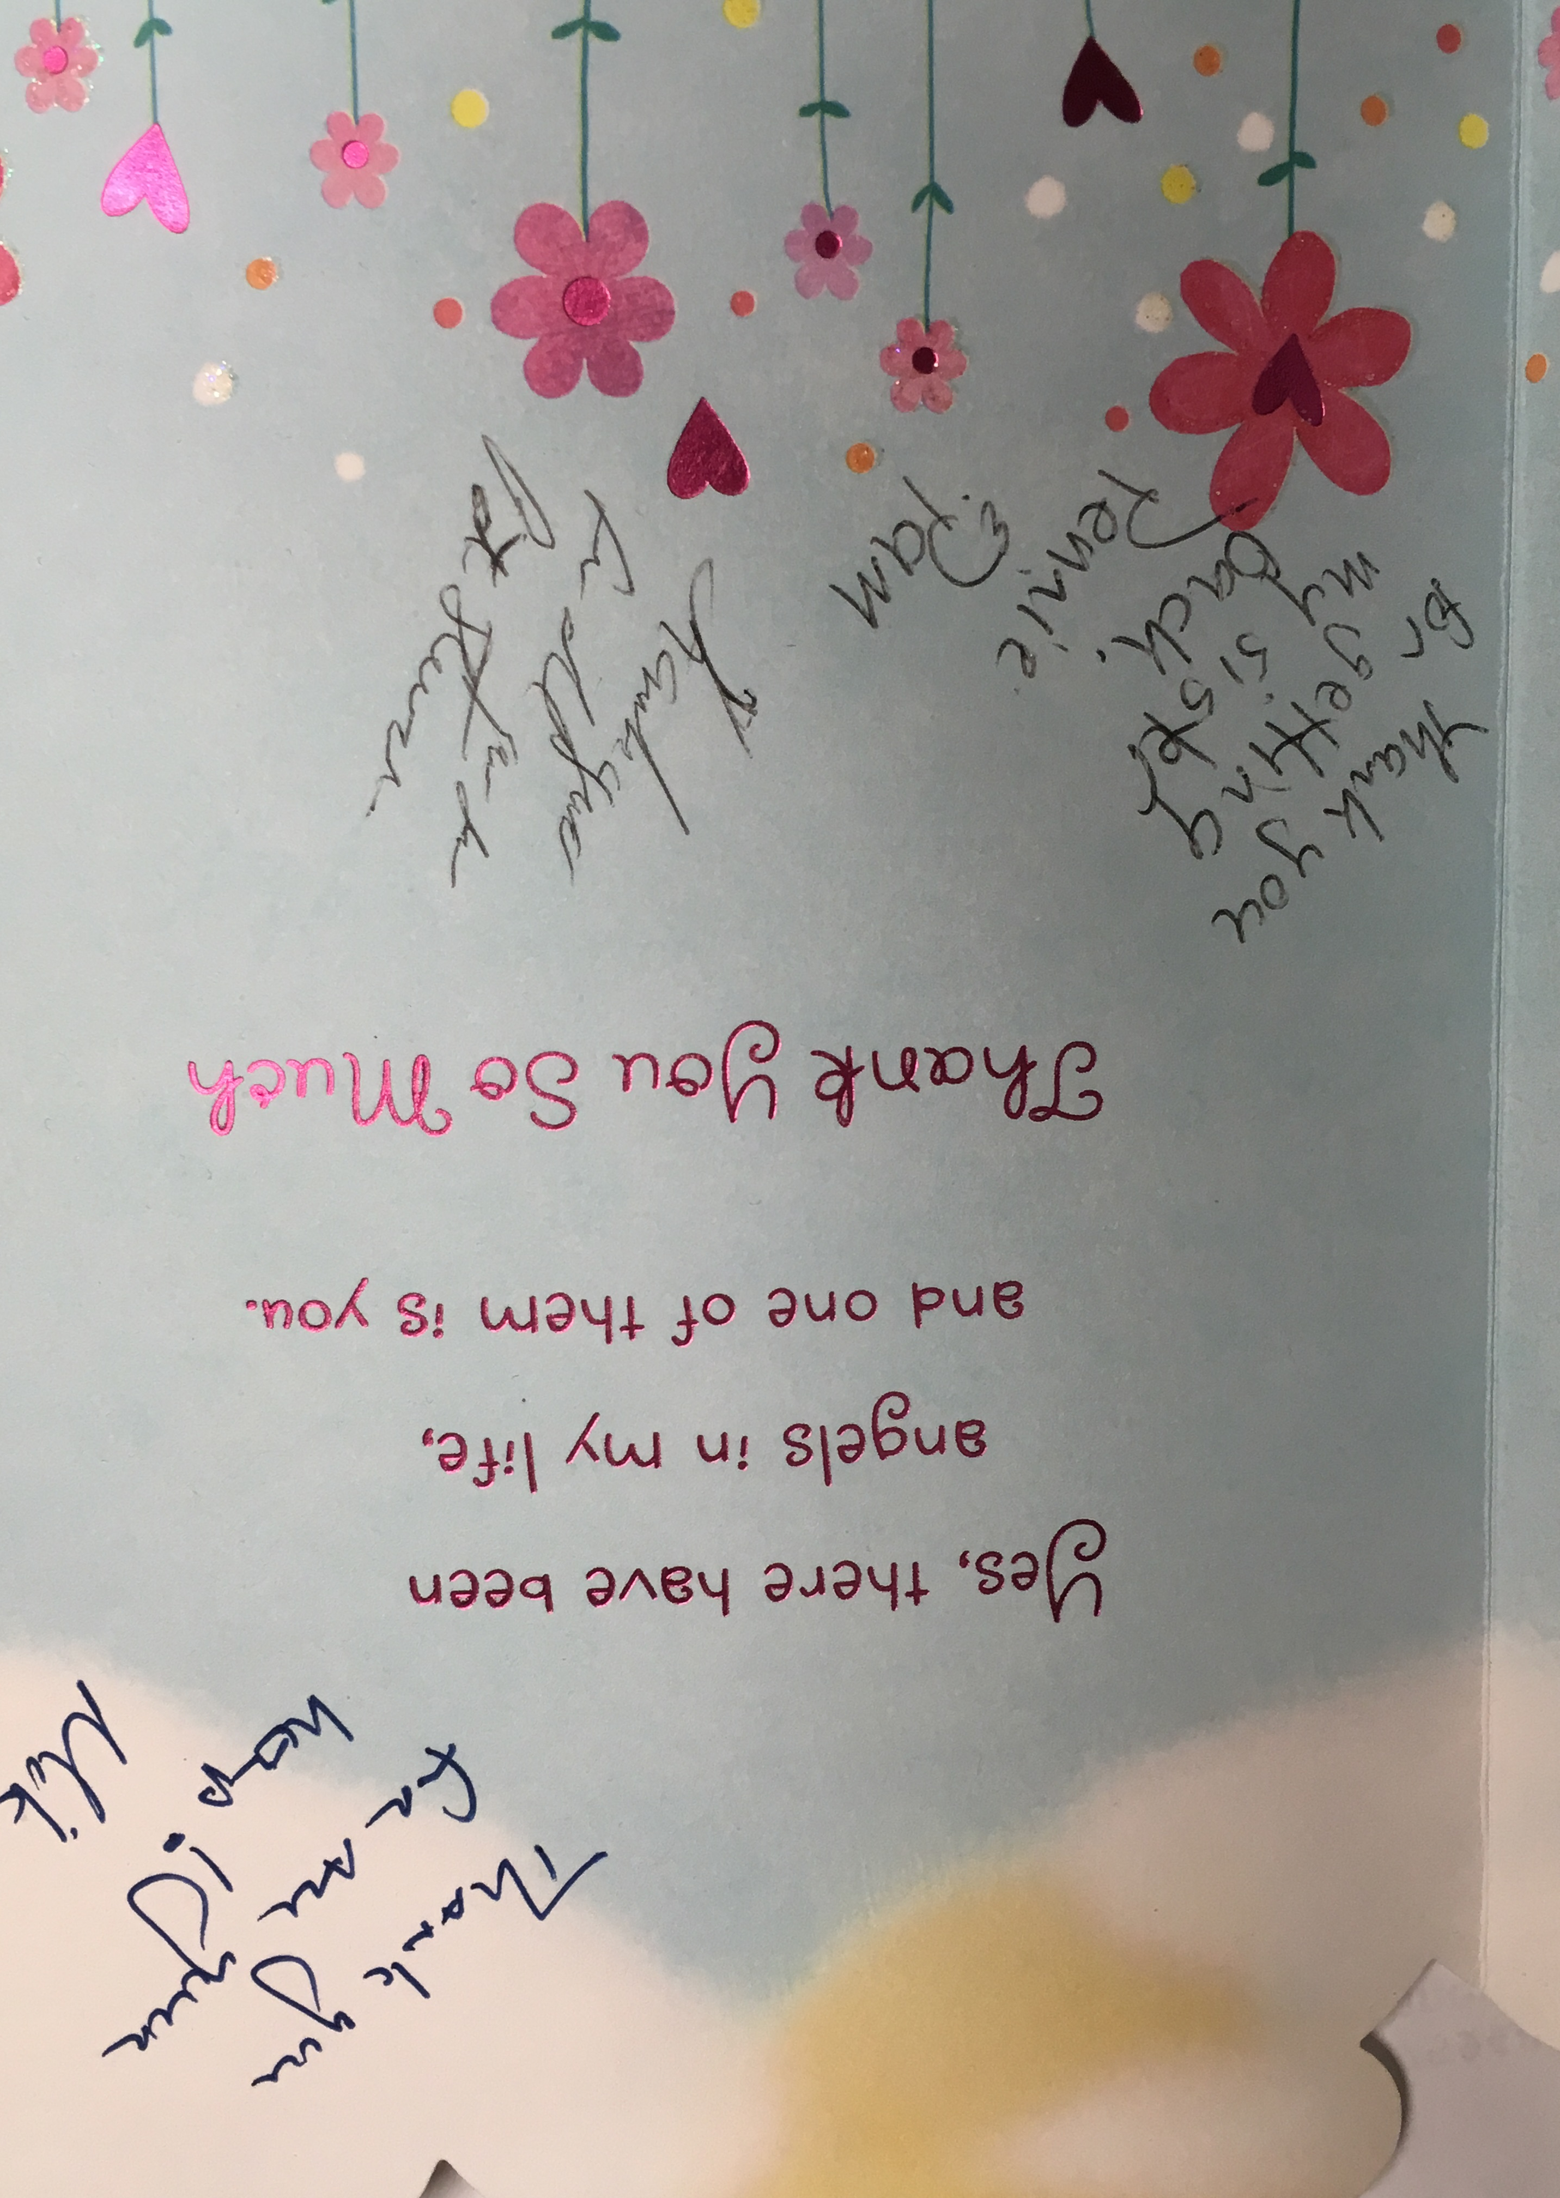
The Power of Possibilities and Access to Care.
Notes:
There is a human impact to believing or not believing myths.
_____________
These lives would not have been if the people around them embraced these myths.

Slide 39

Summary
Need to modify our expectations & treatment approaches
Paradigm shift to treat BI as a chronic condition to enhance care & access to optimize outcomes
Still many unanswered questions ...
Transformative moment
We know enough to begin implementing & studying solutions now
What will you commit to implement?
Notes:
The first thing you can do is check your beliefs; and then help teach others.
RHI/I commitment:
- Annual meeting on CBI
- Patient goals

Slide 40

Indiana Resource Facilitation Program of Research:
The New Indiana TBI State Partnership Program Mentor State Funding Opportunity
Improving Health Outcomes following Traumatic Brain Injury through Building a TBI-informed System of Services and Supports and Resource Facilitation

Slide 41
Flora Hammond, MD
flora.hammond@rhin.com

