Slide 1
Administration for Community Living
ACL Resources to Grantees
The following slides represent a portion of the slide deck presented to grantees - Mentor and Partner ACL Kickoff Webinar, June 2018.
Slide order & content have been tailored to IN Advisory Board Meeting

Slide 2
Overview
Administration for Community Living -organizational structure
TBI State Partnership Program organization & administration
Meet the Grantees
Mentor & Partner State Workgroups
TBI Coordinating Center
Introduction to the ACL State Partnership Program Website

Slide 3
ACL's organizational structure and related programs
Office of External Affairs
Administrator
Principal Deputy Administrator
Center for Management and Budget
Center for Policy & Evaluation
Office of Budget & Finance
Office of Grants Mgmt.
Office of Admin & Personnel
Office of Info RM
Office of Policy Analysis & Development
Office of Policy Performance & Evaluation
Administration on Aging
Center for Integrated Programs
Administration on Disabilities
National Institute on Disability, Independent Living, and Rehabilitation Research (NIDILRR)
Long-Term Care Ombudsman Program
Evidence-Based Falls Prevention Programs
Veteran-Directed Home and Community Based Services
No Wrong Door System
Ind. Living Admin.
Admin. on Intellectual Develop. Disabilities
TBI Model Systems Program
Research grant programs
Amputee Coalition
Centers for Independent Living
Paralysis Resource Center
Statewide Independent Living Councils
TBI Coordinating Center
TBI State Partnership Program
State Councils on Developmental Disabilities
TBI Protection & Advocacy Program
Notes:
Complex structure – departments and associated programs

Slide 4
TBI State Partnership Program
Organization and administration
Mentors: maintain and expand established infrastructure, mentor partners, collaborate with other mentors to improve the national impact of the TBI program
Partners - collaborate with mentor states to build and enhance basic infrastructure
Mentors
Partners
ACL
TBI Coordinating Center
TBI Coordinating Center: collaborate with grantees and other TBI stakeholders to maximize the health and independence of individuals who sustain a TBI
Administer the TBI State Partnership Program to create and strengthen a system of services and supports that maximize the independence, well-being, and health of persons with TBI across the lifespan and aids their families and caregivers
Notes:
The purpose of this program is to create and strengthen a system of services and supports that maximizes the independence, well-being, and health of persons with TBI across the lifespan and aids their families, and their caregivers.
For the 2018 funding cycle, ACL is funding two tiers of grantees through the TBI State Partnership Program: Partner State Grants and Mentor State Grants.
Grantees from both tiers will work together to maximize the program’s impact nationally.
ACL is focused on fostering collaboration between partner and mentor states, and among other TBI stakeholders.

Slide 5








Meet the Grantees
New Grantees | Welcome Back | Criminal Justice | Schools
Arkansas ● California ● Georgia ● Kansas ● Kentucky ● Maryland ● Minnesota ● Oregon ● Rhode Island ● Utah ● Vermont | Alaska ● Colorado ● Idaho ● Indiana ● Iowa ● Massachusetts ● Missouri ● Nebraska ● North Carolina ● Pennsylvania ● Tennessee ● Virginia ● West Virginia | Colorado ● Pennsylvania ● Vermont ● California | Colorado ● Pennsylvania ● Iowa ● Oregon ● Missouri ● Nebraska
Opioid Focus | Resource Facilitation | Registry and Outreach | Underserved Population
Massachusetts ● Virginia ● Kentucky ● Maryland ● North Carolina ● West Virginia | Colorado ● Pennsylvania ● Iowa ● Vermont ● California ● Tennessee ● Indiana ● Oregon ● Nebraska | Georgia ● Kansas ● Minnesota ● Missouri ● Rhode Island ● Idaho ● Maryland ● Utah | Alaska ● Arkansas ● Idaho ● Iowa ● Minnesota ● Nebraska ● Oregon ● West Virginia ● Missouri
Notes:
This is a snapshot of state priority areas – not all inclusive

Slide 6







ACL Identified Mentor and Partner Workgroups
advisory boards & survivor engagement | using data to connect people to services | return to learn & return to play | criminal & juvenile justice | opioid use and mental health concerns
MENTORS: Tennessee ● West Virginia PARTNERS: Arkansas ● Georgia ● Kentucky ● Maryland ● Minnesota ● Rhode Island | MENTORS: Indiana ● Nebraska ● Virginia PARTNERS: Alaska ● Georgia ● Idaho ● Kansas ● Minnesota ● Missouri ● Rhode Island ● Utah ● Vermont | MENTORS: Pennsylvania ● Oregon PARTNERS: Missouri ● Utah | MENTORS: Colorado ● Pennsylvania PARTNERS: California ● Vermont | MENTORS: Massachusetts ● Virginia PARTNERS: Kentucky ● Maryland ● North Carolina
sustainable partnerships | transition and employment | underserved populations | waivers and trust funds
MENTORS: Iowa ● Massachusetts PARTNERS: Georgia ● Kansas ● Kentucky ● Maryland ● Rhode Island | MENTORS: Indiana ● Nebraska ● Tennessee PARTNERS: Alaska ● North Carolina ● Vermont | MENTORS: Oregon ● West Virginia PARTNERS: Arkansas ● California ● Idaho ● Minnesota ● Missouri ● Utah | MENTORS: Colorado ● Iowa PARTNERS: Alaska ● Arkansas ● Idaho ● Kansas ● North Carolina
Notes:
Responsibilities for each group will include at least monthly teleconferences or webinars and a product produced annually.

Slide 7






TBI Coordinating Center - Role and Responsibilities
The TBI Coordinating Center team collaborates with grant recipients and other TBI stakeholders to help all people in the TBI community find and access the information they need.
Assistance is available to the entire TBI community, especially federal partners, TBI survivors, their caregivers, and family members.
TBI Coordinating Center offers, among other things:
summaries of available literature | information about hot topics or promising practices supporting the TBI community | help accessing legacy materials created throughout the TBI Programs' history
a newsletter containing program updates, recent research summaries, and a TBI news round-up | connections to local, state, or nationwide TBI resources for survivors, caregivers, and families | avenues for collaboration with ACL and TBI SPP grant recipients

Slide 8
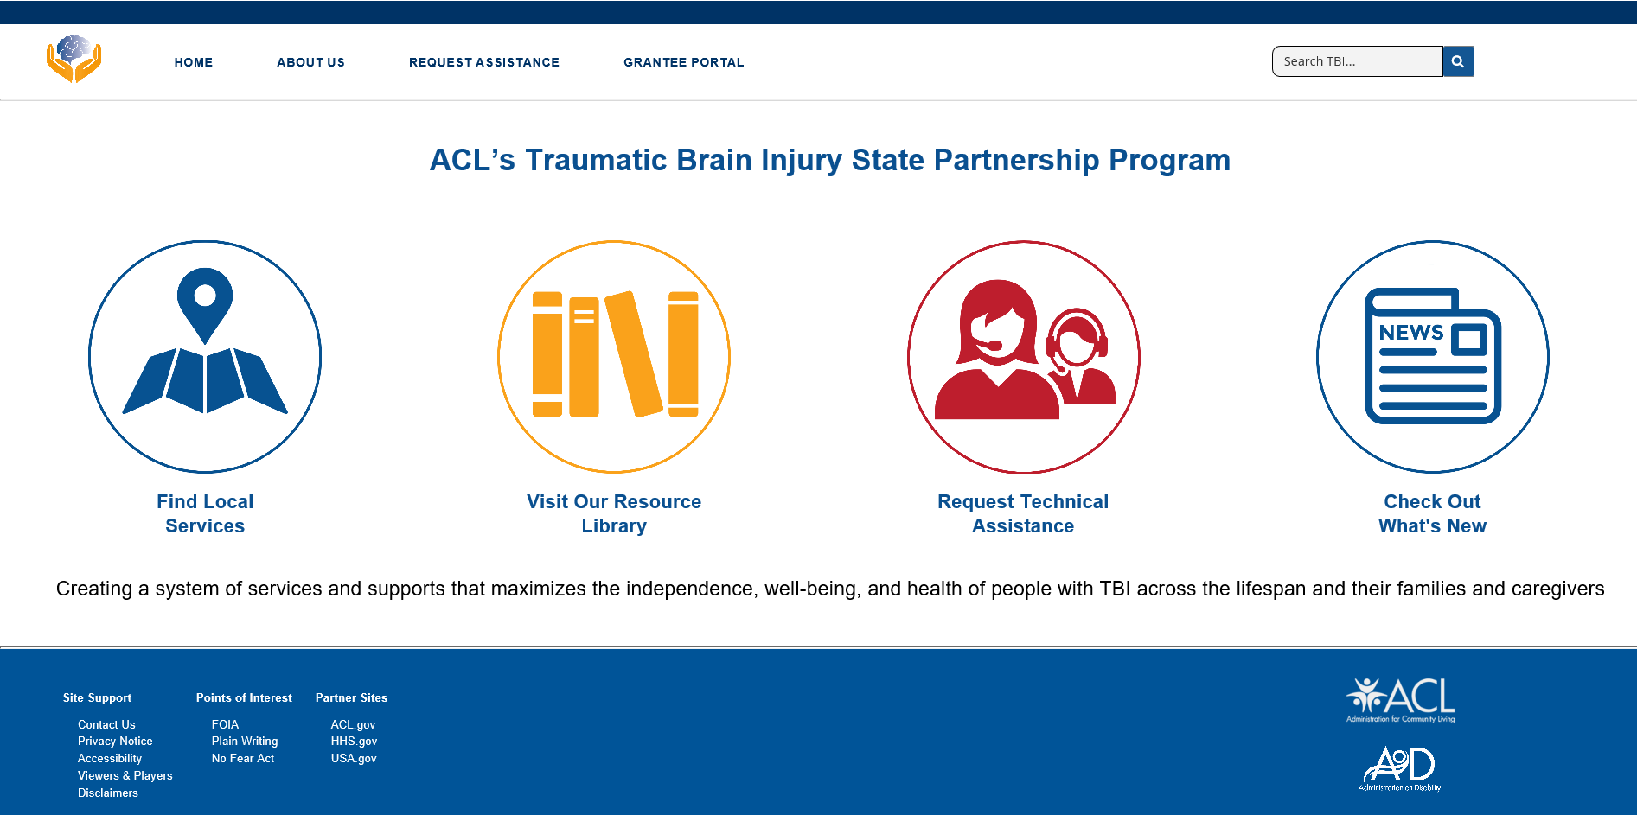
TBI State Partnership Program Website https://tbi.acl.gov
Access TBI and disability-related resources in your state (in development)
Use a searchable database of resources for the TBI community (in development)
Submit a request for assistance from the TBI Coordinating Center
See recent TBI-related research, news, and events (in development)
Notes:
Website is in development
1000’s of legacy documents currently being reviewed, organized, catalogued.
There will be more than one access portal – public access and grantee workspace
Website access may be early 2019
Next slide will show you links that are partially hidden by the info boxes

Slide 9
Site Support: Contact Us, Privacy Notice, Accessibility,
Viewers & Players, Disclaimers
Points of Interest: Freedom of Information Act, Plain Writing,
No Fear Act
Partner Sites: ACL.gov, HHS.gov, USA.gov

Slide 10



Disclosures
Funding for this presentation was made possible (in part) by the Administration for Community Living. The views expressed in written conference materials or publications and by speakers and moderators do not necessarily reflect the official policies of the Department of Health and Human Services, nor does the mention of trade names, commercial practices, or organizations imply endorsement by the U.S. Government.

