Slide 1
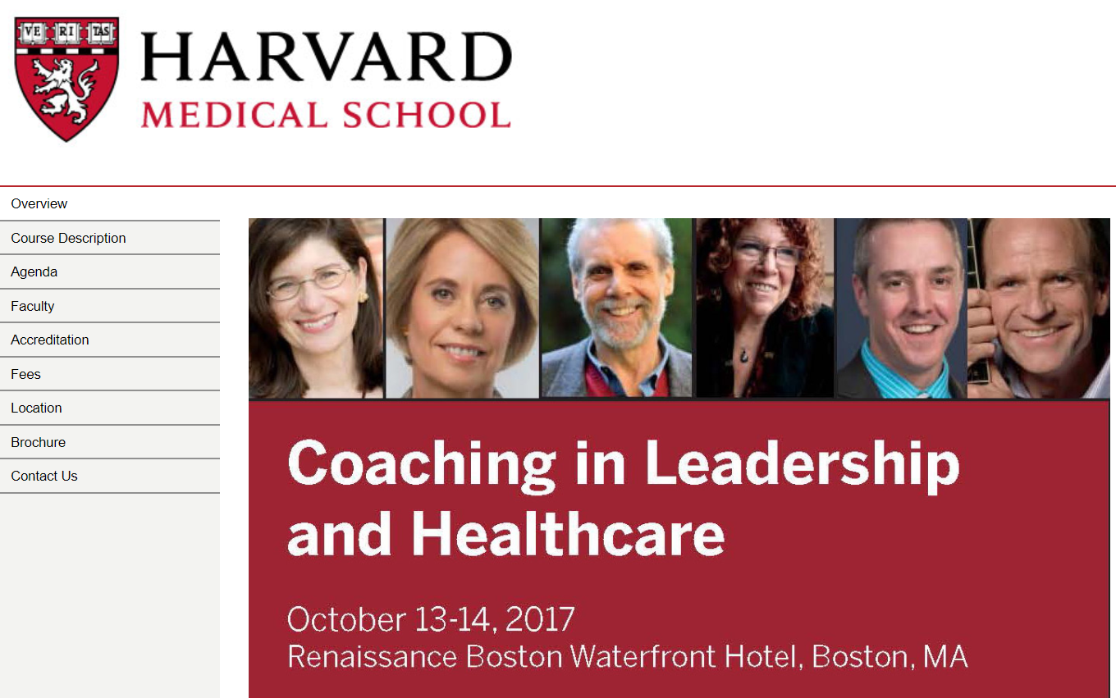
Disclaimer – these are my notes and NOT official conference literature.
Not intended for publication or profit.

Slide 2
Highlights from 2017 Coaching in Leadership and Healthcare
Compiled by Joselyn Hall, International MBA
Wellcoaches® Certified Personal Coach
Wellcoaches® Certified Health and Wellness Coach
Intended for Internal Use ONLY – not conference approved literature
October 13-14, 2017

Slide 3
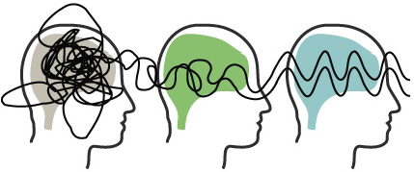
The Science of Mindfulness
Presented by Daniel Goleman, PhD
Meditation is a mental workout
After 8 weeks you can begin to see the benefits
CLEAR
CALM
KIND
Notes:
Clear – increased focus
Calm – increased stress resilience
Kind – increased caring

Slide 4
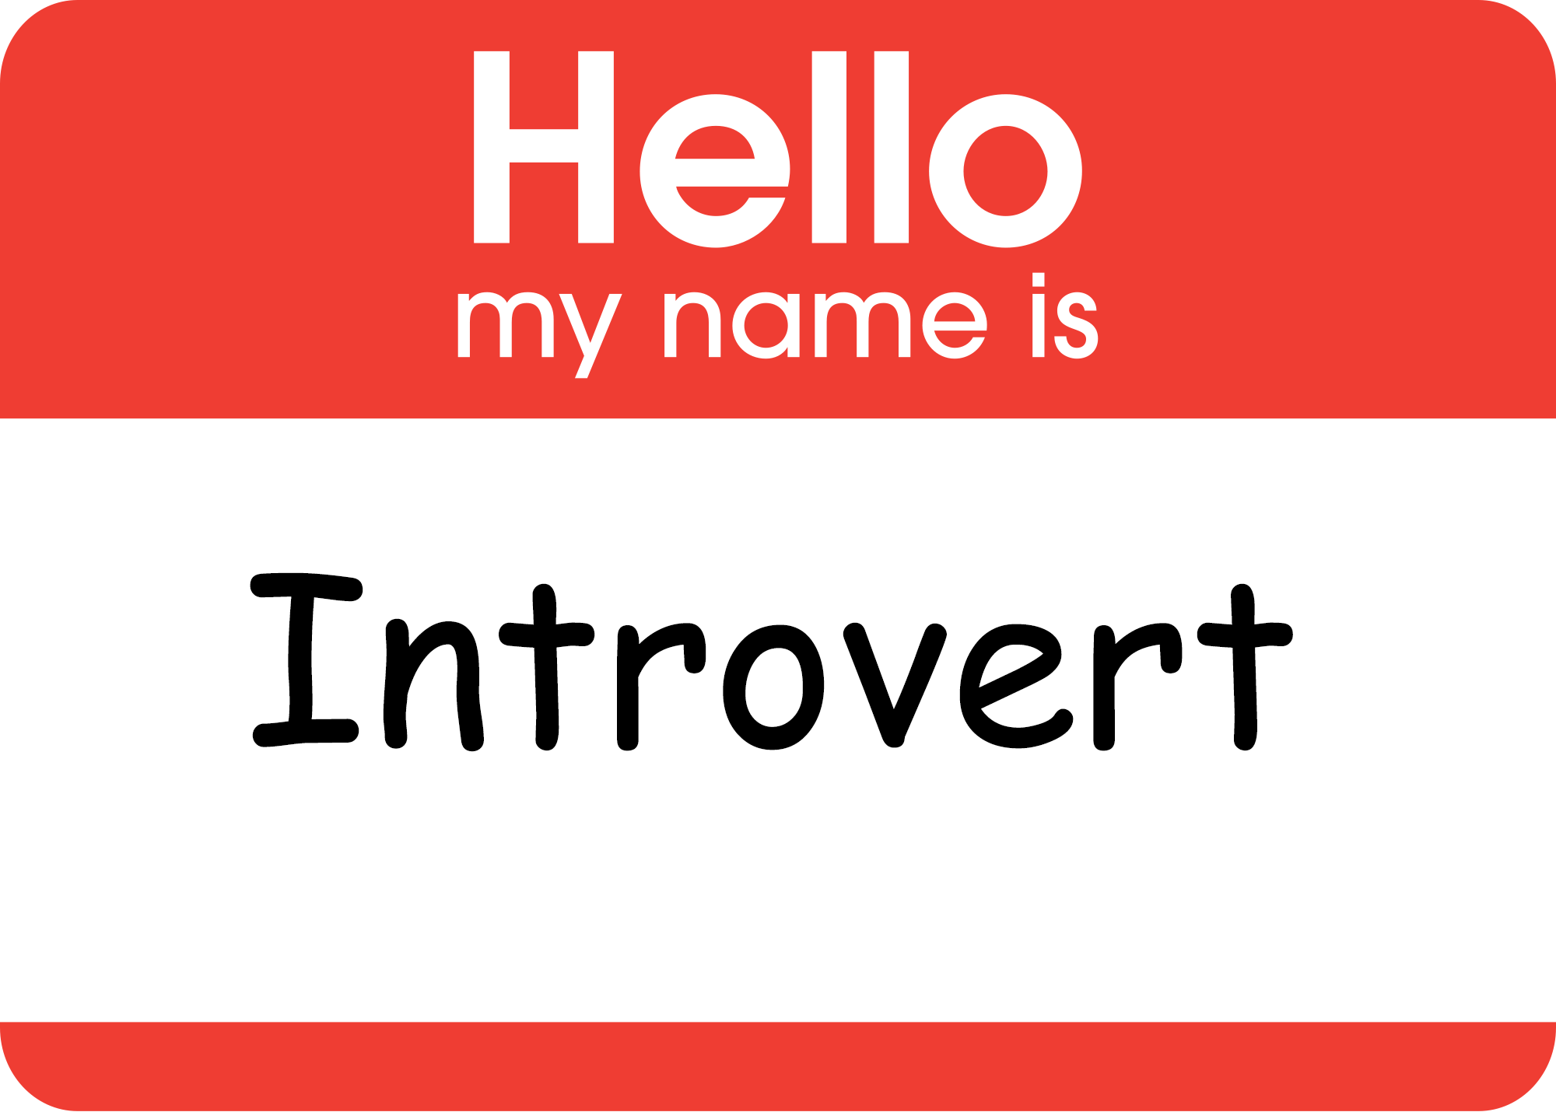

Quiet
How to Transform the Strengths of Introverts
Presented by Susan Cain, Author, Co-Founder, Quiet Revolution
Solitude is needed to figure out your own ORIGINAL thoughts
Check out this group thinking video by Solomon Asch

Slide 5
Positive Psychology
Greatest Hits of Character Strengths
Presented by Ryan M. Niemiec, PsyD
Take the free, scientific VIA Survey of strengths.
Use one signature strength in a new way each day
Don’t know your signature strength? Write down the compliments you receive most often.
Character Strengths Appreciation
Your Partner’s Top 3 Strengths
Recent Admirable Moment
Share, Explain, Appreciate

Slide 6
Restoring Leadership as a Noble Profession
Presented by Margaret J. Wheatley, EdD
Reflection time is essential for leaders
No Ethics
Weak Ethics
Strong Ethics
No Connections
Strong Connections
Loose Connections

Slide 7

Leadership: Executive Coaching on the Cusp of Disruption: What's Up with the Mashup?
Presented by Whitney Johnson, David Peterson, PhD
Evolution isn’t linear
Crouch before you jump
Careers are a series of chutes and ladders

Slide 8
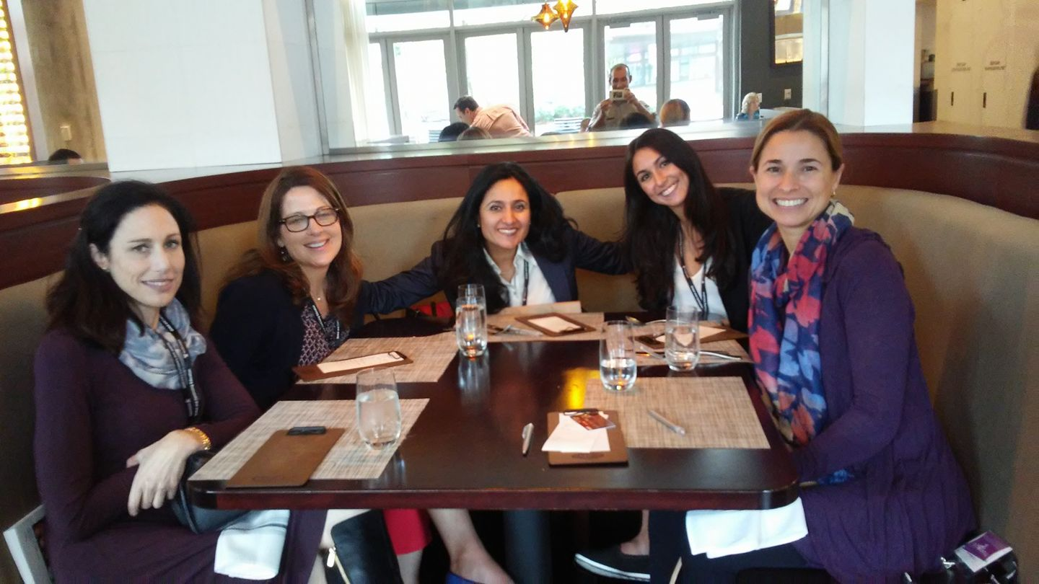
Great to connect with amazing faculty, fellows and friends!

