Slide 1

Plaque de
Memoir
Catalogue
info@felicityandco.net

Slide 2
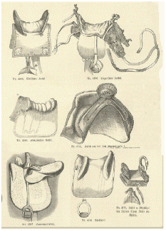
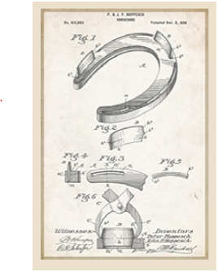
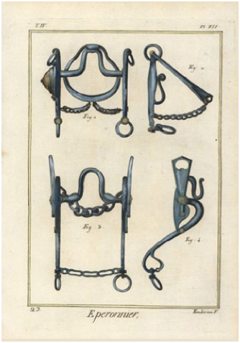
the Equine Series
No. 34 – Take a Seat
No. 36 – Walk a Mile
No. 35 – Bits & Pieces
Notes:
Fjfjfjf

Slide 3

the Milestones
Series
No. 60 - Graduation

Slide 4



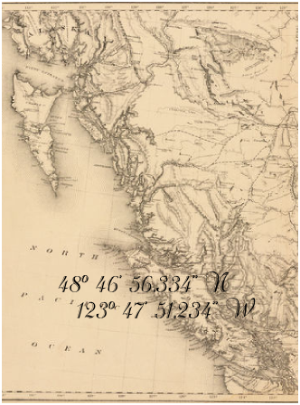
The Cowichan Valley
Series
No. 10
The Warm Place
No. 11
Providence will Provide
No. 13
Under the Whippletree
No. 3
The Cowichan Valley

Slide 5
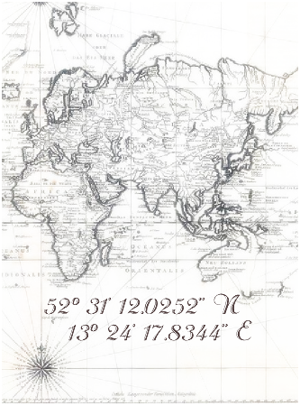
The Where We Were When Series
No. 2 - Berlin
No. 3
The Cowichan Valley

Slide 6




The Passionate Pursuits
Series
No. 40 – Bridge over
Troubled Waters
No. 42 – A Noble Pursuit
No. 41
Fishing & Thinking
No. 43 - Take a Hike

Slide 7



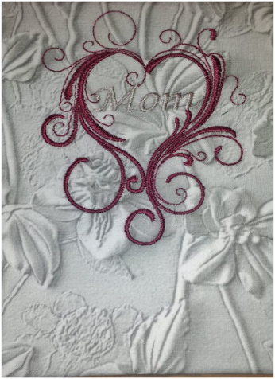
The Family Series
No. 20 – My Mom
No. 21 – My Dad
No. 22
Dad, my foundation
(embroidered)
No. 23
Mom, my inspiration
(embroidered)

Slide 8

The Thoughts Series
No. 1 – And I Think

