Slide 1

Are you a traveling man?
Grand Lodge of Arizona Masonic Leadership Retreat 2019
Information and best practices for traveling the world as a mason

Slide 2
A Brief history of masonic travel
One of the most important rights and privileges of a Master Mason is his freedom to travel. In ancient times, this privilege permitted Master Masons to work and travel in foreign lands, unlike other craftsmen. This special privilege was afforded to our craft, because their labor was required in different locations depending to renew their employment as each building project was completed. As Operative Masonry gave way to Speculative Masonry, this ancient right was retained and a Master Mason was allowed to freely travel from one lodge to another, even though he is not a member of that specific lodge. This fluid nature of the Operative Craft led to the formation of trade societies, known as lodges, to protect the professional integrity of their occupation, and to enhance the moral and social practices of their members. It is surmised, not without some evidence, that the modes of recognition were originated in the operative period as a means of identifying the genuinely skilled mason who came to visit a lodge in search of work
In the modern day, "traveling" is the primary method by which a Masons expands his Masonic horizons, gains increased knowledge of our craft and meets new brothers. By visiting another lodge, a Mason gets to see variations in the work and gains insight into the different ways Masonic Lodges handle their internal business. This valuable experience will make the man traveling a better Mason and in return will make his lodge better by virtue of his experience.

Slide 3
I want to visit a lodge in our jurisdiction as an Arizona mason?
How should I proceed?
There are many masons who are members of our jurisdiction, new and seasoned who have not had the privilege to travel to other lodges or have travelled only a limited amount of times in our great state and often times unsure what to do, say, and how to proceed with the process.
So you have decided on a lodge you would like to visit, researched the date and time of the meeting you plan on attending or just plain information for a future TBD visit. Now what?
It is suggested that you give a call to the lodge and speak to the secretary as the first point of contact (unless you already know a mason in that lodge) and ask these following questions:
What meeting will this be? Stated meeting, degree night, education night? (if its something else, he will let you know!)
What is the dress code for your lodge or for this particular meeting?
Is there a dinner prior or after the meeting? If so, how much?
Will there be any fellowship prior or after the meeting? If so, you should attend and meet the brethren of that lodge in an informal setting! (there may be libations involved)
While on the phone with the secretary, you can inform him that you plan on being there on a specific meeting night as he will usually let the worshipful master know of your planned visitation so he can expect you on that day and receive you properly!

Slide 4
I arrived at the lodge, who should I be speaking to??
The first brother that you see when you walk through the door as members of the lodge would usually be glad to help out a visitor to their lodge! You should introduce yourself to that brother with your name, lodge number, if you are an EA, FC, MM, officer or past and informing him whether you are a first time visitor or returning visitor so he can approach the worshipful master informing him of your visit (the more info you can give, the better). Any worshipful master of a lodge will be happy to have visitors to his lodge!
If you are visiting that lodge for the first time, you will be referred to an investigation committee formed by the Worshipful Master to prove that you are master mason in good standing or in the case if you are and EA or FC, they can handle the investigation differently.
What is an investigation committee and why do I have to be investigated? Can’t the master just take my word?
The investigating committee are a group of members of the lodge, usually consists of the tiler and between 1-3 other members (could be a mix of master masons, lodge officers, past masters).
We do not want those who are not qualified, or who are not members in good standing entering our Lodges. The responsibility is on the worshipful master as he was charged to ensure that no visitor shall be received into his lodge without due examination and the visiting brother has been duly and truly been initiated into a regular lodge.
While there are no specific questions that will be asked by the investigating committee as it will be determined by them to prove that you are a mason in good standing. Generally what they will ask for first is to see your dues card and if you know the tilers oath (it’s okay if you don’t know it).
(*Very important note, always have your dues card with you! You’ll be surprised how often that happens and will be denied entrance into a lodge)

Slide 5
You want to visit a lodge outside the state of Arizona?
How should I proceed?
The process of visiting a lodge outside the state of Arizona is no different than the best practices mentioned in the previous two slides with one additional item to check for when preparing to travel outside of Arizona.
It is important to check with the secretary of your lodge and ask for him to look through what's called a Pantagraph, which is a book also called the “List of Lodges” (which an updated copy is distributed annually to all lodge secretary's. If he doesn’t have one, please call the grand secretary's office and they will assist you.)
This publication lists all recognized Masonic Lodges around the world that the grand lodge of Arizona recognizes and should be used to check the legitimacy of the Lodge in which the brother desires to visit. (masonic recognition between other grand jurisdictions is another topic that can be a class on it’s own but we won’t get into that today, but it is fascinating)

Slide 6
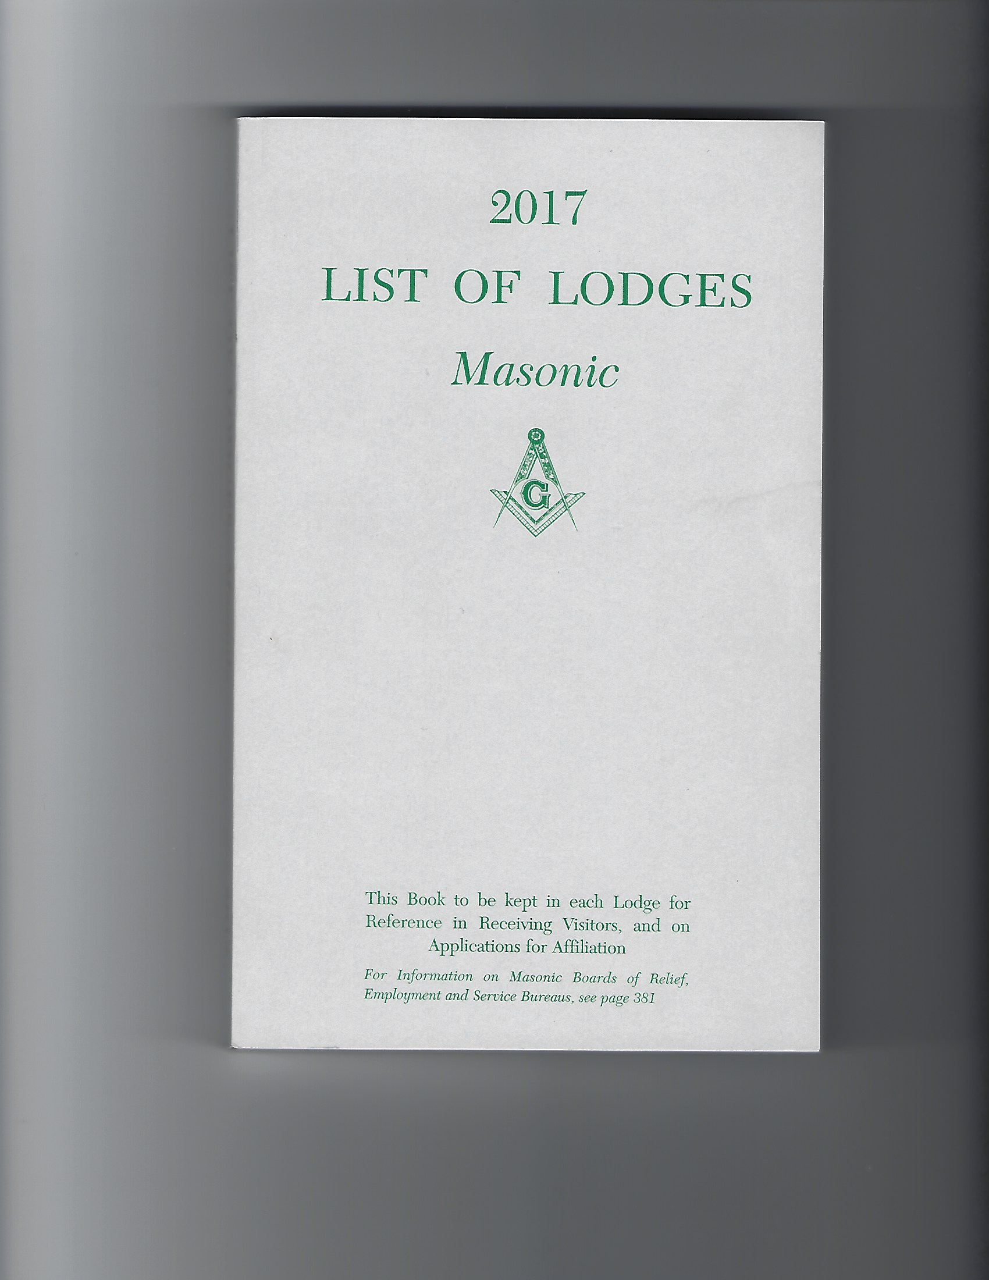

Slide 7
Travelling to a lodge in a grand jurisdiction outside of the United States
Travelling to a lodge in a grand jurisdiction outside of the United States is a fantastic way to see and learn how masonic lodges operate, which will generally completely different than what you imagine than what you are used to.
How do I prepare for a visit to a lodge internationally? Is it the same as visiting a local lodge in Arizona or in the United States?
The answer is yes and no and here are the differences in the process and procedures on what needs to be done to prepare for your visit
Once you have decided which country the lodges you will be visiting (assuming that you have also contacted the lodge secretary via email or a phone call as mentioned in the previous slides for more information), please contact your secretary or the grand secretary's office to ensure that those lodges are in fact recognized by The Grand Lodge of Arizona by checking the Pantagraph/List of Lodges book.
Once confirmed that the lodges you’ve decided to visit are recognized, inform the Grand Secretary your plans and he will draft a document called a “Letter of Introduction”, which will contain necessary information that will inform the lodges you will be visiting that you are indeed a Mason in good standing with the Grand Lodge of Arizona. Information contained in the “Letter of Introduction”:
Confirming that you are a Master Mason in good standing along with the name and # of your lodge
The date that you were raised to the sublime degree of a Master Mason
Informing the Worshipful Master of that lodge to afford you the courtesy of being able to have masonic communication with members of said lodge after due examination
Name and signature of the Grand Secretary
Seal of the Grand Lodge of Arizona
**Please note that all the items mentioned above SHOULD be done at a minimum of ONE month prior to your trip but preferably two to three months to allow the Grand Secretary the time to research the necessary information you have provided, that you are a Master Mason in good standing, and to prepare the “Letter of Introduction/Good Standing” for you to bring with you during your visit.

Slide 8
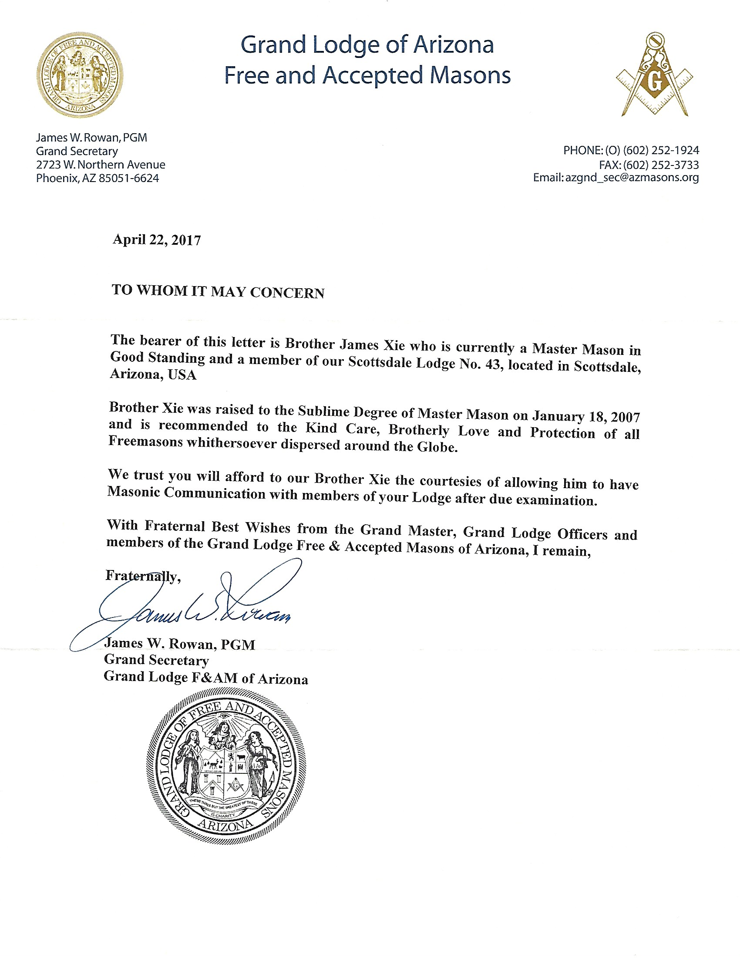

Slide 9
So what should I be bringing with me on my trip?
Your dues card
The “Letter of Introduction” given to you by the Grand Secretary
A suit or a tuxedo (or both), assuming you spoke to the lodge secretary what the dress code is
If asked to speak in front of the lodge on your visit, please prepare words of warm greetings on behalf of your worshipful master and the grand master
(Optional) Gifts on behalf of yourself, your worshipful master/lodge, or the grand master. Items could be a lodge pin, grand lodge pin, coin, plaque, other unique masonic gifts
Your best behavior as you are representing the Grand Master, Grand Line Officers, The Grand Lodge of Arizona and all of it’s members in our jurisdiction no matter where you travel to!

Slide 10
Why is travelling important as a mason? What are the benefits?
Our ritual mentions the word travel many times over and where we coin the phrase “Are you a traveling man?”. Are we practicing what we repeat and preach at each of our degrees?
"traveling" is the primary method by which a Masons expands his Masonic horizons, gains increased knowledge of our craft and meets new brothers. By visiting another lodge, a Mason gets to see variations in the work and gains insight into the different ways Masonic Lodges handle their internal business. This valuable experience will make the man traveling a better Mason and in return will make his lodge better by virtue of his experience.
Additional benefits to traveling as a mason:
To explore the various designs of other masonic temples and to view the architect. Many lodges around the world are several hundreds of years old and to stand in one of these lodges is awe-inspiring
To see the differences in the “work” that the lodges does from their Stated Meetings, Degrees, and Education
Dress code and aprons
Table Lodges (which is a typical things after each of their meetings) and Festive Boards
To talk and become friends with the brothers you will meet, to discuss the differences between the two grand lodges and the individual lodges, share ideas and bring back valuable information back to your lodge and to the Grand Lodge of Arizona what you have learned and that maybe some of it can be incorporated into the operations to make our craft better!
There are of course many other benefits in addition to what was briefly mentioned above!

