Slide 1
ARIZONA MASONIC FOUNDATION FOR CHILDREN'S
Masonic Model Student Assistance Program
(Children at Risk)
INFORMATION BRIEFING
FOR GRAND LODGE LEADERSHIP CONFERENCE
March 29 - 31, 2019

Slide 2
Chinese Proverb
“A child’s life is like a piece of paper on which every person leaves a mark.”

Slide 3
Children and Teens in America Today
Provided by: CDF (2017-2018)
Each Day in America - 2016
  4 Children Are Killed By Abuse Or Neglect - 48 Children Or Teens Are Injured Or Killed With A Gun - 6 Children Or Teens Are Killed By Guns - 6 Children Or Teens Commit Suicide
  4,396 Babies Are Born To Unmarried Mothers - 761 To Teen Mothers - 2,500 Into Poverty 1,151 Into Extreme Poverty. 1,345 Without Health Insurance. 874 At Low Birthweight

Slide 4
Children and Teens in America Today
Provided by: Childrens Defense Fund (2017-2018)
Each Day in America – 2016 (Continued)
3,617 Children Are Arrested - 167 For Violent Crimes - 384 For Drug Crimes
927 Public School Students Are Corporally Punished 16,244 Are Suspended -2,857 HS Students Drop Out.
1,903 Children Are Confirmed As Abused Or Neglected.

Slide 5
State of Arizona Data
Provided by: Childrens Defense Fund (2014)
1,627,988 Children Live In Arizona - 2014
  Every 17 Hours A Child Dies Before His/Her First Birthday
  434,950 (27.2%) Are Poor » 196,441 (12.3%) In Extreme Poverty
  60.5% Under Age 6 Have Parents In The Labor Force - 64,023 Children Are Raised By Their Grandparents
  Arizona Ranks 40th Plus In Many Of The Categories By State Ranking

Slide 6
One In Eight Children In The United States Is Maltreated Before Turning 18
The Study:
  Published In The JAMA June 2, 2014
  Based On Data Gathered Between 2004 And 2011 Representing Nearly 5.7M Confirmed Cases Of Maltreatment
Result
  That 12.5% Of U.S. Children (or 1 in 8) Experienced A CPS Confirmed Case Of Maltreatment By Age 18
  The Term "Maltreatment" Includes Neglect As Well As Physical, Sexual And Emotional Abuse
  Almost 80 Percent Were Cases Of Neglect

Slide 7
PUT IT IN PERSPECTIVE
US CHILDREN POPULATION
  Over 74.7M
  Maltreated US Children – Over 9.3M
Arizona CHILDREN POPULATION
  Over 1.6M
  Maltreated AZ Children – Over 200,000
Maltreatment Is Only One Cause Of At Risk Children

Slide 8


A CHILD AT RISK WILL REMAIN AT RISK UNTIL SOMEONE INTERVENES
Do you know a kid at risk?
Which One Will Be Maltreated By Age 18?

Slide 9
This Is Serious Business We Are Engaged In
Without INTERVENTION – COMING TO A PLACE NEAR YOU:
  Santa Fe High School - Texas
  Marjory Stoneman Douglas High School, Parkland, FL
  Marshall County High School , Benton, KY
  Two 15 Year Old Girls In Mesa – Murder/Suicide
  A 12 Year Old Using A Gun In NM To Shoot Classmates,

Slide 10
This Is Serious Business We Are Engaged In
  Previously,
    20 SMALL CHILDREN GUNNED DOWN in an Elementary School at Christmas time in Connecticut.
    Eric Harris and Dylan Klebold at Columbine High School,
      DIANE SAWYER INTERVIEW
    Thomas "T.J." Lane at Chardon High School in Ohio, etc.
    Jared Loughner At A Safeway Supermarket In Tucson Arizona, -----

Slide 11
EARLY IDENTIFICATION AND INTERVENTION IS ESSENTIAL
In Each Of These Cases Red Flags Were Everywhere.
If Schools Each Attended Had Instituted A Student Assistance Program, Where The School Staff Is Trained To Identify And Assess Warning Flags Like These, And Initiate Early Intervention ??????
Our Children Are Hurting!!! Without Intervention By Us, That Will Not Change.

Slide 12
THE CHILDREN OF ARIZONA ARE HURTING
  What Can We Do?
  We, The ARIZONA MASONIC FOUNDATION FOR CHILDREN, Are Already Doing It, NOW!!!!
  Working The Public/Private Partnership!!

Slide 13
Masonic History the AMFC
Arizona Masonic Foundation for Children was incorporated in November 1995
Tax-exempt as a 501c (3) corporation on October 29, 1997
Arizona Masons such as Gerald H. Lankin, John Krom, C. A. Metcalf, Jr., William Jeffers, Jr., Larry Schafer, Ron Allen and Robert F. Henderson appear on the Articles of Incorporation, which states:
  “the initial and principal purposes of the corporation shall be to do, only in a charitable manner, all those things that will develop character and usefulness of youth, improve the spiritual, mental, social and physical condition of boys and young men, and girls and young women in the State of Arizona; foster responsible citizens; combat and curb juvenile delinquency…” “…by sponsoring, organizing and operating, without profit to the corporation, programs directed at advancing the education of youth, drug and alcohol abuse programs, and other types of youth-oriented activities,…”

Slide 14
Masonic History the AMFC (Continued)
1995 Created The Arizona Masonic “Children At Risk” Program
Originally Created As A “BLUE LODGE” Program
AMFC Has Been Continuously Offering The MSAP Workshop Thru The NMFC Some 24 Years Now.
  Working The Public/Private Partnership!!

Slide 15
Our MSAP Partnership: Serving the Children of Arizona
SOMEONE NEEDS TO MAKE IT HAPPEN - Sponsored by Arizona Masonic Foundation for Children - A 501c3 Tax Deductible Charity, On Behalf Of The Masonic Family Of Arizona
SOMEONE NEEDS TO PROVIDE EXPERTISE - Presented By: Newman/Stecher International Developers of Masonic Model Student Assistance Through the National Masonic Foundation for Children
SOMEONE NEEDS TO TRANSFER THIS EXPERTISE TO THE BENEFIT OF OUR CHILDREN OF ARIZONA
Attended by “Educators” (Administrators, Teachers, Counselors, Nurses, RO, etc)
  Most Frequent Interfacing With The Children
  Environment Conducive To Corrective Action And Intervention For At Risk Children

Slide 16
Our MSAP Partnership Serving the
Children of Arizona - Continued
PARTNERSHIP
  While Donations And Financial Support Is Always Welcomed, In General This $10,000+ Intervention Model Is Offered At No Cost To The Schools/ Participants,
  Who Are Asked in Return for Their Attendance & Commitment for the Entire 3 Days,
  We Provide a Comfortable Learning Environment , and
  Knowledgeable Instructors Like LARRY NEWMAN

Slide 17
Formula for Success
        Life Skills Deficiency
        +
        Life Crisis
        =
      Specific, Descriptive, Observable Data
MSAP Starts With Specific, Descriptive, Observable Behavior
In the Areas Of Academics, Health, Behavior, And Attendance

Slide 18
Formula for Success (Continued)
What is an “At Risk Child”?
  One Who Is Facing A LIFE CRISIS Without The Requisite LIFE SKILLS To Deal With It
  And Displaying Specific, Descriptive, Observable “At Risk” Behavior, in the Areas Of Academics, Health, Behavior, And Attendance
  “At Risk” of What? - Alcohol/Drug Use, Bullying, Violence, Suicide, Poor School Performance & Dropout
  And NOW - Radicalization

Slide 19
VIDEO

Slide 20
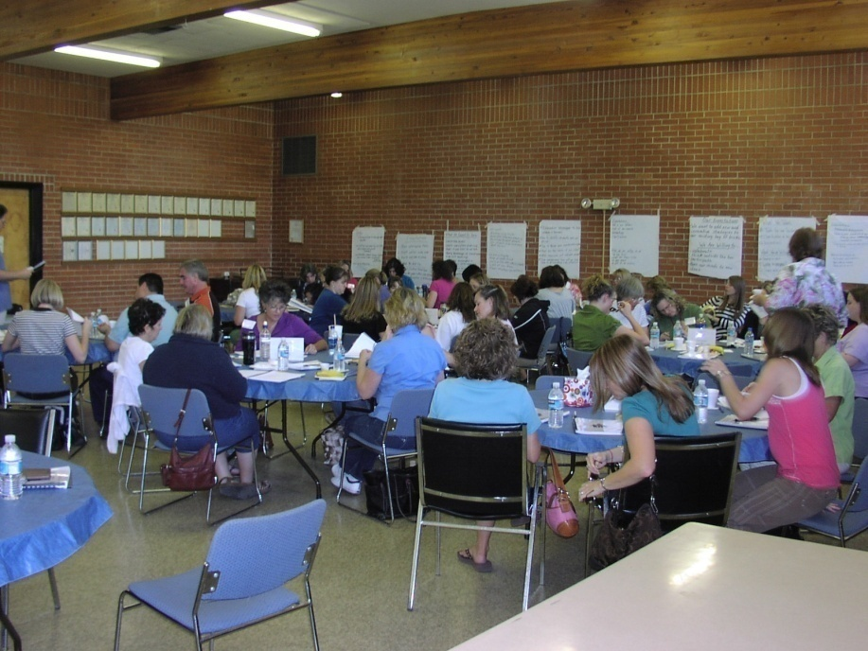
Masonic Model Student Assistance Program (MSAP)
MSAP - What is it?
A Highly Professional, Intensive Three-day Training Workshop, For Arizona Educators” To Learn To, Or Improve Their Ability To:
  Identify, Intervene With, and Create Appropriate Intervention Plans for Students That May Be at Risk
This Workshop Trains a Core Team of Four to Eight Educators From a School Building in How to Intervene Early and Effectively With Students That Display Patterns of Behaviors That Threaten Their Success at School and in Life.

Slide 21
MMSAP Program
Comprehensive Programming
  Prevention
  Identification and Assessment
  Intervention
  Postvention
  Treatment
  Aftercare

Slide 22
MSAP – What is it? continued
MSAP Involves Practical Practice Sessions Designed to Simulate Real Events Along With Presentations on Such Subjects As:
  Chemical Dependency, Depression and Suicide,
  Conflict, Anger, Bullying, and Violence,
  Communication Skills and Intervention,
  Family Dynamics,
  Enabling,
  Life Skills Development,
  Treatment and Aftercare, and
  Group Process.

Slide 23
MSAP – What is it?
(Continued)
Participants Leave the Training With
  A Specific Plan For Behavioral Interventions, and
  A System For Implementing MSAP In Their Schools, And Or Incorporating Worthwhile MSAP Concept/Practices Into Their Current Program
  Ability To Create A More Safe And Supportive School Environment

Slide 24
Is the Masonic Model Student Assistance Program Effective?
YES – MSAP Has Been Validated To Improve Academic Performance, Increase Attendance, And Decrease Behavior Problems Plus Help Promote A Safe And Supportive Learning Environment By Highlighting Social Emotional Learning
External Studies
  NEW JERSEY – 2000 (50% Referral Reduction)
  Illinois –S.A.P. Evaluation – 2002 MULTIPLIER EFFECT
    3500 Educators - 25,000 Referrals - 71% Had An Action Plan Developed By S.A.T. - 29% Referred To Community Agency -68% Showed Improvement In Area Of Referral
  Dr. Carl Fertman – Univ. Of Pitt 3 Yr 2003
    (66% -- Either Stabilized Or Improved Their Attendance; 60% -- No Additional Suspensions; 20% -- 1 More Suspension; 65% -- Promoted Or Graduated High School)

Slide 25
Is the Masonic Model Student Assistance Program Effective? (Continued)
Arizona Results
  In Addition To The Many Past Successes Since 1993, Since 2006 – Remote Training:
    Over 2250 Attendees (We Are Averaging 62.3 Educators/Class)
    56 School Districts
    Over 190 Schools
    1- Day Booster Since 2008 Over 300 Attendees
    At One Time – One District – All Schools Will Have An The MSAP Team
      Holbrook (District – $4500, Co Sheriff/Attorney $2800 RICO)
      TUSD Actually paid for the March 2013 class in Tucson
    S3 GRANT Out Of UA - Class in Sun City – June 2014

Slide 26
ARIZONA RESULTS
MULTIPLIER EFFECT
The MSAP MULTIPLIER EFECT - Since 2006
  2250 Attendees
    National Statistics Tell Us That Every Participant In Our Class, Will Impact 5 -9 At Risk Children By Changing Their Life In A Positive Way, The Very First Year After The Class
    Equates to at Least
      11,250+ Children Affected By Positive Change
      Most Likely - As Many As 20,000+
MULTIPLIER CONTINUES YEAR IN - YEAR OUT

Slide 27
Is the Masonic Model Student Assistance Program Effective? (Continued)
Principal/Team Leader Surveys - 2010
  Statically Arizona Data Shows:
    90.9% Of Students Referred To The MSAP Were Accepted Into The Program; 47.69% Have Completed The Program While 52.3% Were Still Working Through Their Agreed Intervention Plan; Of Those Intervention Plans Being Closed - 88.7% Were Showing A Positive Change, While 11.2% Were Negative Or Would Not Complete Their Intervention Plan
    Referrals Were For The Following Issues: Academic 49.2%, Behavioral 45%, Health 5%, Attendance 9%, Multi Reasons 16%.
Overwhelming Testimonial and Antidotal Evidence

Slide 28
Is the Masonic Model Student Assistance Program Effective? (Continued)
Other Measures Of Success:
  On A Scale Of 1 To 5 With 5 Being An Excellent Rating, Over 2250 Critique Sheets Averaged 4.992 For The 12 Categories Evaluated
  The Arizona DOE Professional Development For CTE Certification For 21 Professional Development Hours.
  Since 2006 Over $530,000 Of Grants And Donations Received.
  On Numerous Occasions, Organization Have Adopted Us As Their Preferred Charity

Slide 29
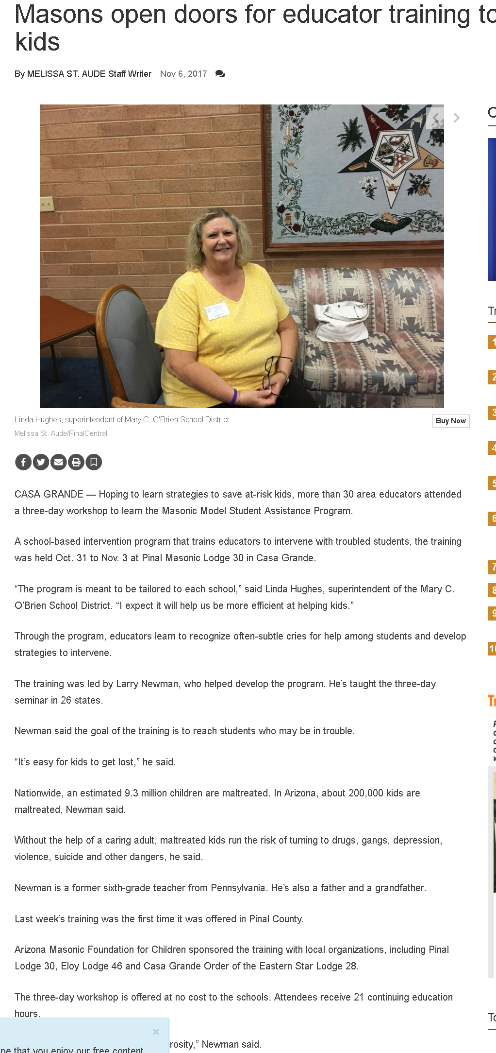
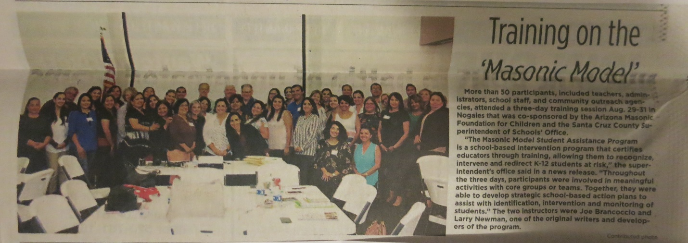
Masonic Community Publicity

Slide 30
Cost Per Class
How Much Is The Life Of A Child Worth?
Per Class $10K – $14K With Average 3 Day Class

Slide 31
Cost Per Child
How Much Is The Life Of A Child Worth?
Per Class $10K – $14K
Remember OUR MULTIPLIER!
  Since 2006 - 2250 Attendees
    @5 Influences Per – 11,250 ($35/Child)
    @9 Influences Per – 20,000 ($19/Child)
    Does Not Include The Collateral Benefit To Non At Risk Children From The Process
    Per Attendee - $172 - $250
4 Suicide Preventions Reported Since 2006
REMEMBER – THE AMFC IS SELF-FUNDING

Slide 32
REMEMBER
THE AMFC IS SELF-FUNDING
While Donations And Financial Support Is Always Welcomed, In General This $10,000+ Intervention Model Is Offered At No Cost To The Schools/ Participants
Our Sources are:
  Individual and Organizational donations
  Grants, e.g. Tribal 202 grants,

Slide 33
Children at Risk Grants from
Native American Tribal Governments
Since 2005 Native American Tribal Governments have financially supported the MSAP Children At Risk Kids Program to Include:
  Gila River Indian Community, (Maricopa, Pinal and Pima Counties);
  Ft. McDowell Yavapai Nation, (Maricopa County);
  Tohono O’odham Nation, (Pima County);
  Pascua Yaqui Tribe, (Pima County); and most recently
  Ak Chin Indian Community, (Pinal County) $24,0000

Slide 34
SUSTAINING THE PROGRAM FOR ANOTHER 24 YEARS
After All This Unprecedented Success:
We Are At A Cross Roads
  Longevity, Age And Health Of Volunteers
  Statewide Nature Of Program
  Lack Of Strong, Direct, And Overt GL Support
We Need Help

Slide 35
AMFC Needs
Children at Risk Program
Help
  Board Members
  Regional Reps
  Foundation Work Areas
  Local Work Areas

Slide 36
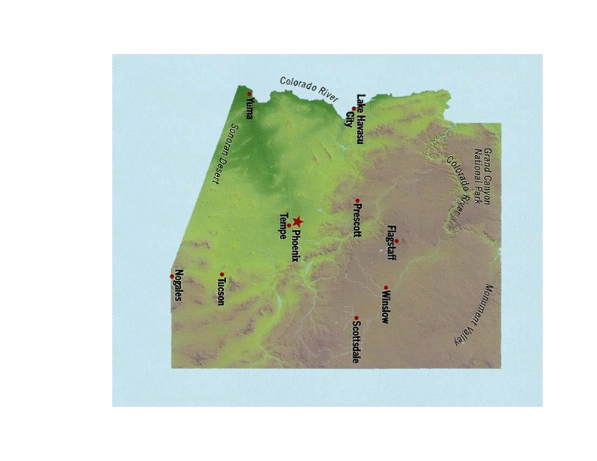
Regional Rep Program

Slide 37
The Duties And Responsibilities Of A Lodge Representative Include:
  Support The AMFC/MSAP
  Support And Provide Lodge Education On AMFC/MSAP
  Generate Lodge And Masonic Enthusiasm & Support
  Support And Participate In Fund Raising
  Support The MSAP Classes

Slide 38
Foundation Work Areas
  Social Media
    Web Site
    Facebook
    E-mail Broadcast
  Fundraising
  Communications
    Lodge
    Annual Letter
    2 Pubs
  Conduct Classes
    Local
    Mobile

Slide 39
LOCAL WORK AREAs
  Regional Rep Support
  Local Networking Support
  Local Class
    Development
    Conduct
    Support

Slide 40
A Child At Risk Will Remain At Risk Until Someone Intervenes
WHAT WE, The AMFC CAN DO?
  Given The Following We Could Schedule A Class For Your Area Today:
    A Location For The Class
    Educators To Attend, and
    A Date
  We Have Funds, Though Not Unlimited, To Start Scheduling Classes Today
  We Are Ready To Facilitate – With Local Help

Slide 41
A Child At Risk Will Remain At Risk Until Someone Intervenes
What You Can Do
  Help Us To:
    Establish A Date
    Establish A Location For The Class
    Obtain Educators To Attend
      Core Team of Four to Eight Educators From a School Building
      MIN 40 MAX 80
    We Can And Will Provide Support To You
  Going Forward With Us

Slide 42
A Child At Risk Will Remain At Risk Until Someone Intervenes
What You Can Do (Continued)
  Going Forward With Us:
    Sustain The Program In Your Area
    Those In A Class Area Help Us Fill The Next Class - EVIT
    :Help With Funding
      County Attorney/Sheriff RICO FUNDS
      Tribal Prop 202 Funding
      Other

Slide 43
LAST THOUGHT
I Will Leave You With This Thought Shared By A Principal At A Tucson “Children At Risk” Dinner:
“We have a student who would no longer be with us if it had not been for your devotion to bring this outstanding intervention program to us. There is no way that we can thank you enough.” Principal

Slide 44
IN CLOSING
A Child At Risk Will Remain At Risk Until Someone Intervenes
Come Join Us And Intervene In The Lives Of At Risk Children

