Slide 1
CPHQ Study Course
Susan Mellott PhD, RN, CPHQ, CPPS, FNAHQ
mellottandassoc@att/net

Slide 2

Test Taking Tips

Slide 3
CPHQ Exam
Candidates who pass the CPHQ examination must understand how all of these important elements of
  Quality and case/care/disease/utilization/risk management, as well as
  Data and general management skills,
  How they integrate to produce an effective and efficient system to monitor and improve care.

Slide 4
Test Taking Tips
CPHQ Exam
  Computerized, comprehensive, job-related objective test
  www.nahq.org – Candidate Handbook
  140 Multiple choice questions - 15 are not scored
This allows the question to be validated as accurate and appropriate before it is included as a measure of candidate competency.

Slide 5
Test Taking Tips
Recall questions test knowledge of specific facts & concepts
  Recall - 23%
Application questions require ability to interpret or apply information to a situation
  Application - 57%
Analysis questions test ability to evaluate, problem solve, or integrate a variety of information and/or judgment into a meaningful whole
  Analysis - 20%

Slide 6
Test Taking Tips
Organizational Leadership (35 items or 28%)
Health Data Analytics(30 items or 24%)
Performance and Process
Improvement (40 items or 32%)
Patient Safety (20 items or 16%)

Slide 7
Test Taking Tips
Test differentiates between candidates who are able to demonstrate competence & those who aren’t
Test is written to test the knowledge, skills & abilities of effective quality professionals who have been performing a majority of the tasks on the exam outline for 2 years
Not a test for entry level & is not appropriate for entry level quality practitioners

Slide 8
Test Taking Tips
References and other Study Materials
  Content Outline itself (Candidate Handbook pg. 25-27)
  See list in Candidate Handbook for references (pg. 22-23)
  Avoid other materials not listed as appropriate reference resources

Slide 9
CPHQ Practice Exam
  CPHQ Practice Exam - $119 members & $149 non-members
130 multiple choice question practice exam is designed to assess your readiness and help you prepare for the CPHQ certification exam.
This exam aligns with the current CPHQ content outline and features immediate feedback with correct answer rationales for each question.
Completed exam results including questions and rationale are recorded, allowing for further review and study.
Users have unlimited access to this product for 1 year upon purchase.

Slide 10
Test Taking Tips
Questions on the test are written by practitioners in the field of healthcare quality management, case/care/disease/utilization management, and risk management
Content of test is representative of important aspects of healthcare quality professional’s job
Content based on International Practice Analysis
  Performed every 3 years
  Next content outline change will be January 2021

Slide 11
Test Taking Tips
Each question on the test must relate to one of the statements (tasks) on the content outline
Each statement was rated significant to practice by QM professionals
Statements are significant to practice in the major types & sizes of healthcare facilities and organizations, including managed care

Slide 12
Test Taking Tips
Calculators ARE allowed
  Simple battery powered pocket calculator with no memory, alphanumeric keypad, can’t print or store data
  Will have a pencil and scratch paper given to you
Wallets and keys are only things allowed in room
  No watch, hats, coats, etc.

Slide 13
Test Taking Tips
Answer those questions with which you are comfortable.
Pass over those that draw a blank
  Blank square to right of time box to bookmark question to return to it later
Comments
  Click on ! To the left of the time box to leave your self or the certification board a note
To check how much time you have left, click on the time box on the lower right hand side of the screen

Slide 14
Test Taking Tips
Have three hours to take test
  To check how much time you have left, click on the time box on the lower right hand side of the screen
Will have 140 questions to answer – BUT only 125 count for the test
  Other 15 questions are being piloted

Slide 15
Test Taking Tips
Read carefully words such as “except” “not” or “least”
Beware of choices such as “always” and “never”
Anticipate the answer, then look for it
Consider all alternatives
Exclude obviously wrong answers
Look for hints in the grammar of the question
Relate each option to the question
No penalty for guessing!

Slide 16
Test Taking Tips
Balance options against each other
Use logical reasoning
Choose answers that contain words you know
Pace yourself -- watch your time
Don’t be distracted by others taking tests
Study groups are great!

Slide 17
Test Taking Tips
To apply go to www.nahq.org
  Select CPHQ Exam
  Complete the application
  Pay the fee for the exam
    Non-Member $469 ($494 if by check)
    NAHQ Members $399 ($424 if by check)
  Will receive an email from PSI about 10 business days later with instructions on how to schedule the exam
  Need to schedule & sit for exam w/in 90 of payment

Slide 18
Test Taking Tips
Testing centers are typically located in PSI Test Centers located throughout the US
Reschedule once at no charge within the eligibility window
If you need to reschedule, must do it at least 2 business days (by 3pm) before the test date
  PSI – 888-519-9901

Slide 19
Test Taking Tips
Times for test are 9am or 1:30pm & days vary by location
You have 3 hours to take the exam.
If 15 minutes or more late – will not be able to enter
Relax the night before. If you don’t know it by then, you don’t know it.
Allow plenty of time for traveling to test destination

Slide 20
Two Questions Always Asked
What is the passing score?
How many pass the test the first time?

Slide 21
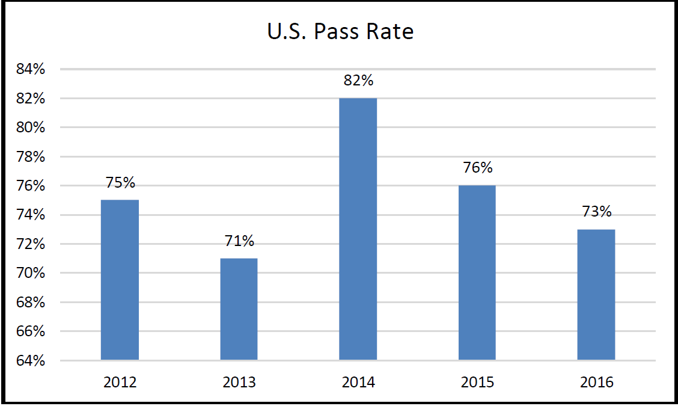

Slide 22
At Your Test Site!
Identification is checked – need 2 IDs
  MUST have one of the following:
    Drivers license with picture
    State Identification card with picture
    Passport
    Military ID with picture
  Other ID must have your name and signature
    Credit card with signature
    Student ID with signature
    Etc.
Name must be exactly the same on both identification cards

Slide 23

At Your Test Site!
Log in
Take your own picture
  Picture appears on Score Report
15 minute pre-test to familiarize with the keyboard and questions.
Begin the exam - 3 hours to complete 140 questions

Slide 24
At Your Test Site!
Evaluation questions -
  After the exam, not part of 3 hour limit
  You can not re-enter exam after entering this section!
Finish the evaluation
Exit the system
Receive Score Report from proctor
Total time - 3 1/2 to 4 hours
Notes:
Then, when they are finished with the evaluation, they will exit the system, the proctor will hand them their score report, and they will leave the center. The whole experience should take between 3-1/2 and 4 hours to complete.
For paper & pencil format candidates, one set of evaluation questions will be contained in their exam booklet and answered by bubbling in the appropriate circle on their answer sheet. The HQCB evaluation form is a separate sheet of paper on HQCB letterhead that has 13 questions. Ideally, they will answer these at the test site and give them to the proctor before leaving. But if they wish, they can take the evaluation with them and mail or fax it to us later.

Slide 25
And Then…...
HQCB will mail you a letter & packet of information about 1 month following the month in which you took the test
For example:
  If exam is taken Feb 15th, then expect letter & packet at the end of March or beginning of April
    ID card
    Certificate
    CPHQ Pin
You may not use the CPHQ credential until you receive your official documentation.

Slide 26
After You Pass the Exam
Renew every 2 years in December
Cycle begins January 1 of the year following the completion of the certification examination
Must have 30 CE hours when renew
CE topics must be on the current Content Outline

Slide 27
Renewal Fees
Members
  Early Bird (before 9/30) $175
  Oct 1 – Dec 31 $225
  Grace Period (Jan 1-31) $275
Nonmembers
  Early Bird (before 9/30) $200
  Oct 1- Dec 31 $250
  Grace Period (Jan 1-31) $300

Slide 28

HEALTHCARE
QUALITY
Basics
Chapter 1

Slide 29
What is Quality?
Page 6
Best defined by the recipient of care or services
It is not just good care or services
Have to also look at the risks of care and the cost of that care

Slide 30

QUALITY, COST,
AND RISK INTEGRATION
Page 7
Quality of Care/Services + Outcomes
Value
=
Cost

Slide 31
Integrated Perspective
Page 7
Clinical
Governance
Management
Support

Slide 32
QUALITY MANAGEMENT:
BASIC PRINCIPLES
Page 8
Productive Work is Accomplished Through Processes.
Sound Customer-Supplier Relationships are Absolutely Necessary for Sound Quality Management.
The Main Source of Quality Defects is Problems in the Process.
Poor Quality is Costly.

Slide 33
QUALITY MANAGEMENT:
BASIC PRINCIPLES
Pages 8-9
Understanding the Variability of Processes is Key to Improving Quality.
Quality Control Should Focus on the Most Vital Processes.
The Modern Approach to Quality is Thoroughly Grounded in Scientific and Statistical Thinking.

Slide 34

QUALITY MANAGEMENT:
BASIC PRINCIPLES
Page 9
Total Employee Involvement is Critical.
Quality Management Employs:
  Quality planning
  Quality control (measurement)
  Quality Improvement

Slide 35

THE CONCEPT OF CUSTOMER
Page 14
“Customer” – One Who Receives Goods or Services
External Customer – Those Outside the Organization Receiving Services
Internal Customer – Those Performing Work, but Dependent On Others Within the Organization Performing Work
Customer Supplier Relationships

Slide 36
RESPONSIBILITIES OF THE
QUALITY PROFESSIONAL
Page 15
Understand Principles of TQM and CQI
Develop a Healthcare Quality Strategy
Participate in Preparation for External Awards
Articulate to Leadership How to Use
  TQM and CQI
  Data Measurement
  Assessment
  Improvement
Lead and facilitate change within the organization

Slide 37
Quality Professionals:
Page 17-18
Critical part of integrating quality functions within an organization
Interdisciplinary collaboration is critical
Table 5 on page 17 of the Healthcare Quality Handbook discusses important role and quality functions

Slide 38
Quality Professionals
Pages 19
Cross training & adaption of new skills
IOM report (2003) – Health Professional Education: A Bridge to Quality
  Patient-centered care
  Interdisciplinary teams
  Evidence-Based practice
  Quality improvement
  Informatics

Slide 39
Quality Professionals
Pages 19-20
Healthcare Quality Essentials (NAHQ)
  Health Data Analytics
  Population Health and Care Transitions
  Performance and Process Improvement
  Regulatory & Accreditation
  Quality Review & Accountability
  Patient Safety
Quality & Safety Education for Nurses (QSEN)
  Six domains & competencies
Certification

