Slide 1

Locking the Means of Egress in Health Care Facilities
Jeff Anderson, RCDD
Associate / Systems Project Manager
Communications, Security & Technology Division
October 14, 2015

Slide 2
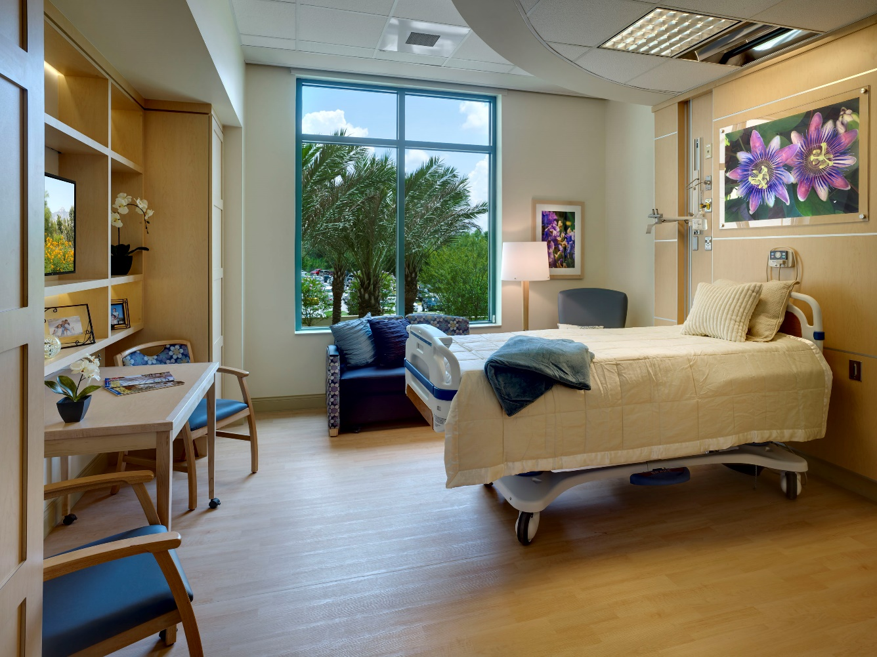

What will I be talking about today
Why would you lock the means of egress?
When you lock what codes apply and who is involved?
What are the special locking arrangements per NFPA 101, Chapter 7?
What are clinical needs and special needs locking arrangements per NFPA 101, Chapter 18?
Examples of acceptable locking arrangements

Slide 3
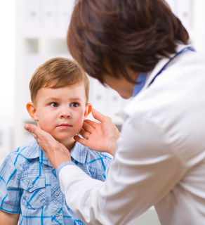
Why would you lock the means of egress?
Pediatric Units
Emergency Departments
Behavioral Health Units
Intensive Care Units
Other Considerations

Slide 4
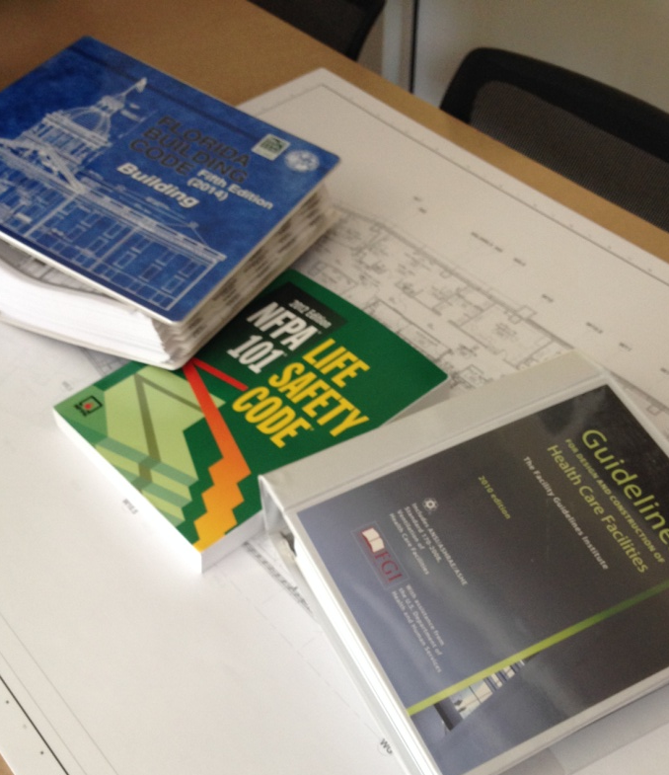
When you lock what codes apply and who is involved?
Authority Having Jurisdiction
Who is involved with the development of a locking strategy?
NFPA 101 - Life Safety Code 2012 edition
Florida Building Code – 2014 (fifth edition)
FGI – Guidelines for Design and Construction of Health Care Facilities

Slide 5
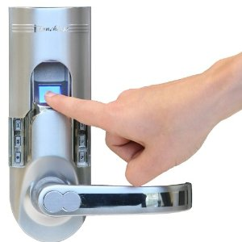
What are the Special Locking Arrangements from NFPA 101 Chapter 7?
Delayed Egress
  Where to use this lock?
  Some considerations
  Code requirements
Access Control
  Does it restrict egress?
  Example of use
  Some considerations
  Code Requirements

Slide 6

What are the Clinical Needs Locking Arrangements per NFPA 101 Chapter 18?
Clinical Needs
  18.2.2.2.5.1*
  A18.2.2.2.5.1

Slide 7
Clinical Needs
18.2.2.2.5.1* Door-locking arrangements shall be permitted where the clinical needs of patients require specialized security measures or where patients pose a security threat, provided that staff can readily unlock doors at all times in accordance with 18.2.2.2.6.
A.18.2.2.2.5.1 Psychiatric units, Alzheimer units, and dementia units are examples of areas with patients who might have clinical needs that justify door locking. Forensic units and detention units are examples of areas with patients who might pose a security threat. Where Alzheimer or dementia patients in nursing homes are not housed in specialized units, the provision of 18.2.2.2.5.1 should not apply.
Criteria to be met for code compliance
How would this locking arrangement look?

Slide 8

What are the Special Needs Locking Arrangements per NFPA 101 Chapter 18?
Special Needs
  18.2.2.2.5.2*
  A18.2.2.2.5.2

Slide 9
Special Needs
18.2.2.2.5.2* Door-locking arrangements shall be permitted where patient special needs require specialized protective measures for their safety, provided that all of the following criteria are met: items 1-5a and b.
A18.2.2.2.5.2 Pediatric units, maternity units, and emergency departments are examples of areas where patients might have special needs that justify door locking.
Criteria to be met for code compliance
How would this locking arrangement look?

Slide 10
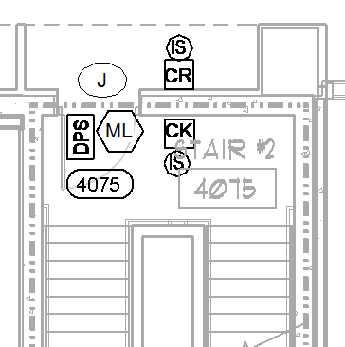
Examples of Acceptable Practice
Pediatric Unit Stair Door
Magnetic lock was used to lock the door
Mechanical latch, non-locking was used to maintain the required fire safety
Card readers on both sides of the doors, for staff entry and exit
Audio/Video intercom door stations on the both sides of the door
Audio/Video intercom master station, remote release and emergency break lock power button at the attending nurse station
Re-entry required by Code
Secure
Unsecure

Slide 11
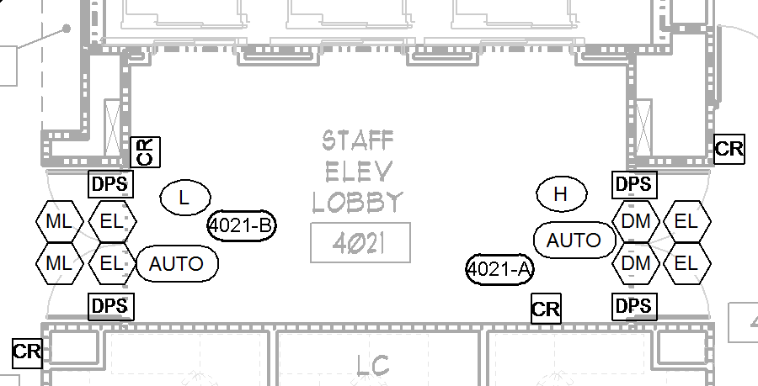
Examples of Acceptable Practice
Service Elevator Lobby
The doors on the left
Magnetic locks were used to lock the doors
Electric latches, non-locking and in the retracted position, release on general building fire alarm to maintain the required fire safety
Card readers on both sides of the doors, for staff entry and exit and activation of the auto operators
Secure
Unsecure
Secure

Slide 12
Examples of Acceptable Practice
Service Elevator Lobby
The doors on the right
Delayed magnetic locks for locking the doors and the means of egress from the elevator lobby
Electric latches, non-locking and in the retracted position, release on general building fire alarm to maintain the required fire safety
Card readers on both sides of the doors, for staff entry and exit and activation of the auto operators
Remote annunciation at the attending nurse station of the activation of the delayed egress function
Secure
Unsecure
Secure

Slide 13
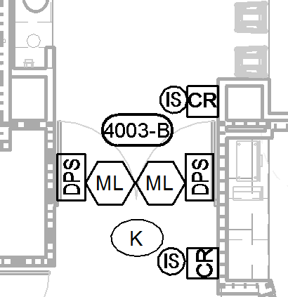
Examples of Acceptable Practice
Pediatric Unit Entrance and Exit
Pediatric Unit Stair Door
Magnetic locks were used to lock the door
Mechanical latch, non-locking were used to maintain the required fire safety
Card readers on both sides of the doors, for staff entry and exit, not required by code
Audio/Video intercom door stations on the egress side of the door for communication to the attending nurse station
Audio/Video intercom master station, remote release and emergency break lock power button at the attending nurse station
Unsecure
Secure

Slide 14
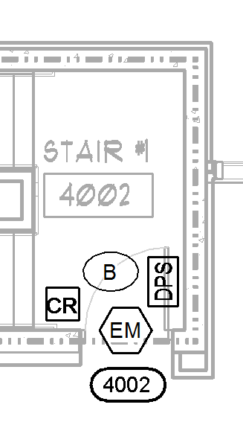
Examples of Acceptable Practice
Public Stair Door
Magnetic lock was used to lock the door
Mechanical latch, non-locking was used to maintain the required fire safety
Card reader on the stair side of the door, for staff entry and exit, not required by code
Audio/Video intercom door stations on the egress side of the door for communication to the attending nurse station
Audio/Video intercom master station, remote release and emergency break lock power button at the attending nurse station
Secure
Unsecure

Slide 15
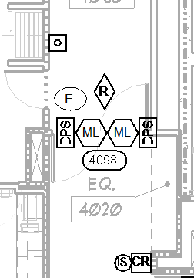
Examples of Acceptable Practice
Access Control and Special Needs Application
Magnetic locks were used to lock the door
Mechanical latches were not required, because these were not cross corridor doors or compartment doors
Card reader on one side of the doors, for staff entry and exit, not required by code
A motion sensor and request to exit button on the secure side of the door for free egress, access control application
Audio/Video intercom door station on the egress side of the door for communication to the attending nurse station
Audio/Video intercom master station, remote release and emergency break lock power button at the attending nurse station for the special needs application
Secure
Unsecure

Slide 16
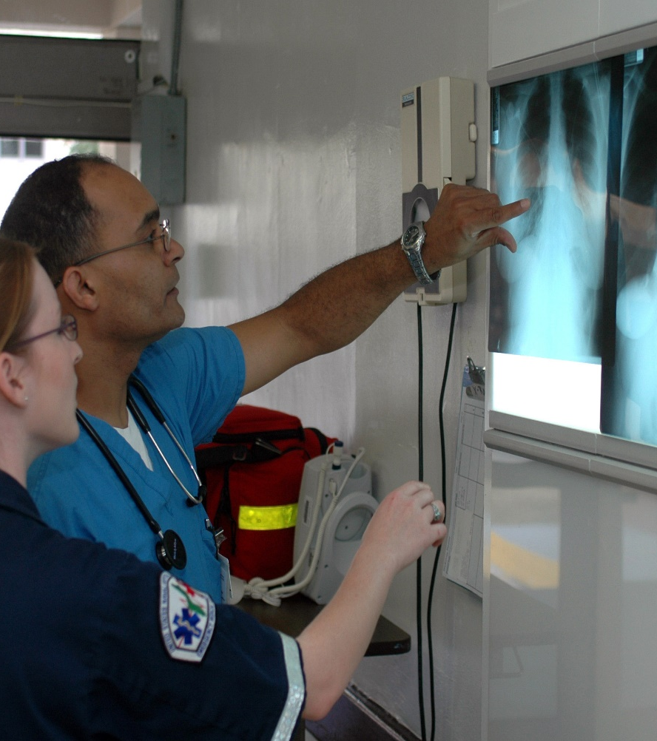
What I covered today
Some reasons why you would lock the means of egress
The codes that apply and who is involved
Identified and explained the special locking arrangements per NFPA 101, Chapter 7?
Identified and explained clinical needs and special needs locking arrangements per NFPA 101, Chapter 18?
Explained some examples of acceptable locking arrangements

