Slide 1


Saturday, August 11th, 2018
Saturday, August 11th, 2018

Slide 2

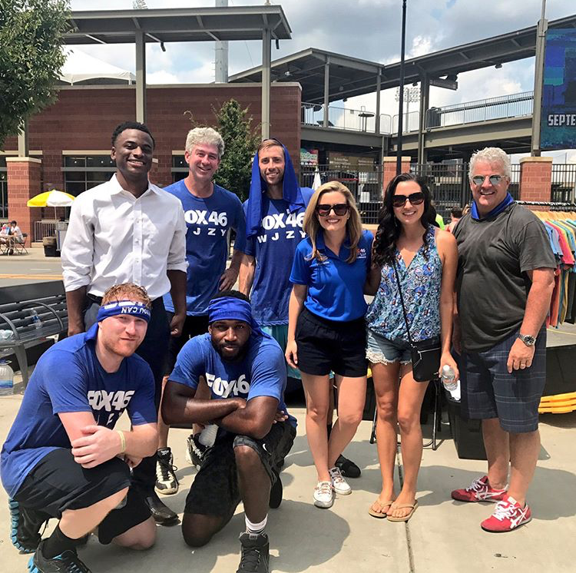
Changing the game for Charlotte’s youth.
TOURNAMENT GAMES
DATE: August 11th, 2018
TIME: 10am – 5pm
DIVISIONS: *Adult *Adult Elite
*Women/Coed *Youth
LOCATION: 324 South Mint St

Slide 3
Changing the game for Charlotte’s youth.
3 ON 3 TOURNAMENT IN THE STREETS:
B.T.E.P.’s 3rd Annual (3v3 Tournament) establishes cross cultural relationships beyond the economic and social strata of our constituents
As a sponsor your brand will resonate with millennials, families,
and star-studded personalities attending our tournament

Slide 4
Title Sponsor
Tournament partial naming rights
Four (4) team spots for the 3 on 3 Tournament
Two (2) vendor spaces for your company, (tables provided)
Jaunt Charlotte carts will distribute company items around Charlotte
Full recognition in all press materials and promos as Title Sponsor
Interviews and working media with partners Fox 46 Charlotte
B.T.E.P. Kickoff: 8 seats provided with a spotlight for the Title Sponsor (Friday)
B.T.E.P. Youth Art Exhibit: 8 tickets include wine and desserts (Friday)
Address the crowd at the tournament (Saturday)
Social media recognition (Reach of 68,000)
$25,000
$25,000

Slide 5
MVP Sponsor
Two (2) Spots Available
Three (3) team spots for the 3 on 3 Tournament
One (1) vendor spaces for your company, (tables provided)
Jaunt Charlotte carts will distribute company items around Charlotte
Full recognition in all press materials and promos as MVP Sponsor
Working Media with partners Fox 46 Charlotte
B.T.E.P. Kickoff: 6 seats provided with opportunity to speak (Friday)
B.T.E.P. Youth Art Exhibit: 6 tickets include wine and desserts (Friday)
Social media recognition (Reach of 68,000)
$10,000
$10,000

Slide 6
Dream Team
Sponsor
Three (3) Spots Available
Two (2) team spots for the 3 on 3 Tournament
One (1) vendor spaces for your company, (tables provided)
Jaunt Charlotte carts will distribute company items around Charlotte
Recognition in all press materials and promos as Dream Team Sponsor
B.T.E.P. Kickoff: 4 seats provided for the sponsor (Friday)
B.T.E.P. Youth Art Exhibit: 4 tickets include wine and desserts (Friday)
Social media recognition (Reach of 68,000)
$5,000
$5,000

Slide 7
Slam Dunk
Sponsor
Four (4) Spots Available
One (1) team spot for the 3 on 3 Tournament
Recognition in promotional materials as Slam Dunk Sponsor
B.T.E.P. Kickoff: 2 seats provided for the sponsor (Friday)
B.T.E.P. Youth Art Exhibit: 2 tickets include wine and desserts (Friday)
Social media recognition (Reach of 68,000)
$2,500
$2,500

Slide 8
Rookie Sponsor
Ten (10) Spots Available
Name/Logo displayed on BTEPs website
B.T.E.P. Kickoff: 1 seat provided for the sponsor (Friday)
B.T.E.P. Youth Art Exhibit: 1 ticket include wine and desserts (Friday)
Social media recognition (Reach of 68,000)
$1,000
$1,000

Slide 9
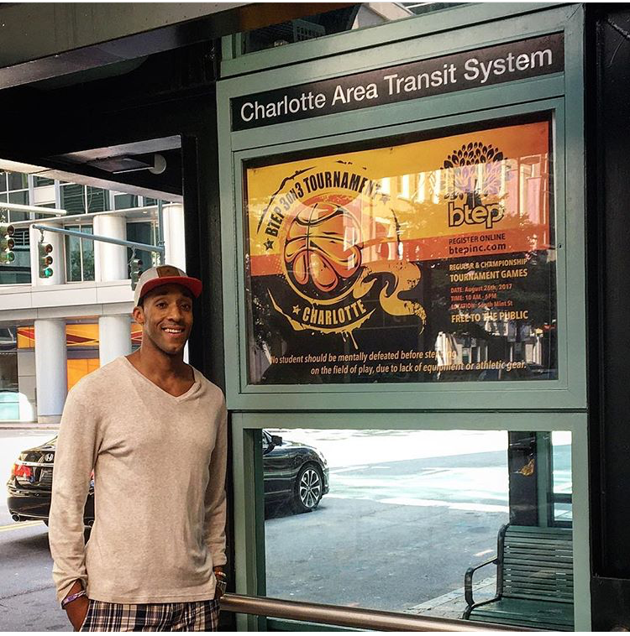
Changing the game for Charlotte’s youth.
Thank you
#BApart #BInspired
#BCreative
(Flexibity in Dream Team, SlamDunk, and Rookie Levels)

