Slide 1
Acts
Written by Myron Heavin

Slide 2
Outline of Acts
Introduction
The Birth of the Church (1:1-5:42)
Persecution and Expansion (6:1-9:32)
The Acts of Peter & Beginnings of Gentile Christianity (9:32-12:24)
Church Extension from Antioch & Jerusalem Council (12:25-15:35)
Paul leaves Antioch and Moves to the Aegean World (15:36-19:20)
Paul Plans to Visit Rome & Arrest (19:21-21:36)
Paul’s Defense of Christianity (22-28)

Slide 3
Introduction
Acts in the New Testament
Origin and Purpose of Acts
Paul in Acts
Return to Main Outline

Slide 4
Acts in the New Testament
Luke wrote a History of Christian Origins comprised of:
  The Gospel According to Luke, and
  Acts
Later on the Gospel and The Apostle was complied.
Then they recognized Acts made sense of the epistles
Acts was instrumental in putting down the Marcionian heresy.
  The Christian religion was a new religion with a new God
  Acts reinforced the authority of the apostles (church)
  Acts was thus renamed “The Acts of the Apostles”.

Slide 5
Origin and Purpose of Acts
Present the gospel from a gentile perspective
Argue why Christianity was acceptable with a condemned criminal as its leader (Jesus) who was not guilty.
To present how Christianity was accepted by Jews and Romans but was persecuted by Jewish leaders
To present a chronological history of the early church origins.
Narrative literature teaching us how to be missionaries.
Clear presentations of the gospel message to various cultures

Slide 6
Paul in Acts
Acts relates and authenticates two separate branches
  Jewish gospel emphasis (Peter, James, John etc.) in Asia
  Gentile gospel emphasis (Paul and Barnabus etc.) in Europe
  This refutes Protestant or Messianic Jewish superiority claims
See how Paul was free to convert even in Rome
  This refutes that Paul / Christianity was criminal in nature
Paul went to the top people, and to the largest port cities
  This is how we do mission

Slide 7
The Birth of the Church (1:1-5:42)
The Forty Days and After (1:1-26)
Pentecost Day (2:1-47)
An Act of Healing and its Consequence (3:1-4:31)
All Things in Common (4:32-5:11)
The Apostles Before the Sanhedrin (5:12-42)
Return to Main Outline

Slide 8
The Forty Days and After
Prologue (1:1-3)
The Apostle’s Commission (1:4-8)
The Ascension (1:9-11)
In the Upper Room (1:12-14)
A Replacement for Judas Iscariot (1:15-26)

Slide 9
Prologue (1:1-3)
Theophilus in introduction links Luke and Acts
The Kingdom of God
  Jesus inaugurates the New Kingdom of God
  It drew near with the inception of His public ministry (Mark 1:14-15)
  It was released with power with his death on the cross (Mark 9:1)
  We are already in the Kingdom of God, but anticipate His coming again when we will be transformed in a new realization

Slide 10
The Apostles Commission (1:4-8)
Jesus ate with His disciples in His resurrection body
  This was a proof He existed (also read Luke 24:42-43)
  We will be invited to a great banquet in heaven
Jesus promised the coming of the Spirit (Luke 24:49 & John 14-16)
  John had baptized with a water baptism of repentance
  Jesus was baptized by John as Messiah at the start of His ministry
  The Apostles would be baptized by the Spirit at the start of their ministry
  We are likely baptized not truly by water but to signify our ministry

Slide 11
The Apostles Commission (1:4-8)
Everyone, including the disciples, thought of Jesus would restore a military Israel (Mark 10:35-45; Luke 24:24-27).
The coming of the Spirit signified a Spiritual Kingdom of God
  The timing belonged to God alone (Mark 13:32).
The coming of the Spirit upon the disciples would inaugurate them as spiritual leaders in the Kingdom of God.
  They would be vested with heavenly power.
  They would be witnesses

Slide 12
The Apostles Commission (1:4-8)
You will be my witnesses in Jerusalem, then Judaea and Samaria, then the whole known world of their day.
  Judaea (fellow Jews) and Samaria (Jews hated Samaritans) are equivalent
These discussions parallel
  The Great Commission (Matt 28:18-20)
  Salvation and Condemnation (Mark 16:15-16)
  Forgiveness of Sins (Luke 24:46-49)

Slide 13
The Ascension (1:9-11)
Jesus had appeared to believers on earth for 40 days.
  This was not his hanging around earth for 40 days after death
  This was his visitations from Heaven for 40 days.
The cloud signifies power
  They were surrounded by a cloud at the Transformation (Luke 9:34-36)
  Jesus will return from a cloud (Mark 13:26; 14:62)
  We will meet Jesus in a cloud (1 Thes 4:16-17)

Slide 14
The Ascension (1:9-11)
Jesus had intended the church would be built by the apostles
  Jesus works thru people
  Jesus builds His church thru us also
Jesus purpose was to train apostles and start a church
  Only 500 people witnessed his resurrection
  Thousands responded to apostle preaching to build the church
Therefore Jesus ascended so the apostles could act
Jesus ascended on high to now fill the whole earth (Eph 4:10)

Slide 15
In the Upper Room (1:12-14)
Which upper room is not important
This list of the 11 apostles is consistent with other lists (Luke 6:14-16; Mark 3:16-19; Matt 10:2-4).
  These lists always have the apostles in 4 groups of 3 with Peter, James, and John always in the first group.
Women and immediate family of Jesus was in the upper room
  Jesus brothers and sisters did not believe in him (John 7:5)
  Jesus appeared to brother James after his resurrection (1 Cor 15:7)

Slide 16
A Replacement for Judas Iscariot (1:15-26)
Apostle Judas Iscariot became a guide who betrayed Jesus
  He fulfilled Scripture (Ps 49:1; 69:25; 109:8)
  There were 12 tribes, there were 12 apostles, see Ps 109:8
Apostle (witness) requirements
  Be with Jesus from baptism by John onward
  See Jesus’ resurrection into heaven (500 in I Cor 15:6)
  Paul did not meet these requirements, His call was special, and Paul would have agreed with this.
Casting lots was typically Old Testament, based on Proverb 16:33

Slide 17
Pentecost Day
The Descent of the Spirit (2:1-4)
The Crowd’s Amazement (2:5-13)
Peter’s Proclamation (2:14-36)
Call to Repentance (2:37-40)
The First Christian Church (2:41-47)
Return to Birth of the Church

Slide 18
The Descent of the Spirit (2:1-4)
Pentecost occurs 50 days after Passover
  Ex 34:22a; Deut 16:10; Num 28:26; Ex 23:16a; Ex 34:22
  Feast of First Fruits (Pentecost) appropriate for birth of church
  Perhaps law was given to Israelites on Sinai on this date (Ex 19:1)
  One of three week-long religious feasts in Jerusalem each year
The Spirit of God came with wind and fire (Luke 3:16-17)
  Tongues like fire came upon all 12 apostles, all 12 spoke in tongues
  The 12 were filled with the Holy Spirit (also 4:18, 31)
  Today the church still speaks in many languages to the world

Slide 19
The Crowd’s Amazement (2:5-13)
Crowd was amazed at sound of the Apostles, not the wind
Feast of Pentecost anniversary date of giving of the law by Moses
Traditionally Law of Moses was given in many languages (Ex 20:18)?
Jews made up about 10% of the Roman Empire and were scattered in many places
There were more Jews in Egypt than in Judaea

Slide 20
The Crowd’s Amazement (2:5-13)
Jews and proselytes from Rome are especially significant
  A proselyte is a gentile convert to Judaism
  The church began in Rome – perhaps from these visitors
It was common in Jewish festivals in Jerusalem for the blessings to be spoken in various languages
The apostles speaking in languages they did not know was miraculous – the reversal of the tower of Babel
Speaking in tongues here meant the apostles spoke one of known languages of the world.

Slide 21
Peter’s Proclamation (2:14-21)
Large Pentecost crowds were attracted to hear Peter speak
Joel 2:28-32 predicted this event
End times began with Jesus baptism and ends with his future return
The Holy Spirit was poured out as the gift of prophecy (explaining what older scriptures meant in today's world)
  Prophecy is 90% forth telling and 10% fore telling
Just 7 weeks before, the earth shook, the sun was dark etc.

Slide 22
Peter’s Proclamation (2:22-28)
Early sermons had 4 parts
  Announcement age of fulfillment had arrived
  Account of ministry, death, and resurrection of Jesus
  Citation of Old Testament scriptures (new testament not written)
  A call to repentance (change your mind about who Jesus is)
This is the heart of the gospel message
Jewish leaders and gentile leaders had crucified Jesus, but God had reversed this judgment.
Quotation from Psalm 16:8-11 (Greek version) speak of how Jesus would never go to Hades (abode of the dead)

Slide 23
Peter’s Proclamation (2:29-36)
Peter now explains to his Jewish audience how the scriptures point to Jesus – who alone was resurrected from the dead
The Spirit which empowered Jesus now empowers apostles
Psalm 110 also points to the Messiah Jesus as well
The main point is the gospel message – death, burial, resurrection

Slide 24
Peter’s Proclamation (2:37-40)
The audience was convinced and their conscience hurt
Repent!
  Change your minds about who Jesus is
  It is about Him – it is not about us
Baptism (follows repentance)
  Not the water baptism of John the Baptist
  We are baptized in the name of Jesus with fire and the Spirit
  Water is an external sign, the Spirit is an internal sign

Slide 25
Call to Repentance (2:37-40)
Repent – change your mind about who Jesus Christ is
  You then need to be baptized in the name of Jesus
  You will then receive the Holy Spirit (same as Apostles)
  Forgiveness of sins results from repentance, not a prerequisite
  It is all about who Jesus is, it is not about me or my sin
  There is no suggestion here that only an apostle can baptize
The promise is for all whom the Lord may call

Slide 26
The First Christian Church (2:41-47)
God worked thru the Apostles not Jesus
  Jesus interested in training Apostles, beginning a church
  Apostles work greater than Jesus (John 14:12)
Jesus came to start a church thru apostles, not himself
Peter’s sermon led to 3,000 new believers (2:41)
  Jerusalem had only 25,000 to 50,000 permanent residents
  1st Church grows to 5,000 members the 1st 8 days! (2:41, 4:4)
  This is 10% to 20% of all Jerusalem’s residents in 8 days!

Slide 27
The First Christian Church (2:41-47)
Ideal esteemed Christian community sharing goods and meals
  Communion as meal at homes established
Worship/witness at both temple and in homes
  House churches very biblical
  Initial Jerusalem church worshipped in Temple
  Community of non-believers highly esteemed them
Early believers were a sect of Jewish faith

Slide 28
An Act of Healing & It’s Consequence
A Cripple Cured (3:1-10)
Peter’s Address in Solomon’s Colonnade (3:11-26)
The Arrest of Peter and John (4:1-4)
Peter & John before the Sanhedrin (4:5-12)
Debate in the Sanhedrin (4:13-17)
The Apostles Dismissed with a Caution (4:18-22)
Peter and John Rejoin Their Friends (4:23-31)

Slide 29
A Cripple Cured (3:1-10)
The Apostles and believers still went to the temple services
Peter healed a man crippled from birth in the temple
  This was an obvious miracle to all in Jerusalem
  The man rose walking and leaping and praising God
  All the temple worshippers were amazed
This was a clear sign to everyone that the Apostles had power
  This was one of many healings done by the Apostles
  See how the Apostles carry on the ministry & authority of Jesus

Slide 30
Peter’s Address in Solomon’s Colonnade (3:11-26)
Peter’s address began after worship and prayer in the temple.
Peter preached the Gospel message: death, burial, and resurrection of Jesus.
Peter showed them the power of Jesus continued after death.
Repent: Change your minds about who Jesus is, and then your sins will be forgiven.
Messiah must suffer and be resurrected to God in glory

Slide 31
Peter’s Address in Solomon’s Colonnade (3:11-26)
Witness of the Prophets (3:22-26)
  Moses, and all the prophets from Samuel onward, spoke of Messiah,
  Deut 18:15, 19 speaks of heeding this prophet.

Slide 32
The Arrest of Peter and John (4:1-4)
Peter and John had been preaching the resurrection of The Messiah, an anathema to the Sadducees.
Annas and Caiaphas had put Jesus to death a few weeks ago, and now Peter and John are before them
  They were before the entire Sanhedrin (ruling council).
  They could not be tried at night so they were jailed for the night.

Slide 33
Peter & John Before the Sanhedrin (4:5-12)
Peter and John plainly told them that
  The cripple was healed in the name of Jesus
  They had crucified Jesus
  Jesus had rose from the dead
  Jesus is the only name on earth for salvation for human beings.
Resurrection of anyone was an anathema for Sadducees
  The Sanhedrin is now on the defensive, 5000 converts!

Slide 34
Debate in the Sanhedrin (4:13-17)
The Sanhedrin was amazed that such uneducated men could argue with trained Rabbi’s
  They recognized Jesus had taught them and others well
  The men had broken no laws, and the people were with them
There was no refuting the bodily resurrection
  The way to end the argument was to produce Jesus’s body
  They were powerless in stopping a movement now far worse than when Jesus was alive.
  They could only warn them not to preach anymore

Slide 35
Apostles Dismissed with a Caution (4:18-22)
They were recalled to the Sanhedrin and ordered to stop preaching
James and John, like Socrates, told them they had to obey God.
The Sanhedrin made a crucial error, they released them
  This told the people the new Way had more power than the Sanhedrin did.
  This told the people there was no problem joining the Way.

Slide 36
Peter and John Rejoin Their Friends (4:23-31)
Psalm 2 was quoted by the Apostles to describe Jesus
Kings include Herod (only mentioned by Luke) and rulers, Pilate, who led the gentiles raging against Jesus.
God was in control as creator of the earth and the church
The arrest further stimulated the Apostles to greater efforts
The new “mega-church” was now 5000 in just a few weeks and growing with huge power.

Slide 37
All Things in Common
Community of Goods (4:32-35)
  Similar to Acts 2:43-47
  See how Apostles distributed the money (taught & provided)
  Reminds one of Qumran community (Esceenes)
  Reminds one of Levite priesthood requirements
  Will need to rely on others when money runs out in Acts 11:28

Slide 38
All Things in Common
They testified to the resurrection of Jesus (4:33)
  Abundant grace was on them all
The Generosity of Barnabas (4:36-37)
  Barnabus (Joseph) is first mentioned (not an Apostle)

Slide 39
All Things in Common
Deceit and Death of Ananias (5:1-6)
  Ananias and Sapphira sold their property as had Barnabus
  But unlike Barnabus, they lied about the price and kept some of it for themselves
Death of Sapphira (5:7-11)
  Peter was inexperienced as a pastor
You do not mess with God and the Holy Spirit
This early Priesthood of Believers was first called a church here

Slide 40
The Apostles before the Sanhedrin
Signs and Wonders (5:12-16)
  The Temple worshipers esteemed them but dared not join them
  Others in Jerusalem believed and joined them
  Now they grew by attracting others from surrounding villages
The Apostles Imprisoned and Released (5:17-21a)
  The Sadducees needed to act, the fellowship is growing
  This time all 12 Apostles were arrested, not just Peter and John
  The Angel of the Lord released them, and they kept on teaching

Slide 41
The Apostles before the Sanhedrin
The Apostles brought before the Sanhedrin (5:21b-26)
  The Rulers were now unsure of Temple Guards loyalty
  The Rulers must surely have felt they were totally threatened
The High Priest’s Charge and the Apostles’ Reply (5:27-32)
  Peter accused them of crucifying an innocent man
  Peter said God exalted Jesus and Jesus can forgive sins

Slide 42
The Apostles before the Sanhedrin
The Courts Decision (5:33-40)
  Elder Gamaliel, a Pharisee, warns them to let God handle the situation
  The Sadduces need Pharisee support in such a case
  Gamaliel was noted later in Acts as Paul’s teacher
The Apostles Continue Their Public Witness (5:41-42)
  The flogging perhaps encouraged them.
  They continued to teach in the Temple and in homes

Slide 43
Persecution and Expansion
Stephen (6:1-8:1a)
Philip (8:1b-40)
Conversion of Paul of Tarsus
Outline of Acts

Slide 44
Stephen (6:1-8:1a)
The Appointing of the Seven Deacons (6:1-6)
  Hellenistic Jews spoke Greek in their Synagogues
  Hebrew Jews spoke Hebrew in their Synagogues
  The finances (alms) were distributed by the Hebrew Jews
  The first 7 Deacons were all Hellenistic Jews
  The last Deacon, Nicolaus was not Jewish, but was a Proselite
    He was from Antioch (as was possibly Luke)
    He possibly founded the Nicolaitans, which were condemned in Rev 2:6, 15.
See how the Hellenistic Jews were rising in the early church!

Slide 45
Stephen (6:1-8:1a)
Progress Report (6:7)
  Luke interrupts with a report of how the Way was spreading so fast, even amongst Temple priests.
  See how there is tension within the priests the way there is tension within the various ethnic groups.
Stephen’s Activity Arouses Opposition (6:8-10)
  Stephen was teaching Jews from the Diaspora (Greek speaking) sanctuary.
  The Hellenistic Jews (not of the Way) condemned him.

Slide 46
Stephen (6:1-8:1a)
Stephen Accused Before the Sanhedrin (6:11-15)
  Stephen evidentially was teaching with more of a Hellenistic viewpoint in Greek-speaking synagogues etc.
    Hellenistic Jews in the diaspora could not worship in the Temple
    Hellenistic Jews therefore less likely to follow customs of Moses
    The new Way, as it met new cultures, less interested in Hebrew cultures
    Ethnic tension is rising
  Stephen never says anything Jesus did not earlier say

Slide 47
Stephen (6:1-8:1a)
High Priest’s Question and Stephen’s Reply (7:1-53)
  Longest speech in Acts
  Two obvious themes and one comment
    God raised up a series of leaders whom the Jews did not recognize
    They responded inappropriately to God’s presence in the temple and the tabernacle
    The Jewish people are a pilgrim people (Polhill)
  Stephen is more on the offense than defense
  Stephen presents a Hellenistic view of worshipping anywhere

Slide 48
Stephen (6:1-8:1a)
High Priest’s Question and Stephen’s Reply (7:1-53)
  In the Sanhedrin, the accused had a chance to reply
  Luke is giving an apology for the Way (Hellenistic view)

Slide 49
Journey to Canaan
Now these are the records of Terah
Genesis 11:27
Terah was father of Abram, Nahor, and Haran
  Haran had son named Lot
  Abram married Sarai (princess) (his half-sister)
  Moved Abram, Sarai, and Lot from Ur of the Chaldeans to go to Canaan.
  Location of Ur of the Chaldeans is uncertain – perhaps in Mesopotamia
  They got as far as Haran and settled there
  Terah died in Haran at the age of 205
  After Terah died, Abram began his journey to a new land

Slide 50
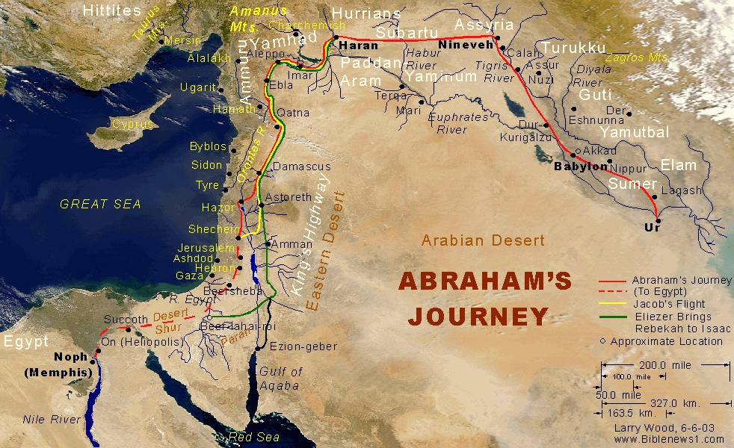
Abram Journey to Egypt

Slide 51
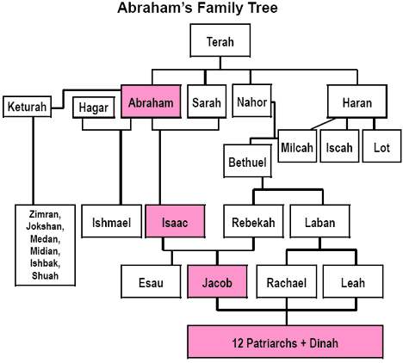

Slide 52
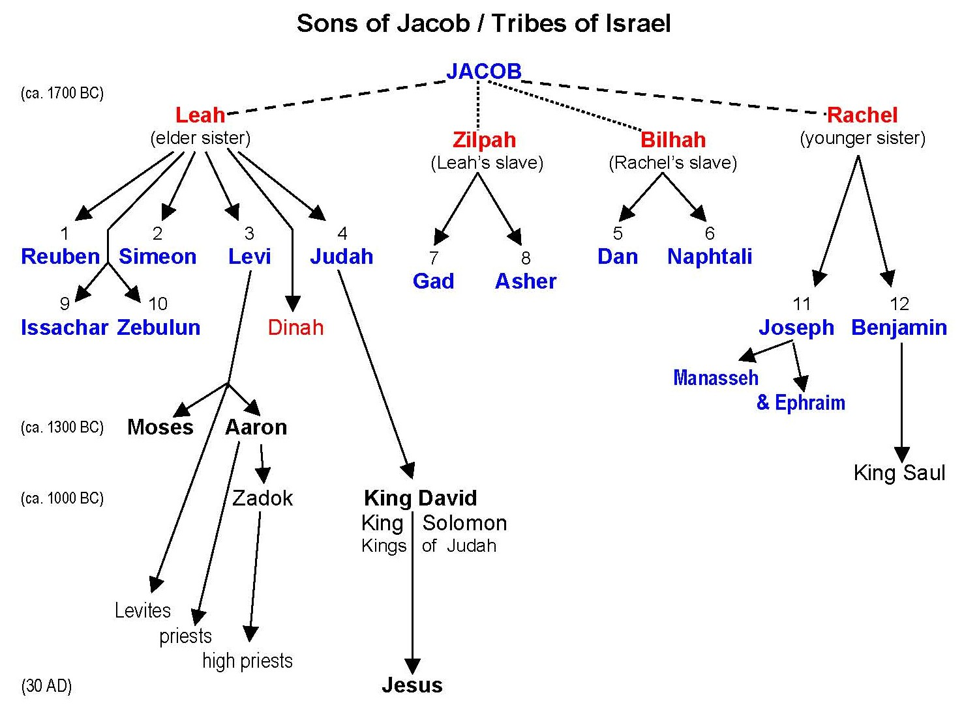

Slide 53
Stephen (6:1-8:1a)
High Priest’s Question and Stephen’s Reply (7:1-53)
  Abraham never owned any land in the land promised to him
  Isaac and Jacob never owned any land there either
  Joseph was rejected by his 11 brothers
    God blessed Joseph
  Moses was rejected by the Israelites in Egypt then in wilderness
    God blessed Moses
  The Israelites rejected God in the wilderness and before Babylon
    God blesses the Israelites anyway

Slide 54
Stephen (6:1-8:1a)
High Priest’s Question and Stephen’s Reply (7:1-53)
  Moses similar to Jesus (Acts 7:35)
    The man rejected by the people becomes a ruler
    He is a deliverer thru signs and wonders
    He is a prototype of the coming one
    He is a mediator between God and man
    He is a receiver and a giver of the words of life
    He is rejected by his people

Slide 55
Stephen (6:1-8:1a)
High Priest’s Question and Stephen’s Reply (7:1-53)
  The Tent of Meeting (Tabernacle) was portable (Ex 25-27)
  God does not live in a house made with human hands (Is 66:2)
  Solomon said that God did not live in the new cedar and brick Temple
  Stephen accused them by saying they were like their fathers who persecuted the prophets that announced the coming of the Messiah
  Stephen accused them of not keeping the Law (given by angels)

Slide 56
Stephen (6:1-8:1a)
The Stoning of Stephen (7:54-8:1a)
  Each of the charges had a Hellenistic slant (customs of Moses, destruction of Temple, rejection of leaders, rejection of Messiah)
  The Sanhedrin was furious and had Stephen stoned
  Israelites could stone people but only Romans could crucify
  Those stoning laid their cloaks at the feet of Saul, a “Hebrew worshipper” rising Jewish leader, born in Tarsus.
  Stephen saw Jesus standing by the throne (not sitting) perhaps as a defender of Stephen
  Jesus asked God to receive his spirit, Stephen asked Jesus

Slide 57
Saul Persecutes the Church (8:1b-4)
The church expands out of Jerusalem
Saul persecuted all believers in The Way, house by house
Persecution scattered the (Hellenistic) Jews out of Jerusalem
  Those scattered abroad preached the Word.
  Hellenists culturally better able to reach outside cultures
The Apostles remained in Jerusalem
  This speaks to most Hebrews remaining while most Hellenist Jews fled
  Commentators F. F. Bruce and Darrell Bock agree on this

Slide 58
Philip and the Samarians (8)
Babylonian Temple destruction scattered the Jews in 586 B.C.
Deacon Hellenistic Philip was preaching, performing sign in Samaria
Luke, the doctor, always differentiates between driving out demons and healing the sick.

Slide 59
Philip and the Samaritans (8)
Simon Magus Believes and is Baptized (8:9-13)
  Simon is a local Samarian magician / religious folk hero
  Simon is impressed, amazed with the signs Philip performs
  Simon genuinely has faith and is baptized
  Simon adheres to Philip (perhaps like a disciple)
  Simon later goes on to found gnostic sects and divide church?
  The Samaritans themselves believe and are baptized

Slide 60
Philip and the Samaritans (8)
Peter and John Visit Samaria (8:14-17)
  Getting healed is not Salvational
  Intellectual belief is not Salvational
  Baptism is not Salvational
  The Laying on of Hands is not Salvational

Slide 61
Philip and the Samaritans (8)
The Holy Spirit worked through the Apostles
  Hellenistic and Samaritan cultures need to respect one church
  Sometimes the Holy Spirit falls on an entire new cultural group all at once (not individually). This is not common. (Acts 19)
  Peter and John laying hands on them to receive the spirit convinces a skeptical Jerusalem that Holy Spirit works through Samarians.
  This is not a proof of apostolic succession (Catholic Church belief)
What does it mean we have received the Holy Spirit?

Slide 62
Philip and the Samaritans (8)
Simon Samaritan Example of Salvation
  Simon believed in Jesus, he was baptized, and he was a close follower of Stephen
  Simon lacked understanding; his heart was not right
  Simon may not have demonstrated he had a right relationship with God (prayer request demonstrates immaturity at best)
Samarian Recap
  Ethnic cultures need to respect the one true church
    The main issue was not the Apostles or Philip, it was togetherness
  The main theological question is how is it that we are saved?
  Darrell Bock adds the Holy Spirit is given by God when He sees fit

Slide 63
Philip
The Apostles Return to Jerusalem (8:25)
  The Apostles preach in Samaria en route but there is no record here they are successful in this cultural setting
  The below Ethiopian example shows how Philip is just as empowered by the Holy Spirit as any Apostle.
  These examples provide insights into how to reach other cultures

Slide 64
Philip and the Ethiopian (8:26-40)
The Ethiopian appears to be a God-fearer (non-Jew) worshipper
  He read aloud, a typical way to read at this time
  He was a Eunuch (castrated)
    He was prohibited from some worship (Deut 23:1)
  He was probably black, a new ethnic group
  Someday they will be restored (Isa 56:3b-5)
The site in Gaza may be near an ancient spring near Tell el-Hesi
  The trip to Jerusalem took 5 months each way

Slide 65
Philip and the Ethiopian (8:26-40)
Angels are common in Acts as they work with the Holy Spirit
  Luke does not think that this Angel is Jesus
  Angel of the Lord in Acts 5:19; 10:3, 7, 22; 12:7-15, 23; 27:23
  Angel in Acts 7:30, 35, 38, 53
  Angel in Luke 1:11, 13, 26, 28; 2:9-10, 13

Slide 66
Philip and the Ethiopian (8:26-40)
Evangelism Example
Philip is guided by the Holy Spirit to GO (OT prophets often ran)
Philip began by asking him a question
The Ethiopian asked him to join him
The Ethiopian asked him to teach him about Isa 53:7
  Philip was prepared to explain Old Testament Scriptures
The Ethiopian asked him if he could be baptized
Notice no conversion experience for a God-fearer (believed in God)

Slide 67
Philip and the Ethiopian (8:26-40)
Philip is whisked to other cities guided by the Holy Spirit
Philip was just as empowered as Peter to help impart The Spirit
See how God directed the church into Ethiopia, Africa!
See how Philip is now being directed just outside of Israel
See how God is directing the church into Ethiopian leadership
The church developed from Hebrew, Greek, & African cultures
  European culture influence came later

Slide 68
Conversion of Paul of Tarsus
Saul’s Expedition to Damascus (9:1-2)
  The Apostles (Hebrew) Jews remained in Jerusalem
  Saul (a Hebrew Jew) appears to be going mainly after Hellenist members of The Way
  Romans had granted Jewish leaders the ability to go into neighboring provinces, grab criminals, and bring the back to Jerusalem.
  The conversion experience happens within 1 to 3 years of Jesus death.

Slide 69
Conversion of Paul of Tarsus
The Light and Voice from Heaven (9:3-7)
  3 Conversion accounts located in Acts 9; 22:3-16 and 26:4-18
  The light was both internal and external (2 Cor 4:4, 6)
  Saul saw the risen Christ (9:17, 27)
  His fellow travelers saw the light (Cor 22:9) but did not understand the words.

Slide 70
Conversion of Paul of Tarsus
The Light and Voice from Heaven (9:3-7)
  Confusion about “we all stood speechless”, or “we had all fallen to the ground” (Acts 26:14) is confusing.
  Saul heard words (Acts 26:15-18)

Slide 71
Conversion of Paul of Tarsus
Saul converted without apparent confession of sins
  See how Samaritans, Ethiopian, and Saul all converted differently
  See how Saul was trained and guided for this moment from birth
  Today we too need to evangelize differently in different settings
  See how one was spoken to so that God could work through one person to reach many.
    God could have spoken and converted all of them, but he did not.
Saul Enters Damascus (9:8-9)

Slide 72
Conversion of Paul of Tarsus
Ananias Sent to Saul (9:10-16)
  The Way had evidently spread to Damascus perhaps from Galilee
  Ananias obeyed Jesus directions (was not an apostle)
Ananias Visits Saul (9:17-19a)
  Saul heard same story from Jesus and from Ananias
  Ananias Lays Hands on Saul, restores his sight, then Baptizes him.
Apostles, Philip, Stephen, Ananias, Saul narratives all speak to how God works through people and methods
  See how order of rites, who performs rites, and how we are saved varies

Slide 73
Conversion Experiences
Peter preached, and 4000 believed.
Samaritans believed, were baptized, but only received the Holy Spirit from laying on of hands by the Apostles
Ethiopian God-fearer was baptized
Saul converted / commissioned by laying on of hands by lay person Ananias following 3 days of fasting and prayer
Gentiles received the Holy Spirit while Peter preached (Acts 10:44) and then they were baptized.
Everyone seems to have a unique conversion experience.

Slide 74
Conversion of Paul of Tarsus
Saul Preaches in Damascus (9:19b-22)
  He immediately preached after conversion in Acts.
    Gal 1:15-17 adds Saul also went to Arabia (Eastern Syria) for 3 years
    Crowd amazement at Saul works best if Saul immediately preached
  He called Jesus “The Son of God” (The Promised Messiah)
    Consistent with Jesus at God’s right hand in conversion experience
  He proclaimed Yeshua (Jesus) uniquely from God

Slide 75
Conversion of Paul of Tarsus
Saul Escapes from Damascus (9:23-25)
  2 Cor 11:32-33 also narrates this story
  Persecution to the gospel presentation arose quickly
  Saul must have been aware of true facts concerning Jesus for the conversion to have happened.
Conversions
  Can be sudden or gradual over time
  God had destined Saul for his unique ministry from his birth

Slide 76
Conversion of Paul of Tarsus
Saul in Jerusalem; He is sent to Tarsus (9:26-30)
  Saul goes to Jerusalem after 3 years and the church accepts him
    It is harder to accept someone who has been away for 3 years
    Barnabus is such a pleasant encourager
    Paul accepted reluctantly by Peter & James (Hebrews) (Gal 1:18-24)
  Paul debates the Hellenists and then they try to kill him
    Remember Paul is a Benjamite (Hebrew)
    They earlier killed Stephen
  Once again ethnic tension & Gospel witness drives The Way out of Jerusalem

Slide 77
The Church Enjoys Peace & Prosperity
The Church Enjoys Peace & Prosperity (9:31)
  The Church (Ecclesia) now exists in Judaea, Galilee, and Samaria
  The greek word ekklesia for church is singular, just one church in 3 locations
  Luke first mentions a Galilean ministry here, the key area of ministry of Jesus
  Fear of the Lord, beginning of wisdom, is major OT theme
Saul’s story recounted later in (22:1-21 and 26:2-29)

Slide 78
Acts of Peter & Beginnings of Gentile Christianity
Peter in Western Judea (9:32-43)
Cornelius (10:1-48)
Peter’s Acts Endorsed in Jerusalem (11:1-18)
Antioch Becomes a Chrisian Base (11:19-30)
Herod Agrippa I and the Church (12:1-24)
Return to Main Outline

Slide 79
Acts of Peter & Beginnings of Gentile Christianity
Peter in Western Judaea (9:32-43)
  Philip & then Peter spread The Way in western Judea
  Peter miraculously heals a paralytic named Aeneus
    There is no mention Aeneus is or becomes a believer
  Peter raises Tabatha (Dorcus) from the dead
    This is the only reference to a female “disciple” in the New Testament
    Upper room washing for the dead is a gentile custom, or denotes resusitation (1 Kings 17:19; 2 Kings 4:10, 21)
  The healing and the raising Tabatha from the dead result in many believing in Western Judaea

Slide 80
Acts of Peter & Beginnings of Gentile Christianity
Peter in Western Judaea (9:32-43)
  Peter then spreads The Way to Joppa, outside of Judea, Samaria, and Galilee
    Joppa, a Hellenistic city then, is today known as Tel-Aviv
    Joppa is on the sea; Israelites fear the sea
    The sea often is a symbol for gentiles
  Peter stayed with a tanner, an anathema to Jews, for they touch dead bodies.
The role of hospitality in Acts is often not properly emphasized

Slide 81
Acts of Peter & Beginnings of Gentile Christianity
The Story of Cornelius (10:1-48)
  Cornelius was an Italian centurion stationed at Caesarea
    He commanded about 100 men in a 600 man cohort
    He was a devout gentile worshipper, “God-Fearer” of God
    He surely did not regularly attend Temple (he was a gentile)
    He gave alms and was always praying (a prayer warrior)
    Describing someone as “always praying” is unique in NT
  The Way spread into gentile communities via God Fearers

Slide 82
Acts of Peter & Beginnings of Gentile Christianity
The Story of Cornelius (10:1-48)
  Cornelius was a gentile God-Fearer
    Fear of the Lord is the beginning of Wisdom (Prov 1:7; Deut 10:12-13; Rom 1:21)
  Performed acts of righteousness
  Responsiveness to God (not our acts) is rewarded by God with more information about how to obtain peace with God and how to serve God in a more pleasing way.

Slide 83
Acts of Peter & Beginnings of Gentile Christianity
The Story of Cornelius Continued (10:1-48)
  Peter saw a vision which opened up The Way to gentiles
    Jews can now enter a gentile’s home, gentiles are also clean
    Peter invites 3 gentile visitors to stay overnight in a Jewish home
  Jewish Peter enters house of gentile Cornelius with many gentile guests (unheard of for a devout Jew).
  Jewish Peter was invited to preach / interpret to gentiles

Slide 84
Acts of Peter & Beginnings of Christianity
Peters sermon / interpretation
  Jesus was appointed by God and empowered by the Holy Spirit
  Jesus came to all men, so should we go to all men
  God loves and cares for all men equally
  Whoever believes in Him will receive forgiveness for their sins

Slide 85
Acts of Peter & Beginnings of Christianity
Peters sermon / interpretation
  Holy Spirit came upon all gentiles while Peter was preaching
    Tongues of fire similar to Acts 2
    Jews astonished that God reached out to gentiles!
    Astonishing that those not circumcised received the Spirit
  Then Peter baptized them in the name of Jesus Christ
    Baptism followed receiving the Spirit

Slide 86
Acts of Peter & Beginnings of Christianity
Evangelistic Sermon Recap
  All creatures are responsible to the Creator
  Jesus life, death, and resurrection
The Trinity is evident here, God takes the initiative, Jesus is at center of plan, and the Holy Spirit confirms
  The church follows God’s leading
No additional Biblical record Peter ever went to gentiles again

Slide 87
Conversion Experiences
Peter preached, and 4000 believed.
Samaritans believed, were baptized, but only received the Holy Spirit from laying on of hands by the Apostles
Ethiopian God-fearer was baptized
Saul converted / commissioned by laying on of hands by lay person Ananias following 3 days of fasting and prayer
Gentiles received the Holy Spirit while Peter preached (Acts 10:44) and then they were baptized without being circumcised.
Everyone seems to have a unique conversion experience.

Slide 88
Acts of Peter & Beginnings of Gentile Christianity
Peter’s Action Endorsed at Jerusalem (11:1-18)
  Jerusalem was initially upset Peter went to gentiles (11:1-3)
    Especially upset he ate with gentiles!
    The problem is food and fellowship
  The vision is retold for the Apostles in Jerusalem
    Now we learn there are 7 witnesses (only 2 are required)
    7 Seals were commonly used in Roman wills (think Revelation)
  They were “stunned” that even gentiles could be saved!

Slide 89
Acts of Peter & Beginnings of Gentile Christianity
Peter’s Action Endorsed at Jerusalem (11:1-18)
  When God reconciles people to himself, he reconciles them to other people as well!
  Today we must differentiate between culture and gospel core values
  The Apostles had good will at Jerusalem because they had not gone to the Hellenistic Jews
  But now Peter had, soon the Roman authorities would persecute
    Soon James killed, Peter arrested, and James (brother) would be head of church

Slide 90
Acts of Peter & Beginnings of Gentile Christianity
Theological Summary
  Divine Judgment arises from our prayers, works, and generosity
  God responds to god-fearers and good acts
  Salvation only comes from His grace (and not our deeds)
  Salvation only came after a gospel presentation by Peter
  Household of family members, slaves – all were saved and baptized at the same time
    Typical in Asian cultural settings

Slide 91
Beginnings of Gentile Christianity
Antioch Becomes a Christian Base (11:19-30)
  Gentile Evangelism in Antioch (11:19-21)
    Some (Hellenistic) Jews fled to Antioch & The Way spread to gentiles
    3rd largest city in the Roman Empire (Rome, Alexandria Egypt)
      600,000 People(est.), 25,000 Jews, cosmopolitan, many gods worshipped, cultic prostitution rampant
    Already contained large number of proselytes & God-fearers
    The Way was an answer to Greek mystery cults and Christianity exploded there, not due to Apostle preaching / teaching

Slide 92
Beginnings of Gentile Christianity
Antioch Becomes a Christian Base (11:19-30)
  Barnabus and Saul’s Ministry at Antioch (11:22-26)
    Barnabus, Son of Encouragement, was born in Cyprus
    Barnabus realized he needed banished Saul, went to Tarsus, and together they organized a highly successful ministry in Antioch
    The church grew because of God, not the apostles
  Famine Relief (11:27-30)
    OT prophets predicted future, NT prophets preach & foretell
    Agabus prophesizes a famine (39-42 AD) in Judaea (44-48 AD)
    Barnabus and Saul, and others, send relief funds to Jerusalem (Gal 2:10, Acts 15)
    This is first use of term Elders in NT, New Testament

Slide 93
Acts of Peter & Beginnings of Gentile Christianity
Herod Agrippa I and the Church (12:1-24)
Martyrdom of James and Imprisonment of Peter (12:1-4)
  Some Apostles had been involved in Gentile evangelism
  This infuriated the Hebrew speaking Jews
  Herod saw that going after them pleased the Jews
  Herod Agrippa 1 was known as a beneficient king by nature

Slide 94
Acts of Peter & Beginnings of Gentile Christianity
Herod Agrippa I and the Church (12:1-24)
  Peter’s Escape from Prison (12:5-11)
    Escape action follows prayers of the whole Jerusalem church
    Some similarities to Luke 2:9 shepherds narrative
    Some think story miraculous, not all commentators agree
    Both Jews and gentile leaders and people surely want him dead
    Peter is saved by God, the main point of the story

Slide 95
Acts of Peter & Beginnings of Gentile Christianity
Herod Agrippa I and the Church (12:1-24)
  Peter reports his escape (12:12-17)
    He first appeared to a house church (Mary mother of Mark)
    Slave girl Rhoda account points out how story is authentic
    Women who discovered Jesus resurrection also not believed
    Peter immediately went into hiding
    James, brother of Jesus, is first mentioned here in Acts

Slide 96
Acts of Peter & Beginnings of Gentile Christianity
Herod Agrippa I and the Church (12:1-24)
  Peter’s Escape Discovered (12:18-19)
    The guards are frantic
    The guards are led away, surely to be executed
  Death of Herod Agrippa I (12:20-23)
    Herod accepted praise he was a god, was struck down, as had been his father Herod (who tried to kill Jesus).
    Josephus gives a great independent account of his silver shiny robe
    Reminder that God supported the church and condemned its enemies

Slide 97
Church Extension from Antioch & Jerusalem Council
The Envoys from Antioch Return (12:25)
  Famine relief successful in Jerusalem
  Barnabus mentioned before Saul, they pick up John Mark
  John Mark brief bio
    Son of Mary (Pentecost was in her house) Acts 12:12
    Went with Barnabus and Saul on 1st missionary journey (Acts 13:5)
    Abandoned the journey, a quitter (Acts 13:13; Col 3:10)
    Wrote the Gospel of Mark (comeback kid!)

Slide 98
Church Extension from Antioch & Jerusalem Council
The Envoys from Antioch Return (12:25)
The First Missionary Journey
  Church Extension From Antioch
  Cyprus (13:4-12)
  Pisidian Antioch (13:13-54)
  Iconium, Lystra, Derbe (14:1-28)
The Council of Jerusalem (15:1-36)
Return to Main Menu

Slide 99
Church Extension from Antioch
Antioch, Syria become the center of Missionary movements
  This represents the 1st time Jerusalem is not the center of Christian movements
  Jewish Jerusalem dislikes Greeks – how can it evangelize them
Barnabas and Saul Sent Out from Antioch (13;1-3)
It all began with 5 leaders in prayer and fasting
  Manaen was raised with Herod (who beheaded John & tried Jesus)
  Perhaps Niger and Lucius were from Africa, perhaps Niger was black
  The church, prompted by the Spirit, called out Barnabus & Saul as teachers

Slide 100
First Missionary Journey
_{Cypress (13:4-12)}
The missionaries arrive in Cyprus (13:4-5)
  The Gospel is always presented to the Jews first
  The God-fearers in every Jewish synagogue provide bridges to gentile ministry

Slide 101
First Missionary Journey
_{Cypress (13:4-12)}
Confrontation at Paphos (13:6-12)
  Evangelical message was given after requested by Sergius
  Saul always went to the top ruler, the main city
  Saul confronted the magician and struck him blind for some time
  Paul, Saul’s Roman name, us used in Greek evangelism & show leadership
  The proconsul was impressed and believed
  They successfully evangelized some of Cyprus
  Contrast the Jewish magician with the Gentile Sergius
  Compare Jewish magician and Saul, both blinded so they could see

Slide 102
First Missionary Journey
Pisidian Antioch (13:13-54)
Arrival at Pisidian Antioch (13:13-15)
  John Mark deserted the mission (13:13; 15:37-38) , cousin of Barnabus
  From this point on it become Paul and Barnabus
  Josephus notes it had 2000 Jewish families
  2 levels of society: synagogue officials, Jews, proselytes, God-fearers, devout women of high standing, Gentiles, & leading men
  Greek God-fearers probably respect God of Israel, not the children of Israel

Slide 103
First Missionary Journey
Pisidian Antioch (13:13-54)
Paul’s Synagogue Address in Pisidian Antioch (13:16-41)
  Began with a great Old Testament kerygma, formal statement of belief
  Paul addresses sons of Abraham(26) & God-fearers (gentiles)
  God loved David, and promised him a throne that would last forever
  God “raised up David” is a wordplay for later God “raised up Jesus”
  Jesus is the fulfillment of the promise to David
  Paul preached the gospel message: death, buried, and resurrection
    Prophesized in Ps 2:7; Isa 55:3; Ps 16:10
  Paul ended message with a call to believe for forgiveness of all things which the Mosaic Covenant could not do

Slide 104
First Missionary Journey
Pisidian Antioch (13:13-54)
Response to Paul’s Address (13:42-43)
  Many of the Jews and gentiles believed and followed Paul and Barnabus.
  Notice Paul mentioned before Barnabus
  The Synagogue rulers would not allow them to speak further because gentiles were now as acceptable as Jews
  Jealousy often arises in ministry between church pastors, priests, & denominations
  God can use this wrong jealousy to build His Kingdom

Slide 105
First Missionary Journey
Pisidian Antioch (13:13-54)
Gentile Interest Arouses Jewish Opposition (12:44-52)
  Jewish worshippers upset with so many gentile visitors
  Jewish leaders upset with turning to the gentiles & the message
    They are afraid Paul is stealing away their proselytes
    Paul had intended they would still worship in synagogue
  Paul said message always goes to Jews first but Israel had failed to bring message to gentiles (Isa 49:6)
  Paul replied the Jewish Rabbis did not have gospel in their hearts
  They were expelled, but left behind joyous gentile believers

Slide 106
First Missionary Journey
Pisidian Antioch (13:13-54)
Paul Models Christ
  Christ went to His own and was rejected
  Christ then went to the gentiles
  Christ obeyed as the suffering servant
  Paul cites Isa 49:6, the suffering servant passage
  Paul and Barnabus now have “servant to Israel” role of Jesus
Those who have been ordained to believe now believe
  God appointed gentiles now believe (or is it individuals)

Slide 107
First Missionary Journey
Iconium, Lystra, Derbe (14:1-28)
Adventures in Iconium (14:1-7)
  Gospel proclaimed in a civilized area
Miraculous Healing at Lystra (14:8-13)
  Gospel proclaimed in a contrasting rural uneducated areas
Proclamation of the Living God (14:14-18)
Persecuted at Lystra, then Derbe, and then retrace Steps (14:19-23)
Return to Antioch on the Orontes (14:24-28)

Slide 108
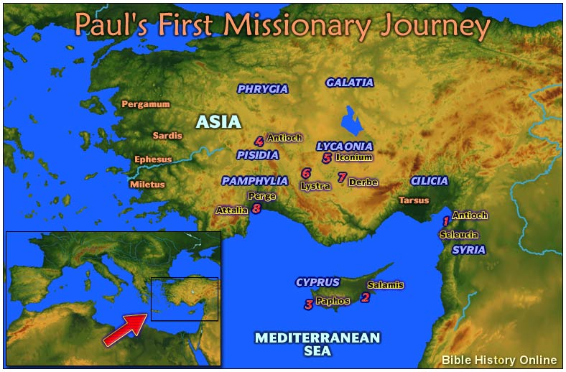
First Missionary Journey

Slide 109
First Missionary Journey
Iconium, Lystra, Derbe (14:1-28)
Adventures in Iconium (14:1-7)
  The cycle of preaching at synagogue, acceptance by some Jews and Greeks, signs and wonders, rejection by synagogue leaders and civic leaders, persecution, and expulsion continues
  Paul preached “the message of grace” (Gal 3:5)
  This caused the population to split, to divide; resulting in a riot

Slide 110
First Missionary Journey
Iconium, Lystra, Derbe (14:1-28)
Miraculous Healing at Lystra (14:8-13)
  New cultural setting, new language, a great sign (miracle)
  The people respond to Paul and Barnabus culturally
Proclamation of the Living God (14:14-18)
  They explained to the crowds they were not gods
  They explained that god indeed had raised up messengers
  The strong native culture made evangelism difficult

Slide 111
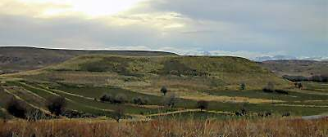
Lystra and Derby from the East

Slide 112
First Missionary Journey
Iconium, Lystra, Derbe (14:1-28)
Persecuted at Lystra, then Derbe, and then retrace Steps (14:19-23)
  The Jewish leaders came from Antioch and Iconium and caused the people to riot, stoning Paul (2 Cor 11:25)
  Paul sees the tribulation period spanning from Christ’s 1st coming to the 2nd coming (Rom 8:12-25).
  They went to Derbe and made many disciples – no opposition

Slide 113
First Missionary Journey
Iconium, Lystra, Derbe (14:1-28)
They returned to Lystra, Iconium, and Antioch appointing elders
  Great courage was shown returning back to those cities
  They were careful to appoint leadership in the new churches
  Elder appointment was a spiritual experience, done with fasting and prayer
  Jewish synagogues also had elders – not a new idea
Return to Antioch on the Orontes (14:24-28)
  They returned to Antioch, reported progress, Jerusalem surely alarmed
  The church (singular) cares for & is connected to missionaries

Slide 114
The Council of Jerusalem (14:28-15:36)
Antioch church spent a long time analyzing 1st journey
  Judaizers visit Antioch insisting on circumcision & ways of Moses (15:1-2)
    The Antioch church sent them to Jerusalem
      Paul & Barnabus reported great progress giving great joy while traveling through Phoenicia & Samaria (gentiles)
    The Jerusalem church received them in Jerusalem
  Pharisee believers insist on circumcision & ways of Moses (15:5)
Jerusalem apostles & elders spent a long time debating (15:6)

Slide 115
The Council of Jerusalem (15:1-36)
Timing
Some see Acts 11:30 related to Galatians 2
  Private meeting, Galatians does not mention results of Council, Galatians 2 is his 2nd trip – Acts 15 is his 3rd, & other reasons
Some see Acts 11:30 written after Galatians 2
  How could Galatians 2:11-14 be written after the Council?
  The decree is missing in Galatians, Galatians must have come 1st
Other commentators disagree – some liberal commentators think Acts 15 was a summary of various meetings

Slide 116
The Council of Jerusalem (15:1-36)
Why?
Perhaps Peter was concerned about Jewish reacting to his fellowshipping with gentiles
Paul seemed more concerned about the true gospel and not keeping the Mosaic covenant
Purposes
  How do we admit gentile believers to church membership?
  Jewish fellowship with gentiles (especially table fellowship)?

Slide 117
The Council of Jerusalem (15:1-36)
_{The Problem (15:1-5)}
Rapid spread of Christianity among Gentiles concerned them
They were concerned rapid spread would destroy moral standards
Moral standards & circumcision not even mentioned to Cornelius
Great concern church was splitting
Ethnic tensions exist in churches and can tear them apart

Slide 118
The Council of Jerusalem (15:1-36)
The Council Meets (15:6) to decide on Gentile matters
Peter’s Speech (15:7-11)
  Peter says he was chosen by God to evangelize gentiles
    He evangelized Cornelius
  Peter solidly supports we are saved by Grace not Mosaic Laws
  At God’s direction, Jews and Gentiles are equally saved
  Gentile hearts are now cleansed without circumcision
  He reminds them Jesus’s burden is light, His yoke is easy
  Peter now disappears from Acts record

Slide 119
The Council of Jerusalem (15:1-36)
Barnabus and Paul Address the Council (15:12)
  They speak as witnesses, not participants of the debate
  They relate what signs and wonders God has done
    See how Israelites are impressed with signs and wonders
  Barnabus name listed before Paul (more highly respected there)

Slide 120
The Council of Jerusalem (15:1-36)
James’s Summing Up (15:13-21)
James was head of church, the decision maker
  He quotes from LXX (Greek) not Hebrew text (respecting gentiles)
People of God equally includes gentiles (a radical idea)
Gentile inclusion is consistent with Prophet writings
Israel made from gentiles
  Israel is not in contrast to gentiles, they are from gentiles
Food restrictions are mentioned to enable table fellowship
Circumcision is not mentioned to avoid putting a yoke on gentiles

Slide 121
The Council of Jerusalem (15:1-36)
The Apostolic Letter to Gentile Christians (15:22-29)
  The food restrictions were considered binding on all gentile churches, and even continued as late as English King Alfred
  The fornication restrictions were mainly to prevent marriages between blood kin and other Lev restrictions
The Church of Antioch Receives the Apostolic Letter (15:30-35)
  Those from Jerusalem spent time encouraging those in Antioch
Paul oddly never mentions decree even in later letters, and later events in Jerusalem imply the decree was only mildly successful

Slide 122
Paul leaves Antioch & Moves to Aegean World
2nd Missionay Journey
  Forming the Team (15:36-41)
  Recently Planted Churches Revisited, Timothy Joins (15:36-16:5)
  Phillipi (where Luke joins) (16:6-40)
  Thessalonica to Athens (17:1-34)
  Corinth (18:1-17)
  Ephesus (18:18-19:20)
Return to Main Outline

Slide 123
Forming the Mission Team
Paul and Barnabus Split Up over John Mark (15:36-41)
  John Mark earlier deserted the trip (Acts 13:13; Col 4:10)
  John Mark was Barnabus’s cousin
  Jerusalem Jews spoke of Barnabus & Paul, but council is now over and suddenly it is Paul & Barnabus in Antioch
Silas is also a Roman citizen – just like Paul (16:37-38)
God can use church splits to spread the gospel

Slide 124
Forming the Mission Team
Timothy joins Paul & Silas in South Galatia (16:1-3)
  Timothy had Jewish mother & Greek Father - some discussion by Darrell Bock about whether Timothy was considered Greek or Jewish
  Timothy had to be circumcised to “fit in” with Jewish Israelites
  Paul wisely implements council agreement into current culture
Paul, Silas, Greek Timothy, & Luke best team for Greek missions.
They visited churches they earlier founded & passed out decrees (16:4).
Churches grow in faith and numbers (16:5)

Slide 125
Forming the Mission Team
The Call from Macedonia (16:6-10)
Sometimes the Spirit leads by opening and closing doors
Sometimes the Spirit leads by our having dreams
Missionaries evangelize new territories, do not stay in old places
Luke uses “we” instead of “they” as the 4th missionary (16:10)
Spirit led Paul to evangelize cities around Ephesus 1st, then Ephesus, making their efforts more fruitful
  Troas to Phillipi (16:11-12a) – A Roman colony

Slide 126
Forming the Mission Team
Recap
Missionary Teams are made from culturally sensitive people
  Paul – Born a Roman Citizen
  Silas – Also a Roman Citizen with a 2nd in command
  Timothy – Greek Father & Jewish Mother - from Lystra
  Luke – Not of the circumcision (perhaps a Palestinian) (Col 4:11,14) – joined at Troas
Missionary teams are guided by a common vision
The Holy Spirit leads in a variety of ways

Slide 127
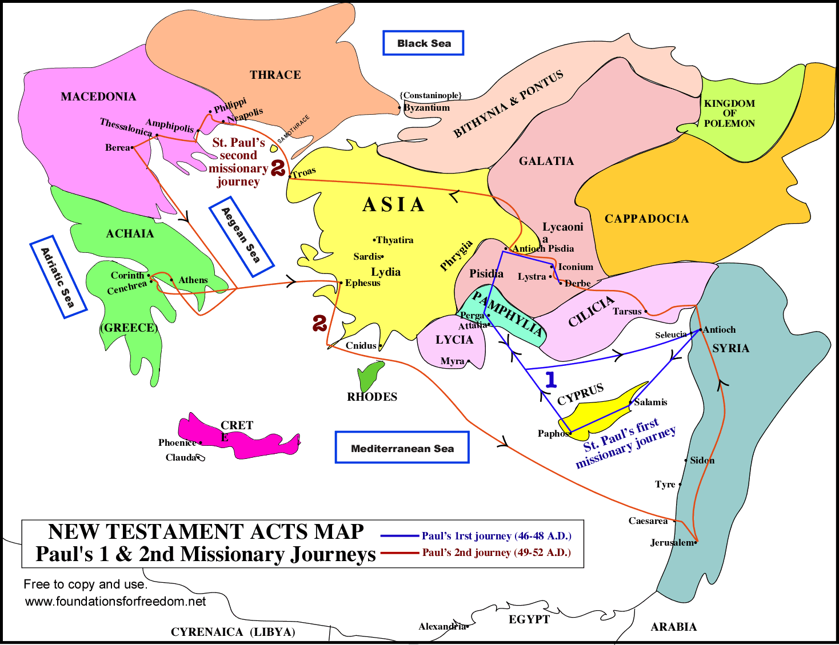
2nd Missionary Journey Map

Slide 128
Paul leaves Antioch & Moves to the Aegean World
The Faith of Lydia in Phillipi (16:12b-15)
  There appears to be no Jewish Synagogue in Phillipi
  Roman women could be independent by Roman law, but by Jewish law you needed at least one man to form a synagogue.
  Paul talking to Jewish women in prayer seems lax Jewish observance
  God is leading Lydia to faith in Jesus, so that she and her entire household were baptized
  The gospel spreads to Jewish only women and gentile societies
  Rev 2:18-29 letter to church at Thyatira a city famous for purple cloth.

Slide 129
Paul leaves Antioch and Moves to the Aegean World
Phillipi (16:6-40)
  The Pythoness (16:16-18)
    Paul now cures a slave girl from a spirit of Apollo (Delphi)
    Beautiful girls believed to cast spells on people
    Declaring “most high God” is a name also attributed to “Zeus” and for a believer in multiple Gods to say this is misleading to Greeks
    Paul was clearly confronted by paganism (multiple gods)
    Slave girl contrasted with head of household Jewish Lydia
    Christianity spreads in a variety of cultural backgrounds

Slide 130
Paul leaves Antioch & Moves to the Aegean World
Paul and Silas Charged & Imprisoned in Philippi (16:19-24)
  These 2 people surely looked Jewish, while companions Luke & Timothy looking gentile were probably not arrested
  Roman support for native religions/livelihoods confronts the new Jewish sect called Christianity (exclusive vs inclusive).
  Philippi was a Roman colony, who prided themselves on Roman worship
  Romans feared Judaism, which did not allow emperor worship
  Similar to Jesus driving spirits into pigs, hurting pig farmers occupations Luke 23:2, 5.
  This is an example of local Roman justice – keep order in the city

Slide 131
Paul leaves Antioch and Moves to the Aegean World
The Philippi Jailer’s Conversion (16:25-34)
  God delivered as Paul and Silas sang in worship
  There was an earthquake at midnight; all prisoners freed
  Paul and Silas remained and convinced other prisoners to remain
  Jailer’s reasons for suicide uncertain after earthquake (not my fault)
  Jailer so impressed he & his family were converted (Asian culture)
  Baptism (of family) follows faith (perhaps an example of sprinkling).

Slide 132
Paul leaves Antioch & Moves to the Aegean World
Christianity on Trial
    Christianity is shaking the ancient culture, they are told to stop, but Christianity is a just (legal) religion
    Paul’s insistence on an apology perhaps saves the new Philippian church from some persecution later on
    Why Paul waited before telling of Roman citizenship not clear
    Christianity can excel against Judaism, native religions & Roman Law
  The situation in Philippi is similar to our story in the USA today

Slide 133
Paul leaves Antioch & Moves to the Aegean World
Philippi (16:6-40) Theological Comments
  3 Different salvations – see the variety of ways The Way spreads
    Lydia was a woman leader, a Jewish family matriarch
    A demon-possessed slave-girl
    A gentile jailer
    See how God works in such different ways to different people
  Male Jews are thankful they are not women, slaves, and gentiles. In Philippi Paul saved a woman, a slave, and a gentile!
  See how in Asian cultures, when the head of household is saved, the entire household (family, slaves etc.) are baptized

Slide 134
Paul leaves Antioch & Moves to the Aegean World
Thessalonica (17:1-4)
  Paul and Silas continue to visit port centers of trade
  They go to the Synagogue 1st of Jews & worshiping Greeks, explaining Old Testament scriptures to all cultures
  They teach gospel message: death, burial, & resurrection of Jesus
  A few Jews, many Greeks, & women believed; a church was born

Slide 135
Paul leaves Antioch & Moves to the Aegean World
New church formed in Thessalonica (17:5-9)
  The jealous unbelievers stirred up a riot
  Civil authorities persecuted Christians as had Jewish authorities earlier
    Disturbing the peace
    Sedition (preaching the Kingdom of God with King) who was hung on a cross as the worst criminal.
  Civil authorities do not judge Christianity guilty – a new church survived
  Paul & Silas expelled
Summary: reasoned, explained, proved, proclaimed - persuaded, joined

Slide 136
Paul leaves Antioch & Moves to the Aegean World
Beroea (17:10-15)
  Paul, Silas, & Timothy were accepted by the open-minded Beroeans; Jews, Greeks, honored women and men.
    Perhaps the Beroeans thought more highly of women
  A Jewish scholastic culture is just as open to Christianity as any other culture
  Again, while a new church was planted, most were stirred up against them.
  Paul fled for his life to Athens, while Silas & Timothy remained

Slide 137
2nd Missionary Journey - Athens (17:16-21)
Athens was the center of intellectual thought, art, culture, philosophy, and learning in the ancient world.
  The Greeks did not believe in resurrection of the dead
  They wanted to hear / judge new ideas & teachings
  The city was filled with idols and great works of man
  Greece was the birthplace of democracy
These things remind one of current USA culture

Slide 138
Paul’s Areopagitica (in Athens) (17:22-31)
Paul adapts his speech to his audience – and so should we
  Paul probably spoke high Greek to these gentiles
  You do not preach Old Testament nor Jesus to pagans
The Unknown God is described as neuter (not masc. or fem.)
  God is a Spirit, and we are created in His nature, therefore temples made out of matter for Him to live in are foolish
  God helps His men & women; they cannot help God.
  God resurrects men: He will someday resurrect us

Slide 139
2nd Missionary Journey - Athens (17:22-34)
Paul’s Areopagitica (17:22-31)
  This was an Hellenistic speech without any Hebrew background
  This speech was somewhat different than Romans 1
  Please contrast the highly educated Jewish Beroeans to Greeks
  The Divine Nature is not made of gold, silver, or stone
    We too are created in His image (not flesh and blood)
  God will also judge all of us in the future through a resurrected man
    This is the gospel message to a gentile audience

Slide 140
2nd Missionary Journey - Athens (17:22-34)
The Athenians’ Reaction (17:32-34)
  They interrupted his speech / sermon
  They had a problem with resurrection of the dead
  Resurrection of the dead is a key element of Christianity
  Some believed, but there is no record of new church formation

Slide 141
2nd Missionary Journey – Corinth (18:1-17)
Paul Arrives in Corinth (18-1-4)
Paul chose missionary locations that were centers of trade & people.
Paul met Priscilla & Aquila there.
  They were also tentmakers (workers of leather).
  They (actually all Jews) had been expelled by Rome by Claudius (18:2-3)
  Prisca (formal name) is often mentioned at the end of Paul’s Epistles. She/they may have written Hebrews.
Rome was uniquely Christianized – Jews had been expelled from Rome by Claudius - only gentiles remained.

Slide 142
2nd Missionary Journey – Corinth (18:1-17)
Paul Spends 18 Months in Corinth (18:5-11)
Paul devoted/absorbed/compelled himself (full-time) to preaching
  Silas and Timothy joined him there (from Thessalonica)
  Paul received support from Philippi and was able to preach full-time
Paul went to the Jews first, then after rejection went to gentiles
  Paul made significant Jewish converts, including head of Synagogue
  This resulted in significant Jewish opposition

Slide 143
2nd Missionary Journey – Corinth (18:1-17)
The “New Faith” is Judged (18:5-11)
The “new faith” is brought to a civilian court – it is judged acceptable under Roman Law
Gallio realizes the difference between the “New Faith” and the political interest of the state
  The status of Christianity has subtly changed
  Later Roman rulers will judge Christianity more harshly
Today we often intertwine country and religion – and fail to recognize the “New Faith” is independent of country

Slide 144
2nd Missionary Journey – Corinth (18:1-17)
Paul Before Gallio (18:12-17)
Gallio was a Roman proconsul, and as such his rulings would have had empire-wise implications
The charge was that Christianity was not a religion recognized by Roman Law collegium licitum and therefore illegal
Gallio ruled it was a variation of Judaism and not a Roman concern
This ruling (Christian apologetic) gave Christians legal relief for 10 years

Slide 145
2nd Missionary Journey – Ephesus
Hasty Visit (18:18-21)
Ephesus is 4th largest city in Roman Empire – major port city
  Estimated to have 250,000 people
  Site of Temple of Artemis, one of the 7 wonders of the world.
Paul, perhaps encouraged by judicial ruling, cuts hair
Paul was in a hurry to get back to Jerusalem, perhaps Passover
  He left Priscilla, Aquila, & Timothy in Ephesus
  He perhaps was laying groundwork for future ministry here
  See how his ministry team now included a woman, Priscilla

Slide 146
2nd Missionary Journey – Ending
Brief Visit to Judaea and Syria (18:22-23)
Paul visited the mother church in Jerusalem
Paul then went down to the church in Antioch, & surrounding territories, strengthening the young churches
Luke covered a 1500 mile journey in a single sentence

Slide 147
3rd Missionary Journey – Background
Apollos (18:24-28)
  A great Jewish scholar preacher, full of the Spirit of God
  Priscilla & Aquila taught him about “The Way”
    Others were at work preparing for extended Ephesus ministry
  We also take people aside & teach them privately instead of publically
  The early church (and today) have great effective preachers who are not fully informed about Jesus
  Apollos is sent back to Greece, Paul will later encounter him in 1 Cor 1-4, 3:9, 16:12
  Summary: Potential preachers are taught privately, sent by the church to new places, & do great work. There is mutual encouragement.

Slide 148
3rd Missionary Journey – Ephesus
Christian Ephesian Apologetic Summary
  Ephesus shows Christianity is superior to paganism
  Not a threat to Roman order
  Paul has non-Christian friends in high places
  Pagan opposition is weak and confused

Slide 149
3rd Missionary Journey – Ephesus
Paul and the Twelve Disciples of Ephesus (19:1-7)
    Water baptism is not enough, we need Spirit Baptism
    All those baptized by John the Baptist needed to be rebaptized
    There is no Acts pattern to spirit coming before or after baptism
    John the Baptist did preach the Spirit sent by Jesus (Luke 3:15-16)
    Only case of rebaptism in the entire NT
    Spirit of Baptism of believers is the norm in the NT, no exceptions
    Baptism and Laying On of Hands are truly significant events
  Both Apollos & the Ephesian Disciples needed further instruction

Slide 150
3rd Missionary Journey – Ephesus
Paul preached first in the synagogue for 3 months (19:8)
  Most people in the synagogue hardened themselves against The Way
The Lecture Hall of Tyrannus (19:8-10)
  Ephesus was like all other cities, go to Jews, rejection, persecution, some believe, and birth of new Christian church
  Paul was preaching in a lecture hall, not a synagogue
  Paul preached for two years in Ephesus
  Paul’s preaching was accompanied by many miracles
  Apparently Paul’s companions, such as Epaphras, preached in surrounding cities, perhaps establishing the 7 Revelation churches

Slide 151
3rd Missionary Journey – Ephesus
Conflict with the Magicians (19:11-19)
  Ephesus was a center for dark magical demonic arts
  Colossians was written to show Jesus and His church was stronger than the rulers, principalities, and powers (dark angels)
  God can speak to those that believe in magic using their language (Paul also became a better magician)
  Paul displayed God’s power, magicians try to use (force) God
  God speaks through His pastors and teachers today using the language of todays cultures

Slide 152
3rd Missionary Journey – Ephesus
Ephesus (18:18-19:20)
  Further Progress Report (19:20)
    This fifth progress report shows a mightily growing church

Slide 153
Paul Plans to Visit Rome, His Arrest, & Journey
He Prepares to Leave for Ephesus for Macedonia & Achaia (19:21-20:6)
The Journey to Jerusalem (20:7-21:16)
Paul at Jerusalem (21:17-23:30)
Paul at Caesarea (23:31-26:32)
Paul’s Voyage and Shipwreck (27:1-44)
Winter in Malta (28:1-10)
Rome at Last (28:11-31)
Return to Main Outline

Slide 154
Paul Plans to Visit Rome, His Arrest, & Journey
He Prepares to Leave for Ephesus for Macedonia & Achaia (19:21-20:6)
  Paul Makes Plans for the Future (19:21-22)
    Paul had transitioned from a traveling missionary to a preacher in Ephesus, and wished to resume his former missionary life
    Others had settled Egypt, the East, Rome etc.
    Spain is the next great planned target
    Paul needed to take his collection for the Saints back to Jerusalem

Slide 155
3rd Missionary Journey – Ephesus
The Riot at Ephesus (19:23-41)
  The Temple to Artemis is huge – larger than a football field and largest temple in Greco-Roman world. It was one of the 7 wonders of the ancient world
  Christianity is challenging those who make statues & worship idols
  This causes a huge turmoil in the community
  Financial gain and religion together are powerful combinations
  This is the 4th story in Luke about collision of Christianity & pagan religions

Slide 156
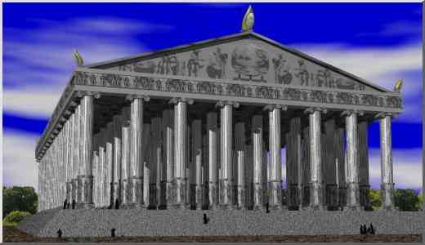
The Temple to Artemis is larger than a football field - largest temple in Greco-Roman world- one of the 7 wonders of the ancient world

Slide 157
3rd Missionary Journey – Ephesus
The Riot at Ephesus (19:23-41)
  Three main points about “The Way” emphasized
    It reacts against a pagan cult
    It does not insult other gods and temples (subtle)
    Christianity has a right to exist

Slide 158
3rd Missionary Journey – Ephesus
Demonstration at the Theater (19:29-34)
  The charges against “The Way” were : 1 Profit, 2 gods made with hands are not real gods, and 3 Artemis and the silversmiths may fall into disrepute.
  The demonstration had an anti-Jewish flavor (Jews did not worship the goddess Artemis)
  The Way is associated with Judaism, & anti-Jewish persecution at stake
  Many did not know why they were there – a mob scene
The Town Clerk calms the agitation (19:35-41)
  The civil authorities were not against Christians at this time

Slide 159
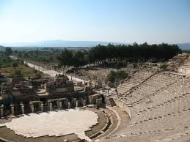
Theater at Ephesus holds 24,000 people

Slide 160
3rd Missionary Journey – Ephesus Summary
Paul preached and taught in one spot for two years
He changed the culture of the entire area around Ephesus
  The temple worship of Artemis was greatly impacted
  The silversmith trade was greatly impacted
  Magic arts was greatly impacted
  Huge numbers of books burned implying civilization had changed
  New churches founded at Colossae, Laodicea etc.
  Repercussions – time for other personalities to carry on

Slide 161
Paul Plans to Visit Rome, His Arrest, & Journey
Paul visits Macedonia and Greece (20:1-6)
  Paul had already planned to leave Ephesus & go to Jerusalem, perhaps from 55 to late 56 (1 Cor 16:8)
    They visited their new churches along the way for short periods of time
    Most were Hellenistic Jews
    Paul perhaps wrote and sent Romans during this time (Corinth)
  Acts now uses “we” implying Luke accompanied them
  Missionaries today best start new churches, remain their a few years, & move on to new locations

Slide 162
Paul Plans to Visit Rome, His Arrest, & Journey
Paul visits Macedonia and Greece (20:1-6)
  This journey may have taken 2 to 3 years
  Paul & companions were collecting an offering for Jerusalem
    Seven delegates accompanied him, mostly of Greek origin representing the various churches giving the offering
      Macedonia – Sopater, Aristarchus, and Secundus
      Asia – Tychicus and Trophimus
      Galatia – Gaius the Derbaean
      Timothy was from Galatia but was Paul’s junior colleague
      Rom 16:16 alludes to the group accompanying him
    Paul surely was collecting monies for Jerusalem (24:17; Rom 15:25-26; 2 Cor 8:16-24)

Slide 163
Paul Plans to Visit Rome, His Arrest, & Journey
Paul visits Macedonia and Greece (20:1-6)
  Paul set sail from Phillipi at feast of unleavened bread (April 7 to 14 in A.D. 57)
  This means the collection would arrive on Pentecost seven weeks later

Slide 164
The Journey to Jerusalem (20:7-21:16)
Paul at Troas (20:7-12)
  Luke reports far more details when he accompanies Paul
  Paul celebrates feast of unleavened bread (April 7 to 14 in A.D. 57)
  This is earliest text reporting Sunday services
  Perhaps churches met in evening as they worked during day (Saturday may have been day of rest – Sunday a work day?)
  1 Kings 17:21 and 2 Kings 4;34-35 have similar stories of restoration to life, for it is not clear the boy died
  This is Paul’s last recorded miracle in Acts

Slide 165
The Journey to Jerusalem (20:7-21:16)
From Troas to Miletus (20:13-16)
  Paul’s and companions took fast ships back to Jerusalem to make sure collection could be given at Pentecost
  Paul walked to Assos while companions sailed – safety issue?
  This meant by-passing church at Ephesus
Paul sends for the Elders of the Ephesian Church (20:17)
  He gave them his only recorded sermon to a Christian audience
  This was a farewell sermon, reminding one of his last letters

Slide 166
Paul Plans to Visit Rome, His Arrest, & Journey
Paul Bids Farewell to the Ephesian Church (20:18-35)
  Only recorded sermon Paul ever gave to a Christian audience
  3rd major speech (Antioch Jews 13:16-41); Athens gentiles (17:22-31)
  Retrospective on his Ephesian ministry (20:18-21)
    Serving with humility, tears, and trials
    Teaching both publically and house-to-house
    Testifying to all about repentance towards God and faith in Jesus Christ

Slide 167
Paul Plans to Visit Rome, His Arrest, & Journey
Paul Bids Farewell to the Ephesian Church (20:18-35)
  Paul’s prospects include imprisonment and troubles (20:22-24), (Rom 15:30-31)
  His charge to the elders (20:25-31) include watching over the church, for wolves wait to pounce, both from outside and inside
    Elders (Overseers/Bishops) are appointed by the Holy Spirit
  Final admonition (20:32-35) includes elders earning their own way, not domineering, and give more than they receive
    Follow Paul’s example of financial supporting other elders
    Follow Paul’s example of serving, teaching, & testifying
    Churches that are net consumers of resources find it hard to grow

Slide 168
The Journey to Jerusalem (20:7-21:16)
An Affectionate Parting (20:36-38)
  He parted with such weeping as they knew his ministry of 6 to 7 years in that part of the world was finished & they would never see him again.
  Missionaries plant a church, then other personalities are needed to watch over the established church
  Today most church growth happens when new churches are created while existing older churches maintain existing members
  Both new church planters and elders (overseers) are equally esteemed

Slide 169
The Journey to Jerusalem (20:7-21:16)
Miletus to Tyre (21:1-6)
  Paul was led by the Spirit to go to Jerusalem to give the offering at Pentecost (20:16)
  Other Christians along the way with the gift of prophecy warned Paul that persecution and arrest await him in Jerusalem.
  He met new (Messianic) Christian friends in Tyre, & they bonded quickly
    Contrast their greetings with Jews in Jerusalem
  We should also quickly make friends with fellow Christians

Slide 170
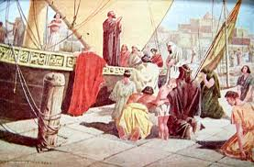
Paul Leaves Troaz

Slide 171
The Journey to Jerusalem (20:7-21:16)
Tyre to Caesarea (21:7-9)
  Evangelist Philip was one of the seven deacons (6:5), settled in Caesarea (8:40), and 20 years later still there with 4 daughters
  His daughters also had the gift of prophecy
  No record of their prophecy exists

Slide 172
The Journey to Jerusalem (20:7-21:16)
Prophet Agabus Reappears (21:10-14)
  He previously reported a famine (11:27-28)
  He now prophesizes Paul’s arrest in Jerusalem, using Paul’s money belt (think collection) as a visual example
  He never said not to go to Jerusalem
Paul was determined to follow the leading of the Spirit, like Jesus in Luke 22:42; Paul in Rom 15:30-31
  The Spirit bound Paul to go to Jerusalem then Rome (19:21; 20:22-24)
Sometimes the church “gets it wrong” as one person “gets it right”

Slide 173
Paul At Jerusalem (21:17-23:30)
  Arrival at Jerusalem (21:15-16)
    Their host in Jerusalem welcomed Jewish & Gentile Believers
Meeting with James & The Elders (21:17-26)
  All the apostles were in the mission field, but James remained
  Hebrews typically had 70 elders
  They were glad to hear the report of Paul
  The Pentecost offering is unmentioned (curious)

Slide 174
Paul At Jerusalem (21:17-23:30)
Meeting with James & The Elders (21:17-26)
  Great concern about beliefs Paul does not teach Jews to follow Mosaic Law. They see Paul teaching apostasy (disrespect for Law)
    Messianic Jews are zealous for following the Law
    Requirements: Gen 17:10, 21:4; Deut 10:16, 30:6; Jer 4:4
    Teachings: I Cor 7:18; Gal 2-1-14, 3:10-25, 6:15; Rom 3:19-20, 31
  Rising tensions between gentiles and nationalistic Jews
  There seems a natural split between Christians & Messianic Jews

Slide 175
Paul At Jerusalem (21:17-23:30)
Meeting with James & The Elders (21:17-26)
  The Elders would not dare publicize any gifts from Gentile churches
  Paul followed their advice, shaved his head, and took Nazarene vows along with 4 others
    Perhaps this was in order that the Elders would accept the Pentecost offerings

Slide 176
Paul At Jerusalem (21:17-23:30)
Riot in the Temple (21:27-30)
  The Jews from Asia (not Messianic) who fought Paul in Ephesus and other cities now see him in Jerusalem
    They stirred up a riot by falsely accused him of:
      Teaching Jews not to obey Moses & against the temple,
      Bringing a Gentile into the inner court (racial)
  The Temple Court gates were shut (Luke 21:6). Perhaps now the fate of the Temple is sealed – they excluded God’s chosen servant

Slide 177
Paul At Jerusalem (21:17-23:30)
Paul Rescued by the Romans (21:31-36)
  Roman Fortress (Antonia) built into temple wall to control riots
  A Roman cohort has 1000 solders (760 on foot & 240 horsemen)
  They arrested Paul to stop a riot
  They could not determine what to charge him with
  They shouted “Away with him”, same thing they shouted at Jesus 27 years earlier
  Jerusalem has now rejected Jesus, Peter, John, Stephen, and Paul

Slide 178
Paul’s Defense of Christianity (22-28)
Paul at Jerusalem (21:17-23:30)
Paul at Caesarea (23:31-26:32)
Paul’s Voyage & Shipwreck (27:1-44)
Rome at Last (28:11-31)
Return to Main Outline

Slide 179
Paul’s Defense of Christianity (22-28)
Paul at Jerusalem (21:17-23:30)
  Paul Obtains Leave to Address Crowd (21:37-40)
    Paul quickly takes charge of all situations
    The tribune let Paul speak to the crowd, impressed he knew Greek
    “Hebrew” means Aramaic dialect in the New Testament (except Revelation)
    Cilician city of Tarsus meant little to the tribune, he would be later impressed to learn he was a Roman citizen.
    Paul speaks primarily in Acts to defend Christianity more than missionary (obtain new disciples) or what caused the riot.

Slide 180
Paul’s Defense of Christianity (22-28)
Paul at Jerusalem (21:17-23:30)
  Paul’s Defense to the People of Jerusalem (22:1-21)
    His Early Days (22:1-5)
      He makes a 1st person autobiography instead of 3rd person (9:1-22)
      He was born in Tarsus, but raised and educated in Jerusalem under Gamaliel. He became a Pharisee. (Gal 1:14).
      He was zealous to pursue The Way, even to Damascus

Slide 181
Paul’s Defense of Christianity (22-28)
Paul’s Defense to the People of Jerusalem (22:1-21)
  The Damascus Road (22:6-11) – he was blinded by bright light & addressed to by Jesus
    Acts 26:16 states Paul was commissioned at this time
  Ananias of Damascus (22:12-16) – he received further instructions from a pious Jew (appropriate for this Jewish audience).
    The current High Priest in Jerusalem was named Ananias
    Paul continued to be obedient to Jewish customs & Law
  Paul’s Vision in the Temple (22:17-21) – Paul was told in a trance he needed to get out of Jerusalem and go to the Gentiles

Slide 182
Paul’s Defense of Christianity (22-28)
Paul at Jerusalem (21:17-23:30)
  Saying “go to the Gentiles” caused a riot –they hated gentiles
    Jesus could not have “gone to the Gentiles”
    The tribune perhaps might not have well understood Aramaic
  Paul Reveals his Roman citizenship (22:22-29)
    The right setting to do this was alone with Romans, not before Jews
    The Roman state protected Paul, it was not an enemy of Christianity
  Paul brought before the Sanhedrin (22:30) – the tribune wanted to know the reason for the disturbance – so he faced his accusers

Slide 183
Paul’s Defense of Christianity (22-28)
  Paul at Jerusalem (21:17-23:30) - Before the Sanhedrin (23:1-10)
  Paul said he conducted himself with good conscious to this day.
    The High Priest ordered him struck in the mouth, an illegal action under the Mosaic Law (Exod 23:28)
    Paul asks how the Chief Priest can judge under the Mosaic Law when he has just broken the Mosaic Law
    Paul strove for his rights, while Jesus was passive
    Paul then said he was on trial for the resurrection of the dead. This caused a riot between Sadducees and Pharisees.
      Paul was fighting for the heart of Christianity

Slide 184
Paul’s Defense of Christianity (22-28)
  Paul at Jerusalem (21:17-23:30) - Before the Sanhedrin (23:1-10)
  Is there a Resurrection of the dead?
    Resurrection of Christ key Christian belief
    Sadducees said no - difficult for them to become Christians
    Pharisees said yes – easier for them to become Christian
  Pharisees said he was innocent while Sadducees condemned him
  Little or no Biblical basis for Sadducees not believing in angels
  Luke is defending the strong link between Judaism & Christianity

Slide 185
Paul’s Defense of Christianity (22-28)
  Paul at Jerusalem (21:17-23:30) - Before the Sanhedrin (23:1-10)
  Sadducees belief in angels, spirits, & resurrection of dead
    Paul used their division to show Romans the issue was religious
    Various commentators have tried to satisfactorily show where Sadducees were coming from – but hard to do today
    Perhaps issue was who spoke to Paul (how could a resurrected Jesus have spoken to Paul if people cannot be resurrected)?
    Since Paul received teachings from resurrected Jesus, are they true?
    Many modern Christians do not believe in evil spirits (a literal devil) and resurrection.

Slide 186
Paul’s Defense of Christianity (22-28)
Paul at Jerusalem (21:17-23:30)
  The Lord Appears to Paul by Night (22:11) – He is going to Rome
    God moves behind the scene so Paul can witness to highest levels in Roman society
    Paul would not have had such access as a missionary to Rome
    His defense statements along the way would be great witnesses for why Christianity was a legal religion

Slide 187
Paul’s Defense of Christianity (22-28)
Paul at Jerusalem (21:17-23:30)
  Plot against Paul’s Life (23:12-15) – God Acts to get Paul to Rome
    A Band of 40+ plans to ambush Paul and the Elders agree
    They have vowed against God’s plan with High Priests knowledge
  The Plot Revealed to Paul & Tribune (23:16-22) - by Paul’s sisters son
  The Tribune Prepares to send Paul to Caesarea (23:23-24)
    Paul cannot remain in Jerusalem – journey to Rome begins
    This is the 3rd time Romans have saved Paul from certain death

Slide 188
Paul’s Defense of Christianity (22-28)
Paul at Jerusalem (21:17-23:30)
  Letter from the Tribune to Felix (23:25-30)
    Tribune Claudius Lysias prevented a Roman citizen from being killed over questions of “their law”
    There was no charge against him worthy of death of imprisonment
    Because of a plot against him, he had to be moved to Jerusalem so his accuser's could bring charges against him in Caesarea before Felix

Slide 189
Paul at Caesarea (23:31-26:32)
Paul Taken to Caesarea (23:31-35) (A.D. 58)
  The trip was probably a 35 mile forced night march by 200 infantrymen, 70 horsemen, and 200 men with spears.
  Paul was mounted on a horse or mule for additional mobility in case of attack
  The cavalry then probably accompanied him another 27 miles to Caesarea
  This show of power also was a reminder to the Jews of the power of Rome

Slide 190
Paul at Caesarea (23:31-26:32)
Tiberius Claudius Felix (A.D. 58)
  Felix was a cruel freed slave, a forced marriage by Claudius to Drusilla the daughter of Herod Agrippa I (who was married to another) His first wife was the (great) granddaughter of Antony & Cleopatra
  Felix would be later removed for not keeping peace
  Felix first determined Paul was a Cilician Roman citizen
  Felix seemed fair that he would hear both sides of the argument at the same time before both parties
  But he kept an innocent Paul in custody for 2 years awaiting Roman justice

Slide 191
Paul at Caesarea (23:31-26:32)
Practical Applications
  We too sometimes “process data” like Felix, going through the system, year after year, without thinking about fundamental issues.
  We too sometimes “think theologically” like the Jews judging the scriptures against our traditions without thinking about fundamental issues.
  We too can put off decisions year after year.

Slide 192
Paul at Caesarea (23:31-26:32)
Paul Accused Before Felix (24:1-9)
  The Sanhedrin accuses him of:
    Fomenting strife around the world,
    Ringleader of the Nazoreans (sedition), and
    Trying to profane (be disruptive) at the Temple.
  Most of the speech praises Felix, a bloody ferocious tyrant, for keeping peace (his main job). The way to further peace is to remove Paul from stirring up more trouble.
    (Historian Josephus notes peace grew worse during Felix reign).

Slide 193
Paul at Caesarea (23:31-26:32)
Paul’s Defense Before Felix (24:10-21)
  Paul came to Jerusalem (after being away 5 years) to bring alms and offerings (at Pentecost) (24:17) (thus supporting Israel).
    Typically Jews come to Jerusalem at Pentecost to present offering (Clinton, ZIBBC, 485).
  Luke says little about the offering because if the main purpose of the visit was to bring alms, why were they not presented at the Temple? (Gal 2:10; Rom 15:26; 2 Cor 8:1-9:15)
    This issue is potentially divisive while resurrection is a main point
  Resurrection of the dead at the riot in Jerusalem is a theme that the Roman guards can attest to.

Slide 194
Paul at Caesarea (23:31-26:32)
Paul’s Defense Before Felix (24:10-21)
  Paul had been in Jerusalem for 12 days, peaceful and purified, and some Jews from Asia came and caused trouble.
  Paul clearly states the Jews from Asia should be at the trial
  Perhaps Jews do not bring Asian Jews knowing Felix will quickly see right through their false charges
  Paul states they cannot prove any of their charges

Slide 195
Paul at Caesarea (23:31-26:32)
Paul’s Defense Before Felix (24:10-21)
  Paul highly stresses the resurrection and judgment awaiting all, the most significant issue.
  Paul has to be blameless knowing he faces a future judgment
  Only place in scripture where Paul says just and unjust resurrected
    The resurrection of just and unjust is a challenge to Felix
Felix adjourns the proceedings (24:22-23)
  He has discerned the Jews and state have no charge against Paul

Slide 196
Paul at Caesarea (23:31-26:32)
Paul’s Interviews with Felix (24:24-26)
  Felix & his 3rd wife Drusilla (a Jewess) were very interested in The Way
  Felix wanted money from Paul (Paul brought alms & offerings to Jerusalem).
  Perhaps Paul’s emphasis on morality (righteousness), self-control, & future judgment makes Felix (& Drusilla) very nervous.
  Felix (Roman society) is both highly interested in “The Way” & also bribes (corrupt)

Slide 197
Paul at Caesarea (23:31-26:32)
Felix replaced by Festus; Paul left in custody (24:27)
  Paul left in prison there about 2 years
    Perhaps this was a favor to the Jews (Paul could not stir them up)
  Felix replaced due to bloody handling of Jewish riot at Caesarea
    About AD 59-60 (some debate on this – sketchy information)
    Ugly political situation – zealots growing – temple destroyed 70 AD
  Festus had better reputation for fairness

Slide 198
Paul at Caesarea (23:31-26:32)
Summary : Powerful people have many issues
  They are privileged, capable, in a slippery place, and need to perform
  God cares for them and the truth is clearly shown to them
  We believers need to teach / preach to them
  God is responsible for the results – not us
  God is in charge of the larger situation
    It may seem like Paul is in prison due to the Jews
    Instead Jerusalem is going to be destroyed in 68-70 AD.

Slide 199
Paul at Caesarea (23:31-26:32)
Festus Visits Jerusalem (25:1-5)
  Festus was a new inexperienced governor
  They asked Festus to send Paul to Jerusalem
    This shows how important this was to Jewish leadership
    There was a power struggle going on within the Jews at this time
  The Jewish leaders again wanted to kill Paul in an ambush
  Festus wisely asked them to come to Caesarea for a new hearing
  Again the overall background is a looming revolution and the wishes of a new leader to avoid bloody riots and confrontation

Slide 200
Paul at Caesarea (23:31-26:32)
Hearing before Procurator Festus (25:6-12)
  Jews made charges they could not prove
  Paul had but to show they could not prove their charges
  Festus like the idea of a trial in Jerusalem, but Paul thought that this would prejudice his case.
  What was on trial was also that The Way was legitimate

Slide 201
Paul at Caesarea (23:31-26:32)
Paul appealed to Caesar
  Charges of violating Jewish law are not a major state issue
  Charges of insurrection and being a pest are state issues
  The Jews overplayed their hand, they pushed the issue to Rome
  In a way this means that the state not the Jewish leadership judges “The Way, and it gets Paul away to Rome
  This gets Festus “off the hook” of having to appease the restive Jewish population
  Festus has remaining problem of writing a report about the charge to Rome

Slide 202
Paul at Caesarea (23:31-26:32)
Agrippa II and Bernice Visit Festus (25:13-22)
  Agrippa II was a Son of Herod Agrippa; Bernice was a queen
  Festus was surprised that the Jews accused Paul of religious differences & needed to prepare a report for Rome
  Agrippa provided Festus an opportunity for more information in a formal setting before the city leaders
  This is not a trial
  See how God used Paul to testify to the city leaders

Slide 203
Paul at Caesarea (23:31-26:32)
Paul Appears before Agrippa II & Bernice (25:23-27)
  Lower level Roman judges handle local civic complaints, while religions matters belong in the Synagogue – Festus clearly recognizes there is a deeper charge here – Paul is fundamentally challenging and changing Roman society
  Festus clearly stated Paul had done nothing deserving death and is not sure what the charges are against Paul & needs help
  Luke is saying The Way is not guilty of religious or civil charges
  See how pagan Romans defend Paul while Jewish “men of God” seek his death

Slide 204
Paul at Caesarea (23:31-26:32)
Agrippa II and Bernice Visit Festus (25:13-22)
  This section has two major apologetic themes:
    The defense of the cross
    Luke is also giving an apology here for Christian beliefs (an extension of Judaism)

Slide 205
Paul at Caesarea (23:31-26:32)
Herod Agrippa II (25:23-27)
  Formal name is Marcus Julius Agrippa
  Only surviving son of Herod Agrippa I who died in Acts 12:23.
  Grandson of Herod the Great
  He was a king, ruling over Judea, much of Galilee, Lebanon and to the East, Samaria
  He was ½ Jewish, pious, devout, and appointed the high priest. He sided with Rome in later war with Judea in 70 AD
  Rome ruled using local native rulers such as Agrippa II. Therefore Festus (who tried Paul) sought advice from a native subject (Agrippa II)

Slide 206
Paul at Caesarea (23:31-26:32)
Agrippa’s sister Drusilla was wife of previous governor Felix
Agrippa’s other sister was Julia Bernice
  Lived in palace with Agrippa II
  Earlier married to her uncle king of Lebanon, & to King Polemon of Cilicia
  Rumored to be his incestuous lover (a sister)
  Later mistress to Emperor Vespasian and especially to Emperor Titus
  Titus wanted to marry her but did not because she was partly Jewish

Slide 207
Paul at Caesarea (23:31-26:32)
Paul’s “Apologia pro vita sua” (26:1-23)
  Paul Accepts Agrippa’s Invitation to Speak (26:1)
  Exordium (26:2-3)
  The Resurrection Hope (26:4-8)
    The Resurrection of Jesus fulfills the promised hope of Israel.
    Paul, in announcing this fulfillment, is condemned by Israel itself!
    Pharisees believe in resurrection of the dead, so does Paul, so if God has resurrected one man, why should this so upset the Jews?

Slide 208
Paul at Caesarea (23:31-26:32)
Paul’s “Apologia pro vita sua” (26:1-23)
  The Persecution of “The Saints” (26:9-11)
    “Jesus of Nazareth” is a prosecutor reference to a common criminal
    Saul understood the Jewish frame of mind, for it was his also
    Saul voted for his death; Jews could not kill people – illegal
    Saul tried to get “The Saints” to blaspheme
    This persecution is more frenzied than in Acts 22:3-4

Slide 209
Paul at Caesarea (23:31-26:32)
Paul’s “Apologia pro vita sua” (26:1-23)
The Heavenly vision (26:12-18)
  God asked him to be a witness to the Gentiles
    Servants Commission (Isa 42:1-7) as said in Acts 13:47)
  Gentiles need to turn (repent) from the kingdom of darkness to light
  We receive forgiveness of sins following our being reborn into the light
  We need to act with deeds consistent with our forgiveness
Saul must have had a basic understanding of “The Way” and its theology to have been converted with such understanding

Slide 210
Paul at Caesarea (23:31-26:32)
Paul’s “Apologia pro vita sua” (26:1-23)
Paul’s Obedience to the Vision (26:19-20)
  Paul urged his followers to repent (change their minds) and to do good
  Paul had repented (changed his mind about Jesus) and now does as He commanded.
  We are saved by faith, but equally we must do works as He commands (Eph 2:8-10)

Slide 211
Paul at Caesarea (23:31-26:32)
Paul’s “Apologia pro vita sua” (26:1-23)
The Jews arrest Paul and try to kill him (26:21)
  He preached equally a free-law gospel to Jews and Gentiles alike
    Paul preached the barrier of the Law separating Jews & Gentiles was abolished (Eph 2:11-17)
    This undermines Temple usefulness and leaders
  Paul preaching the gospel to the Gentiles caused the riot
    Bringing in gentiles into the temple was just an excuse
  This is why he was arrested & what Festus can report on to Rome for the trial

Slide 212
Paul at Caesarea (23:31-26:32)
Paul’s “Apologia pro vita sua” (26:1-23)
Peroration (26:22-23)
  Paul sums up his defense by stating only what Moses and the Prophets had predicted, and that when Messiah Jesus had risen, then this brought light to both Jews and Gentiles
  The gospel message was to two separate groups, Jews and Gentiles
    They remain separated throughout Acts
  The gospel going to Gentiles is what stirred up the arrest
    In a way this is what was meant by Paul bringing gentiles into the temple

Slide 213
Paul at Caesarea (23:31-26:32)
Paul’s “Apologia pro vita sua” (26:1-23)
Interchange between Festus, Paul, & Agrippa (26:24-29)
  Paul was presenting the gospel message to all, & hoped they would believe
  The basic gospel message is foolishness to the world
  The two leaders would not publically become followers of Christ
Agreement on Paul’s Innocence (26:30-32)
  The two leaders thought Paul should have been set free.
  This is a great defense Luke wrote for Christianity
  Paul delivered the message, it was up to those that heard to respond

Slide 214
Paul’s Voyage & Shipwreck (27:1-44)
Caesarea to Myra (27:1-5)
  This “we” section shows Luke was with Paul
  Andriake (near Myra) was an ancient imperial grain service port
  They took a large coastal grain ship from Alexandria
    Egypt was the principal supplier of grain for Rome
    Rome guaranteed ships against storms as they were vital for Rome
  The commander, Julius, was kind to Paul, and let him visit friends

Slide 215
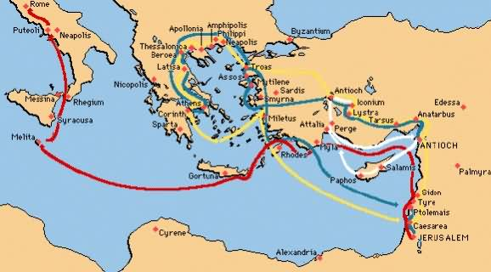
Paul’s Voyage & Shipwreck (27:1-44)

Slide 216
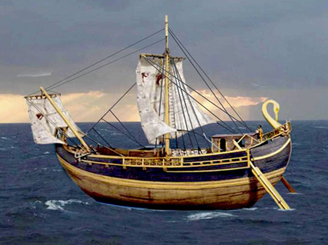
Paul’s Voyage & Shipwreck (27:1-44)
They Tranship at Myra and Sail to Crete (27:6-8)
  They transferred to another grain ship going to Italy
  The ship arrived at Fair Havens (Crete)
  They were sailing against the wind

Slide 217
Paul’s Voyage & Shipwreck (27:1-44)
Paul’s Advice Rejected (27:9-12)
  Paul is an experienced traveler (2 Cor 11:25-26)
  He gives advice, but later will give different words from The Spirit
  They were into the dangerous winter season (Sept 14th to Nov 11th)
  The Fast, Yom Kippur, was over (Tishri 10)

Slide 218
Paul’s Voyage & Shipwreck (27:1-44)
They are caught by the wind Euraquilo (27:13-20)
  They cast off in gentle winds, but soon were trapped by a violent storm
  They sought protection under some low lying islands, and jettisoned the grain, then the spare gear overboard.
  They (including prisoners) tried to wrap the ship in ropes somehow to keep the timbers together
    The details of frapping are not understood today.
  They lost all hope of survival as the storm continued to rage
    They did not eat, perhaps due to sheer stress

Slide 219
Paul’s Voyage & Shipwreck (27:1-44)
Paul’s Encouragement (27:21-26)
  Paul was also a prophet who received a message from an angel
    He is only a servant, and only announces God’s plan
    Everyone on board would be saved, but the ship lost
  Paul was reassured he need to bear witness in Rome
They Approach Land (27:27-29) (Malta)
  They could probably hear dangerous breakers ahead and set anchor

Slide 220
Paul’s Voyage & Shipwreck (27:1-44)
The Sailor’s Attempt to Escape Frustrated (27:30-32)
  Paul’s advice is now beginning to make sense to the centurion
  They cut the dingy lose so they cannot escape, and thus are available to help save everyone
The Meal on Board (27:33-38)
  All 276 people on board ate and refreshed themselves at dawn
  This is not to say they did not snack during the last 14 days
  They ate bread – the terms wine and cup are not in Acts

Slide 221
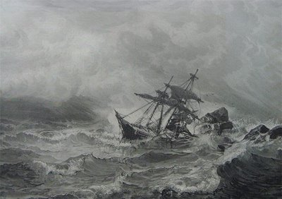
Paul’s Voyage & Shipwreck (27:1-44)
The Shipwreck (27:39-41)
  The ship’s bow ran into sand & then clay and got stuck, while the weakened stern was battered and destroyed by the waves.
  This situation allowed everyone to be saved, not one soul lost
  The centurion saved Paul’s life by stopping the soldiers from killing the prisoners.

Slide 222
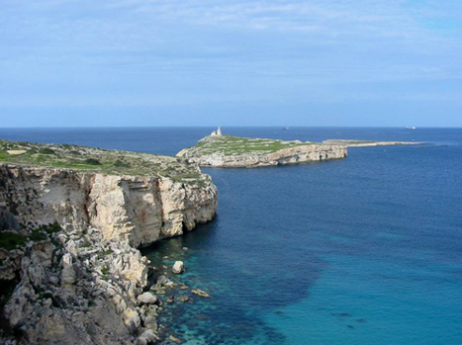
Paul’s Voyage & Shipwreck (27:1-44)
Winter in Malta (28:1-10)
  Welcome to Malta (28:1-6)
    Melita is the Canaanite name for
    “refuge”
    Paul was as useful on land as on
    sea, he was bit by a snake (Mark 16:18)?
    The Maltese thought the snake poisonous, therefore it surely was
    This enhances Paul’s words to everyone

Slide 223
Paul’s Voyage & Shipwreck (27:1-44)
Winter in Malta (28:1-10)
  Works of Healing in Malta (28:7-10)
    Paul always “goes to the top man” & cured his father.
      Acts 13:7, 16:22, 17:19, 18:12, 19:31
    Soon Paul (not a doctor) was healing folks from all over the island
    This must have made a huge impact on the seamen & soldiers.
    This narration reads like it was written by a doctor (Luke)
    Everyone spent the 3 winter months in Malta (Feb AD 60)

Slide 224
Rome at Last (28:11-31)
The Last Lap; “And So We Come To Rome” (28:11-15)
  The West winds start to blow again after winter on Feb 8th
  Their boat, Alexandrian, was surely another grain boat
    The masthead, Castor and Pollux implied truth & punishing liars
  Puteoli was the most important port for grain in Italy
  There were Christians already at Puteoli who greeted them
  Roman Christian Brothers met them as far as 35 to 45 miles from Rome to accompany him to Rome.
  God fulfills his promise to His chosen servants when the situation seems impossible

Slide 225
Rome at Last (28:11-31)
The Last Lap; “And So We Come To Rome” (28:11-15)
  This reinforces how Christianity has come to southern Italy region long before any Apostle ever arrived there.
  Paul certainly was greatly encouraged by what he experienced, but still he had much to offer this great growing community of new believers.
  Tiberius expelled the Jews from Rome in A.D. 19, Claudius in A.D. 49
  Paul arrived in Rome 60 A.D.

Slide 226
Rome at Last (28:11-31)
Paul Handed Over to be Kept Under Guard (28:16)
  Paul was kept outside the barracks with the elite praetorium guards
  He surely provided his own lodging

Slide 227
Rome at Last (28:11-31)
Paul and the Roman Jews (28:17-28
  First Interview (28:17-22)
    After just 3 days, Paul quickly spoke to the local Jewish populations
      To the Jews first
    His prisoner status requires he invite all the local leaders to visit him
    He gives them a brief background of why he is a prisoner
    The Jewish leaders in Rome had heard nothing from Jerusalem about Paul.

Slide 228
Rome at Last (28:11-31)
Paul and the Roman Jews (28:17-28
  First Interview (28:17-22)
    Christianity came to Rome perhaps 12 years before Paul did
      Jewish Leaders were somewhat unfavorably aware of this Jewish sect
      They had heard nothing about Paul
    The Romans considered Paul innocent; the Judean Jews considered Paul worthy of death
      Paul has no charge against the Jewish Nation
    The Roman Jews mostly rejected The Way as had other Jews

Slide 229
Rome at Last (28:11-31)
Paul and the Roman Jews (28:17-28
  Second Interview (28:23-28)
    They listened to him a second day, some believed, some did not
    When Paul went to Jews 1st and was rejected, he went to gentiles
    The Isaiah passage confirms that the Jews would reject the saving gospel message even as the gentiles would accept it
    Still one must observe a few, a remnant of the Jews, BELIEVED!
  Acts ends as it starts, an inclusio; that Jesus is the fulfillment of the prophets and the law, explaining the Hebrew scriptures

Slide 230
Rome at Last (28:11-31)
The Gospel Advances without Hindrance in Rome (28:30-31)
  Paul remained preaching the gospel in Rome for 2 years
  He had total freedom of speech, and no one hindered him
  The Christian Apologetic here is that in the heart of the Roman Empire, living with a Roman soldier chained to him, he was free to spread the gospel for 2 years, and thus the Roman Authorities were not concerned about this.
  We suspect, but do not know for sure, Paul was acquitted, later imprisoned, and was martyred (2 Timothy(4:6-8)
The Gospel has reached “the ends of the earth” (Rome); this concludes this open-ended story of God

Slide 231
Bibliography
Arnold, Clinton E. Acts. Zondervan Illustrated Bible Background Commentary. (Grand Rapids: Zondervan, 2002).
Bock, Darrell L. Acts. Baker Exegetical Commentary on the New Testament. (Grand Rapids: Baker, 2008).
Bruce, F. F. The Book of the Acts, Rev. New International Commentary of The New Testament, (Grand Rapids: Eerdmans, 1988).
Fernando, Ajith. Acts. The NIV Application Commentary. (Grand Rapids: Zondervan, 1998).
The Holmes Bible Atlas. (Nashville: Holman, 1998).

