Slide 1
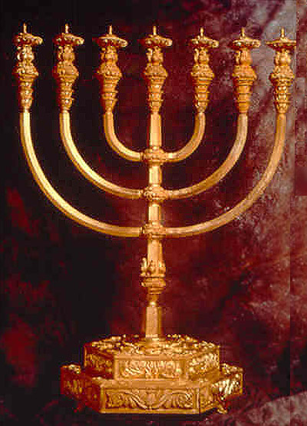
James
Commit Yourself Wholeheartedly to your God
Who Demands Absolute Allegiance (James 4:4-5)

Slide 2
Outline
Background
  Theology
Introduction (James 1)
The Excellence of Poverty and Generosity (James 2)
The Demand for Pure Speech (James 3:1-4:12)
Testing Through Wealth (4:13-5:6)
Closing Statement (5:7-20)
Bibliography

Slide 3
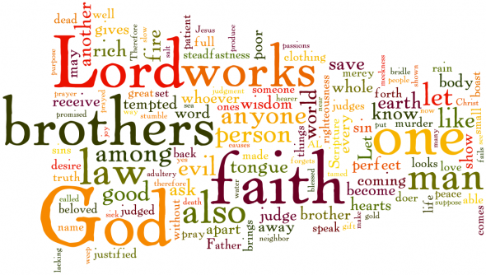
Outline

Slide 4
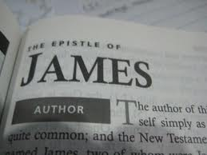
Author
James the Just, the brother of the Lord
Jesus brothers did not believe in Jesus
when he lived (Mark 3:31; John 7:2-8).
Jesus brothers had close relationship (Matt 13:55; Mark 6:3; John 2:12; 7:2-10).
Became a believer when Jesus appeared after the resurrection. (I Cor 15:7)
First mentioned as church leader in Acts 12:17.
The leader of the Jerusalem church council (Acts 15:13-21).

Slide 5
Author
Issued the Proclamation of Gentile Christianity (Acts 15;22-29)
Mentioned in Gal 2:12
Paul first visited him going to Jerusalem for last time (Acts 21:17-26)
James was married (I Cor 9:5)
Martyred by stoning in A.D. 62.
  Josephus records his death by Ananus (son of Annas) in 20:9:1
  Josephus records this as a reason the temple was destroyed in 70 A.D.

Slide 6
Literary Letter
Not a personal letter, or written to a specific location
Perhaps a sermon to be read aloud
Written in excellent Greek, best Greek in New Testament
Similar in form to I Peter and I John
Contains many sayings common to what Jesus said, especially the Sermon on the Mount.

Slide 7
Audience
Jewish Believers in the diaspora (scattered abroad)
  Writing to the 12 tribes indicates no tribes were “lost”.
James, Hebrews, I & II Peter, and Jude written to Messianic Jews
Probably the first written New Testament Book
  44 - 48 AD or earlier? (Perhaps before Paul’s conversion)
  Perhaps written before Jerusalem Council in Acts 15
  High respect for the Law (Mosaic Covenant)
  Jesus only mentioned by name twice.
Somewhat surprising that a Galillean (James) would use such good Greek for a Greek-speaking Jewish audience

Slide 8
Themes
Believers must commit themselves wholeheartedly to their God, who demands absolute allegiance.
  Encouragement for believers, who are suffering trials.
  God’s perspective on wealth and poverty.
  The need for biblical faith to always show itself in good works.

Slide 9
Theme
“The proving of your faith” (James 1:3) (Fruchtenbaum)
  Tested by response to God’s Word (1:19-27)
  Tested by response to social distinctions (2:1-13)
  Tested by its production of works (2:14-26)
  Tested by developing self-control (3:1-18)
  Tested by reaction to world and worldliness (4:1-5:12)
  Tested by how it always resorts to prayer (5:19-20)

Slide 10
5 Characteristics of James
Fruchtenbaum see 5 distinct characteristics in James
Oldest book in the New Testament with undeveloped theology
Emphasizes practical theology
Most authoritative book (54 imperatives out of 108 verses)
Almost no development of Christology
Reveals nature of early Messianic Jewish Movement
  Before revelations of God to Paul

Slide 11
Sermon on the Mount Similarities
James | Matthew
1:2 | 5:10-12
1:4 | 5:48
1:5 | 7:7
1:22 | 7:24, 27
2:14 | 7:21-23
3:12 | 7:16-20
3:17-18 | 5:9
4:4 | 6:24
4:11-12 | 7:1
5:10 | 5:12
5:12 | 5:34-37

Slide 12
Martin Luther on James
“Saint John’s gospel and his first letter, Saint Paul’s letters, especially those to the Romans, Galatians, Ephesians, and Saint Peter’s first letter – these are the books that show Christ to you and teach you everything needed and blessed for you to know even though you never see or hear any other book or doctrine. Therefore Saint James’s letter is a right-strawy epistle in comparison with them, for it has no gospel character in it. Therefore I will not have it in my Bible in the number of the proper chief books, but do not intend by this to forbid anyone to place and exalt it as he pleases, for there is many a good saying in it” (Martin Luther in the introduction to the first edition of his German New Testament, September 1522).

Slide 13

Martin Luther on James
“Therefore Saint James’s letter is a right-strawy epistle in comparison with them, for it has no gospel character in it. Therefore I will not have it in my Bible in the number of the proper chief books, but do not intend by this to forbid anyone to place and exalt it as he pleases, for there is many a good saying in it” (Martin Luther in the introduction to the first edition of his German New Testament, September 1522).

Slide 14
Theology
Suffering / Testing in Judaism
Eschatology
Christology
Poverty – Piety
Law, Grace, and Faith
Wisdom
Prayer

Slide 15
Suffering/Testing in Judaism
Suffering is associated with sin in early Judaism.
In the exile period and thru the prophets, Judaism became aware that suffering is often the lot of the righteous and not sinfulness, but in spiritual realities larger than the individual.
  If the sufferer gives in and blames God, God and he both lose.
  If the sufferer perseveres, then God wins and the person is rewarded.
There were two thoughts concerning sin:
  Sin was an internal evil impulse in individuals, and
  Sin comes from an external source (Satan) who is in a battle with God for His people.

Slide 16
Eschatology
James views “the time is near” as the coming of Christ.
  He was surely convinced that Christ would come within 10 to 20 years max (just like many Christians believe today).
Fruchtchtenbaum (Messianic Jewish) says James was thinking of the immanent destruction of Jerusalem in 70 AD.
Prophecy often has a near and a future application.
This creates a tension between living now and expecting His coming at any moment

Slide 17
Christology
There are only 2 passages in James that discuss Christ directly:
  James (1:1) thinks of himself as a servant (slave) of Jesus Christ and God (Paul said the same thing in Rom 1:1; Phil 1:1 etc.); and
  James (2:1) refers to “a faith of our glorious Lord, Jesus Christ”.
James refers to God 17 times (typically Messianic Jewish).

Slide 18
Christology
James referred to Kurios (Lord) 11 times, where he thought of Him as the resurrected Lord (relatively undeveloped in 44 – 48 AD).
  The source of spiritual gifts of wisdom etc.
  The one before whom we should be humbled
  The one who controls history and personal destiny
  The one who will come and end history
  The one to whom the sick are anointed

Slide 19
Poverty - Piety
Earliest Jewish thoughts glorified riches as a reward from God
Later prophets thought piety led to poverty as ruthless people took advantage of the honest and upright person
The prophets railed against the rich (Ezk 16:49 typical).
  Failing to help the poor is a crime, a sin
  They are condemned not for being rich, but how they used it
  The Mosaic Covenant demands this (Deut 10:16-19 etc.)

Slide 20
Poverty - Piety
Intertestament period had 2 developments:
  Caring for the poor became a religious duty, and
  The rich were increasingly regarded as unable to be pious and often to be cursed.
The early church identified itself with “the poor”
  Jesus often blessed the poor (Mk 10:28-30; Luke 6:20-21).
  Jesus often cursed the rich (Luke 6:24-25 and many other places).
  The rich can hardly enter the kingdom due to wealth (Mk 10:24-25 typical) (No man can serve two masters etc.).

Slide 21
Author
 | James | Paul
Became a believer | After Jesus died and appeared to him | On the road to Damascus when Jesus appeared to him
 | Remained in Jerusalem | Went away for 3 years to Arabia, then to Damascus (Gal 1:17-18)
First meeting | Met James & Peter for a few days in Jerusalem (Gal 1:18)
Ministries | Head of church in Jerusalem reaching out to Jews | Preached for 14 years to Gentiles (Gal 2:1)
 | Met again in Jerusalem where the church approved Paul and his gospel message (Gal 2:2-10)
1st Missionary Journey (Act 13) |  | Church in Antioch sends Barnabus & Paul to Gentiles
Acts 15 Council | James declares in Jerusalem that Gentiles only need to abstain from idols, blood, things strangled, and fornication.
.

Slide 22
Law, Grace, and Faith
The Law was not an issue with Israelites (1:25, 2:8-12; 4:11-12)
  It was not questioned ever - for it was assumed in 44-48 AD.
  The Law was the perfect guide for life, similar to Matt 5:17-20
  James has 36 parallels to Matthew, Luke, & Q.
    25 Parallels to Sermon on the Mount, 3 to Sermon on the Plain (Luke)
    James may be closer to Luke than to Matthew: vocabulary, escatology, and social outlook
  James and others of the time thought the words of Jesus were also a new law.
  The Law for James is primarily an ethical commandment.

Slide 23
Law, Grace, and Faith
James does not conflict with Paul, but instead uses key theological concepts quite differently.
  Stresses results of commitment to Christ.
  Notices many say they believe in Christ but do not demonstrate patience/endurance and follow-thru.
  Paul sees works as following the Law for salvation (ceremonies).
  Sees works as moral deeds, charity, the types of things Paul would command his believers to do from true faith.
  Paul sees righteousness as a forensic declaration; James is “show to be righteous”.
  An intellectual belief in Christ without fruit is not salvific; it is an abomination showing lack of endurance and a double mind.

Slide 24
Wisdom
Old Testament wisdom is tied to both practical action and to God.
Wisdom is related to God’s Spirit, often highly personified, such as a good woman in Proverbs.
The Greek word for wisdom is Sopia.
Intertestamental period has wisdom almost disappearing as an independent idea, takes over the creation, and both wisdom and the Spirit mediate between man and God.
Wisdom belongs to God, and is a gift of His grace. Apocalyptic literature has wisdom being an eschatological gift to the righteous.

Slide 25
Wisdom
James sees wisdom thru the above lens as: A gift of God only to Christians, and results in a series of virtues (humility, admirable purity, patience, discernment, abundant charity, unending goodness, and steadfastness of heart).
James has a wisdom pneumatology – wisdom is to James as Spirit is to Paul.
Wisdom helps one to stand, delivers one from “the flesh”, and produces the fruit of the Christian life.

Slide 26
Prayer
The three purposes of prayer are:
  To request wisdom,
  To obtain healing, and
  (possibly) to seek material goods.
Prayer has unlimited possibilities.
Relationship with God is more important in prayer than relationship with the material world.

Slide 27
Prayer
James is institutionalizing what had been a charismatic activity.
Elders (a community) can pray for healing and forgiveness of sin. Therefore divine wisdom (Spirit) is a community possession as much as an individual possession (think Asian culture here).

Slide 28
Introduction (James 1)
Epistolary Introduction (1:1)
Opening Statement (1:2-27)
  Testing, Wisdom, Wealth (1:2-11)
  Testing, Speech, Generosity (1:12-25)
  Summary and Transition (1:26-27)

Slide 29
Epistolary Introduction
Introduction 1:1
  The author names himself as Jacob (James).
    King James insisted one biblical character be named after him (so the brother of Jesus was renamed James in the KJV).
  Typical Greek style (not Israelite style)
  This letter was written by a Hellenistic Christian.
  This letter was written to Israelites living outside Palestine.

Slide 30
Testing, Wisdom, Wealth
Opening Paragraph Summary (1:2-11)
  Genuineness of faith will be tested, for this produces character
  Wisdom, a gift from God, is needed to discern the test and stand fast.
    Can the wealthy Christian stand the test?
    Will he share with his poorer brother?

Slide 31
Testing, Wisdom, Wealth
Testing Produces Joy (1:2-4)
  Chain statement is similar to Rom 5:2b-5, James 1:2-4; 1 Peter 1:6-7.
  James is theocentric thus chain leads to virtuous character.
  Be joyful for the test will produce endurance, leading to you becoming perfect and complete.
  Without the test, your character will not be improved.
  Endurance and Patience from God are contrasted with double-minded
  This is the pattern of eschatological perfection.

Slide 32
Testing, Wisdom, Wealth
Wisdom Comes Through Prayer (1:5-8)
  Pray for wisdom, for God gives this gift to Christians
  Prayer is more effective with a stronger faith and no doubting
  You cannot look both to the world and to God, for this is being double-minded (faithless) and is an abomination to God
  Wisdom, which comes from prayer, enables one to stand the test
  James never discusses the Holy Spirit (Pauline perspective)

Slide 33
Testing, Wisdom, Wealth
Poverty Excels Wealth (1:9-11)
  The poor man should glory in his high position.
  The rich man should glory in his humiliation now because he will soon pass away.
  The poor believers are perhaps being contrasted with the rich non-believers who got rich by robbing them of proper wages and benefits.
  Today the world highly esteems rich people and looks down on the poor, and sadly our churches tend to go along with this.

Slide 34
Testing, Speech, Generosity
Testing Produces Blessedness (1:12-18)
  God rewards those that endure various trials with the crown of life.
  Trials happen because of internal evil impulses.
  Trials happen because of outside satanic evil impulses.
  People that blame God and fail the test, such as the Israelites did in the desert, and will surely die.
  God only gives us good things, and we are his firstfruits.

Slide 35
Testing, Speech, Generosity
Pure Speech Contains No Anger (1:19-21)
  Be quick to listen, slow to speak, and slow to anger.
    James was last one to speak in Acts 15:13-21.
  The human outburst of anger does not come from wisdom.
    This is not God’s standard for humans.
  Christians must now turn away from evil and malice.
    They must repent (change their minds).
  Christians in politics today seem to have forgotten these words.

Slide 36
Testing, Speech, Generosity
Obedience Requires Generosity (1:22-25)
  Be doers of the word, not merely hearers who delude themselves.
  If you only hear, then you have not received the word.
  Jewish Christians think the law is the will of God, but Messiah has perfected it with his new law.
  The Sermon on the Mount is an example of his perfected new law (or reinterpretation of it).
  There awaits a future blessing for those that obey the Law.

Slide 37
Summary and Transition (1:26-27)
The true Christian must control his tongue, or his religion is worthless (1:19-21).
He must engage in charity in the sight of our God and Father (1:22-25).
He must resist temptation, that is, the evil and corrupt world (1:2-4).
  These 3 points are first stated negatively and then positively, and are perhaps part of a final polishing of James.

Slide 38
Excellence of Poverty & Generosity
No Partiality is Allowable (2:1-13)
Generosity is Necessary (2:14-26)

Slide 39
No Partiality is Allowable (2:1-13)
Illustration: Church Judicial Assembly (2-1-4)
  Believers do not show partiality in courts between rich and poor.
  Partiality in the Bible almost exclusively concerns judicial settings in the church.
  How can you have the rich sit and the poor stand?
    Remember La Purisima Mission (dual sit/stand masses).
  If you favor the rich, and God favors the poor, then you are choosing for the rich that persecute the church.

Slide 40
No Partiality is Allowable (2:1-13)
Rational Argument (2:5-7)
  The church knows that God chooses the poor/pious over the rich.
  He chose Israel over Rome, Assyria, and Babylon etc.
  But the poor/pious Believers select the rich persecutors over fellow believers.
  The believers blaspheme the good name of God as they fear losing control of a synagogue, dislike morality, dislike superstitions of slaves / tenants etc.

Slide 41
No Partiality is Allowable (2:1-13)
Biblical Argument (2:8-12)
  Discrimination against the poor breaks the Royal Law of love (“Love your neighbor as yourself”) (Lev 19:18; or 19:15?).
  His audience would have thought of this also as breaking the commandment of Jesus.
  Such a person showing partiality to the rich commits sin.
  Every command is important – we break the law, not a law.
  If we show no mercy to the poor, God will show us no mercy.

Slide 42
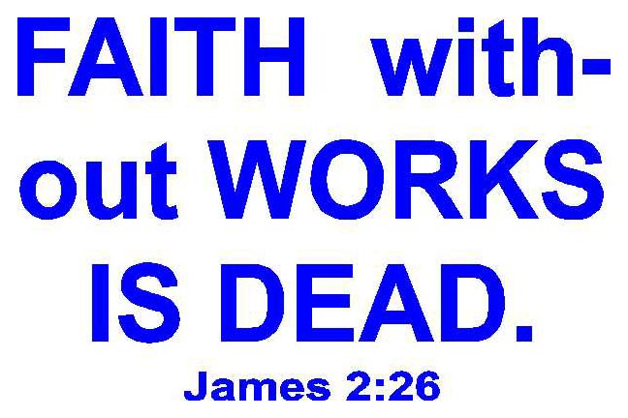
Generosity is Necessary (2:14-26)
Poor Christian (2:14-17)
  Faith without works (charity) is useless,
  it is a sham.
  Professed beliefs, prayers, doctrine etc. will
  not save you for they are empty without works (acts of mercy).
  If a brother or sister is hungry or needs clothes, and you say, “go in peace” and do not help them, what use is that to you?
  Faith without works is dead, being by itself.
  (Works to James does not mean obeying the ceremonial laws).

Slide 43
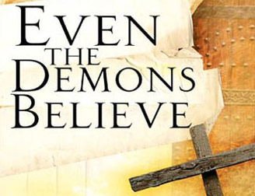
Generosity is Necessary (2:14-26)
Rational Argument (2:18-20)
  Can you say one person has faith and another works? Does not God give different gifts to different people?
  The demons believe in God, they have no works (of mercy or charity) and they shudder in fear.
  Therefore only faith or belief without works does not save you.

Slide 44
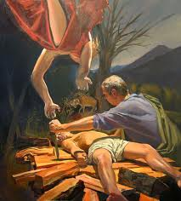
Generosity is Necessary (2:14-26)
Biblical Argument : Abraham and Rehab (2:21-26)
Abram “believed and He reckoned to him as righteousness” (Gen 15:6). His belief needed to be later fulfilled by works.
Was not Abraham justified by a deed of mercy when he offered up Isaac? For only then, did God say, “ now I know” (Gen 22:12).

Slide 45
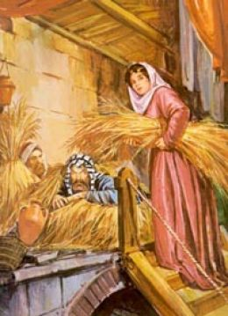
Generosity is Necessary (2:14-26)
Biblical Argument : Abraham and Rehab (2:21-26)
  Was not Rahab justified by works when she hid the two spies of Israel and lied to the Canaanites (Joshua 2:1-3; Heb 11:31 emphasizes faith)?
  Earlier beliefs are later justified by works. For later works perfect the initial justifying forensic faith, and that the earlier belief is now fulfilled.

Slide 46
Generosity is Necessary (2:14-26)
Biblical Argument : Abraham and Rehab (2:21-26)
  Therefore faith without works is dead.
  James basic point is, “from one’s work’s, that God declares one righteous in the final judgment”. (Davids, James, 132).
  God is pleased only when confessed faith leads to action.
  What will be the final test of our entrance to heaven?
    “Come, you who are blessed of my Father, inherit the kingdom prepared for you... For I was hungry, and you gave me something to eat, I was thirsty and you gave me something to drink, I was naked and you clothed me, I was in jail and you visited me. ” Matt 25:34b-36) .

Slide 47
The Demand for Pure Speech
Pure Speech Has No Anger (3:1-12)
Pure Speech Comes from Wisdom (3:13-18)
Pure Prayer is without Anger / in Trust (4:1-10(12))
Pure Speech is Uncondemning (4:11-12)

Slide 48
Pure Speech Has No Anger
Warning Against Self-Exaltation (3:1-2a)
People want the status of being a teacher, and any associated honor. This can include pastors, teachers, TV news commentators, politicians, and individuals like ourselves.
This can produce rivalries and divisions as church leaders fight against other church leaders, or TV News commentators get people all “worked up” as they try to secure a following.
“To whom much is given, from him much is required” (Luke 12:48).

Slide 49
Pure Speech Has No Anger
Warning Against Self-Exaltation (3:1-2a)
Prov 6:16-19; 10:18-21, 31-21; 15:1-7; 17:4, 7, 27-28; 18:21; 21:6, 23: 25:15; 26:28; 28:23; 31:26
Identify main points of these proverbs

Slide 50
Pure Speech Has No Anger
Warning Against Self-Exaltation (3:1-2a)
“Beware lest any man spoil you through philosophy and vain deceit, after the tradition of men, after the rudiments of this world, and not after Christ” (Col 2:8).
  Passage may be directed against Jewish Rabbi’s. False teachers will be the most severely punished.
Today passage may be directed against the media and false teachings
  TV, authors, TBN, commentators, politicians etc.
  Problem is most are inspired by the devil, not Christ

Slide 51
Pure Speech Has No Anger
Bridal bit controls a horse; can a person control their tongue? (3)
Rudder controls a ship as a tongue rules body (4-5)
Forest burnt down by a small flame as tongue sets men on fire (6-7)
No one can control the tongue; a restless evil
It both blesses and curses (8)
  Fountains only send forth fresh or salt water (11)
  Fig trees produce figs, not olives (12)
  Can salt water produce fresh water? (12b)

Slide 52
Pure Speech Has No Anger
Warning Against The Power of the Tongue (3:2b-5a)
This example applies to all of us, including teachers.
Words can control churches and nations. Bad words can set a church or nation on fire.
It is not that the tongue does not control the ship, it rather that the wrong person is controlling the words said.

Slide 53
Pure Speech Has No Anger
Warning Against The Power of the Tongue (3:2b-5a)

Slide 54
Pure Speech Has No Anger
Warning Against The Doubleness of the Tongue (3:5b-12)
  The same tongue can bless God and curse men made in His likeness.
  The tongue represents the evil world itself in our very heart.
  The tongue sets fire to the whole world and our bodies. It can destroy a church.
  The real problem is one’s heart condition, not the tongue.

Slide 55
Pure Speech Has No Anger
Warning Against The Power of the Tongue (3:2b-5a)

Slide 56
Pure Speech Comes from Wisdom
We think, we try to keep quiet
We watch bad stuff on TV, in books, on radio
  Our Hearts think evil
It always comes out at the worst time

Slide 57
Pure Speech Comes from Wisdom
Wisdom comes from above (3:13:18)
  James never uses the term “Holy Spirit”, but instead asks for wisdom from above to guide how we live our lives.
  Paul uses wisdom as a “cosmos wisdom” or wise about the world around us.
  The chief characteristics of wisdom from above is purity. Other characteristics are peaceful, gentle, and non-combative
Those “teachers” in the church that stir up trouble and division often have wisdom that come from below (demonic)
  This wisdom is: earthly, unspiritual, and demonic

Slide 58
Pure Speech Comes from Wisdom

Slide 59
Pure Speech Comes from Wisdom
Act with gentleness guided by wisdom. (3:13-18)
  If you are filled with bitterness and anger, be honest with yourself, for this wisdom comes from within or from demons.
  Jealousy and selfish ambition are not from God. This includes encouraging instead of attacking those who suggest improvements.
  Wisdom from above is peaceful, gentle, reasonable etc.
Today our politicians, TV commentators, company execs, even our church leaders are fighting using wisdom from below.

Slide 60
Pure Speech Comes from Wisdom
James is talking to congregation members.
  We believers “teach” or follow “teachers” that stir up jealousy or rivalry. We believers promote church divisions – doctrine is not the issue
  We believers do not pursue pure speech coming from wisdom from above
  We believers pursue an emotional “Holy Spirit” rather than a peaceful “Wisdom/ Holy Spirit”
  Wisdom (Holy Spirit) from above implies thinking and learning

Slide 61
Pure Prayer is without Anger/in Trust
Prayer with Anger and Desire (4:1-3)
  Church members (teachers) fight among themselves due to the evil impulse within.
  Your selfish, envious, murderous prayers are not answered.
  Double-minded believers are pushed by good and evil impulses.
  God is not a robot who must answer the prayers of believers who pray with evil lusts for their own desires.

Slide 62
Pure Prayer is without Anger/in Trust
Condemnation of Compromise (4:4-6)
  The preacher James calls all believers Adulteresses. Israel was often called an unfaithful adulteress in the Old Testment.
  This self-seeking is tantamount to apostasy.
  You cannot be both a follower of Christ and love the world.
  There is no middle ground, no compromise, for our jealous God demands 100% loyalty from us.

Slide 63
Pure Prayer is without Anger/in Trust
Call to Repentance (4:7-10)
  Submit to God. Resist the devil, draw near to God, cleanse your hands, purify your hearts, be miserable, and humble yourself.
  James asks to be realistic about the evil still in the hearts of believers.
  If you church members repent, He will exult you!
  James agrees with Paul that the devil is behind our evil impulses.

Slide 64
Pure Speech is Uncondemning (4:11-12)
Do not speak against one another, (slander) brethren, for this is to judge him. This is against the Mosaic Law and breaks this Law two different ways:
Who are you to judge others for when you accuse others of breaking any one law, you are actually breaking that law itself.
  The Royal Law: Love your neighbor as yourself (Lev 19:13-18)
  Commands not to judge others: Mt: 7:1-5; Luke 6:37-42; Rom 2:1; 14:4; 1 Cor. 4:4; 5:12; John 7:24; 8:15-16.
Only God judges other believers, and you are usurping the role of God.

Slide 65
Testing Through Wealth (4:13-5:6)
The Test of Wealth (4:13-17)
The Test of the Wealthy (5:1-6)
These two sections describe love of the world which results from love of material wealth. Both wealthy Christians and unbelievers are condemned, but await different fates.

Slide 66
The Test of Wealth (4:13-17)
The Christian merchant class stands self-condemned.
  They think of their worldly profits instead of God’s will. Their sin appears in that they have no concern for the poor.
  Merchants cannot plan their future, only God can do this.
  James is not against planning for the future, but instead wants planning based on putting God first in their lives.
  Merchants boast of themselves instead of boasting of God. They have shut God out of their commercial lives.
  Wealth is not bad, but what is your motive in gathering wealth?
  Pastors are taught not to plan their future – instead rely on God

Slide 67
The Test of Wealthy (5:1-6)
The landlord class outside the church will soon go to hell.
  Rich unbelievers identified by clothing, gold, and silver.
    Rich became rich by not paying laborers just wages.
    The rich were unjust to them, and did not share with them.
    The poor cry out to God even from their graves.

Slide 68
The Test of Wealthy (5:1-6)
Rich class condemned by Christ (for robbing the poor)
  Is 5:7-9 (Condemnation of the rich)
  Matt 6:19-21 (The Sermon on the Mount)
  Luke 6:20-26 (The Sermon on the Plain)
  Luke 16:19-31 (The parable of the rich man and Lazaras)
  Rev 3:14-22 (The Church at Laodicea)

Slide 69
The Test of Wealthy (5:1-6)
The landlord class outside the church will soon go to hell.
  Weep, for God has heard the cries of the poor believers.
    The rich unbelievers face the future judgment of God.
    Their flesh will become tattered and rust away in hell.

Slide 70
The Test of Wealthy (5:1-6)
Applications for today’s Believers
  Many today get rich upon the labors of the poor
  Many today want to get richer by paying less taxes and lowering support for the poor
  Many today condemn the poor who pick their food
  Many today honor and look up to the rich and famous (Hollywood and Royalty)
  Believers today have not thought through wealth, poverty, culture, and Christianity

Slide 71
Closing Statement (5:7-20)
Endurance in the Test (5:7-11)
Rejection of Oaths (5:12)
Helping One Another Through Prayer/Forgiveness (5:13-18)
Closing Encouragement (5:19-20)

Slide 72
Endurance in the Test (5:7-11)
Patience, not resistance, is the virtue of the poor believers.
  The farmer risks everything waiting on these rains. Early and late rains are characteristics of Palestine.
  They hope in God who will come to save them and judge the rich (unbelievers).
  They are not to complain against others as they endure.
  The poor are not to judge the wicked, leave that to God.
.

Slide 73
Endurance in the Test (5:7-11)
Remember how the Biblical prophets suffered, and how God showed them mercy and compassion.
  Job also suffered and God repaid Job for all his suffering.
  Those that endure suffering are blessed.

Slide 74
Rejection of Oaths (5:12)
Normal for an ancient epistle to have an oath near its end.
This is similar to Matt 5:34-37.
  Jesus says oaths come from devils while James threatens judgment
James is not prohibiting official, judicial oaths.
James insists that believers do not use oaths in private speech.
Let your yes be yes, and let your no be no.
The issue is truthfulness in speech – oaths make some speech more honest than other speech – believers need to be always honest.
The issue is taking God’s name in vain (Fruchtenbaum).

Slide 75
Helping One Another Through Prayer/Forgiveness (5:13-18)
Are you suffering (under great stress)?
  You need to pray to God (not to strike back)
Are you cheerful?
  You need to sing praises to God
Are you sick?
  You need to have others (the church elders) pray for you
It is O.K. to pray to God more when times are bad, but we also need to remember to praise God when times are good.

Slide 76
Helping One Another Through Prayer/Forgiveness (5:13-18)
Healing sessions are very meaningful to people suffering.
This is a ceremony for elders (plural), not a minister, to perform.
  These elders do not necessarily have the spiritual gift of healing.
Miraculous healing by Jesus and in Acts was for promotion of the gospel – what is your motive for healing / getting healed?
This ceremony is not a substitute for modern medical care.
  Many report miraculous cures, but often hard to prove.

Slide 77
Helping One Another Through Prayer/Forgiveness (5:13-18)
Prayer more important than olive oil when healing.
  Ordinary members in good standing, not just the elders, can have powerful prayers.
  It does not mean the harder one prays the more God will act.
  The important thing is God’s response, not the one praying.

Slide 78
Helping One Another Through Prayer/Forgiveness (5:13-18)
Suffering and sickness can result from sin
  Do not assume you are well and he is sick because he sinned and you did not.
  Do not assume you are sick / stressed out because you sinned.
  God forgives our sins when we turn to Him in prayer and this assurance can help to heal us.
Suffering and sickness can be purely physical
  Germs, bugs, hormones etc.
  Medicine and doctors can be of great help

Slide 79
Helping One Another Through Prayer/Forgiveness (5:13-18)
Today many ministers and priests seek glory by healing others.
Likewise those healed tend to glorify themselves – look what God (my pastor) did to me (bragging).
  Those prayed over but not healed can feel even more depressed.
Passage also “grew” into final rites performed by Catholic priests
  Pastors today want to anoint with oil, bypassing the elders.
  Catholic priests now claim only they can perform final rites.
  Tendency is to “go solo” rather than group efforts.

Slide 80
Closing Encouragement (5:19-20)
James himself has written this epistle to warn fellow believers to turn from sin and therefore be saved from destruction.
  Fitting end to this great epistle
  James takes sin seriously, seeks repentance from his Christian audience, and warns of serious consequences of not responding.
We (believers) all face final judgment for our actions.
  Pray for wisdom, the practical knowledge of living.
  God will reward us believers based on our deeds.
  “Fear of God is the beginning of knowledge,
  fools despise wisdom and instruction” (Prov 1:7) .

Slide 81
Bibliography
Davids, Peter H. The Epistle of James. The New Greek Testament Commentary. Grand Rapids: Eerdmans, 1982.
Gundry, Robert H. A Survey of the New Testament, 4th ed. Grand Rapids: Eerdmans, 2003.
Fruchtenbaum, Arnold G. The Messianic Jewish Epistles, Ariel’s Bible Commentary, Tustin Ca: Ariel Ministries, 2005.
Josephus, The Complete Works. Nashville: Thomas Nelson, 1998.
Moo, Douglas J. James. Zondervan Illustrated Bible Backgrounds Commentary. Grand Rapids: Zondervan, 2002.

Slide 82
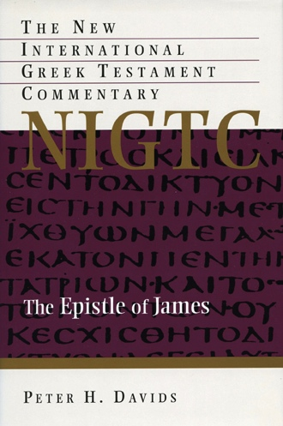
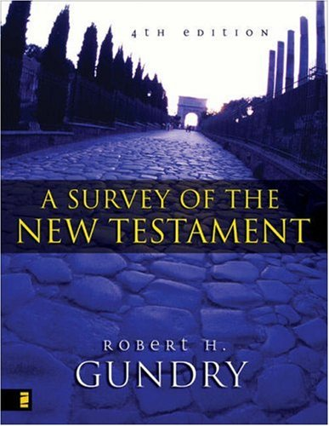
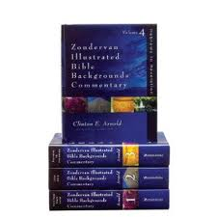
Bibliography

