Slide 1
Judge’s Briefing Here!

Slide 2
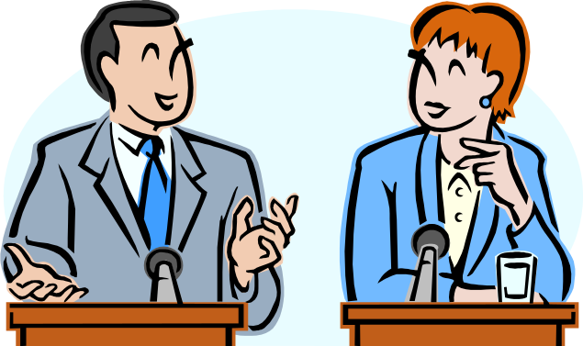

So you want* to become a Debate Judge?
*were forced by your kid

Slide 3

THANK YOU!
Notes:
Debate is made possible thanks to parents. Appreciate taking time out of busy schedules to help your kids and other kids grow and gain a positive experience, etc.

Slide 4
What is Debate?
Discussion of a Resolution
Resolutions are worded as: This House Believes That / Would / etc. (THBT/THW)
  i.e., THBT judging debate is wonderful fun!
Proposition/Government/Affirmative: Argues FOR the resolution – pushes for change.
Opposition/Negative: Argues AGAINST the resolution – defends status quo.

Slide 5
Types of Debate
Junior High
  Junior Beginner: Grade 8 and under in their FIRST YEAR of debate.
  Junior Open: Grade 9 or any EXPERIENCED debater.
All Debates in Junior High are Canadian National Style
Notes:
Canadian National Style is nationally recommended, will be the style they primarily use in high school, generally more fun.

Slide 6
Canadian National Style Setup
Team
Team
Chair/Timekeeper
Judges

Slide 7
Canadian National Style
1st Proposition Constructive Speech | 1st Opposition Constructive Speech
2nd Proposition Constructive Speech | 2nd Opposition Constructive Speech
Proposition Rebuttal (Typically delivered by first speaker) | Opposition Rebuttal (Typically delivered by first speaker)

Slide 8
1st Proposition Constructive Speech
State the Resolution
Define the Terms
  Simple, Layman’s Terms ideal. Should be obvious in reference to the topic. i.e. right to bear arms.
Outline Arguments / Pillars (Usually 2)
Construct Arguments with cited evidence.
Accept POI’s (More on this later)
BURDEN OF PROOF: Falls on Prop
Notes:
Restate resolution for clarity, define terms for clarity. No squirreling, terms should be acceptable to all parties. Any attempt to skew the definition of terms towards one’s own side should be reflected heavily in their final score. Arguments: Pay attention to signposting. GOOD FEEDBACK! Regardless of how well thought out the case is, if the judge cannot follow the case, hard to keep track of evidence and declare them victorious. BURDEN OF PROOF: It is up to Prop to convince you to create change, Opp only has to convince you to keep things the way they are. Prop’s job is generally more difficult, so they get first and last say. If they fail to convince you with their arguments that the resolution should be put forth, then they lose.

Slide 9
What the heck is a POI?
POI: Points of Information
Interjection (in the form of a question or statement) from the other team during a speech.
“Give 2 Take 2 Rule” (FLEXIBLE)
Can be offered during constructive speeches, but not during the first and final minute. NO POI’s during Rebuttal speeches.
POI’s should be purposeful/effective. No whack-a-mole!
Debaters may: Accept/Reject/Hold
Notes:
Parliament Powdered Wig Story.
USE OWN DISCRETION RE: GIVE 2 TAKE 2. GUIDELINE. If it feels like too much it probably is, if it feels like too little it probably is.

Slide 10
Evidence
Good idea to take notes.
An argument without evidence carries no weight.
Evidence MUST be factually accurate.
If a judge is CERTAIN evidence has been DELIBERATELY falsified, points may be deducted only if the opposing team recognizes it.
Notes:
It is not expected for EVERY piece of evidence presented to be backed up with proper citation, but debaters SHOULD be able to bring up said citation should the opposing team request it. It is BAD FORM for the opposing team to ask for proper citation for every single piece of evidence. Use own discretion.

Slide 11
1st Opposition Constructive Speech
Restate Resolution
Respond to the Definition of Terms:
  99% of the time, accepted, move on.
  Can challenge terms if Prop’s terms are unreasonable for fair debate and present their own terms.
CLASH!
Outline/Construct Arguments
Accept POI’s
Notes:
Judge’s discretion re: terms if challenged. One will be more reasonable than the other.

Slide 12
Clash
Clash must refute arguments through logic or evidence – contradiction is not clash.
Keep track of successfully refuted arguments.
Clash should ideally be the deciding factor of a debate.
Notes:
“Well that’s not true” without any further elaboration is not sufficient refutation. Checkmark things, helps. Provided stylistic semantics have been taken care of, clash is deciding factor. Battle Analogy: Construct Fortifications, Beat each other down. Whoever has most structurally sound case by the end of the debate should win.

Slide 13
2nd Proposition/Opposition Speech
CLASH!
Restate/Reconstruct Proposition Arguments.
Outline/Deliver Final Arguments.
Accept POI’s.
Notes:
In reconstruction, the speaker should be able to show you why the opponent’s clash was insufficient to defeat the point, and why it still stands. Perhaps with additional evidence on their own side.

Slide 14
Rebuttal / Reply Speeches
3 Minute Break – Take/Review Notes on what’s happened so far!
Final Word
Summarize Cases and Clash. EXPLAIN why their team won the debate.
During Rebuttal:
  NO NEW ARGUMENTS
  New evidence to back up existing arguments OK
  NO POI’s

Slide 15
So, Where do I come in?
Judges must:
  Decide a winning team.
  Award individual speaker points.
    Winning team MUST have more points.
Judges are HIGHLY ENCOURAGED to:
  Give Feedback! It’s how we learn and grow.
Notes:
If the reason for loss is not related to speaker points, adjust speaker points anyway.

Slide 16
The Decision
Judges should consider arguments, evidence, clash, speaking ability, etc. in their decision.
If obligations of the debate are not met (proper terms, etc.), winner demonstrates best debate skills.
NO DRAWS. Can’t decide, Opposition wins.
Breaches of courtesy (Regarding POI’s, manners) can factor into decision.
Notes:
Opp wins in draw due to burden of proof on Prop. If you can’t decide, they haven’t convinced you. Breaches of Courtesy: Giving excessive POI’s for the sole purpose of distraction, noise, etc. Debate is a sophisticated sport, mudslinging discouraged.

Slide 17
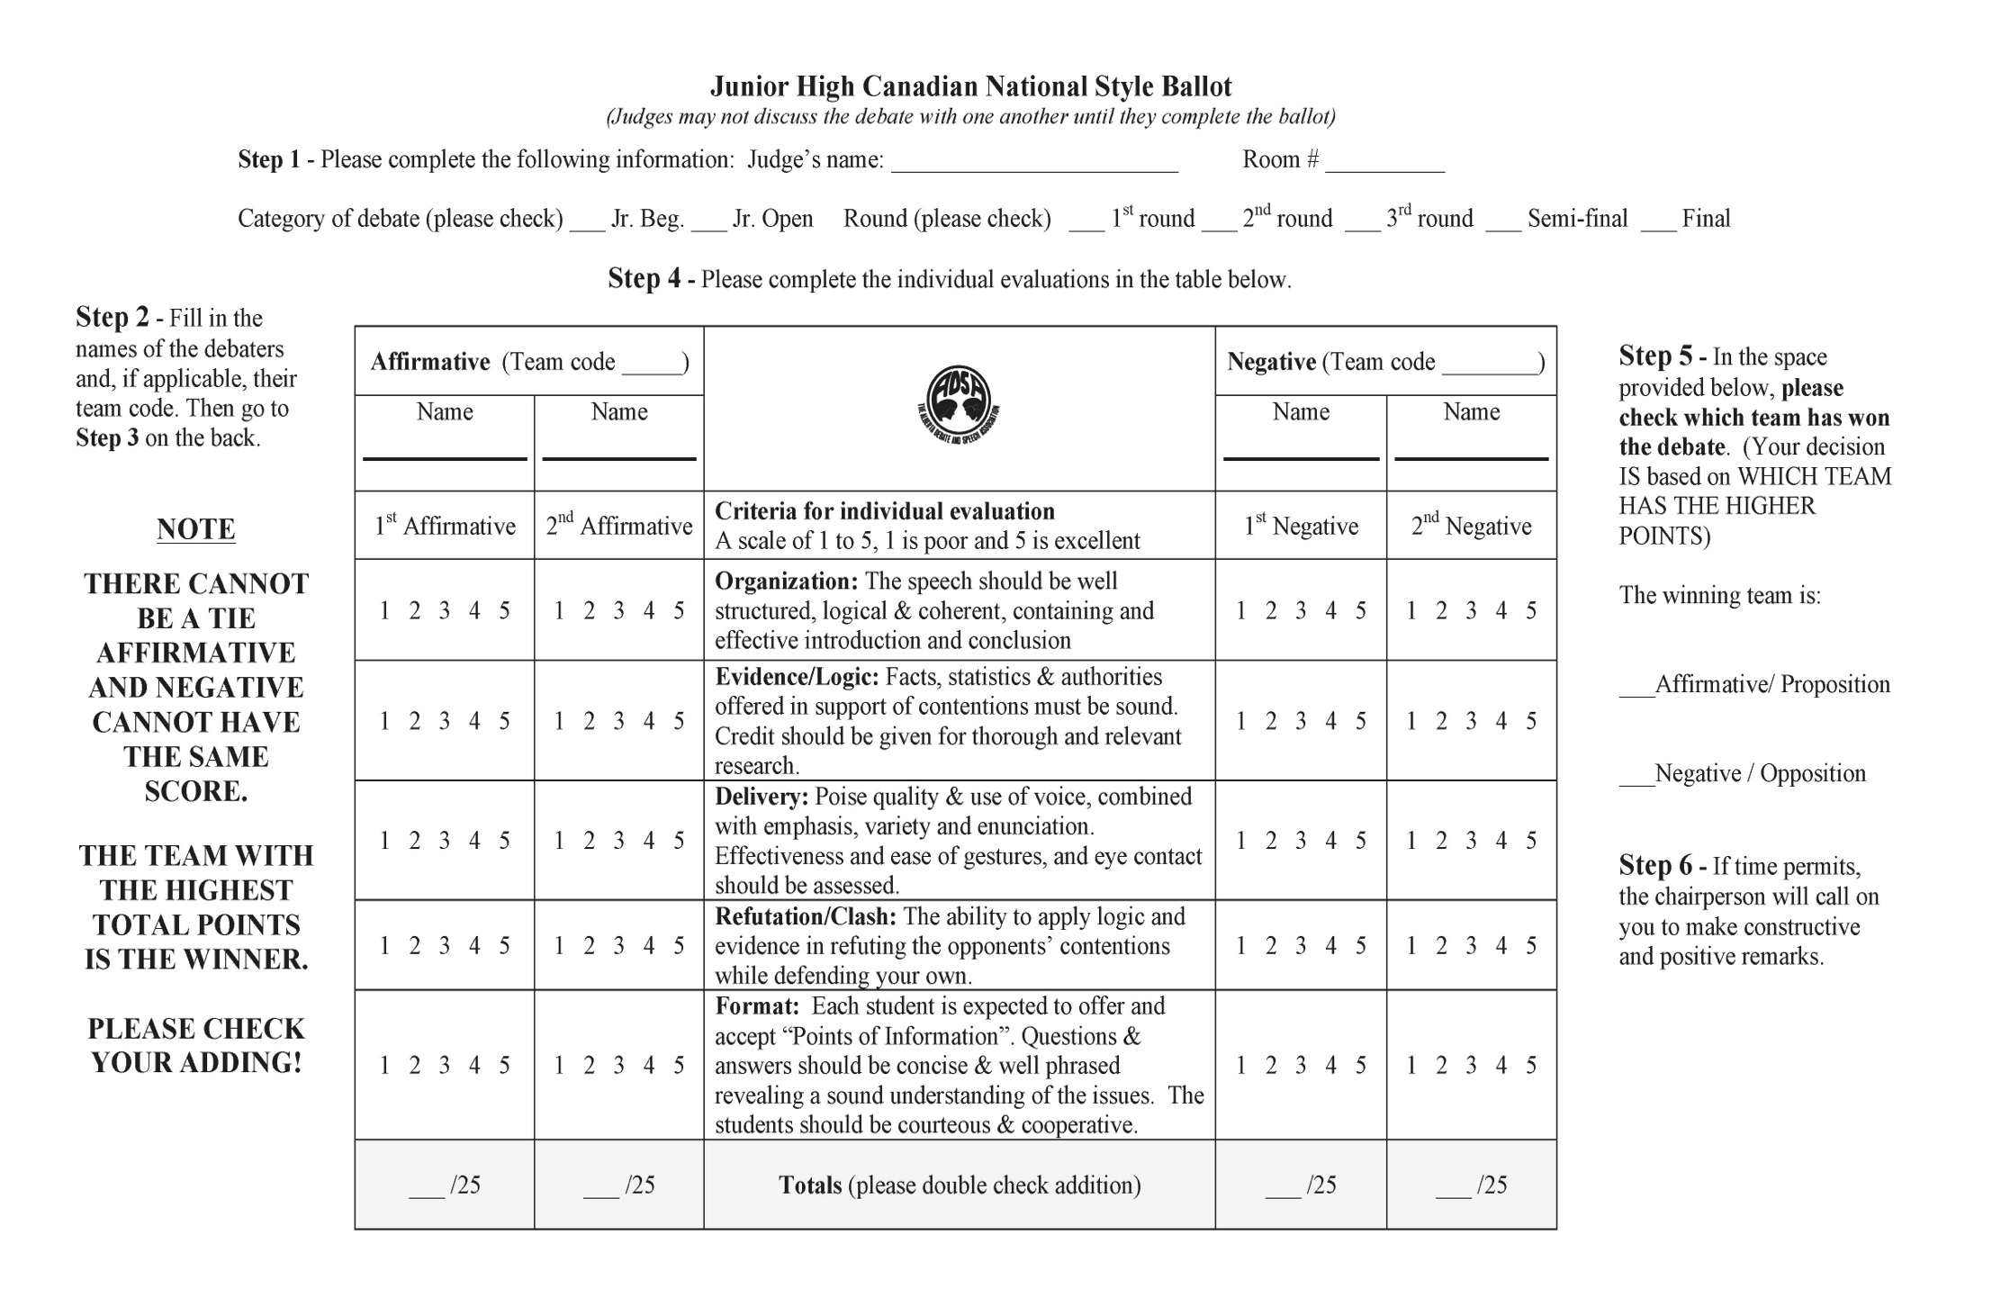
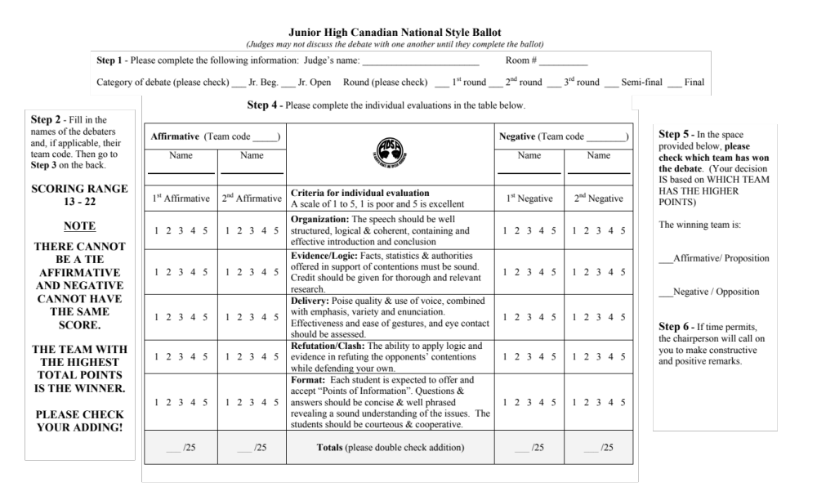
SCORING RANGE 13 - 22
Notes:
Talk about speaker points, briefly explain each criteria.

Slide 18
Feedback
Optional, Highly Recommended. Debaters always have room for growth.
Feedback should be:
  PRECISE: To the point, deal with most significant areas of growth.
  CONCISE: Keep it brief, avoid repetition.
Stay Positive/Constructive!
Notes:
We want them to keep debating/growing!

Slide 19
Final Considerations
Be Impartial: Act on what is presented, not what you already know.
If you know a debater in the room, call the office and you will be moved.
Judges should not discuss their ballots/decision.
Judges should not talk until feedback.
YOU ARE ALWAYS RIGHT!

Slide 20
?!
Notes:
Questions / Feedback for me.

