Slide 1

IEEE Presidents Forum
IEEE Leadership Takes Your Questions Live

Slide 2
People
The many people that helped make this event possible
Committee-
  Bob Case Black Hills
  Jim Look R5 Director-elect
  Ian MacMillan Denver
  John Meredith Pikes Peak
  Peter O’Neill High Plains
  Mehmet Ogut YP
  Richard Toftness High Plains
Region 5
  Faye Kahn West Area Chair
  Robert Shapiro Director
  Nasr Ullah Pace
Staff-
  Cecelia Jankowski
  Elizabeth McCarthy
  Monika Stickel
  Ann Townley
  Chris Wright
IEEE.tv
  Brad Kloza
  Steve Esker
CSU
  Jim Dotson
  Matt Flick
  Andrea Leland
  Tony Maciejewski
  Jason Rohein
Sponsors-
  Black Hills Sub-Section
  Denver Section
  High Plains Section
  Pikes Peak Section
  IEEE-USA
  Region 5 PACE
  Region 5

Slide 3
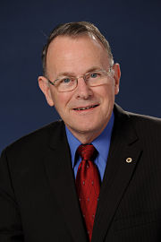
John Meredith
John Meredith passed away on Wednesday morning after a short illness. He was 77 years old.
He was a huge supporter of IEEE and an active volunteer and officer. Many of us thought of him as “Mr. IEEE”
John's wife of 49 years said he was so interested in the Presidents Forum that he insisted she bring a laptop to the hospital.
John’s influence, kindness and intellect will be greatly missed.
“We would like to dedicated this event to John”.

Slide 4
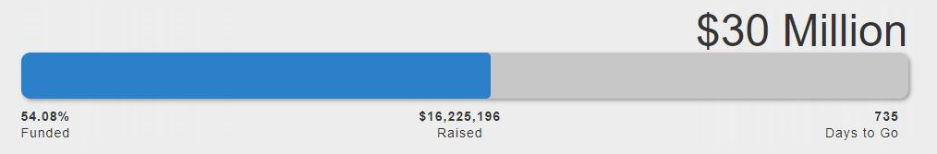
Additional Announcements
Important happenings at IEEE
IEEE Foundation Fund Drive
TRANSFORMING LIVES THROUGH THE POWER OF TECHNOLOGY AND EDUCATION
IEEE President-Elect, 2019
IEEE-USA President-Elect, 2019

Slide 5
Tonight’s Schedule
4:30-6:00 pm Reception
4:30- 8:30 pm Bar Service Mindock Hall
Soft Drinks and Water are Free, Well Liquor $6, Wine by Glass-$6, Beer-$6
4:30-7:30 pm Appetizers Mindock Hall
Vegetarian Dishes are available
6:00-6:15 pm Welcome and Credits
6:15-7:00 pm Presentations
7:00-7:05 pm Break During the break a video of CSU and the EiR Program will be broadcast
7:05-9:00 pm Questions and Answer Session
9:00 pm Sign Off-Closing Comments

