Slide 1
2017 Health & Safety Update

Slide 2
OVERVIEW
Research Update
Concussion Protocols
Wearable Sensor Technology
Helmet Laboratory Study
Shoe Safety and Performance
Field Surfaces Committee

Slide 3

Medical Research Update
  Player driven family of studies designed to improve the health and well-being of former NFL players by finding better ways to diagnose, treat and prevent health issues that impact quality of life.

Slide 4
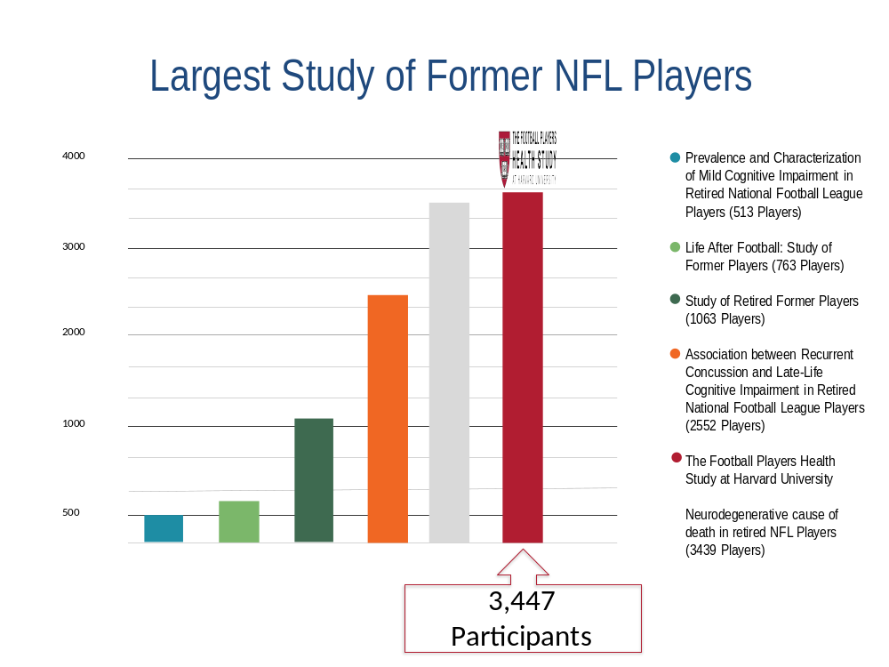

Slide 5
Ongoing Pilot Studies
Pain and Mobility
Cardiac Issues Among Athletes
Chronic Traumatic Encephalopathy (CTE)

Slide 6
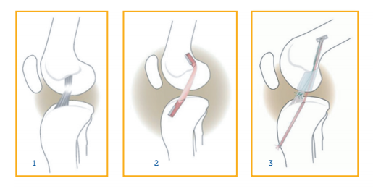
Pain and Mobility
Bridge-enhanced (BEAR) ACL repair
Treatment of Posttraumatic Osteoarthritis
Protect-When-Needed Knee Bracing Technology
BEAR at a glance
Notes:
Drawing 1: ACL tear w/o treatment
2: Traditional ACL reconstruction with graft tendon
3: BEAR – ACL heals with stitches and a sponge

Slide 7
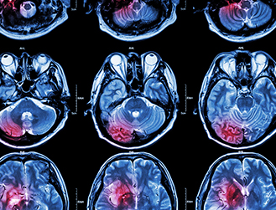
Other Studies
Cardiac Issues Among Athletes
CTE
  Diagnosis in living individuals
  Antibody therapy
Notes:
WHATS NEXT? Artificial Intelligence to map chemical libraries for drug compounds that may be beneficial for player-specific injuries and illnesses.
A public RFA to fund early stage treatments for concussion, PCS and long term neurodegenerative diseases.

Slide 8
CONCUSSION PROTOCOLS
2015 - 16 Enhancements
  Violations of Protocols subject to discipline
  Medical Timeouts
  Increased autonomy for UNCs and Booth ATCs

Slide 9
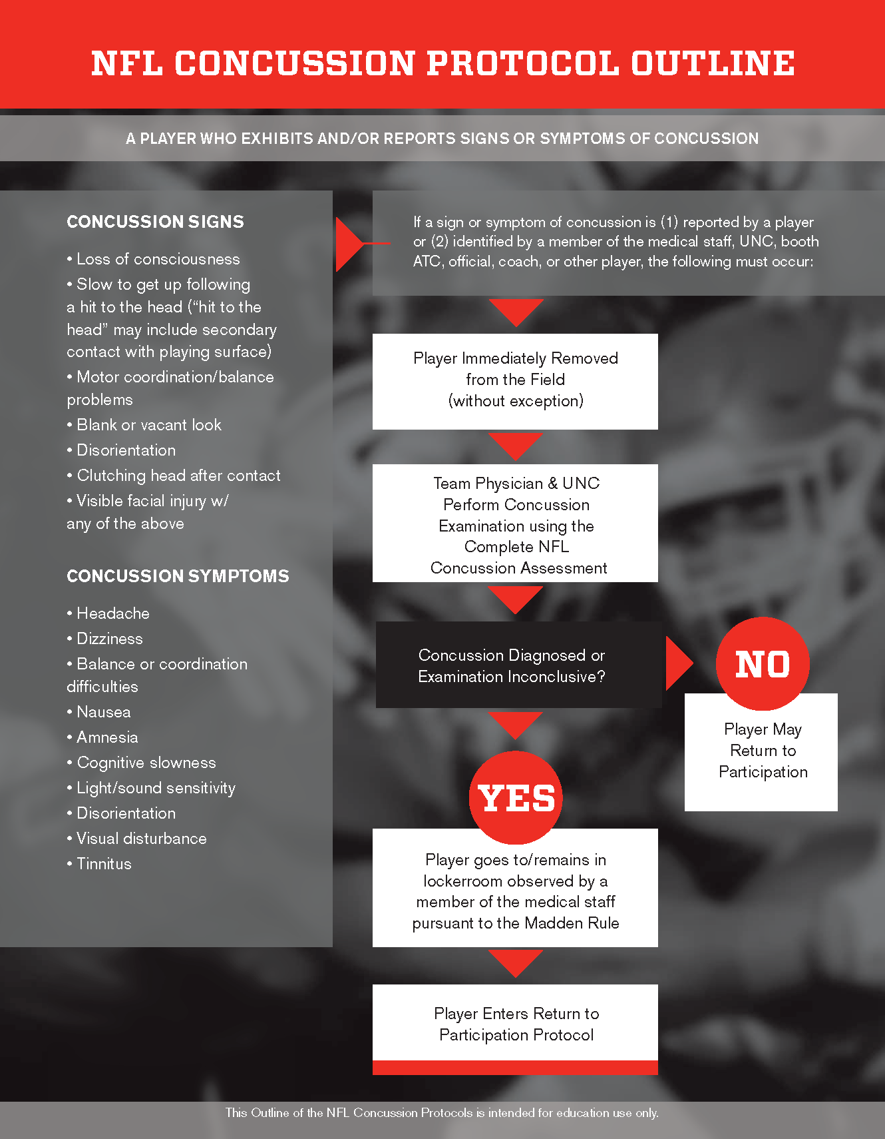
Notes:
Break it down. Sign or symptom of concussion reported by player or exhibited – LOCKER ROOM EXAMINATION
If occurance of concussion is unclear, but one of our “TRIGGERS” raises a concern – then focused neurological examination on the sideline to determine if a full locker room examination is necessary. The UNC is co-piloting in every aspect of the examination.

Slide 10
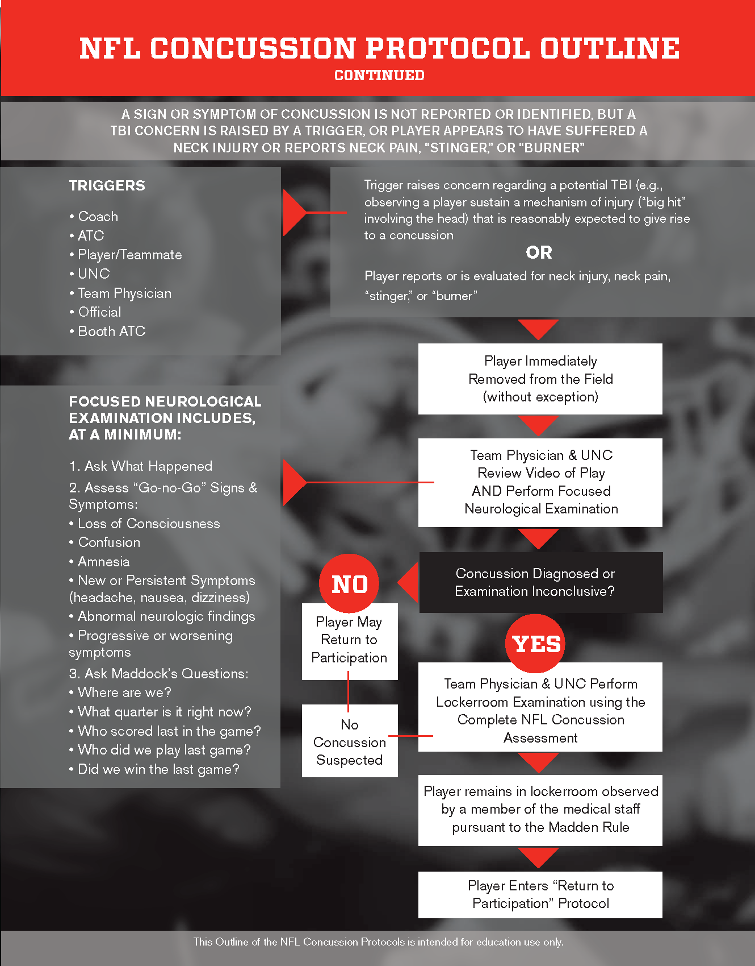

Slide 11
Enforcement
Compliance with NFL Concussion Protocols is MANDATORY
NFL and NFLPA tasked with enforcement
Violations subject to discipline
Independent Arbitration

Slide 12
Discipline
Failure to comply will result in discipline
1st offense | Reprimand, mandatory remedial education, and/or fine up to $150,000
1st offense w/ aggravating circumstances | Minimum $50,000 fine
2nd offense | Minimum $100,00 fine
Competitive considerations | Additional fines and/or forfeiture of draft picks

Slide 13
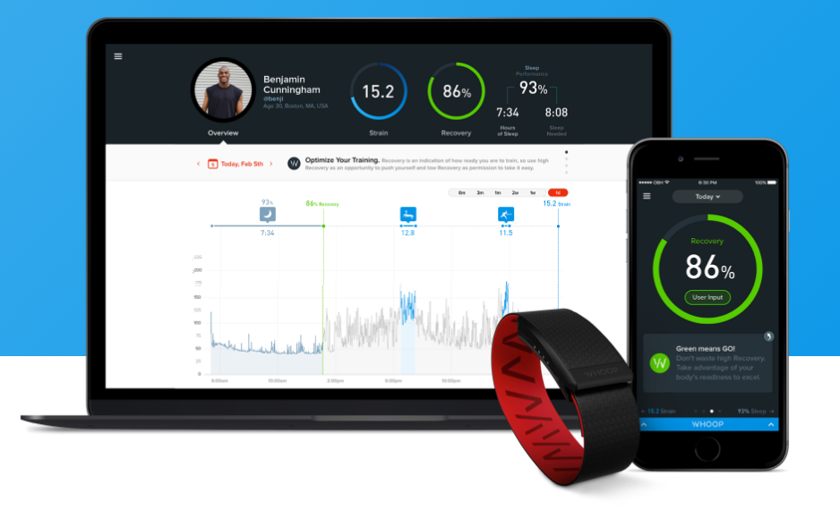
Sensor Technology
Important considerations for players:
Data Privacy/Security
Unauthorized Use
Data Ownership
Notes:
CBA states NFL may require players to wear non-obtrusive sensors for purposes of monitoring performance but if used in connection with Health or Medical requires NFLPA approval.
If you know your players’ team is using sensors don’t hesitate to let us know.

Slide 14
Sleep Studies
CBA Compliance Form
New CBA side letter limiting Club’s use of sleep studies/sensors on players
“Sleep Studies” shall mean any effort to test, monitor, observe, analyze or collect information on or in connection with the sleep activity of an NFL player (including through the use of wearable sleep trackers).
Notes:
*Lower Teir Agreements, no merging with EMR, limitations on longitudinal usage

Slide 15
Limitations on Sleep Studies
Clubs must hire qualified 3rd party company to conduct study
Only during OTAs or preseason training camp
Player participation is strictly voluntary
Each player owns his individual data
Data may not be shared with Club without player consent
Data/results may only be used for purposes supporting player health and/or performance

Slide 16
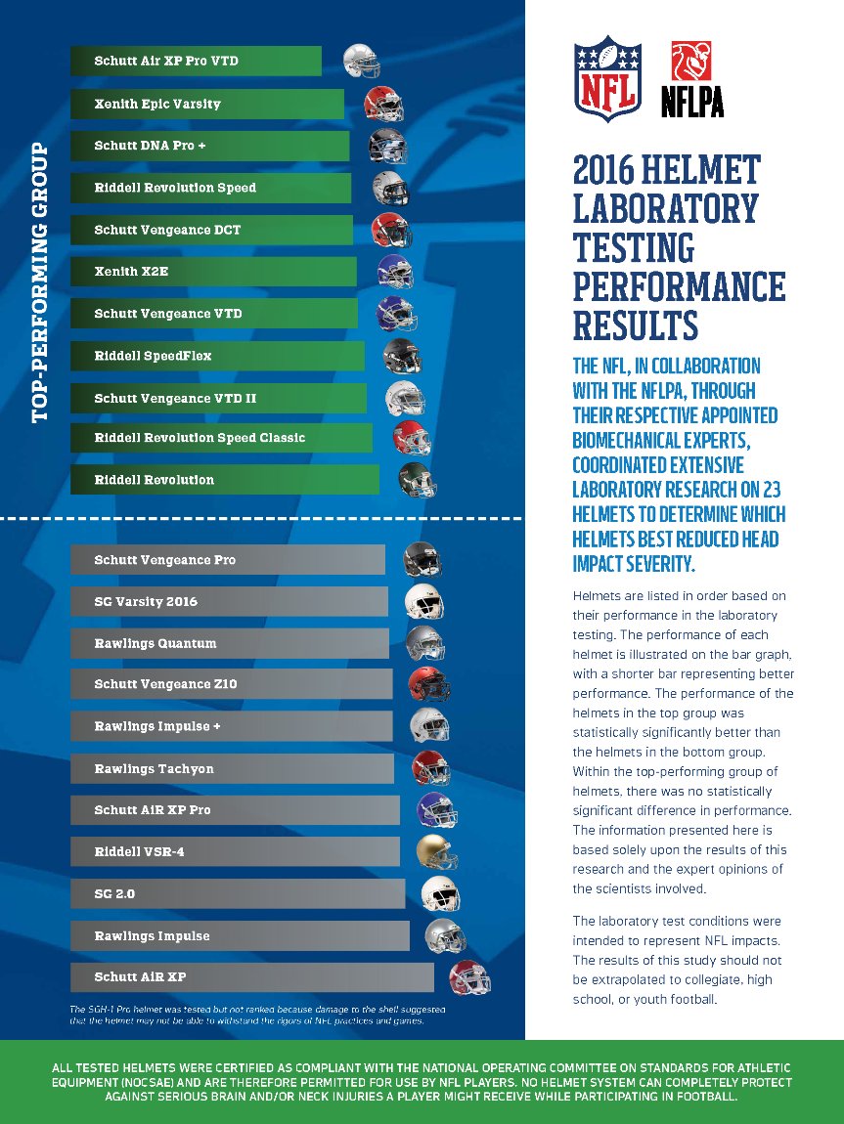
Equipment Testing
Lab testing demonstrates which helmets used in the NFL perform better than others in laboratory testing designed to replicate impacts.
Note: The study cannot be used to predict a specific reduction in risk of sustaining a concussion on the field.

Slide 17
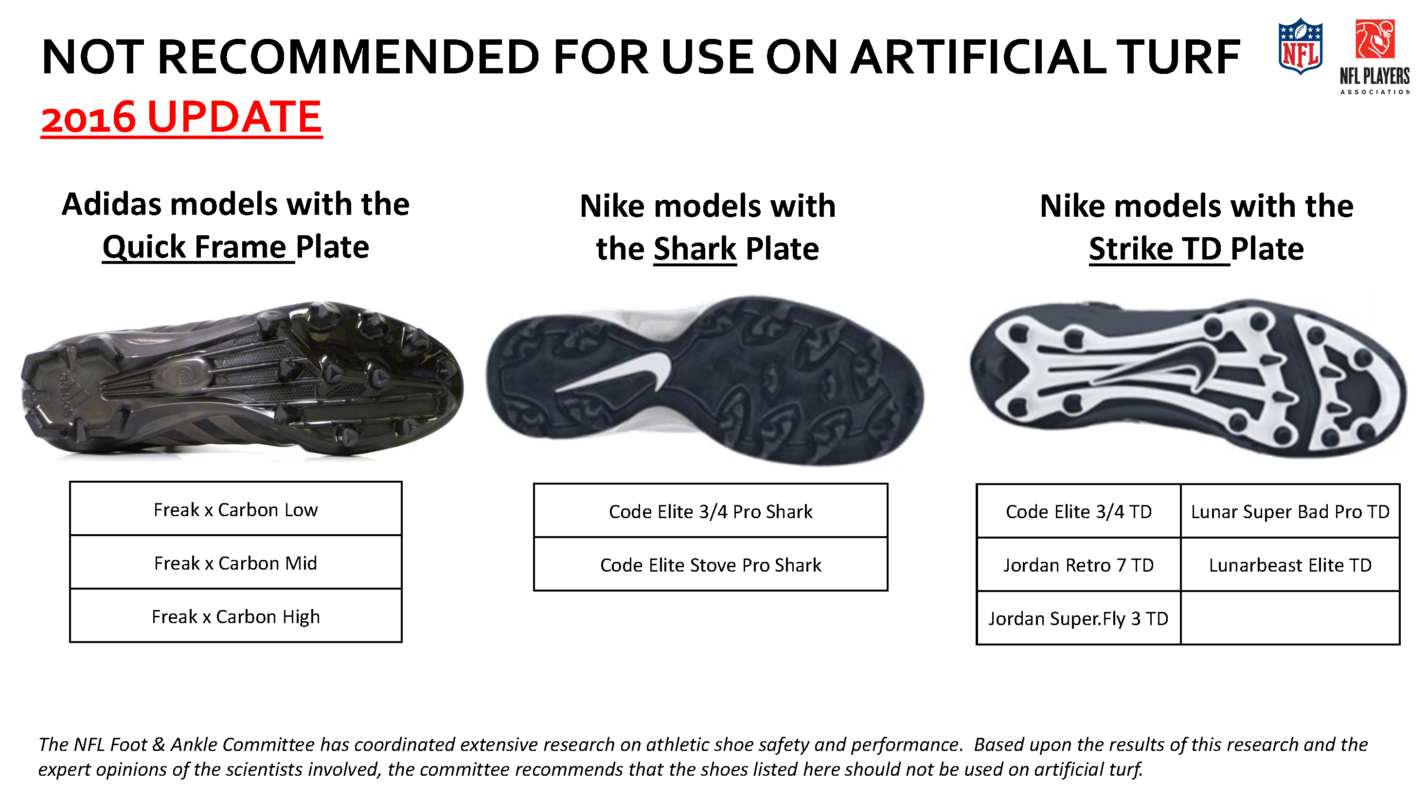
Cleat Safety

Slide 18
Field Surfaces
Newly formed Field Surface and Performance Committee
Provides guidance regarding safety, performance and testing practices of game-day and practice field surfaces
Establishing mandatory testing and maintenance protocols for start of 2017 season

Slide 19
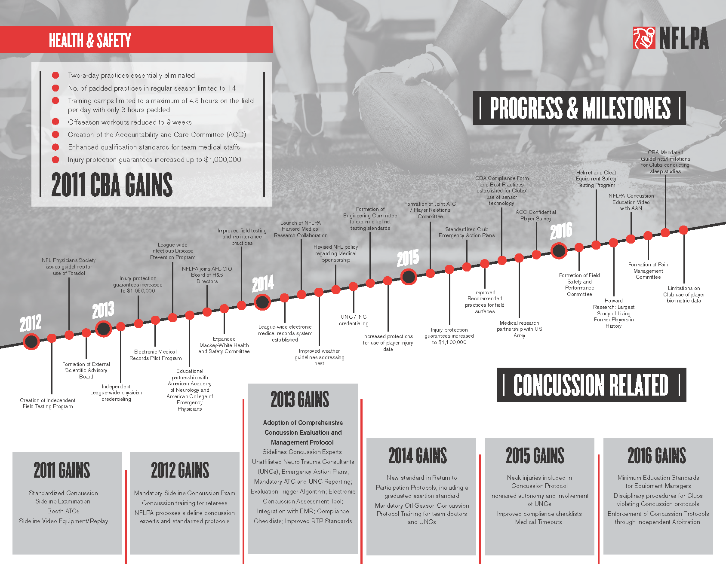

Slide 20
Questions?

