Slide 1
Vaping & E-cigarettes
What we all NEED to Know.

Slide 2
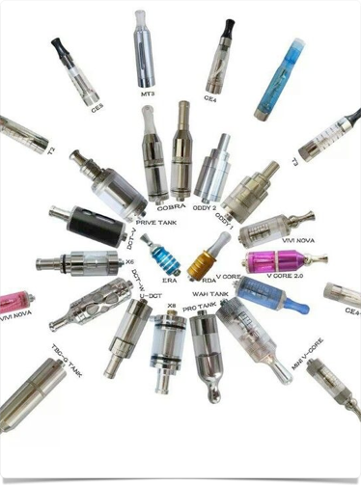

What is Vaping?
According to the National Center on Addiction and Abuse-Vaping is the act of inhaling and exhaling the aerosol, often referred to as vapor, which is produced by an e-cigarette or similar device. The term is used because e-cigarettes do not produce tobacco smoke, but rather an aerosol, often mistaken for water vapor, that actually consists of fine particles. Many of these particles contain varying amounts of toxic chemicals, which have been linked to cancer, as well as respiratory and heart disease.

Slide 3
Vaping Devices
Vaping devices include e-cigarettes, vape pens and advanced personal vaporizers (also known as ‘MODS’) e-pens, e-pipes, e-hookah, and e-cigars are known collectively as ENDS.
Introduced to the mass market in the U.S. in 2007, and not regulated by the FDA to date.
Vaping device consists of a mouthpiece, a battery, a cartridge for containing the e-liquid or e-juice,
and a heating component for the device that is powered by a battery.
The e-liquid in vaporizer products usually contains a propylene glycol or vegetable glycerin-based
liquid with nicotine, flavoring, THC, other chemicals and/or metals.

Slide 4


Social Dangers
1. E-cigarettes and vaping target young people
  offering a techie gadget to re-introduce nicotine,
  and threaten to re-normalize tobacco use.
2. Many teens self report after vaping they introduced
  themselves to regular marijuana/THC use.
3. The device is discreet, “cool” and has been marketed
  and is believed to be “safe”.
4. Virtually undetectable by odor and as small as a flash
  drive the device can be publicly un-noticed and a
  socially acceptable alternative to cigarettes.

Slide 5
Prevalence
Manufacturers must register with FDA by August 8, 2016,and then will have two additional years to submit an application to remain in the marketplace. Until that time, the nearly 500 brands and 7,700 flavors of e-cigarettes will remain on the market – before FDA is able to fully evaluate them.
Youth are using e-cigarettes at increasing and alarming rates. Between 2011 and 2015, the U.S. Surgeon General found e-cigarette use among high school students increased by 900 percent, with more teens now using e-cigarettes than cigarettes.
The tobacco industry aggressively markets e-cigarettes to youth, glamorizing e-cigarette use in advertisements and offering e-cigarettes in candy flavors like bubble gum and gummy bears. Kids can also easily buy e-cigarettes online, according to a March 2015 study published in JAMA Pediatrics.
https://vapingdaily.com/what-is-vaping/

Slide 6
health Risks
We don't presently know what is in e-cigarettes. However, in initial lab tests conducted in 2009 the FDA found detectable levels of toxic cancer-causing chemicals, including an ingredient used in anti-freeze, in two leading brands of e-cigarettes and 18 various cartridges.
Nicotine is an addictive substance, and almost all e-cigarettes contain nicotine.
Nicotine also has a negative impact on adolescent brain development. Human brain development continues far longer than was previously realized, and nicotine use during adolescence and young adulthood has been associated with lasting cognitive and behavioral impairments, including effects on working memory and attention.
The U.S. Surgeon General has concluded that e-cigarettes can expose users to several potentially harmful chemicals, including nicotine, carbonyl compounds and volatile organic compounds (VOC’s).
Diacetyl a fermentation compound found in vaping devices, when heated is linked to serious and debilitating lung diseases.

Slide 7

Bottom LINe
It is not just water vapor.
Vape devices are tobacco products.
It is hard to detect.
Vaping can lead to smoking and drugs use.
Vaping targets young people.
Informed parents and children are our best defense.

