Slide 1
Ports Energy and Carbon Savings
Energy sharing initiatives
Omgevingsdienst IJmond
IndaChlor
PECS Kick off meeting - Southampton – 19/01/2018

Slide 2
Program
Welcome
Presentation 1: INDAVER (5-10 min)
    ECLUSE
    Jan-Kees De Voogd
Presentation 2: Omgevingsdienst IJmond (5-10 min)
    LEM platform
    Nick Ruiter
Workshop activities (15-20 min)
Plenary discussion (10 min)

Slide 3
Introduction
What is the best way forward for all stakeholders in a port, such as the port authority, the administration and the industry to create maximum energy efficiency (balancing and using each others residual energy) and reach maximum carbon emission reduction?
    How do you organise this in practice?
    What are the key challenges for utilization of energy production?
    What are the obstacles for organising this mutualisation.

Slide 4
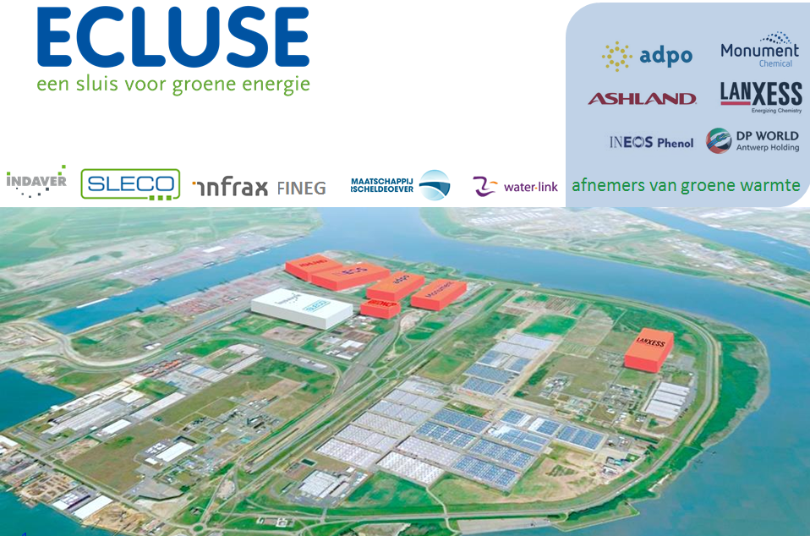
Presentation 1: INDAVER

Slide 5
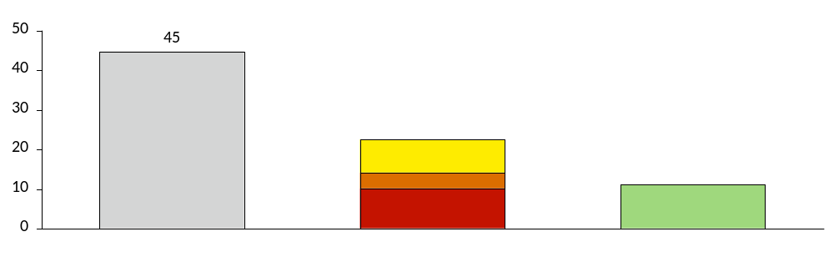
Heat was only indirectly targeted by existing EU policies, which focused more on power production with renewable energy
  H&C Industry
  H&C Services
  EJ
  H&C Residential
  22
  11
  Total Energy demand EU
  Energy Demand
  Heating & Cooling
  Excess heat
“The barriers for application of waste heat … are lack of awareness and information …; inadequate business models and incentives; a lack of heat networks; and lack of cooperation …” – EU Strategy on Heating and Cooling - 16/02/2016
2020 doelstellingen Belgie:
15% reductie van CO2
13% hernieuwbare energie
Europese lange-termijndoelstellingen:
2030: 40% vermindering tov 1990
2050: 80% vermindering tov 1990
Doelstellingen 2030:
ETS: 43% reductie tov 2005
Niet-ETS Belgie: 35% reductie tov 2005
In oktober 2014 bereiken de Europese regeringsleiders een akkoord over het Klimaat- en Energiepakket 2030. Dit pakket bevat 3 doelstellingen:
- een bindende, interne broeikasgasvermindering van minstens -40% t.o.v. 1990;
- een op EU-niveau bindende belofte voor hernieuwbare energie van minstens 27%;
- een indicatieve energie-efficiëntiedoelstelling van minstens 27%.

Slide 6
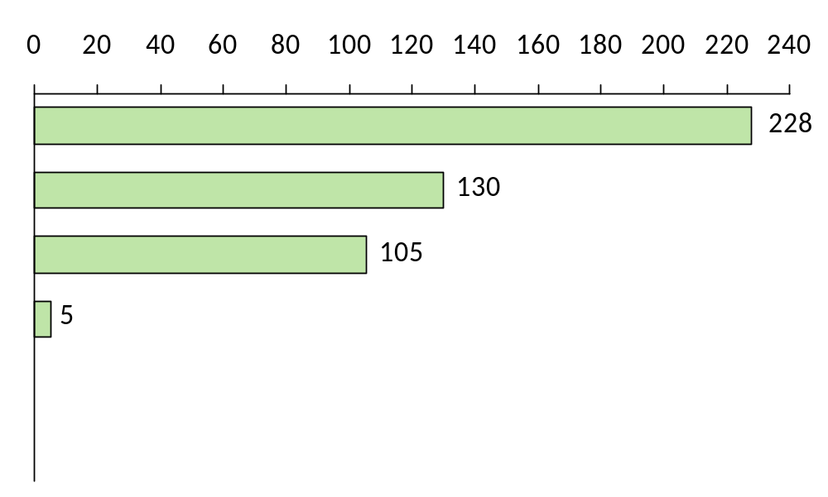
Comparison of allowances for CO₂ saving techniques
  EUR/ton CO₂
  Offshore wind
  Ground mounted PV
  Onshore wind
  ECLUSE
  -95%
  District heating excess heat
  -72%
  Statement:
      Reduction of CO2 with excess heat is very cost efficient
      A large potential of excess heat can still be utilized if the right policies and incentives are in place.
Source: CPI report, Policy and investment, 4/2016
Feed in tariff = average LCOE – 35 EUR/MWh
Conversion factor Feed in tarrif (EUR/MWh) to cost of CO2 reduction (EUR/ton CO2) = 1 / 0,42

Slide 7
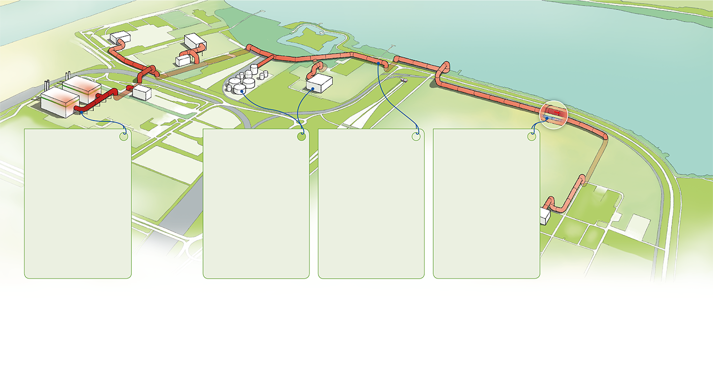


ECLUSE steam network…. THE CONCEPT
Reduction of 100,000 tonnes of
CO2-emissions per year
Waste 2 Energy plant
waste & sludge:
1 mio t/y
250 MW steam
  Nearby
  Chemical industry
5 large-scale companies
need steam for production processes
10-13y offtake agreements
  Steam duct 6 km
  partly above /below ground
  Steam: 40Bar
  and 400 °C
  Capacity: 160 MW
  Investment: app. 30 mln EUR
  Condensate
  return duct
Used for heating purposes
Physically separated circuits.
Location: Waasland Port

Slide 8
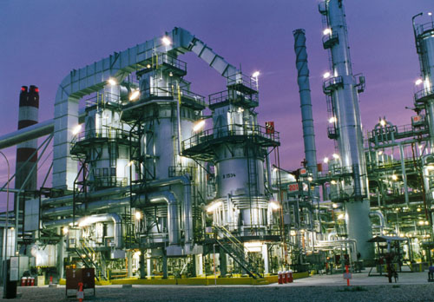
Existing situation at the consumers
Port of Antwerp is home to the largest chemical cluster in Europe
Chemical industry: Energy intensive and very stable consumption
Applications for steam:
      Distillation
      Evaporation / Drying
      Cleaning
      Chemical reactions
  Steam production:
      Energy source: Natural gas
      Installations: Steam boilers and CHP
  ECLUSE will provide steam for 6 chemical companies and replace approximately 10 steam boilers
8

Slide 9
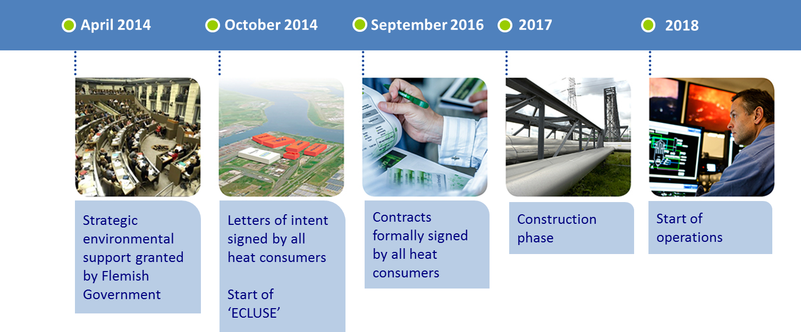
Planning van het project

Slide 10
Key succes factors
The consumers:
      The active and positive support of the participating consumers
      The number of consumers made the project self-supporting
      Long term and binding commitments for offtake of energy
Full support of the local authorities (aMT, MLSO, Beveren, …)
A cost efficient and sustainable energy source:
      A favorable price ratio of gas to electricity (contrary to CCGT or CHP)
A flexible and powerful support mechanism of the Flemish government (STRES)
      A one time investment subsidy is cost effective and transparant
      However budget was significantly decreased since 2014
The energy cluster Ecluse acts as a starting point for other investment initiatives:
  Availability of sustainable process heat attracts new companies (eg. Kebony)
  The steam network can be used for demand response management
  The condensate return duct can be used for distribution of demineralised water
  The condensate return duct can be used for district heating (low temperature)

Slide 11
Presentation 2: ODIJ

Slide 12
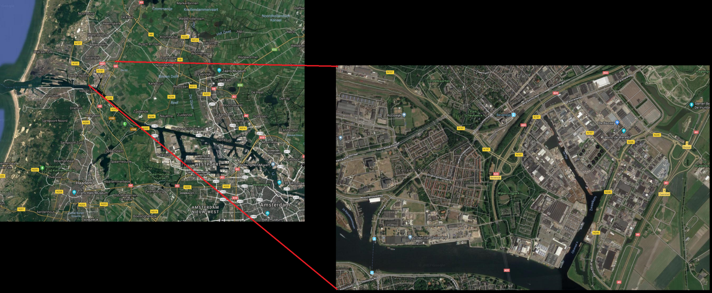
Project area

Slide 13
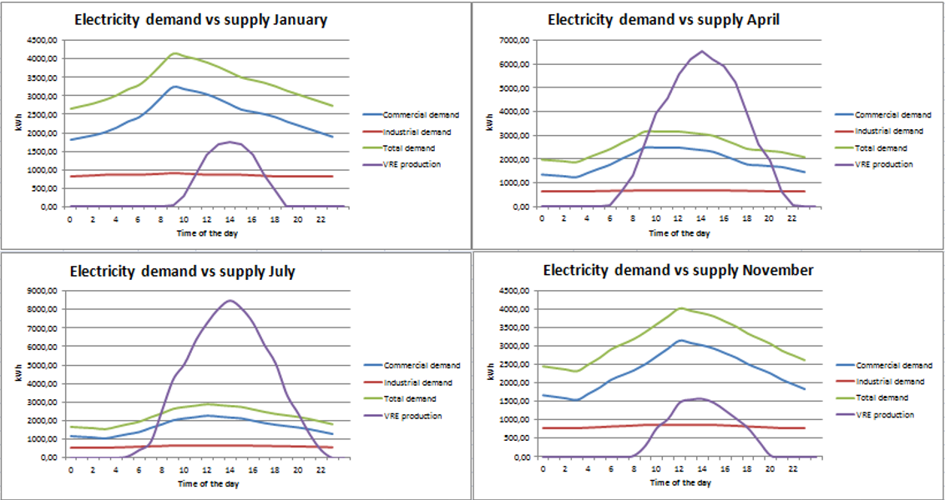
What is the cause?
ODIJ is transitioning business parks towards a low carbon energy supply
The main source of electricity is solar
This causes a ‘mismatch’ between supply and demand
Supply and demand are not equal
Pressure on the power grid

Slide 14
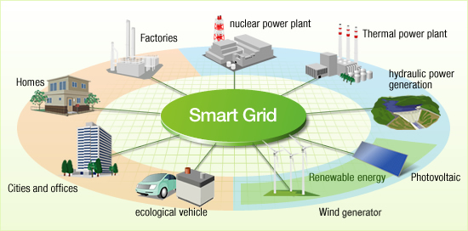
How to solve this?
A LEM platform could be implemented
    Local energy market
    Directly exchanging energy with your neighbors
    Only trading with the wholesale market when local supply is not sufficient
A smart grid environment is necessary

Slide 15
What are possible bottlenecks?
Public support is necessary
High degree of cooperation is needed
    Businesses
    Government
    Power grid administrator
    Electricity supplier
    Knowledge institutes
Could be achieved trough setting up and ESCo
    Energy service company
Price sensitivity of consumers is important
    How do different electricity prices affect the consumer

Slide 16
How did ODIJ tackle these issues?
Close cooperation with entrepreneurs on business parks
    Trough our ‘Greenbiz’ network
Start off with a pilot project on one of the business parks
    Kagerweg business park in Beverwijk
    Approximately 110 businesses
    Complete PECS project area is 4-5 times larger
Carry out an energy audit
    To inform the entrepreneurs
Keep communicating how the process is going
Start a study together with Dutch knowledge institute TNO

Slide 17
The workshop
Four groups
Assessment of possible bottlenecks with cooperation projects
    Experiences of ODIJ and Indachlor are given
    Your experiences are asked
Conclude with a summary of your findings

Slide 18
Questions?

Slide 19
























Partners
Observers
With the financial support of

