Slide 1
Integrating Renewables into the Grid
James Loewen
Goshen College Science Speaker Series
January 16, 2019

Slide 2
This talk
Electricity and sustainability: potential employers and careers
Integrating renewables into the grid. What? Why? How?

Slide 3
Energy and sustainability
Electric Cars
Wind Farm Siting Rules
Carbon Capture and Storage (CCS)
Appliance Efficiency Standards
Transit
Subsidies
Transmission Lines
Integrating Solar and Wind into the Grid
Cap ‘n’ Trade
Trade Tariffs (Solar Panels)
Elections in South America
Ethanol
Subsidies
Electric Utility Rates
Weather Stripping
Rooftop Solar Rebates
Fracking Restrictions
Forest Management
Environmental Impact Studies
CAFÉ Standards

Slide 4
Grids and Renewables: the Players
Federal government: Energy Info Administration (data), EPA (environment), DOE (nuclear power), Dept. of Commerce (trade tariffs), Dept. of State and Dept. of Defense (foreign wars and peace), FERC, Federal labs (NREL, LBNL, LLNL, White Sands, Sandia, Oak Ridge, etc.)
State governments: public utilities commissions, state EPAs, depts. of transportation, etc.
Cities and counties: offices of sustainability, solar rebates, transit electrification, etc.
Utilities: privately owned, publicly owned
Para-governmental organizations (RTOs, ISOs, WECCs)
Manufacturers: cars, buses, wind turbines, solar panels, appliances, windows, HVAC, batteries, etc.
Finance: banks, institutional investors, local governments (PACE), etc.
Installers and builders: solar, wind, fossil gen, nukes, transmission lines, distribution lines, etc.
Non-profits: Sierra Club, Green Peace, The Nature Conservancy, consumer advocates, etc.
Universities and colleges
International: World Bank, UNEP, IEA
Consultants

Slide 5
What professions are involved?
Hard sciences: physics, chemistry, biology
Environmental science, policy, and management
Engineering
Economics
Business
Communications
Law
Policy
Teaching
Preaching
Politics: federal, state, local
Etc.

Slide 6
Integrating renewables into the grid
What?
Why?
How?

Slide 7


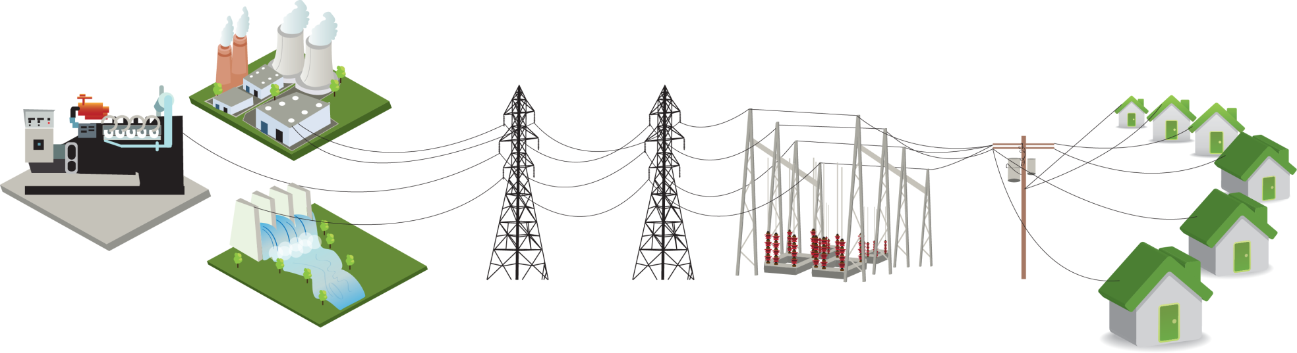
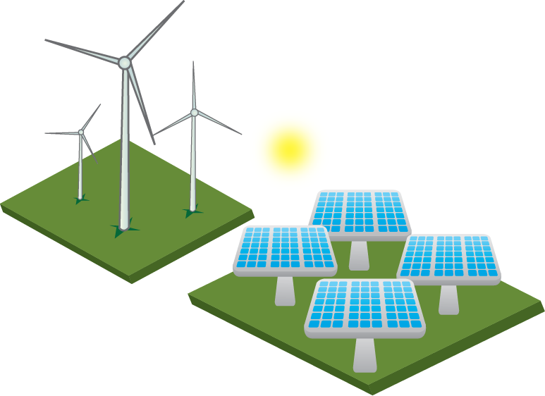
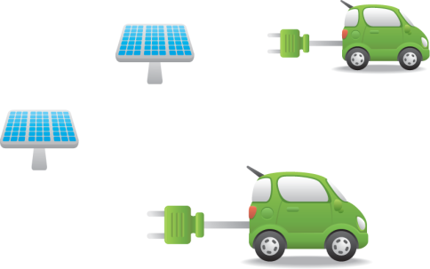
Utility infrastructure
Utility-Scale Storage
Distributed Storage
Plug-in Electric Vehicles
Rooftop Solar

Slide 8
Special characteristics of electricity
Need (near) total reliability
Supply must meet demand from second to second
Storing electricity is difficult and expensive
Dangerous commodity
Grids are natural monopolies (economies of scale)

Slide 9
Policy Goals for the Grid
Safety
Reliability
Affordability
Low environmental impact
  Global/greenhouse gasses (GHGs): CO2 and methane
  Local/environmental justice: SOx, NOx, particulate matter
  Thermal pollution of rivers and oceans
  Water consumption (once-through cooling for thermal plants)

Slide 10
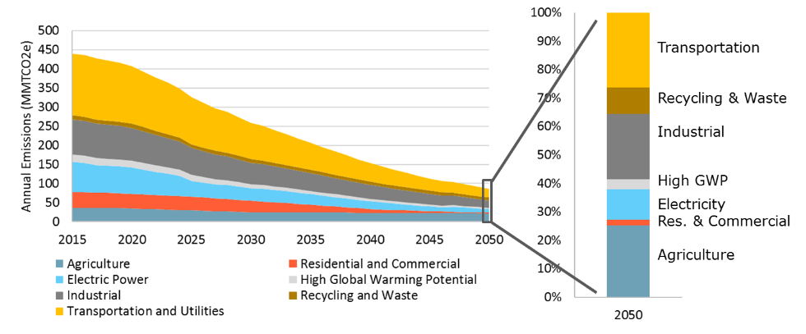
GHGs: the Grid vs. the Rest
California CEC June 2018. Deep Decarbonization in a High Renewables Future

Slide 11
How to pollute less?
[Fewer people]
Reduce electric use: fewer kWh per customer; fewer kWh per dollar of output
Make the grid cleaner (power from less polluting sources)

Slide 12
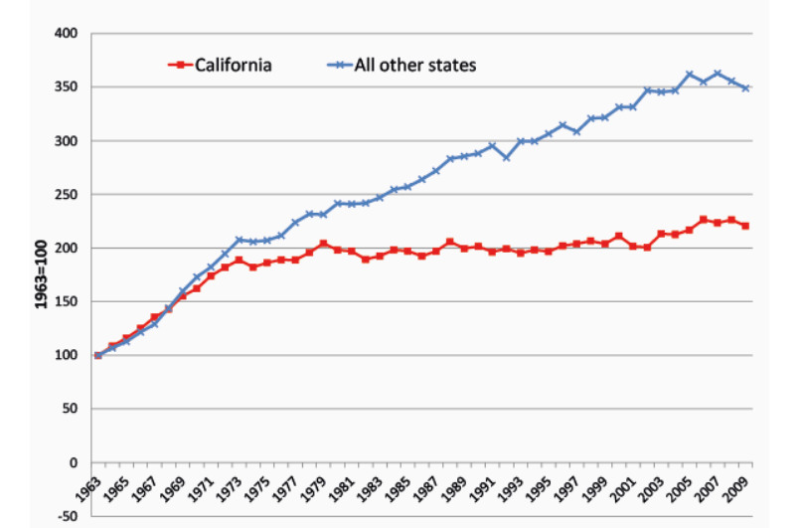
Usage per capita

Slide 13
Lower use per customer. How?
Energy Efficiency programs:
  Houses and commercial buildings:
    Passive measures (the shell)
    Active measures (lighting and HVAC)
  Appliances: California’s Title 24
Rate design, high marginal rates (can lead to other challenges)
Mild climate

Slide 14
How to make the grid cleaner?
Traditional non-GHG energy sources: big hydro and nuclear
  Pros
  Cons
“New” clean sources:
  Wind, solar, geothermal (e.g. geysers), biofuel, wave, tidal
  (Transmission)
NIMBY

Slide 15
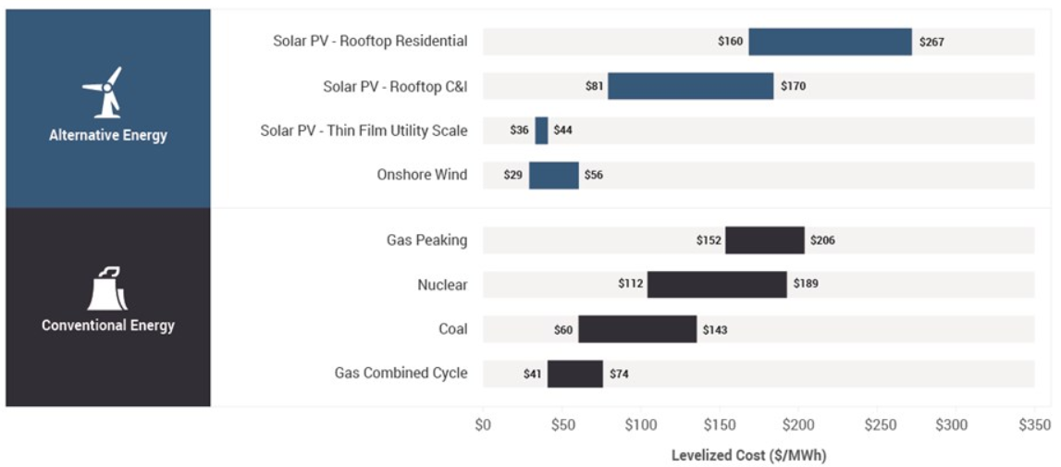
How much do new renewables cost?
Lazard, November 2018

Slide 16
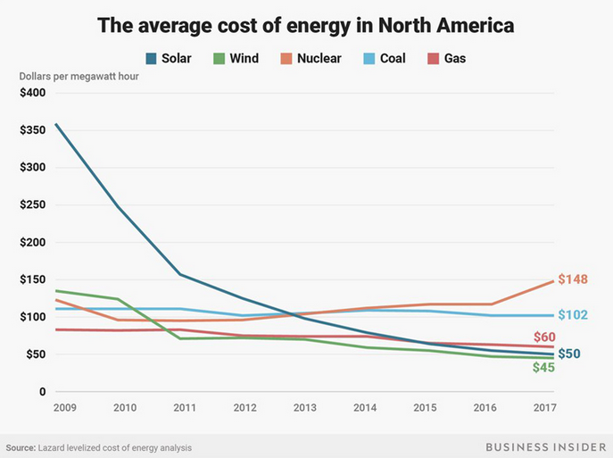
Cost Trends

Slide 17
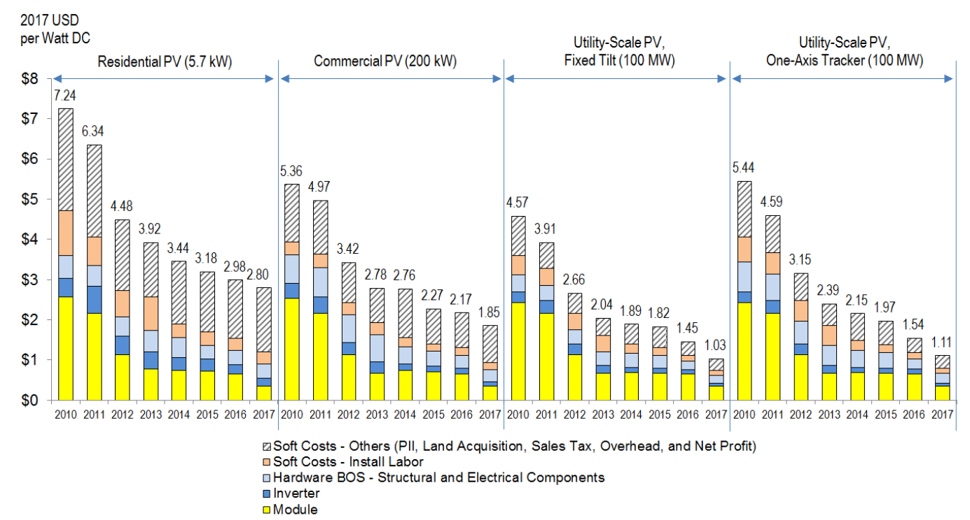
Solar Cost Components
NREL September 2017

Slide 18
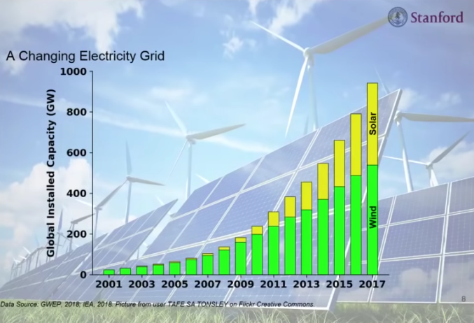
Renewables are Exploding

Slide 19
Renewables are already cheap! So, what’s the problem?
Resource costs vary by geography
Intermittent and non-dispatchable

Slide 20
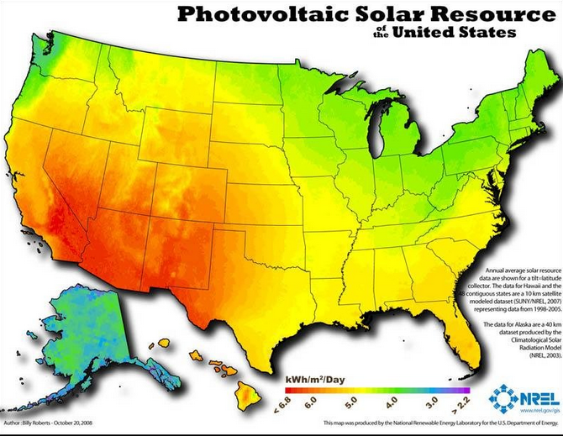
Sunny spots

Slide 21
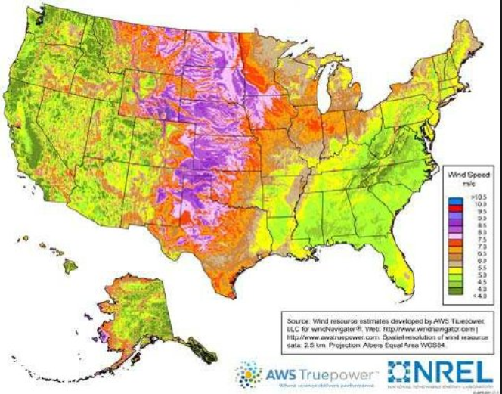
Where the wind blows

Slide 22
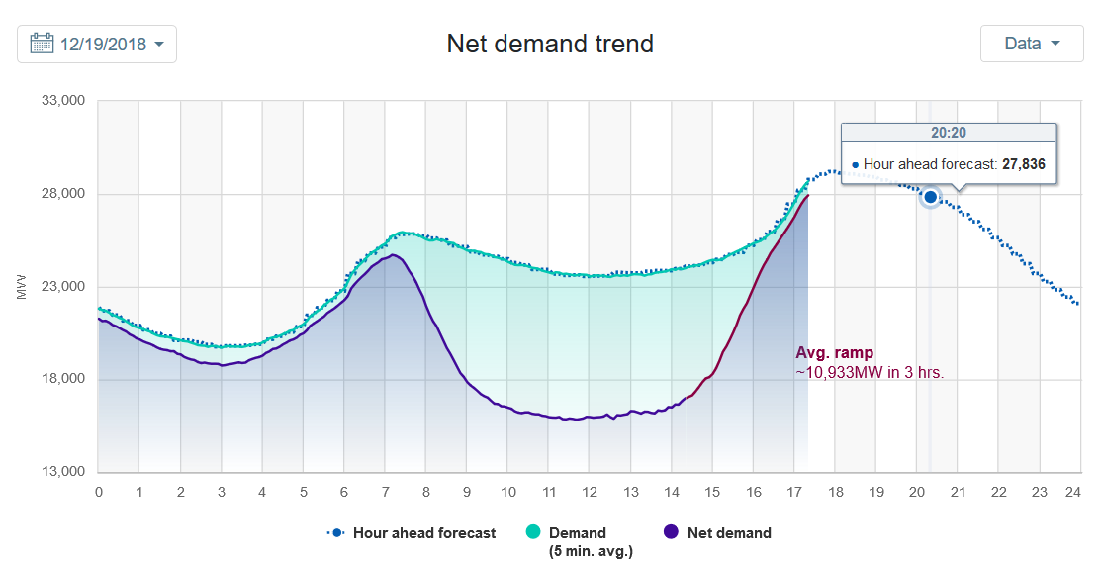
December 19, 2018 net demand in CA

Slide 23
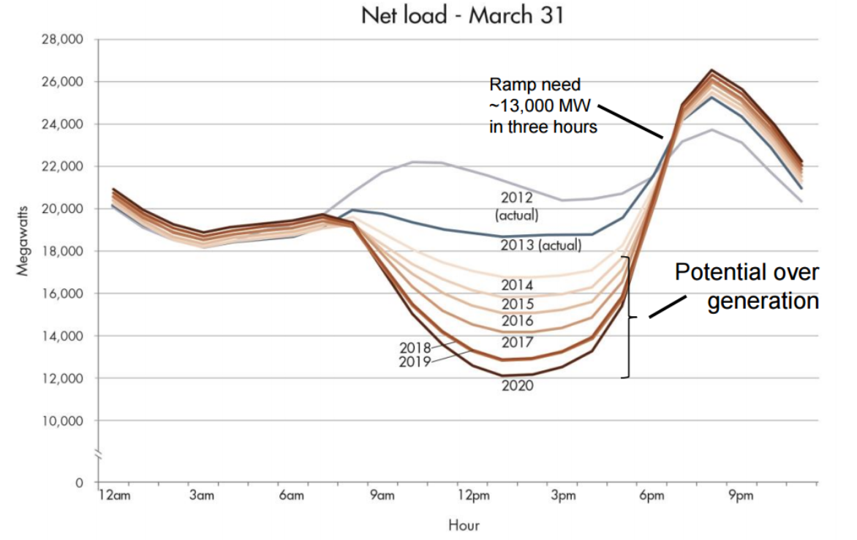
Total CA “load” minus renewable generation: The Duck Curve

Slide 24
Duck hunting
Lots of gen sources – the “law of large numbers” – spread over large area
Lots of wires: transmission and distribution
A “diversified portfolio”, e.g., wind plus solar plus biomass plus…
Energy storage
Customer incentives: time of use (TOU) rates, demand charges
Overbuilding/curtailment of renewables
Keep some fossil for the last 10% – 20%
Virtual: Purchases RECs (renewable energy credits)

Slide 25
Ways to store energy
Mechanical inertia: flywheel
Pumped hydro
Other mechanical gravity: rails, conveyor belts, cylinders, etc.
Chemical: Hydrogen; converted biomass
Thermal: molten salt (from solar)
Electro-chemical batteries

Slide 26
Key battery characteristics:
Installed cost per kW
Installed cost per kWh (or, how many hours at the peak kW)?
How fast to charge? (especially for cars)
Round trip efficiency
Durability (rate of degradation per cycle)
Compactness and weight. Important for
  Cars/trucks/buses
  Customer-sited vs. residential grid vs. wilderness grid
Environmental impact (is it toxic?)
Supply security (is the metal/mineral mined in Russia, China, Congo?)

Slide 27
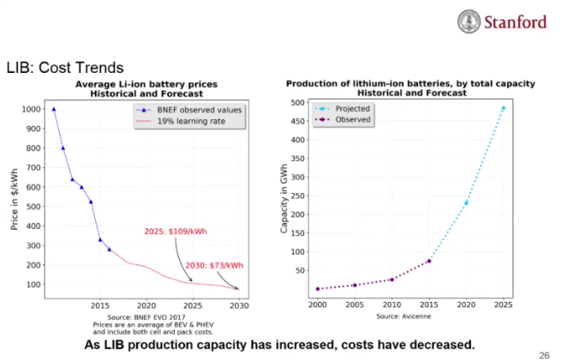
Cost trends for batteries

Slide 28
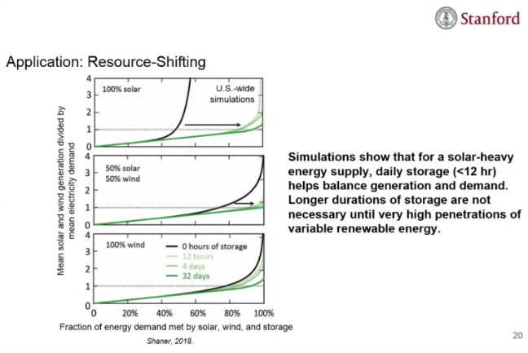
Is wind a better bet?

Slide 29
Wind (cont’d)
Texas example:
  “Scientists found that between wind energy from West Texas and the Gulf Coast, and solar energy across the state, Texas could meet a significant portion of its electricity demand from renewable power without extensive battery storage. The reason: These sources generate power at different times of day, meaning that coordinating them could replace production from coal-fired plants.” [Houston Chronicle, re Rice University study]
Off-shore wind:
  More constant (less intermittent)
  Less NIMBYism
  More expensive, but costs are dropping

Slide 30
The cheapest solution…
Really depends on:
Local “load” (consumption profile),
Natural resources available (e.g. Norway, Nevada, Wyoming)
Historical infrastructure (France)
Cost trends for batteries
Etc.

Slide 31
In CA, up to 90% renewable is easy…
"Simulations show up to 90% of California's power can come from a combination of wind, solar, batteries and geothermal," E3 Senior Partner Arne Olsen told Utility Dive. "Beyond 90%, it gets difficult and expensive.“ [Utility Dive]

Slide 32
What about electric cars?
Environmental impact – how clean is the grid
Electric grid needs to expand
Batteries help grid as mobile storage - but they also wear out the batteries.
Utilities love EVs
Takeaway: positive but complicated

Slide 33
Rooftop solar is great, right?
Well, not so fast
  From Lazard, utility scale solar farms are MUCH cheaper
  “Net energy metering” is a subsidy
So how come everyone likes rooftop solar?
  Costs are hidden
  Benefits are visible and financially tangible to the gen owner
  It’s really making solar energy
  Employs a lot of installers
I would do it if I had the chance

Slide 34
NIPSCO plans to go green
Coal contribution to NIPSCO mix
  2018 – 65 %
  2023 – 15 %
  2028 – 0 %
Will replace with:
  1,500 MW of solar with battery backup
  150 MW of wind
  125 MW of reduced demand through efficiency and demand-side management programs
  50 MW of electricity purchased from other utilities, all by 2028.
Claims long run savings of $4 billion. Requests 12% rate hike now.

Slide 35
Thank you!
james@everspring-energy.com

Slide 36
Backup Slides

Slide 37
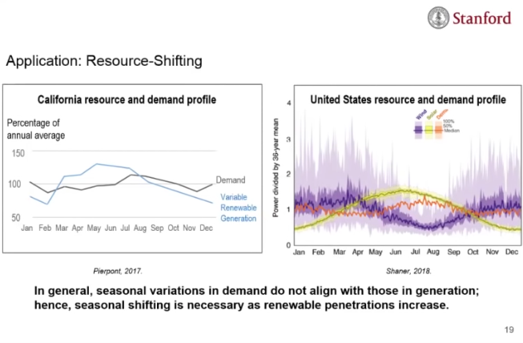
Seasonal mismatch – demand vs. renewables

Slide 38
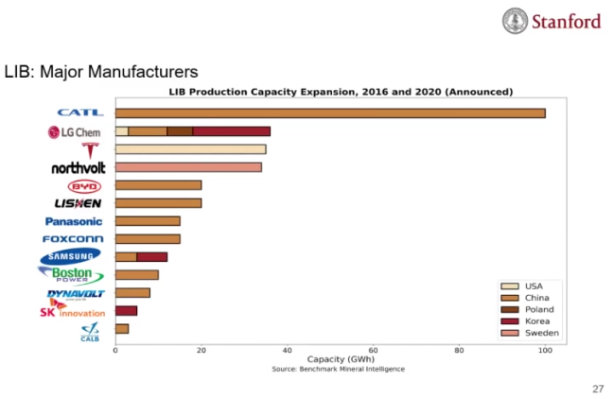
Battery manufacturers

Slide 39
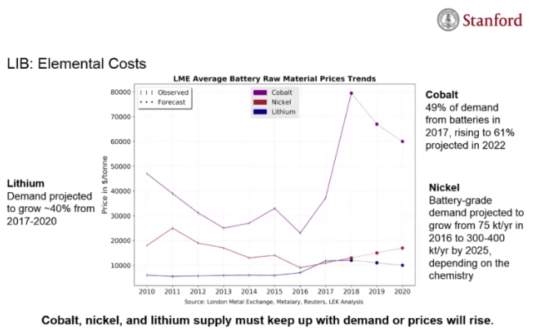
Cost of Lithium Ion Battery Inputs

Slide 40
Grid modernization
Investments in distribution and transmission system technologies that improve the grid's reliability, resilience and efficiency. They range from advanced metering infrastructure (AMI) to distributed energy resources (DER) to smart grid and automation hardware and software.
Very much in favor
Very expensive

Slide 41
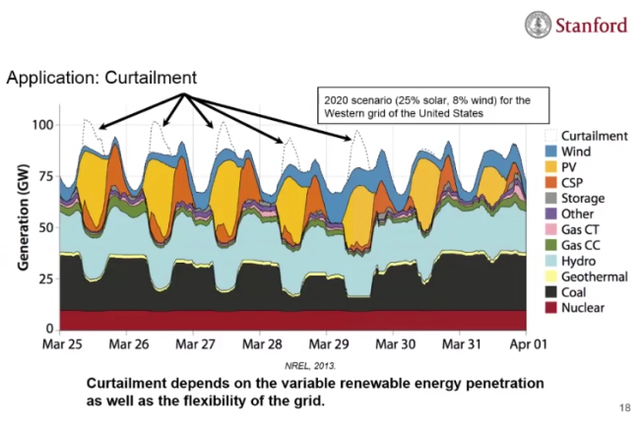
The Western Grid - 2020

Slide 42
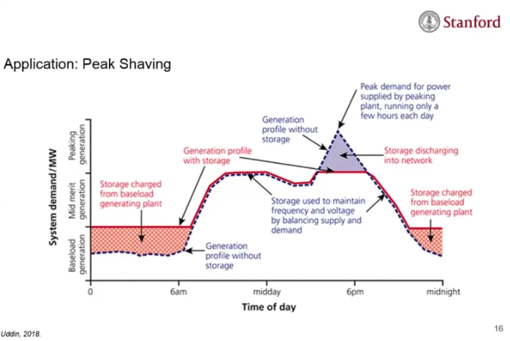
Storage for peak shaving

Slide 43
Different battery technologies
Lithium batteries: many different sub-chemistries
Flow batteries: industrial scale, cheaper, slower to charge, less efficient, more durable, not appropriate for customer-sited
Many press releases from labs, but getting to commercial volume is a whole different challenge

Slide 44
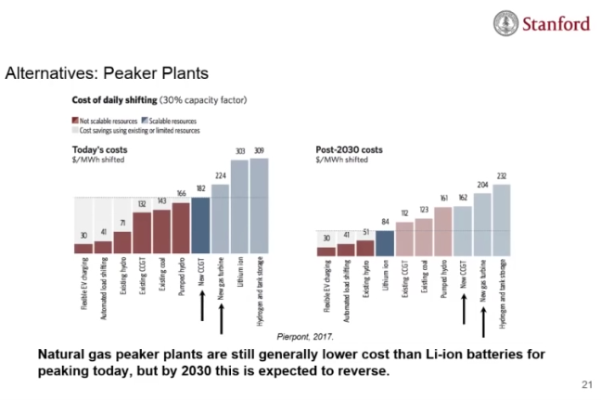
Gas peakers instead of storage

Slide 45
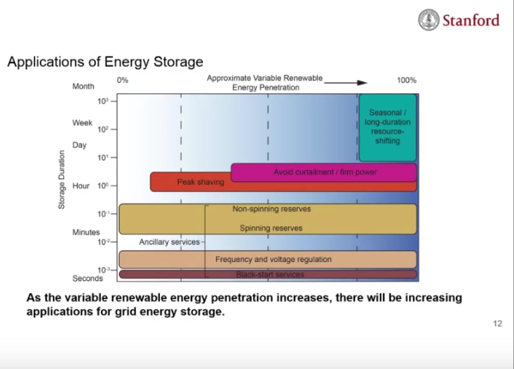
How storage can help the grid

