Slide 1

VIA Quarterly Newsletter
December 2020-March 2021
Venture International Academy
2880 David Walker Drive, #346
Eustis, Florida 32726
352-978-9520
www.ventureinthesunusa.org
www.ventureinthesunusa.org

Slide 2
Dian Joy, CEO/President
Contact us…
Dian Joy
CEO/President
352-742-5086
Djoy.@ventureinternationalacademy.com
www.ventureinthesunusa.org
Julie Hall
Regional Director – F1 Program
352-978-9520
Jpearson.venture@gmail.com
Dr. Kathleen Miller
Regional Director-J-1 Program
Grant Manager
drmiller@ventureinternationalacademy.com

Slide 3
COVID CONTINUES TO SPREAD- BE PREPARED
Dear In-Network Schools and host families,
It has been such a journey for everyone during this pandemic. We have watched as you continue to make sure that all our students are safe during the beginning of the Pandemic and now with the Opening of your schools. VIA is here for all our in-network school’s, host families and students.
We know that things are uncertain for many of our schools with their international programs. As we all adjust and explore other avenues to balance our international programs, please know we are here to give support where needed.
PLEASE SEE THE NOTIFICATION BELOW OF OUR IN-NETWORK SCHOOLS.
We look forward in seeing our students who are currently in their home countries FOR August 2021. We encourage all our schools, families and current students to be adventurous, just live, don’t be afraid we are all in this together.
Please contact Dian Joy: djoy@ventureinternationalacademy.com if your interested in receiving masks.
Dian Joy: CEO

Slide 4
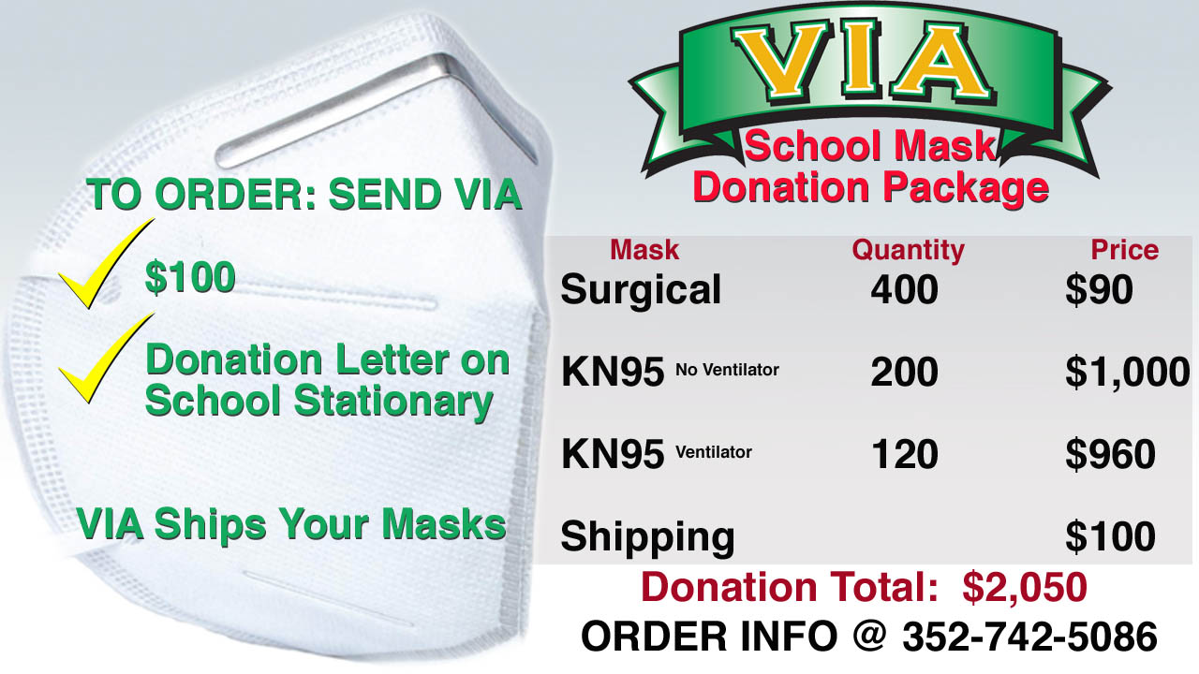

Slide 5
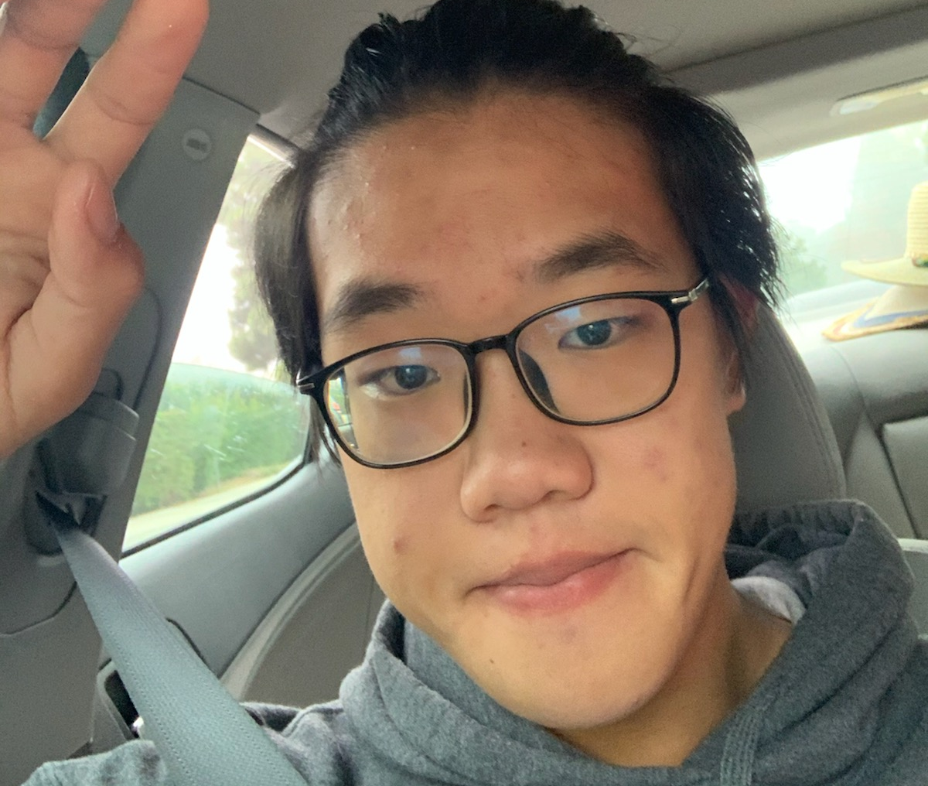
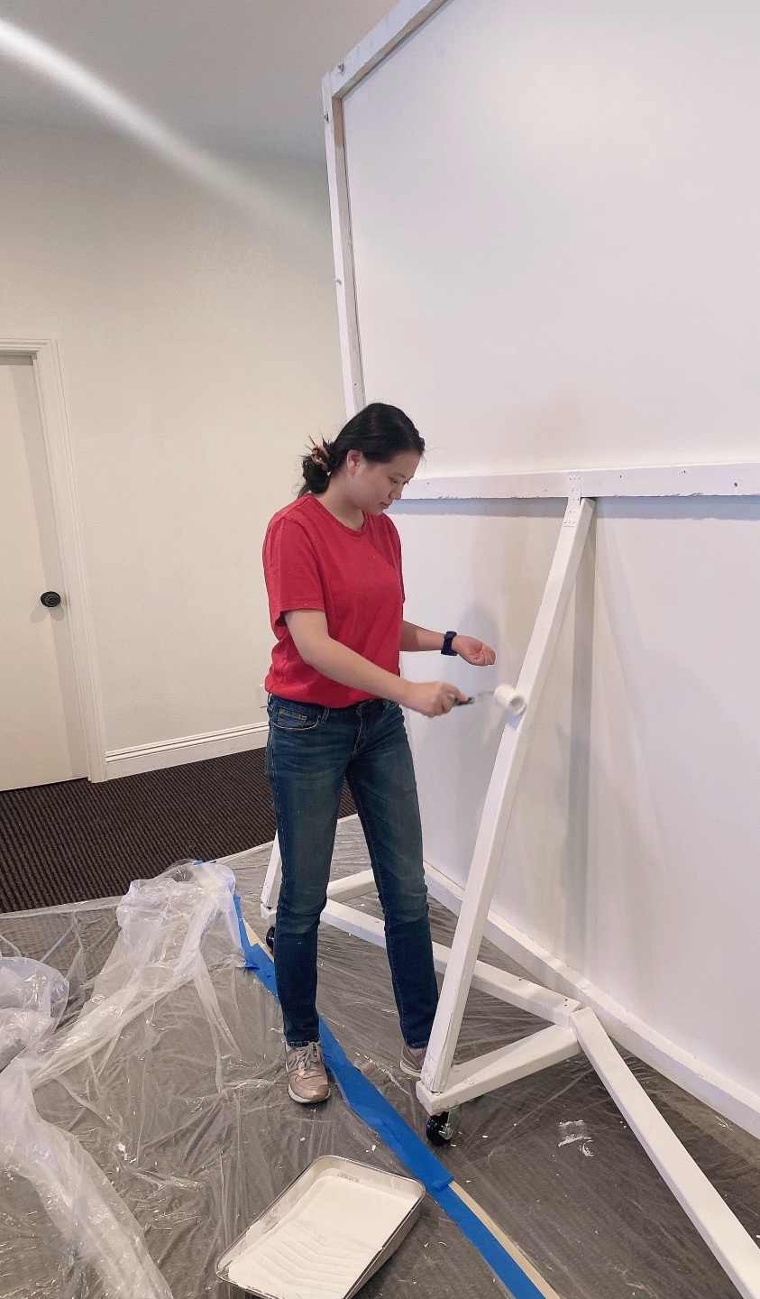
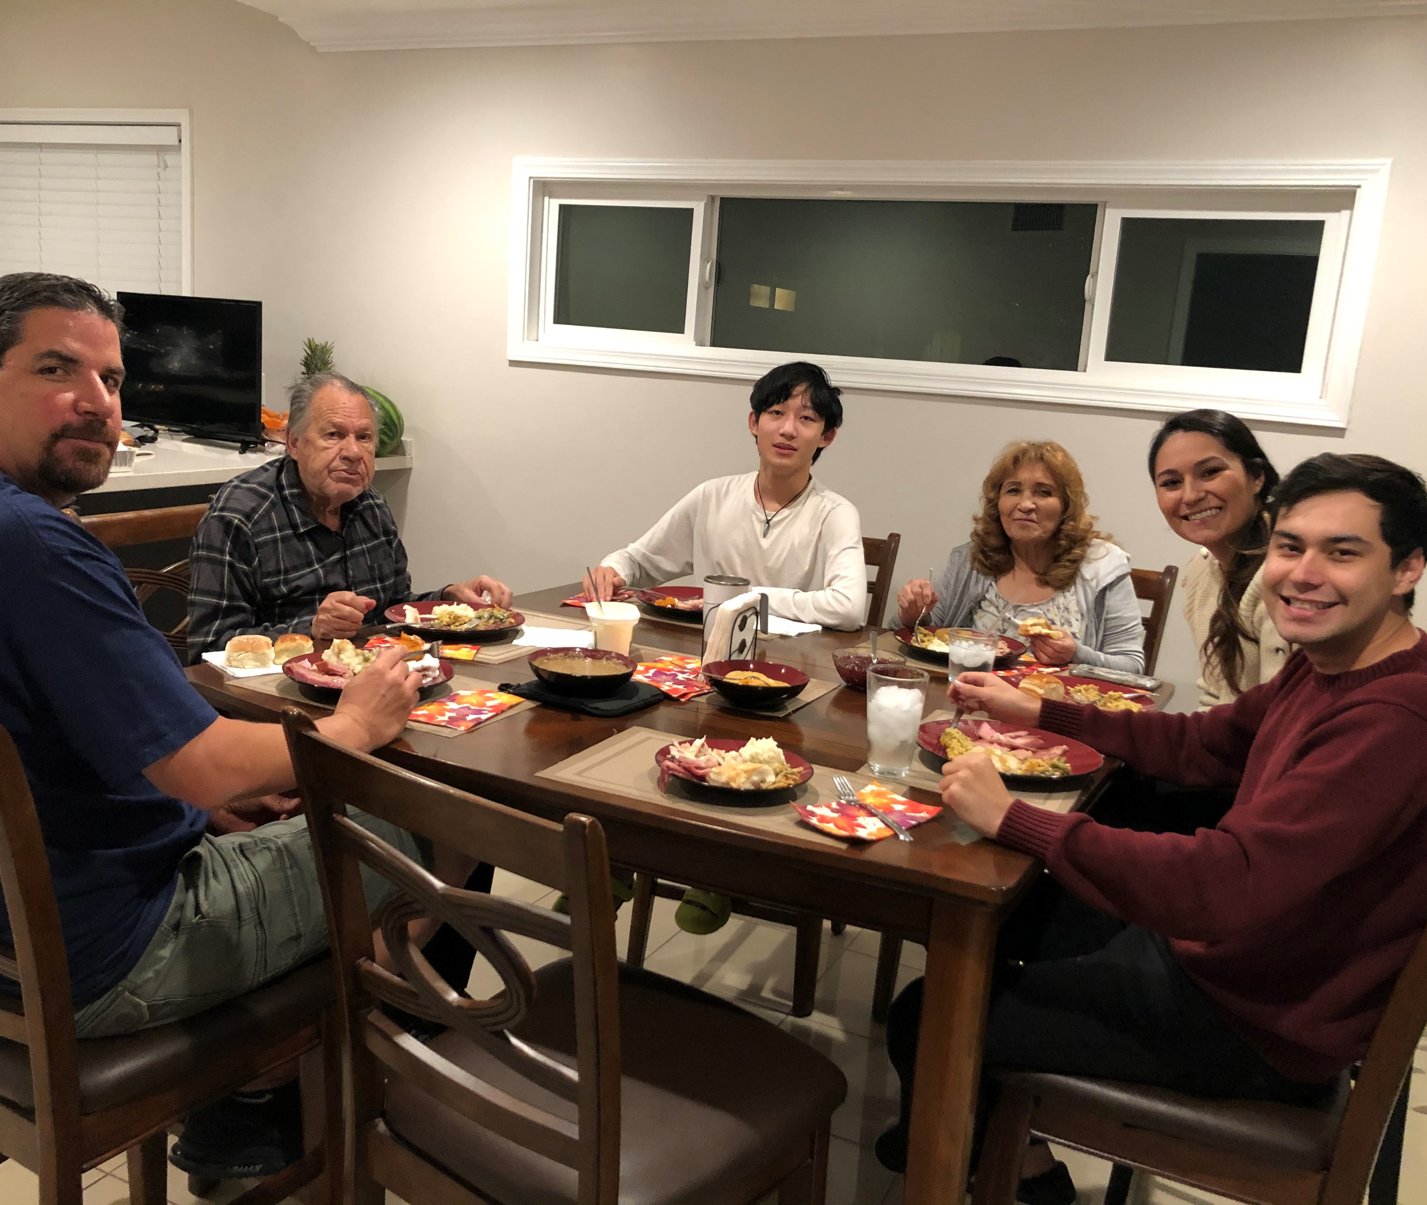
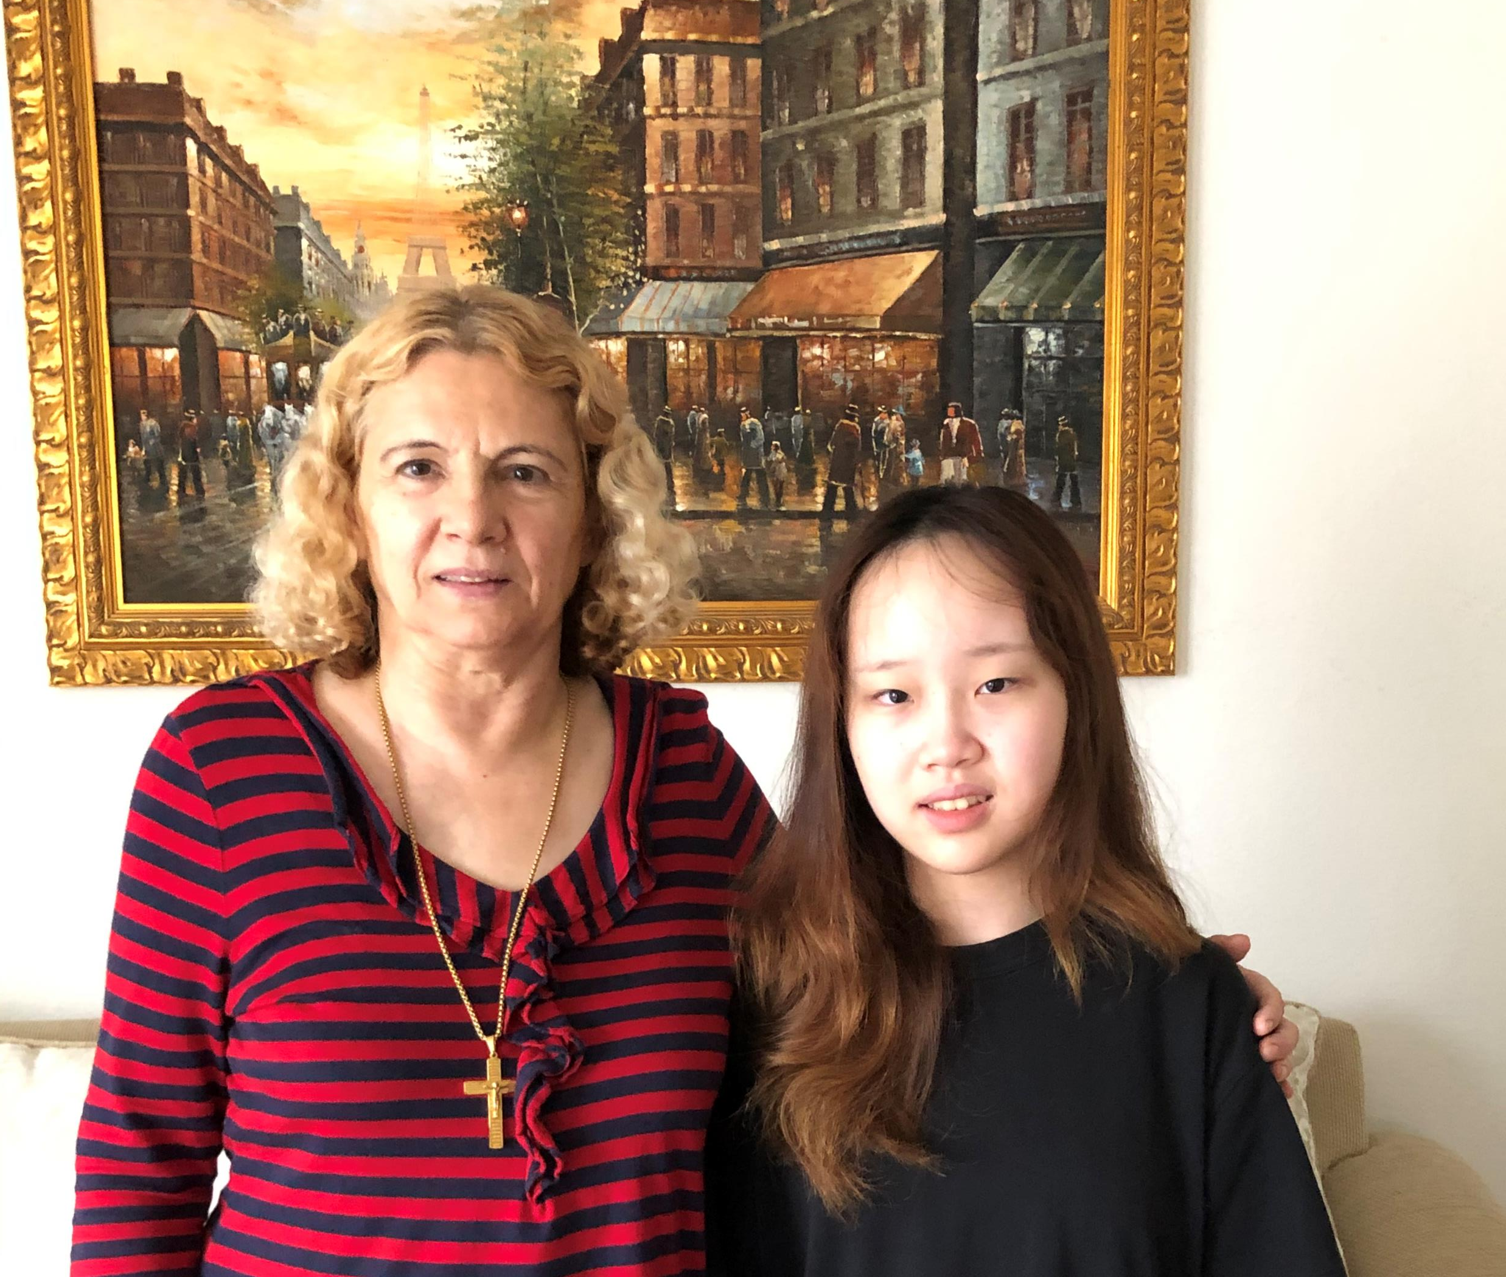
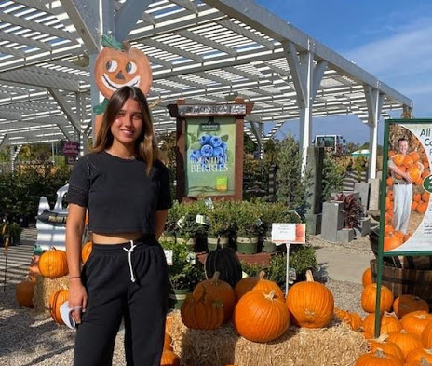

Slide 6


J1 Program
Contact djoy@ventureinternationalacademy.com
Venture
01-352-742-5086
Coming Soon

Slide 7
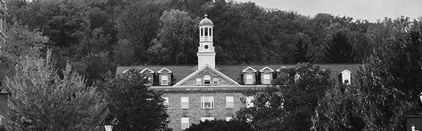


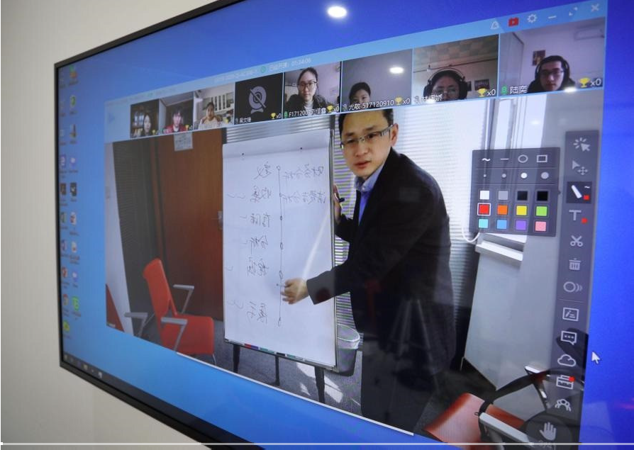





KLEINE KLASSE SCHULE
VENTURE IS OFFERING
AN INTERACTIVE INTERNATIONAL DIPLOMA PROGRAM
$3,000 PER YEAR PER STUDENT
MINIMUM OF 5 STUDENTS FROM A INTERNATIONAL SCHOOL OR AGENT
COMISSION OFFERED FOR EACH STUDENT PER YEAR FOR OUR AGENTS AND THE SCHOOL
CONTACT: DIAN JOY
DJOY@VENTUREINTERNATIONALACADEMY.COM
WELCOME
To our Interactive Online Program, where you earn your high school diploma from a regionally accredited school, so you can be confident that your diploma will be respected and accepted at any major College or University in the United States.
Dual Partnership International Diploma Program
(IDP) – International students looking for options for American education, while remaining in their home country.
Interactive Classes delivered live in
Students time zone.
Significant cost savings over American tuition levels. $3,000 Yearly.
INTERACTIVE TEACHING
Our courses give the closest interactive experience online keeping the quality and expectations of our students high for success. 1 Credit course will be the required 120 hours, 60 of which are live interaction with instructors and 60 are
flipped classroom videos.
100 % AUTHENTIC US EDUCATION
> F U L L Y T R A N S F E R A B L E
C R E D I T S
> F U L L R A N G E O F A P C O U R S E S
S I G N I F I C A N T C O S T
S A V I N G S O V E R A M E R I C A N T U I T I O N L E V E L S
$ 3 , 0 0 0 Y E A R L Y
>
Seniors can graduate with US High
School Diploma
hesunusa.org
Venture International: www.ventureint

Slide 8





NEWSPAPER
AUGUST / / 01 / / ISSUE NUMBER 1
VENTURE IS OFFERING
A SELF PACED
INTERNATIONAL DIPLOMA PROGRAM
$2,000 PER YEAR PER STUDENT
MINIMUM OF 5 STUDENTS FROM A INTERNATIONAL SCHOOL OR AGENT
COMISSION OFFERED FOR EACH STUDENT PER YEAR FOR OUR AGENTS AND THE SCHOOL
CONTACT: DIAN JOY
DJOY@VENTUREINTERNATIONALACADEMY.COM
IDP: INTERNATIONAL DIPLOMA PROGRAM
Offering Self-Paced Diploma Program
AUTHOR: VENTURE INTERNATIONAL WWW.VENTUREINTHESUNUSA.ORG
The Ogburn School is regionally accredited:
Online Study is a significant cost SAVINGS over American tuition levels. $2,000.00 Yearly
Accreditation International (Ai)
AdvancEd – Southern Association of Colleges and Schools Commission on Accreditation and School Improvement (SACS CASI)
Middle States Association Commissions on Elementary and Secondary Schools (MSA-CESS) National Council for Private School Accreditation (NCPSA).
Students receive
Credits may be transferrable for the courses they take to our U.S partner schools, however students need to check with the college institution they plan to attend as each college has its own requirements.
Access to all courses online available 24 hours a day, 365 days a year!
Teacher Support
Grading Service
Academic Counseling
Transcript preparation
We offer a few AP courses to grades 11 & 12, allowing the potential to have a full years’ worth of college credits completed before graduation. AP courses are an added
expense (and materials will need to be purchased).
Our online program operates year-round, so you can enroll anytime. Our students have the option of working through the summer, so you can graduate early!
Graduation Requirements
4 English Credits
4 Math Credits
4 Science Credits
4 Required Social Studies courses
Electives (9 credits)
Why Wait? Graduate Early By Enrolling Today!
Seniors can graduate with US high school diploma
Contact Venture International: www.ventureinthesunusa.org
PAGE 1

Slide 9
VIA Offering College Application Assistance
Top 50 US Colleges or Universities
$7500 for 5 applications
Top 51-100 US Colleges or Universities
$4500 for 5 applications
Art Students : 5 Applications $5000 with portfolio
For more information Contact VIA: djoy@ventureinternationalacademy.com
Chinese/ Vietnamese Counselors Available
Phone: 352-978-9520 or 352-742-5086
www.ventureinthesunusa.org

Slide 10

Letters For The Elderly Campaign
I
Community Service Opportunity for your students.
Our Elderly Need Your Support!
Start a letter Writing Chapter!
Looking for ways to give your students community service hours.
Create a letter writing chapter
Monthly meetings to write letters to our elderly.
Give community service hours each month.
Show your gratitude by writing letters to those suffering from loneliness. Loveforourelders.org is in desperate need of letters right now and we can help!
Contact Dian Joy: djoy@ventureinternatonalacademy.com
352-742-5086 for more information

Slide 11
Letters to the Elderly Guidelines
1. Letters must be legible (large print) and handwritten. No worries if you’re not artistic– make your card as what you’d like to receive.
2. Avoid religion, if possible. Your letter should resonate with anyone.
3. Exclude the date (day, month, and year).
4. Embrace creativity! Recipients love it when the letters are personal. We encourage you to make your letters colorful and fun– photos, crosswords, and drawings are great!
5. Be kind & thoughtful. This is a one-way letter exchange, so you will not receive a letter back. Receiving nothing in return is part of the beauty of your act of kindness, and recipients aren’t burdened by feeling obligated or unable to respond.
6. Envelope your letters if you can! It’s so much nicer to receive an enveloped card. If you’re sending more than 1 letter, leave your enveloped letters unsealed and unstamped and send them in a larger envelope or box.
7. Share your act of kindness! Tag us @loveforourelders
8. Send us as many cards as you’d like! We accept letters year-round, so there’s no deadline for when you must send them by. If your cards are holiday-themed or seasonal, send them a month before that holiday or the end of that season (if you send your letters late, we’ll save them for the next year).
9. Ready to mail? Yay! Send to:
Love For Our Elders
P.O. Box 24248
Cleveland, OH 44124
USA

Slide 12


2021-2022
Visit Our Website and see all our in-network schools that are accepting applications.
www.ventureinthesunusa.org
Several schools have reduced fees or have frozen their tuitions for 2021-2022.
Contact VIA to discuss your student's options and placement.
Buckingham Browne & Nichols School
REDWOOD
FIRST ACADEMY
CVCS
CHRISTIAN UNIFIED
FUTURES ACADEMY
KINGS ACADEMY
BRIDGEPORT INTERNATIONAL
THE CITY SCHOOL
TRINITY CHRISTIAN ACADEMY
MICHIGAN LUTHERAN
SOUTHWEST ACADEMY
FAITH CHRISTIAN ACADEMY
NORTHLAND CHRISTIAN
CHILDREN’S PERFORMING ARTS
BISHOP ACADEMY
FAIRFAX CHRISTIAN
MERCERSBURG ACADEMY
ALL OUR PRIVATE SCHOOLS ARE
OPEN AND ACCEPTING STUDENTS
CONTACT VENTURE FOR OUR SCHOOLS LIST

Slide 13

TO OUR INTERNATIONAL FAMILIES AND PARTNERS
This year has been challenging for all our international students, their natural families as well as all our schools, host families and our VIA staff.
I want thank all our counselors, host families and in network schools for all their support and understanding during these trying times.
All the daily changes have our international families concerned about their students continued education for 2020-2021.VIA has been proud to support all your students and are here if any students are wanting to stay within their current area during the summer.
We are looking forward to 2021-2022 and welcoming all our partners to send applications now for all our in-network private schools. They are OPEN and accepting students.
CONTACT VIA TO GET THE FULL LIST OF SCHOOLS.
Covid 19

Slide 14
