Slide 1
13
P A R T D
The Peripheral Nervous System (PNS)
Reflexes

Slide 2
Innervation of Joints
Hilton’s law: any nerve serving a muscle that produces movement at a joint also innervates the joint itself and the skin over the joint

Slide 3
Motor Endings
PNS elements that activate effectors by releasing neurotransmitters at:
  Neuromuscular junctions
  Varicosities at smooth muscle and glands

Slide 4
Innervation of Skeletal Muscle
Takes place at a neuromusclular junction
Acetylcholine is the neurotransmitter that diffuses across the synaptic cleft
ACh binds to receptors resulting in:
  Movement of Na⁺ and K⁺ across the membrane
  Depolarization of the interior of the muscle cell
  An end-plate potential that triggers an action potential

Slide 5
Innervation of Visceral Muscle and Glands
Autonomic motor endings and visceral effectors are simpler than somatic junctions
Branches form synapses en passant via varicosities
Acetylcholine and norepinephrine are used as neurotransmitters
Visceral responses are slower than somatic responses

Slide 6
Levels of Motor Control
The three levels of motor control are
  Segmental level
  Projection level
  Precommand level

Slide 7
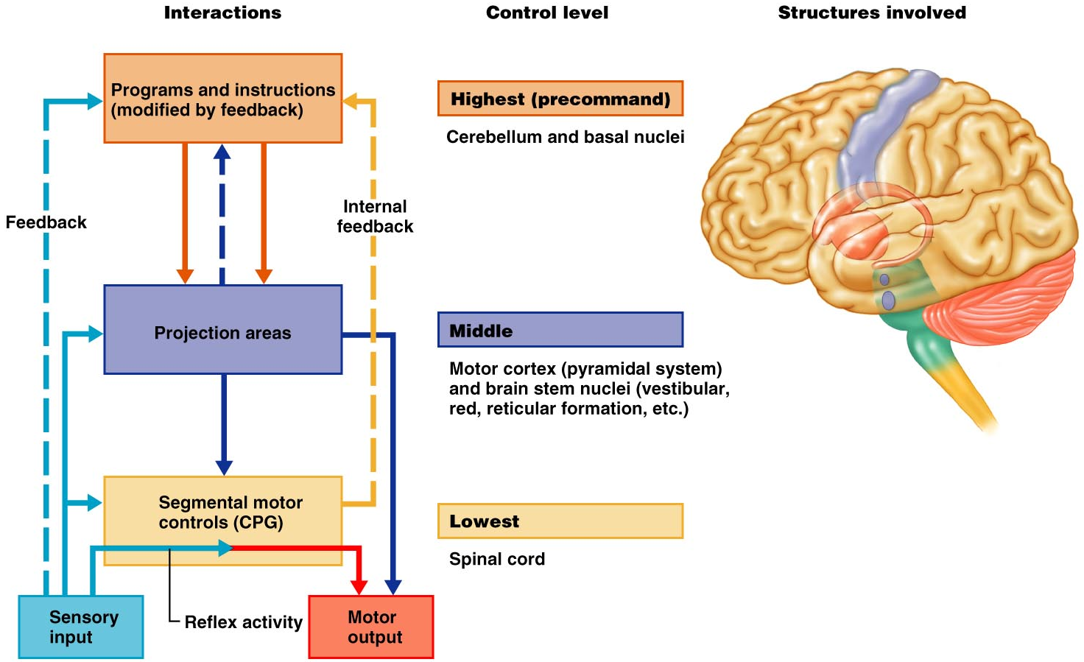
Hierarchy of Motor Control
Figure 13.13

Slide 8
Segmental Level
The segmental level is the lowest level of motor hierarchy
It consists of segmental circuits of the spinal cord
Its circuits control locomotion and specific, oft-repeated motor activity
These circuits are called central pattern generators (CPGs)

Slide 9
Projection Level
The projection level consists of:
  Cortical motor areas that produce the direct (pyramidal) system
  Brain stem motor areas that oversee the indirect (multineuronal) system
Helps control reflex and fixed-pattern activity and houses command neurons that modify the segmental apparatus

Slide 10
Precommand Level
Cerebellar and basal nuclei systems that:
  Regulate motor activity
  Precisely start or stop movements
  Coordinate movements with posture
  Block unwanted movements
  Monitor muscle tone

Slide 11
Reflexes
A reflex is a rapid, predictable motor response to a stimulus
Reflexes may:
  Be inborn (intrinsic) or learned (acquired)
  Involve only peripheral nerves and the spinal cord
  Involve higher brain centers as well

Slide 12
Reflex Arc
There are five components of a reflex arc
  Receptor – site of stimulus
  Sensory neuron – transmits the afferent impulse to the CNS
  Integration center – either monosynaptic or polysynaptic region within the CNS
  Motor neuron – conducts efferent impulses from the integration center to an effector
  Effector – muscle fiber or gland that responds to the efferent impulse

Slide 13
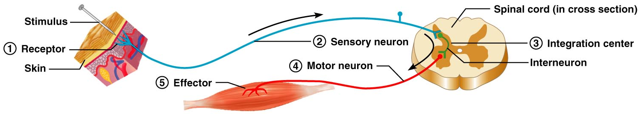
Reflex Arc
Figure 13.14

Slide 14
Stretch and Deep Tendon Reflexes
For skeletal muscles to perform normally:
  The Golgi tendon organs (proprioceptors) must constantly inform the brain as to the state of the muscle
  Stretch reflexes initiated by muscle spindles must maintain healthy muscle tone

Slide 15
Muscle Spindles
Are composed of 3-10 intrafusal muscle fibers that lack myofilaments in their central regions, are noncontractile, and serve as receptive surfaces
Muscle spindles are wrapped with two types of afferent endings: primary sensory endings of type Ia fibers and secondary sensory endings of type II fibers
These regions are innervated by gamma (γ) efferent fibers
Note: contractile muscle fibers are extrafusal fibers and are innervated by alpha (α) efferent fibers

Slide 16
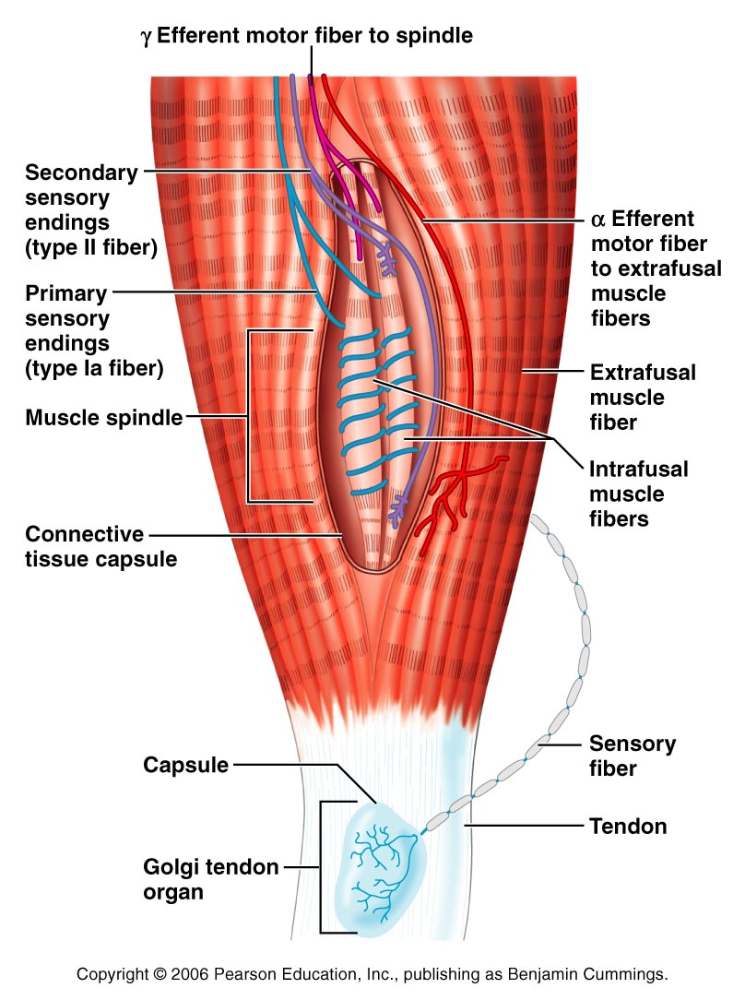
Muscle Spindles
Figure 13.15

Slide 17
Operation of the Muscle Spindles
Stretching the muscles activates the muscle spindle
  There is an increased rate of action potential in Ia fibers
Contracting the muscle reduces tension on the muscle spindle
  There is a decreased rate of action potential on Ia fibers

Slide 18
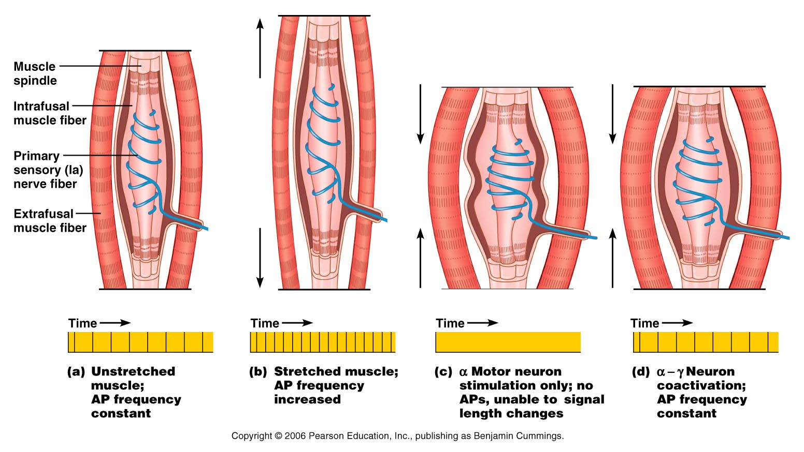
Operation of the Muscle Spindle
Figure 13.17

Slide 19
Stretch Reflex
Stretching the muscle activates the muscle spindle
Excited γ motor neurons of the spindle cause the stretched muscle to contract
Afferent impulses from the spindle result in inhibition of the antagonist
Example: patellar reflex
  Tapping the patellar tendon stretches the quadriceps and starts the reflex action
  The quadriceps contract and the antagonistic hamstrings relax

Slide 20
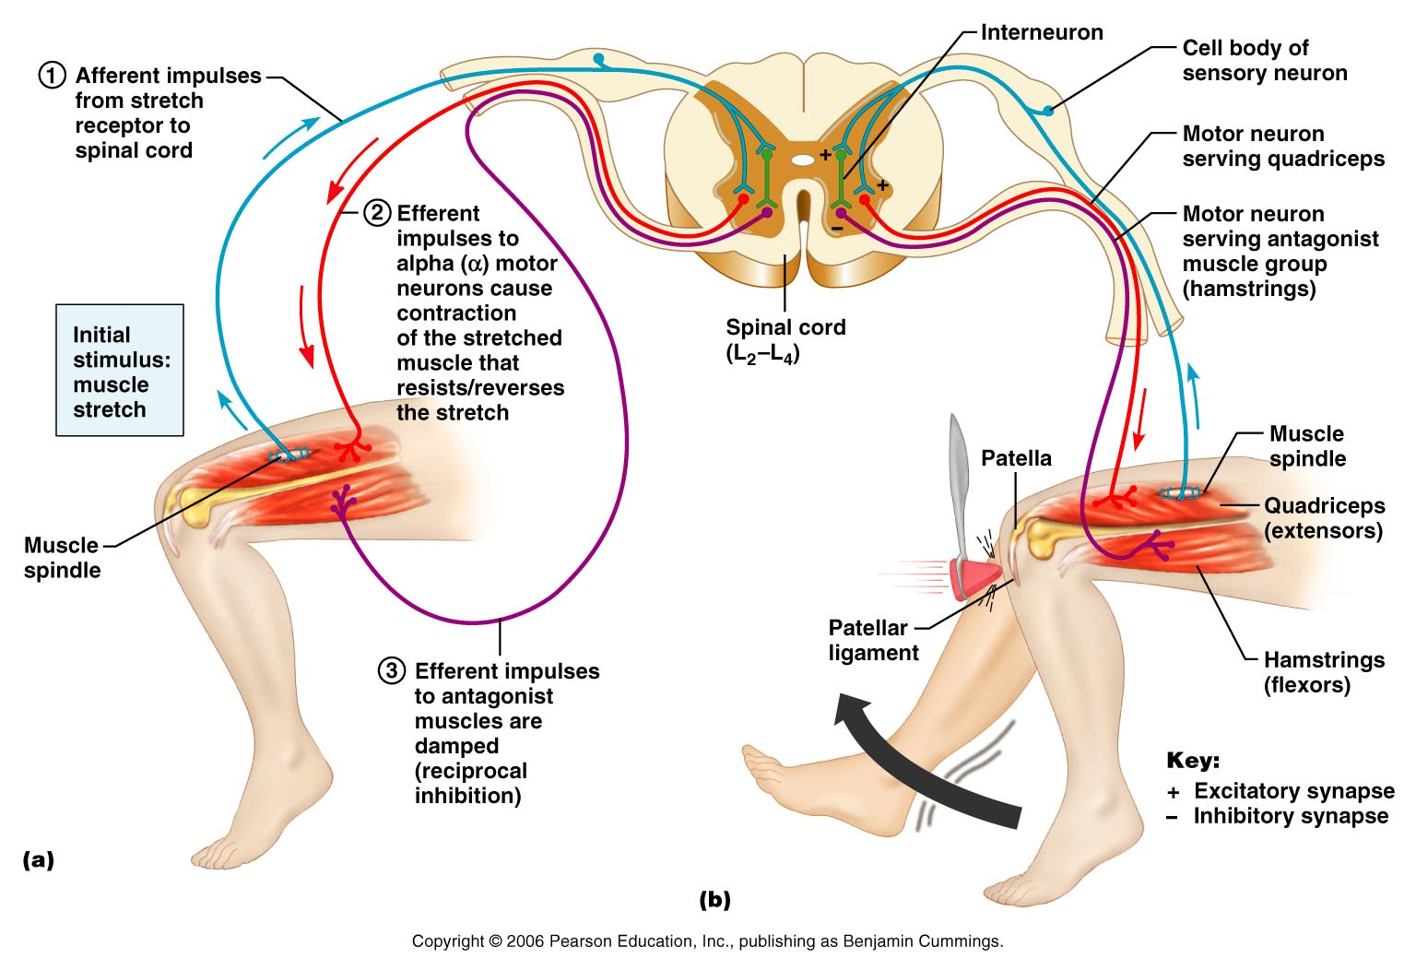
Stretch Reflex
Figure 13.16

Slide 21
Golgi Tendon Reflex
The opposite of the stretch reflex
Contracting the muscle activates the Golgi tendon organs
Afferent Golgi tendon neurons are stimulated, neurons inhibit the contracting muscle, and the antagonistic muscle is activated
As a result, the contracting muscle relaxes and the antagonist contracts

Slide 22
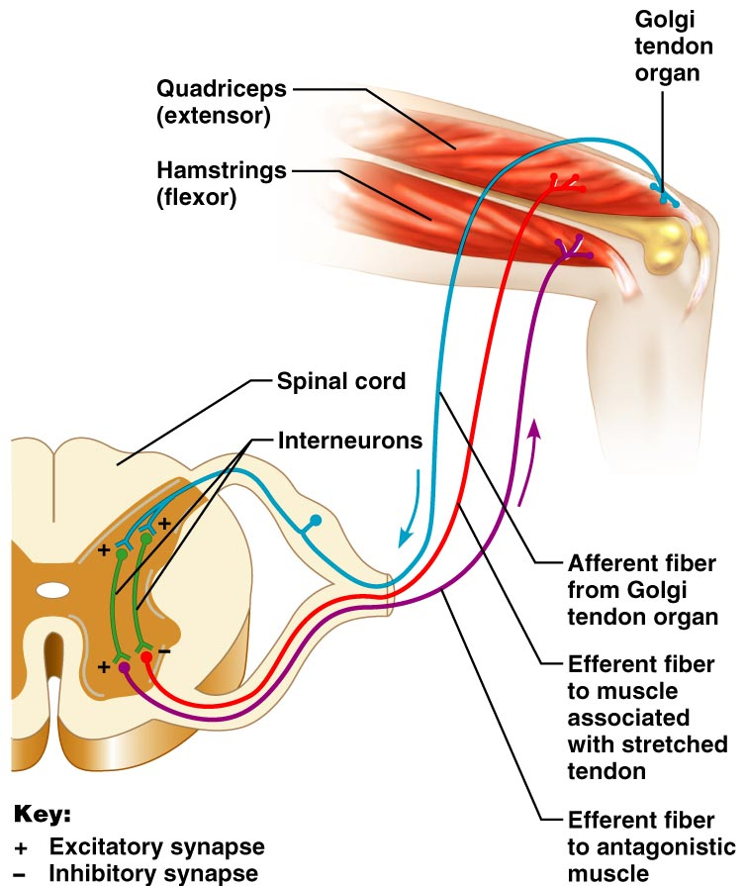
Golgi Tendon Reflex
Figure 13.18

Slide 23
Flexor and Crossed Extensor Reflexes
The flexor reflex is initiated by a painful stimulus (actual or perceived) that causes automatic withdrawal of the threatened body part
The crossed extensor reflex has two parts
  The stimulated side is withdrawn
  The contralateral side is extended

Slide 24
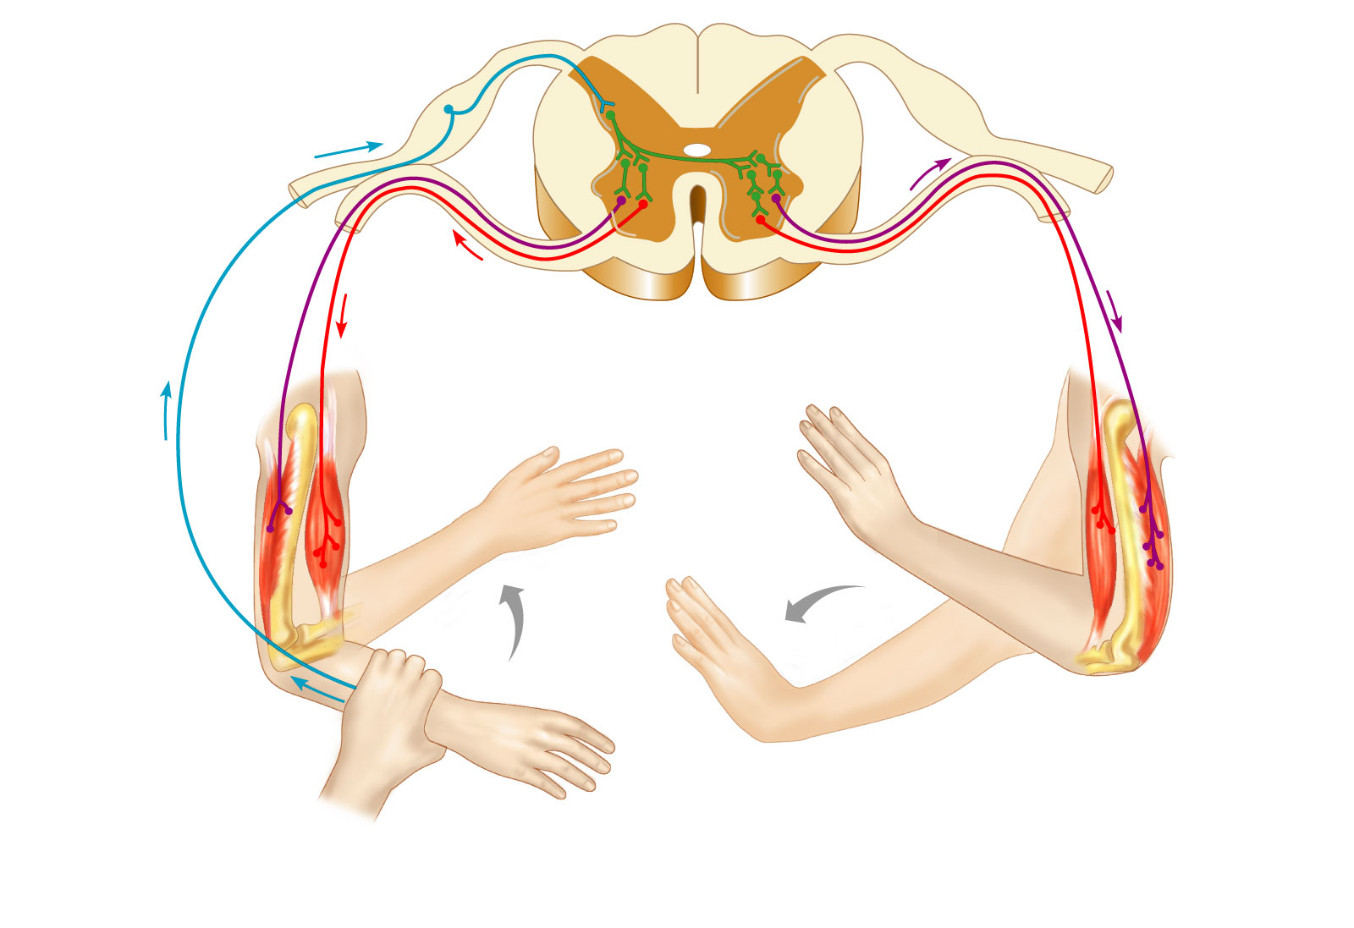
Crossed Extensor Reflex
+
Interneurons
+
–
+
+
–
Afferent
fiber
Efferent
fibers
Efferent
fibers
Extensor
inhibited
Flexor
inhibited
Flexor
stimulated
Flexes
Arm movements
Extensor
stimulated
Extends
Key:
+ Excitatory synapse
– Inhibitory synapse
Right arm
(site of stimulus)
Left arm (site of
reciprocal activation)
Figure 13.19

Slide 25
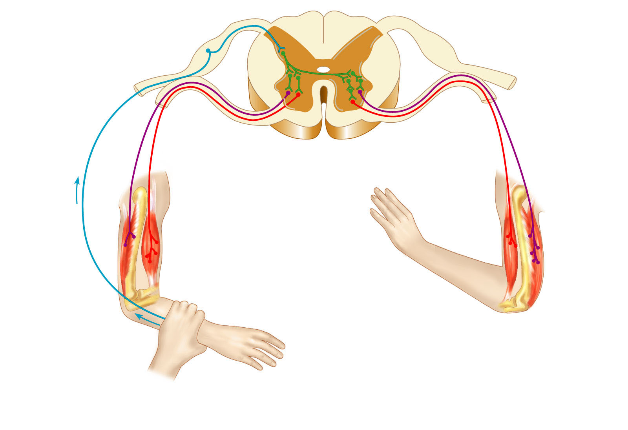
Crossed Extensor Reflex
+
+
–
+
+
–
Afferent
fiber
Key:
+ Excitatory synapse
– Inhibitory synapse
Right arm
(site of stimulus)
Figure 13.19

Slide 26
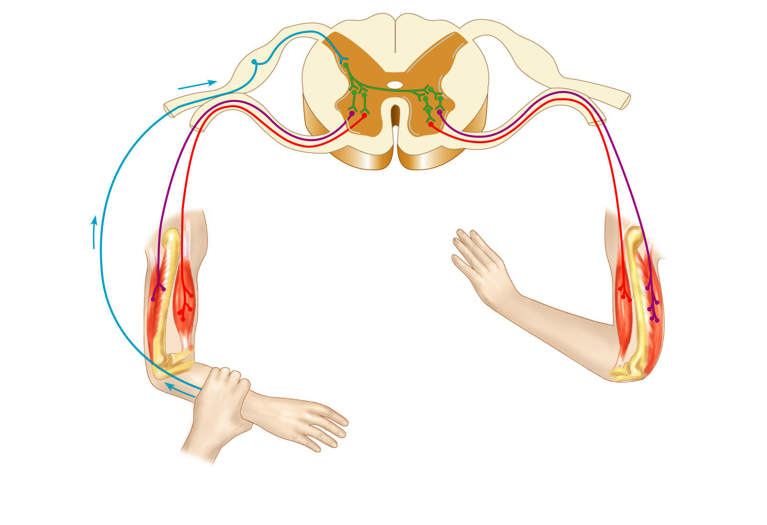
Crossed Extensor Reflex
+
Interneurons
+
–
+
+
–
Afferent
fiber
Key:
+ Excitatory synapse
– Inhibitory synapse
Right arm
(site of stimulus)
Figure 13.19

Slide 27

Crossed Extensor Reflex
+
Interneurons
+
–
+
+
–
Afferent
fiber
Efferent
fibers
Efferent
fibers
Key:
+ Excitatory synapse
– Inhibitory synapse
Right arm
(site of stimulus)
Left arm (site of
reciprocal activation)
Figure 13.19

Slide 28
Crossed Extensor Reflex
+
Interneurons
+
–
+
+
–
Afferent
fiber
Efferent
fibers
Efferent
fibers
Extensor
inhibited
Flexor
inhibited
Flexor
stimulated
Extensor
stimulated
Key:
+ Excitatory synapse
– Inhibitory synapse
Right arm
(site of stimulus)
Left arm (site of
reciprocal activation)
Figure 13.19

Slide 29
Crossed Extensor Reflex
+
Interneurons
+
–
+
+
–
Afferent
fiber
Efferent
fibers
Efferent
fibers
Extensor
inhibited
Flexor
inhibited
Flexor
stimulated
Flexes
Arm movements
Extensor
stimulated
Extends
Key:
+ Excitatory synapse
– Inhibitory synapse
Right arm
(site of stimulus)
Left arm (site of
reciprocal activation)
Figure 13.19

Slide 30
Superficial Reflexes
Initiated by gentle cutaneous stimulation
Example:
  Plantar reflex is initiated by stimulating the lateral aspect of the sole of the foot
  The response is downward flexion of the toes
  Indirectly tests for proper corticospinal tract functioning
  Babinski’s sign: abnormal plantar reflex indicating corticospinal damage where the great toe dorsiflexes and the smaller toes fan laterally

Slide 31
Developmental Aspects of the PNS
Spinal nerves branch from the developing spinal cord and neural crest cells
  Supply motor and sensory function to developing muscles
Cranial nerves innervate muscles of the head

Slide 32
Developmental Aspects of the PNS
Distribution and growth of spinal nerves correlate with the segmented body plan
Sensory receptors atrophy with age and muscle tone lessens
Peripheral nerves remain viable throughout life unless subjected to trauma

